Slide 1
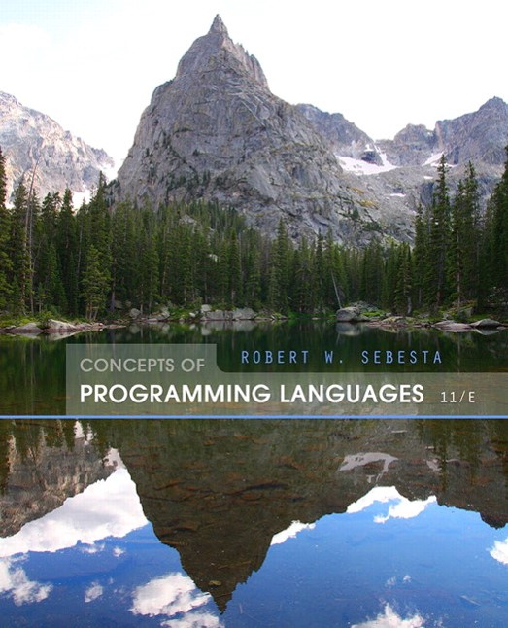
Concepts of Programming Languages
Eleventh Edition
Chapter 3
Describing Syntax and Semantics
Copyright © 2016, 2013, 2010 Pearson Education, Inc. All Rights Reserved
Notes:
If this PowerPoint presentation contains mathematical equations, you may need to check that your computer has the following installed:
1) Math Type Plugin
2) Math Player (free versions available)
3) NVDA Reader (free versions available)

Slide 2
Objectives
3.1 Introduction
3.2 The General Problem of Describing Syntax
3.3 Formal Methods of Describing Syntax
3.4 Attribute Grammars
3.5 Describing the Meanings of Programs: Dynamic Semantics

Slide 3
Introduction
Syntax: the form or structure of the expressions, statements, and program units
Semantics: the meaning of the expressions, statements, and program units
Syntax and semantics provide a language’s definition
Users of a language definition
Other language designers
Implementers
Programmers (the users of the language)

Slide 4
The General Problem of Describing Syntax: Terminology
A sentence is a string of characters over some alphabet
A language is a set of sentences
A lexeme is the lowest level syntactic unit of a language (e.g., *, sum, begin)
A token is a category of lexemes (e.g., identifier)

Slide 5
Formal Definition of Languages
Recognizers
A recognition device reads input strings over the alphabet of the language and decides whether the input strings belong to the language
Example: syntax analysis part of a compiler
Detailed discussion of syntax analysis appears in Chapter 4
Generators
A device that generates sentences of a language
One can determine if the syntax of a particular sentence is syntactically correct by comparing it to the structure of the generator

Slide 6
B N F and Context-Free Grammars
Context-Free Grammars
Developed by Noam Chomsky in the mid-1950s
Language generators, meant to describe the syntax of natural languages
Define a class of languages called context-free languages
Backus-Naur Form (1959)
Invented by John Backus to describe the syntax of Algol 58
B N F is equivalent to context-free grammars

Slide 7
B N F Fundamentals (1 of 2)
In B N F, abstractions are used to represent classes of syntactic structures they act like syntactic variables (also called nonterminal symbols, or just terminals)
Terminals are lexemes or tokens
A rule has a left-hand side (L H S), which is a nonterminal, and a right-hand side (R H S), which is a string of terminals and/or nonterminals

Slide 8
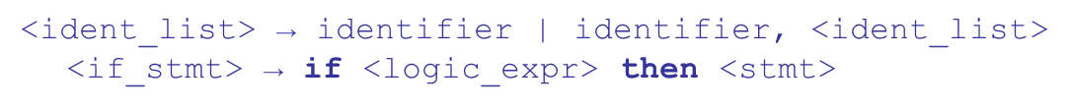
B N F Fundamentals (2 of 2)
Nonterminals are often enclosed in angle brackets
Examples of B N F rules:
Grammar: a finite non-empty set of rules
A start symbol is a special element of the nonterminals of a grammar

Slide 9
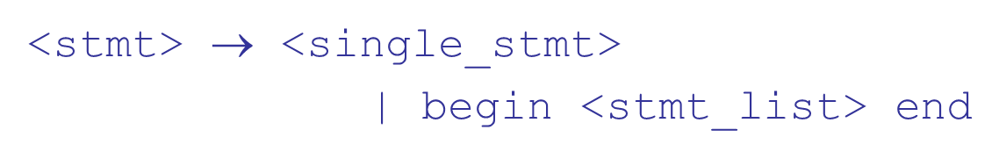
B N F Rules
An abstraction (or nonterminal symbol) can have more than one R H S

Slide 10
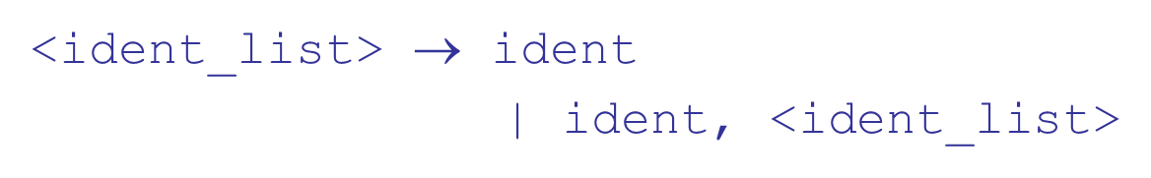
Describing Lists
Syntactic lists are described using recursion
A derivation is a repeated application of rules, starting with the start symbol and ending with a sentence (all terminal symbols)

Slide 11
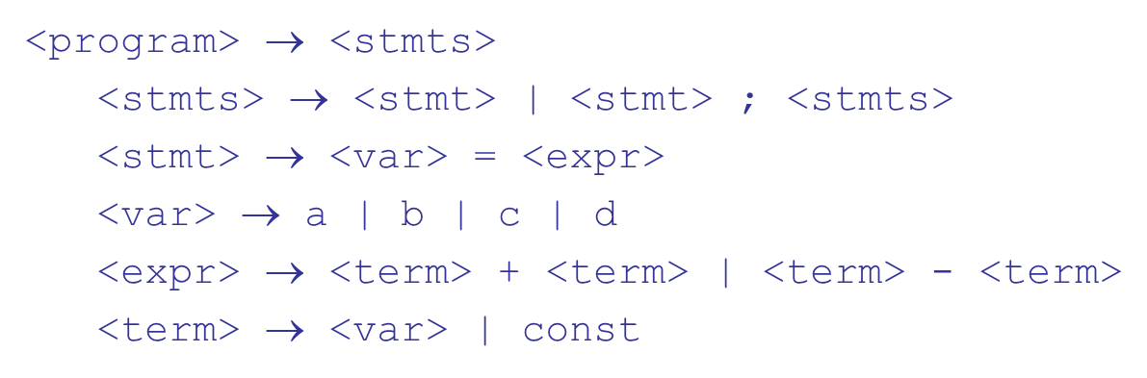
An Example Grammar

Slide 12
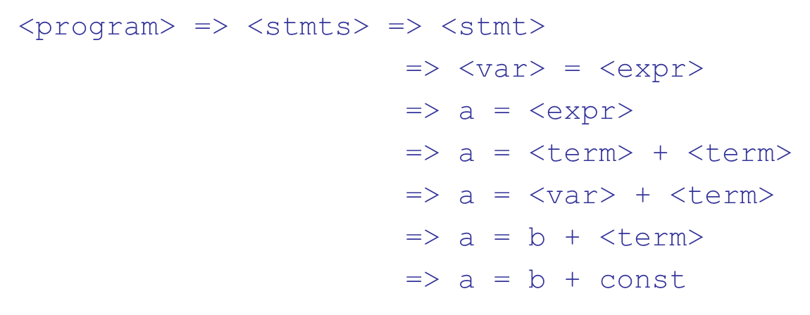
An Example Derivation

Slide 13
Derivations
Every string of symbols in a derivation is a sentential form
A sentence is a sentential form that has only terminal symbols
A leftmost derivation is one in which the leftmost nonterminal in each sentential form is the one that is expanded
A derivation may be neither leftmost nor rightmost

Slide 14
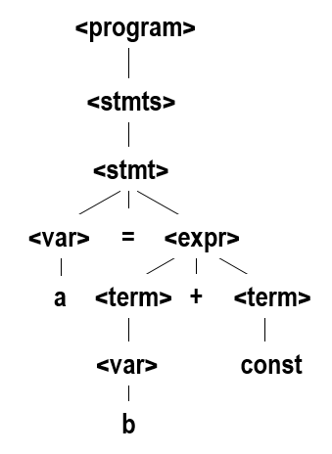
Parse Tree
A hierarchical representation of a derivation

Slide 15
Ambiguity in Grammars
A grammar is ambiguous if and only if it generates a sentential form that has two or more distinct parse trees

Slide 16

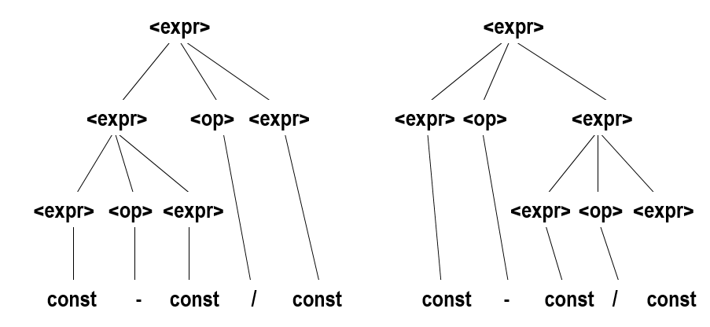
An Ambiguous Expression Grammar

Slide 17

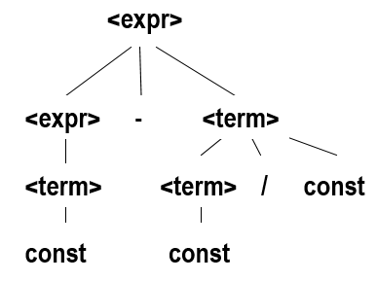
An Unambiguous Expression Grammar
If we use the parse tree to indicate precedence levels of the operators, we cannot have ambiguity

Slide 18

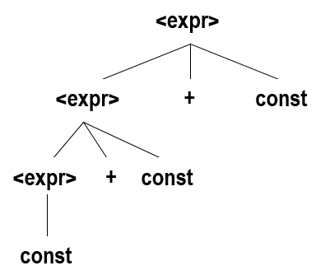
Associativity of Operators
Operator associativity can also be indicated by a grammar

Slide 19

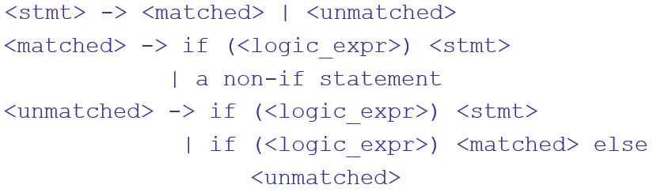
Unambiguous Grammar for Selector
Java if-then-else grammar
Ambiguous!
An unambiguous grammar for if-then-else

Slide 20
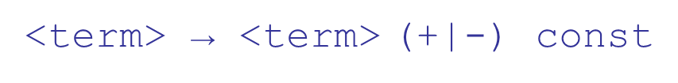
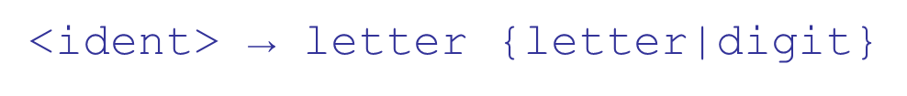
Extended B N F
Optional parts are placed in brackets [ ]
Alternative parts of R H Ss are placed inside parentheses and separated via vertical bars
Repetitions (0 or more) are placed inside braces { }

Slide 21
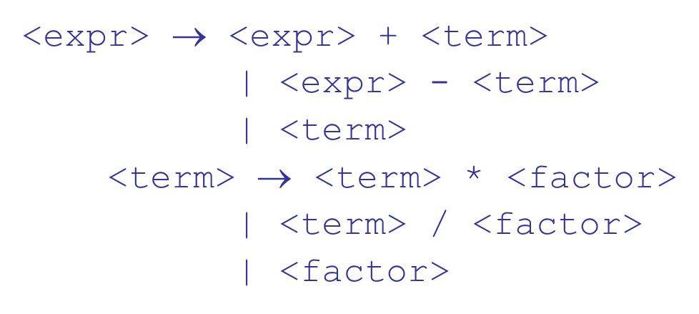
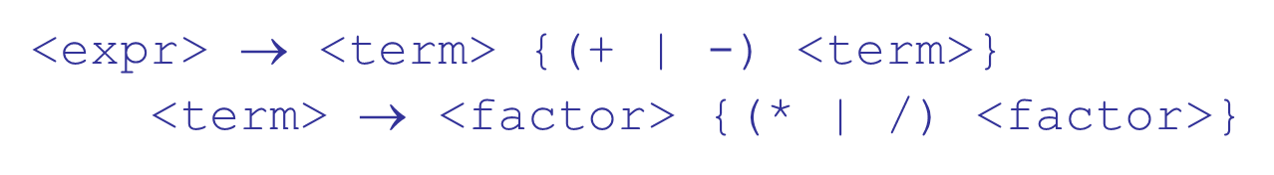
B N F and E B N F
B N F
E B N F

Slide 22
Recent Variations in E B N F
Alternative R H Ss are put on separate lines
Use of a colon instead of
Use of opt for optional parts
Use of oneof for choices

Slide 23
Static Semantics
Nothing to do with meaning
Context-free grammars (C F Gs) cannot describe all of the syntax of programming languages
Categories of constructs that are trouble:
Context-free, but cumbersome (e.g.,types of operands in expressions)
Non-context-free (e.g., variables must be declared before they are used)

Slide 24
Attribute Grammars
Attribute grammars (A Gs) have additions to C F Gs to carry some semantic info on parse tree nodes
Primary value of A Gs:
Static semantics specification
Compiler design (static semantics checking)

Slide 25
Attribute Grammars : Definition
Def: An attribute grammar is a context-free grammar G = (S, N, T, P) with the following additions:
For each grammar symbol x there is a set A(x) of attribute values
Each rule has a set of functions that define certain attributes of the nonterminals in the rule
Each rule has a (possibly empty) set of predicates to check for attribute consistency

Slide 26
Attribute Grammars: Definition
Let
be a rule
Functions of the form
define synthesized attributes
Functions of the form
define inherited attributes
Initially, there are intrinsic attributes on the leaves

Slide 27
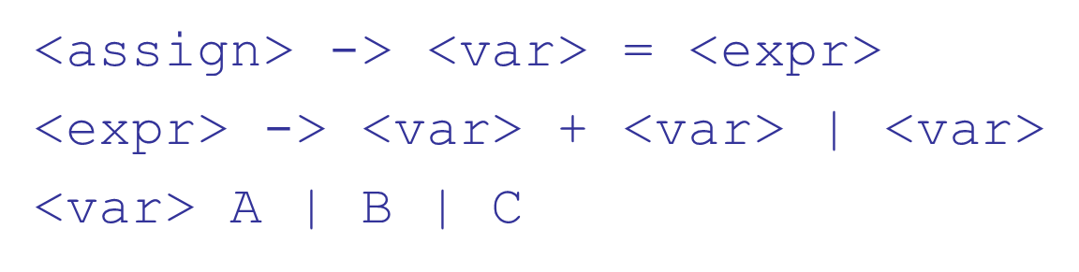
Attribute Grammars: An Example (1 of 4)
Syntax
actual_type: synthesized for <var> and <expr>
expected_type: inherited for <expr>

Slide 28


Attribute Grammars: An Example (2 of 4)
Syntax rule:
Semantic rules:
Predicate:
Syntax rule:
Semantic rule:

Slide 29
Attribute Grammars: An Example (3 of 4)
How are attribute values computed?
If all attributes were inherited, the tree could be decorated in top-down order.
If all attributes were synthesized, the tree could be decorated in bottom-up order.
In many cases, both kinds of attributes are used, and it is some combination of top-down and bottom-up that must be used.

Slide 30
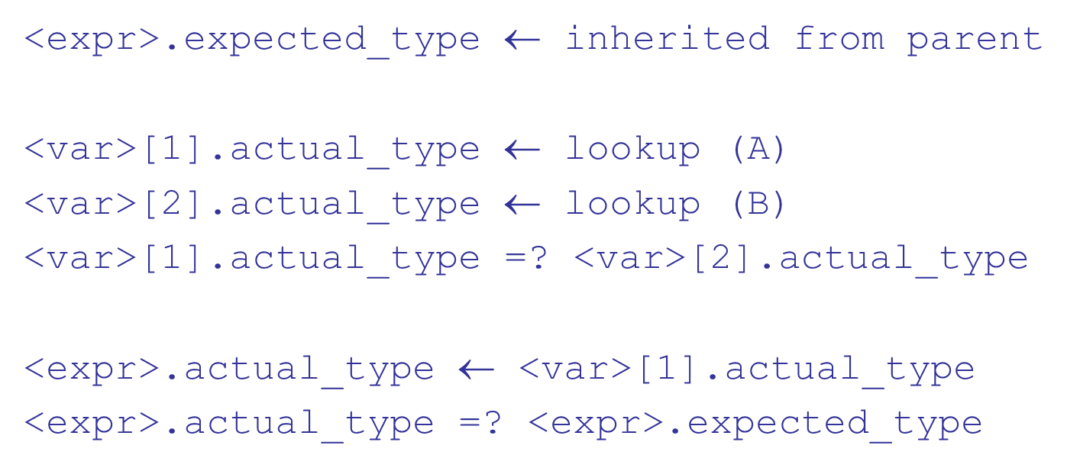
Attribute Grammars: An Example (4 of 4)

Slide 31
Semantics
There is no single widely acceptable notation or formalism for describing semantics
Several needs for a methodology and notation for semantics:
Programmers need to know what statements mean
Compiler writers must know exactly what language constructs do
Correctness proofs would be possible
Compiler generators would be possible
Designers could detect ambiguities and inconsistencies

Slide 32
Operational Semantics (1 of 4)
Operational Semantics
Describe the meaning of a program by executing its statements on a machine, either simulated or actual. The change in the state of the machine (memory, registers, etc.) defines the meaning of the statement
To use operational semantics for a high-level language, a virtual machine is needed

Slide 33
Operational Semantics (2 of 4)
A hardware pure interpreter would be too expensive
A software pure interpreter also has problems
The detailed characteristics of the particular computer would make actions difficult to understand
Such a semantic definition would be machine- dependent

Slide 34
Operational Semantics (3 of 4)
A better alternative: A complete computer simulation
The process:
Build a translator (translates source code to the machine code of an idealized computer)
Build a simulator for the idealized computer
Evaluation of operational semantics:
Good if used informally (language manuals, etc.)
Extremely complex if used formally (e.g., V D L), it was used for describing semantics of P L/I.

Slide 35
Operational Semantics (4 of 4)
Uses of operational semantics:
Language manuals and textbooks
Teaching programming languages
Two different levels of uses of operational semantics:
Natural operational semantics
Structural operational semantics
Evaluation
Good if used informally (language manuals, etc.)
Extremely complex if used formally (e.g.,V D L)

Slide 36
Denotational Semantics (1 of 2)
Based on recursive function theory
The most abstract semantics description method
Originally developed by Scott and Strachey (1970)

Slide 37
Denotational Semantics (2 of 2)
The process of building a denotational specification for a language:
Define a mathematical object for each language entity
Define a function that maps instances of the language entities onto instances of the corresponding mathematical objects
The meaning of language constructs are defined by only the values of the program's variables

Slide 38

Denotational Semantics: Program State
The state of a program is the values of all its current variables
Let VARMAP be a function that, when given a variable name and a state, returns the current value of the variable

Slide 39
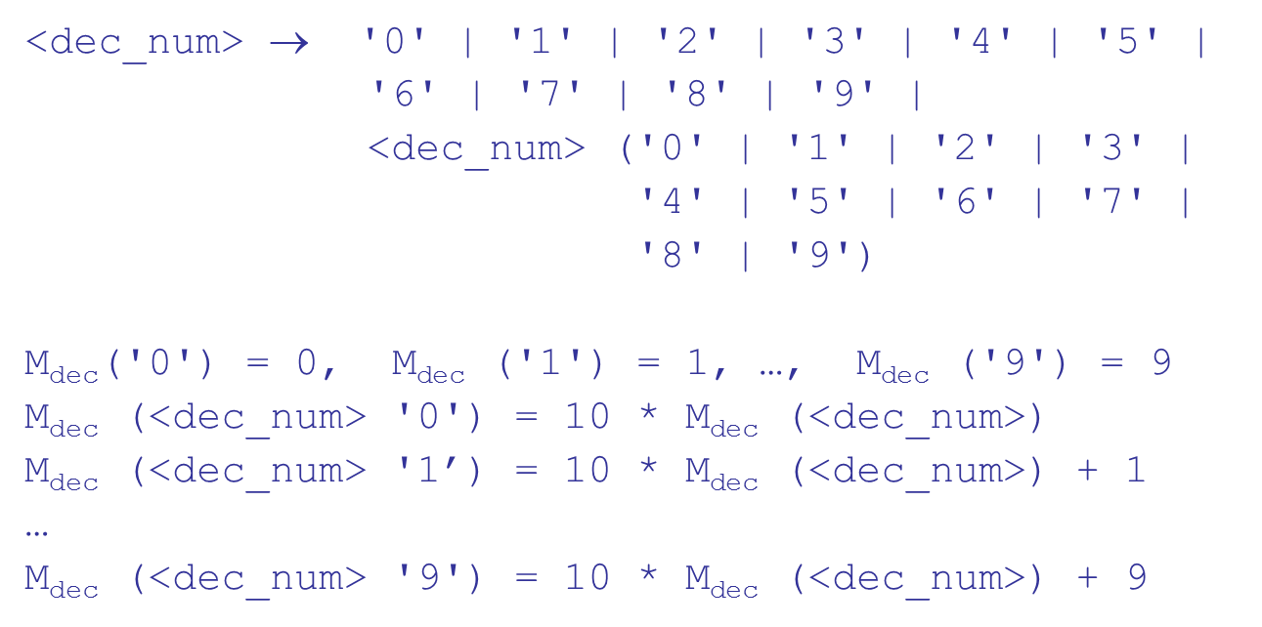
Decimal Numbers

Slide 40
Expressions (1 of 2)
Map expressions onto Z
We assume expressions are decimal numbers, variables, or binary expressions having one arithmetic operator and two operands, each of which can be an expression

Slide 41
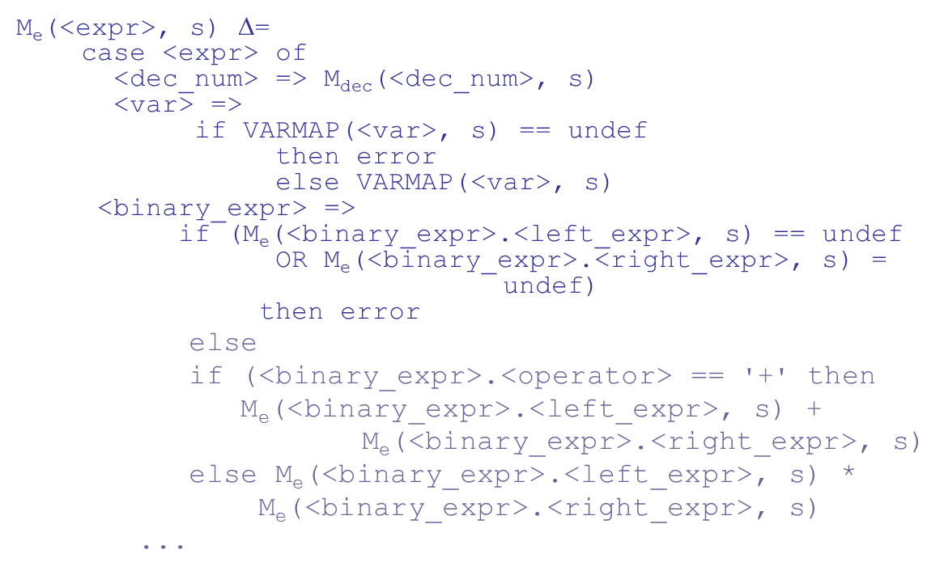
Expressions (2 of 2)

Slide 42
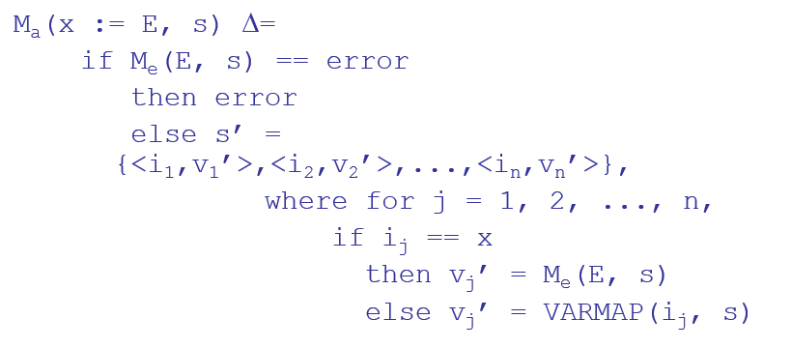
Assignment Statements
Maps state sets to state sets

Slide 43
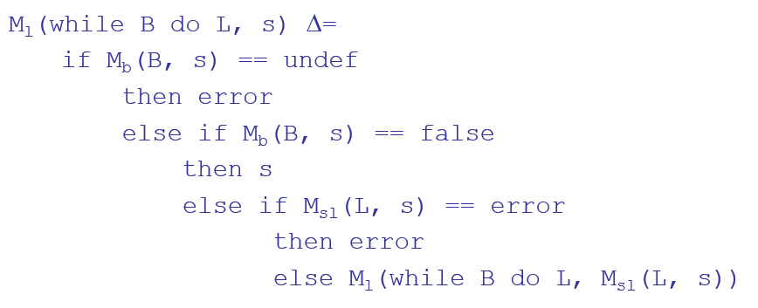
Logical Pretest Loops
Maps state sets to state sets

Slide 44
Loop Meaning
The meaning of the loop is the value of the program variables after the statements in the loop have been executed the prescribed number of times, assuming there have been no errors
In essence, the loop has been converted from iteration to recursion, where the recursive control is mathematically defined by other recursive state mapping functions
Recursion, when compared to iteration, is easier to describe with mathematical rigor

Slide 45
Evaluation of Denotational Semantics
Can be used to prove the correctness of programs
Provides a rigorous way to think about programs
Can be an aid to language design
Has been used in compiler generation systems
Because of its complexity, it are of little use to language users

Slide 46
Axiomatic Semantics (1 of 2)
Based on formal logic (predicate calculus)
Original purpose: formal program verification
Axioms or inference rules are defined for each statement type in the language (to allow transformations of logic expressions into more formal logic expressions)
The logic expressions are called assertions

Slide 47
Axiomatic Semantics (2 of 2)
An assertion before a statement (a precondition) states the relationships and constraints among variables that are true at that point in execution
An assertion following a statement is a postcondition
A weakest precondition is the least restrictive precondition that will guarantee the postcondition

Slide 48
Axiomatic Semantics Form
Pre-, post form: {P} statement {Q}
An example
a = b + 1
One possible precondition:
Weakest precondition:

Slide 49
Program Proof Process
The postcondition for the entire program is the desired result
Work back through the program to the first statement. If the precondition on the first statement is the same as the program specification, the program is correct.

Slide 50
Axiomatic Semantics: Assignment
An axiom for assignment statements
The Rule of Consequence:

Slide 51
Axiomatic Semantics: Sequences
An inference rule for sequences of the form S1; S2
{P1} S1 {P2}
{P2} S2 {P3}

Slide 52
Axiomatic Semantics: Selection
An inference rules for selection
if B then S1 else S2

Slide 53
Axiomatic Semantics: Loops
An inference rule for logical pretest loops
{P} while B do S end {Q}
where I is the loop invariant (the inductive hypothesis)

Slide 54
Axiomatic Semantics: Axioms
Characteristics of the loop invariant: I must meet the following conditions:
P
I the loop invariant must be true initially
{I} B {I} evaluation of the Boolean must not change the validity of I
{I and B} S {I} I is not changed by executing the body of the loop
(I and (not B))
Q if I is true and B is false, Q is implied
The loop terminates can be difficult to prove

Slide 55
Loop Invariant
The loop invariant I is a weakened version of the loop postcondition, and it is also a precondition.
I must be weak enough to be satisfied prior to the beginning of the loop, but when combined with the loop exit condition, it must be strong enough to force the truth of the postcondition

Slide 56
Evaluation of Axiomatic Semantics
Developing axioms or inference rules for all of the statements in a language is difficult
It is a good tool for correctness proofs, and an excellent framework for reasoning about programs, but it is not as useful for language users and compiler writers
Its usefulness in describing the meaning of a programming language is limited for language users or compiler writers

Slide 57
Denotation Semantics vs Operational Semantics
In operational semantics, the state changes are defined by coded algorithms
In denotational semantics, the state changes are defined by rigorous mathematical functions

Slide 58
Summary
B N F and context-free grammars are equivalent meta-languages
Well-suited for describing the syntax of programming languages
An attribute grammar is a descriptive formalism that can describe both the syntax and the semantics of a language
Three primary methods of semantics description
Operation, axiomatic, denotational

Slide 59
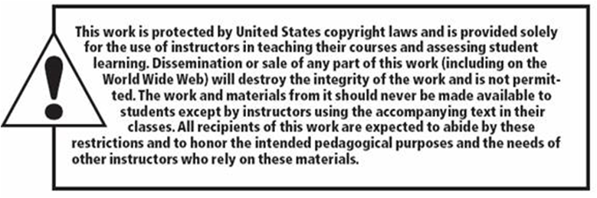
Copyright

