Slide 1
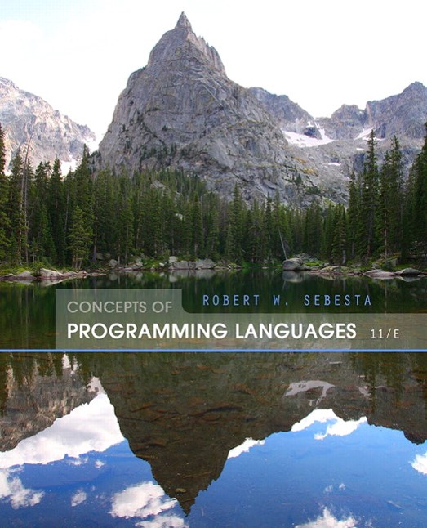
Concepts of Programming Languages
Eleventh Edition
Chapter 5
Names, Bindings, and Scopes
Copyright © 2016, 2013, 2010 Pearson Education, Inc. All Rights Reserved
Notes:
If this PowerPoint presentation contains mathematical equations, you may need to check that your computer has the following installed:
1) Math Type Plugin
2) Math Player (free versions available)
3) NVDA Reader (free versions available)

Slide 2
Objectives
5.1 Introduction
5.2 Names
5.3 Variables
5.4 The Concept of Binding
5.5 Scope
5.6 Scope and Lifetime
5.7 Referencing Environments
5.8 Named Constants

Slide 3
Introduction
Imperative languages are abstractions of von Neumann architecture
Memory
Processor
Variables are characterized by attributes
To design a type, must consider scope, lifetime, type checking, initialization, and type compatibility

Slide 4
Names (1 of 5)
Design issues for names:
Are names case sensitive?
Are special words reserved words or keywords?

Slide 5
Names (2 of 5)
Length
If too short, they cannot be connotative
Language examples:
C99: no limit but only the first 63 are significant; also, external names are limited to a maximum of 31
C
and Java: no limit, and all are significant
C++: no limit, but implementers often impose one

Slide 6
Names (3 of 5)
Special characters
P H P: all variable names must begin with dollar signs
Perl: all variable names begin with special characters, which specify the variable’s type
Ruby: variable names that begin with @ are instance variables; those that begin with @@ are class variables

Slide 7
Names (4 of 5)
Case sensitivity
Disadvantage: readability (names that look alike are different)
Names in the C-based languages are case sensitive
Names in others are not
Worse in C++, Java, and C# because predefined names are mixed case (e.g. IndexOutOfBoundsException)

Slide 8
Names (5 of 5)
Special words
An aid to readability; used to delimit or separate statement clauses
A keyword is a word that is special only in certain contexts
A reserved word is a special word that cannot be used as a user-defined name
Potential problem with reserved words: If there are too many, many collisions occur (e.g., COBOL has 300 reserved words!)

Slide 9
Variables
A variable is an abstraction of a memory cell
Variables can be characterized as a sextuple of attributes:
Name
Address
Value
Type
Lifetime
Scope

Slide 10
Variables Attributes (1 of 3)
Name - not all variables have them
Address - the memory address with which it is associated
A variable may have different addresses at different times during execution
A variable may have different addresses at different places in a program
If two variable names can be used to access the same memory location, they are called aliases
Aliases are created via pointers, reference variables, C and C++ unions
Aliases are harmful to readability (program readers must remember all of them)

Slide 11
Variables Attributes (2 of 3)
Type - determines the range of values of variables and the set of operations that are defined for values of that type; in the case of floating point, type also determines the precision
Value - the contents of the location with which the variable is associated
The l-value of a variable is its address
The r-value of a variable is its value
Abstract memory cell - the physical cell or collection of cells associated with a variable

Slide 12
The Concept of Binding
A binding is an association between an entity and an attribute, such as between a variable and its type or value, or between an operation and a symbol
Binding time is the time at which a binding takes place.

Slide 13
Possible Binding Times
Language design time -- bind operator symbols to operations
Language implementation time-- bind floating point type to a representation
Compile time -- bind a variable to a type in C or Java
Load time -- bind a C or C++ static variable to a memory cell)
Runtime -- bind a nonstatic local variable to a memory cell

Slide 14
Static and Dynamic Binding
A binding is static if it first occurs before run time and remains unchanged throughout program execution.
A binding is dynamic if it first occurs during execution or can change during execution of the program

Slide 15
Type Binding
How is a type specified?
When does the binding take place?
If static, the type may be specified by either an explicit or an implicit declaration

Slide 16
Explicit/Implicit Declaration (1 of 2)
An explicit declaration is a program statement used for declaring the types of variables
An implicit declaration is a default mechanism for specifying types of variables through default conventions, rather than declaration statements
Basic, Perl, Ruby, JavaScript, and P H P provide implicit declarations
Advantage: writability (a minor convenience)
Disadvantage: reliability (less trouble with Perl)

Slide 17
Explicit/Implicit Declaration (2 of 2)
Some languages use type inferencing to determine types of variables (context)
C
a variable can be declared with var and an initial
value. The initial value sets the type
Visual Basic 9.0+, M L, Haskell, and F# use type inferencing. The context of the appearance of a variable determines its type

Slide 18
Dynamic Type Binding
Dynamic Type Binding (JavaScript, Python, Ruby, P H P, and C
(limited))
Specified through an assignment statement e.g., JavaScript
list = [2, 4.33, 6, 8];
list = 17.3;
Advantage: flexibility (generic program units)
Disadvantages:
High cost (dynamic type checking and interpretation)
Type error detection by the compiler is difficult

Slide 19
Variable Attributes (3 of 3)
Storage Bindings & Lifetime
Allocation - getting a cell from some pool of available cells
Deallocation - putting a cell back into the pool
The lifetime of a variable is the time during which it is bound to a particular memory cell

Slide 20
Categories of Variables by Lifetimes (1 of 4)
Static--bound to memory cells before execution begins and remains bound to the same memory cell throughout execution, e.g., C and C++ static variables in functions
Advantages: efficiency (direct addressing), history-sensitive subprogram support
Disadvantage: lack of flexibility (no recursion)

Slide 21
Categories of Variables by Lifetimes (2 of 4)
Stack-dynamic--Storage bindings are created for variables when their declaration statements are elaborated. (A declaration is elaborated when the executable code associated with it is executed)
If scalar, all attributes except address are statically bound
local variables in C subprograms (not declared static) and Java methods
Advantage: allows recursion; conserves storage
Disadvantages:
Overhead of allocation and deallocation
Subprograms cannot be history sensitive
Inefficient references (indirect addressing)

Slide 22
Categories of Variables by Lifetimes (3 of 4)
Explicit heap-dynamic -- Allocated and deallocated by explicit directives, specified by the programmer, which take effect during execution
Referenced only through pointers or references, e.g. dynamic objects in C++ (via new and delete), all objects in Java
Advantage: provides for dynamic storage management
Disadvantage: inefficient and unreliable

Slide 23
Categories of Variables by Lifetimes (4 of 4)
Implicit heap-dynamic--Allocation and deallocation caused by assignment statements
all variables in A P L; all strings and arrays in Perl, JavaScript, and P H P
Advantage: flexibility (generic code)
Disadvantages:
Inefficient, because all attributes are dynamic
Loss of error detection

Slide 24
Variable Attributes: Scope
The scope of a variable is the range of statements over which it is visible
The local variables of a program unit are those that are declared in that unit
The nonlocal variables of a program unit are those that are visible in the unit but not declared there
Global variables are a special category of nonlocal variables
The scope rules of a language determine how references to names are associated with variables

Slide 25
Static Scope (1 of 2)
Based on program text
To connect a name reference to a variable, you (or the compiler) must find the declaration
Search process: search declarations, first locally, then in increasingly larger enclosing scopes, until one is found for the given name
Enclosing static scopes (to a specific scope) are called its static ancestors; the nearest static ancestor is called a static parent
Some languages allow nested subprogram definitions, which create nested static scopes (e.g., Ada, JavaScript, Common Lisp, Scheme, Fortran 2003+, F
, and Python)

Slide 26
Static Scope (2 of 2)
Variables can be hidden from a unit by having a "closer" variable with the same name

Slide 27
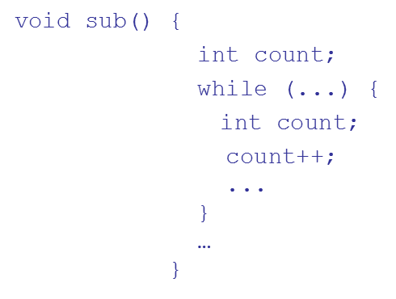
Blocks
A method of creating static scopes inside program units--from ALGOL 60
Example in C:
Note: legal in C and C++, but not in Java and C
- too error-prone

Slide 28
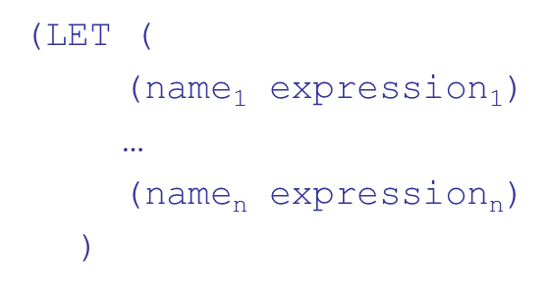
The LET Construct (1 of 2)
Most functional languages include some form of let construct
A let construct has two parts
The first part binds names to values
The second part uses the names defined in the first part
In Scheme:

Slide 29
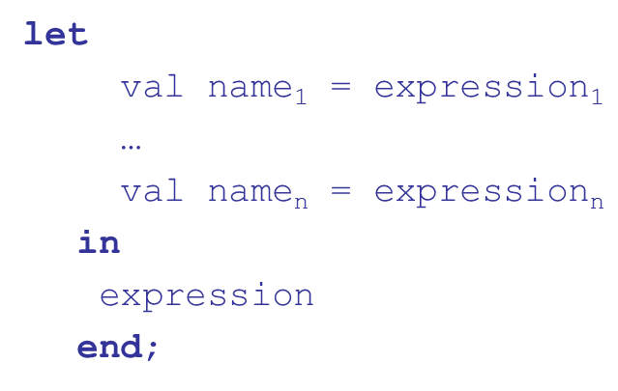
The LET Construct (2 of 2)
In M L:
In
First part: let left_side = expression
(left_side is either a name or a tuple pattern)
All that follows is the second part

Slide 30
Declaration Order (1 of 2)
allow variable declarations to
C99, C++, Java, and
appear anywhere a statement can appear
In C99, C++, and Java, the scope of all local variables is from the declaration to the end of the block
In
, the scope of any variable declared in a block is
the whole block, regardless of the position of the declaration in the block
However, a variable still must be declared before it can be used

Slide 31
Declaration Order (2 of 2)
In C++, Java, and
, variables can be declared in for
statements
The scope of such variables is restricted to the for construct

Slide 32
Global Scope (1 of 3)
C, C++, P H P, and Python support a program structure that consists of a sequence of function definitions in a file
These languages allow variable declarations to appear outside function definitions
C and C++have both declarations (just attributes) and definitions (attributes and storage)
A declaration outside a function definition specifies that it is defined in another file

Slide 33
Global Scope (2 of 3)
P H P
Programs are embedded in H T M L markup documents, in any number of fragments, some statements and some function definitions
The scope of a variable (implicitly) declared in a function is local to the function
The scope of a variable implicitly declared outside functions is from the declaration to the end of the program, but skips over any intervening functions
Global variables can be accessed in a function through the $GLOBALS array or by declaring it global

Slide 34
Global Scope (3 of 3)
Python
A global variable can be referenced in functions, but can be assigned in a function only if it has been declared to be global in the function

Slide 35
Evaluation of Static Scoping
Works well in many situations
Problems:
In most cases, too much access is possible
As a program evolves, the initial structure is destroyed and local variables often become global; subprograms also gravitate toward become global, rather than nested

Slide 36
Dynamic Scope
Based on calling sequences of program units, not their textual layout (temporal versus spatial)
References to variables are connected to declarations by searching back through the chain of subprogram calls that forced execution to this point

Slide 37
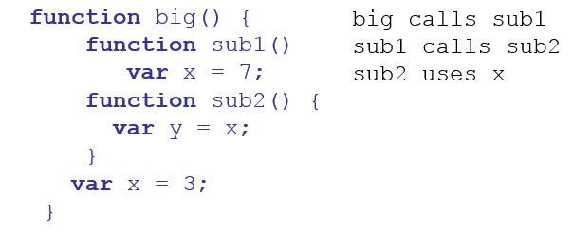
Scope Example (1 of 2)
Static scoping
Reference to x in sub2 is to big's x
Dynamic scoping
Reference to x in sub2 is to sub1's x

Slide 38
Scope Example (2 of 2)
Evaluation of Dynamic Scoping:
Advantage: convenience
Disadvantages:
While a subprogram is executing, its variables are visible to all subprograms it calls
Impossible to statically type check
Poor readability- it is not possible to statically determine the type of a variable

Slide 39
Scope and Lifetime
Scope and lifetime are sometimes closely related, but are different concepts
Consider a static variable in a C or C++ function

Slide 40
Referencing Environments
The referencing environment of a statement is the collection of all names that are visible in the statement
In a static-scoped language, it is the local variables plus all of the visible variables in all of the enclosing scopes
A subprogram is active if its execution has begun but has not yet terminated
In a dynamic-scoped language, the referencing environment is the local variables plus all visible variables in all active subprograms

Slide 41
Named Constants
A named constant is a variable that is bound to a value only when it is bound to storage
Advantages: readability and modifiability
Used to parameterize programs
The binding of values to named constants can be either static (called manifest constants) or dynamic
Languages:
C++ and Java: expressions of any kind, dynamically bound
C
has two kinds, readonly and const
The values of const named constants are bound at compile time
The values of readonly named constants are dynamically bound

Slide 42
Summary
Case sensitivity and the relationship of names to special words represent design issues of names
Variables are characterized by the sextuples: name, address, value, type, lifetime, scope
Binding is the association of attributes with program entities
Scalar variables are categorized as: static, stack dynamic, explicit heap dynamic, implicit heap dynamic
Strong typing means detecting all type errors

Slide 43

Copyright

