Slide 1
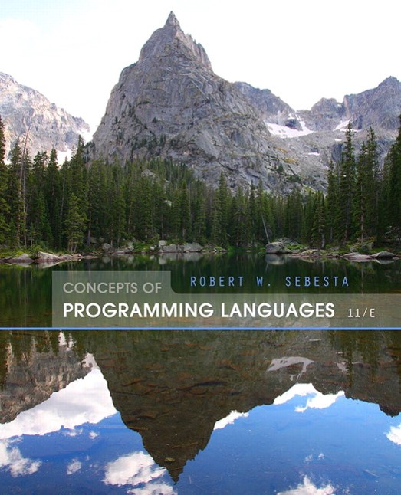
Concepts of Programming Languages
Eleventh Edition
Chapter 4
Data Types
Copyright © 2016, 2013, 2010 Pearson Education, Inc. All Rights Reserved
Notes:
If this PowerPoint presentation contains mathematical equations, you may need to check that your computer has the following installed:
1) Math Type Plugin
2) Math Player (free versions available)
3) NVDA Reader (free versions available)

Slide 2
Objectives (1 of 2)
4.1 Introduction
4.2 Primitive Data Types
4.3 Character String Types
4.4 Enumeration Types
4.5 Array Types
4.6 Associative Arrays
4.7 Record Types
4.8 Tuple Types

Slide 3
Objectives (2 of 2)
4.9 List Types
4.10 Union Types
4.11 Pointer and Reference Types
4.12 Type Checking
4.13 Strong Typing
4.14 Type Equivalence
4.15 Theory and Data Types

Slide 4
Introduction
A data type defines a collection of data objects and a set of predefined operations on those objects
A descriptor is the collection of the attributes of a variable
An object represents an instance of a user-defined (abstract data) type
One design issue for all data types: What operations are defined and how are they specified?

Slide 5
Primitive Data Types
Almost all programming languages provide a set of primitive data types
Primitive data types: Those not defined in terms of other data types
Some primitive data types are merely reflections of the hardware
Others require only a little non-hardware support for their implementation

Slide 6
Primitive Data Types: Integer
Almost always an exact reflection of the hardware so the mapping is trivial
There may be as many as eight different integer types in a language
Java’s signed integer sizes: byte, short, int, long

Slide 7
Primitive Data Types: Floating Point
Model real numbers, but only as approximations
Languages for scientific use support at least two floating-point types (e.g., float and double; sometimes more
Usually exactly like the hardware, but not always
I E E E Floating-Point Standard 754

Slide 8
Primitive Data Types: Complex
Some languages support a complex type, e.g., C99, Fortran, and Python
Each value consists of two floats, the real part and the imaginary part
Literal form (in Python):
(7 + 3j), where 7 is the real part and 3 is the imaginary part

Slide 9
Primitive Data Types: Decimal
For business applications (money)
Essential to COBOL
C
offers a decimal data type
Store a fixed number of decimal digits, in coded form (B C D)
Advantage: accuracy
Disadvantages: limited range, wastes memory

Slide 10
Primitive Data Types: Boolean (1 of 2)
Simplest of all
Range of values: two elements, one for “true” and one for “false”
Could be implemented as bits, but often as bytes
Advantage: readability

Slide 11
Primitive Data Types: Boolean (2 of 2)
Stored as numeric codings
Most commonly used coding: ASCII
An alternative, 16-bit coding: Unicode (U C S-2)
Includes characters from most natural languages
Originally used in Java
C
and JavaScript also support Unicode
32-bit Unicode (U C S-4)
Supported by Fortran, starting with 2003

Slide 12
Character String Types
Values are sequences of characters
Design issues:
Is it a primitive type or just a special kind of array?
Should the length of strings be static or dynamic?

Slide 13
Character String Types Operations
Typical operations:
Assignment and copying
Comparison (=, >, etc.)
Catenation
Substring reference
Pattern matching

Slide 14
Character String Type in Certain Languages (1 of 2)
C and C++
Not primitive
Use char arrays and a library of functions that provide operations
SNOBOL4 (a string manipulation language)
Primitive
Many operations, including elaborate pattern matching
Fortran and Python
Primitive type with assignment and several operations

Slide 15
Character String Type in Certain Languages (2 of 2)
Java
Primitive via the String class
Perl, JavaScript, Ruby, and P H P
Provide built-in pattern matching, using regular expressions

Slide 16
Character String Length Options
Static: COBOL, Java’s String class
Limited Dynamic Length: C and C++
In these languages, a special character is used to indicate the end of a string’s characters, rather than maintaining the length
Dynamic (no maximum): SNOBOL4, Perl, JavaScript

Slide 17
Character String Type Evaluation
Aid to writability
As a primitive type with static length, they are inexpensive to provide--why not have them?
Dynamic length is nice, but is it worth the expense?

Slide 18
Character String Implementation
Static length: compile-time descriptor
Limited dynamic length: may need a run-time descriptor for length (but not in C and C++)
Dynamic length: need run-time descriptor; allocation/deallocation is the biggest implementation problem

Slide 19
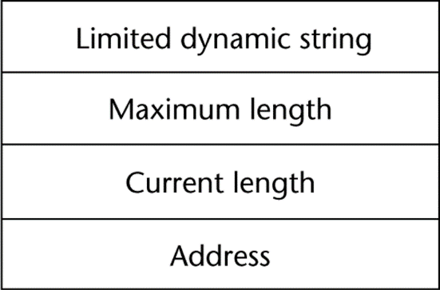
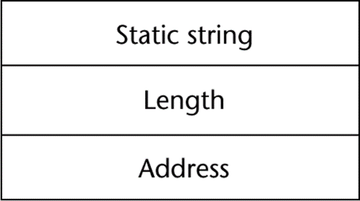
Compile- and Run-Time Descriptors
Compile-time descriptor for static strings
Run-time descriptor for limited dynamic strings

Slide 20
User-Defined Ordinal Types
An ordinal type is one in which the range of possible values can be easily associated with the set of positive integers
Examples of primitive ordinal types in Java
integer
char
boolean

Slide 21
Enumeration Types
All possible values, which are named constants, are provided in the definition
Design issues
Is an enumeration constant allowed to appear in more than one type definition, and if so, how is the type of an occurrence of that constant checked?
Are enumeration values coerced to integer?
Any other type coerced to an enumeration type?

Slide 22
Evaluation of Enumerated Type
Aid to readability, e.g., no need to code a color as a number
Aid to reliability, e.g., compiler can check:
operations (don’t allow colors to be added)
No enumeration variable can be assigned a value outside its defined range
C
and Java 5.0 provide better support for
enumeration than C++ because enumeration type variables in these languages are not coerced into integer types

Slide 23
Array Types
An array is a homogeneous aggregate of data elements in which an individual element is identified by its position in the aggregate, relative to the first element.

Slide 24
Array Design Issues
What types are legal for subscripts?
Are subscripting expressions in element references range checked?
When are subscript ranges bound?
When does allocation take place?
Are ragged or rectangular multidimensional arrays allowed, or both?
What is the maximum number of subscripts?
Can array objects be initialized?
Are any kind of slices supported?

Slide 25
Array Indexing
Indexing (or subscripting) is a mapping from indices to elements
Index Syntax
Fortran and Ada use parentheses
Ada explicitly uses parentheses to show uniformity between array references and function calls because both are mappings
Most other languages use brackets

Slide 26
Arrays Index (Subscript) Types
FORTRAN, C: integer only
Java: integer types only
Index range checking
C, C++, Perl, and Fortran do not specify range checking
Java, M L, C
specify range checking

Slide 27
Subscript Binding and Array Categories (1 of 4)
Static: subscript ranges are statically bound and storage allocation is static (before run-time)
Advantage: efficiency (no dynamic allocation)
Fixed stack-dynamic: subscript ranges are statically bound, but the allocation is done at declaration time
Advantage: space efficiency

Slide 28
Subscript Binding and Array Categories (2 of 4)
Fixed heap-dynamic: similar to fixed stack-dynamic: storage binding is dynamic but fixed after allocation (i.e., binding is done when requested and storage is allocated from heap, not stack)

Slide 29
Subscript Binding and Array Categories (3 of 4)
Heap-dynamic: binding of subscript ranges and storage allocation is dynamic and can change any number of times
Advantage: flexibility (arrays can grow or shrink during program execution)

Slide 30
Subscript Binding and Array Categories (4 of 4)
C and C++ arrays that include static modifier are static
C and C++ arrays without static modifier are fixed stack-dynamic
C and C++ provide fixed heap-dynamic arrays
C
includes a second array class ArrayList that
provides fixed heap-dynamic
Perl, JavaScript, Python, and Ruby support heap-dynamic arrays

Slide 31


Array Initialization (1 of 2)
Some language allow initialization at the time of storage allocation
C, C++, Java, C# example
Character strings in C and C++
Arrays of strings in C and C++
Java initialization of String objects

Slide 32
Heterogeneous Arrays
A heterogeneous array is one in which the elements need not be of the same type
Supported by Perl, Python, JavaScript, and Ruby

Slide 33

Array Initialization (2 of 2)
C-based languages
Python
List comprehensions

Slide 34
Arrays Operations
A P L provides the most powerful array processing operations for vectors and matrixes as well as unary operators (for example, to reverse column elements)
Python’s array assignments, but they are only reference changes. Python also supports array catenation and element membership operations
Ruby also provides array catenation

Slide 35
Rectangular and Jagged Arrays
A rectangular array is a multi-dimensioned array in which all of the rows have the same number of elements and all columns have the same number of elements
A jagged matrix has rows with varying number of elements
Possible when multi-dimensioned arrays actually appear as arrays of arrays
C, C++, and Java support jagged arrays
F
and C
support rectangular arrays and jagged arrays

Slide 36
Slices
A slice is some substructure of an array; nothing more than a referencing mechanism
Slices are only useful in languages that have array operations

Slide 37
Slice Examples
Python
vector = [2, 4, 6, 8, 10, 12, 14, 16]
mat = [[1, 2, 3], [4, 5, 6], [7, 8, 9]]
vector (3:6) is a three-element array
mat[0][0:2] is the first and second element of the first row of mat
Ruby supports slices with the slice method
list.slice(2, 2) returns the third and fourth elements of list

Slide 38
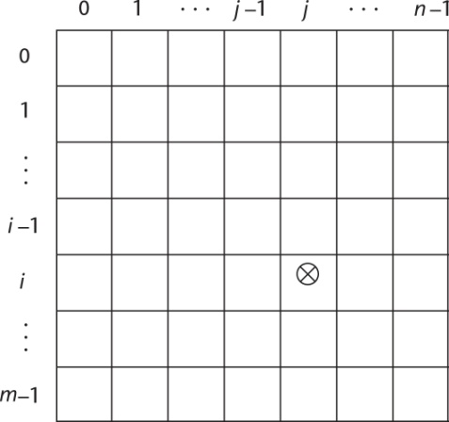
Implementation of Arrays
Access function maps subscript expressions to an address in the array
Access function for single-dimensioned arrays:

Slide 39
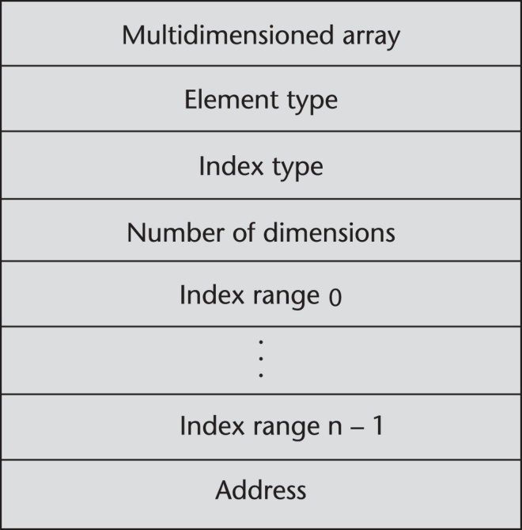
Accessing Multi-dimensioned Arrays
Two common ways:
Row major order (by rows) – used in most languages
Column major order (by columns) – used in Fortran
A compile-time descriptor for a multidimensional array

Slide 40
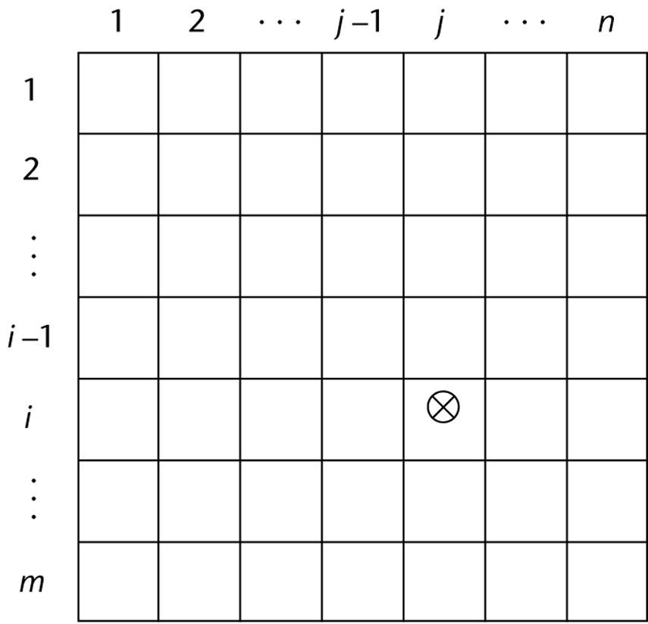
Locating an Element in a Multi-dimensioned Array
General format

Slide 41
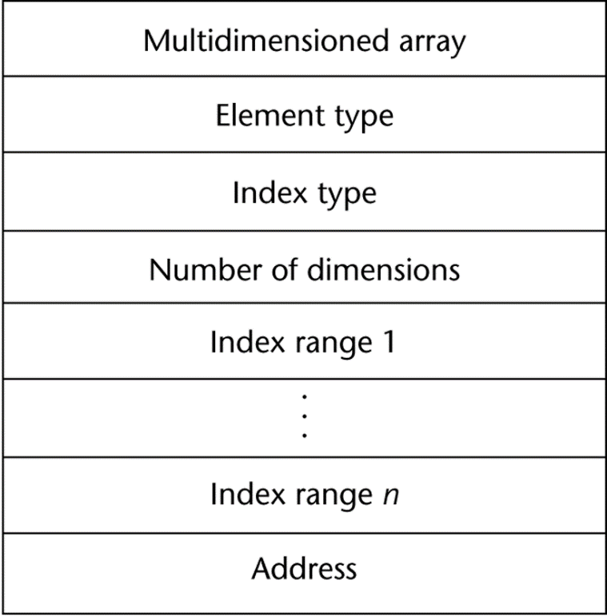
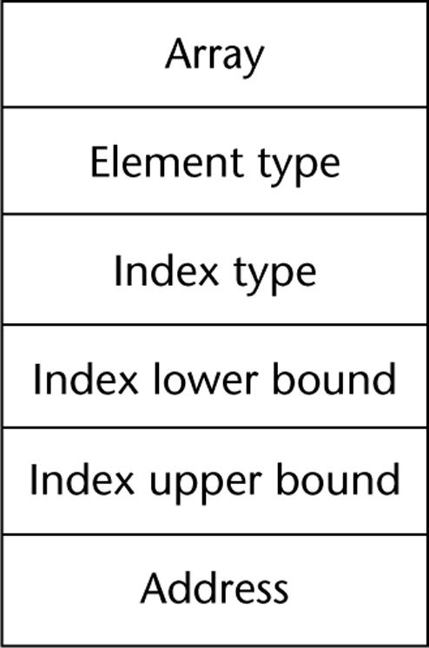
Compile-Time Descriptors
Single-dimensioned array
Multidimensional array

Slide 42
Associative Arrays
An associative array is an unordered collection of data elements that are indexed by an equal number of values called keys
User-defined keys must be stored
Design issues:
What is the form of references to elements?
Is the size static or dynamic?
Built-in type in Perl, Python, Ruby, and Lua
In Lua, they are supported by tables

Slide 43


Associative Arrays in Perl
Names begin with %; literals are delimited by parentheses
Subscripting is done using braces and keys
Elements can be removed with delete

Slide 44
Record Types
A record is a possibly heterogeneous aggregate of data elements in which the individual elements are identified by names
Design issues:
What is the syntactic form of references to the field?
Are elliptical references allowed

Slide 45
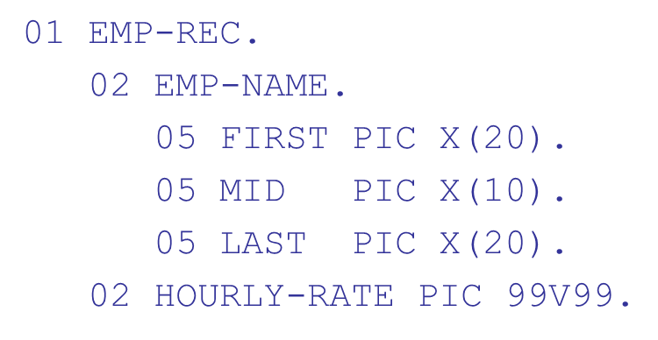
Definition of Records in COBOL
COBOL uses level numbers to show nested records; others use recursive definition

Slide 46
References to Records
Record field references
1. COBOL
field_name OF record_name_1 OF ... OF record_name_n
2. Others (dot notation)
record_name_1.record_name_2. ... record_name_n.field_name
Fully qualified references must include all record names
Elliptical references allow leaving out record names as long as the reference is unambiguous, for example in COBOL FIRST, FIRST OF EMP-NAME, and FIRST of EMP-REC are elliptical references to the employee’s first name

Slide 47
Evaluation and Comparison to Arrays
Records are used when collection of data values is heterogeneous
Access to array elements is much slower than access to record fields, because subscripts are dynamic (field names are static)
Dynamic subscripts could be used with record field access, but it would disallow type checking and it would be much slower

Slide 48
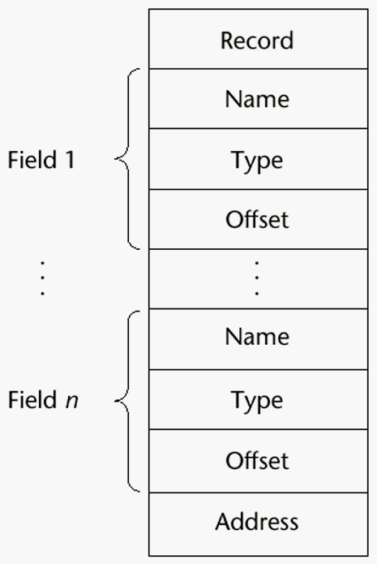
Implementation of Record Type
Offset address relative to the beginning of the records is associated with each field

Slide 49
Tuple Types (1 of 2)
A tuple is a data type that is similar to a record, except that the elements are not named
Used in Python, ML, and F# to allow functions to return multiple values
Python
Closely related to its lists, but immutable
Create with a tuple literal
myTuple = (3, 5.8, ′apple′)
Referenced with subscripts (begin at 1)
Catenation with + and deleted with del

Slide 50
Tuple Types (2 of 2)
ML
val myTuple = (3, 5.8, ′apple′);
Access as follows:
(myTuple) is the first element
A new tuple type can be defined
F
let tup = (3, 5, 7)
let a, b, c = tup This assigns a tuple to a tuple pattern

Slide 51
List Types (1 of 6)
Lists in Lisp and Scheme are delimited by parentheses and use no commas
Data and code have the same form
As data,
is literally what it is
As code,
is the function A applied to the parameters B and C
The interpreter needs to know which a list is, so if it is data, we quote it with an apostrophe

Slide 52
List Types (2 of 6)
List Operations in Scheme
CAR returns the first element of its list parameter
CDR returns the remainder of its list parameter after the first element has been removed
CONS puts its first parameter into its second parameter, a list, to make a new list
LIST returns a new list of its parameters

Slide 53
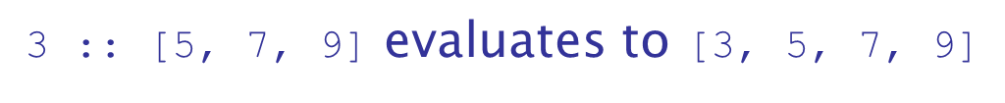
List Types (3 of 6)
List Operations in M L
Lists are written in brackets and the elements are separated by commas
List elements must be of the same type
The Scheme CONS function is a binary operator in M L, ::
The Scheme CAR and CDR functions are named hd and tl, respectively

Slide 54
List Types (4 of 6)
F
Lists
Like those of M L, except elements are separated by semicolons and h d and t l are methods of the List class
Python Lists
The list data type also serves as Python’s arrays
Unlike Scheme, Common Lisp, M L, and F
Python’s lists are mutable
Elements can be of any type
Create a list with an assignment
myList = [3, 5.8, "grape"]

Slide 55
List Types (5 of 6)
Python Lists
List elements are referenced with subscripting, with indices beginning at zero
x = myList[1] Sets x to 5.8
List elements can be deleted with del
del myList[1]
List Comprehensions – derived from set notation
range(12) creates [0, 1, 2, 3, 4, 5, 6]
Constructed list: [0, 9, 36]

Slide 56
List Types (6 of 6)
Haskell’s List Comprehensions
The original
F
List Comprehensions
Both C# and Java supports lists through their generic heap-dynamic collection classes, List and ArrayList, respectively

Slide 57
Unions Types
A union is a type whose variables are allowed to store different type values at different times during execution
Design issue
Should type checking be required?

Slide 58
Discriminated vs. Free Unions
C and C++ provide union constructs in which there is no language support for type checking; the union in these languages is called free union
Type checking of unions require that each union include a type indicator called a discriminant
Supported by M L, Haskell, and F

Slide 59
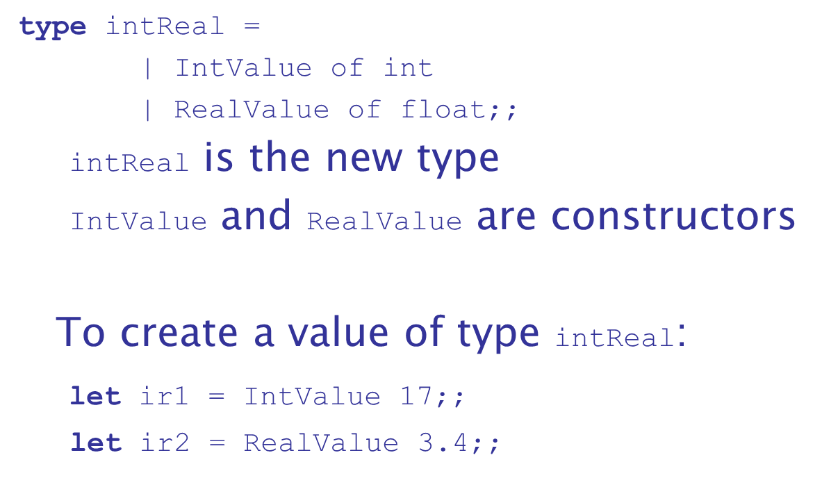
Unions in F (1 of 4)
Defined with a type statement using OR

Slide 60
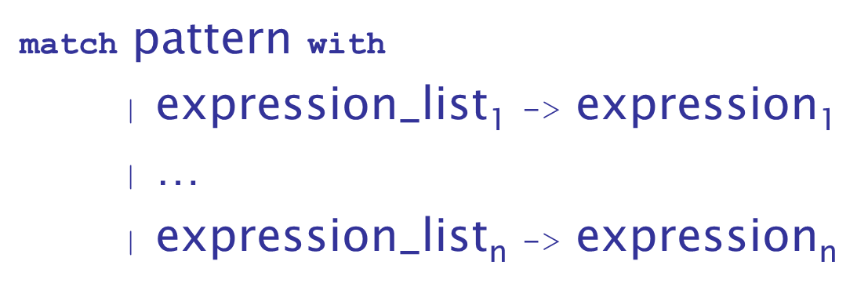
Unions in F (2 of 4)
Accessing the value of a union is done with pattern matching
Pattern can be any data type
The expression list can have wild cards (_)

Slide 61
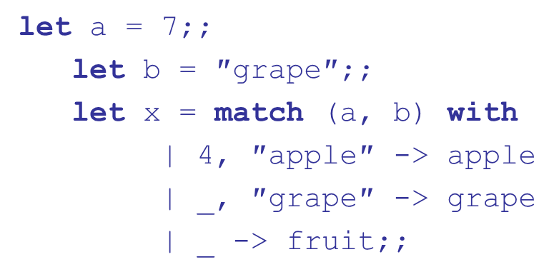
Unions in F (3 of 4)
Example:

Slide 62
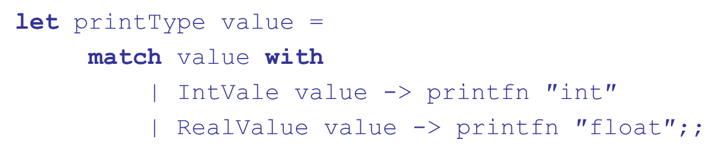
Unions in F (4 of 4)
To display the type of the intReal union:
If
are defined as previously,

Slide 63
Evaluation of Unions
Free unions are unsafe
Do not allow type checking
Java and
do not support unions
Reflective of growing concerns for safety in programming language

Slide 64
Pointer and Reference Types
A pointer type variable has a range of values that consists of memory addresses and a special value, nil
Provide the power of indirect addressing
Provide a way to manage dynamic memory
A pointer can be used to access a location in the area where storage is dynamically created (usually called a heap)

Slide 65
Design Issues of Pointers
What are the scope of and lifetime of a pointer variable?
What is the lifetime of a heap-dynamic variable?
Are pointers restricted as to the type of value to which they can point?
Are pointers used for dynamic storage management, indirect addressing, or both?
Should the language support pointer types, reference types, or both?

Slide 66
Pointer Operations
Two fundamental operations: assignment and dereferencing
Assignment is used to set a pointer variable’s value to some useful address
Dereferencing yields the value stored at the location represented by the pointer’s value
Dereferencing can be explicit or implicit
C++ uses an explicit operation via
sets j to the value located at

Slide 67
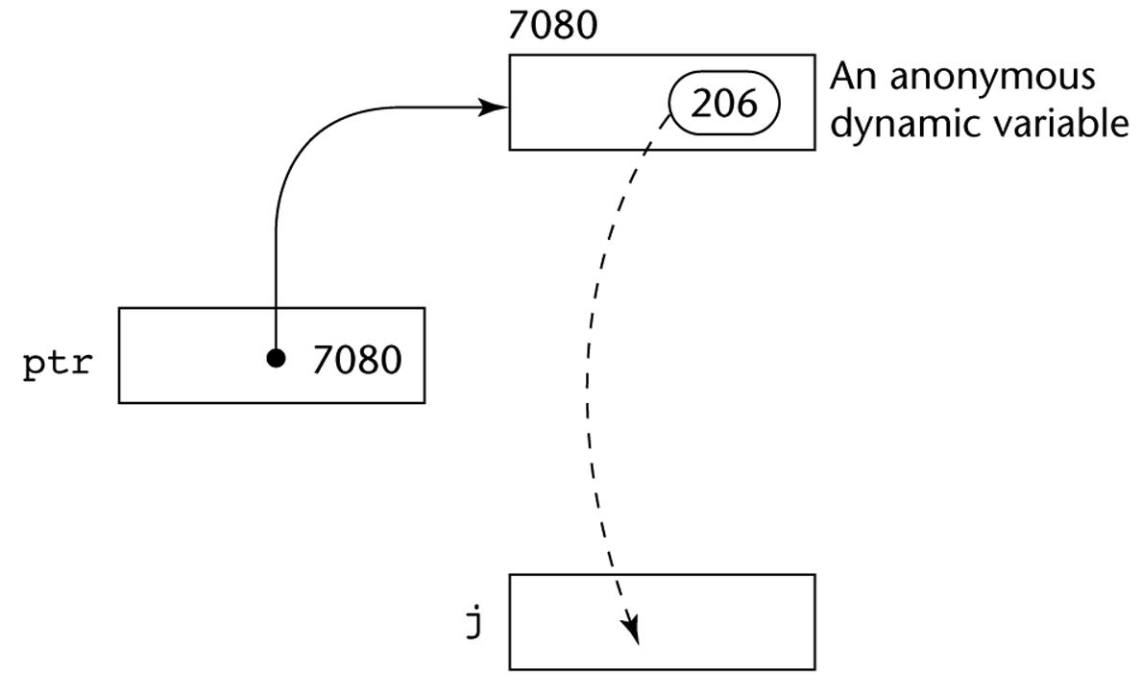
Pointer Assignment Illustrated
The assignment operation

Slide 68
Problems with Pointers
Dangling pointers (dangerous)
A pointer points to a heap-dynamic variable that has been deallocated
Lost heap-dynamic variable
An allocated heap-dynamic variable that is no longer accessible to the user program (often called garbage)
Pointer p1 is set to point to a newly created heap-dynamic variable
Pointer p1 is later set to point to another newly created heap-dynamic variable
The process of losing heap-dynamic variables is called memory leakage

Slide 69
Pointers in C and C++
Extremely flexible but must be used with care
Pointers can point at any variable regardless of when or where it was allocated
Used for dynamic storage management and addressing
Pointer arithmetic is possible
Explicit dereferencing and address-of operators
Domain type need not be fixed
can point to any type and can be type
checked (cannot be de-referenced)

Slide 70
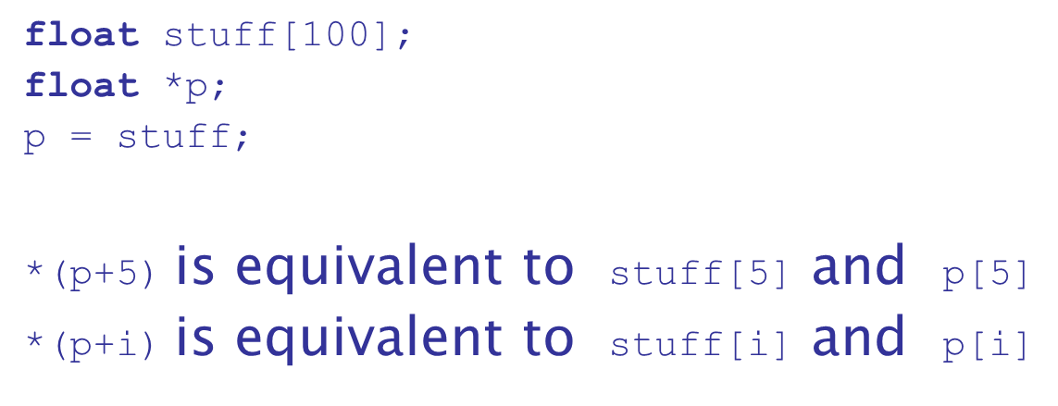
Pointer Arithmetic in C and C++

Slide 71
Reference Types
C++ includes a special kind of pointer type called a reference type that is used primarily for formal parameters
Advantages of both pass-by-reference and pass-by-value
Java extends C++’s reference variables and allows them to replace pointers entirely
References are references to objects, rather than being addresses
C
includes both the references of Java and the pointers
of C++

Slide 72
Evaluation of Pointers
Dangling pointers and dangling objects are problems as is heap management
Pointers are like goto's--they widen the range of cells that can be accessed by a variable
Pointers or references are necessary for dynamic data structures--so we can't design a language without them

Slide 73
Representations of Pointers
Large computers use single values
Intel microprocessors use segment and offset

Slide 74
Dangling Pointer Problem
Tombstone: extra heap cell that is a pointer to the heap-dynamic variable
The actual pointer variable points only at tombstones
When heap-dynamic variable de-allocated, tombstone remains but set to nil
Costly in time and space
Locks-and-keys: Pointer values are represented as (key, address) pairs
Heap-dynamic variables are represented as variable plus cell for integer lock value
When heap-dynamic variable allocated, lock value is created and placed in lock cell and key cell of pointer

Slide 75
Heap Management
A very complex run-time process
Single-size cells vs. variable-size cells
Two approaches to reclaim garbage
Reference counters (eager approach): reclamation is gradual
Mark-sweep (lazy approach): reclamation occurs when the list of variable space becomes empty

Slide 76
Reference Counter
Reference counters: maintain a counter in every cell that store the number of pointers currently pointing at the cell
Disadvantages: space required, execution time required, complications for cells connected circularly
Advantage: it is intrinsically incremental, so significant delays in the application execution are avoided

Slide 77
Mark-Sweep
The run-time system allocates storage cells as requested and disconnects pointers from cells as necessary; mark-sweep then begins
Every heap cell has an extra bit used by collection algorithm
All cells initially set to garbage
All pointers traced into heap, and reachable cells marked as not garbage
All garbage cells returned to list of available cells
Disadvantages: in its original form, it was done too infrequently. When done, it caused significant delays in application execution. Contemporary mark-sweep algorithms avoid this by doing it more often—called incremental mark-sweep

Slide 78
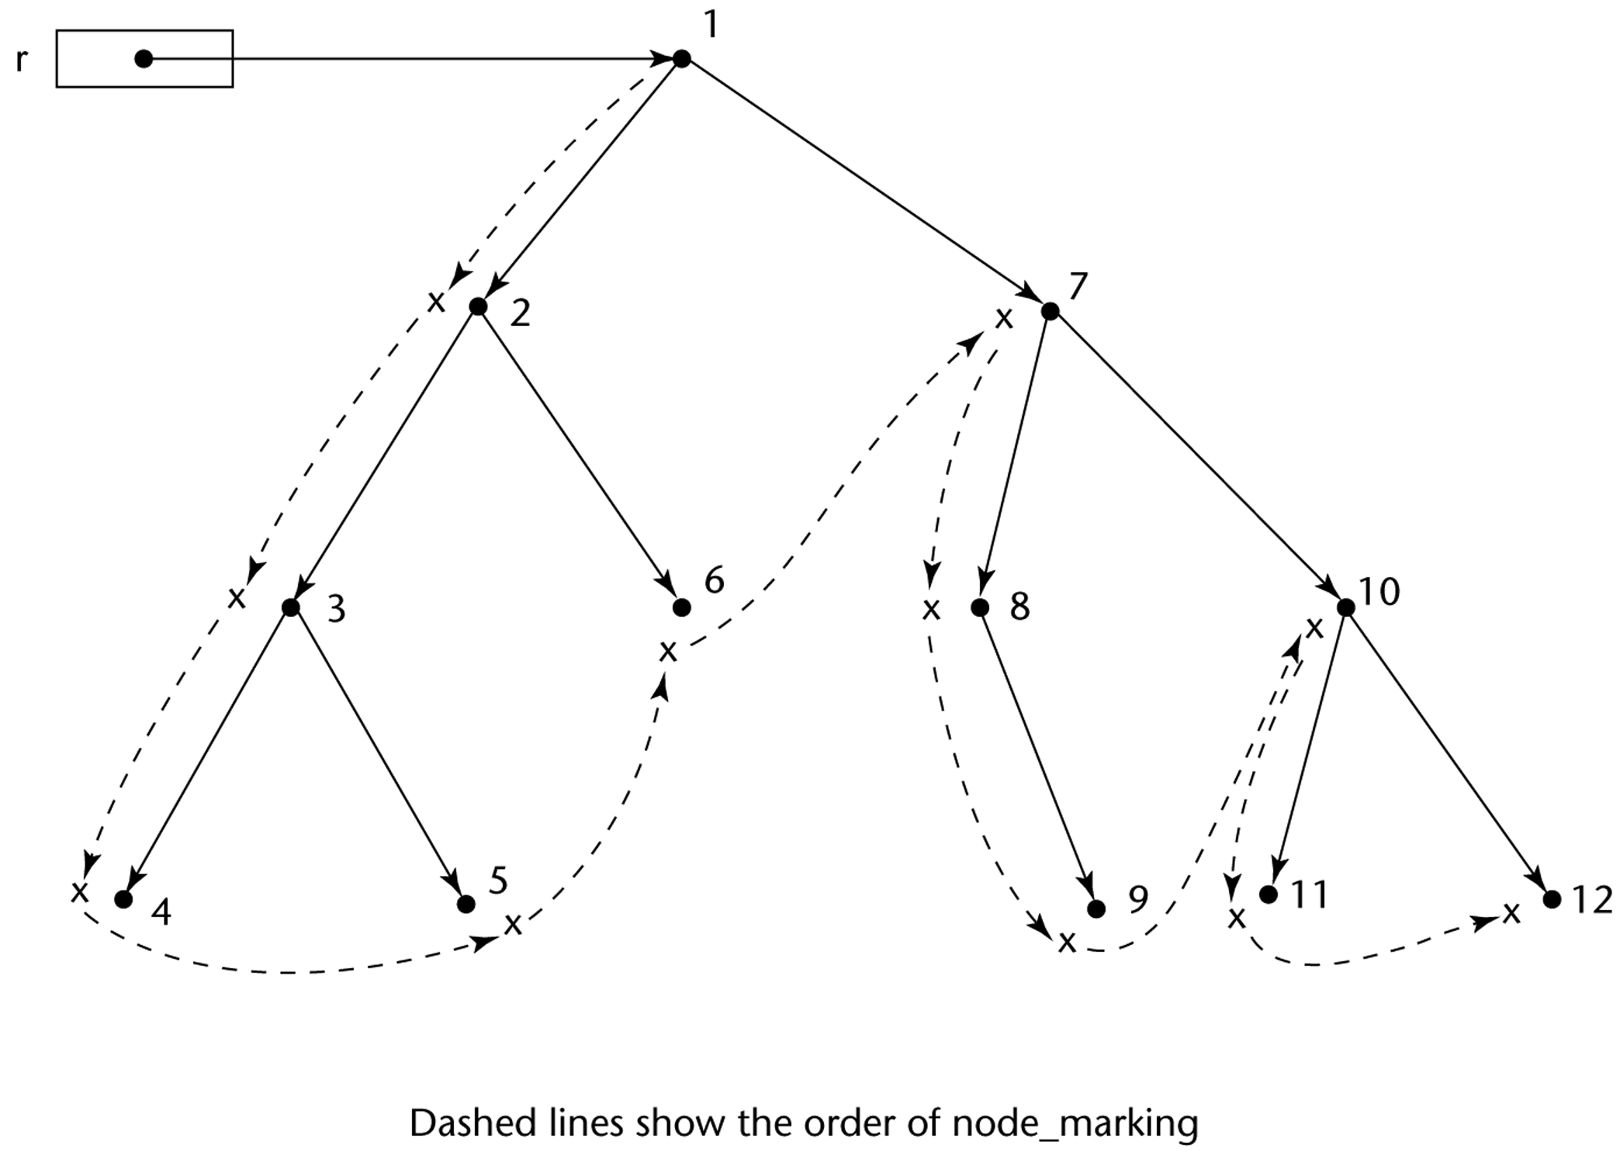
Marking Algorithm

Slide 79
Variable-Size Cells
All the difficulties of single-size cells plus more
Required by most programming languages
If mark-sweep is used, additional problems occur
The initial setting of the indicators of all cells in the heap is difficult
The marking process in nontrivial
Maintaining the list of available space is another source of overhead

Slide 80
Type Checking (1 of 2)
Generalize the concept of operands and operators to include subprograms and assignments
Type checking is the activity of ensuring that the operands of an operator are of compatible types
A compatible type is one that is either legal for the operator, or is allowed under language rules to be implicitly converted, by compiler- generated code, to a legal type
This automatic conversion is called a coercion.
A type error is the application of an operator to an operand of an inappropriate type

Slide 81
Type Checking (2 of 2)
If all type bindings are static, nearly all type checking can be static
If type bindings are dynamic, type checking must be dynamic
A programming language is strongly typed if type errors are always detected
Advantage of strong typing: allows the detection of the misuses of variables that result in type errors

Slide 82
Strong Typing (1 of 2)
Language examples:
C and C++ are not: parameter type checking can be avoided; unions are not type checked
Java and C
are, almost (because of explicit type
casting)
ML and
are

Slide 83
Strong Typing (2 of 2)
Coercion rules strongly affect strong typing--they can weaken it considerably (C++ versus ML and
Although Java has just half the assignment coercions of C++, its strong typing is still far less effective than that of Ada

Slide 84
Name Type Equivalence
Name type equivalence means the two variables have equivalent types if they are in either the same declaration or in declarations that use the same type name
Easy to implement but highly restrictive:
Subranges of integer types are not equivalent with integer types
Formal parameters must be the same type as their corresponding actual parameters

Slide 85
Structure Type Equivalence (1 of 2)
Structure type equivalence means that two variables have equivalent types if their types have identical structures
More flexible, but harder to implement

Slide 86
Structure Type Equivalence (2 of 2)
Consider the problem of two structured types:
Are two record types equivalent if they are structurally the same but use different field names?
Are two array types equivalent if they are the same except that the subscripts are different? (e.g. [1..10] and [0..9])
Are two enumeration types equivalent if their components are spelled differently?
With structural type equivalence, you cannot differentiate between types of the same structure (e.g. different units of speed, both float)

Slide 87
Theory and Data Types (1 of 2)
Type theory is a broad area of study in mathematics, logic, computer science, and philosophy
Two branches of type theory in computer science:
Practical – data types in commercial languages
Abstract – typed lambda calculus
A type system is a set of types and the rules that govern their use in programs

Slide 88
Theory and Data Types (2 of 2)
Formal model of a type system is a set of types and a collection of functions that define the type rules
Either an attribute grammar or a type map could be used for the functions
Finite mappings – model arrays and functions
Cartesian products – model tuples and records
Set unions – model union types
Subsets – model subtypes

Slide 89
Summary
The data types of a language are a large part of what determines that language’s style and usefulness
The primitive data types of most imperative languages include numeric, character, and Boolean types
The user-defined enumeration and subrange types are convenient and add to the readability and reliability of programs
Arrays and records are included in most languages
Pointers are used for addressing flexibility and to control dynamic storage management

Slide 90

Copyright

