Slide 1
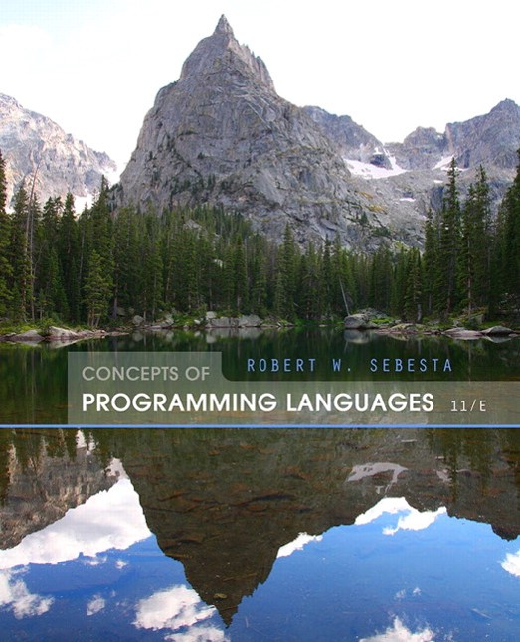
Concepts of Programming Languages
Eleventh Edition
Chapter 7
Expressions and Assignment Statements
Copyright © 2016, 2013, 2010 Pearson Education, Inc. All Rights Reserved
Notes:
If this PowerPoint presentation contains mathematical equations, you may need to check that your computer has the following installed:
1) Math Type Plugin
2) Math Player (free versions available)
3) NVDA Reader (free versions available)

Slide 2
Objectives
7.1 Introduction
7.2 Arithmetic Expressions
7.3 Overloaded Operators
7.4 Type Conversions
7.5 Relational and Boolean Expressions
7.6 Short-Circuit Evaluation
7.7 Assignment Statements
7.8 Mixed-Mode Assignment

Slide 3
Introduction
Expressions are the fundamental means of specifying computations in a programming language
To understand expression evaluation, need to be familiar with the orders of operator and operand evaluation
Essence of imperative languages is dominant role of assignment statements

Slide 4
Arithmetic Expressions
Arithmetic evaluation was one of the motivations for the development of the first programming languages
Arithmetic expressions consist of operators, operands, parentheses, and function calls

Slide 5
Arithmetic Expressions: Design Issues
Design issues for arithmetic expressions
Operator precedence rules?
Operator associativity rules?
Order of operand evaluation?
Operand evaluation side effects?
Operator overloading?
Type mixing in expressions?

Slide 6
Arithmetic Expressions: Operators
A unary operator has one operand
A binary operator has two operands
A ternary operator has three operands

Slide 7
Arithmetic Expressions: Operator Precedence Rules
The operator precedence rules for expression evaluation define the order in which “adjacent” operators of different precedence levels are evaluated
Typical precedence levels
parentheses
unary operators
** (if the language supports it)
*, /
+, −

Slide 8
Arithmetic Expressions: Operator Associativity Rule
The operator associativity rules for expression evaluation define the order in which adjacent operators with the same precedence level are evaluated
Typical associativity rules
Left to right, except **, which is right to left
Sometimes unary operators associate right to left (e.g., in FORTRAN)
A P L is different; all operators have equal precedence and all operators associate right to left
Precedence and associativity rules can be overriden with parentheses

Slide 9
Expressions in Ruby and Scheme
Ruby
All arithmetic, relational, and assignment operators, as well as array indexing, shifts, and bit-wise logic operators, are implemented as methods
One result of this is that these operators can all be overriden by application programs
Scheme (and Common Lisp)
All arithmetic and logic operations are by explicitly called subprograms

Slide 10
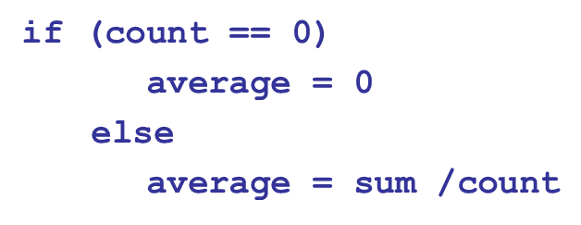
Arithmetic Expressions: Conditional Expressions
Conditional Expressions
C-based languages (e.g., C, C++)
An example:
Evaluates as if written as follows:

Slide 11
Arithmetic Expressions: Operand Evaluation Order
Operand evaluation order
Variables: fetch the value from memory
Constants: sometimes a fetch from memory; sometimes the constant is in the machine language instruction
Parenthesized expressions: evaluate all operands and operators first
The most interesting case is when an operand is a function call

Slide 12
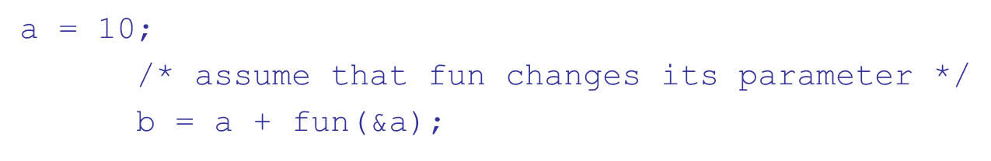
Arithmetic Expressions: Potentials for Side Effects
Functional side effects: when a function changes a two-way parameter or a non-local variable
Problem with functional side effects:
When a function referenced in an expression alters another operand of the expression; e.g., for a parameter change:

Slide 13
Functional Side Effects
Two possible solutions to the problem
Write the language definition to disallow functional side effects
No two-way parameters in functions
No non-local references in functions
Advantage: it works!
Disadvantage: inflexibility of one-way parameters and lack of non-local references
Write the language definition to demand that operand evaluation order be fixed
Disadvantage: limits some compiler optimizations
Java requires that operands appear to be evaluated in left-to-right order

Slide 14
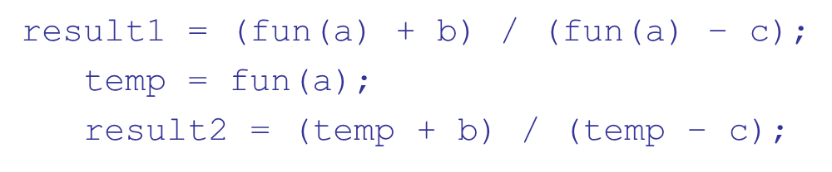
Referential Transparency (1 of 2)
A program has the property of referential transparency if any two expressions in the program that have the same value can be substituted for one another anywhere in the program, without affecting the action of the program
If fun has no side effects, result1 = result2
Otherwise, not, and referential transparency is violated

Slide 15
Referential Transparency (2 of 2)
Advantage of referential transparency
Semantics of a program is much easier to understand if it has referential transparency
Because they do not have variables, programs in pure functional languages are referentially transparent
Functions cannot have state, which would be stored in local variables
If a function uses an outside value, it must be a constant (there are no variables). So, the value of a function depends only on its parameters

Slide 16
Overloaded Operators (1 of 2)
Use of an operator for more than one purpose is called operator overloading
Some are common (e.g., + for int and float)
Some are potential trouble (e.g., * in C and C++)
Loss of compiler error detection (omission of an operand should be a detectable error)
Some loss of readability

Slide 17
Overloaded Operators (2 of 2)
C++,
allow user-defined overloaded operators
When sensibly used, such operators can be an aid to readability (avoid method calls, expressions appear natural)
Potential problems:
Users can define nonsense operations
Readability may suffer, even when the operators make sense

Slide 18
Type Conversions
A narrowing conversion is one that converts an object to a type that cannot include all of the values of the original type e.g., float to int
A widening conversion is one in which an object is converted to a type that can include at least approximations to all of the values of the original type e.g., int to float

Slide 19
Type Conversions: Mixed Mode
A mixed-mode expression is one that has operands of different types
A coercion is an implicit type conversion
Disadvantage of coercions:
They decrease in the type error detection ability of the compiler
In most languages, all numeric types are coerced in expressions, using widening conversions
In M L and
, there are no coercions in expressions

Slide 20
Explicit Type Conversions
Called casting in C-based languages
Examples
C: (int)angle
F
: float(sum)
Note that F#’s syntax is similar to that of function calls

Slide 21
Errors in Expressions
Causes
Inherent limitations of arithmetic e.g., division by zero
Limitations of computer arithmetic e.g. overflow
Often ignored by the run-time system

Slide 22
Relational and Boolean Expressions (1 of 2)
Relational Expressions
Use relational operators and operands of various types
Evaluate to some Boolean representation
Operator symbols used vary somewhat among languages
JavaScript and PHP have two additional relational operator,
Similar to their cousins,
except that they do not coerce their operands
Ruby uses == for equality relation operator that uses
coercions and
for those that do not

Slide 23
Relational and Boolean Expressions (2 of 2)
Boolean Expressions
Operands are Boolean and the result is Boolean
Example operators
C89 has no Boolean type -- it uses int type with 0 for false and nonzero for true
One odd characteristic of C’s expressions:
is a legal expression, but the result is not what you might expect:
Left operator is evaluated, producing 0 or 1
The evaluation result is then compared with the third operand (i.e., c)

Slide 24
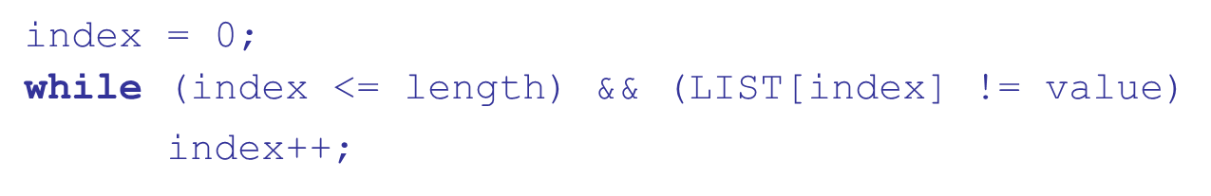
Short Circuit Evaluation (1 of 2)
An expression in which the result is determined without evaluating all of the operands and/or operators
Example:
If a is zero, there is no need to evaluate
Problem with non-short-circuit evaluation
When
will cause an indexing problem

Slide 25
Short Circuit Evaluation (2 of 2)
C, C++, and Java: use short-circuit evaluation for the usual Boolean operators
, but also provide
bitwise Boolean operators that are not short circuit
All logic operators in Ruby, Perl, ML,
and Python are
short-circuit evaluated
Short-circuit evaluation exposes the potential problem of side effects in expressions e.g.

Slide 26
Assignment Statements
The general syntax
The assignment operator
= Fortran, BASIC, the C-based languages
:= Ada
= can be bad when it is overloaded for the relational operator for equality (that’s why the C-based languages use == as the relational operator)

Slide 27
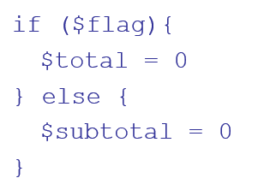
Assignment Statements: Conditional Targets
Conditional targets (Perl)
Which is equivalent to

Slide 28
Assignment Statements: Compound Assignment Operators
A shorthand method of specifying a commonly needed form of assignment
Introduced in ALGOL; adopted by C and the C-based languages
Example
a = a + b
can be written as
a += b

Slide 29
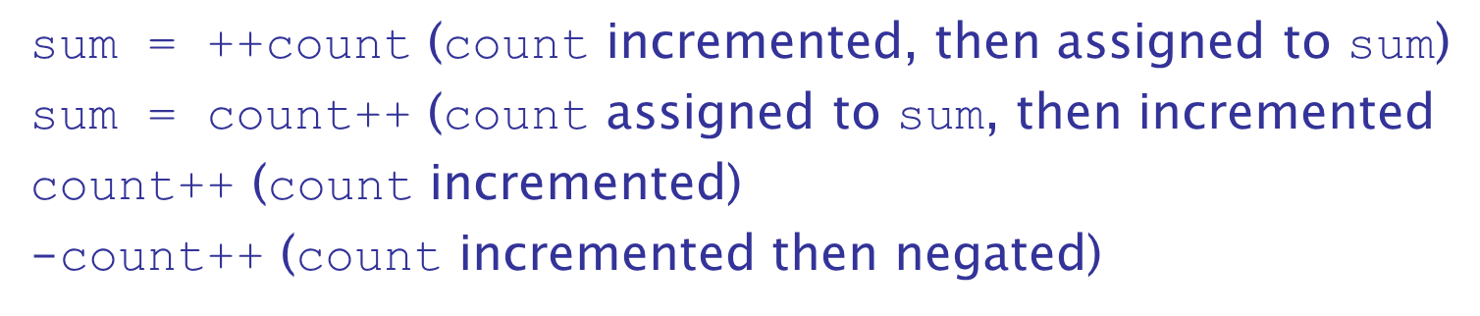
Assignment Statements: Unary Assignment Operators
Unary assignment operators in C-based languages combine increment and decrement operations with assignment
Examples

Slide 30
Assignment as an Expression
In the C-based languages, Perl, and JavaScript, the assignment statement produces a result and can be used as an operand
is carried out; the result (assigned to
is used as a conditional value for the while statement
Disadvantage: another kind of expression side effect

Slide 31
Multiple Assignments
Perl, Ruby, and Lua allow multiple-target multiple-source assignments
Also, the following is legal and performs an interchange:

Slide 32
Assignment in Functional Languages
Identifiers in functional languages are only names of values
M L
Names are bound to values with val
val fruit = apples + oranges;
If another val for fruit follows, it is a new and different name
F
let is like M L’s val, except let also creates a
new scope

Slide 33
Mixed-Mode Assignment
Assignment statements can also be mixed-mode
In Fortran, C, Perl, and C++, any numeric type value can be assigned to any numeric type variable
In Java and
only widening assignment coercions are
done
In Ada, there is no assignment coercion

Slide 34
Summary
Expressions
Operator precedence and associativity
Operator overloading
Mixed-type expressions
Various forms of assignment

Slide 35
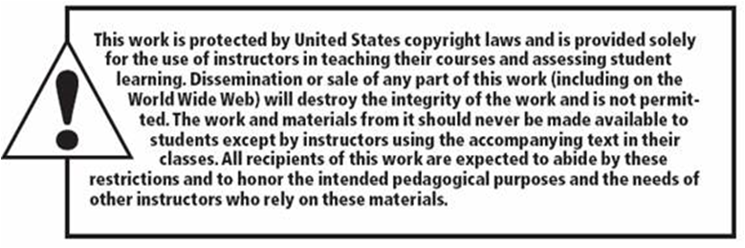
Copyright

