Slide 1
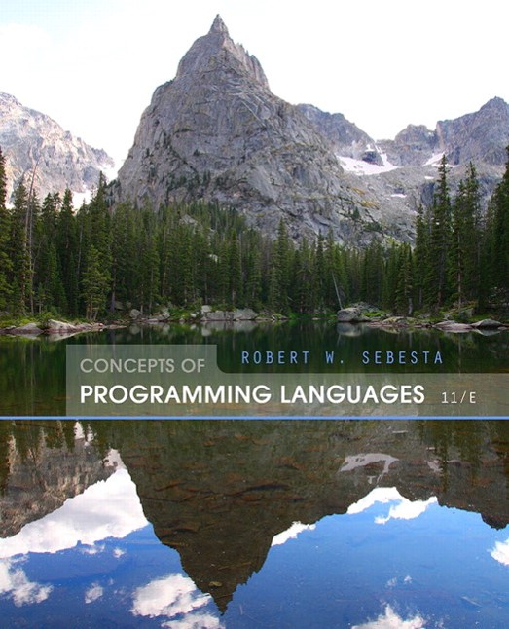
Concepts of Programming Languages
Eleventh Edition
Chapter 8
Statement-Level Control Structures
Copyright © 2016, 2013, 2010 Pearson Education, Inc. All Rights Reserved
Notes:
If this PowerPoint presentation contains mathematical equations, you may need to check that your computer has the following installed:
1) Math Type Plugin
2) Math Player (free versions available)
3) NVDA Reader (free versions available)

Slide 2
Objectives
8.1 Introduction
8.2 Selection Statements
8.3 Iterative Statements
8.4 Unconditional Branching
8.5 Guarded Commands
8.6 Conclusions

Slide 3
Levels of Control Flow
Within expressions (Chapter 7)
Among program units (Chapter 9)
Among program statements (this chapter)

Slide 4
Control Statements: Evolution
FORTRAN I control statements were based directly on I B M 704 hardware
Much research and argument in the 1960s about the issue
One important result: It was proven that all algorithms represented by flowcharts can be coded with only two-way selection and pretest logical loops

Slide 5
Control Structure
A control structure is a control statement and the statements whose execution it controls
Design question
Should a control structure have multiple entries?

Slide 6
Selection Statements
A selection statement provides the means of choosing between two or more paths of execution
Two general categories:
Two-way selectors
Multiple-way selectors

Slide 7
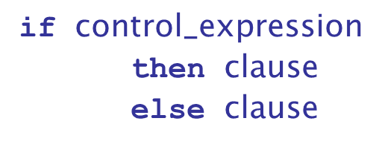
Two-Way Selection Statements
General form:
Design Issues:
What is the form and type of the control expression?
How are the then and else clauses specified?
How should the meaning of nested selectors be specified?

Slide 8
The Control Expression
If the then reserved word or some other syntactic marker is not used to introduce the then clause, the control expression is placed in parentheses
In C89, C99, Python, and C++, the control expression can be arithmetic
In most other languages, the control expression must be Boolean

Slide 9
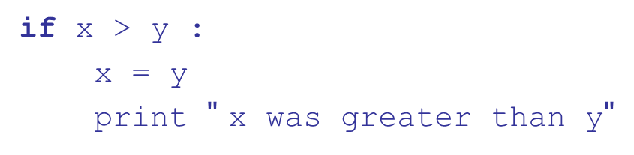
Clause Form
In many contemporary languages, the then and else clauses can be single statements or compound statements
In Perl, all clauses must be delimited by braces (they must be compound)
In Python and Ruby, clauses are statement sequences
Python uses indentation to define clauses

Slide 10
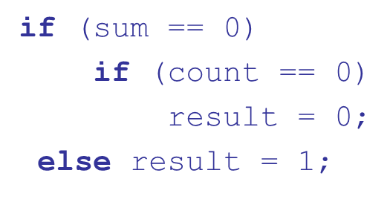
Nesting Selectors (1 of 4)
Java example
Which if gets the else?
Java's static semantics rule: else matches with the nearest previous if

Slide 11
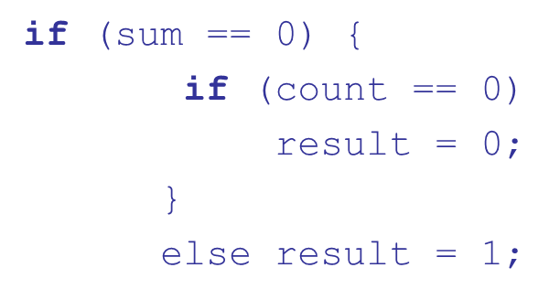
Nesting Selectors (2 of 4)
To force an alternative semantics, compound statements may be used:
The above solution is used in C, C++, and C

Slide 12
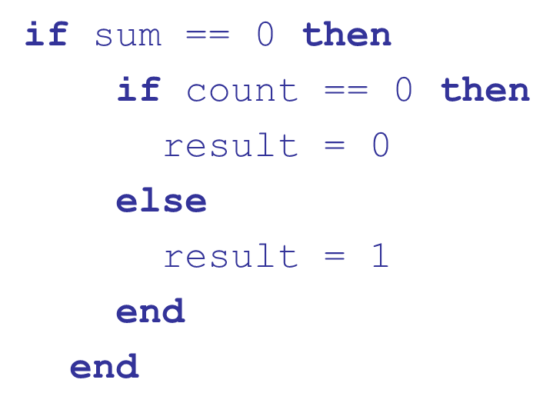
Nesting Selectors (3 of 4)
Statement sequences as clauses: Ruby

Slide 13
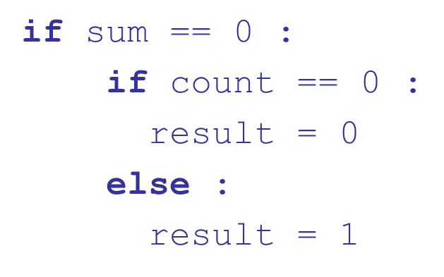
Nesting Selectors (4 of 4)
Python

Slide 14
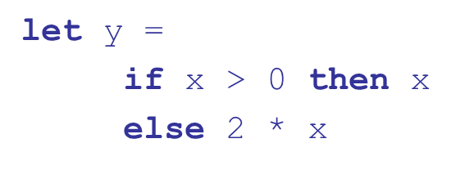
Selector Expressions
In M L,
and Lisp, the selector is an expression; in
If the if expression returns a value, there must be an else clause (the expression could produce a unit type, which has no value). The types of the values returned by then and else clauses must be the same.

Slide 15
Multiple-Way Selection Statements
Allow the selection of one of any number of statements or statement groups
Design Issues:
What is the form and type of the control expression?
How are the selectable segments specified?
Is execution flow through the structure restricted to include just a single selectable segment?
How are case values specified?
What is done about unrepresented expression values?

Slide 16
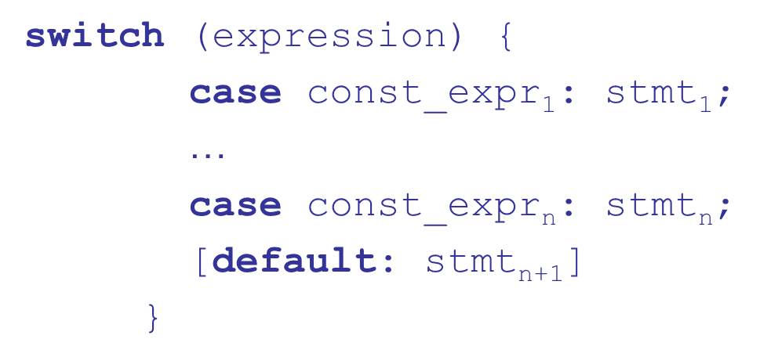
Multiple-Way Selection: Examples (1 of 4)
C, C++, Java, and JavaScript

Slide 17
Multiple-Way Selection: Examples (2 of 4)
Design choices for C’s switch statement
Control expression can be only an integer type
Selectable segments can be statement sequences, blocks, or compound statements
Any number of segments can be executed in one execution of the construct (there is no implicit branch at the end of selectable segments)
default clause is for unrepresented values (if there is no default, the whole statement does nothing)

Slide 18
Multiple-Way Selection: Examples (3 of 4)
C
Differs from C in that it has a static semantics rule that disallows the implicit execution of more than one segment
Each selectable segment must end with an unconditional branch (goto or break)
Also, in
the control expression and the case
constants can be strings

Slide 19
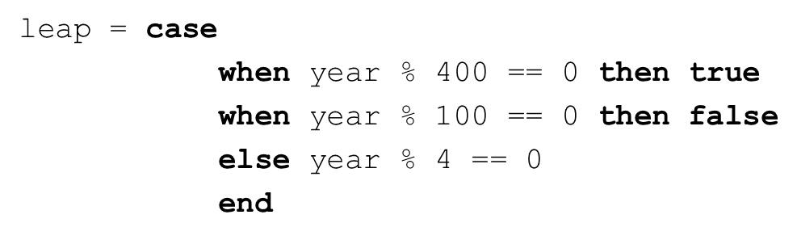
Multiple-Way Selection: Examples (4 of 4)
Ruby has two forms of case statements-we’ll cover only one

Slide 20
Implementing Multiple Selectors
Approaches:
Multiple conditional branches
Store case values in a table and use a linear search of the table
When there are more than ten cases, a hash table of case values can be used
If the number of cases is small and more than half of the whole range of case values are represented, an array whose indices are the case values and whose values are the case labels can be used

Slide 21
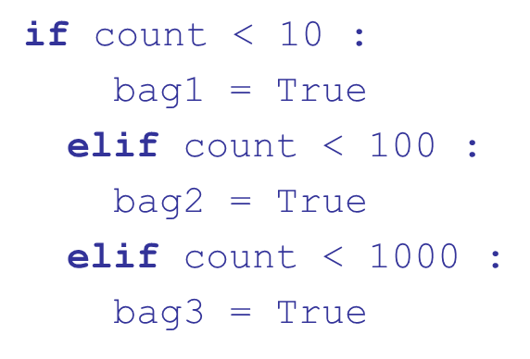
Multiple-Way Selection Using if (1 of 2)
Multiple Selectors can appear as direct extensions to two-way selectors, using else-if clauses, for example in Python:

Slide 22
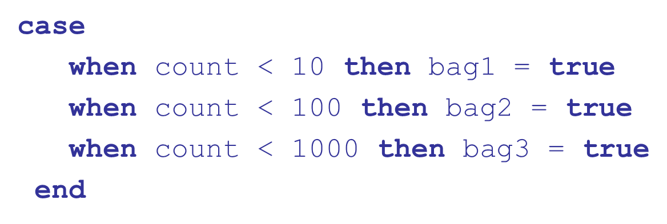
Multiple-Way Selection Using if (2 of 2)
The Python example can be written as a Ruby case

Slide 23
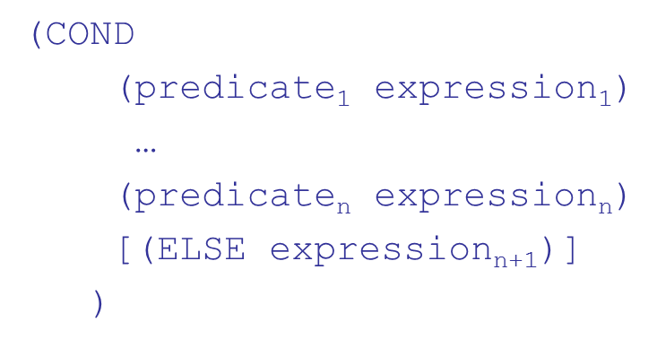
Scheme’s Multiple Selector
General form of a call to COND:
The ELSE clause is optional; ELSE is a synonym for true
Each predicate-expression pair is a parameter
Semantics: The value of the evaluation of COND is the value of the expression associated with the first predicate expression that is true

Slide 24
Iterative Statements
The repeated execution of a statement or compound statement is accomplished either by iteration or recursion
General design issues for iteration control statements:
How is iteration controlled?
Where is the control mechanism in the loop?

Slide 25
Counter-Controlled Loops
A counting iterative statement has a loop variable, and a means of specifying the initial and terminal, and stepsize values
Design Issues:
What are the type and scope of the loop variable?
Should it be legal for the loop variable or loop parameters to be changed in the loop body, and if so, does the change affect loop control?
Should the loop parameters be evaluated only once, or once for every iteration?

Slide 26
Counter-Controlled Loops: Examples (1 of 4)
C-based languages
The expressions can be whole statements, or even statement sequences, with the statements separated by commas
The value of a multiple-statement expression is the value of the last statement in the expression
If the second expression is absent, it is an infinite loop
Design choices:
There is no explicit loop variable
Everything can be changed in the loop
The first expression is evaluated once, but the other two are evaluated with each iteration
It is legal to branch into the body of a for loop in C

Slide 27
Counter-Controlled Loops: Examples (2 of 4)
C++ differs from C in two ways:
The control expression can also be Boolean
The initial expression can include variable definitions (scope is from the definition to the end of the loop body)
Java and
Differs from C++ in that the control expression must be Boolean

Slide 28
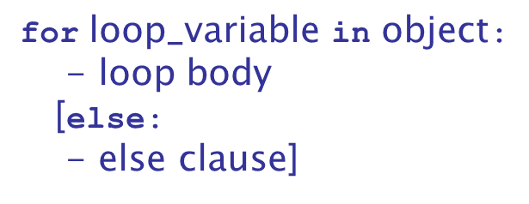
Counter-Controlled Loops: Examples (3 of 4)
Python
The object is often a range, which is either a list of values in brackets
, or a call to the range function
which returns 0,1, 2,3,4
The loop variable takes on the values specified in the given range, one for each iteration
The else clause, which is optional, is executed if the loop terminates normally

Slide 29
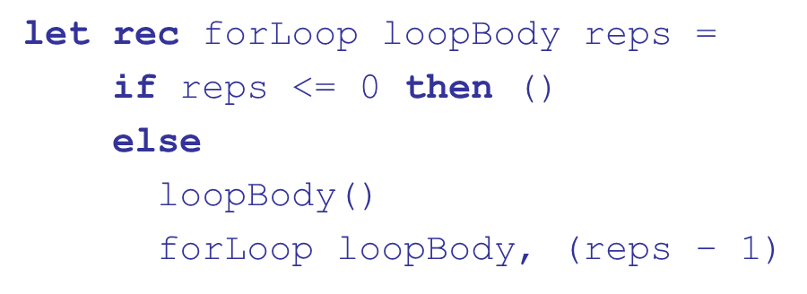
Counter-Controlled Loops: Examples (4 of 4)
F
Because counters require variables, and functional languages do not have variables, counter-controlled loops must be simulated with recursive functions
This defines the recursive function forLoop with the parameters loopBody (a function that defines the loop’s body) and the number of repetitions
() means do nothing and return nothing

Slide 30
Logically-Controlled Loops
Repetition control is based on a Boolean expression
Design issues:
Pretest or posttest?
Should the logically controlled loop be a special case of the counting loop statement or a separate statement?

Slide 31
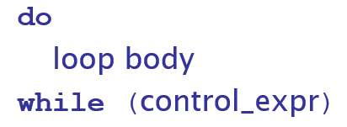
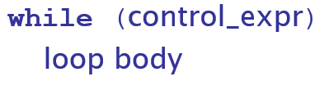
Logically-Controlled Loops: Examples (1 of 2)
C and C++ have both pretest and posttest forms, in which the control expression can be arithmetic:
In both C and C++ it is legal to branch into the body of a logically-controlled loop
Java is like C and C++, except the control expression must be Boolean (and the body can only be entered at the beginning -- Java has no goto

Slide 32
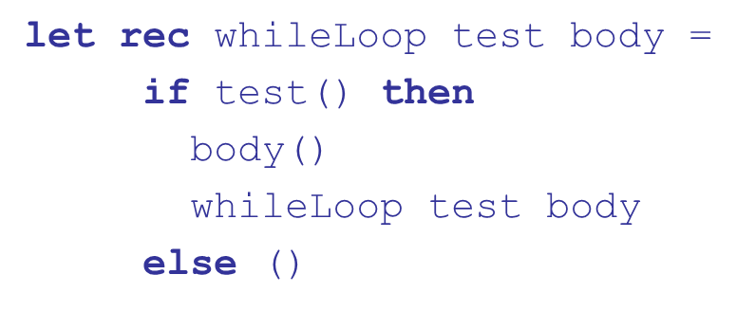
Logically-Controlled Loops: Examples (2 of 2)
F
As with counter-controlled loops, logically-controlled loops can be simulated with recursive functions
This defines the recursive function whileLoop with parameters test and body, both functions. test defines the control expression

Slide 33
User-Located Loop Control Mechanisms (1 of 2)
Sometimes it is convenient for the programmers to decide a location for loop control (other than top or bottom of the loop)
Simple design for single loops (e.g., break)
Design issues for nested loops
Should the conditional be part of the exit?
Should control be transferable out of more than one loop?

Slide 34
User-Located Loop Control Mechanisms (2 of 2)
C, C++, Python, Ruby, and C# have unconditional unlabeled exits (break)
Java and Perl have unconditional labeled exits (break in Java, last in Perl)
C, C++, and Python have an unlabeled control statement, continue, that skips the remainder of the current iteration, but does not exit the loop
Java and Perl have labeled versions of continue

Slide 35
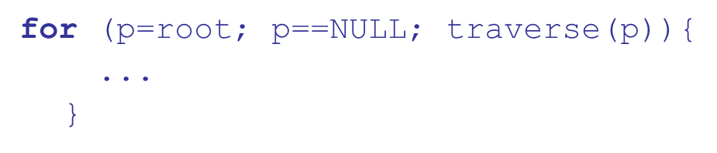
Iteration Based on Data Structures (1 of 5)
The number of elements in a data structure controls loop iteration
Control mechanism is a call to an iterator function that returns the next element in some chosen order, if there is one; else loop is terminate
C's for can be used to build a user-defined iterator:

Slide 36
Iteration Based on Data Structures (2 of 5)
PHP
current points at one element of the array
next moves current to the next element
reset moves current to the first element
Java 5.0 (uses for, although it is called
For arrays and any other class that implements the Iterable interface, e.g., ArrayList

Slide 37
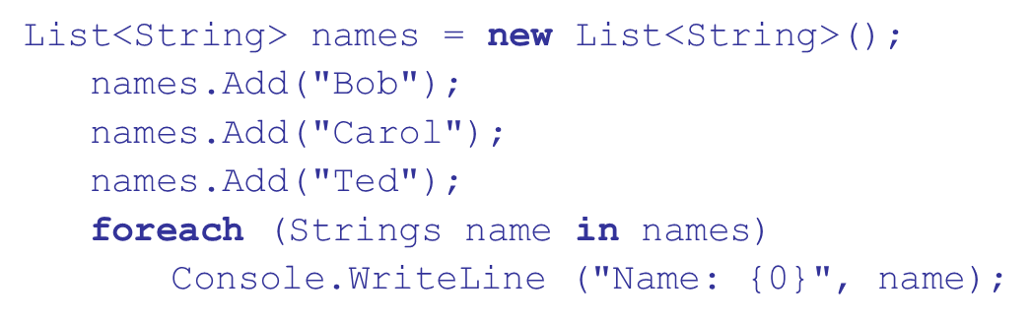
Iteration Based on Data Structures (3 of 5)
(and the other .NET languages) have generic
library classes, like Java 5.0 (for arrays, lists, stacks, and queues). Can iterate over these with the
statement. User-defined collections can implement the
interface and also use

Slide 38
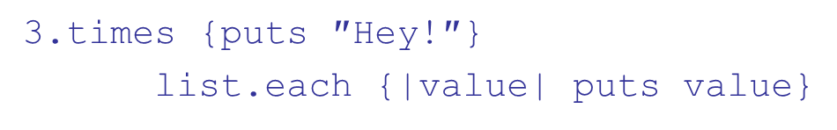

Iteration Based on Data Structures (4 of 5)
Ruby blocks are sequences of code, delimited by either braces or do and end
Blocks can be used with methods to create iterators
Predefined iterator methods (times, each, upto):
(list is an array; value is a block parameter)
Iterators are implemented with blocks, which can also be defined by applications

Slide 39
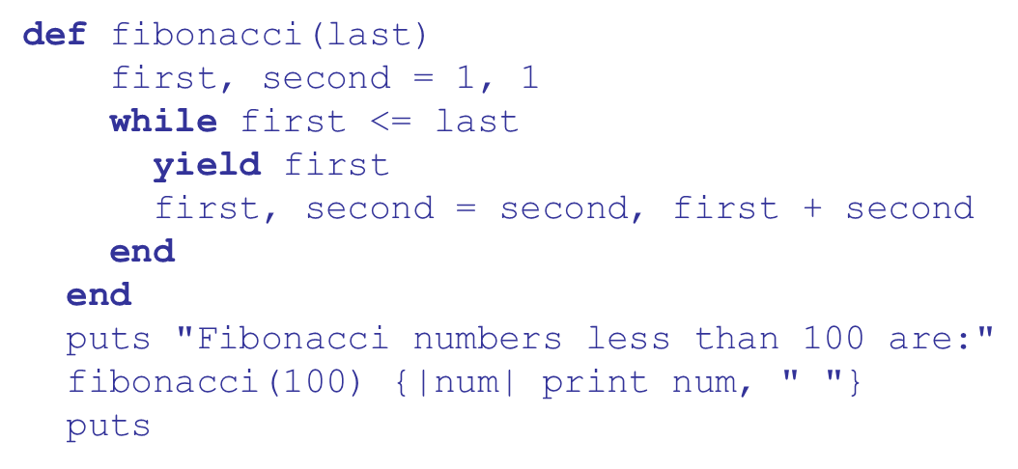
Iteration Based on Data Structures (5 of 5)
Ruby blocks are attached methods calls; they can have parameters (in vertical bars); they are executed when the method executes a yield statement
Ruby has a for statement, but Ruby converts them to upto method calls

Slide 40
Unconditional Branching
Transfers execution control to a specified place in the program
Represented one of the most heated debates in 1960’s and 1970’s
Major concern: Readability
Some languages do not support goto statement (e.g., Java)
C
offers goto statement (can be used in switch
statements)
Loop exit statements are restricted and somewhat camouflaged goto’s

Slide 41
Guarded Commands
Designed by Dijkstra
Purpose: to support a new programming methodology that supported verification (correctness) during development
Basis for two linguistic mechanisms for concurrent programming (in C S P)
Basic Idea: if the order of evaluation is not important, the program should not specify one

Slide 42
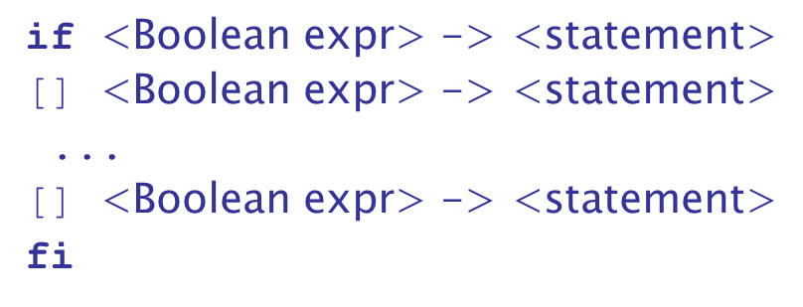
Selection Guarded Command
Form
Semantics: when construct is reached,
Evaluate all Boolean expressions
If more than one are true, choose one non deterministically
If none are true, it is a runtime error

Slide 43
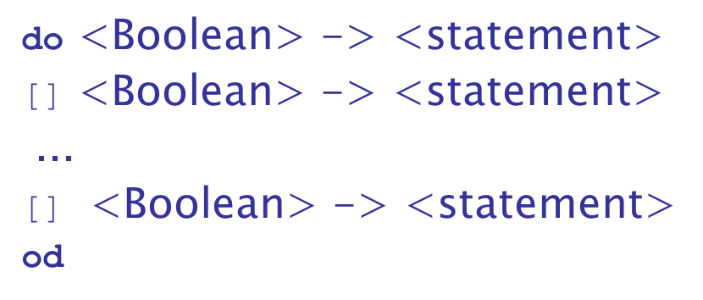
Loop Guarded Command
Form
Semantics: for each iteration
Evaluate all Boolean expressions
If more than one are true, choose one non-deterministically; then start loop again
If none are true, exit loop

Slide 44
Guarded Commands: Rationale
Connection between control statements and program verification is intimate
Verification is impossible with goto statements
Verification is possible with only selection and logical pretest loops
Verification is relatively simple with only guarded commands

Slide 45
Conclusions
Variety of statement-level structures
Choice of control statements beyond selection and logical pretest loops is a trade-off between language size and writability
Functional and logic programming languages use quite different control structures

Slide 46

Copyright

