Slide 1
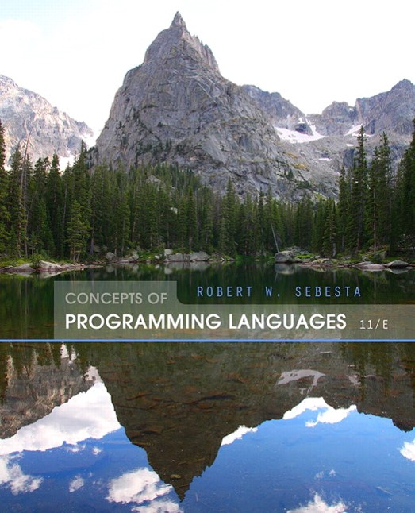
Concepts of Programming Languages
Eleventh Edition
Chapter 9
Subprograms
Copyright © 2016, 2013, 2010 Pearson Education, Inc. All Rights Reserved
Notes:
If this PowerPoint presentation contains mathematical equations, you may need to check that your computer has the following installed:
1) Math Type Plugin
2) Math Player (free versions available)
3) NVDA Reader (free versions available)

Slide 2
Objectives (1 of 2)
9.1 Introduction
9.2 Fundamentals of Subprograms
9.3 Design Issues for Subprograms
9.4 Local Referencing Environments
9.5 Parameter-Passing Methods
9.6 Parameters That Are Subprograms
9.7 Calling Subprograms Indirectly
9.8 Design Issues for Functions

Slide 3
Objectives (2 of 2)
9.9 Overloaded Subprograms
9.10 Generic Subprograms
9.11 User-Defined Overloaded Operators
9.12 Closures
9.13 Coroutines

Slide 4
Introduction
Two fundamental abstraction facilities
Process abstraction
Emphasized from early days
Discussed in this chapter
Data abstraction
Emphasized in the1980s
Discussed at length in Chapter 11

Slide 5
Fundamentals of Subprograms
Each subprogram has a single entry point
The calling program is suspended during execution of the called subprogram
Control always returns to the caller when the called subprogram’s execution terminates

Slide 6
Basic Definitions (1 of 3)
A subprogram definition describes the interface to and the actions of the subprogram abstraction
In Python, function definitions are executable; in all other languages, they are non-executable
In Ruby, function definitions can appear either in or outside of class definitions. If outside, they are methods of Object. They can be called without an object, like a function
In Lua, all functions are anonymous
A subprogram call is an explicit request that the subprogram be executed

Slide 7
Basic Definitions (2 of 3)
A subprogram header is the first part of the definition, including the name, the kind of subprogram, and the formal parameters
The parameter profile (aka signature) of a subprogram is the number, order, and types of its parameters
The protocol is a subprogram’s parameter profile and, if it is a function, its return type

Slide 8
Basic Definitions (3 of 3)
Function declarations in C and C++ are often called prototypes
A subprogram declaration provides the protocol, but not the body, of the subprogram
A formal parameter is a dummy variable listed in the subprogram header and used in the subprogram
An actual parameter represents a value or address used in the subprogram call statement

Slide 9
Actual/Formal Parameter Correspondence
Positional
The binding of actual parameters to formal parameters is by position: the first actual parameter is bound to the first formal parameter and so forth
Safe and effective
Keyword
The name of the formal parameter to which an actual parameter is to be bound is specified with the actual parameter
Advantage: Parameters can appear in any order, thereby avoiding parameter correspondence errors
Disadvantage: User must know the formal parameter’s names

Slide 10
Formal Parameter Default Values
In certain languages (e.g., C++, Python, Ruby, PHP), formal parameters can have default values (if no actual parameter is passed)
In C++, default parameters must appear last because parameters are positionally associated (no keyword parameters)
Variable numbers of parameters
C
methods can accept a variable number of parameters as long
as they are of the same type-the corresponding formal parameter is an array preceded by
In Ruby, the actual parameters are sent as elements of a hash literal and the corresponding formal parameter is preceded by an asterisk.

Slide 11
Variable Numbers of Parameters
In Python, the actual is a list of values and the corresponding formal parameter is a name with an asterisk
In Lua, a variable number of parameters is represented as a formal parameter with three periods; they are accessed with a for statement or with a multiple assignment from the three periods

Slide 12
Procedures and Functions
There are two categories of subprograms
Procedures are collection of statements that define parameterized computations
Functions structurally resemble procedures but are semantically modeled on mathematical functions
They are expected to produce no side effects
In practice, program functions have side effects

Slide 13
Design Issues for Subprograms (1 of 2)
Are local variables static or dynamic?
Can subprogram definitions appear in other subprogram definitions?
What parameter passing methods are provided?
Are parameter types checked?
If subprograms can be passed as parameters and subprograms can be nested, what is the referencing environment of a passed subprogram?
Are functional side effects allowed?

Slide 14
Design Issues for Subprograms (2 of 2)
What types of values can be returned from functions?
How many values can be returned from functions?
Can subprograms be overloaded?
Can subprogram be generic?
If the language allows nested subprograms, are closures supported?

Slide 15
Local Referencing Environments
Local variables can be stack-dynamic
Advantages
Support for recursion
Storage for locals is shared among some subprograms
Disadvantages
Allocation/de-allocation, initialization time
Indirect addressing
Subprograms cannot be history sensitive
Local variables can be static
Advantages and disadvantages are the opposite of those for stack-dynamic local variables

Slide 16
Local Referencing Environments: Examples
In most contemporary languages, locals are stack dynamic
In C-based languages, locals are by default stack dynamic, but can be declared static
The methods of C++, Java, Python, and
only have
stack dynamic locals
In Lua, all implicitly declared variables are global; local variables are declared with local and are stack dynamic

Slide 17
Semantic Models of Parameter Passing
In mode
Out mode
Inout mode

Slide 18
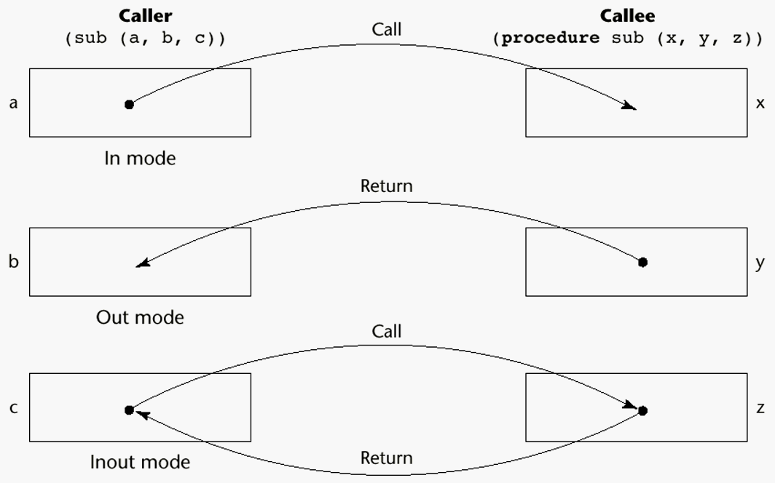
Models of Parameter Passing

Slide 19
Conceptual Models of Transfer
Physically move a value
Move an access path to a value

Slide 20
Pass-by-Value (In Mode)
The value of the actual parameter is used to initialize the corresponding formal parameter
Normally implemented by copying
Can be implemented by transmitting an access path but not recommended (enforcing write protection is not easy)
Disadvantages (if by physical move): additional storage is required (stored twice) and the actual move can be costly (for large parameters)
Disadvantages (if by access path method): must write-protect in the called subprogram and accesses cost more (indirect addressing)

Slide 21
Pass-by-Result (Out Mode)
When a parameter is passed by result, no value is transmitted to the subprogram; the corresponding formal parameter acts as a local variable; its value is transmitted to caller’s actual parameter when control is returned to the caller, by physical move
Require extra storage location and copy operation
Potential problems:
whichever formal parameter is copied back
will represent the current value of
Compute address of
at the beginning of the subprogram or end?

Slide 22
Pass-by-Value-Result (inout Mode)
A combination of pass-by-value and pass-by-result
Sometimes called pass-by-copy
Formal parameters have local storage
Disadvantages:
Those of pass-by-result
Those of pass-by-value

Slide 23
Pass-by-Reference (Inout Mode)
Pass an access path
Also called pass-by-sharing
Advantage: Passing process is efficient (no copying and no duplicated storage)
Disadvantages
Slower accesses (compared to pass-by-value) to formal parameters
Potentials for unwanted side effects (collisions)
Unwanted aliases (access broadened)

Slide 24
Pass-by-Name (Inout Mode)
By textual substitution
Formals are bound to an access method at the time of the call, but actual binding to a value or address takes place at the time of a reference or assignment
Allows flexibility in late binding
Implementation requires that the referencing environment of the caller is passed with the parameter, so the actual parameter address can be calculated

Slide 25
Implementing Parameter-Passing Methods (1 of 2)
In most languages parameter communication takes place thru the run-time stack
Pass-by-reference are the simplest to implement; only an address is placed in the stack

Slide 26
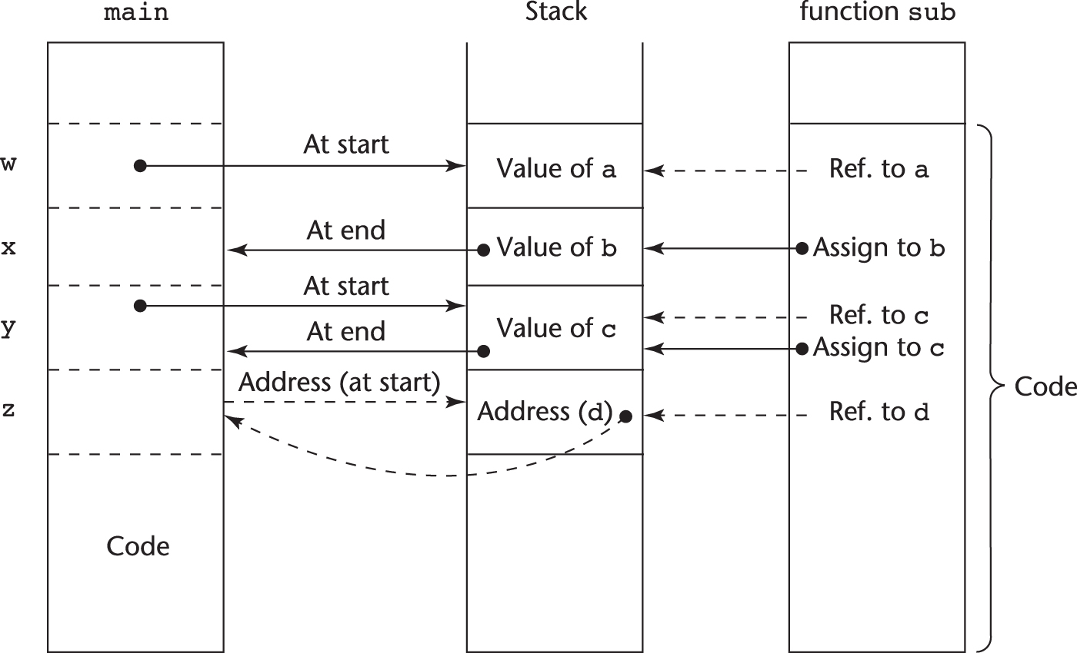
Implementing Parameter-Passing Methods (2 of 2)
Function header:
Function call in main:
(pass w by value, x by result, y by value-result, z by reference)

Slide 27
Parameter Passing Methods of Major Languages (1 of 2)
C
Pass-by-value
Pass-by-reference is achieved by using pointers as parameters
C++
A special pointer type called reference type for pass-by-reference
Java
All parameters are passed are passed by value
Object parameters are passed by reference

Slide 28
Parameter Passing Methods of Major Languages (2 of 2)
Fortran 95+
Parameters can be declared to be in, out, or inout mode
C
Default method: pass-by-value
Pass-by-reference is specified by preceding both a formal parameter and its actual parameter with
P H P: very similar to
except that either the actual or the formal parameter
can specify ref
Perl: all actual parameters are implicitly placed in a predefined array named @_
Python and Ruby use pass-by-assignment (all data values are objects); the actual is assigned to the formal

Slide 29
Type Checking Parameters
Considered very important for reliability
FORTRAN 77 and original C: none
Pascal and Java: it is always required
ANSI C and C++: choice is made by the user
Prototypes
Relatively new languages Perl, JavaScript, and P H P do not require type checking
In Python and Ruby, variables do not have types (objects do), so parameter type checking is not possible

Slide 30
Multidimensional Arrays as Parameters
If a multidimensional array is passed to a subprogram and the subprogram is separately compiled, the compiler needs to know the declared size of that array to build the storage mapping function

Slide 31
Multidimensional Arrays as Parameters: C and C++
Programmer is required to include the declared sizes of all but the first subscript in the actual parameter
Disallows writing flexible subprograms
Solution: pass a pointer to the array and the sizes of the dimensions as other parameters; the user must include the storage mapping function in terms of the size parameters

Slide 32
Multidimensional Arrays as Parameters: Java and
Similar to Ada
Arrays are objects; they are all single-dimensioned, but the elements can be arrays
Each array inherits a named constant (length in Java, Length in
) that is set to the length of the array when
the array object is created

Slide 33
Design Considerations for Parameter Passing
Two important considerations
Efficiency
One-way or two-way data transfer
But the above considerations are in conflict
Good programming suggest limited access to variables, which means one-way whenever possible
But pass-by-reference is more efficient to pass structures of significant size

Slide 34
Parameters that are Subprogram Names
It is sometimes convenient to pass subprogram names as parameters
Issues:
Are parameter types checked?
What is the correct referencing environment for a subprogram that was sent as a parameter?

Slide 35
Parameters that are Subprogram Names: Referencing Environment
Shallow binding: The environment of the call statement that enacts the passed subprogram
Most natural for dynamic-scoped languages
Deep binding: The environment of the definition of the passed subprogram
Most natural for static-scoped languages
Ad hoc binding: The environment of the call statement that passed the subprogram

Slide 36
Calling Subprograms Indirectly (1 of 2)
Usually when there are several possible subprograms to be called and the correct one on a particular run of the program is not know until execution (e.g., event handling and G U Is)
In C and C++, such calls are made through function pointers

Slide 37
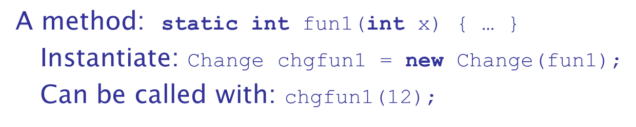
Calling Subprograms Indirectly (2 of 2)
In C#, method pointers are implemented as objects called delegates
A delegate declaration:
This delegate type, named Change, can be instantiated with any method that takes an int parameter and returns an int value
A delegate can store more than one address, which is called a multicast delegate

Slide 38
Design Issues for Functions
Are side effects allowed?
Parameters should always be in-mode to reduce side effect (like Ada)
What types of return values are allowed?
Most imperative languages restrict the return types
C allows any type except arrays and functions
C++ is like C but also allows user-defined types
Java and
methods can return any type (but because methods
are not types, they cannot be returned)
Python and Ruby treat methods as first-class objects, so they can be returned, as well as any other class
Lua allows functions to return multiple values

Slide 39
Overloaded Subprograms
An overloaded subprogram is one that has the same name as another subprogram in the same referencing environment
Every version of an overloaded subprogram has a unique protocol
C++, Java,
and Ada include predefined overloaded
subprograms
In Ada, the return type of an overloaded function can be used to disambiguate calls (thus two overloaded functions can have the same parameters)
Ada, Java, C++, and
allow users to write multiple
versions of subprograms with the same name

Slide 40
Generic Subprograms (1 of 8)
A generic or polymorphic subprogram takes parameters of different types on different activations
Overloaded subprograms provide ad hoc polymorphism
Subtype polymorphism means that a variable of type T can access any object of type T or any type derived from T (OOP languages)
A subprogram that takes a generic parameter that is used in a type expression that describes the type of the parameters of the subprogram provides parametric polymorphism
A cheap compile-time substitute for dynamic binding

Slide 41
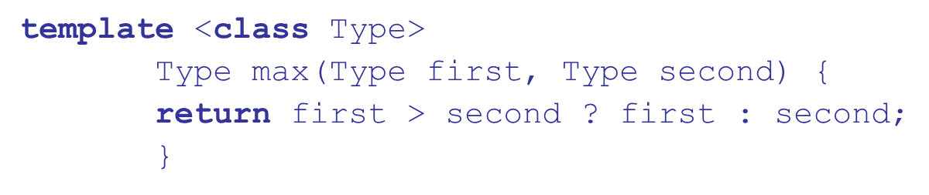
Generic Subprograms (2 of 8)
C++
Versions of a generic subprogram are created implicitly when the subprogram is named in a call or when its address is taken with the & operator
Generic subprograms are preceded by a template clause that lists the generic variables, which can be type names or class names

Slide 42
Generic Subprograms (3 of 8)
Java 5.0
Differences between generics in Java 5.0 and those of C++:
Generic parameters in Java 5.0 must be classes
Java 5.0 generic methods are instantiated just once as truly generic methods
Restrictions can be specified on the range of classes that can be passed to the generic method as generic parameters
Wildcard types of generic parameters

Slide 43

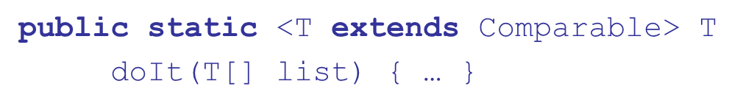
Generic Subprograms (4 of 8)
The parameter is an array of generic elements (T is the name of the type)
A call:
Generic parameters can have bounds:
The generic type must be of a class that implements the Comparable interface

Slide 44
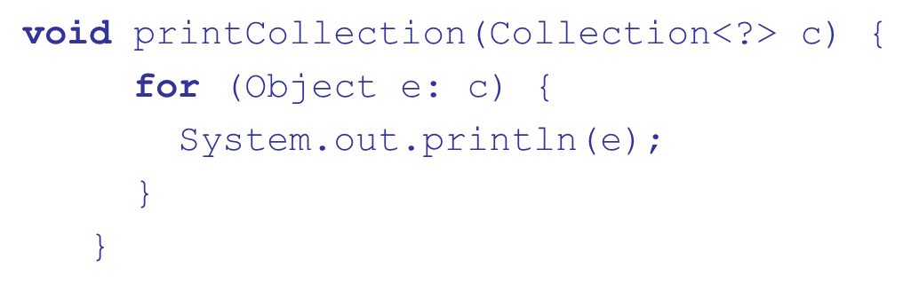
Generic Subprograms (5 of 8)
Wildcard types
is a wildcard type for collection classes
Works for any collection class

Slide 45
Generic Subprograms (6 of 8)
2005
C
Supports generic methods that are similar to those of Java 5.0
One difference: actual type parameters in a call can be omitted if the compiler can infer the unspecified type
Another –
2005 does not support wildcards

Slide 46
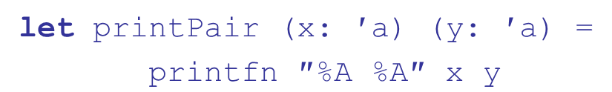
Generic Subprograms (7 of 8)
F
Infers a generic type if it cannot determine the type of a parameter or the return type of a function – automatic generalization
Such types are denoted with an apostrophe and a single letter, e.g.,
Functions can be defined to have generic parameters
%A is a format code for any type
These parameters are not type constrained

Slide 47
Generic Subprograms (8 of 8)
If the parameters of a function are used with arithmetic operators, they are type constrained, even if the parameters are specified to be generic
Because of type inferencing and the lack of type coercions, F
generic functions are far less useful
than those of C++, Java 5.0+, and

Slide 48
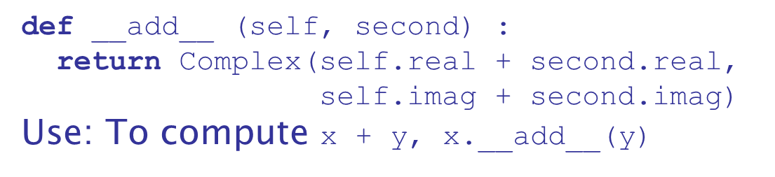
User-Defined Overloaded Operators
Operators can be overloaded in Ada, C++, Python, and Ruby
A Python example

Slide 49
Closures (1 of 3)
A closure is a subprogram and the referencing environment where it was defined
The referencing environment is needed if the subprogram can be called from any arbitrary place in the program
A static-scoped language that does not permit nested subprograms doesn’t need closures
Closures are only needed if a subprogram can access variables in nesting scopes and it can be called from anywhere
To support closures, an implementation may need to provide unlimited extent to some variables (because a subprogram may access a nonlocal variable that is normally no longer alive)

Slide 50
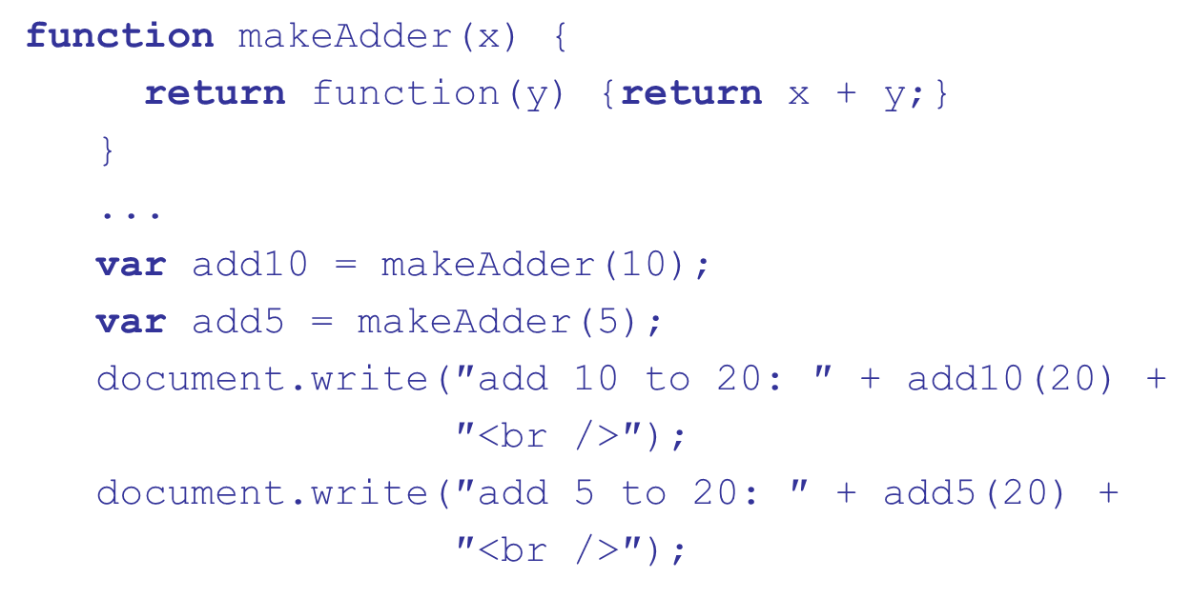
Closures (2 of 3)
A JavaScript closure:
The closure is the anonymous function returned by makeAdder

Slide 51
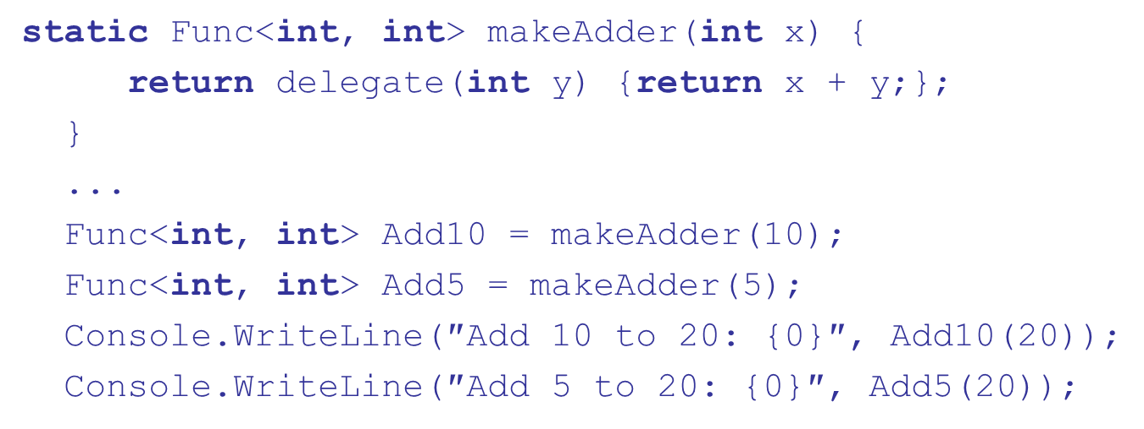
Closures (3 of 3)
C
We can write the same closure in
using a nested
anonymous delegate
(the return type) specifies a delegate that
takes an int as a parameter and returns and int

Slide 52
Coroutines
A coroutine is a subprogram that has multiple entries and controls them itself – supported directly in Lua
Also called symmetric control: caller and called coroutines are on a more equal basis
A coroutine call is named a resume
The first resume of a coroutine is to its beginning, but subsequent calls enter at the point just after the last executed statement in the coroutine
Coroutines repeatedly resume each other, possibly forever
Coroutines provide quasi-concurrent execution of program units (the coroutines); their execution is interleaved, but not overlapped

Slide 53
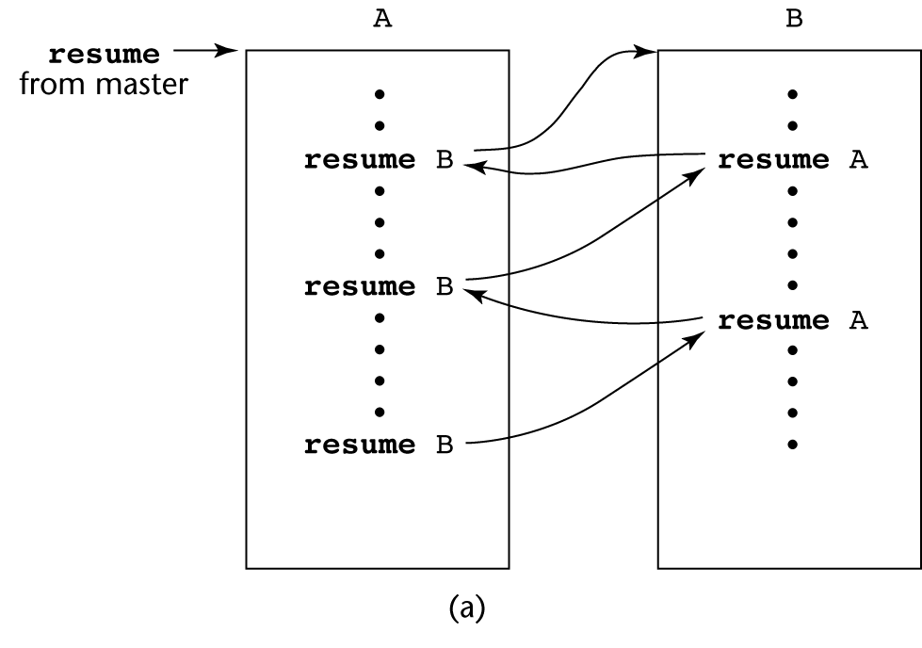
Coroutines Illustrated: Possible Execution Controls (1 of 2)

Slide 54
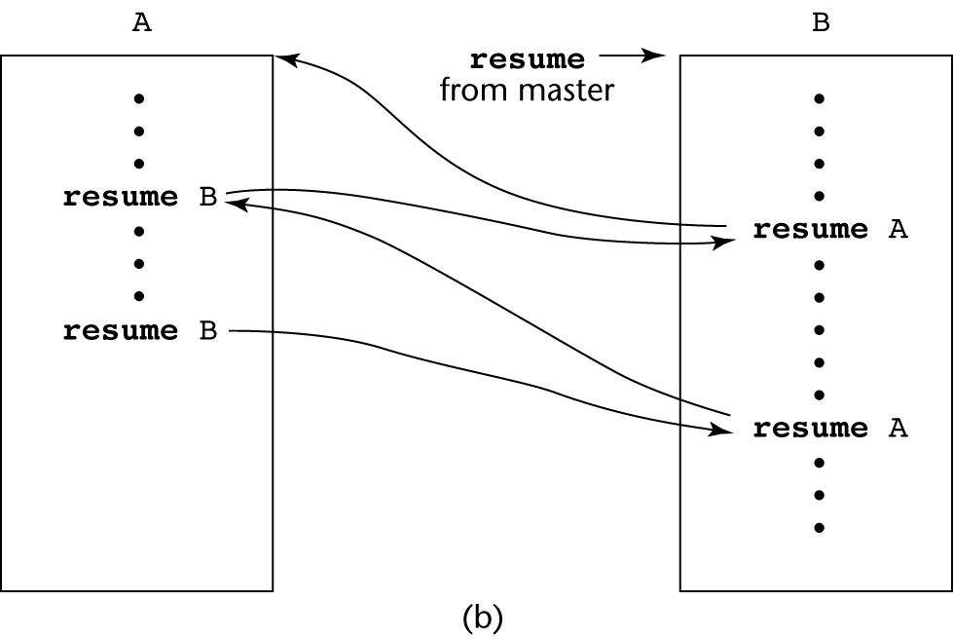
Coroutines Illustrated: Possible Execution Controls (2 of 2)

Slide 55
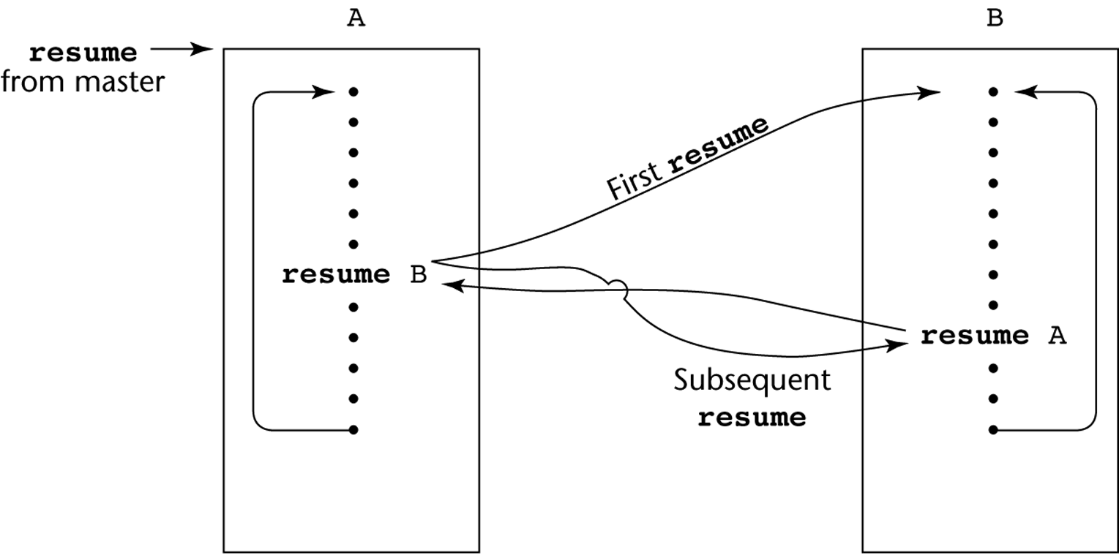
Coroutines Illustrated: Possible Execution Controls with Loops

Slide 56
Summary
A subprogram definition describes the actions represented by the subprogram
Subprograms can be either functions or procedures
Local variables in subprograms can be stack-dynamic or static
Three models of parameter passing: in mode, out mode, and inout mode
Some languages allow operator overloading
Subprograms can be generic
A closure is a subprogram and its ref. environment
A coroutine is a special subprogram with multiple entries

Slide 57
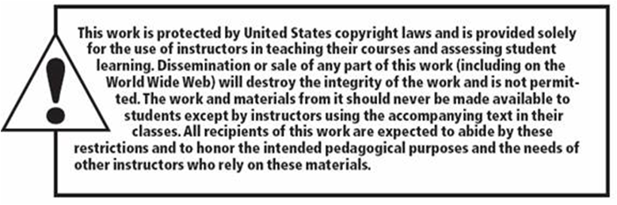
Copyright

