Slide 1
DS 110 Final Project
By: Aarom Guillauime, Daralyn Wen, Rachel Young
Notes:
Daralyn (Happy friday! How are we feeling? Hope everyone had a good week!)
30s per slide

Slide 2
Problem Statements
Our team seeks to analyze data for Covid related to vaccines, death, and GDP in order to understand if there are potential correlations between the variables:
Significant Difference between the average number of daily cases and deaths before and after first vaccination date
Correlation between the number of vaccinations and deaths
Correlation between vaccinations and a country’s GDP
Notes:
Rachel For our problem statement, our team wanted to come to understand how the number of vaccinations, deaths, and the GDP of countries relate to each other :
The our first question being
How is the average number of daily deaths changes after the release date of first vaccination, the correlation between number of deaths and number of vaccinations, and the correlation between country GDP and number of vaccinations

Slide 3
Backstory
Seeing the US open up, we were curious: how the rest of the world was dealing with the pandemic –vaccinations, cases and deaths
Specifically how access to the vaccine and country GDP might impact number of deaths
Notes:
Rachel
Backstory - Why did you become interested in this problem?
We became interested in this problem as we were brainstorming because seeing how the US is dealing with the pandemic we also wanted to observe how other countries were

Slide 4
Methods
Searched for data sets on WHO
Scrub data
→ .isnull(), .dropna()
Split up the questions (branches), select data
Use pandas, DataFrames and methods to select data appropriately
Use pyplot & plotly to graph/visualize correlations
Notes:
Daralyn
Methods - What exactly did you do?

Slide 5
Challenges
Large data set…dealing with dates
Had to find the range of row numbers that correlated to each country we were going to analyze manually, which took time
Moments where we were lost on what functions to use in the project
Solutions: patience and using Google
Notes:
Aarom
Challenge - What's one challenge you overcame while working on the project, and how did you solve it?

Slide 6
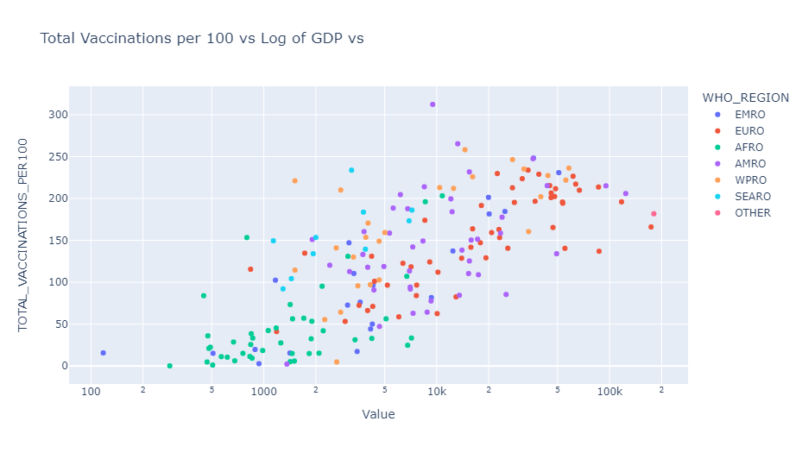
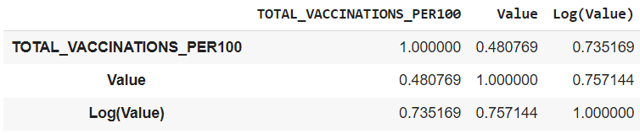
Results
Notes:
Daralyn
Results - Show your most interesting result so far.

Slide 7
Conclusions
We learned …
Organization (of code)
How to find trends in data
How to use pandas to merge, select and analyze data
Not all our questions had the correlations we expected
Notes:
Aarom
Conclusions - What did you learn doing this?

Slide 8
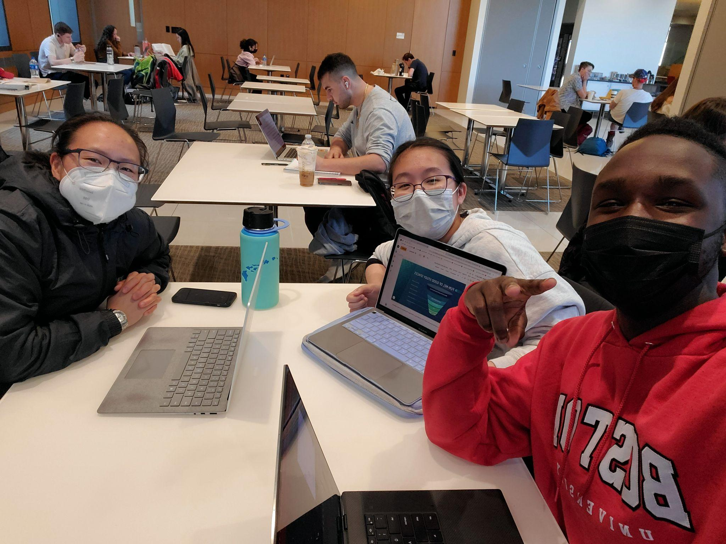
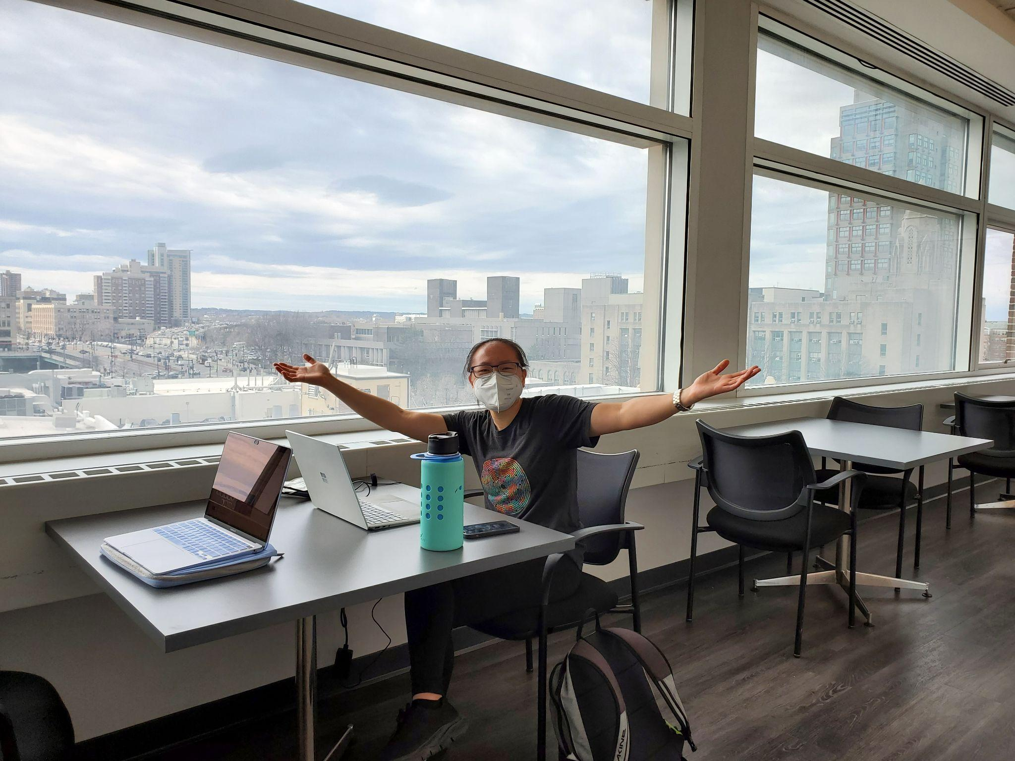
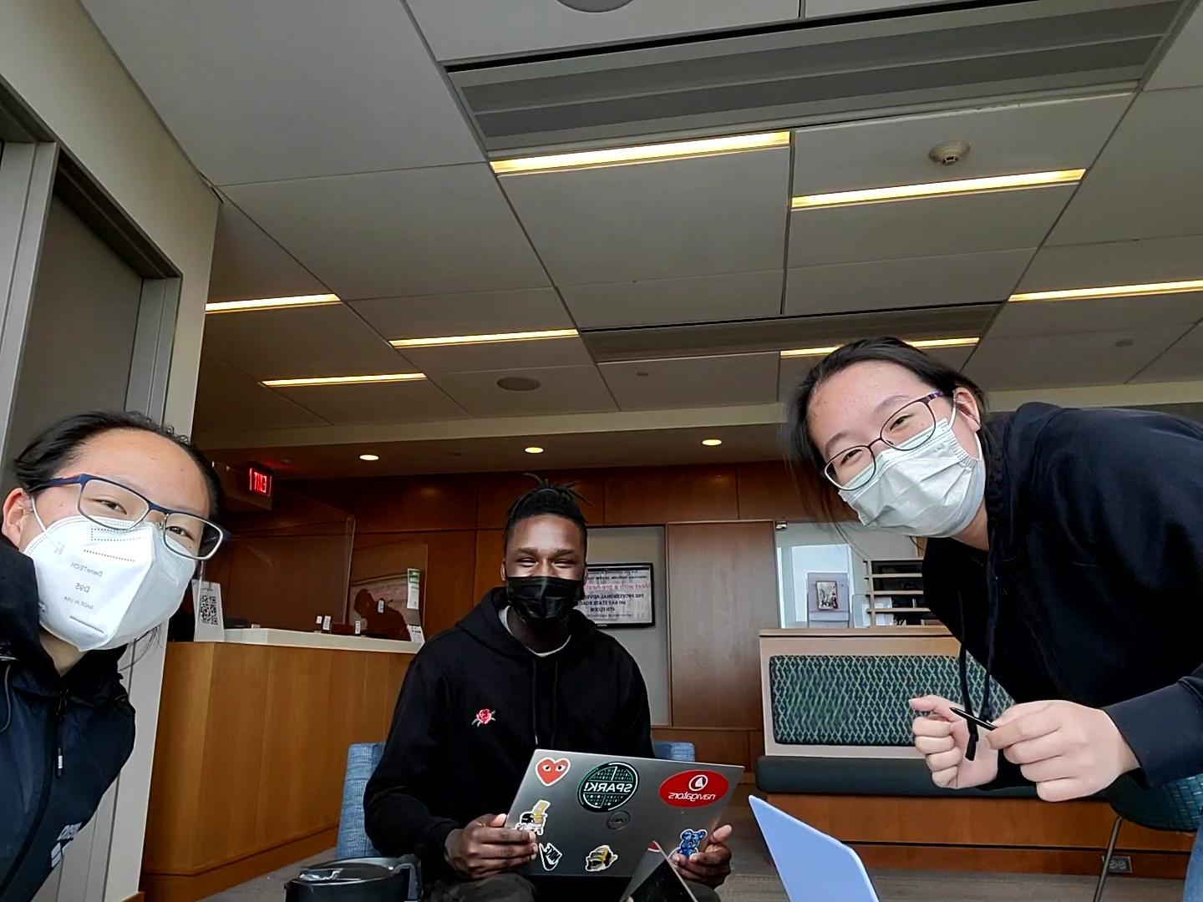
FUN-NEL OF GOOD STUDY SPACES
Where all the good study spaces are
LAW BUILDING CAFE
PHOTONICS
YAWKEY CENTER
QUESTROM TEAM
ROOMS
GSU
Notes:
Rachel
Fun fact - What is one random thing you learned during this project that is entertaining or interesting to the audience but mostly beside the point?

Slide 9
THANKS!
ANY QUESTIONS?

