Slide 1



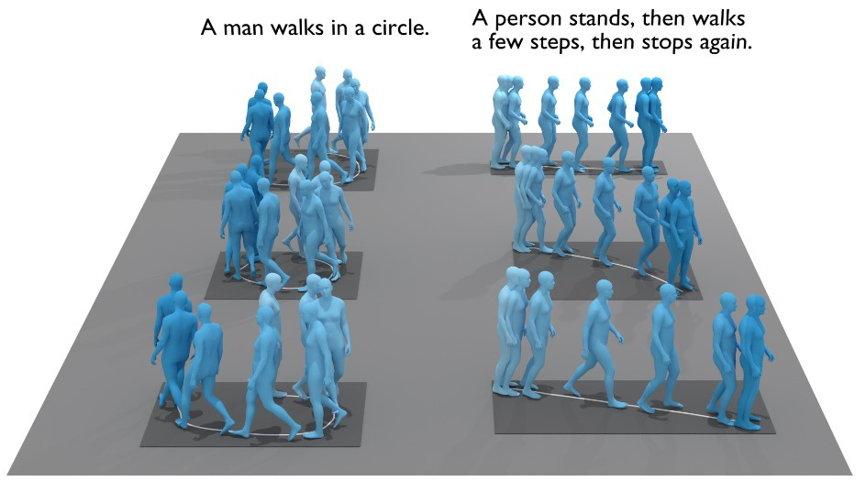
Evaluating Text-to-Motion Models
Across Language Backgrounds
and Instruction Granularity
Angie Song (as620), Serena(Xin) You (xy68), Shizuka Dara (sd205), Tanishka Sonar (ts158)
Prof. Hanjie Chen (Ph.D)
Date : 22nd April 2026
1
Notes:
Hi everyone, we're presenting our project on evaluating text-to-motion models across language backgrounds and instruction granularity.

Slide 2








Introduction
Artificial Intelligence is currently learning to bridge the gap between abstract thought and physical reality
Broad Impact: Advances in text-to-motion have significant implications for several key fields, including robotics, accessibility, and entertainment.
Research Gap: To address gaps in current research, it is necessary to examine how models handle the diversity of human speech.
2
Notes:
Text-to-motion generation is the task of converting a natural language description, into a 3D human motion sequence.
This is a rapidly growing area at the intersection of NLP and computer vision, with applications in entertainment and game animation, accessibility tools for people with disabilities, and robotics where agents need to understand human instructions.
Current state-of-the-art approaches include diffusion-based models like MDM, VQ-based autoregressive models like T2M-GPT, and emerging multimodal LLMs. Most of these models rely on CLIP as their text encoder, which works well for English but raises a question:
what happens when users describe motion differently in a different language like chinese, or with different levels of detail? That is what we are trying to evaluate

Slide 3

Problem Statement
The Core Problem:
While natural language is used to control human motion generation, descriptive styles vary drastically between professional and non-professional users.
Linguistic conventions differ significantly across languages (e.g., Chinese vs. English).
Current text-to-motion models are rarely evaluated for their robustness to these linguistic variations.
Project Objectives:
Study how specific linguistic contexts affect motion generation quality.
Analyze the impact of varying instruction details and semantic combinations on model output.
3
Notes:
This brings us to our core problem. Natural language descriptions of motion vary widely. And a Chinese speaker might structure the same instruction completely differently than an English speaker.
Existing text-to-motion models are almost exclusively trained and evaluated on English prompts, and they rarely test robustness to these kinds of linguistic variations.

Slide 4

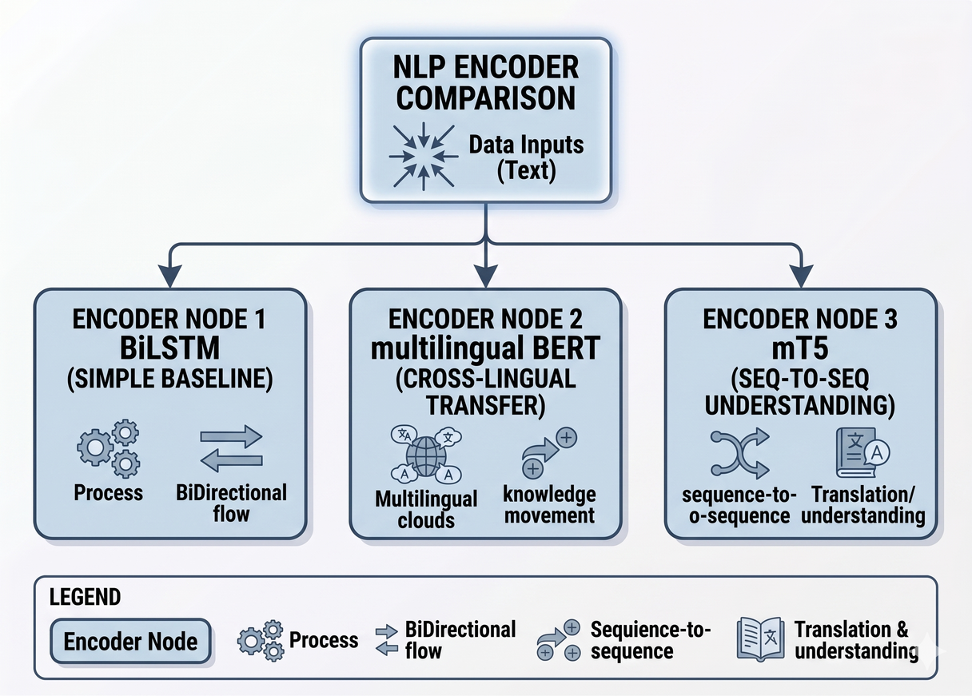
Objective
Goal:
Study how linguistic context affects text-to-motion generation.
Analyze the impact of instruction detail and semantic combinations.
Approach:
Compare several text representation models, including BILSTM, mBERT, and mT5-based text encoders.
Evaluation:
Quantitative retrieval experiments, motion executability assessment, and cross-lingual human evaluation.
4
Notes:
Our objective is to study how the choice of text encoder affects motion generation quality, both within English and chinese. We compare three encoders: BiLSTM as a simple baseline, multilingual BERT for its cross-lingual transfer ability, and mT5 for its sequence-to-sequence multilingual understanding. We evaluate using both standard quantitative metrics and a human evaluation study.

Slide 5
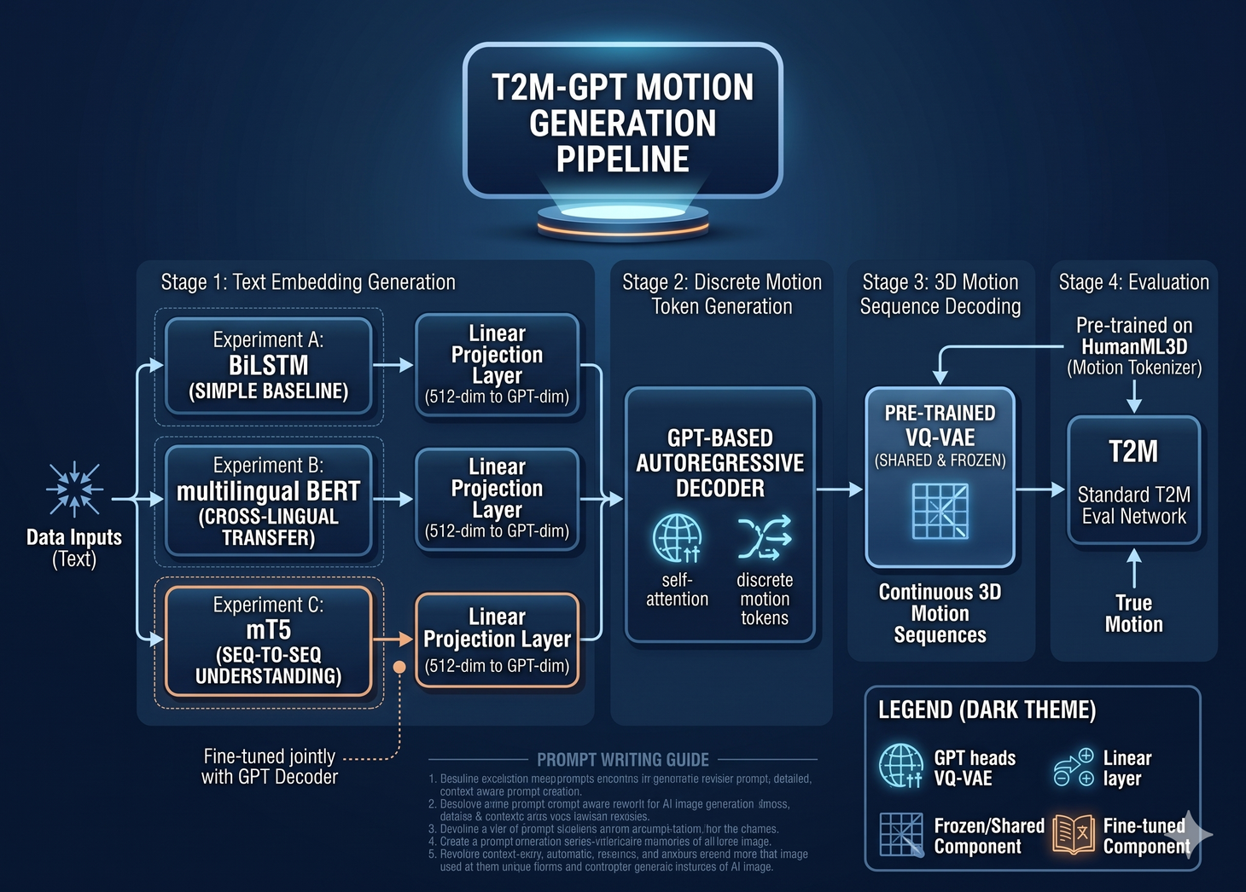


Approach:
We are comparing multiple text representation models, specifically focusing on BILSTM, mBERT, and mT5-based text encoders.
The system takes English text as an input, processes it through the encoder, decodes it using T2M-GPT, and produces a motion sequence.
Dataset: HumanML3D
Method
5
Notes:
Our architecture follows the T2M-GPT framework. The pipeline has three stages. First, text goes into one of our three encoders — BiLSTM, mBERT, or mT5 — which produces a 512-dimensional text embedding. Second, this embedding conditions a GPT-based autoregressive decoder that generates discrete motion tokens. Third, a pre-trained VQ-VAE decodes those tokens back into continuous 3D motion sequences.
The VQ-VAE is shared and frozen across all experiments — it was pre-trained on HumanML3D and acts as a motion tokenizer. This means the only variable across our three experiments is the text encoder, which makes the comparison fair.
we use the encoders with a linear projection layer to map its 512-dimensional hidden states to the embedding size the GPT decoder expects. We fine-tune both the mT5 encoder and the projection layer jointly with the GPT decoder. For evaluation, we use the standard T2M evaluation network,

Slide 6

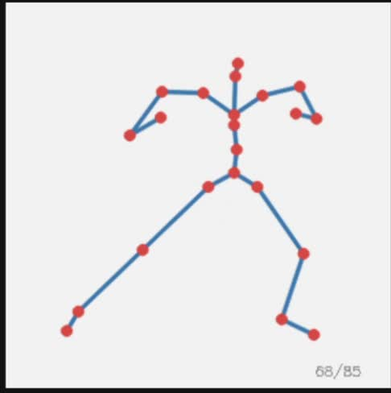
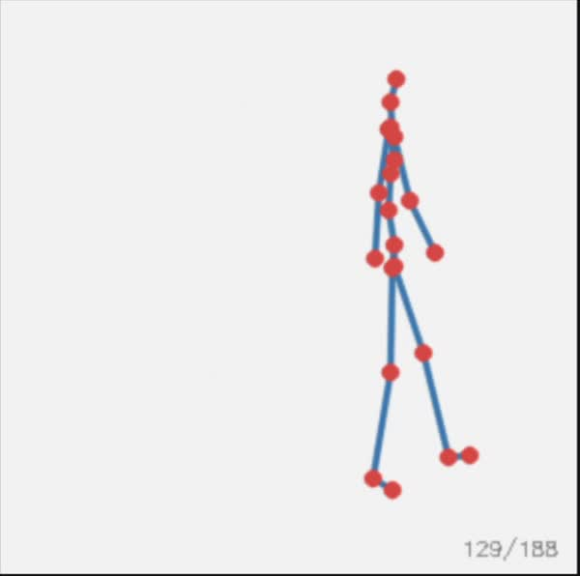
Experiments
Quantitative Evaluation: R@1, R@5, FID, and MultiModal Distance on existing text-to-motion datasets (e.g., official test split on HumanML3D).
Human Evaluation:
Cross-language: Generate 100 Chinese (zero-shot) and 100 English movement description sentences.
Multi-Granularity: A mixture of simple and complex sentences.
Testing which of three movements best describes the input sentence.
a person slowly punches with their right hand and then slowly punches with their left hand.
www.reallygreatsite.com
the person paces to his right, then to his left, and finally to his right again.
7
Notes:
We trained all three models on the HumanML3D dataset, which contains about 15,000 motion clips with 44,000 text descriptions. We evaluated on the official test split using standard metrics: FID measures the distributional distance between generated and real motions, R at K measures text-motion retrieval accuracy, and Diversity measures variety in generated motions.
For human evaluation, we have 100 paired English-Chinese prompts spanning seven categories: simple locomotion, jumping, sitting and standing, arm movements, leg movements, compound actions, and style variations. Each prompt exists in both English and Chinese, giving us 200 total inputs. All three models generate motions for the same prompts, and we select which of the three motions best matches the text description.
This lets us measure two things: which encoder produces the most faithful motions overall, and whether multilingual encoders like mBERT and mT5 maintain quality on Chinese prompts where BiLSTM is expected to fail.

Slide 7
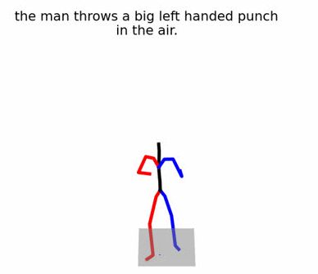
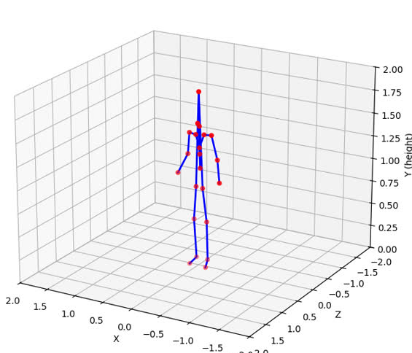
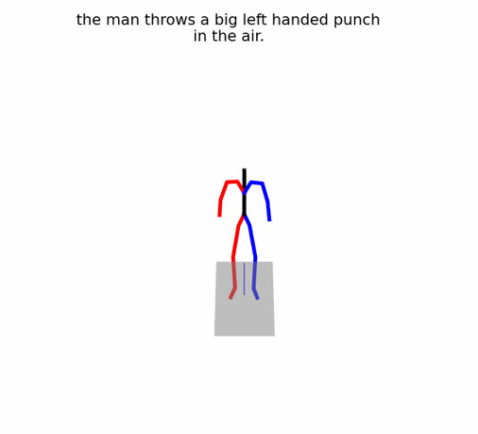
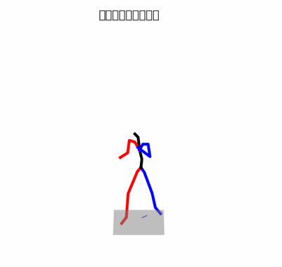
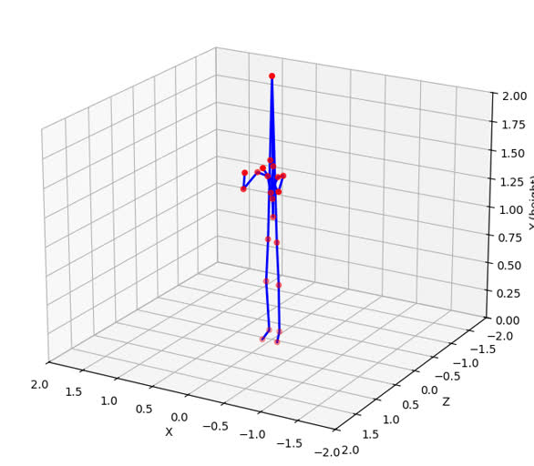
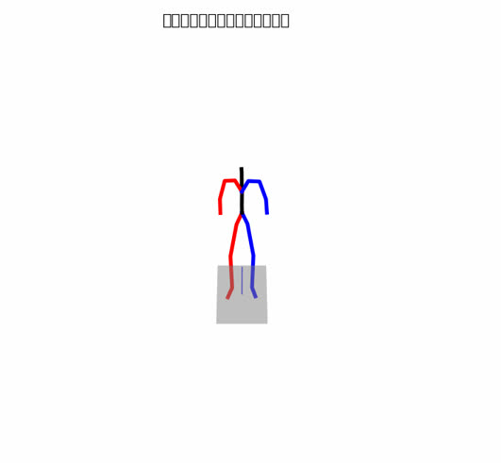
Visualization
mBert
mT5
BiLSTM
English
Chinese
9
Notes:
This is an example visualization. The text input is "the man throws a big left handed punch in the air".
As you can see, mBert performs the best as it looks clean and accurate. mT5 struggles but performs an action. The BiLSTM encoder struggles to map textual semantics into the motion token space

Slide 8
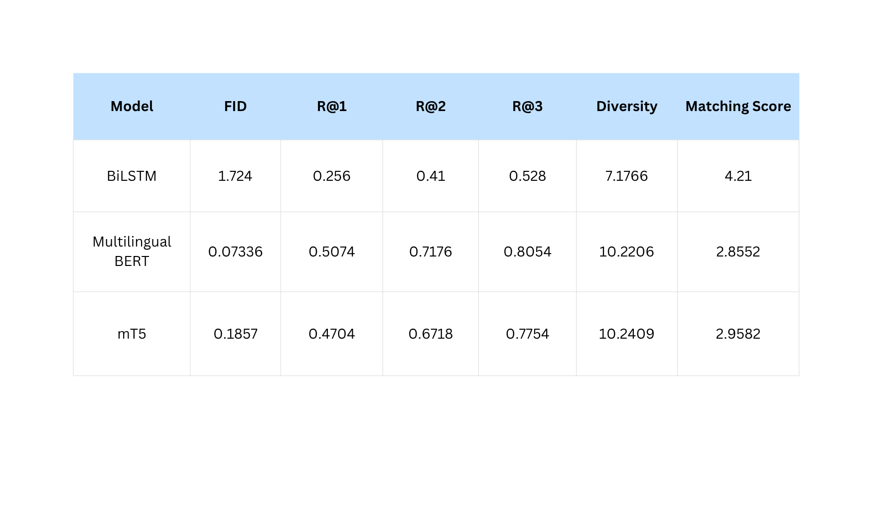
Quantitative Metrics
Notes:
Here I briefly summarize the quantitative results.We compare three different encoders: BiLSTM, Multilingual BERT, and mT5.
Overall, Multilingual BERT and mT5 significantly outperform BiLSTM across all metrics, especially in recall, where we see large improvements in R@1, R@2, and R@3.
They also achieve much higher diversity scores, indicating more varied generation results.
Between the two, Multilingual BERT performs slightly better on recall, while mT5 achieves the best matching score.
Overall, both transformer-based models show clear advantages over BiLSTM in both alignment and diversity.
Extra [DO NOT SPEAK]:
takes all your generated motions and all the ground truth motions, runs them through the evaluation network's motion encoder to get feature vectors. Computes the mean and covariance of each set, then measures the distance between those two distributions. If your model generates motions that "look like" real motion capture data statistically, FID is low. Your 0.186 means the distribution of your generated motions is very close to real.
R@K (Recall at K) — Higher is better
Takes a batch of 32 generated motions and their 32 text descriptions. Embeds all of them using the evaluation network (GloVe-based text encoder + motion encoder). For each motion, ranks all 32 texts by distance. R@1 asks: is the correct text the closest match? R@3 asks: is the correct text in the top 3? Your R@1 of 0.47 means 47% of the time, the evaluation network can correctly match your generated motion to its text on the first try. Cumulative R@3 of 0.78 means 78% of the time it's in the top 3.
Matching Score — Lower is better
The average Euclidean distance between each text embedding and its corresponding motion embedding from the evaluation network. It's literally distance_matrix.trace() / N. Lower means tighter alignment between what the text says and what the motion looks like. Your 2.96 means on average the text and motion embeddings are 2.96 apart in the evaluation network's feature space.
Diversity — Closer to ground truth is better
Randomly samples 300 pairs of generated motions, computes the average L2 distance between their feature vectors. If diversity is too low, your model is producing the same motion for everything. If too high, it's generating random noise. You want it close to the ground truth diversity. Your 10.24 is very close to ground truth, meaning your model produces appropriately varied motions.
MultiModality :
Generates multiple motions for the same text prompt, then measures how different they are. High multimodality means the model can produce diverse motions for the same instruction, which is desirable — there are many valid ways to "walk forward."

Slide 9


Conclusion and
Team Contributions
To achieve true cross-lingual motion generation, we must shift from English-centric architectures to multilingual models like mT5 and mBERT. Ultimately, the field must evolve its evaluation standards to prioritize linguistic diversity and real-world robustness over standard English benchmarks.
Team Contributions:
Angie Song (as620): BILSTM fine-tuning and quantitative evaluation.
Serena (Xin) You (xy68): mBERT fine-tuning and quantitative evaluation.
Shizuka Dara (sd205): mT5 fine-tuning and quantitative evaluation.
Tanishka Sonar (ts158): Visualization and human evaluation.
10
Notes:
mT5 and mBERT have a natural advantage for cross-lingual motion generation since they can process Chinese input directly, whereas BiLSTM and CLIP-based systems cannot.
The broader implication is that text-to-motion systems should be evaluated beyond standard English benchmarks. As these models move toward real-world deployment, robustness to linguistic diversity — different languages, different levels of instruction detail — becomes critical.

Slide 10
References
Zhang, J., Zhang, Y., Cun, X., Huang, S., Zhang, Y., Zhao, H., Lu, H., & Shen, X. (2023). T2M-GPT: Generating Human Motion from Textual Descriptions with Discrete Representations. Proceedings of the IEEE/CVF Conference on Computer Vision and Pattern Recognition (CVPR), 17564–17574.
Guo, C., Zou, S., Zuo, X., Wang, S., Ji, W., Li, X., & Cheng, L. (2022). Generating Diverse and Natural 3D Human Motions From Text. Proceedings of the IEEE/CVF Conference on Computer Vision and Pattern Recognition (CVPR), 5152–5161.
Xue, L., Constant, N., Roberts, A., Kale, M., Al-Rfou, R., Siddhant, A., Barua, A., & Raffel, C. (2021). mT5: A Massively Multilingual Pre-trained Text-to-Text Transformer. Proceedings of the 2021 Conference of the North American Chapter of the Association for Computational Linguistics: Human Language Technologies, 483–498.
Devlin, J., Chang, M.-W., Lee, K., & Toutanova, K. (2019). BERT: Pre-training of Deep Bidirectional Transformers for Language Understanding. Proceedings of the 2019 Conference of the North American Chapter of the Association for Computational Linguistics (NAACL).
Pires, T., Schlinger, E., & Garrette, D. (2019). How multilingual is Multilingual BERT? Proceedings of the 57th Annual Meeting of the Association for Computational Linguistics (ACL), 4996–5001.
Schuster, M., & Paliwal, K. K. (1997). Bidirectional recurrent neural networks. IEEE Transactions on Signal Processing, 45(11), 2673–2681.
3

