Slide 1
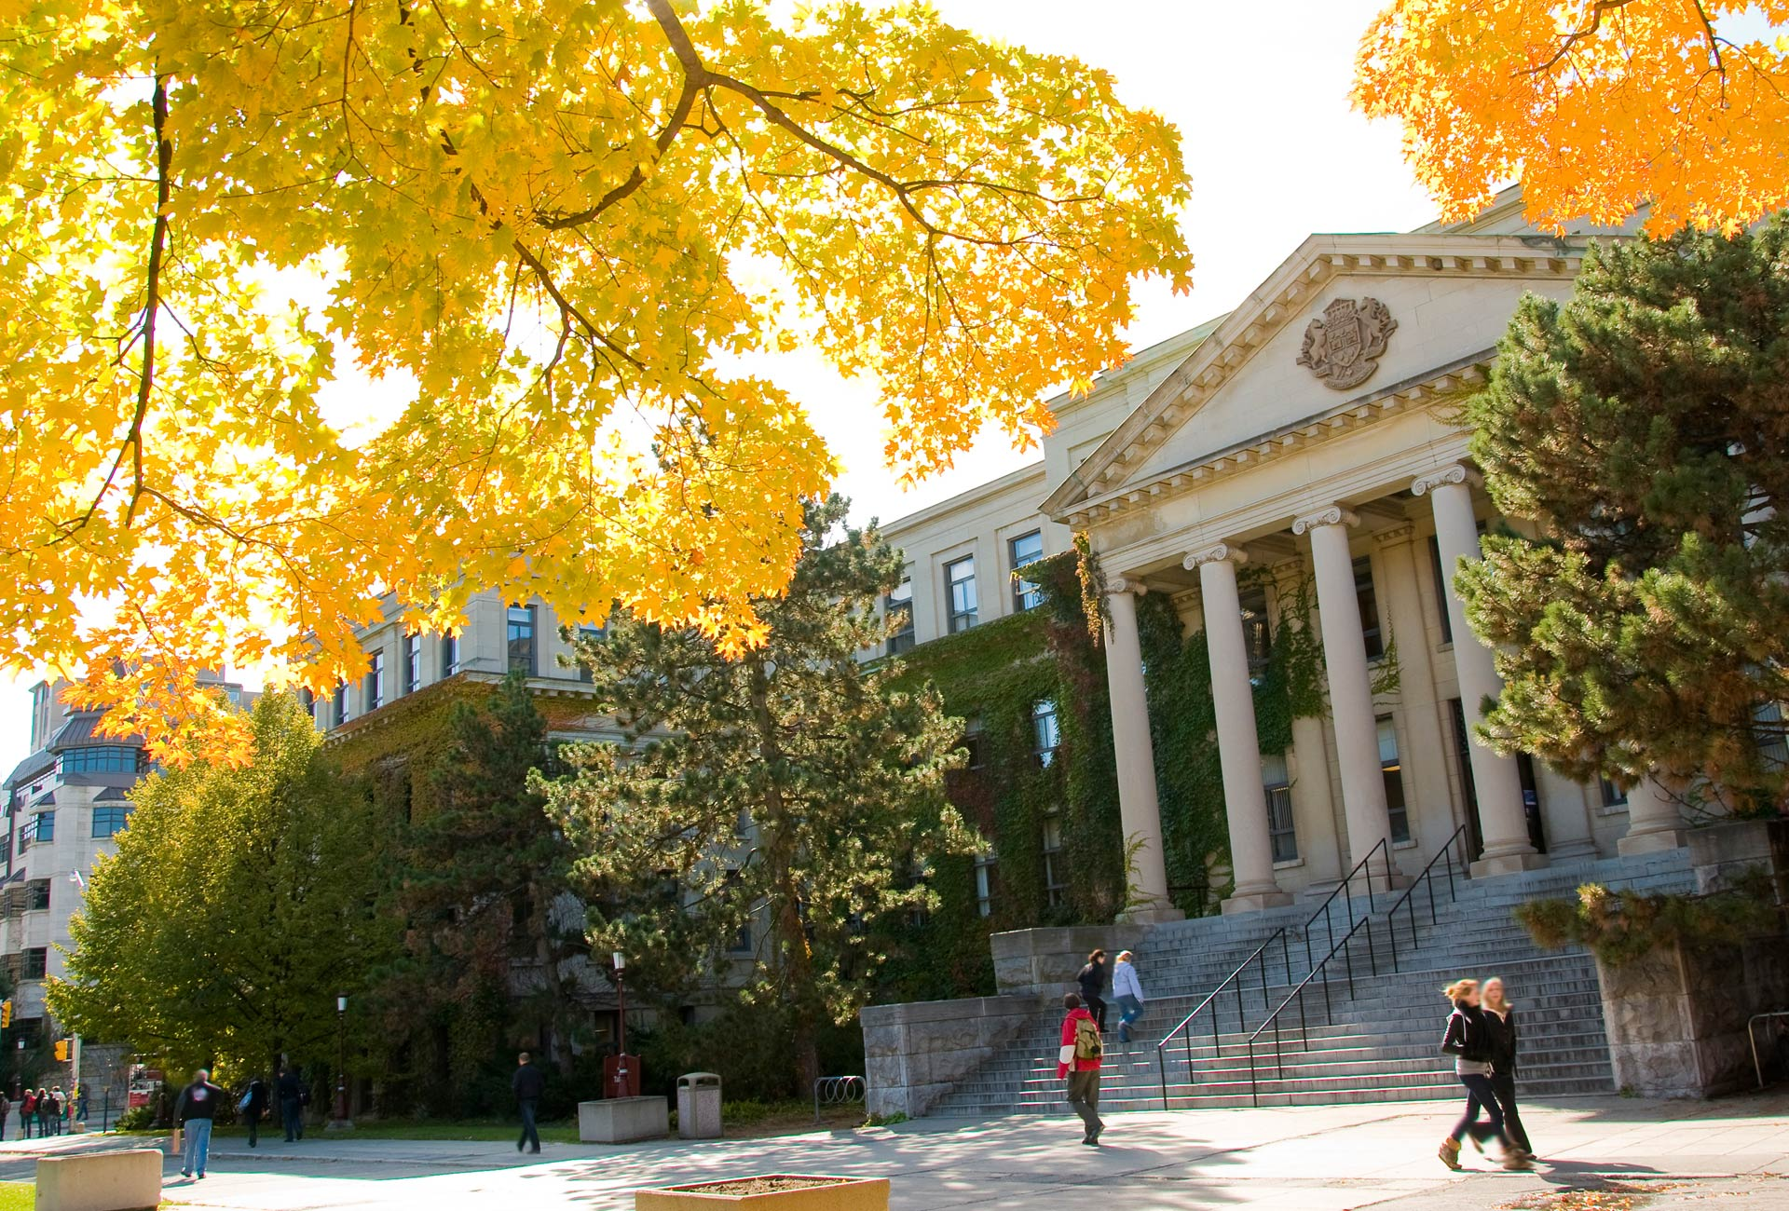

Phishing URL Detection using RoBERTa for Feature Extraction
December 8th, 2023
Presented by: Tejasvi Kashyap, Rohan Sood, Supriya Dara, Kaixi Xu
uOttawa.ca
Notes:
PAGE COUVERTURE (option 1) REMARQUE : À lire avant d’utiliser le gabarit
Les éléments suivants du gabarit ne peuvent pas être modifiés : • En-tête institutionnel grenat (Université d’Ottawa | University of Ottawa) • Pied de page institutionnel comprenant la bande grise et grenat ainsi que le logo
Les éléments suivants du gabarit peuvent être modifiés : • L’adresse Web uOttawa.ca dans le pied de page peut être personnalisée afin de répondre aux besoins de l’utilisateur et le nom du document peut être inséré à la droite de l’URL si nécessaire. Vous pouvez simplement taper l’adresse Web désirée dans la boîte appropriée
• La photo ou l’image de fond peut être remplacée par celle de votre choix
COVER PAGE (option 1)
NOTE: Read before using template
The following elements of the template must remain untouched and cannot be modified:
• Corporate (Université d'Ottawa | University of Ottawa) garnet header
• Corporate uOttawa footer including the grey/garnet stripe and logo
The following elements of the template may be customized:
• You may include the uOttawa.ca URL of your choice in the footer, and insert the name of the document to the right of the URL, if needed
• The URL can be customized to a specific URL by following these simple steps: On the PowerPoint View tab, in the Master Views group, select Slide Master. Select the third slide on the left side panel, and type in the desired URL on the slide • The photo or background image may be replaced by the photo or background image of your choice

Slide 2
Why need to identify the URLs phishing?
Phishing persuades website visitors to divulge confidential information like user ID, money by disguising as a trustworthy source.
Phishing causes users' loss including money or personal information.
A report by APWG shows that in 2022 there were over 4.7 million attacks, which is an increase of about 150% from the previous year.
Identifying URL phishing stops costing consumers and businesses money and leaking users personal information

Slide 3

URLs and their Features
A typical URL has the following structure:-
Features extracted from URLs can be broadly categorized as follows:
Host-Based Features
Domain Based Features
Lexical Features
Behavioral Features
Content-Based Features

Slide 4
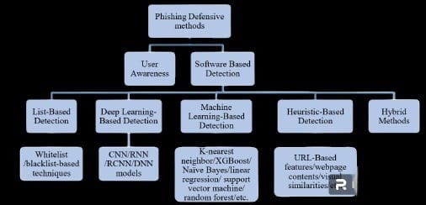
Literature Review
Phishing Detection using URLs is a widely researched problem and the solutions mostly belong to one of the categories shown below.

Slide 5
Phishing Defensive Methods
User Awareness
Software Based Detection
List Based Detection
Deep Learning Based Detection
Machine Learning Based Detection
Heuristic Based Detection
Hybrid Methods
Whitelist/Blacklist based techniques
CNN/RNN/DNN/RCNN models
KNN/ Naïve Bayes/ XGBoost/ LR/ SVM/ RF etc.
URL Based Features/ WebPage Content etc.

Slide 6
Literature Review (Continued)
We went through multiple papers researching about most of the above-listed solutions. The highest results came from deep-leaning models which used Neural Networks for NLP.
Sahingoz et al. [17] were able to achieve an accuracy of 97.98% using NLP techniques and Random Forrest for classification.
The Base paper behind the project is authored by Jishnu et al. [10] They use RoBERTa for feature extraction and integrate it with LSTM and were able to achieve an accuracy of 97.14%. Our aim was to try and improve on these results.

Slide 7
What novelty does our project have?
Use RoBERTa for URL feature extraction
Remove the task of manual feature engineering
Trained 550,000 unique URLs，URLs features extracted by RoBERTa

Slide 8
Before we start, what is RoBERTa?
NLP model, evolved from BERT, called 'Robustly Optimized BERT Pretraining Approach'.
Advanced understanding of language context and semantics
In this project, divide text into different parts in spam detection and information extraction

Slide 9
What used in code?
RobertaTokenizer and RobertaForSequenceClassification
Add your second bullet point here
Add your third bullet point here

Slide 10







Tokenize, Padding & Create Tensor
Dataset
Train batch = 32
Test batch = 64
Results
Visualization
RoBerta
Sequential
Classifier

Slide 11
Future work
SHAP for roBERTa
Use more algorithm under RoBERTa

Slide 12
What metric used?
precision
Recall
False positive / true positive
loss

Slide 13
References
[1] Aljofey, Ali, et al. "An effective phishing detection model based on character level convolutional neural network from URL." Electronics 9.9 (2020): 1514. J.
[2] Zouina, Mouad, and Benaceur Outtaj. "A novel lightweight URL phishing detection system using SVM and similarity index." Human-centric Computing and Information Sciences 7.1 (2017): 1-13.
[3] Almeida, Rômulo, and Carla Westphall. "Heuristic phishing detection and URL checking methodology based on scraping and web crawling." 2020 IEEE International Conference on Intelligence and Security Informatics (ISI). IEEE, 2020.
[4] Baykan, Eda, et al. "A comprehensive study of features and algorithms for URL-based topic classification." ACM Transactions on the Web (TWEB) 5.3 (2011): 1-29.
[5] El Aassal, Ayman, et al. "An in-depth benchmarking and evaluation of phishing detection research for security needs." IEEE Access 8 (2020): 22170-22192.
[6] Safi, Asadullah, and Satwinder Singh. "A systematic literature review on phishing website detection techniques." Journal of King Saud University-Computer and Information Sciences (2023).
[7] Dobolyi, David G., and Ahmed Abbasi. "Phishmonger: A free and open source public archive of real-world phishing websites." 2016 IEEE conference on intelligence and security informatics (ISI). IEEE, 2016.
[8] Blum, Aaron, et al. "Lexical feature based phishing URL detection using online learning." Proceedings of the 3rd ACM Workshop on Artificial Intelligence and Security. 2010.
[9] Dhamija, Rachna, J. Doug Tygar, and Marti Hearst. "Why phishing works." Proceedings of the SIGCHI conference on Human Factors in computing systems. 2006.
[10] Jishnu, K. S., and B. Arthi. "Phishing URL detection by leveraging RoBERTa for feature extraction and LSTM for classification." 2023 Second International Conference on Augmented Intelligence and Sustainable Systems (ICAISS). IEEE, 2023.
[11] “Phishing Activity Trends Report” https://apwg.org/trendsreports/
[12] Azeez, Nureni Ayofe, et al. "Adopting automated whitelist approach for detecting phishing attacks." Computers & Security 108 (2021): 102328.
[13] Das, Avisha, et al. "SoK: a comprehensive reexamination of phishing research from the security perspective." IEEE Communications Surveys & Tutorials 22.1 (2019): 671-708.
[14] Xiang, Guang, et al. "Cantina+ a feature-rich machine learning framework for detecting phishing web sites." ACM Transactions on Information and System Security (TISSEC) 14.2 (2011): 1-28.
[15] Rao, Routhu Srinivasa, Tatti Vaishnavi, and Alwyn Roshan Pais. "CatchPhish: detection of phishing websites by inspecting URLs." Journal of Ambient Intelligence and Humanized Computing 11 (2020): 813-825.
[16] Felegyhazi, Mark, Christian Kreibich, and Vern Paxson. "On the Potential of Proactive Domain Blacklisting." LEET 10 (2010): 6-6.
[17] Sahingoz, Ozgur Koray, et al. "Machine learning based phishing detection from URLs." Expert Systems with Applications 117 (2019): 345-357.
[18] Rao, Routhu Srinivasa, and Alwyn Roshan Pais. "Two level filtering mechanism to detect phishing sites using lightweight visual similarity approach." Journal of Ambient Intelligence and Humanized Computing 11.9 (2020): 3853-3872.
Maneriker, Pranav, et al. "URLTran: Improving phishing URL detection using transformers." MILCOM 2021-2021 IEEE Military Communications Conference (MILCOM). IEEE, 2021.

Slide 14
Thank you

