Slide 1

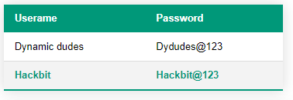
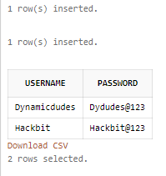
When user enters the username and password, it searches in the database and if it matches, then logs in. Data is stored.
(PLATFORM USED: SQL)

Slide 2
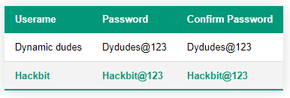
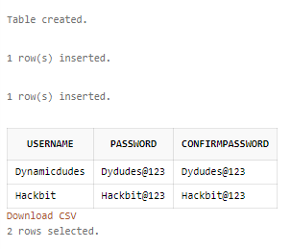
When a user sign up, they can enter username, password,
confirm password and it is stored in database.
(PLATFORM USED: SQL)

