Slide 1
Progress Report
Yida Zhang
9/10/2024

Slide 2
Outline
Train with time information on real dataset
Dataset generation

Slide 3
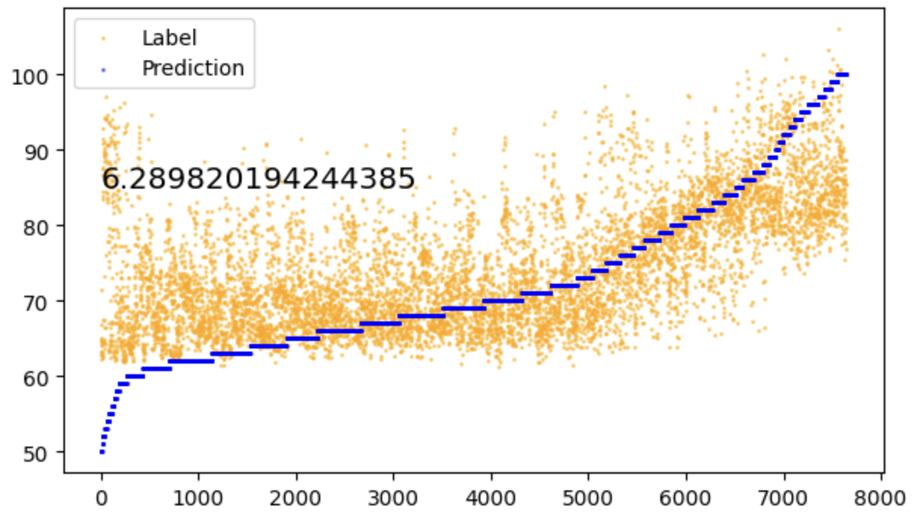
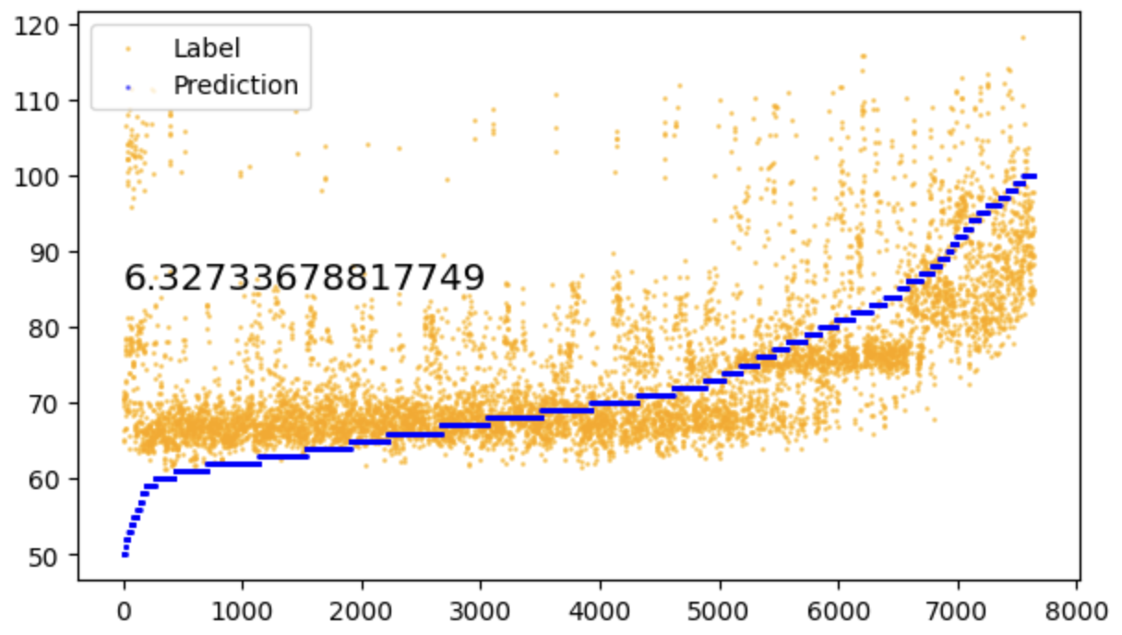
Train with time information
Description: Assume a person’s blood pressure follows a daily cycle and convert the original Unix timestamp into a number between 0 and 24, then concatenate it with the 1000 signal
Without time information
With time information

Slide 4
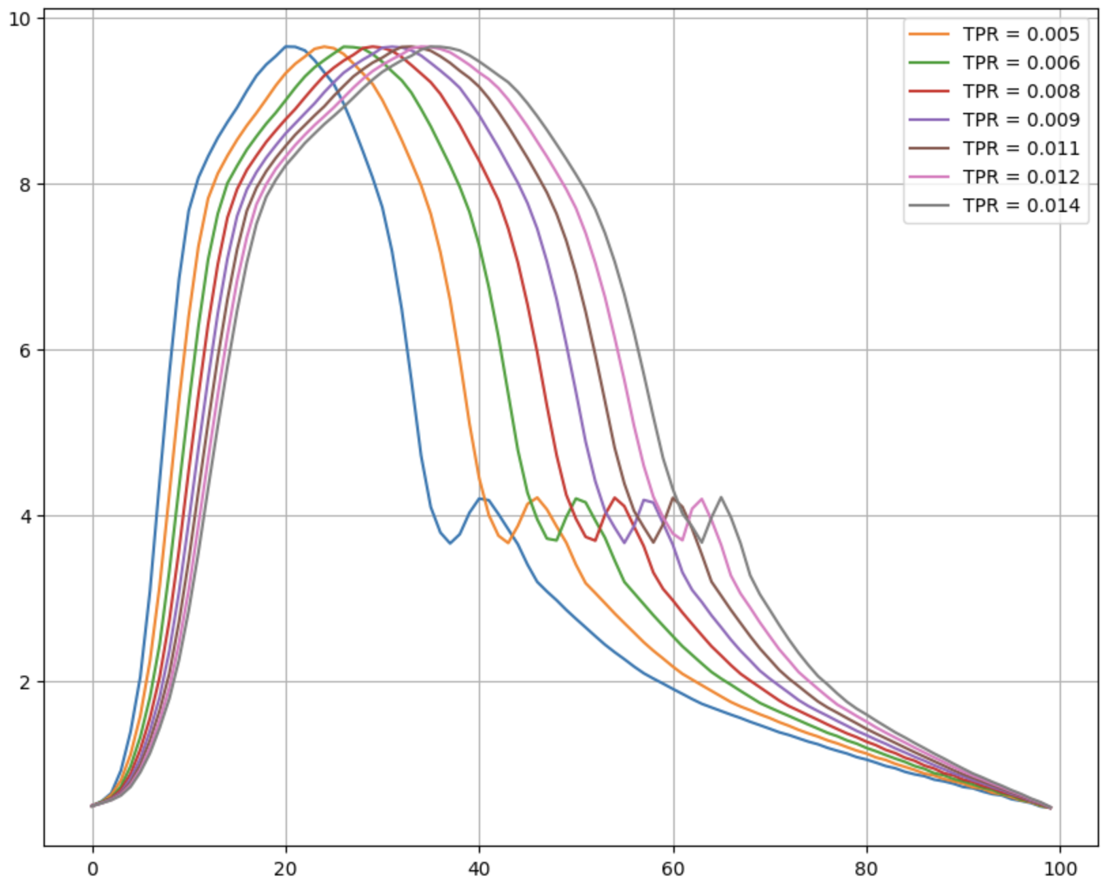
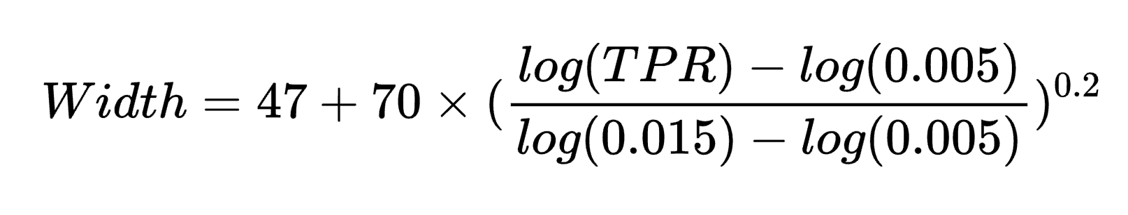
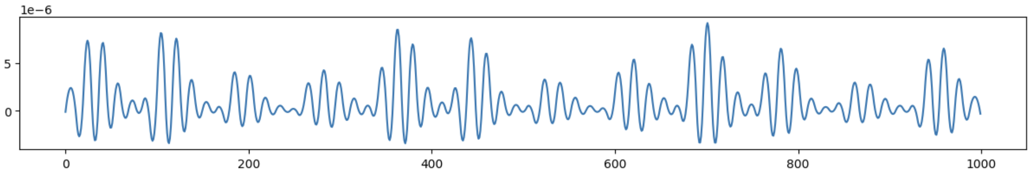
Dataset generation
Description: I involve the TPR into the ABP heartbeat cycle, using TPR to determine the width of the main part, so that DL can learn the time related information from the signal. So currently the dataset has three noises: TPR random noise + TPR time noise + respiration.
The relationship of width and TPR is:
New Waveform

Slide 5
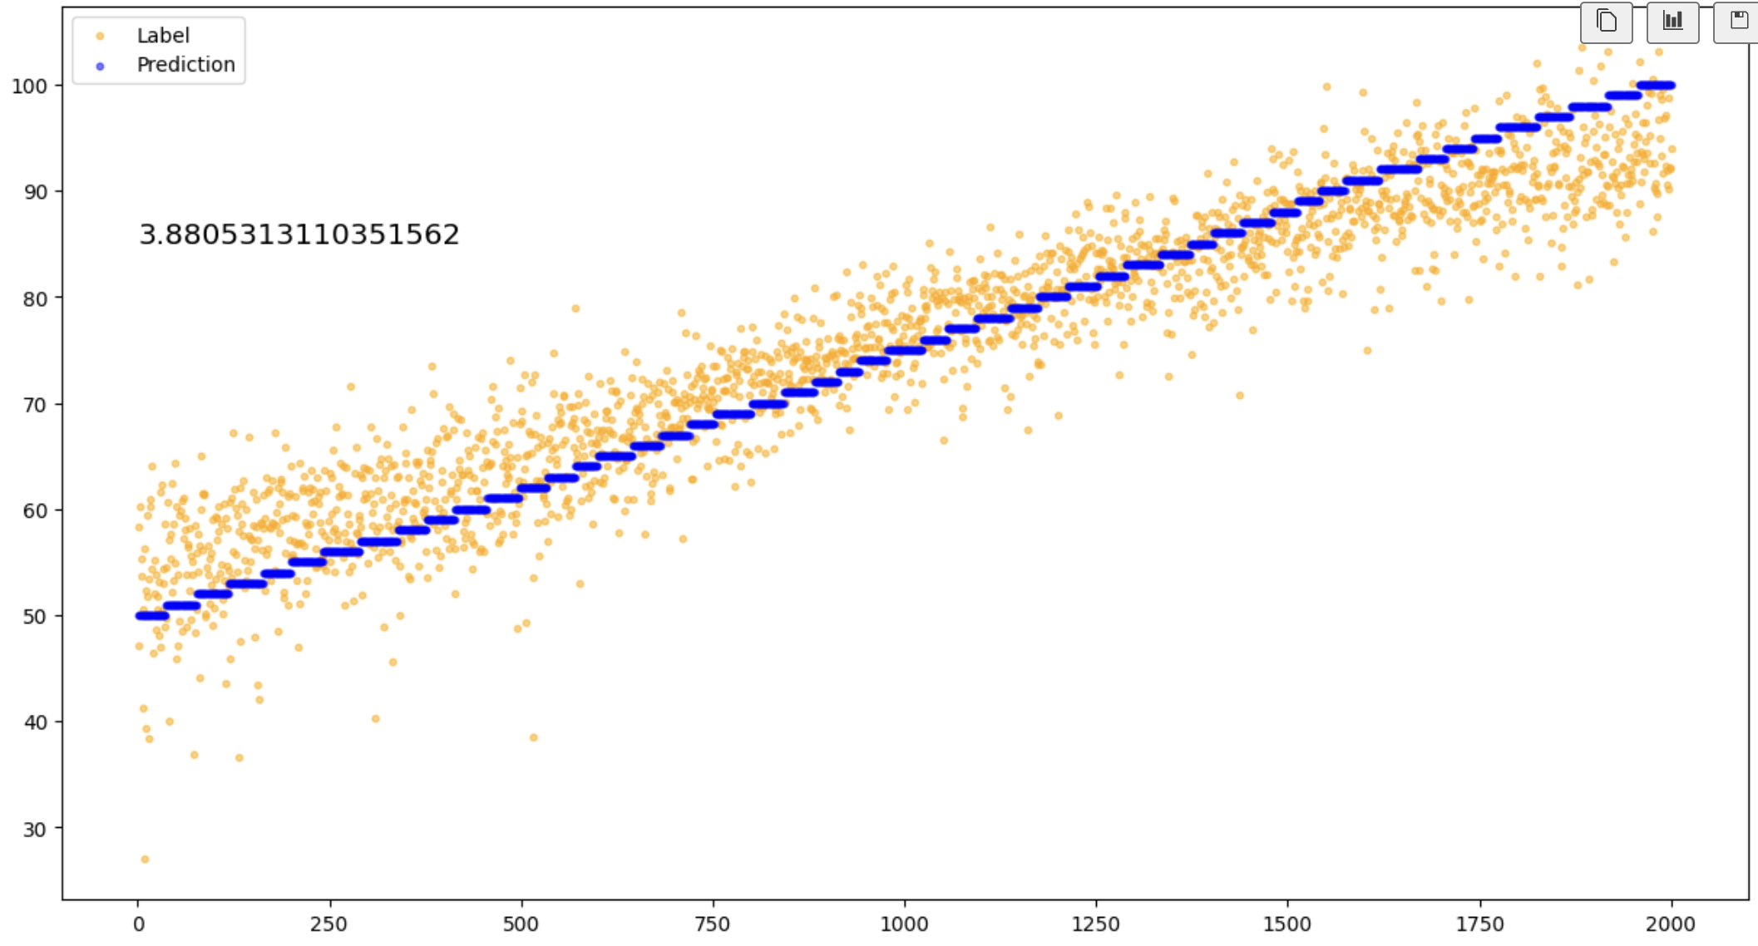
Prediction result of DL
Prediction result of DL

Slide 6
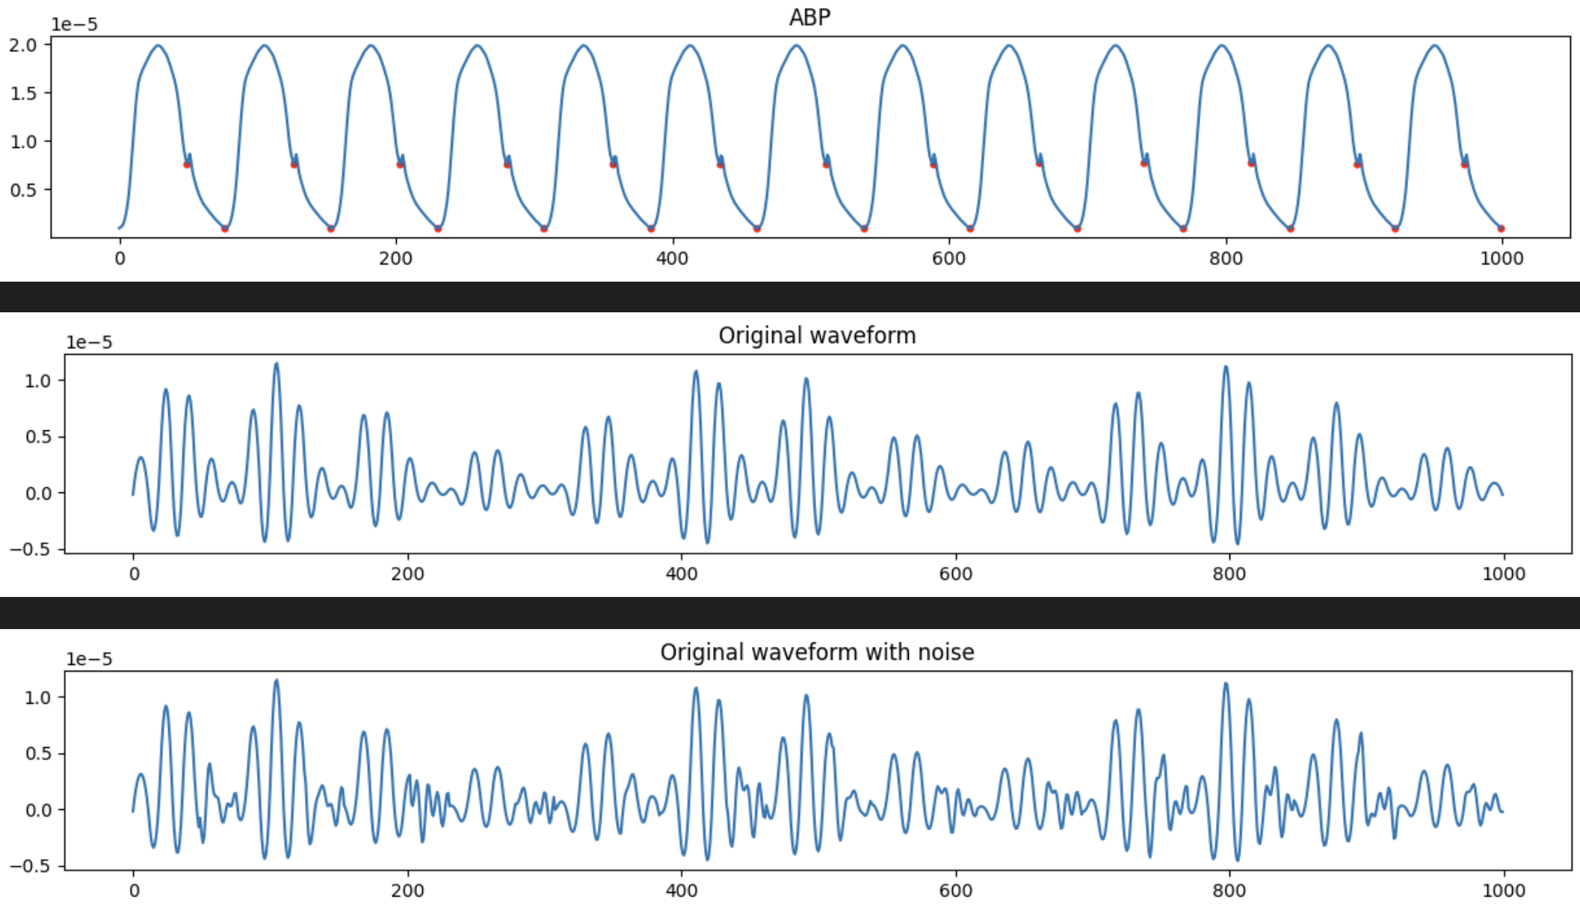
Validate whether DL learns the right area
Description: Add 10-15 Hz noise only to the specific part, which will not influence the area of SV.

Slide 7
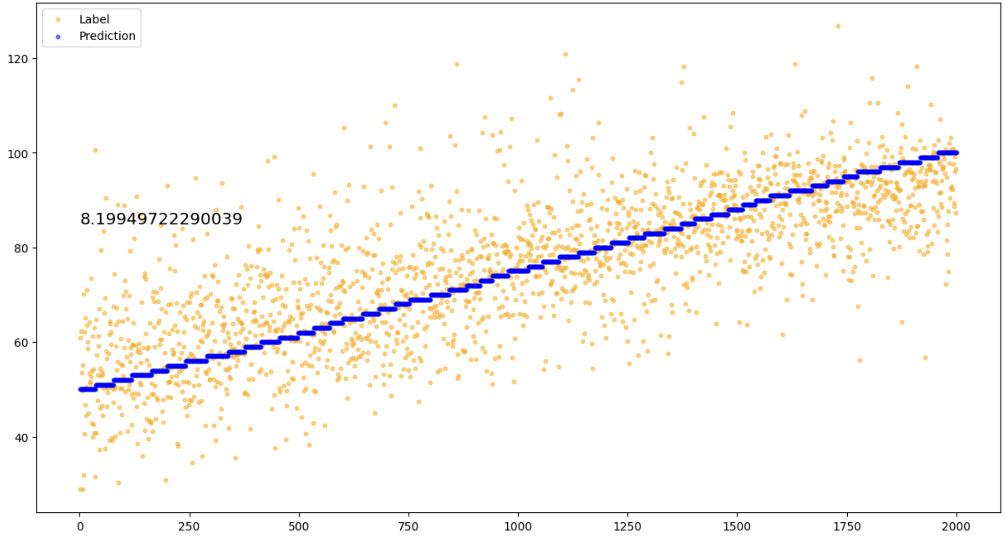
Prediction result of DL
Description: Train with the dataset without noise and test the model with the dataset with noise. If the DL model actually learns the SV area, the noise won’t change the result.
Prediction result of dataset with noise
Conclusion: The DL model may learn something about area, but it can’t identify the notch accurately.
Notes:
I still try to add noise to the whole part or only to the tail, and separate the dataset as train and test set, the DL can learn well.

Slide 8
Thanks

