Slide 1
Weekly Progress Report
Yida Zhang
2023.8.14
Notes:
Hello Professor Song

Slide 2
Progress
Application materials, mainly the Research Proposal
Advanced Digital Signal Processing and Noise Reduction: One Chapter
Analyze relationship between features and S, and implement feature selection algorithms
Implement K-shape on SCG dataset and compare it with other algorithms
Notes:
My main progress this week includes completing application materials, mainly focused on writing the research proposal. And, I studied a chapter on ADSPNR. Furthermore, I analyze the relationship between features and "S," and based on this, I implement several feature selection algorithms. I also implement the kshape algorithm on the SCG dataset.

Slide 3
Feature selection
Removing features with low variance
Univariate feature selection
Recursive feature elimination
Random forest
Notes:
Last week, Professor Song shared a link in the Google document about feature selection methods and recommended me using random forests for feature selection. Therefore, this week, I tried these methods

Slide 4
Relationship between features and S
The vertical difference between Peak1 and Peak2 is linearly correlated with D
The horizontal difference between Peak1 and Peak2 is NOT linearly correlated with S
Notes:
Before performing feature selection, we need to understand the relationship between different features and "S", so that we can validate the correctness of the selected features by the feature selection algorithms. I previously believed that there was a linear relationship between "S" and the horizontal distance between peak1 and peak2. Therefore, I used linear regression as a model. However, upon closer examination of the code and mathematical derivation, I discovered that "D" indeed has a linear relationship with the vertical distance of the peaks, however the horizontal distance of peaks doesn’t has linear relationship with S. This also explains why the absolute values of the Pearson coefficients for D12 and D21 were not very large in the last week's report.

Slide 5
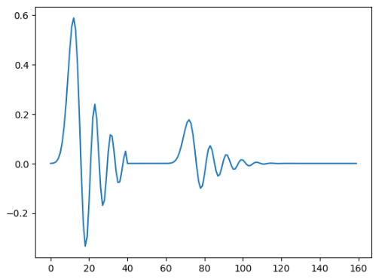
Relationship between features and S
40
20
100
cardiac_s = scipy.signal.wavelets.daub(ind)
cardiac_d = scipy.signal.wavelets.daub(ind)*0.3*diastolic
cardiac_s = scipy.signal.resample(cardiac_s, 100)
cardiac_d = scipy.signal.resample(cardiac_d, 100)
cardiac_s = cardiac_s[0:40]
distance = 180-systolic # systolic 81-180
zero_signal = np.zeros(distance)
cardiac = np.concatenate([cardiac_s, zero_signal, cardiac_d])
systolic=160
Notes:
So, let’s go throught the code . Firstly,we generated a waveform with a length of 40 samples of "S" in the beginning, followed by 180-s zero-value samples, and finally 100 samples of "D." This constitutes one cycle.

Slide 6
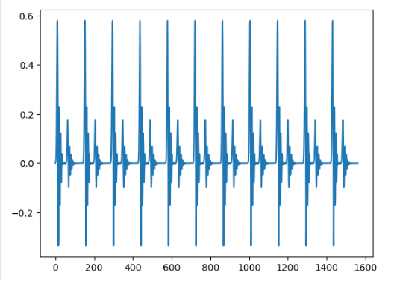
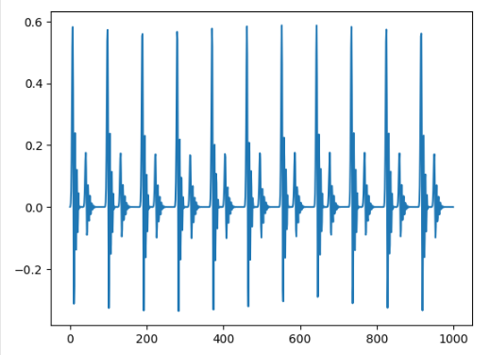
Relationship between features and S
num_heart_beats = int(duration * heart_rate / 60)
scg = np.tile(cardiac, num_heart_beats)
scg = signal_resample (
scg, sampling_rate=int(len(scg) / 10), desired_length=length, desired_sampling_rate=sampling_rate )
Notes:
This cycle is then repeated num_heasrt_beats times to form the complete signal, where num_heart_beats is determined by the heart rate. Finally, the complete signal is resampled to have a total of 1000 samples.

Slide 7
Relationship between features and S
40
20
100
D21_before
length_cycle_before
=
D21_after (Known)
length_cycle_after
where:
D21_before = 40 + 180 - S
D21_after = The feature we have extracted
(D21: horizontal difference from high peak to low peak)
length_cycle_before = 40 + 180 - S +100
length_cycle_after = 1000/num_heart_beats = 6000/heart_rate
S = 320 + 600000 / (D21_after * hr - 6000)
systolic=160
The relationship is Non_Linear
40+180-S
D21_before
Notes:
From the above synthetic code, we derive an equation where xxx represents the horizontal distance between peak1 and peak2 in the original signal, measured in the number of samples, xxx represents the length of one cycle in the original signal, xxx represents the horizontal distance between peak1 and peak2 after resampling, and xxx represents the length of one cycle after resampling. As resampling has a proportional effect on D21 and D_cycle, we can establish this equation. Solving this equation allows us to determine the relationship between "S" and D21.

Slide 8
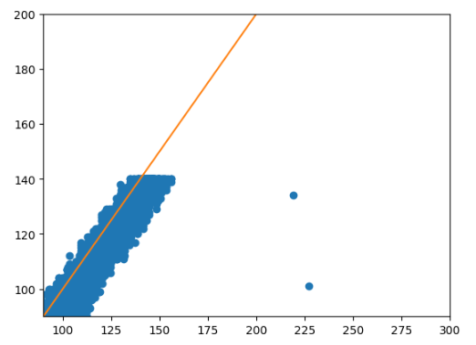
Relationship between features and S
Orange line: y = x
X_axis: 320 + 600000 / (D21_after * hr - 6000)
Y_axis: S
S = 320 + 600000 / (D21_after * hr - 6000)
S = 320 - 600000 / (D12_after * hr)
Notes:
We can validate this equation. For the signals in the training set, I calculated the value on the right side of the equation and plotted it on the x-axis, while the corresponding "S" values were plotted on the y-axis. The orange line representing y=x can effectively fit these points, indicating the correctness of the relationship between "S" and D21. Similarly, we can derive the relationship between D12 and "S" using the same method, which is also nonlinear. This equation confirms that the horizontal difference between peak1 and peak2 and "S" has a nonlinear relationship, aligning with the Pearson coefficients I obtained last week – both D21 and D12's Pearson coefficients were not very large.

Slide 9
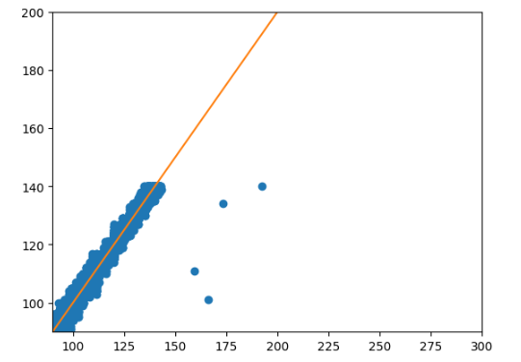
Relationship between features and S
S = 320 + 600000 / (D21_after * hr - 6000)
S = 320 - 600000 / (D12_after * hr)
D21 = (6000 * S - 6000 * 220) / (hr * S - hr * 320)
D12 = 600000 / (hr * 320 - hr * S)
D21/D12 = 2.2 - 0.01 * S
Orange line: y = x
X_axis: 220 - 100 * D21/D12
Y_axis: S
S = 220 - 100 * D21/D12
Notes:
However, last week, we observed a significant Pearson coefficient between D21 diveded by D12. We can find the reason from the previous equation. Using that equation, we can deduce the expressions for D21 and D12 and divide them to obtain the relationship between "S" and the ratio D21/D12. By graphically verifying the equation, we can find that the ratio D21/D12 exhibits a linear relationship with "S." This also explains why the Pearson coefficient for D21/D12 was significant last week. Another important point to note is that from the graph, we can see that the relationship between the two is not a perfect linear relationship; there is some error. This error arises from the information loss caused by resampling. Based on the above analysis, we conclude that neither D21 nor D12 is linearly correlated with "S," but the ratio of the two (D21/D12) exhibits a linear correlation with "S," making it the most important feature.

Slide 10
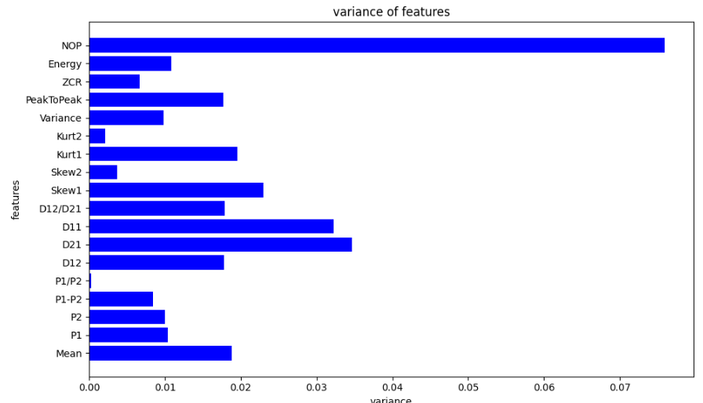
Removing features with low variance
Normalize all features
Set the threshold as 0.005
Remove three features: Kurt2, Skew2, P1/P2
Notes:
Next comes feature selection. I used four methods to select features from the 18 features I extracted. First, I removed features with low variance. Low variance means that the features do not change significantly, so they do not contribute much to the prediction target and should be removed. Before removal, I normalized all features, allowing me to use the same criteria for feature selection. The variances of all 18 features are shown in a graph, and I set the threshold to 0.005, resulting in the removal of three features through this step.

Slide 11
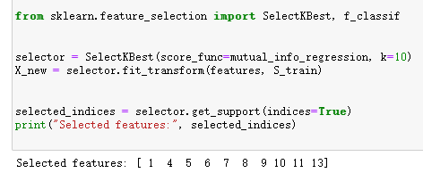
Univariate feature selection
Choose 10 highest scoring features, using mutual_info_regression as score function
Selected features: P1, D12, D21, D11, D21/D12, Skew1, Kurt1, Variance, PeakToPeak, Energy
Notes:
Next was Univariate Feature Selection, which uses univariate statistical tests to select the most relevant features. The Pearson coefficient I previously used is also this feature selection method. This time, I chose mutual information as the ceriteria because it can measure nonlinear relationships between features and the target. I selected the top 10 scoring features out of 15 for further processing. It can be observed that the selected features include those we previously deemed important, such as D21 and D21 divided by D12.

Slide 12
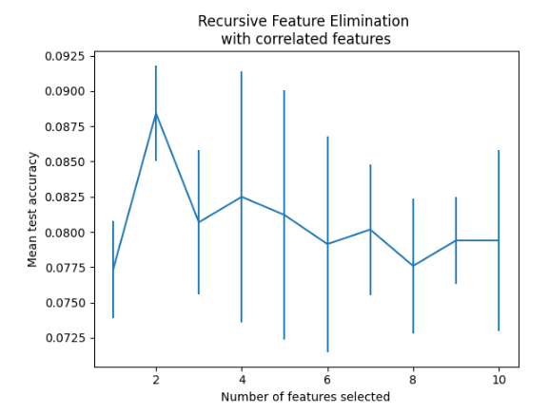
Recursive feature elimination (RFE)
Selected features: D12, D21/D12
Notes:
The third step is Recursive Feature Elimination. It works by initially using all features for prediction, calculating the contribution of each feature to the prediction, and then removing the least contributing feature. This process is repeated until only one feature remains. In each iteration, prediction accuracy is calculated, and the feature with the highest accuracy is selected as the final feature. The graph shows how prediction accuracy changes with the number of features. It can be seen that when there are only two features, prediction accuracy is highest, and these two features are D12 and D21 divided by D12 – perfectly aligning with our previous conclusion.

Slide 13
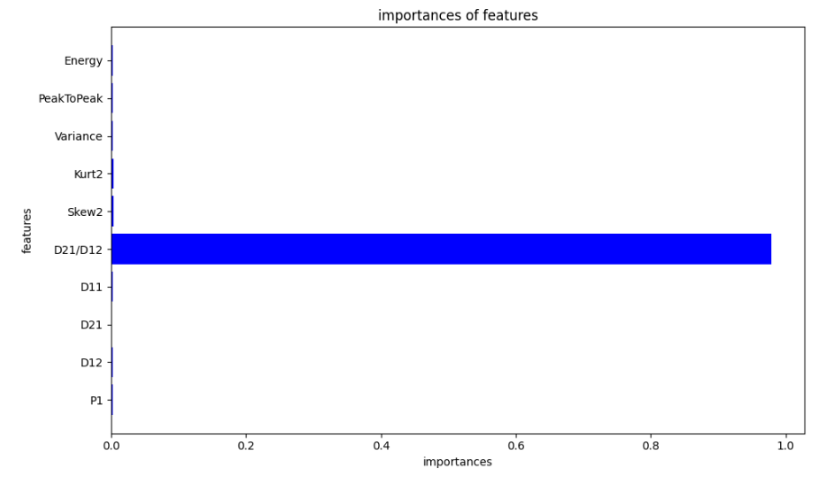
Random forest
Use “model.feature_importances_” to get the importances of features
Notes:
Lastly, I applied the random forest algorithm. Random forests consist of many decision trees, which are interpretable machine learning algorithms, allowing us to use them for feature selection. The implementation was based on the previously filtered 10 features. The graph shows that the importance of D21/D12 is much greater than other features, which also aligns with our previous conclusion. I have uploaded all of this code to a GitHub repository.

Slide 14
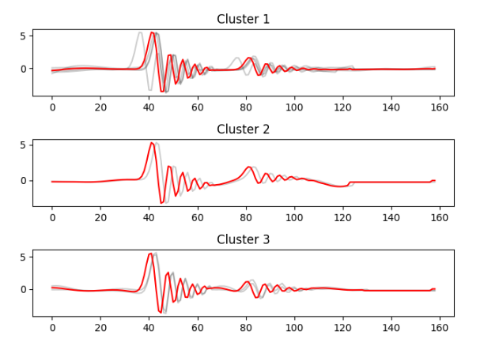
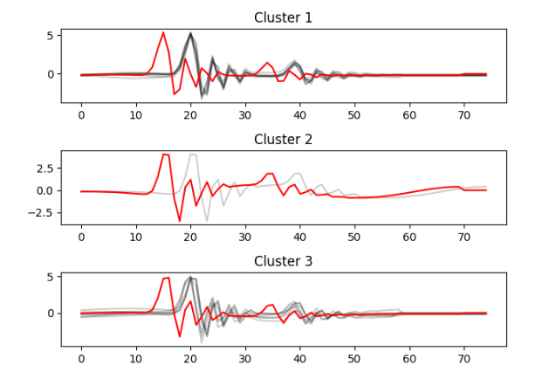
K-shape
kmeans and kmedoids
Silhouette Score and Calinski-Harabasz
Notes:
I also ran the kshape clustering algorithm on the SCG dataset. The kshape algorithm worked well on some datasets but provided templates with noticeable advancements compared to the original signal on the other signals. I haven't yet figured out why this occurs, but I intend to address this issue next week. Additionally, I compared the kshape algorithm with other clustering algorithms like kmeans and kmedoids, which also require setting the target cluster number (n_clusters). I used Silhouette Score and Calinski-Harabasz to compare the clustering effectiveness. I aimed to determine the best number of clusters using these indicators, by trying different number of clusters from 2 to one-third of the signal count. However, I encountered some issues in implementation. For example, using the dataset from the provided link, it's clear that there are only three distinct shapes in the signals. However, if I use the Calinski-Harabasz index, it suggests that dividing into four clusters is best, while the Silhouette Score suggests dividing into two clusters is best. This is strange, and I plan to investigate the algorithms underlying these two metrics to explain this unexpected phenomenon.

Slide 15
Thanks for listening

