Slide 1
Progress Report
2024.2.5
Yida Zhang

Slide 2
Outline
Experiment of Feature Selection Layer on the new dataset
Experiment of AutoEncoder
Experiment of LVM
Questions

Slide 3
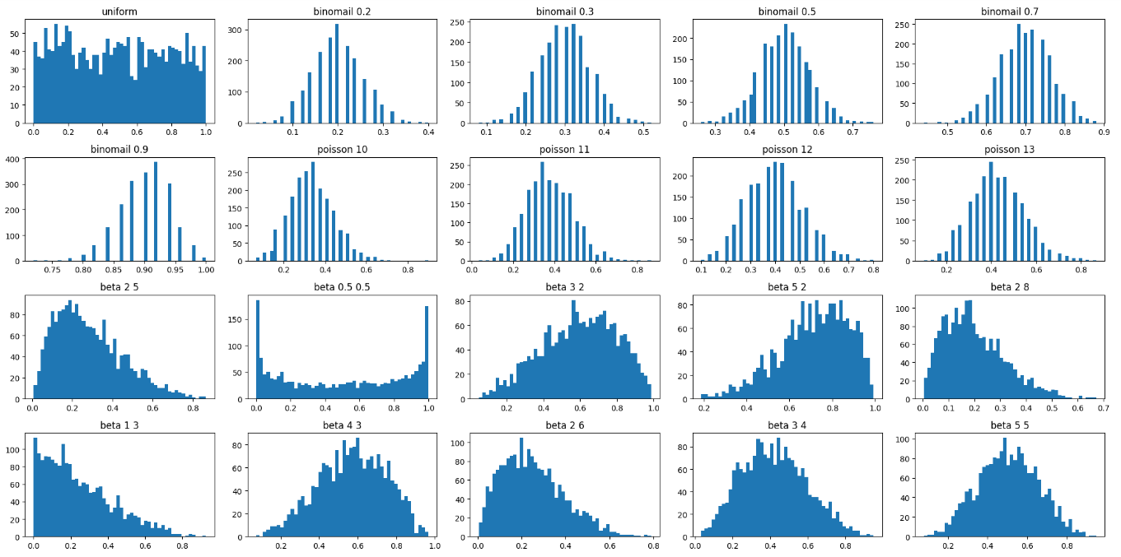
Introduction of New Dataset

Slide 4
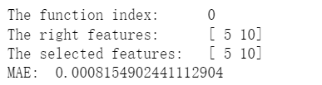
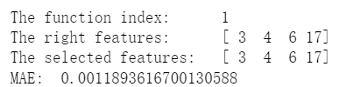
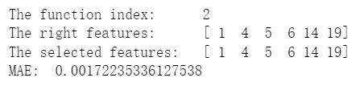
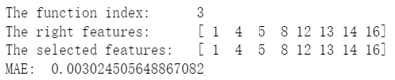
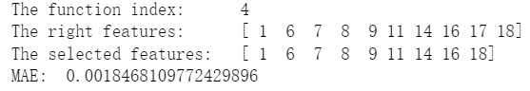
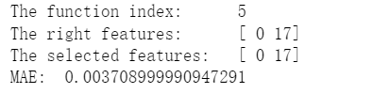
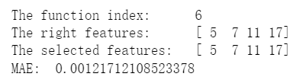
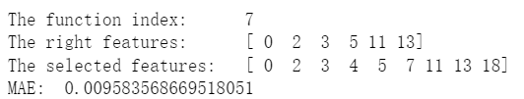
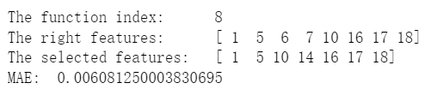
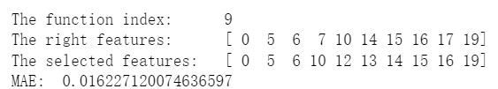
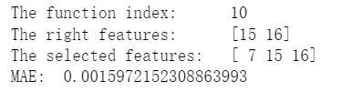
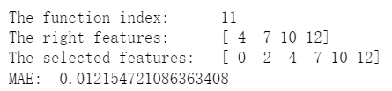
Experiment Result of Feature Selection Layer
Green: right selected red: select more features
Notes:
解释结果含义
解释少选的原因
Lambda在新数据集上普遍小
Mae

Slide 5



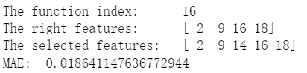
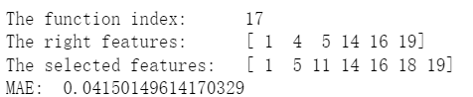
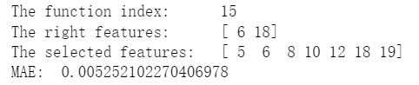
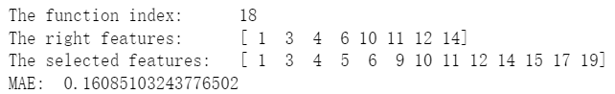
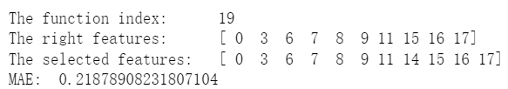
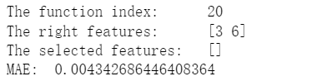
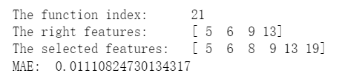
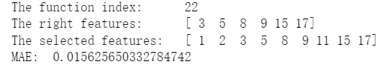
Experiment Result of Feature Selection Layer
Green: right selected red: select more features

Slide 6
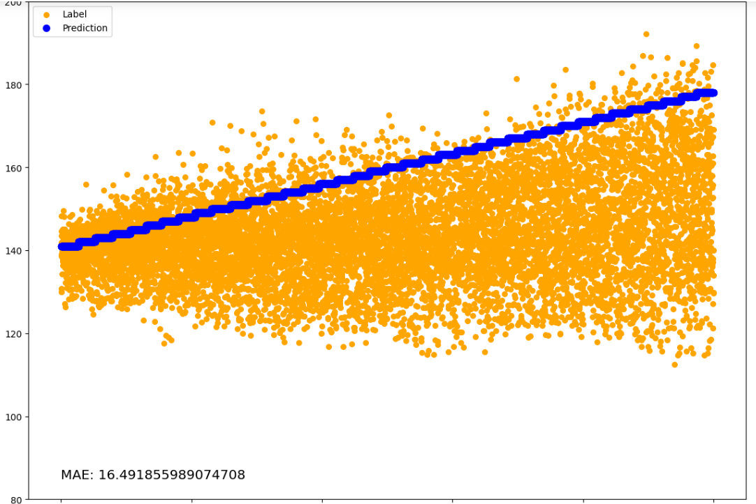
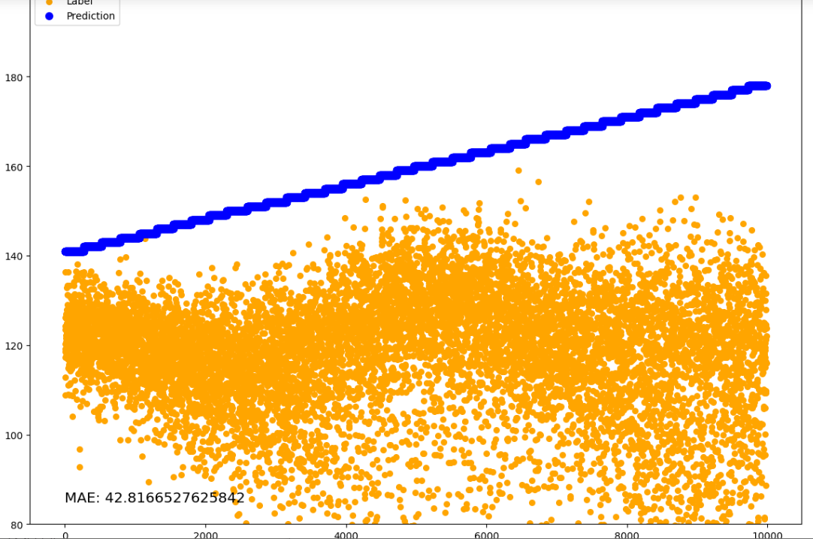
Experiment Result of AutoEncoder
Train set: SCG generated by daubechies wavelet
Test set: SCG generated by morlet wavelet with resonance noise
4 layers CNN
AutoEncoder to encode representation
MLP to do prediction

Slide 7
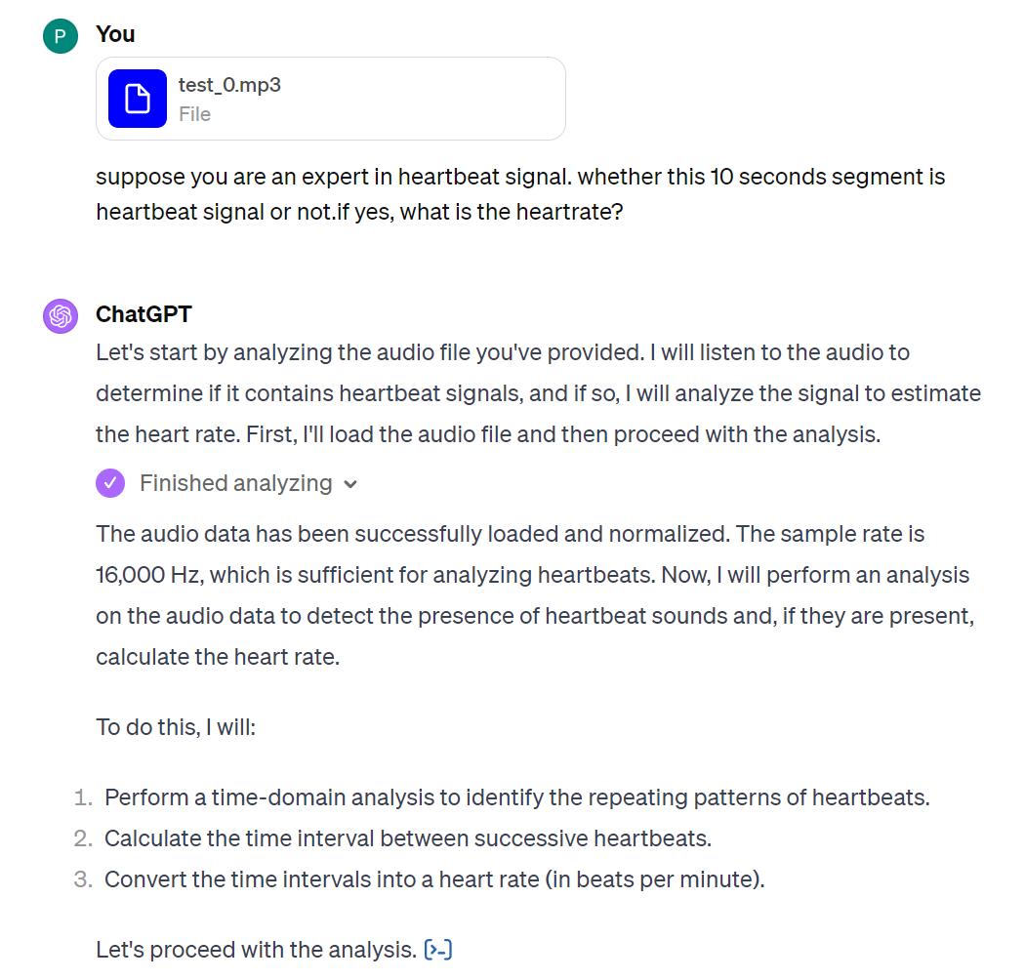
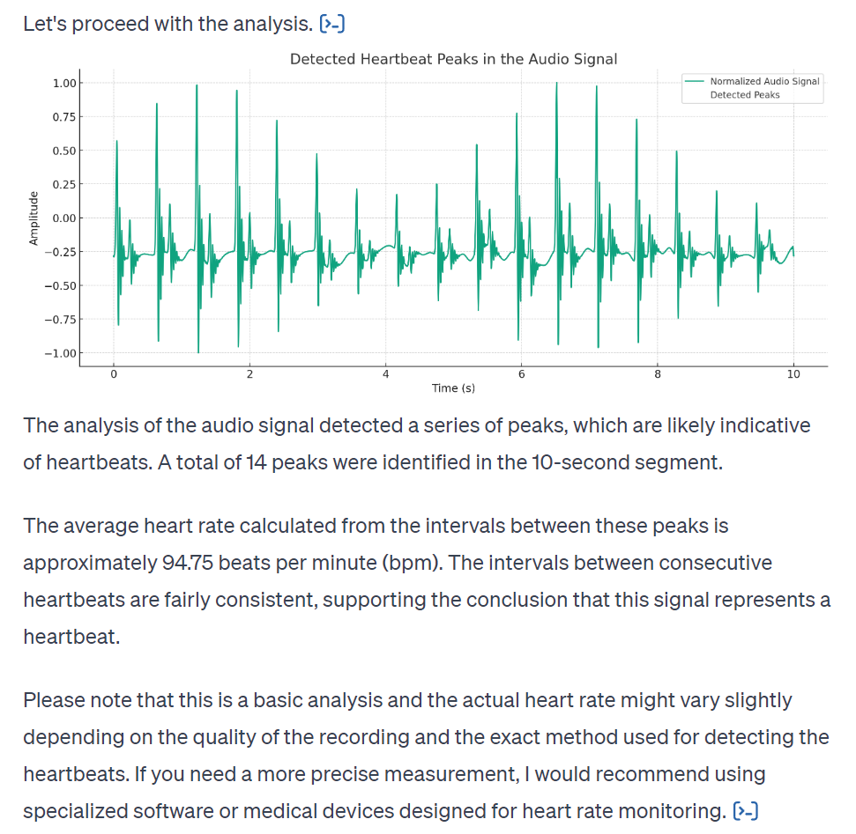
Experiment Result of LVM: Heart Rate Estimation

Slide 8
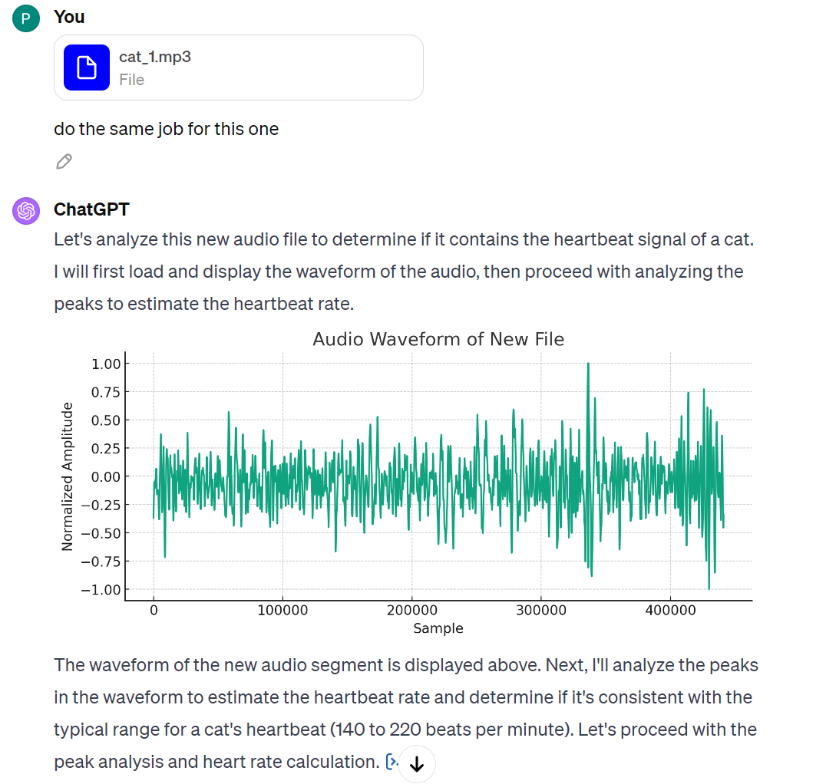
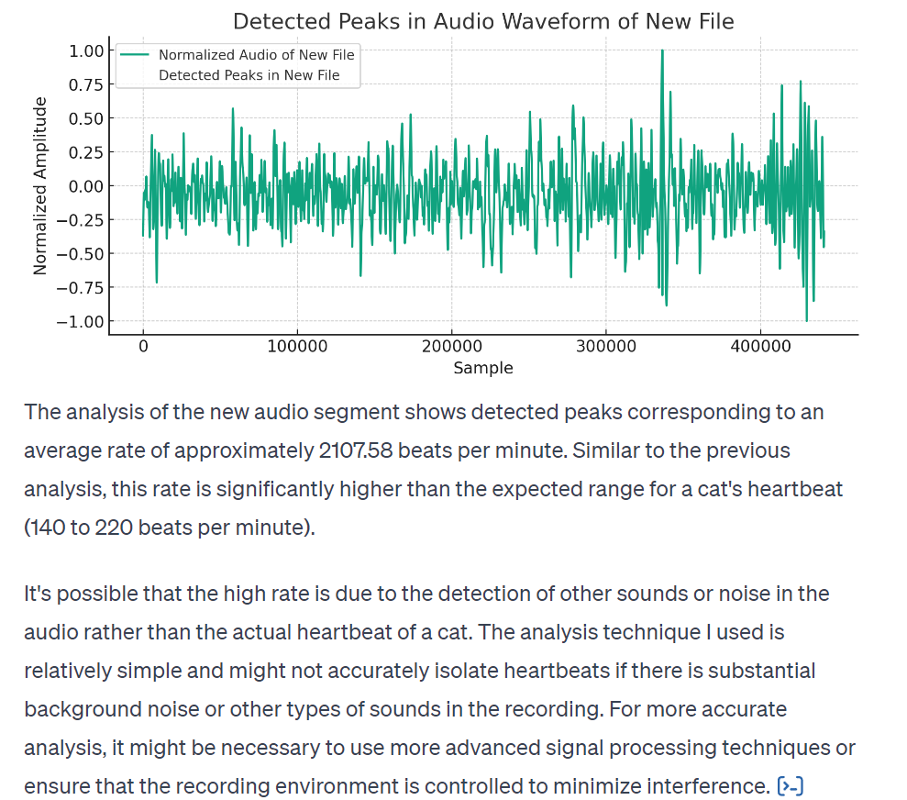
Experiment Result of LVM: Heart Rate Estimation

Slide 9
Experiment Analysis
What the GPT4v will do is the same as what a human will to estimate the heart rate. It first convert the steps into code, then calculate the Heart Rate according to the result of code.
The code provided by LVM is very simple and can’t detect the peaks properly.
The GPT4v doesn’t have “magic”. It doesn’t contain information that we don’t know.
Fine-tunable pre-train large time-series may work.

Slide 10
Questions:
1. What is model guided neural network?
2. What is BSG signal? And what’s the difference between BSG and SCG and BCG

