Slide 1
Progress Report
2023.10.30
Yida Zhang

Slide 2
Progress
Paper Reading
Group-aware Contrastive Regression for Action Quality Assessment
Contrastive Regression for Domain Adaptation on Gaze Estimation
Contrastive Learning for Regression in Multi-Site Brain Age Prediction
Deep Feature Synthesis: Towards Automating Data Science Endeavors
Code Implementation in DSP Textbook Learning
Auto Correlation and DCT
Start to read the ADSP book you recommend and keep improve the tutorial next week
Experiments about Feature Synthesis
Notes:
The first is paper reading. I read four papers this week. Three of them are about the contrastive regression and another is about the feature synthesis you mentioned in the email.
The second progress is the code implementation in DSP textbook learning. I implement some methods which mainly about auto correlation and DCT and I have uploaded them to the github. Just as I planned, I will start to read the ADSP book you recommend and keep improve the tutorial next week.
The third progress is the experiment about feature synthesis. I will introduce it detailly latter.
To begin with, I will do a brief paper report and talk about my insight as last meeting. THe first three papers are all the papers you put on the google doc.

Slide 3
Group-aware Contrastive Regression for Action Quality Assessment
2021 ICCV
Problem
Subtle differences between videos will lead to large variations in scores. Most existing approaches which regress a quality score from a single video can’t capture these subtle differences.
Method
First, the author regresses the difference of score between the input and the example instead of regressing score of input directly (CoRe).
Second, the author convert the score regression into two easier sub-problems: coarse-to-fine classification, aiming to know which interval the difference falls in, and regression in the small interval (GART).
Notes:
The first paper is Group-aware contrastive regression for action quality assessment.
The problem the author faced is that the subtle differences between videos will lead to large variations in the scores. So most existing approaches which regress a quality score from a single video can’t capture these subtle differences. So the author proposes a new framework to do action quality assessment.
First, the author views the problem from a different perspective. He regresses the difference of score between the input and the example instead of regressing score of input directly. The idea that regresses the difference is called CoRe, contrastive regression.
And second, the author convert the score regression into two easier sub-problems. The first is coarse-to-fine classification, aiming to know which interval the difference falls in, and the second is the regression in the small interval. And this algorithm is called GART, group aware regression tree.

Slide 4
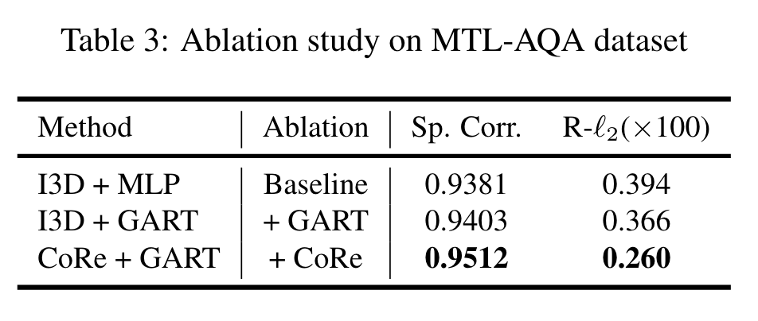
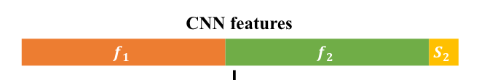
Insight
Q: Which part is the main contributor to the good result?
A: CoRe. The idea to regress the difference of score.
Q: Why it is more accurate to regress difference than regress the final score.?
A: The former method provide more information for the Neurol network.
Q: What information is the most important?
A: The difference between the representations.
Q: Future work?
A: Design a module to focus on the difference instead of putting all information into the NN directly.
Notes:
After reading the paper, we can find that the framework composes two different part. The first is a idea which regresses the difference and the second is a regression algorithm. This leads me to thinking about which one is core. In the ablation study, we can find that the improvement by GART which is 0.002 is much smaller than that by CoRe which is 0.01, the latter one is ten times bigger than the former. So I think we can draw the conclusion that is core of the framework is the CoRe.
After we get the conclusion, the next question is why the CoRe idea works. Why regress difference is better than regress the score directly. We know that when we regress the difference, the input is not only the original input, but also the example and its score, so Intuitively speaking, the more information will lead to better result.
Next, we need to figure out what information leads to better result. When we know that, we can design a module to focus on the key information instead of treat all the information equally. We know that the difference of score is caused by the difference of the feature map, or also called the representation. So I think the key point is how to learn the difference of representations.
The author is method is just putting all the information into the Neurol network. The additional information leads to the good result, but maybe he doesn’t make full use of the information. So I think the future direction can be designing a module to foucs on the difference of representations. I haven’t find a way to foucs on the difference, but I believe there has to be some way to do that. And I think it will work.
That’s all for the first paper.

Slide 5
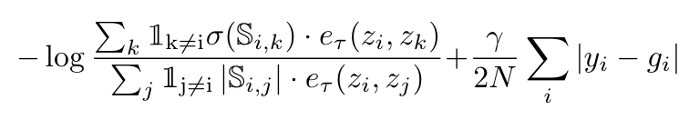
Contrastive Regression for Domain Adaptation on Gaze Estimation
2022 CVPR
Problem
Domain shift exists in Gaze Estimation Tasks. And the existing methods for domain adaptation on Gaze Estimation require additional models or annotations which lead to extra complexity of the learning pipeline. So the author proposes a new adaptation approach in unsupervised manner.
Method
First, the author uses the Contrastive Domain Generalization (CDG) module, which leverages CDG loss to learn a stable representation from the source domain. The CDG loss contains the contrastive loss and L1 loss.
Second, the author uses the Contrastive Self-training Adaptation (CSA) module to improve the adaptation performance on the target domain. In this module, the training loss is the same as CDG module, except that the label is a pseudo label generated by the pre-train model.
Notes:
The second paper is Contrastive regression for domain adaptation on Gaze estimation.
The background of this paper is domain shift in Gaze Estimation tasks. And the existing methods for domain adaptation on Gaze Estimation require additional models or annotations which lead to extra complexity of the learning pipeline. So the author proposes a new adaptation approach in unsupervised manner.
First, the author uses the Contrastive Domain Generalization module, which leverages CDG loss to learn a stable representation from the source domain. The CDG loss contains the contrastive loss and L1 loss. I will talk about it latter.
Second, the author uses the Contrastive Self-training Adaptation (CSA) module to improve the adaptation performance on the target domain. In this module, the training loss is the same as CDG module, except that the label is a pseudo label generated by the CDG module.
Just as you mentioned last meeting, the key point of the OOD problem is learning the invariant feature, which is called the stable representation in this paper. And contrastive learning is an approach to learn the invariant feature. And for regression task, the loss function design is a key point. And the main contribution of this paper is the novel contrastive loss. So let’s focus on this equation. We can find that it contains two part, the latter one is just the l1 loss between prediction and label. It is easy to understand, so we only foucs on the former one.

Slide 6
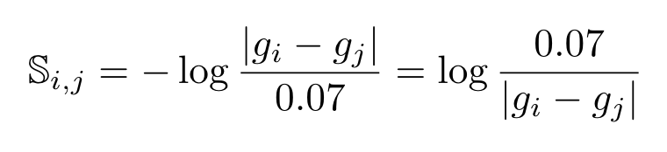
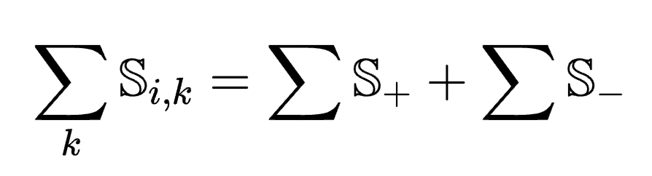
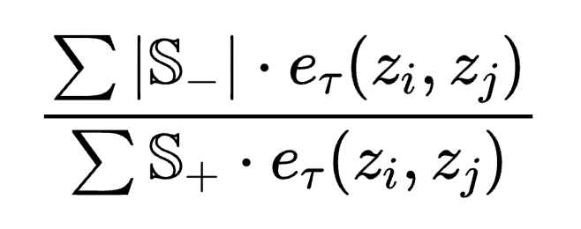
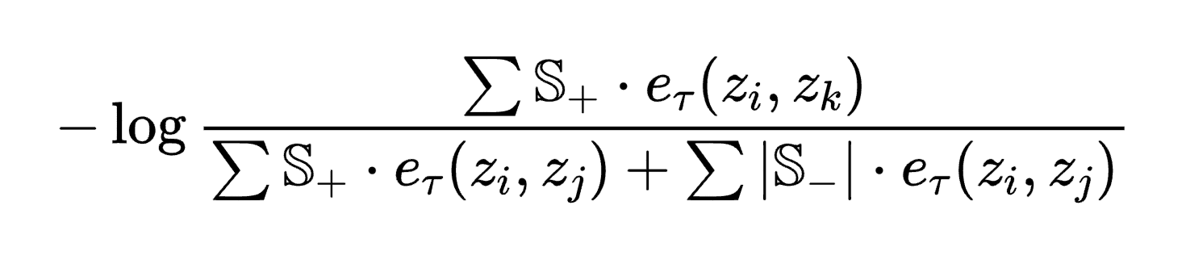
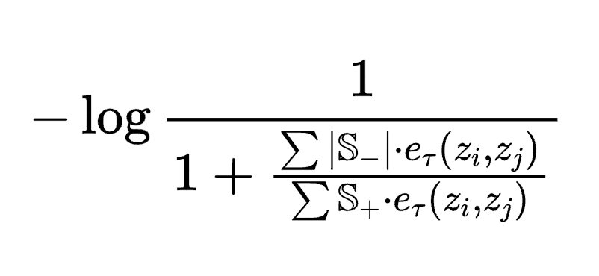
(1)
(2)
(3)
(6)
Conclusion: When we optimize the loss function, we are making the numerator smaller, the dominator bigger.
What the author actually does is use a constant number to determine which is postive pair and which is negative pair. Then pull together the postive representation and push apart the negative pair. And the degree of pull or push depends on the S which is the similarity of the label.
(4)
(5)
Notes:
The equation one is the former one. We can find there is sigma in the numerator. It means relu function which only preserves the postive number. And in the dominator, we can find there is a absolute function which is also about postive and negative number. So it is helpful to divide the S as postive part and negative part. After doing this, the equation one can be transformed to equation four. And we can divide the dominator by the numerator, we can get equation five.
So when we optimize the loss function, what we actucally do is reduce the value of the equation six, which makes the numerator go down and the dominator go up.
So let’s foucs on equation six. The S means the similarity of the label. It is a constant coefficient of each pair. We can find that if the difference of labels is bigger than 0.07, the S is negative. If it is smaller than 0.07, the S is postive. The more the label is similar, the bigger the S is. So what the author actually does is use a constant number to determine which is postive pair and which is negative pair. And the constant number is 0.07
And the e part is the cosine similarity of two representations. So what we do is reducing the cosine similarity of the representations with negative S, and increasing the cosine similarity of the representations with postive S. That is just what the contrastive learning does. And the coefficient S determines how fast or how much we pull together or push apart the pairs in each step.
I will introduce the third paper before I talk about my insight, because I think their idea of loss function is similar

Slide 7
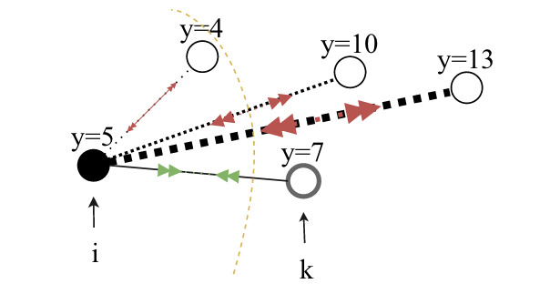
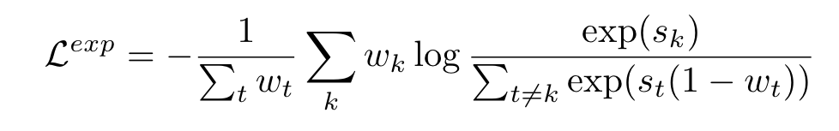
Contrastive Learning for Regression in Multi-Site Brain Age Prediction
2023 ISBI
Problem
Domain shift in Brain Age Prediction tasks.
Method
The author proposes a novel contrastive loss for regression.
Wk: Similarity of label
Sk: Similarity of representation
Notes:
The third paper is about the domain shift in brain age prediction tasks. To reduce the influence of domain shift, the author also chooses contrastive learning to help learn the invariant feature. And he proposes a loss function. The w means the similarity of the label and the s means the similarity of the representation.
And just as the analysis in last paper, we make the numerator bigger and the dominator smaller. We can find that there is a coefficient in the dominator, which is 1 minus wt. It acts like a temperature value, by giving more weight to the samples which are farther away from the anchor. It means push them apart further. The key point of this loss function is also add a weight to the similarity of representation and the weight is derived from the similarity of the label. It is similar with the last paper.

Slide 8
Insight
Label 1 = 3 Label 2 = 3.1 Diff = 0.1 > 0.07
Label 3 = 3 Label 4 = 4 Diff = 1 > 0.07
Similarity of representation
Destination
Destination
Destination
Notes:
I think these two loss function are what you mentioned in last meeting. You said that we can add a weight to treat the different negative pair differently. After reading the two papers, I have understand what you mean.
And I think there is still some space to improve. Let’s look at this equation. When we optimize the loss function, what we actually do is decrease the numerator and increase the dominator. Because we want to make the loss function as small as possible, so we want to make the numerator as small as possible. That is, although we use the weight S to control how fast the move, but their destination are same.
Let me give an example. We have two pairs and we know that the threshold of postive and negative pair is 0.07. The first pair is the green one, the difference of label is 0.1 which is greater than 0.07, so it is a negative pair. The second pair is the rad one and its difference of label is 1, so it is also a negative pair.
At begining, their similarity of representation looks like this. And after one epoch of training. They look like this. Due to the red pair has large S, so it moves further than green. But as the training goes on, they will all be close to the destination, which means the similarity of them are same, but the label of them is very different. So I think we should not only treat them differently by the weight, we should also set different destination to them.

Slide 9
Deep Feature Synthesis: Towards Automating Data Science Endeavors
2015 DSAA
Problem
In DL or ML, sometimes the data we get is not directly related to the label. As a result, we need to synthesize the data to get invariant features. However, transforming raw data, which is provided by the relational datasets, into features is often the part of the process that most heavily involves humans, because it is driven by intuition. So the author proposes a automatic method to synthesize data, which is called Deep Feature Synthesis.
Method
The author divedes the transformation as three part: rfeat, dfeat, efeat. Dfeat and rfeat is to aggregate feature from other tables. And efeat is to transform the data in a single table. We must first synthesize rfeat and dfeat features so we can apply efeat feature to the results.
The rfeat functions contains: AVG(), MAX(), MIN(), SUM(), STD(), and COUNT().
The efeat functions contains: length() to calculate the number of characters in a text field, and WEEKDAY() and MONTH() to convert dates to the day of the week or month they occurred.
Notes:
And the fourth paper is about the feature synthesis. You also mention it in the google doc.
The background of the paper is that, in
I will give a quick example to explain this concept.

Slide 10
Customer
Loans
Customer ID | Birth | Income | Number of loan
001 | 1990-3-4 | 2000 | 1
002 | 1994-5-19 | 4000 | 2
Customer ID | Loan ID | Loan amount | Rate
001 | 750 | 800 | 1.2
002 | 751 | 400 | 1.3
002 | 752 | 500 | 1.4
rfeat: Max(), Avg()
Customer ID | Birth | Income | Number of loan | Max loan amount | Avg loan amout
001 | 1990-3-4 | 2000 | 1 | 800 | 800
002 | 1994-5-19 | 4000 | 2 | 500 | 450
efeat: Year(), Month()
Customer ID | Birth Year | Birth Month | Income | Number of loan | Max loan amount | Avarge loan amout
001 | 1990 | 3 | 2000 | 1 | 800 | 800
002 | 1994 | 5 | 4000 | 2 | 500 | 450
Notes:
At beginning, we have two tables. They are the information about customer and loans.
If we choose the customer table as main table and want to get its rfeat, what we should do is apply the rfeat function to other tables which refer the customer table. We can see that the loans table refer to the customer table. So we use the max and average function to get the max and average loan amount for each customer. So here is the new table after rfeat transformation.
And the efeat means transform the data in a single table. Here, we use the Year and month function to transform the birthday to year and month. So this table is the final table, and it provides the synthesized data we input into the ML or DL model.
I think this method can’t do what we want. Because the it only has few transformation type, which are AVG(), MAX() and so on like I mentioned in last slide. And it can’t synthesize complicated feature. So if we want to synthesize the complicated feature, NN is more suitable.
That’s all for my paper report.

Slide 11
Experiments setup
Four sets of experiments:
TSFEL features without regularization
Random number without regularization
Random number with L1 regularization
For each sets, I add 0, 2, 4, 8, 16, 32 unrelated features respectively.
Network: FCN with 2 hidden layers, the activation function is Relu
Learning rate: 0.001
Batchsize: 32
Optimizer: Adam
Criterion: MAE
Notes:
And the second part is about the experiments on feature synthesis. Last week, I have succeeded in predict the S with only x1x2 and h as input. So this week I tried to add some unrelated features to see whether the FC network can work well.
I design four sets of experiments. The first is adding the unrelated feature extracted by TSFEL. The second is add random numbers as unrelated features. The third is adding random numbers and using L1 regularization. And the fourth is using L2 regularization.

Slide 12
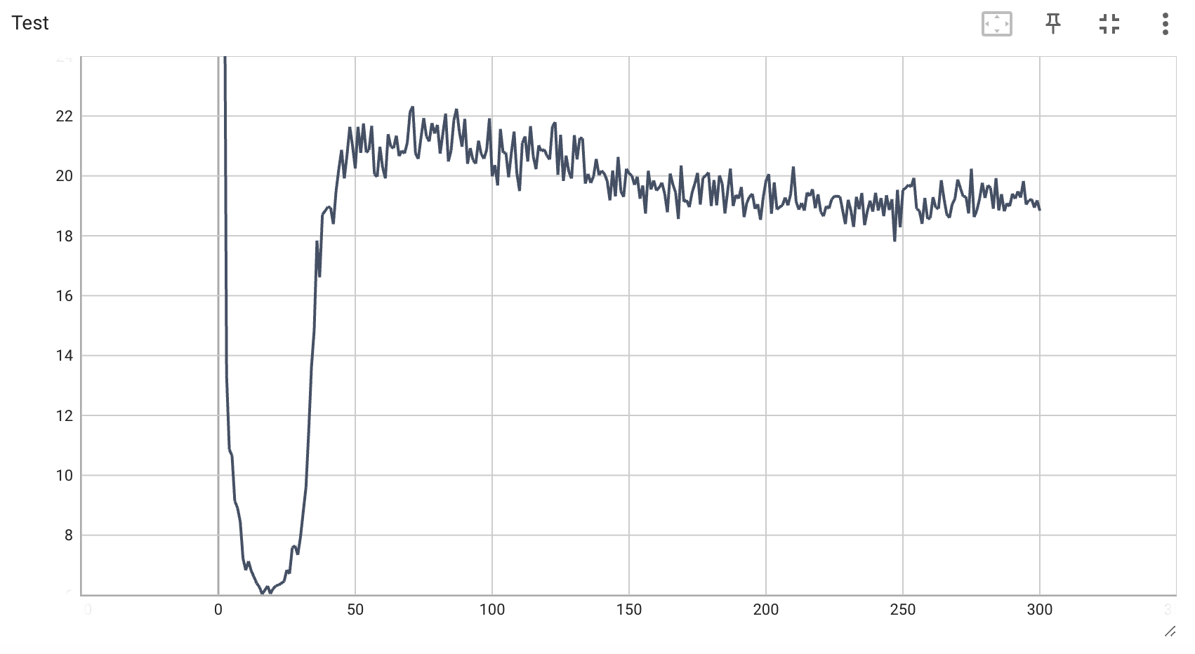
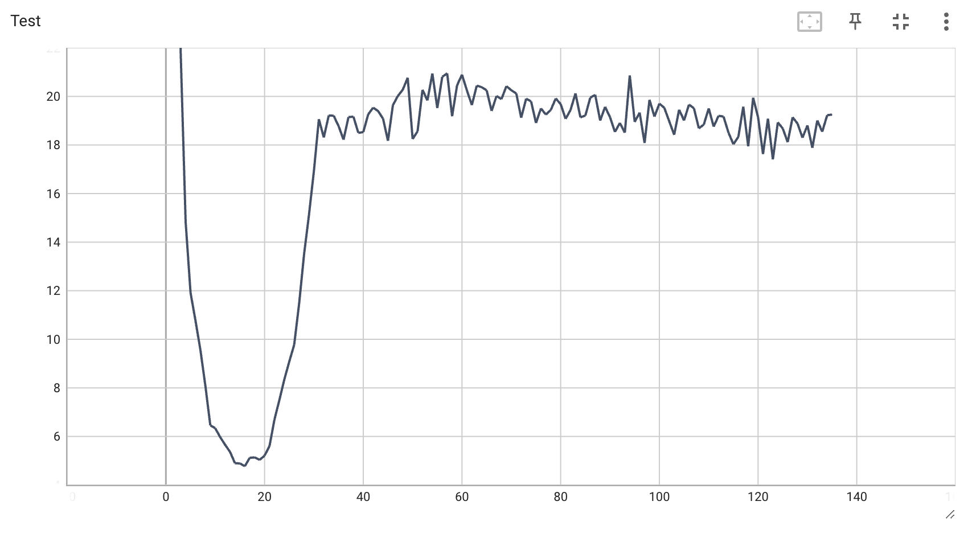
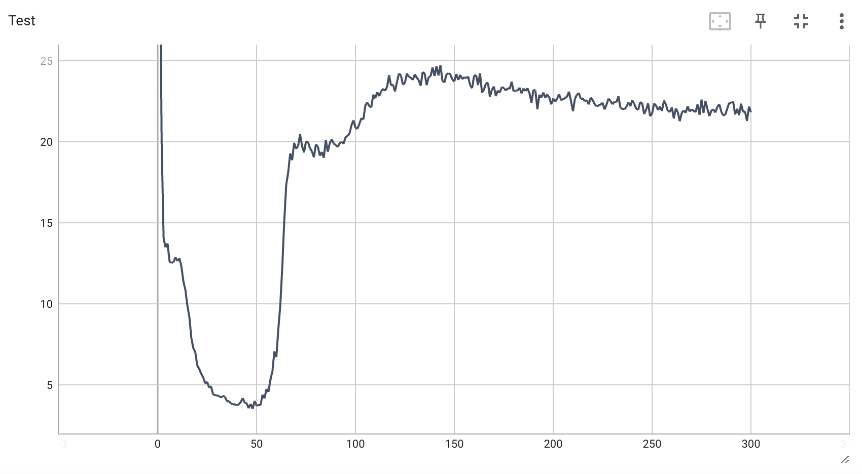
0
2
TSFEL
Random
Number

Slide 13
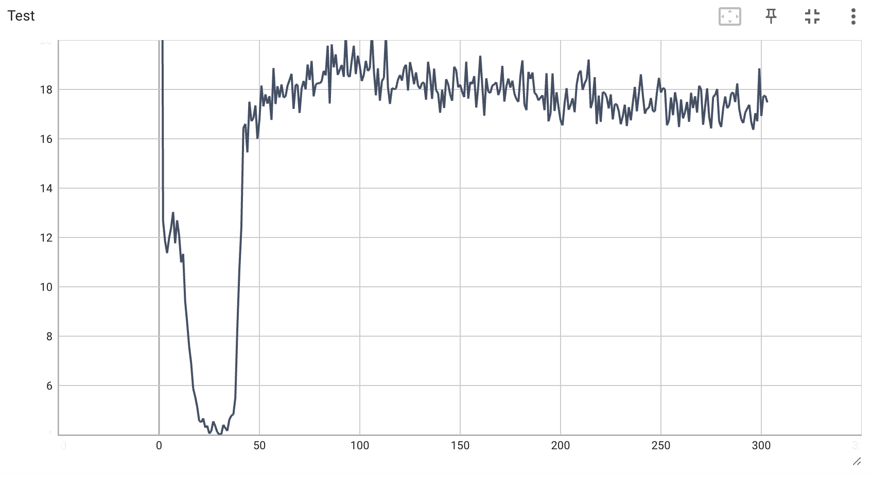
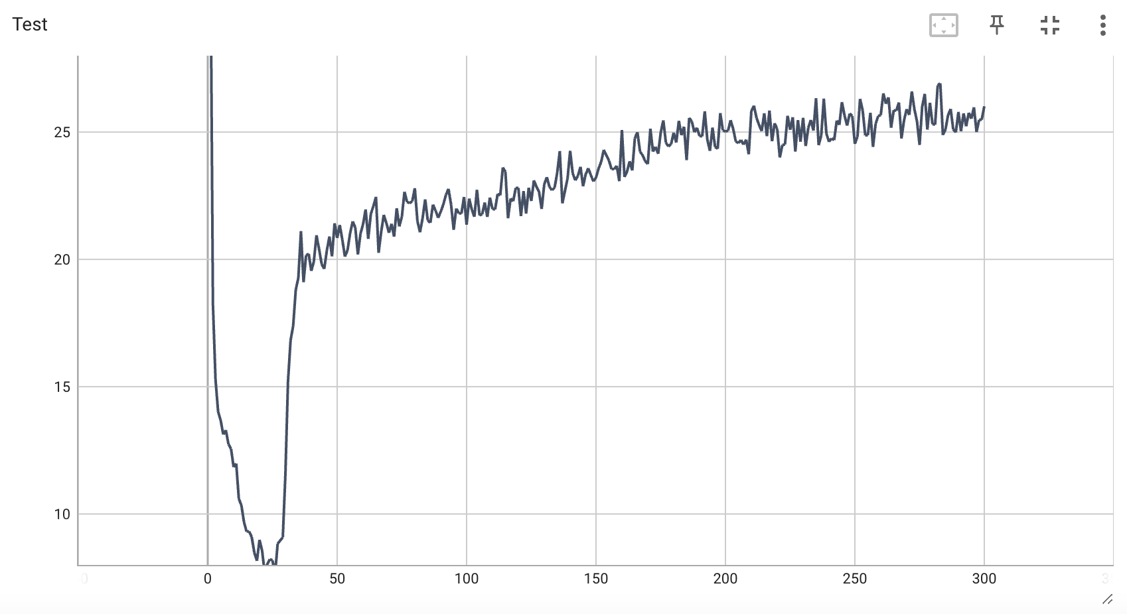
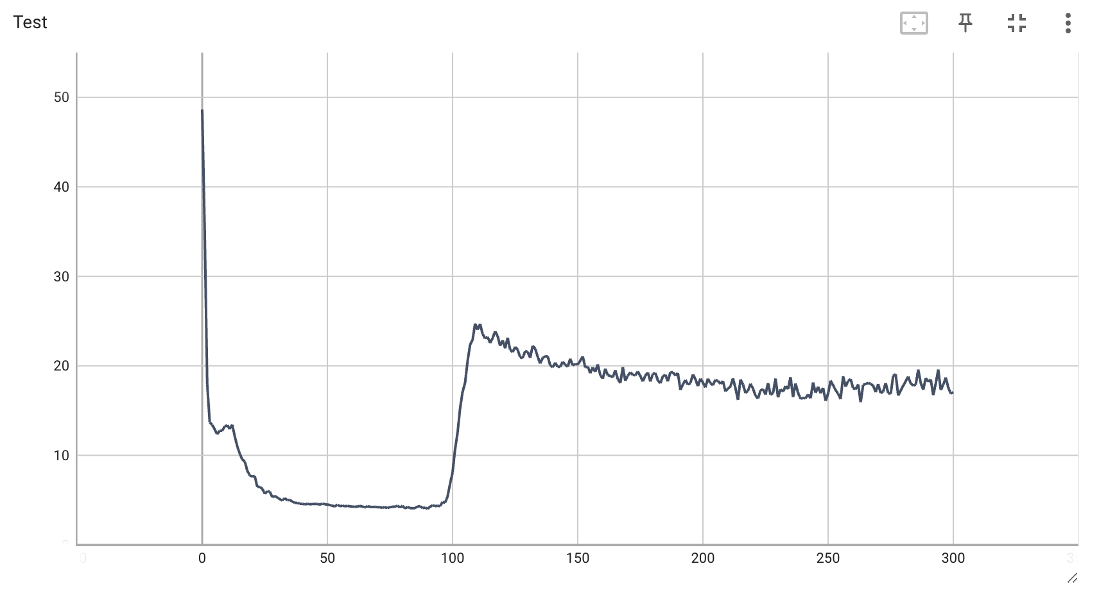
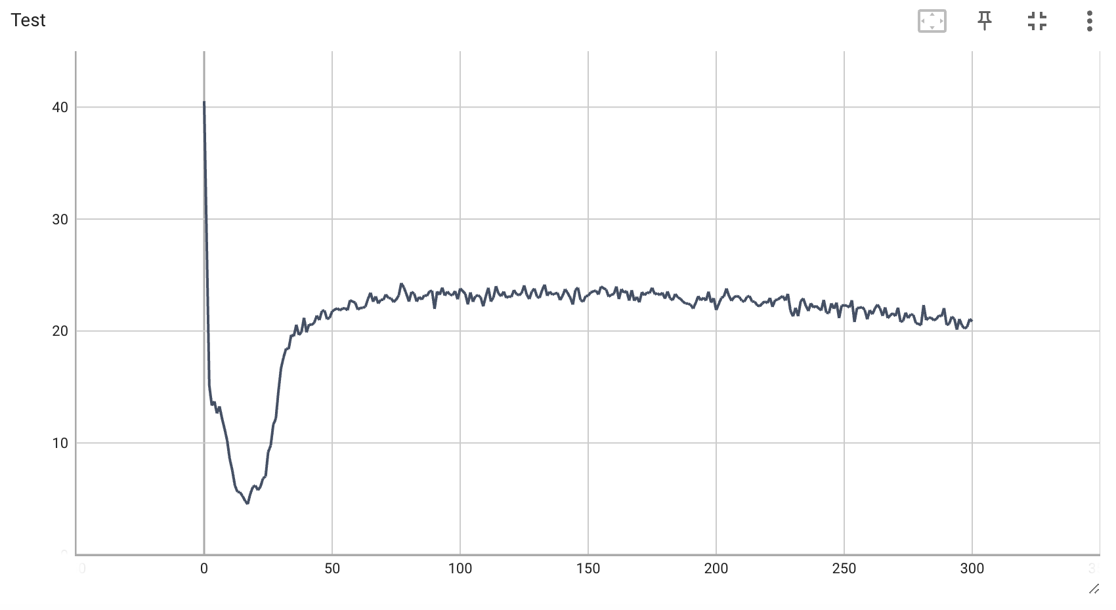
4
8
TSFEL
Random
Number

Slide 14
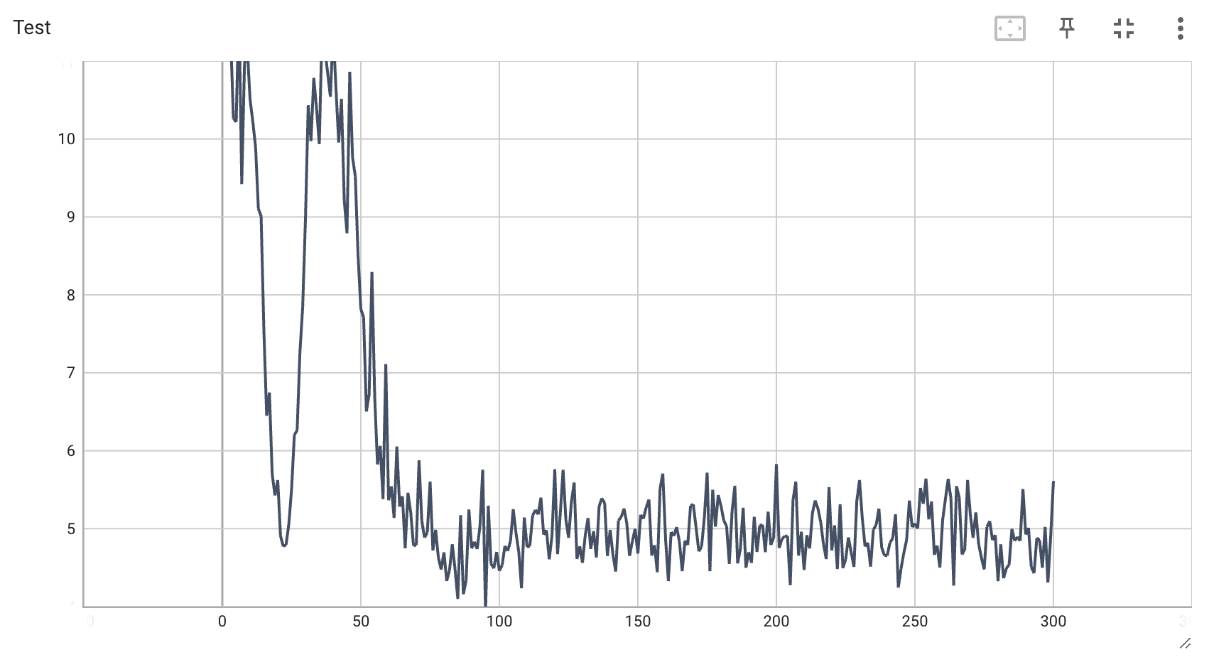
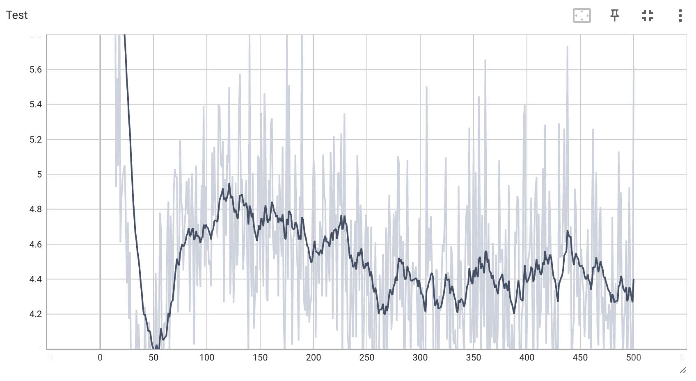
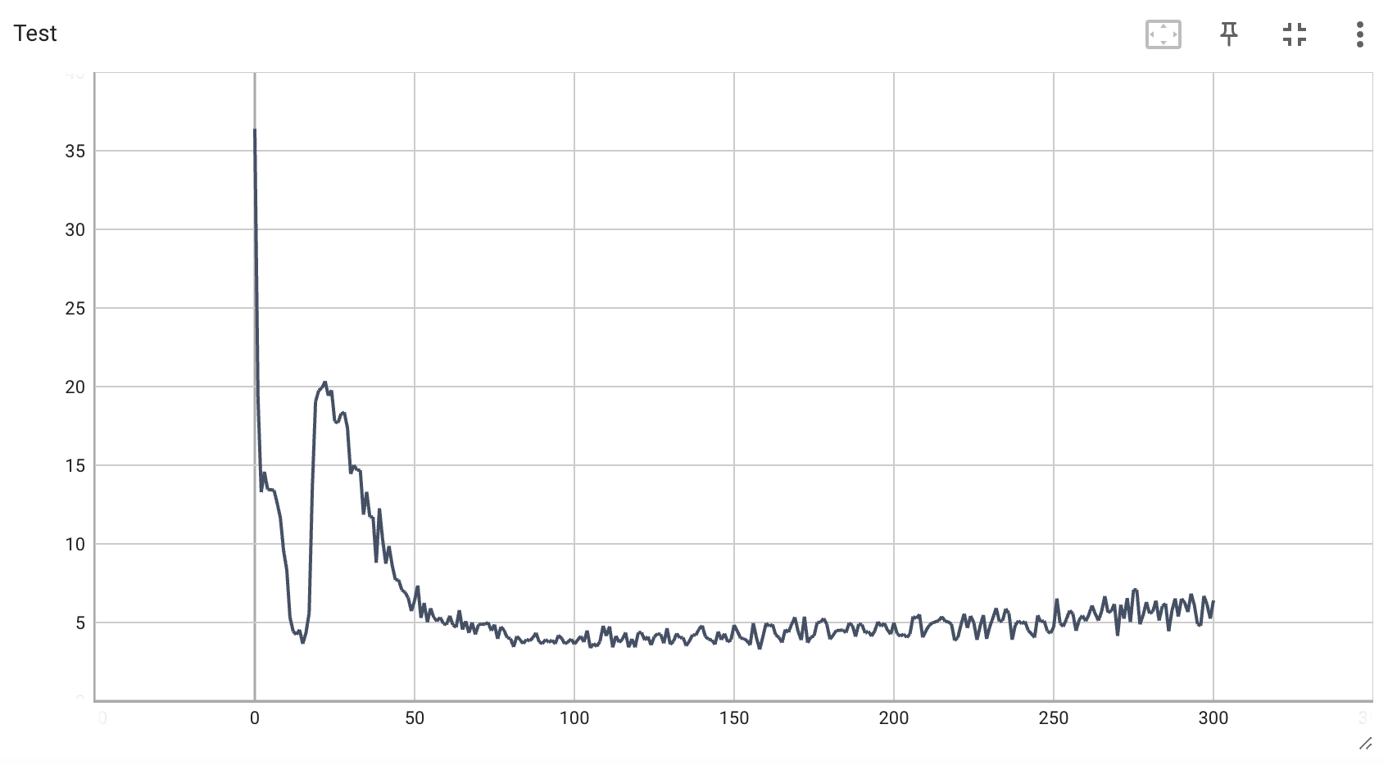
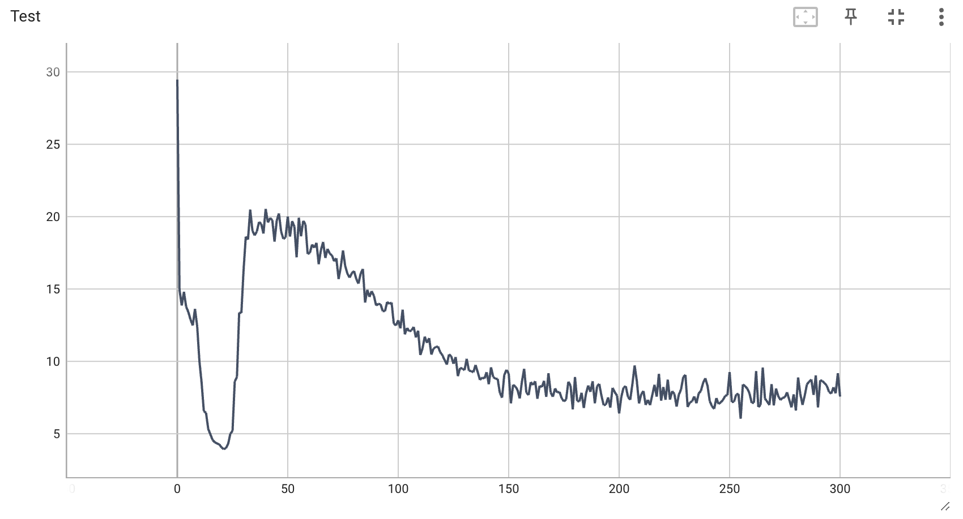
16
32
TSFEL
Random
Number

Slide 15
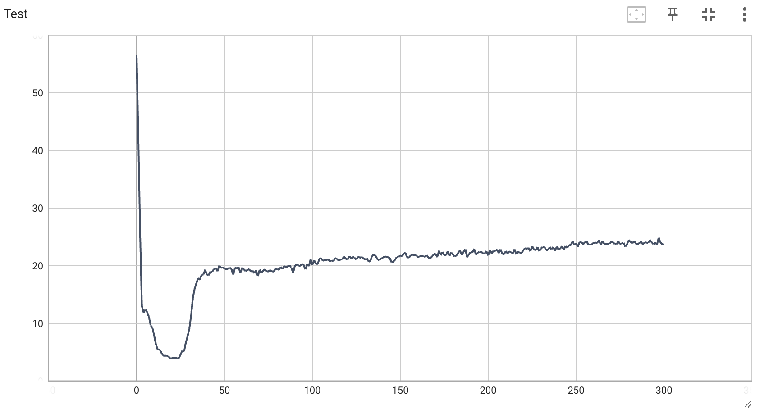
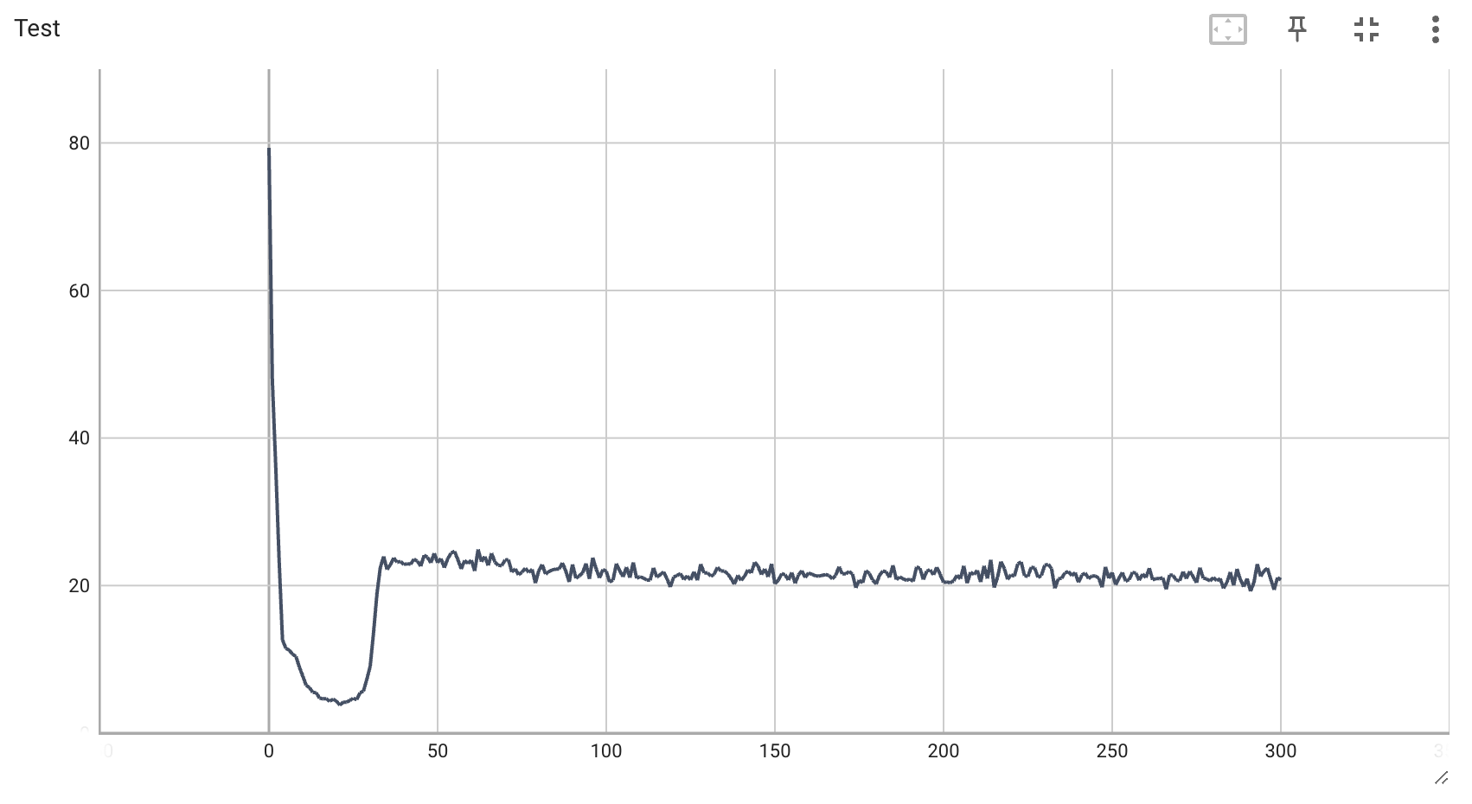
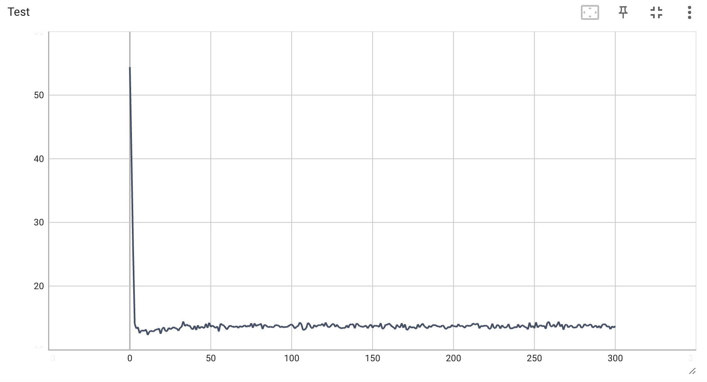
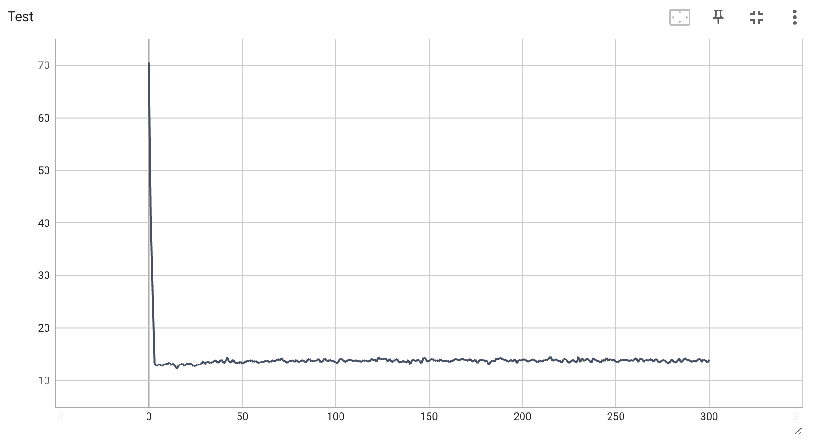
Random number (2) with L1 regularization
lamda_l1 = 0.001
lamda_l1 = 0.005
lamda_l1 = 0.0075
lamda_l1 = 0.01

Slide 16
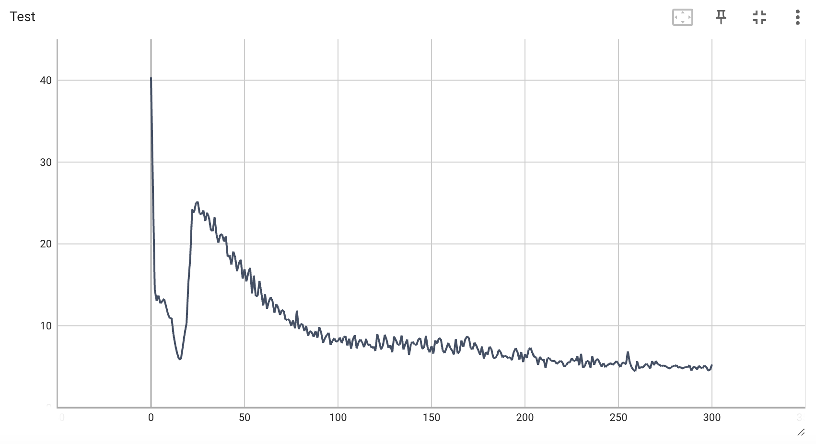
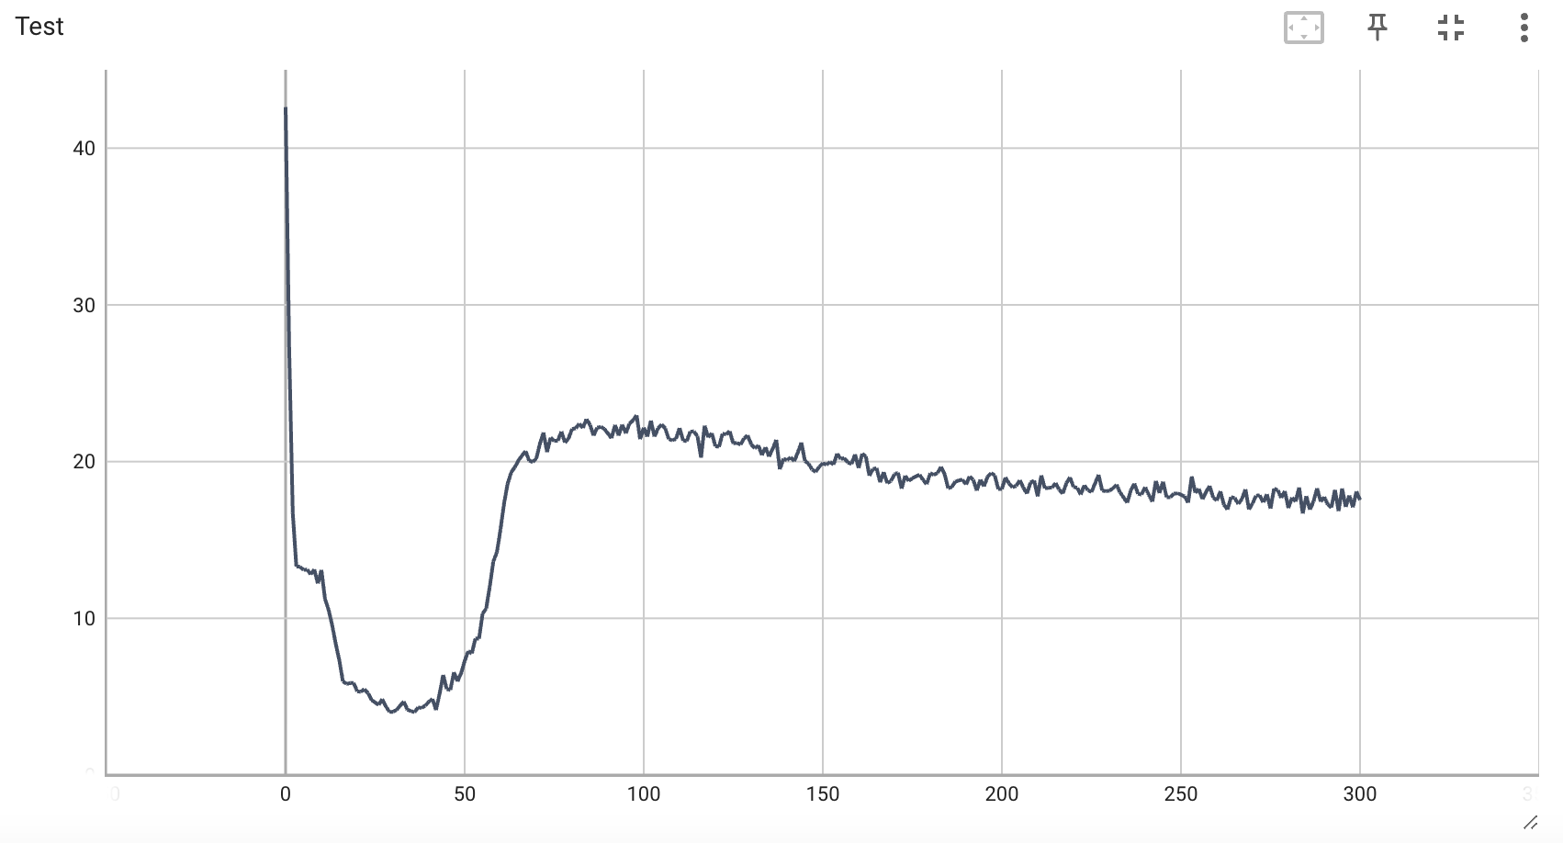
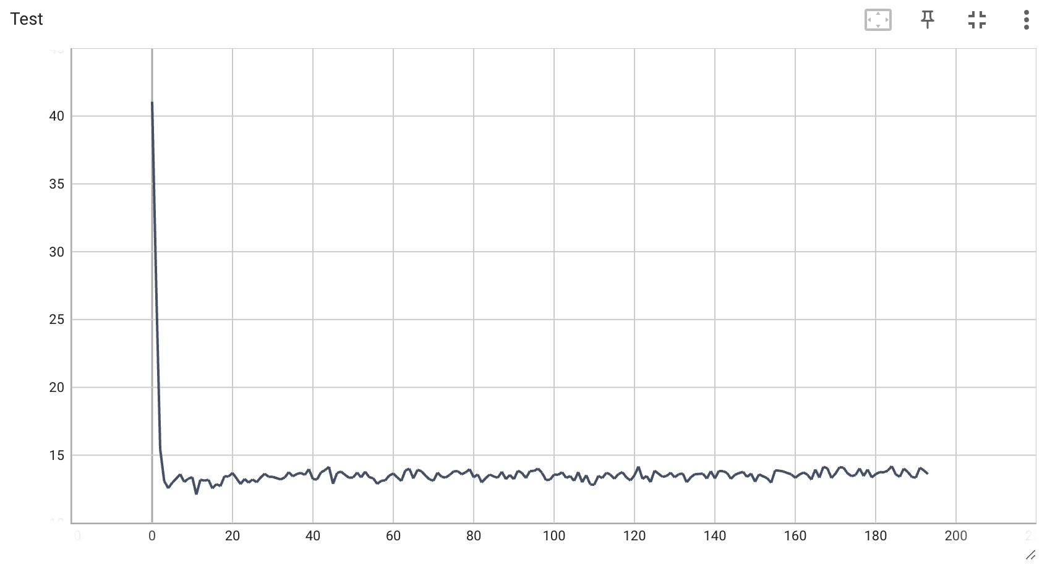
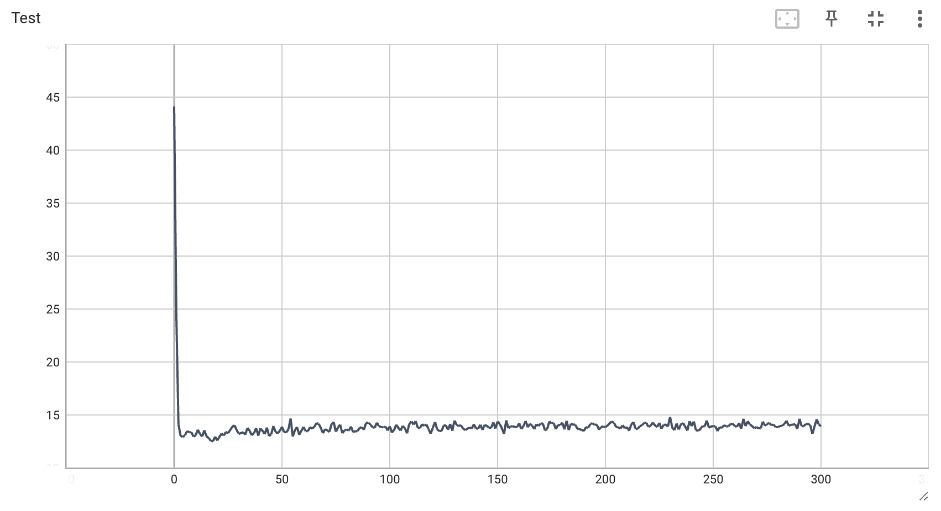
Random number (8) with L1 regularization
lamda_l1 = 0.001
lamda_l1 = 0.005
lamda_l1 = 0.0075
lamda_l1 = 0.01

Slide 17
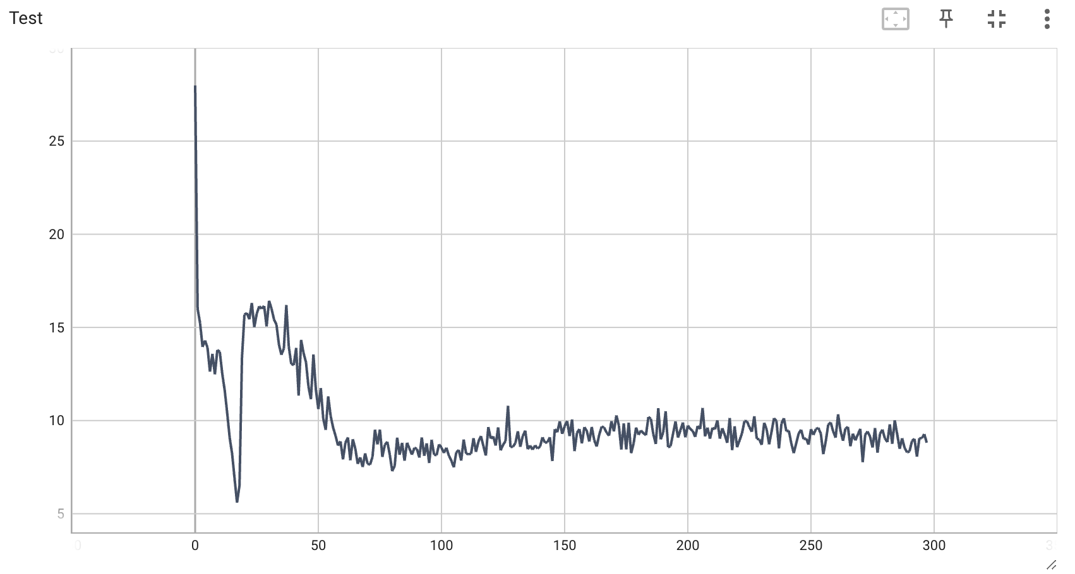
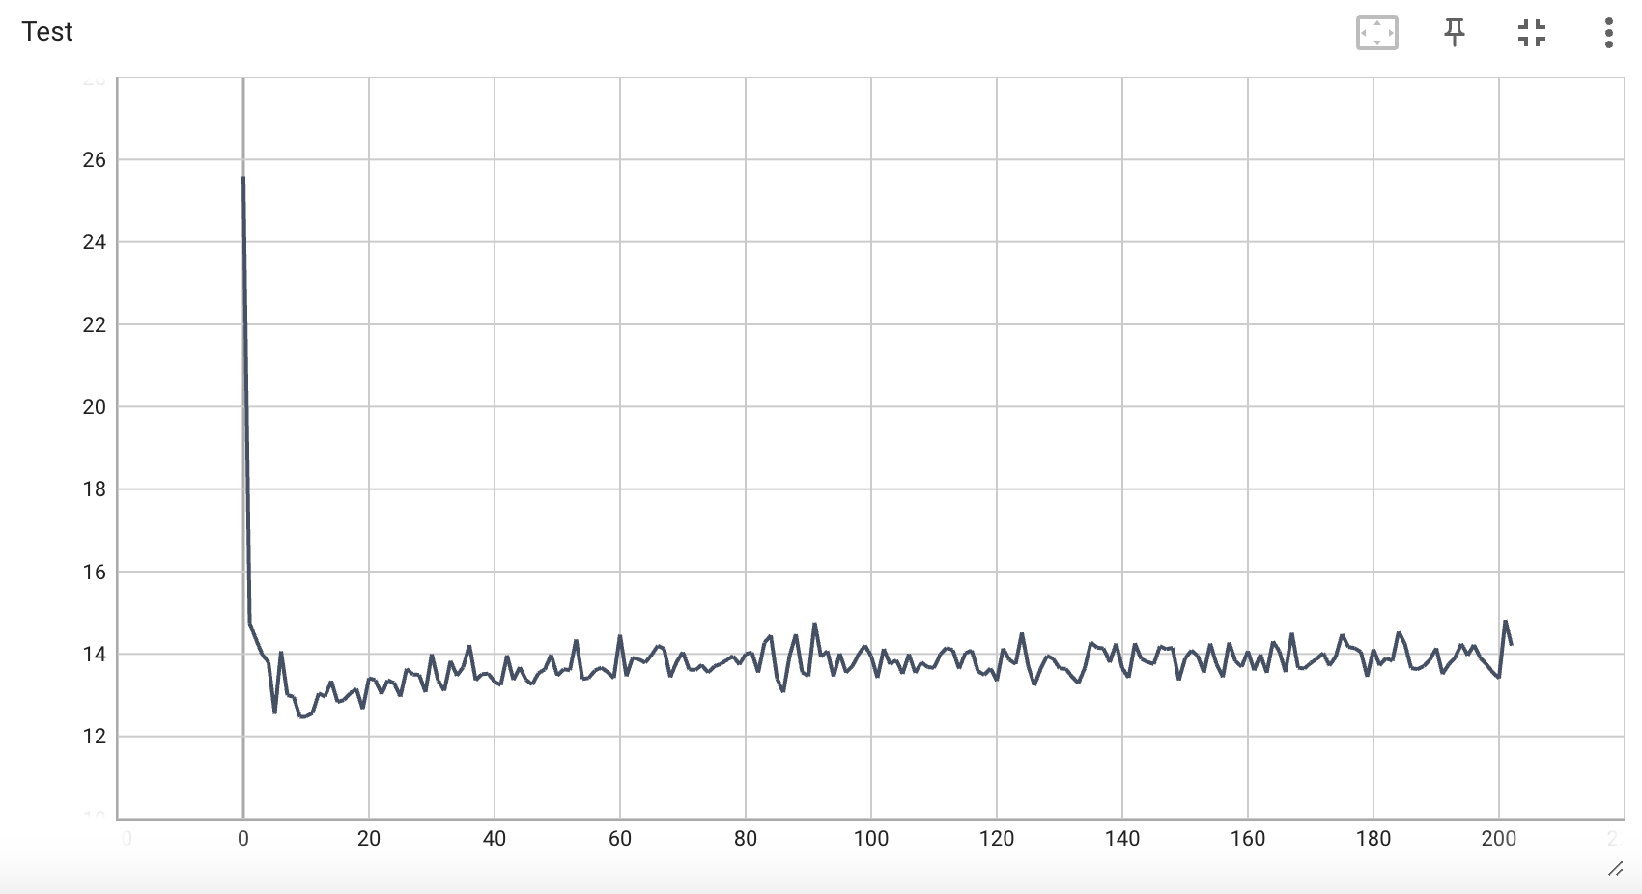
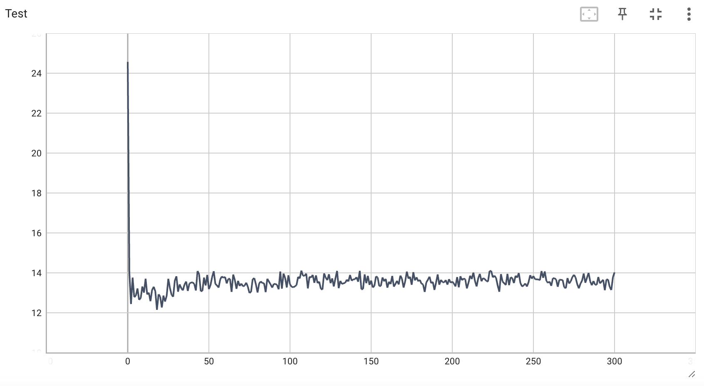
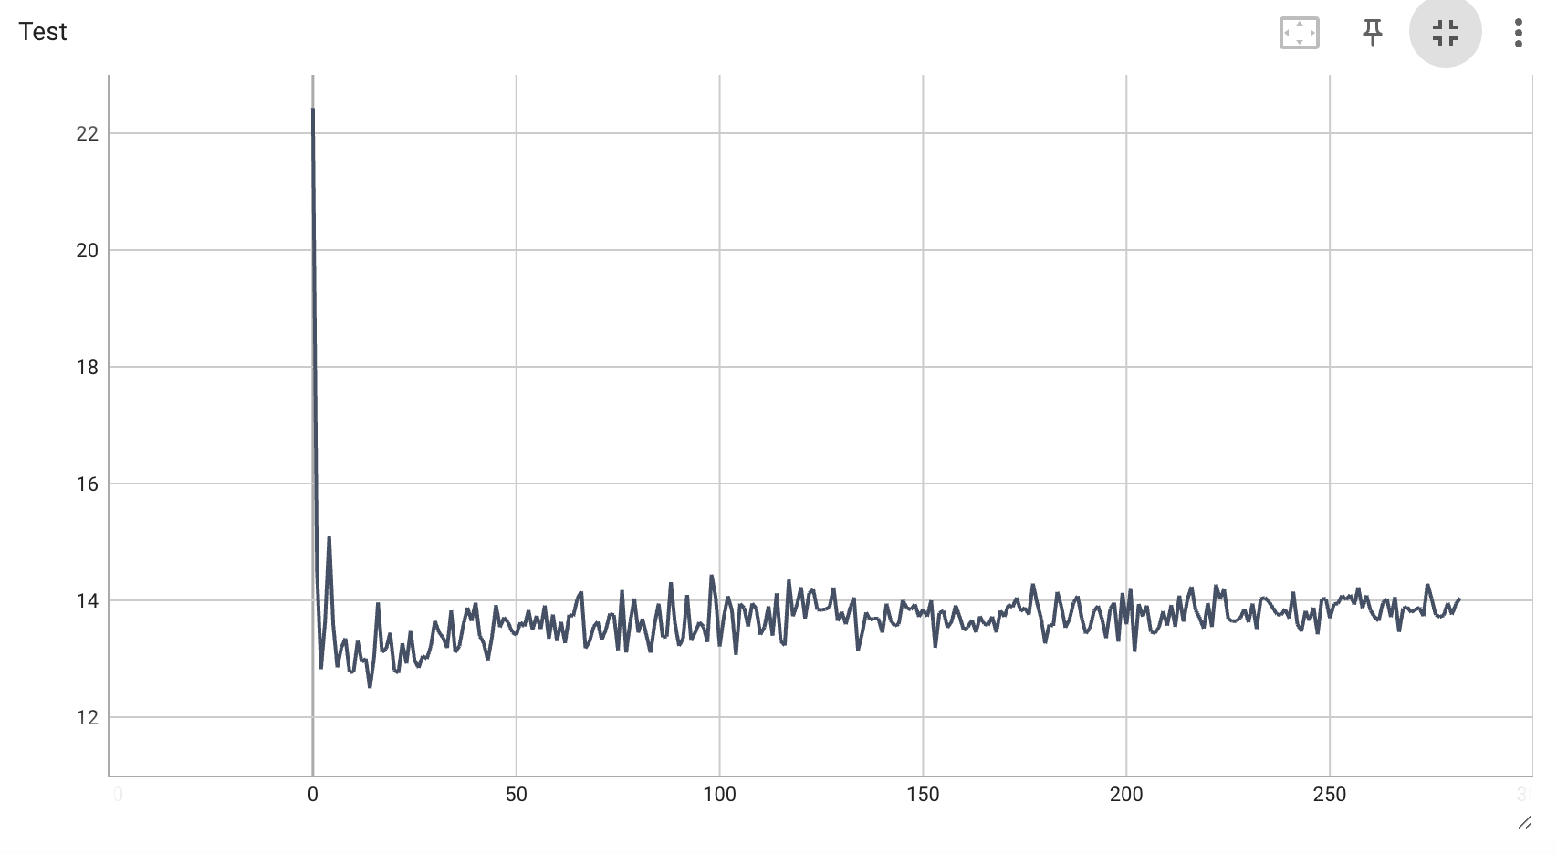
Random number (32) with L1 regularization
lamda_l1 = 0.001
lamda_l1 = 0.005
lamda_l1 = 0.0075
lamda_l1 = 0.01

Slide 18
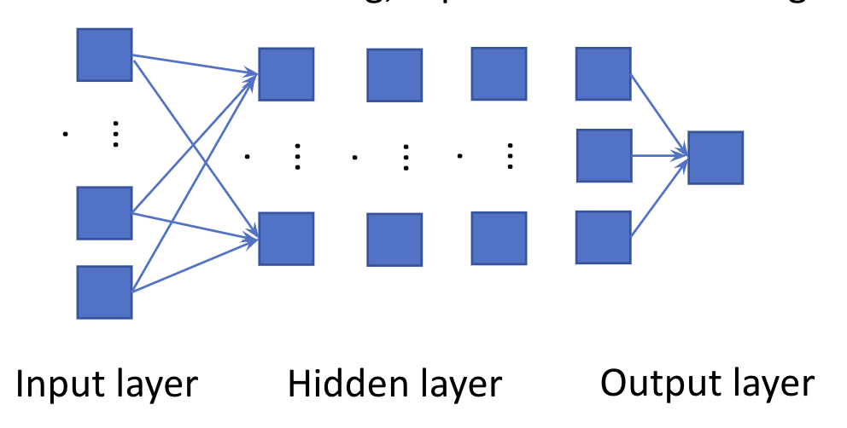
Question
If we use the neurol network to synthesize feature, what is the synthesized feature? The output of hidden layer? If yes, which layer?
How to prove that the neurol network synthesizes the right feature? Use the prediction result?

