Slide 1
Progress Report
2023.12.11
Yida Zhang

Slide 2
Progress
Paper Reading
Wang J, Lan C, Liu C, et al. Generalizing to unseen domains: A survey on domain generalization[J]. IEEE Transactions on Knowledge and Data Engineering, 2022.^{[1]}
Li J, Cheng K, Wang S, et al. Feature selection: A data perspective[J]. ACM computing surveys (CSUR), 2017, 50(6): 1-45.^{[2]}
Paper on google doc
Tutorial Building
Experiments on Feature Selection and Synthesis
Wrapper method: FCN + GA (not work)
Embedded method: Feature selection layer (work)
Contrastive learning for feature synthesis (not work)
Add Validation set to evaluate model, avoiding data leakage
Experiments on New Dataset
CNN
CNN + Contrastive learning

Slide 3
Current problem
Feature selection and Feature synthesis both need the other one to be done first.
If we don’t select the right features, the synthesis process will involve the wrong features
If we don’t synthesize right feature, the initial feature is meaningless by itself, for example x1, x2
Concerning different selection strategies, feature selection methods can be broadly categorized as wrapper, filter, and embedded methods^{[1]}
Filter: Most of filter methods are based on the information or statistical theory so that it is hard for them to concern the relationship of different initial feature.
Wrapper: Use Genetic Algorithm to generate the subset of initial feature set and use the prediction result of FCN to evaluate the subset.
Embedded: Let the model to determine which feature is important. I use a one-to-one connected layer as the feature selection layer and use the weight to determine which feature to be selected.
[1] Li J, Cheng K, Wang S, et al. Feature selection: A data perspective[J]. ACM computing surveys (CSUR), 2017, 50(6): 1-45.
Notes:
Just like we talk about last meeting, the current problem is that.
Let’s focus on the feature selection first.
And the wrapper and embedded method is possible to work, because they don’t focus on only one feature.
I tried each of them. For wrapper, .... I will introduce it detailly later.

Slide 4
Wrapper: GA + FCN
Input the initial feature set
Generate subset
Evaluate
the subset
Whether
the stop condition is met
Output the subset
Yes
No
Illustration of common Wrapper method
Subset generation method: Genetic algorithm
Evaluation model: FCN
Evaluation criteria: MAE of the prediction
Notes:
here is the illustration of the common wrapper method.
It first receive the initial feature set as input, and use some method to generate the subset. then use some method to evaluate the generated subset. If the subset meets the stop condition, it will output the subset. otherwise it will continue the loop.
In my experiment, I

Slide 5
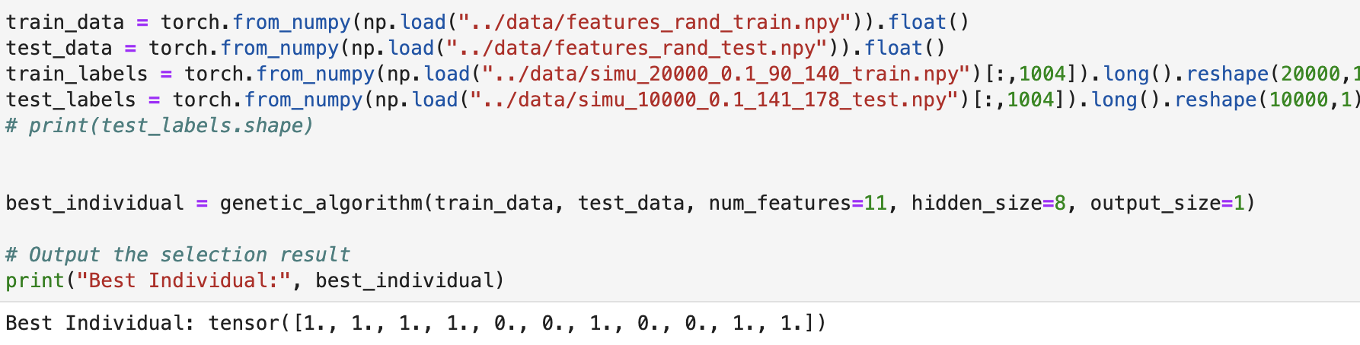
Result and analysis
Right features: H, X1, X2
Result: The output subset includes the right features, but also includes other unrelated features.
Analysis:
FCN needs to be mannully tuned, for example the cofficient of the regularization.
Some features may happen to improve the prediction result.
The selected subset is model-specific.
Notes:
The output is the subset. 1 stands for selected and 0 stands for unselected.

Slide 6
Embedded: Feature selection layer
Regularization is a method, adding the weight to the loss function, to make the model simpler, so that it is often used to prevent overfit.
...
...
Before regularization
After regularization
Regularization actually doesn’t exclude the wrong feature completely.
...
...
Before regularization
(only do the regularization on the feature selection layer)
After regularization
Notes:
before I introduce my method. I would like to analyse the regularization first.
the feature selection layer is a layer before the first layer. It is one to one conneced. And we only do reg on the feature selection layer
so that is the reg makes the weight to be zero. It will remove the connection of the wrong feature competely.

Slide 7
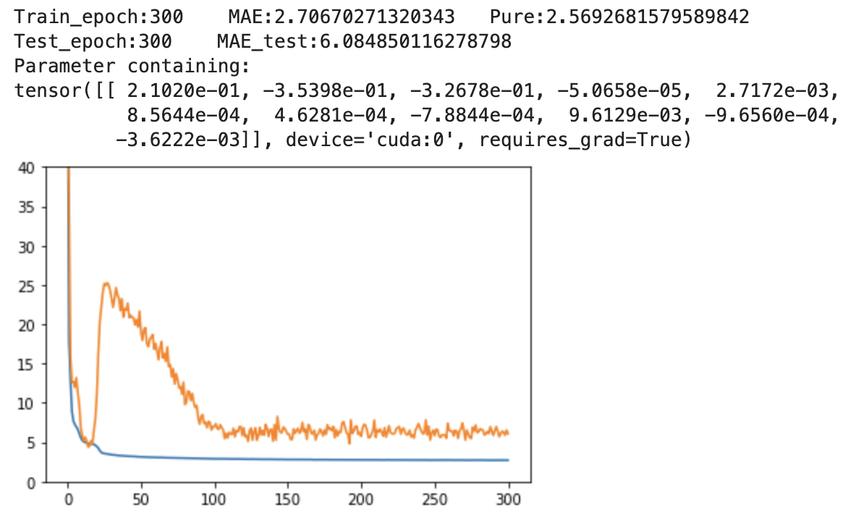
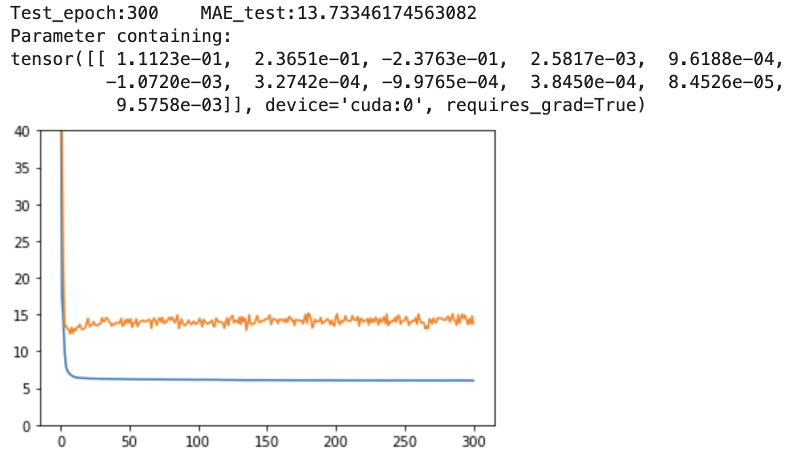
Result
Training curve 1 of model with feature selection layer
Training curve 2 of model with feature selection layer
Regularization Lambda of feature selection layer is 0.15. Regularization lambda of other layers are 0
The weight of the right features is much bigger than that of wrong features, from 100 to 1000 times.
Notes:
先不要关注最后的mae，因为这只是特征选择部分.
feature selection layer的正则化只涉及网络的第一层，所以它无法对后续的特征合成过程产生影响。

Slide 8
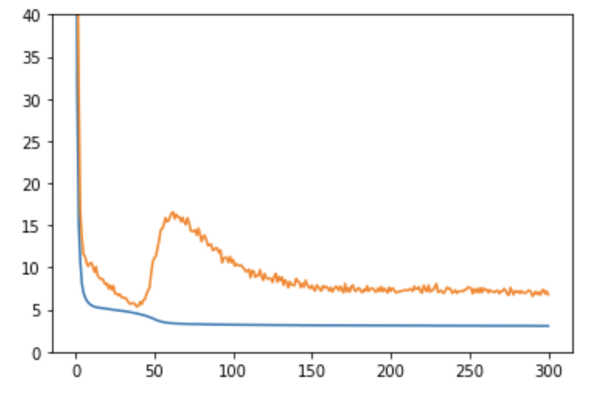
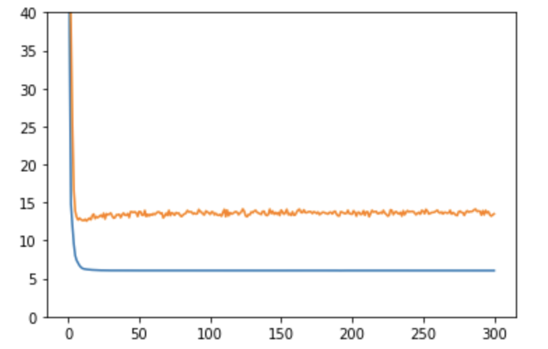
Training curve of model with right feature input
The training curve with right feature input is very similar with the training curve with feature selection layer, which proves that the feature selection layer is effective.
Next, we need to make the model synthesize the features so that it can generalize to testing set. According to the training curve, we need solve two problems.
The first, how to prevent the overfit.
The second, how to know that we have get the right model.
Notes:
可以看出，即使我们直接用正确的特征作为FCN的输入，我们也无法在测试集上取得好效果，因为网络会过拟合训练集数据。那么假设我们能够通过选择层来解决特征选择的问题，那么接下来的问题就是如何防止模型过拟合。一般防止过拟合的方法有正则化和dropout等，但是这些方法都只是通过防止模型过于复杂，以此来防止过拟合，但是不过于复杂不代表模型就模拟了输入和输出之间正确的函数。

Slide 9
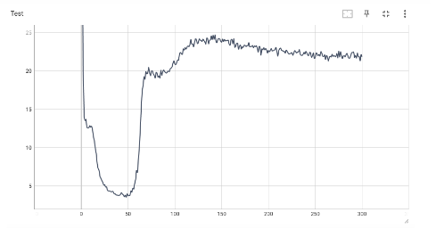
Contrastive Learning (not work)
If we separate the learning process of FCN as two part: feature selection and feature synthess, contrastive learning works for selection, not synthesis.
Regularization
Notes:
通过feature selection layer，我们就可以在没有进行特征合成的情况下选择出正确的特征了。这个方法将特征合成和特征选择两个相互制约的问题分解了开来。接下来就是如何进行特征合成的部分了。通过图片可以看出，即使我们只输入正确的特征，没有任何无关特征，FCN在测试集上的结果都并不令人满意，原因在于FCN只是拟合了
what contrastive learning do is it makes the synthsized feature to be similar if the label is similar. But assuming the input data are all right feature
Here is a result figure of meeting several weeks ago. I think it is very typical. most the trainin curve with regularization is like this one. We can find

Slide 10
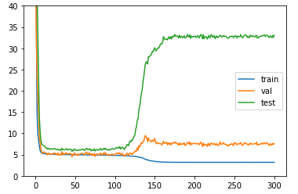
Validate set
Training set [90, 130] Validation set [130,140] Testing set [140,180]

Slide 11
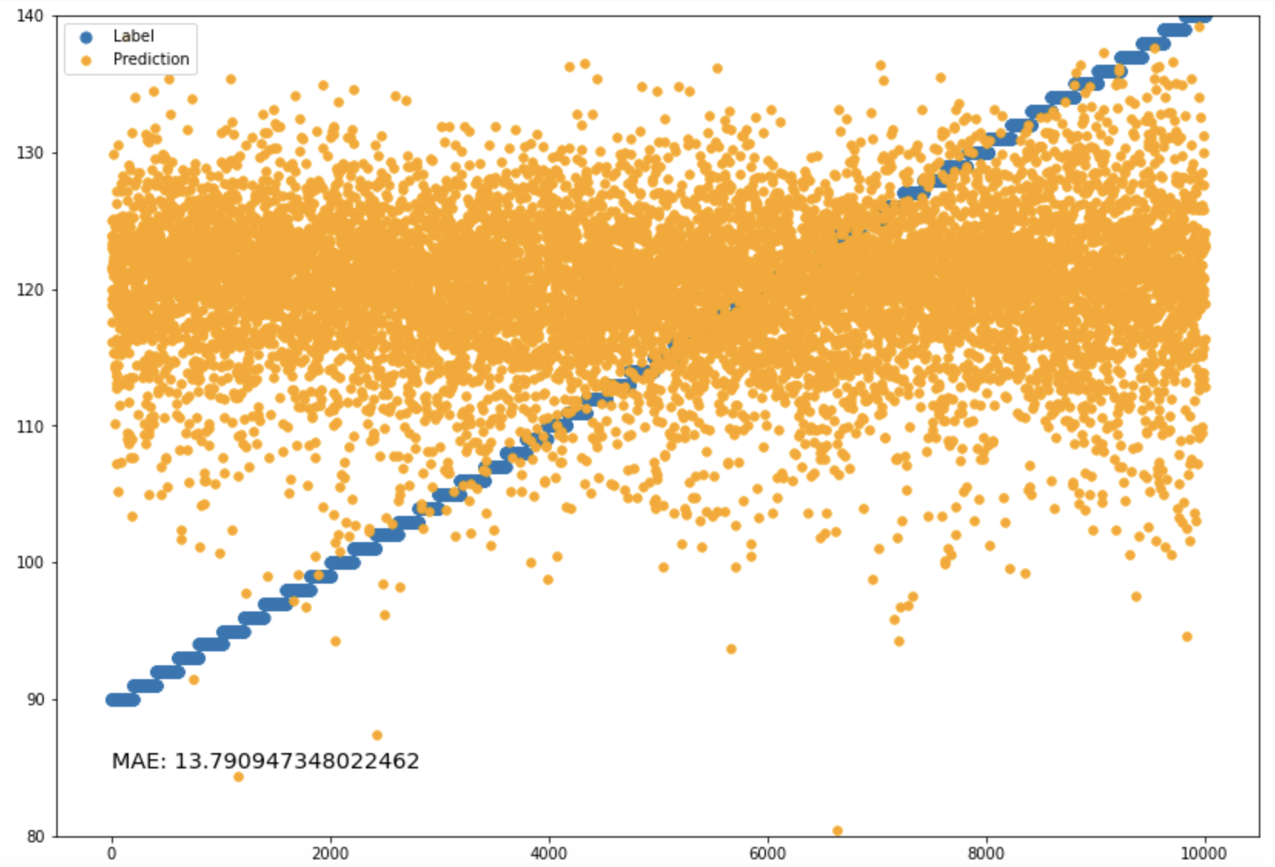
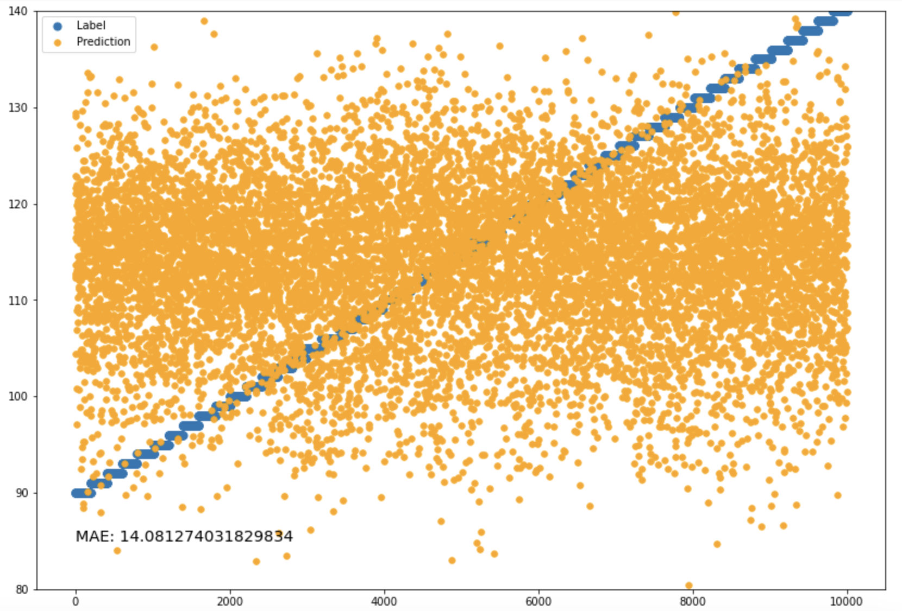
New dataset
CNN
CNN+Contrastive learning

