Slide 1
Progress Report
Yida Zhang
8/16/2024

Slide 2
Outline:
Reproduce the experiment of 5fold on 3AE4 dataset without quality control
Experiment the same dataset with quality control
Contrastive regression
Thoughts about template generation

Slide 3
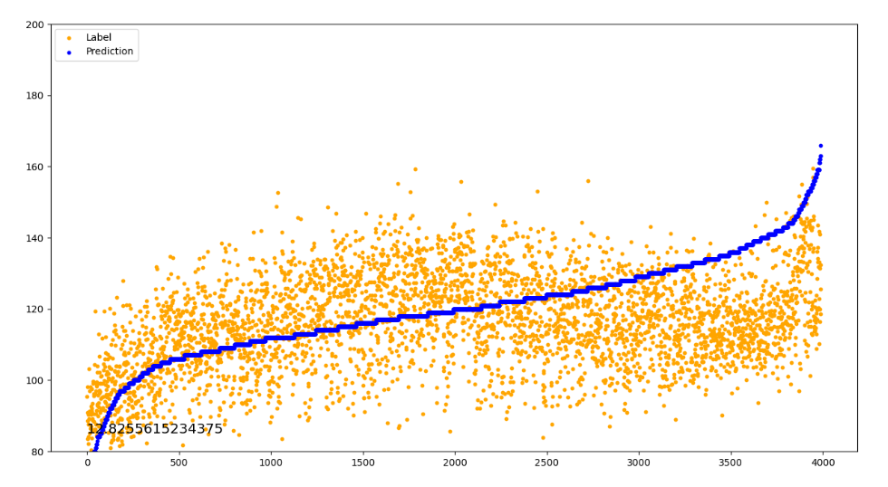
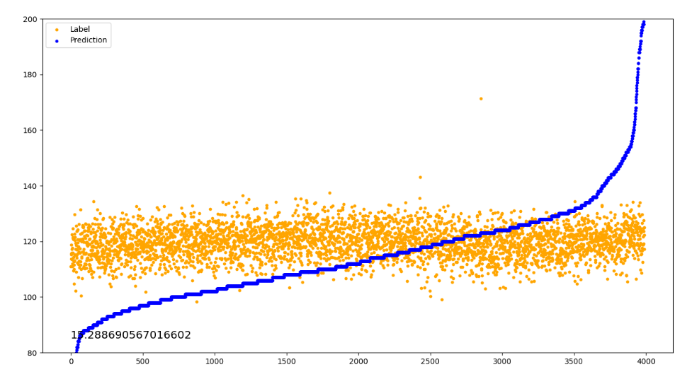
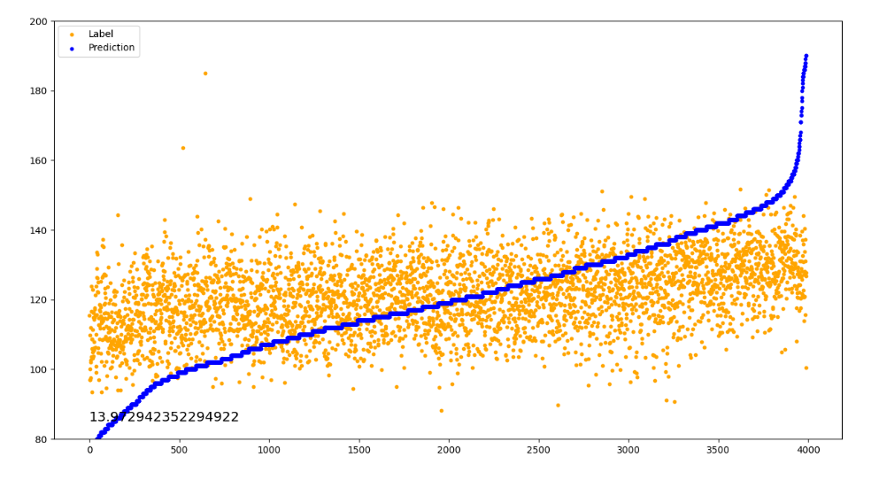
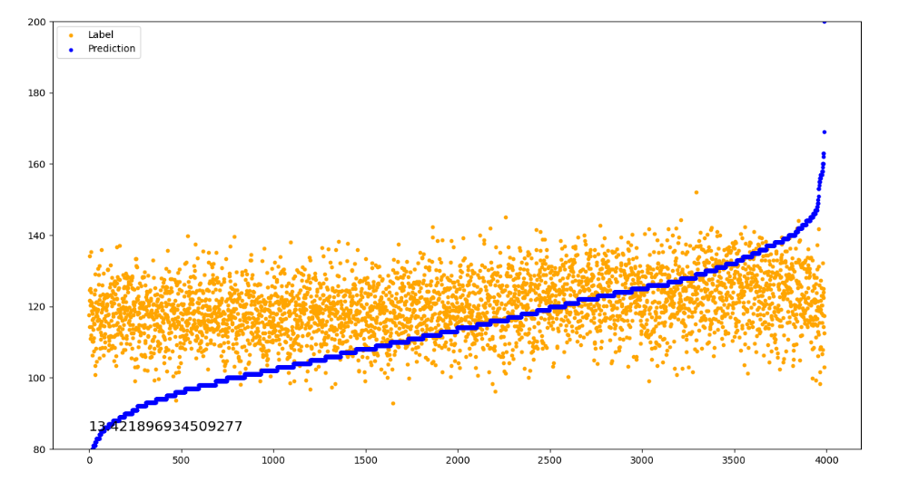
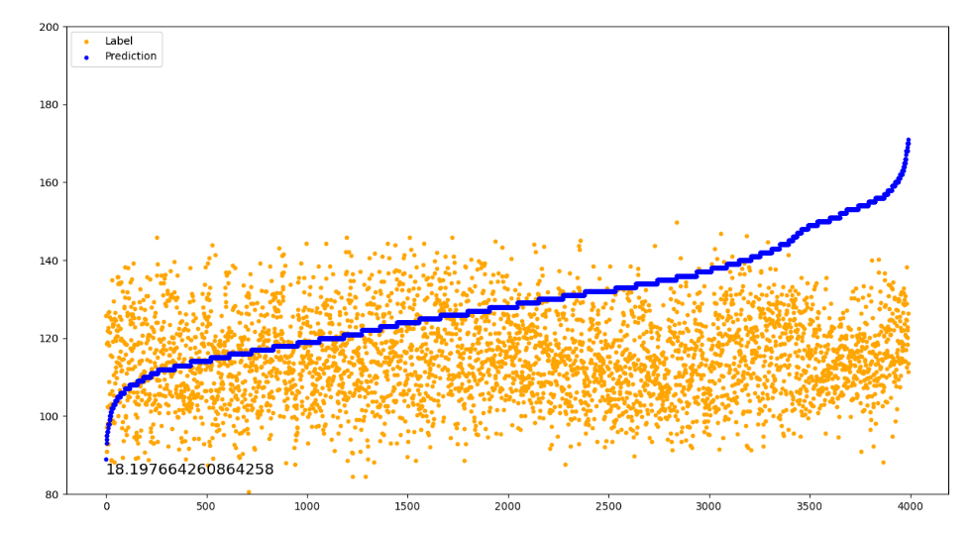
5 fold regression without quality control (baseline)
0 MAE: 12.8
1 MAE: 15.3
2 MAE: 13.9
3 MAE: 13.4
4 MAE: 18.2
Notes:
复现子轩实验，并以此作为baseline和后续实验对比

Slide 4
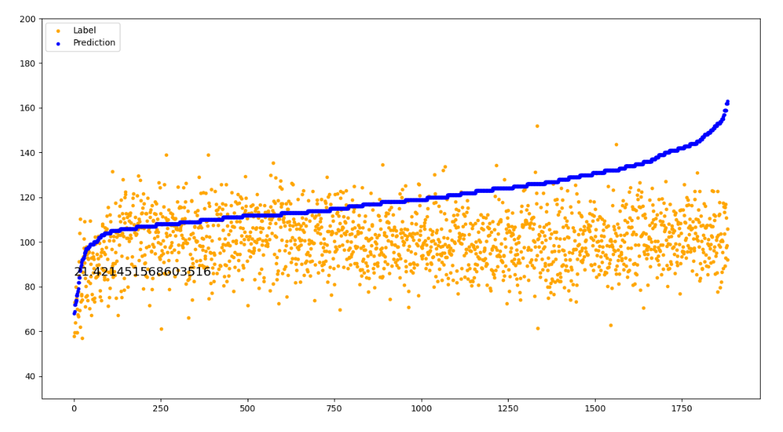
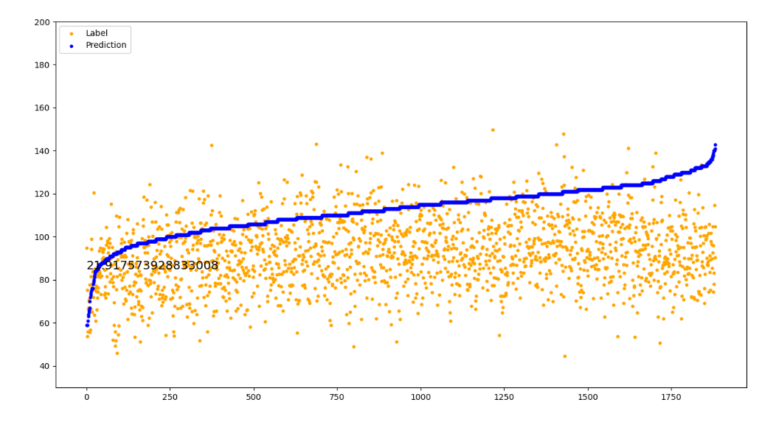
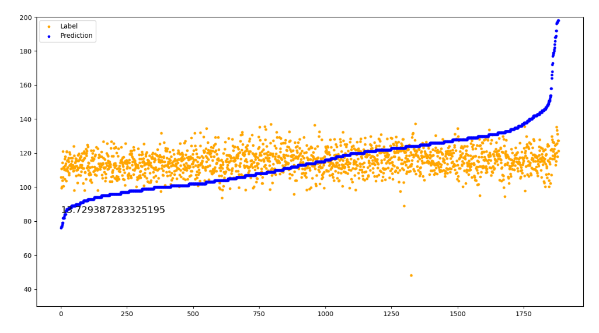
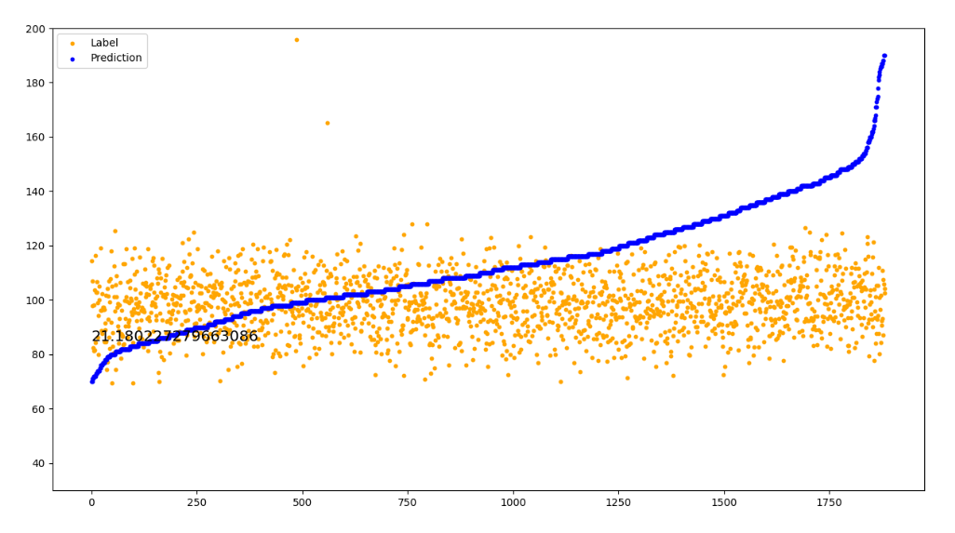
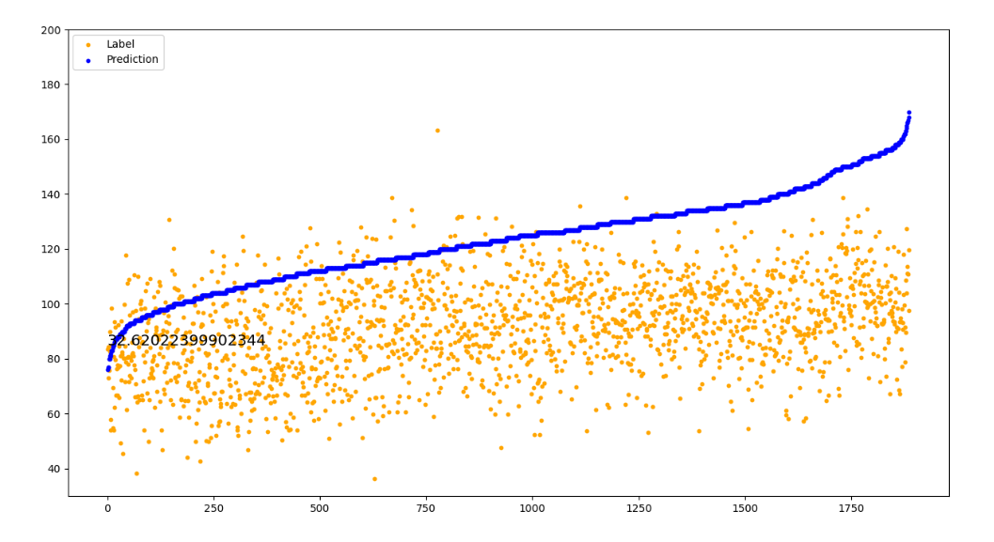
5 fold regression with quality control
0 MAE: 21.4
1 MAE: 21.9
2 MAE: 13.7
When the lower cutoff of the band-pass filter is below 3, VTCN will fail
3 MAE: 21.1
4 MAE: 31.6

Slide 5
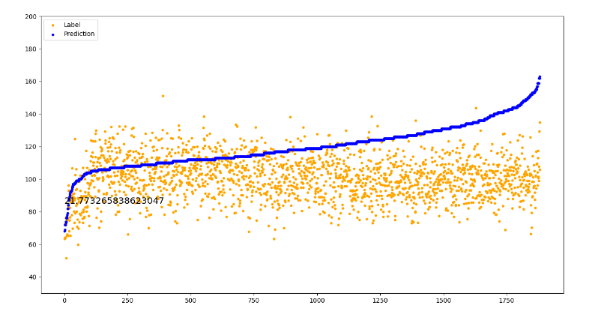
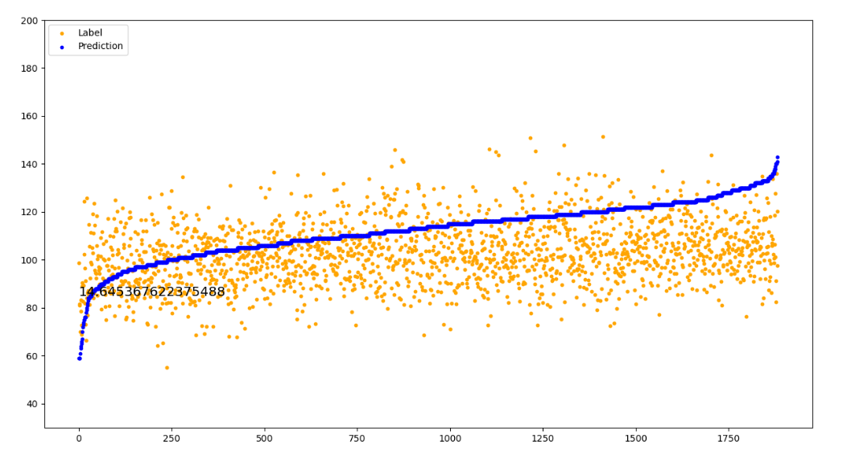

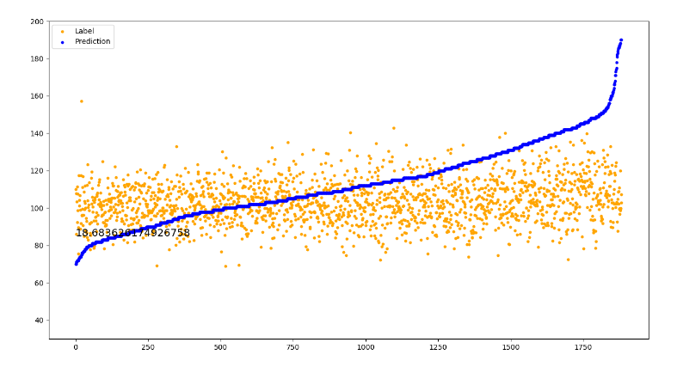
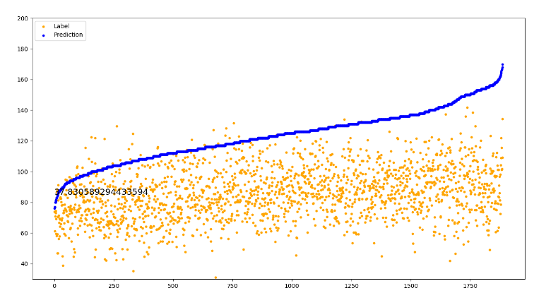
5 fold contrastive regression (Rank-n-contrast^{[1]})
0 MAE: 21.7
1 MAE: 14.6
2 MAE: 14.4
3 MAE: 18.6
4 MAE: 37.8
[1]Zha K, Cao P, Son J, et al. Rank-n-contrast: learning continuous representations for regression[J]. Advances in Neural Information Processing Systems, 2024, 36.

Slide 6

Idea for template generation
Quality Control
Segmentation
Input: signal
Preprocessing
Input: signal
Heartbeat Cycle
Encode
Autoencoder
Feature Fusion
template

Slide 7
Thanks

