Slide 1
Weekly Progress Report
Yida Zhang
2023.8.21

Slide 2
Progress
Research questions:
Verification of the relationship between D21/D12 and S using Linear Regression
Feature extraction by TSFEL
RFE with extracted features
Feature combination using genetic algorithm (GA)
Tutorial:
Organize and refine the tutorial based on the example and outline
Notes:
My main progress this week includes two parts. About research questions, I verify the relationship between D21 divided by the D12 and S using the Linear Regresssion, extract the feature using TSFEL and implement the Recurssive Feature Elimination on them, and design a feature combination algortihm based on genetic algorithm. About tutorial, I organize and refine the it based on the example and outline

Slide 3
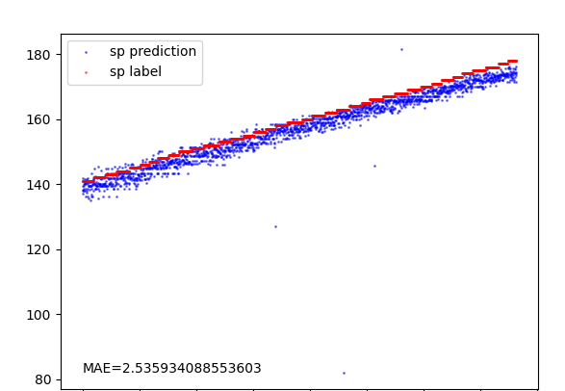
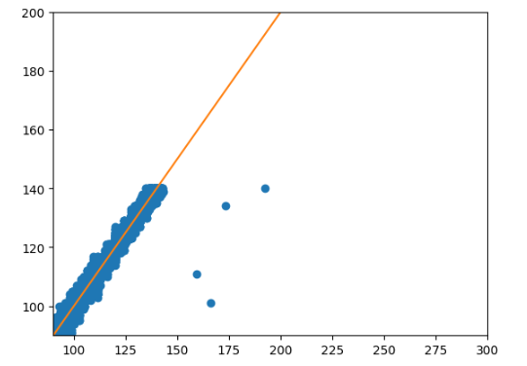
Verification of the relationship (S = 220 - 100 * D21/D12)
y = x
Verification based on formula deriviation (Last week)
X_axis: 220 - 100 * D21/D12
Y_axis: S
Verification based on LR (This week)
Input: D21/D12
Model: Linear Regression
Notes:
Last week, I merely verify the relationship between S and the feature based on the formula driviation. Professor Song suggested that I should input the features into a model to observe the effect of prediction. And I follow the advice this weekj. The left graph depicts the results of plotting the values of this formula as the x-axis and the corresponding S values as the y-axis. On the right, the features were used as inputs, and the results were predicted using linear regression (LR). We can find that is result is very good, proving the relationship is right.

Slide 4
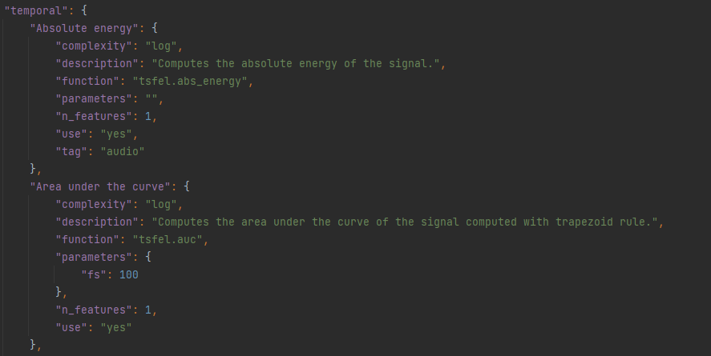
Feature extraction by TSFEL
Feature domain: Statistical, Temporal, Spectral Number of features: 49 + 18
Function: tsfel.time_series_features_extractor (parameters)
json file
Notes:
Then what I do is feature extraction. Last week, I extracted 18 features mannully and achieved a good result on Recurrsive Feature Elimination. This week, I use the TSFEL to automatically extract all the possible significant features, to verify whether the RFE is still effective. TSFEL can extract features from three domains: they are statistical, temporal, and spectral features. We can choose which domain to extract by modifying the function's parameters. Since we want to verify whether RFE can select the correct features when there are lots of features, we directly extract all features.
By examining the JSON file, we can see that there are a total of 60 features, most of which can be represented by a single value, as shown by "n_features" equal to 1 in the figure. However, some features need to be represented by an array whose length may vary. To ensure consistent feature vector lengths for each signal, we don't extract these features, ensuring that the length of feature vectors extracted for each signal are the same. Moreover, based on prior knowledge, we know that these excluded features are not key features, so their removal doesn't affect prediction performance. Feature exclusion is accomplished by setting the "use" of features to "no" in the JSON file. Using the FSFEL’s function, we extracted a total of 49 features. Combined with the 18 features I manually extracted earlier, so we have a total of 67 features for prediction now.

Slide 5
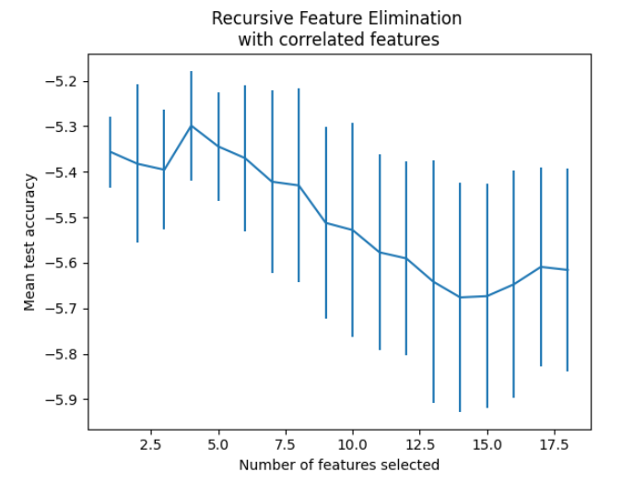
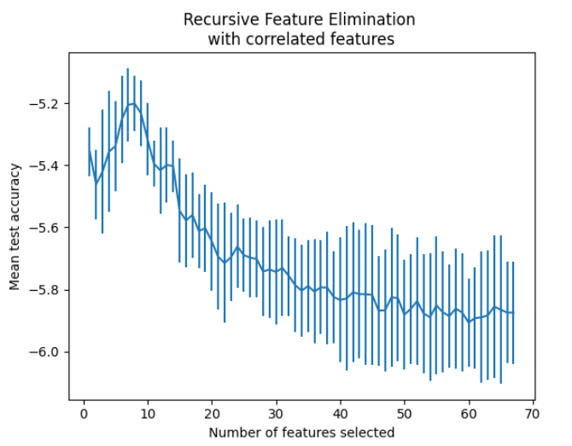
RFE with extracted features
Select 4 from 18 features
Selected features: D12, D21 D21/D12, Kurt1
Select 8 from 67 features
Selected features: D21/D12 included
Notes:
After extracting all features, we can input them into the RFE. There is something I should clarify, last week, I didn’t use the mae as the scorer function, I just use the the function of the example in the scikit-learn, which is not suitable. And this week , I redo the mae using the mae as scorer. here is the result. The mae can still find the best feature, but the number of included feature increases. And if we select from 67 features, we can still get the D21/D12, but the number of features in the best feature set increases too. I think maybe the additional feature get provide more information which only exsit in the dataset we use, if we use more data to train, finally we will only get one feature by mae.

Slide 6
Feature combination
What we assume: We know D21/D12 is important, so we calculate it and include is in the feature set
Under most circumstances: We don’t know what combination is appropriate
Purpose of feature combination: Enhance the representational power of features and help learning models better understand and learn the patterns and relationships in data.
Notes:
In the above content, we assumed that we know D21/D12 is an important feature, so we included it in our feature set for selection. However, in a more general scenario, we may extract features where each individual feature may not correlate strongly with the label, but a function of a set of features may correlate well with the label. so Finding suitable ways to combine these features becomes a new problem, which is known as feature combination. Feature combination is a crucial part of feature engineering, enhancing the representational power of features and helping machine learning models better understand and learn patterns and relationships in the data, thereby improving model performance.

Slide 7
Feature combination (using tuples to represent combination)
Example
China, Man
[1, 0, 0, 0, 0, 0]
China, Woman
[0, 1, 0, 0, 0, 0]
China
[1, 0, 0]
USA, Man
[0, 0, 1, 0, 0, 0]
+
=
Man
[0]
USA
[0, 1, 0]
Woman
[1]
USA, Woman
[0, 0, 0, 1, 0, 0]
UK
[0, 0, 1]
UK, Man
[0, 0, 0, 0, 1, 0]
UK, Woman
[0, 0, 0, 0, 0, 1]
Notes:
There are generally two types of feature combination methods. One type involves forming tuples of different features to create new features, mainly suitable for discrete value features. For example, countries could be represented by one-hot arrays, and gender could be represented by 0 and 1. Here is the example of this kind of combination. These tuple-combined features are also called "feature crosses" and are primarily used in click-through rate prediction, with methods like DeepFM and DCN having been developed for this purpose.

Slide 8
Feature combination (Numerical combination)
Ways of combination:
Based on the prior domain knowledge
Generate all combined features, then select
Disadvantage:
Too many number of new features, which is unacceptable
n features ----> n(n-1)/2
Automatical ways of combination:
Polynomial regression (only get features like aF1^2 + bF2^3)
Genetic algorithms
Neural networks (Overfitting and lack of interpretability)
Notes:
The other type of feature combination involves numerical combinations, mainly suitable for continuous value features. For instance, in the SCG signal, the ratio of D21 to D12 is a new feature derived from numerical combination. This type of combined feature helps the model learn nonlinear relationships between individual features and labels, improving information capturing capabilities. We can combine features and add these combined features to our feature set for prediction. Regarding how to combine features, one method involves manual combination based on prior domain knowledge, for example if we know D21/D12 is important, we can include it . Without such knowledge, a straightforward approach is to generate all possible feature combinations and then use feature selection methods to narrow down the feature count before prediction. However, if the initial feature count is large and there are numerous combination possibilities, the number of generated combined features becomes excessively large, which is not feasible. For example, with n features, considering only pairwise multiplication could result in xxxx new features.
Therefore, we need an efficient and automated feature combination method to generate suitable features. Based on my research, primary feature combination methods include polynomial regression, genetic algorithms, neural networks, and others. While polynomial regression can only generate polynomial features like xxxx but cannot create division-based features like D21/D12, neural network methods can create complex feature combinations but are often too complex, leading to overfitting and lack of interpretability. Thus, genetic algorithms are a reasonable choice.

Slide 9
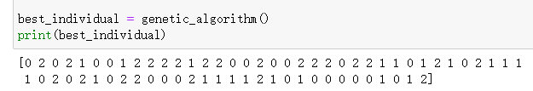
Feature combination based on genetic algorithm (GA)
Preliminary feature selection
Gene representation
0 means the feature isn't part of the combination, 1 means it's multiplied with existing features, and 2 means it's divided.
[0, 2, 0, 1, 0 ..... 0, 0, 1] : number is 67
Feature4 * Feature 67 / Feature2
Fitness function: MAE
Notes:
Next, I'll introduce a feature combination algorithm based on Genetic Algorithms (GA). The initial steps involve preliminary feature selection, such as removing low-variance or low-correlation features, to narrow the search space and enhance the efficiency of the genetic algorithm. The second step involves defining the gene representation. Since we're interested in combinations like D21/D12, I initially consider only multiplication or division between features. By starting with a limited number of feature combination methods, I can verify the approach's correctness. If the method can produce the D21/D12 feature combination, it indicates correctness, and I can introduce more combination methods by modifying the gene definition. The gene I defined is an array of length 67, representing the initial 67 features. Each element can be 0, 1, or 2. 0 means the feature isn't part of the combination, 1 means it's multiplied with existing features, and 2 means it's divided. For example, a gene like xxxx corresponds to a feature combination of xxxxxx. The third step involves designing the fitness function. We can use statistical metrics like Pearson's coefficient or mutual information to measure the combination feature's correlation with the label. Alternatively, we can directly predict the label using the combination feature and use prediction results (e.g., Mean Absolute Error) to evaluate the feature's quality. In this case, I chose the latter. The fourth step involves initializing the population and performing standard genetic algorithm steps such as selection, crossover, and mutation. The best gene obtained represents the optimal feature combination method. I've attempted to implement this algorithm, but the results aren't entirely satisfactory. The algorithm produced the best gene as shown in the figure, representing the combination xxxxx, which doesn't match our knowledge of the best combination, D21/D12. I suspect this is due to improperly tuned parameters like iteration count and mutation rate, leading the algorithm to converge to a local optimal solution. I'm currently working on adjusting these parameters.

Slide 10
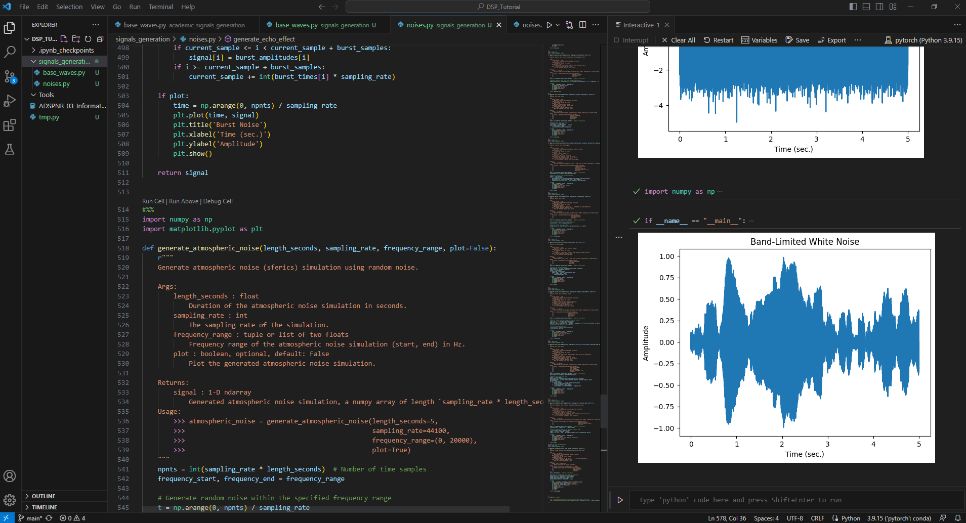
Tutorial
Notes:
Regarding the tutorial, based on the outline and division of tasks with Jiayu, I plan to complete Academic Signals Generation and Feature Extraction and Analysis in order. I skipped Noise Reduction and Signal Reconstruction for now. This week, I referred to Professor Song's suggestions and the `signalgenerate.py` file. I reorganized and improved my previous tutorial content and completed the implementation of the code related to Academic Signals Generation. I wrote two files, `basewaves.py` and `noises.py`, responsible for generating base waves and noise, respectively. Some of the `basewaves` code was adapted from `scipy.signal`, which I modified to fit our format.
I've seen Professor Song's updates in the Google Docs, but I didn't have time to work on them this week. I will attempt to use neural network or neuron ideas to combine features next week. Additionally, I will continue refining the tutorial content and debugging the feature combination method based on GA.

Slide 11
Thanks for listening

