Slide 1
Weekly Progress Report
Yida Zhang
2023.9.11

Slide 2
Progress
Tutorial:
1. Learn and translate 18 R language functions as planned
2. Learn and implement the remaining topics in outline
Research:
3. Simulate a dataset with data shift in D and observe whether CNN can work
4. Read the paper^{[1]} about BPD features, construct a dataset with BPD feature, and use it to predict S
5. Read the paper^{[2]} about Contrastive Learning and implement a part of the algorithm on SCG dataset
[1] Su B Y, Enayati M, Ho K C, et al. Monitoring the relative blood pressure using a hydraulic bed sensor system[J]. IEEE Transactions on Biomedical Engineering, 2018, 66(3): 740-748.
[2] Eldele E, Ragab M, Chen Z, et al. Time-series representation learning via temporal and contextual contrasting[J]. IJCAI-21
Notes:
BCG pulse deviation
the paper about bpd is this one, which is put on the google doc by professor song

Slide 3
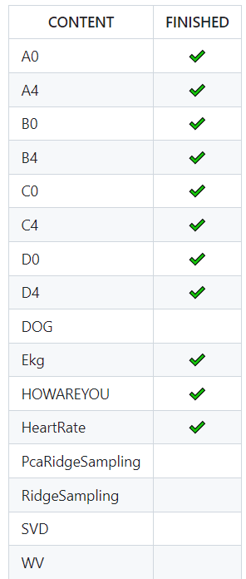
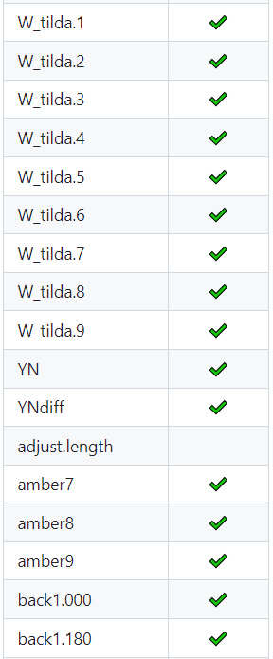
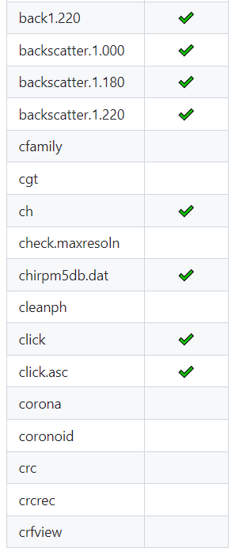
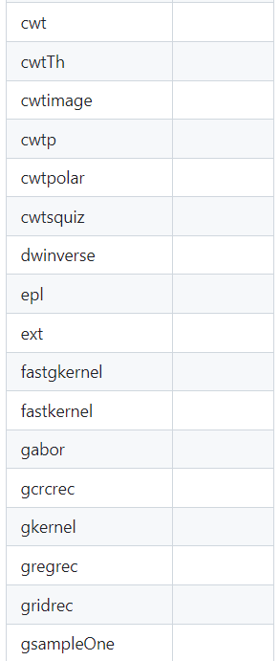

Tutorial
Notes:
Regarding the tutorial, I have translated 18 functions this week, which are the items marked with red checkmarks in the figure.

Slide 4
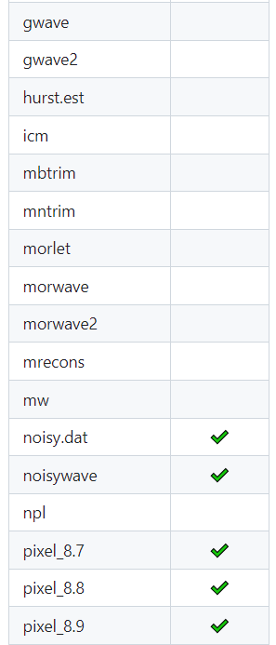
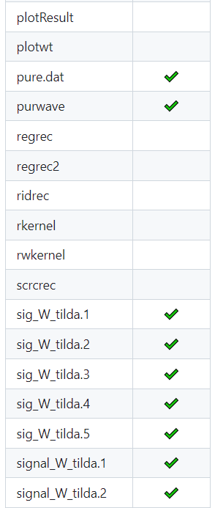
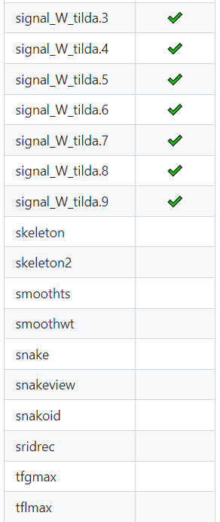
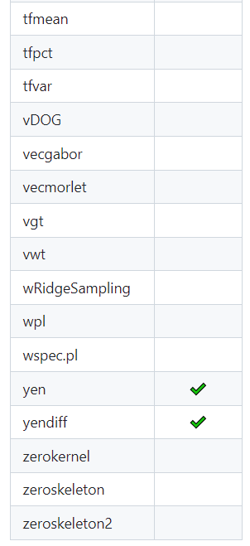
Tutorial

Slide 5
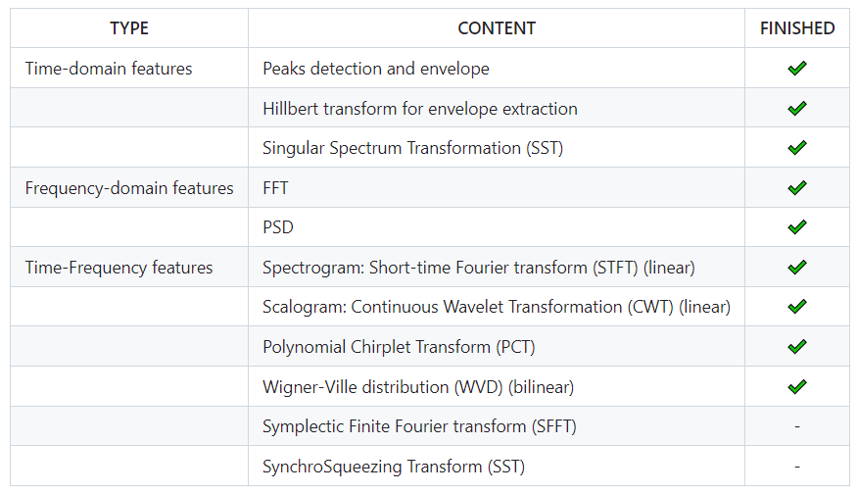
Tutorial
Rwave:
Finished: 76/134 (57%)
Three weeks to finish them all as last week’s plan
Outline:
Notes:
Currently, out of the 134 functions, I've translated 76. According to last week's plan, I estimate that I'll need approximately 3 weeks to complete all the translations. As for the outline, I notice that there are some new topics added this week. I've completed most of it, but there are still few topics that I currently can't fully grasp. I plan to gradually work on them as I go deeper into the study of DSP

Slide 6
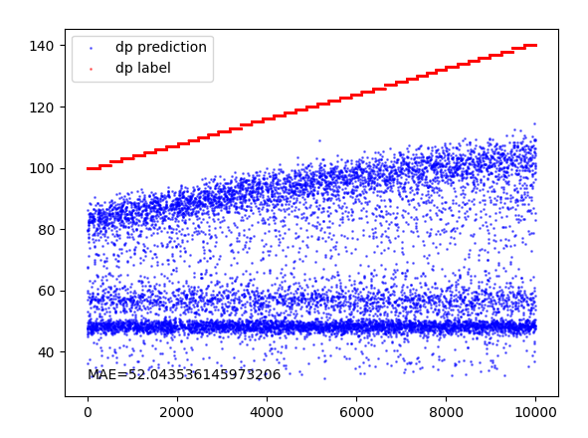
Work 3: Data shift in D
Result:
Last week’s XAI methods indicated that CNN had learned the key feature of D. However, when D is shifted, CNN still cannot provide accurate predictions. The result this week suggests that CNN may not have fully learned the key feature, which is a contradiction with the conclusion last week.
My hypothesis:
CNN indeed learned the key feature within the training dataset; it can recognize the magnitude of peaks and predict D correctly based on their relationship. However, when the domain shifts to the test dataset, although CNN still understands the relationship between the magnitude of peaks and D, it struggles to accurately identify the magnitude of peaks due to the shifting D.
Training Set: D∈[60, 100]
Test Set: D∈[100, 140]
Notes:
"My third task this week is to construct a dataset with data shift in D and observe whether CNN can work on it. The original range of D is from 60 to 100 and I simulate a test set where the range of D is from 100 to 140. Then I use the test set as input to the CNN which I implement the perturbation based method last week. This left figure is the result. Last week’s .....
And my hypothesis about this phenomenen is that, I thin
And I think that’s why the XAI methods prove it learns the key feature but the final result is not good.

Slide 7
Work 4: BPD (BCG Pulse Deviation) feature
Title: Monitoring the Relative Blood Pressure Using a Hydraulic Bed Sensor System
Source: IEEE TRANSACTIONS ON BIOMEDICAL ENGINEERING 2019
Background:
Blood pressure is a crucial physiological indicator. Currently, the main methods for blood pressure detection can be divided into two categories: wearable and non-wearable. Wearable methods, such as those based on ECG and PPG signals, tend to yield better blood pressure prediction results, but they are not suitable for continuous use and will make the users uncomfortable. Therefore, finding a low-cost, continuous non-wearable blood pressure prediction method is of great importance
Method:
The author finds that BCG signals can provide effective predictions of blood pressure. The paper extracts two features to predict. The first feature is BCG Pulse Strength (BPS), which is related to stroke volume, and stroke volume can to some extent indicate blood pressure. The second feature is the shape of the BCG signal, which proves effective in predicting blood pressure.
Notes:
And the last two works are paper reading and the related code implementation. And for each paper, I will start with a brief paper report to introduce what the paper is about and my understanding of it. Then, I introduce some code work I did related to the paper.
The first paper is 'Monitoring the Relative Blood Pressure Using a Hydraulic Bed Sensor System.' This paper is shared on Google Docs by Professor Song, which aims to help us simulate the BPD feature mentioned in the paper and attempt to learn this feature. And the BPD is BCG pulse deviation and I will discuss it latter.
First, let me provide some background on this paper. We know that blood pressure is a crucial indicator that can provide an early warning to prevent diseases. Currently, the main methods for blood pressure detection is using sensors to receive relevant biomedical signals and then using them to predict blood pressure. These methods can be divided into two categories: wearable and non-wearable. Wearable methods tend to yield better blood pressure prediction results, but they are not suitable for continuous use and will make the users uncomfortable. As a result, how to finding a low-cost, continuous non-wearable blood pressure prediction method is of great importance.
The author, in previous research, discovered that BCG signals can effectively predict heart rate and respiratory rate. Therefore, the author conducted related research and proposed a blood pressure prediction method based on BCG signals, which utilizes two features BCG signals to predict systolic blood pressure (SBP) and achieved excellent results.
The first feature is 'Ballistocardiogram Pulse Strength,' which also callded BPS XXXX
The focus here is on the second feature, which is based on the morphology of BCG in each heartbeat cycle.

Slide 8
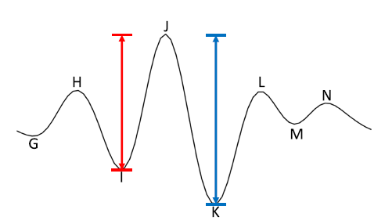
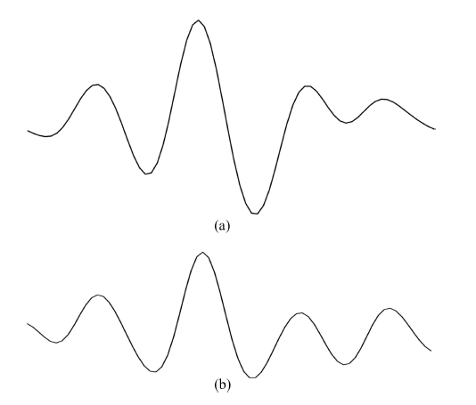
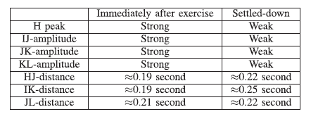
Work 4: BPD feature (JK - IJ)/IJ
BCG immediately after exercise
Typical cycle of BCG
BCG settled-down
details of difference of BCG
between calm down and after exercise
Notes:
Let’s take a close look at the BCG singal. The top-left figure represents a typical cycle of BCG, and from this, we can see that there are some candidate features that can be extracted. These include IJ amplitude, indicated by the red line in the image, as well as JK amplitude, represented by the blue line. There are also horizontal distances, such as HJ or IK distance.
The author observe the shape changes of BCG signals after exercise and when they settle down to distinguish which features are closely related to blood pressure by . This is because we know that after exercise, there is a significant increase in systolic blood pressure. The two figures on the left are BCG signals after exercise and when settled down, respectively. We can observe significant changes in features based on vertical distances like IJ and JK. After experimentation, the author ultimately chose JK-IJ as the final feature which is also called BPD. To further eliminate the scaling effect of sensor signals, the BPD can be calculated as (JK - IJ)/IJ.

Slide 9
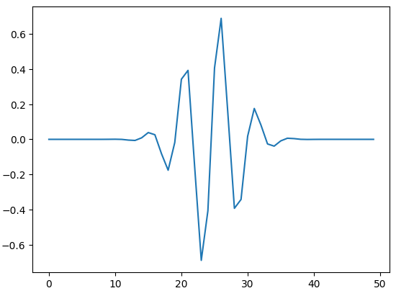
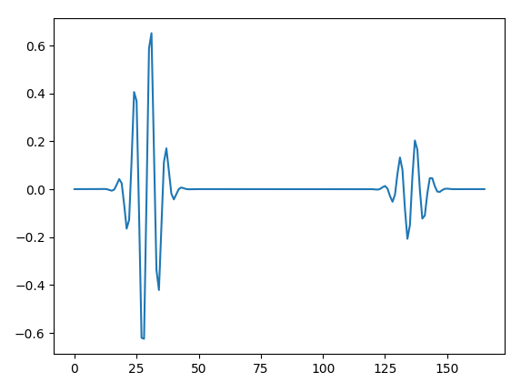
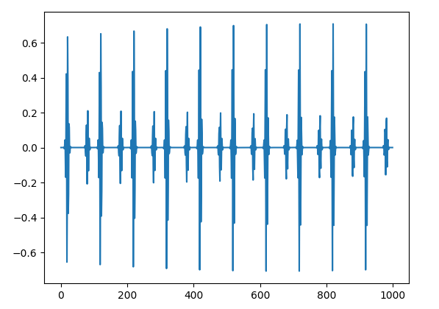
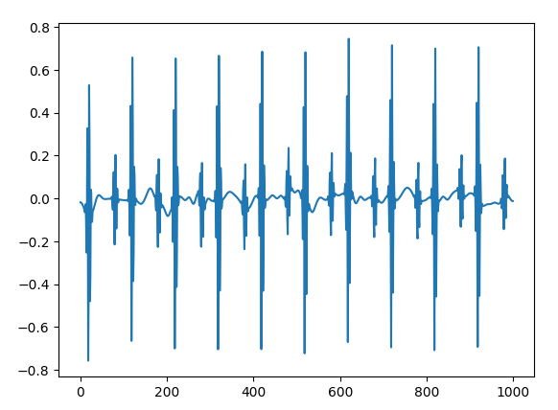
Work 4: BPD feature
J
IJ * (S / 80) = JK
BPD = (JK - IJ) / IJ = (S - 80) / 80
K
I
Typical shape (scipy.signal.morlet())
Typical cycle
Whole signal
Whole signal with noise (0.1)
Notes:
"After reading this paper, I simulated our SCG (Seismocardiogram) signal based on BPD as described in the paper. As shown in the figure, I first used the XX function to generate a typical shape, and we can observe that the shape of this small wave is quite similar to the shape of the BCG signal mentioned in the paper. After generating the typical shape, the subsequent steps are the same as the original SCG simulated process. We reduce the wave's height based on D, concatenate them to form a cycle, determine the number of cycles based on heart rate, and finally add noise. The generated signal is shown in the figure.
By modifying the values of certain sample points in this signal based on S, we can make the value of BPD correlated with S. Here's how I relate S with BPD. If we have a S, then we make IJ and JK satisfy this equation. And what I do is to lower the values of K,which is the red point, so that IJ and JK will satisfy this equation.
This equation implies that BPD has such relationship with S. In other words, we can use a simple linear regression (LR) model to predict S. if we know the BPD
I did not add a respirate to this signal because the paper assumed that the respirate is added to the pure signal and can be easily removed using a simple band-pass filter. In the paper, the removal of the respirate signal is not the focus, so I did not simulate it here.

Slide 10
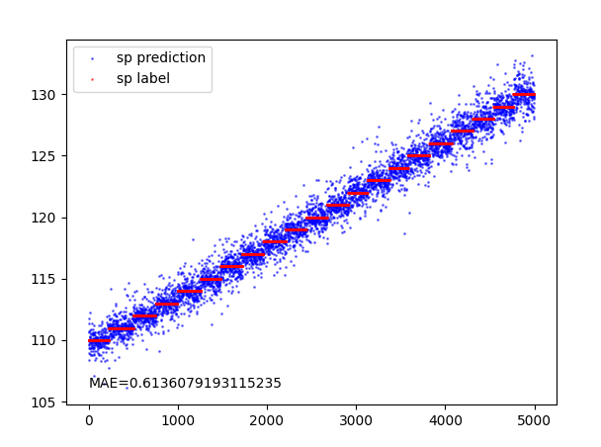
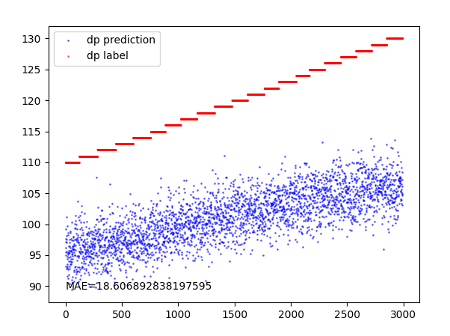
Work 4: BPD feature
Training Set: S∈[90, 110] Test Set: S∈[110, 130]
Using BPD feature as input
Model: Linear Regression
Result: Good
Using whole signal as input
Model: CNN
Result: Poor
Notes:
I generated two sets of signals, one with an range of S from 90-110 and the other with a range of S from 130-150, simulating a domain shift.
On the signal with BPD, I tried two methods to predict S. One method was to first extract features and then use Linear Regression to predict S, as shown in the figure. When we extract the right feature, which is the bpd, the (MAE) can be reduced to a very low value, which is consistent with how our signal was generated.
I also tried using deep learning methods to predict the signal. As can be seen, due to the presence of data shift, CNN only learned the features from the training set. And this result is similar to the results obtained when training with original SCG signals before. In both cases, it requires some form of domain adaptation to learn the correct features, such as IRM (Invariant Risk Minimization) and Contrastive Learning."

Slide 11
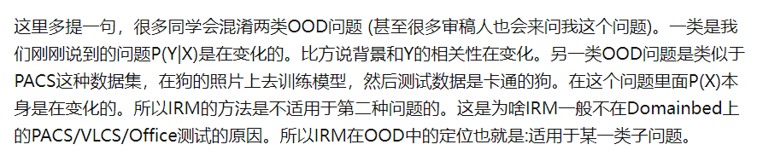
IRM
Blog Author: Lin Yong (林勇) who has published several papers on CVPR，ICML，NeurIPS
https://zhuanlan.zhihu.com/p/567666715
In SCG dataset, the horizontal or vertical difference is “X” mentioned in the text above, which changes with the domains. So I think that’s why IRM doesn’t work on SCG dataset
Notes:
"That's all the work from the first paper. Before I introduce the second paper, I'd like to discuss something about IRM (Invariant Risk Minimization). This week, I attempted to debug the IRM program I wrote last week and I also read some blogs online. Here's something from a blog; the author of the blog has published papers on IRM at CVPR, ICML, and NeurIPS. The blog mentions that IRM doesn't work when the key feature is different across different domains. I believe that the issue we're currently facing falls into this category.
IN scg ....
So I think we need to try other methods to learn the key feature."

Slide 12
Work 5: Contrastive Learning
Title: Time-Series Representation Learning via Temporal and Contextual Contrasting
Source: IJCAI 2021 (CCF-A）
Background:
Time-series data often lacks labels. So self-supervised approaches can be good ways to learn key feature representations. Self-supervised learning is typically achieved by setting up pretext tasks for the model to complete, but the choice of these pretext tasks can limit the generality of the learned features. Contrastive learning is another form of self-supervised learning. In the field of computer vision, there have been many methods for contrastive learning. However, most of these methods cannot be directly applied to time-series data, and the few that have explored contrastive learning in time series have focused on specific signals. Therefore, the author proposes a framework for time-series contrastive learning to fill this gap in the field."
Method:
TS-TCC: It uses data augmentation techniques to generate two different yet correlated views of the input data. Subsequently, a time-contrastive module is introduced, which leverages autoregressive models to explore the temporal features of the data. These models use the past of one view to predict the future of another view, accomplishing a challenging cross-view prediction task. Further enhancement of consistency between the autoregressive model's contexts is achieved through the context-contrast module."
Notes:
"The second paper I read is about Contrastive Learning. Professor Song shared this paper on Google Docs with the title 'Self-supervised Contrastive Representation Learning for Semi-supervised Time-Series Classification.' However, while reading this paper, I realized that its work is essentially an extension of the author's previous conference paper titled 'Time-Series Representation Learning via Temporal and Contextual Contrasting,' published at IJCAI in 2021, which is a prestigious A-level conference. Therefore, I started by reading the conference paper this week.
The background of the paper is that time-series data often lack annotations. Therefore, learning key feature representations within time sequences often requires self-supervised methods. This is typically achieved by setting up pretext tasks to make the model complete, but the choice of these pretext tasks can limit the generality of the learned features. Contrastive learning is another form of self-supervised learning. It explores different views of the input data by first applying data augmentation techniques and then learns the representations by maximizing the similarity of different views from the same sample and minimizing the similarity with views from different samples. In the field of computer vision, there are already many methods for contrastive learning, but most of them cannot be directly applied to time series data. The few studies on contrastive learning in time series focus on specific signals. Therefore, the author proposed a time-series contrastive learning framework to fill this gap.
The framework proposed by the author consists of three main parts. The first part generates two different yet correlated views of the input data based on strong and weak augmentations. Then, a temporal contrasting module is introduced to explore the temporal features of the data with an autoregressive model. These models perform a challenging cross-view prediction task by predicting the future of one view using the past of the other. Further agreement between the contexts of the autoregressive models is maximized by a contextual contrasting module."

Slide 13
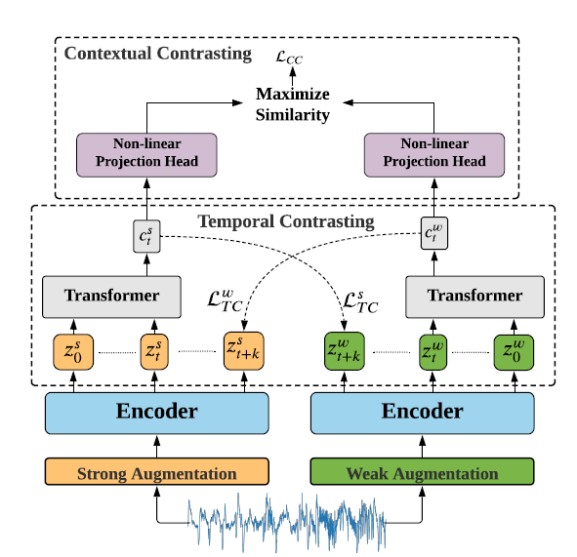
Data Augmentation Module:
This module takes the original signal and generates two views using data augmentation techniques. One is 'weak,' achieved through jitter and scaling, while the other is 'strong' and involves permutation. After obtaining these two views, CNN is utilized to extract latent representations 'z' (feature length * timestep).
Temporal Contrasting Module:
This module employs an autoregressive model (transformer) to map the first t timesteps of 'weak z' to a context vector ‘c’. Then propose a tough cross-view prediction task by using the context of the strong ‘c’ to predict the future timesteps of the weak ‘z’ and vice versa. Finally, through this time-contrast module, the initial low-level feature representation ‘z’ can be transformed into a high-level feature representation 'c' with temporal dependencies.
Contextual Contrasting Module:
For 'n' pairss of views input into this module, it calculates the similarity between them. Views from the same original data source should have high similarity, while views from different original data sources should have low similarity, as they originate from different datasets."
Work 5: Contrastive Learning
Framework of TS-TCC

Slide 14
Work 5: Contrastive Learning
Low-level
representation ‘z’
High-level
representation ‘c’
Raw data
Data
Augmentation
Weak view
CNN to learn representation
Temporal
Contrast
Contextual
Contrast
Strong view
Loss = Temporal_loss + Contextual_loss
Low-level
representation ‘z’
Raw data
Data
Augmentation
Weak view
CNN to learn representation
Contextual
Contrast
Strong view
CNN model
to predict
Loss = Prediction_loss + Contextual_loss
Notes:
Regarding D, I employed the XAI (Explainable Artificial Intelligence) method known as Perturbation-based method, just as what i discussed with Professor song last week. I try to alter key features, observe the extent and trend of changes in predictive results, thereby inferring whether the model has learned the key features. I designed three sets of experiments, labeled 1, 2, and 3. In these experiments, 1.4 means increasing peaks magnitude by 1.4 times, and 0.7 means the same and they are reciprocal [rɪˈsɪprəkl].

Slide 15
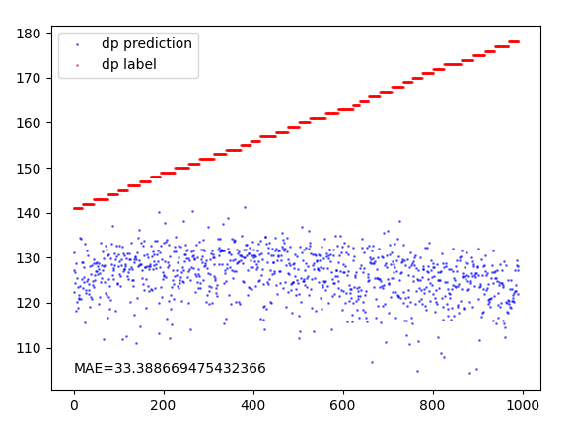
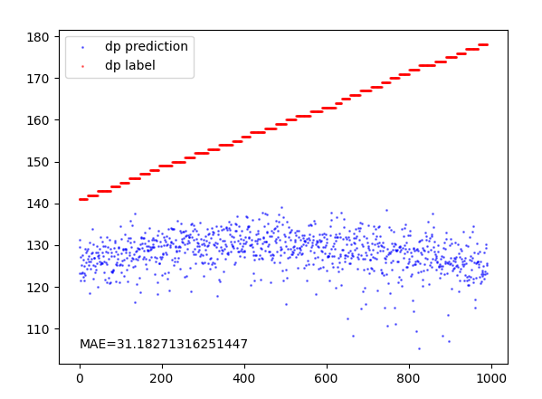
Work 5: Contrastive Learning
Without Contrastive Learning
With Contrastive Learning

Slide 16
Questions:
How to explain the poor performance of CNN when there is a shift in D, and how to determine whether it has truly learned the key feature?

Slide 17
Thanks for listening

