Slide 1
Brief Paper Report and
Discussion about Undergraduate Thesis Topic
Yida Zhang
2023.10.16
Notes:
宋老师您好，这次和您开会主要是想和您讨论一下我毕业论文选题的事情，我有些一些想法还有一些疑问想想您请教。在讨论前我会先对我这周读的论文进行一个简单的汇报。
The main purpose of this meeting is to discuss with you about my undergraduate thesis topic, I have some ideas and some questions I would like to ask you for advice. Before the discussion, I would like to give a brief report on the papers I read this week.

Slide 2
Problem
Method
Insight
Notes:
对于每篇论文我主要从三个角度来进行报告，分别是论文解决的问题，论文提出的方法，以及我从这篇论文中得到的一些对我本科毕设有帮助的insight。这三篇论文都是您放在google doc里的。
I read three papers this week which are all written in the google doc. And for each paper, I would like to report it from three perspectives, which are the problem the paper solves, how the paper solves the problem and the insight it gives to me about my work.

Slide 3
Self-Supervised Contrastive Pre-Training for Time Series via Time-Frequency Consistency
2022 NeurIPS
Problem:
Due to the mismatch between pre-training and target domains, the representation learned by the pre-train model has poor downstream performance.
Method:
To solve the problem above, the representation learned by the pre-train model should contain the generalized property which exists in any time series, regardless of the domains.
A signal can be viewed from both the time domain and frequency domain. Though the two domains can provide different information about the signal, the information is intrinsically interconvertible. Because the time domain can be transformed to frequency domain by Fourier Transformation. So the author believe that if we project the time-based representation and frequency-based representation to time-frequency space, they should be similar.
So the author use the two time-frequency space representation as postive pair, forcing the model to learn the feature which satisfies the time-frequency consistency.
Notes:
The first paper is.
The problem addressed in this paper can be summarized as follows:Due to the mismatch between pre-training and target domains, the representation learned by the pre-train model has poor downstream performance. For example, if the data on we use to pre-train the model are low-frequency signals, the representation learned by pre-training model will contain information that is more useful for low-frequency signals, and if the data on the downstream task are high-frequency signals, the representation learned by the pre-train model may have poor performance. To solve the problem above, the representation learned by the pre-train model should contain the generalized property which exists in any time series, regardless of the domains. For example, for CV, this generalized property is the edges of an object.
We know that.
And the property learned throught time-frequency consistency is the generalized property, becasue every signal satisfies the time-frequency consistency.

Slide 4
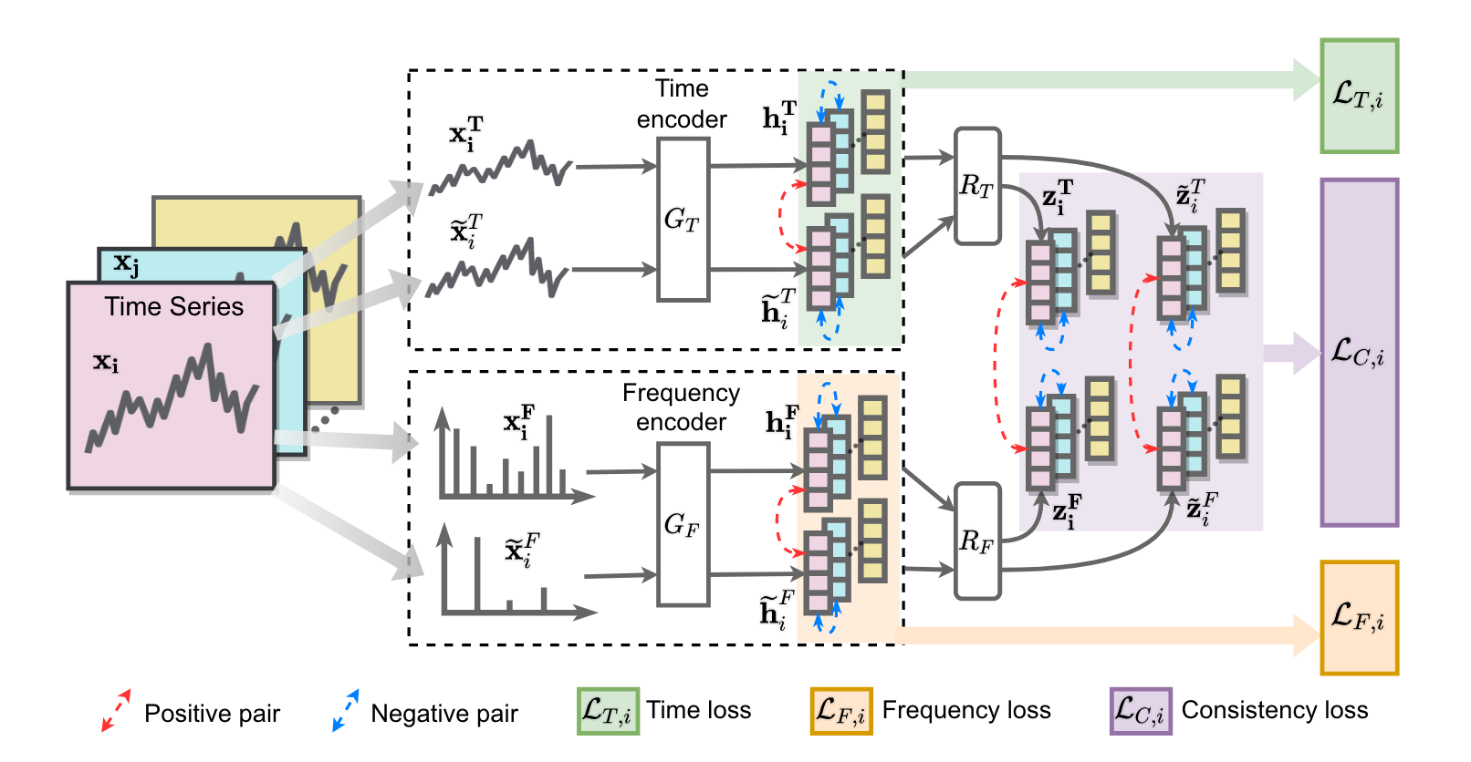
Illustration
Notes:
And here is the illustration of the framework.
The author first uses the time encoder and frequency encoder to get the time-based and frequency-based representations, which is the ht and hf, then he projects the two representations to the time-frequency space.
The author uses the contrastive learning in three place, so we can get three contrastive loss. They are time loss, frequency loss and consistency loss. The contrastive learning used in Time encoder and frequency encoder makes the time-based and frequency-based representation more accurate. And the contrastive learning used in the purple part makes the model learn the property satisfying the time-frequency consistency.

Slide 5
Insight
The time-frequency domain is also a perspective to look at the signal and it contains more features than the time or frequency domains. I think maybe we can try to replace the frequency-based representations with time-frequency-based representations, so the representations may contains more information about the time series.
If we take the features of the signal as input and use contrastive learning to optimize feature synthesis, can we also synthesize the frequency domain and time domain features separately and use contrastive learning to make them similar to each other?
However, since we are mapping from the extracted features, not directly from the time or frequency domain signal, and the features can reflect only part of the information in the time or frequency domain, that is to say, the expressive power of the features is much weaker than that of the raw signal, so there is also possibility that the time-based and frequency-based synthesized features can’t be close to each other theoretically.
Notes:
Here is the insight I get from the paper.
The first thought is we know that
And when I read the paper and think the problem I work on, which is synthesis of the features.
That’s my initial idea. Howerver, when I go deeper, It comes to my mind that
That’s some of my thoughts about the first paper.

Slide 6
TS2Vec: Towards Universal Representation of Time Series
2022 AAAI
Problem:
The existing method for representation learning can only get specific level of granularity, such as instance level or timestamp level. But the downstream task may need representations of different levels.
Method:
The authors propose a method to learn representations of any granularity.
The authors first use contrastive learning to learn the smallest granularity representation, i.e., the representation of a timestamp, and then use max pooling to integrate the information of neighboring timestamps to form a larger granularity representation. In order to ensure that the larger granularity representations also reflect the correct information, the authors apply contrastive learning to each granularity representation, adding all the losses together and optimizing them at the same time. So the learned representations, if viewed individually in a column, are the representations of a timestamp, and if the representations of neighboring timestamps are merged by maxpool, they can reflect the information of this sub-sequence.
Notes:
The universal is the key point.
The problem in this paper can be summarized as follows:
The instance level means that the representation has the information about the whole signal, but it can’t describe its subseries or timestamp. And the timestamp level means the representation can used to describe the information of each timestamp, but we can’t get the globel information about the whole signal.
Specifically,

Slide 7
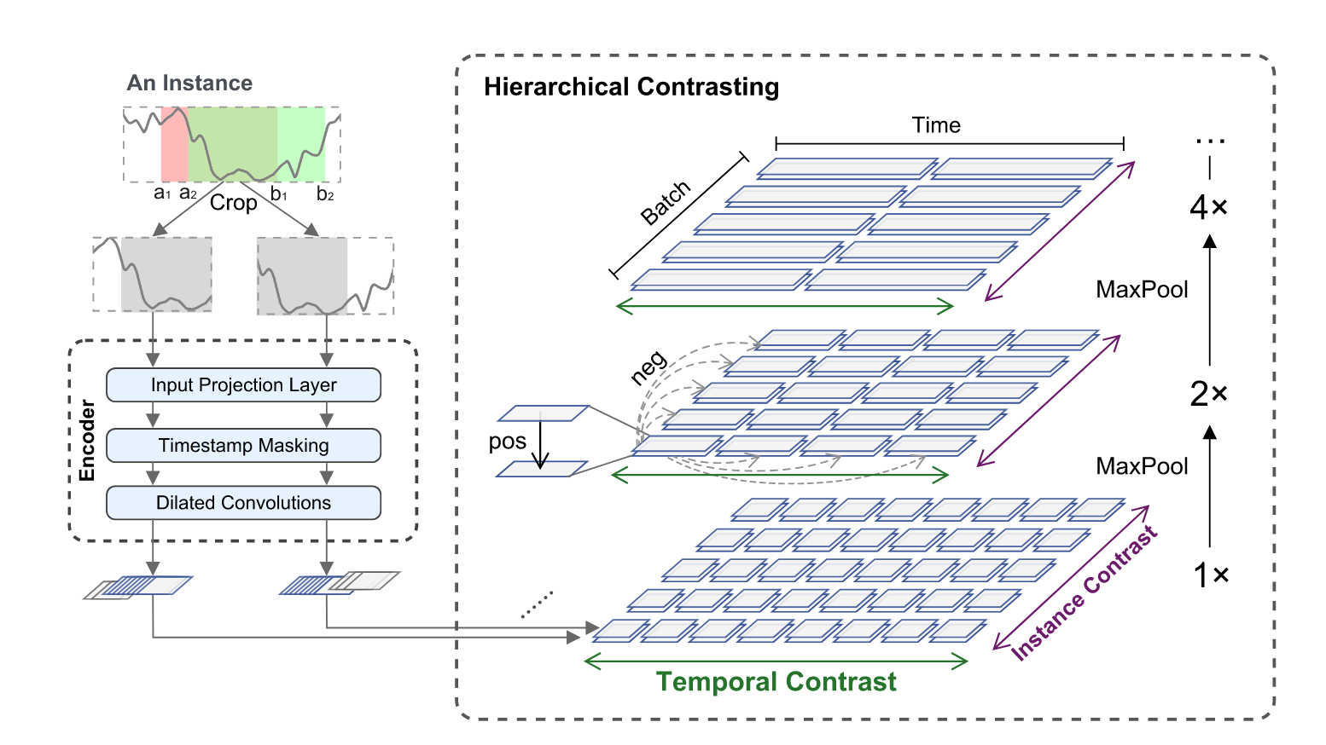
Illustration
Notes:
And here is the illustrain of the framework. And we can see that for each granularity level, the author uses the contrastive learning to make the representation can reflect the right information of that granularity.

Slide 8
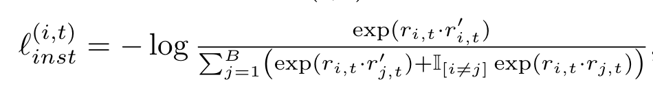
Insight
For different downstream tasks we need different information, e.g., local information may be more beneficial for prediction, while global information helps in classification. The representations we learn can either correspond to each timestamp or be used to describe the whole signal, the former one containing local information while the latter one containing global information.
The loss setting is a direction that can be improved. In the loss of this paper, all negative pairs are treated equally. But in fact, there is a difference between negative pairs, and the degree of similarity between them is different. If we push away an extremely dissimilar and a slightly dissimilar negative pair in the same way, we are actually ignoring such information as the degree of similarity.
Notes:
And here is the insight I can from the paper. The first point the paper teaches me is that
And I think
For example, this is the loss function of the paper. If we want to minimize the loss function, minimizing the dominator is what we need to do. And the dominator is actually the similarity of the negative pairs. When we optimize this loss function, we equally hope the similarity of negative pair become smaller, but in fact the dissimilarity of each negative pair is different. Maybe my expression is not clear enough, and if you have questions about my insight, I can use chinese to describe it latter.

Slide 9
SimTS: Rethinking Contrastive Representation Learning for Time Series Forecasting
2023 Arxiv
Problem:
The performance of the representation learned by most existing method is not satisfactory enough when the downstream task is forecasting. The author thinks there are two main reasons:
1. The contrastive learning task is based on instance discrimination
2. It’s hard for data augmentation methods to preserve the semantic information when construct the postive pair
Method:
The author uses FORCASTING as the goal of contrastive learning rather than INSTANCE DISCRIMINATION.
Specifically, the author uses the history representation to predict the future representation, and view the predicted representation and the real representation as a postive pair. When we construct postive pair like this, we can force the model to learn the representations that helps to predict the future.
In addition, the authors did not use negative pairs, avoiding erroneous push-offs (the role played by negative pairs is realized with the stop-gradient method). Also, this method used by the authors to construct postive pairs does not depend on any characteristics of the signal and can be applied to any signal.
Notes:
Here is third paper.
And the problem it faces can be summarized as follows:
which means that if the task is discriminate the instance, the representation tends to contain the information which is helpful to discriminate the instance, instead of forecasting.
The author think when we augment the signal to generate postive pair, it will break the information that can be used to forecast
To improve the forecasting performance of representation

Slide 10
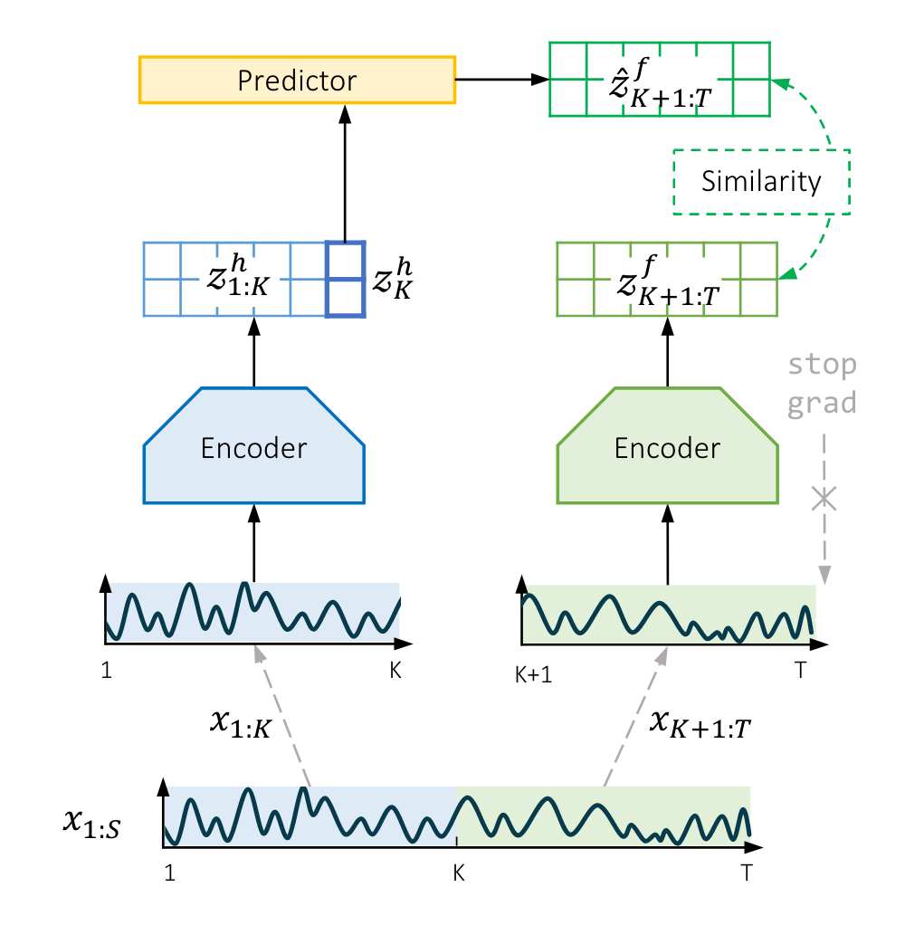
Illustration
Notes:
Here is the illustration of the framework, the author first seperate the signal as history and future, then use the same encoder to get the representation. Then, the author uses the history representation to predict the future representation, and use the negative similarity as loss function. So in order to minimize the loss function, the representation is forced to contain the information that helps predict the future.

Slide 11
Insight
There are many property in a postive pair, some of which are the same for the pair and some of which are different. Since our loss is designed to bring the representations of the postive pair close together, this means that the representations will only be close together if the representations are used to embody those properties that are the same for the pair. The point of negative pair is to destroy the the similar properties that are not important, so that the model does not learn those unimportant properties. This is actually somewhat similar to some of the ideas in interpretable deep learning, i.e., perturbing some parts of the input, and if the output remains unchanged, it means that the perturbed parts are unimportant. This inspires us to find ways to create postive and negative pairs from some of the methods of the interpretable deep learning.
Notes:
The article also mentions that NEGATIVE PAIRS can lead to incorrect push-offs. This got me thinking about what makes a good negative pair design.
We know that representation learning is about extracting the information of the signal into the representation that can be useful for downstream tasks, and contrastive learning is to help learn such representations. We know that there are many features in a postive pair, some of which are the same for the pair and some of which are different. Since our loss is designed to bring the representations of the postive pair close together, this means that the representations will be close together only if the representations are used to embody those features that are the same for the pair. For example, if we want to learn a certain feature, then we have to make sure that this feature is the same for the postive pair, so we can't destroy this similarity when we augment the data. The point of negative pair is to destroy the similarity of those features that are not important, so that the model does not learn those unimportant features.
And I think This is actually somewhat similar to some of the ideas in interpretable deep learning, i.e., perturbing some parts of the input, and if the output remains unchanged, it means that the perturbed parts are unimportant. This inspires us to find ways to create postive and negative pairs from some of the methods of perturbing signals in interpretable deep learning.
And that’s all for my paper report. Do you have any comments, or if I didn’t express something clearly, I can explain it to you.

Slide 12
How to perform feature extraction, selection and synthesis and discover the complex (non-linear) relationship between a subset of features and the label？
Does “feature extraction” means using DSP methods to get the meaningful feature from the raw signal?
What’s the purpose of “Feature Synthesis”?
Better understanding, representation learning or dimensionality reduction
....
....
....
....
Input layer
Hidden layer
Output layer
What’s the comparison method?
Notes:
第一个问题：我在读论文的时候看到feature extraction的另外一个定义，它属于dimensionality reduction的一个方法
第二个问题：是为了更好的理解信号吗，比如说我们有一个特征是总量，另一个特征是总个数，我们通过特种组合发现了总量除以总个数和label相关，那么我们就能知道是这个量的平均值是很有意义的。这就是更好理解信号的含义。但是如果我们通过神经网络来进行合成，那么合成的特征会非常的复杂，很难从中发现什么现实意义。
如果说特征合成的目的是像表征学习那样，可以将这个合成的特征用于下游的各种任务，但是我们目前的状况是，我们只有预测血压一个任务，完全可以直接用神经网络来预测。
所以我认为特征合成的目的是为了进行降维，把高维的特征映射到低维。映射的过程就可以理解为一种合成

