Slide 1
Progress Report
2024.4.8
Yida Zhang

Slide 2
Outline
Methods to remove the redundant features based on the number of big weight
A loss function for contrastive regression
Questions

Slide 3
Method 1: Constant Ratio
Count the big weight (>0.1) between Feature Selection Layer and MLP. If the number is less than (total_weight_number * ratio), then remove it.
Linear: a₁x₁+a₂x₂+a₃x₃+a₄
Num of total feature
Best ratio(%)
Num of missed and redundant
10 in 1000 | 20 in 1000 | 30 in 1000 | 40 in 1000 | 50 in 1000
19-24 | 12-21 | 21 | 25-26 | 24
0.1 | 2.1 | 5.3 | 9.3 | 16.1
Non-Linear: x₁^a₁+lnx₂+e^x₃
Num of total feature
Best ratio(%)
Num of missed and redundant
10 in 1000 | 20 in 1000 | 30 in 1000 | 40 in 1000 | 50 in 1000
10-31 | 44-45 | 44-46 | 47-48 | 43
0 | 8.6 | 12.6 | 24.2 | 26.7
Interaction: x₁x₂x₃/x₄x₅
Num of total feature
Best ratio(%)
Num of missed and redundant
10 in 1000 | 20 in 1000 | 30 in 1000 | 40 in 1000 | 50 in 1000
7-24 | 22-23 | 27-28 | 32 | 35
0 | 2.7 | 5.6 | 11.1 | 16.6
Notes:
关于如何移除多余特征的第一个想法就是设定一个固定的比例，我们先去统计在选择曾和MLP之间有效特征的数量，然后删除小于一定比例的特征。因为通过上周的实验可以看出，如果我们筛掉有效weight数量小于10的特征，那就可以消除掉大部分的无关特征。因此我在三种方程，五种特征数量的情况下，遍历了所有的比例，然后去观察最佳比例是多少。
解释值的含义
两个现象。
结论：没有固定ratio

Slide 4
Method 2: Ratio predicted by ML (LR/RF/SVR)
Train a ML model to predict the threshold (total_weight_number * ratio)
Linear: a₁x₁+a₂x₂+a₃x₃+a₄
Num of total feature
Num of missed and redundant
10 in 1000 | 20 in 1000 | 30 in 1000 | 40 in 1000 | 50 in 1000
0/0/0 | 2/2/2 | 4.5/4.5/4.5 | 4/7/3.5 | 18/18/17.5
Non-Linear: x₁^a₁+lnx₂+e^x₃
Num of total feature
Num of missed and redundant
10 in 1000 | 20 in 1000 | 30 in 1000 | 40 in 1000 | 50 in 1000
0/0/0 | 14.5/28/19 | 13/26/30 | 26.5/23/31 | 25/24/27.5
Interaction: x₁x₂x₃/x₄x₅
Num of total feature
Num of missed and redundant
10 in 1000 | 20 in 1000 | 30 in 1000 | 40 in 1000 | 50 in 1000
0/3/0 | 6/10.5/2 | 10/10.5/9 | 22/16/16.5 | 29.5/24/20
Notes:
解释x/x/x

Slide 5
Method 3: Predict based on weight(LogisticR/RF/SVC)
Train a ML model to predict whether to remove the feature based on the weight value
Interaction: x₁x₂x₃/x₄x₅
Num of total feature
Num of missed and redundant
10 in 1000 | 20 in 1000 | 30 in 1000 | 40 in 1000 | 50 in 1000
5/0/0 | 13.5/0/0 | 16.5/1/1 | 24/1/1.5 | 33.5/3/3

Slide 6

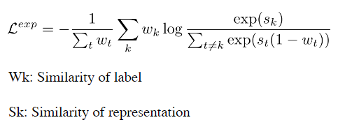
Contrastive Regression
Wang Y, Jiang Y, Li J, et al. Contrastive regression for domain adaptation on gaze estimation[C]//Proceedings of the IEEE/CVF Conference on Computer Vision and Pattern Recognition. 2022: 19376-19385.
Barbano C A, Dufumier B, Duchesnay E, et al. Contrastive learning for regression in multi-site brain age prediction[C]//2023 IEEE 20th International Symposium on Biomedical Imaging (ISBI). IEEE, 2023: 1-4.

Slide 7
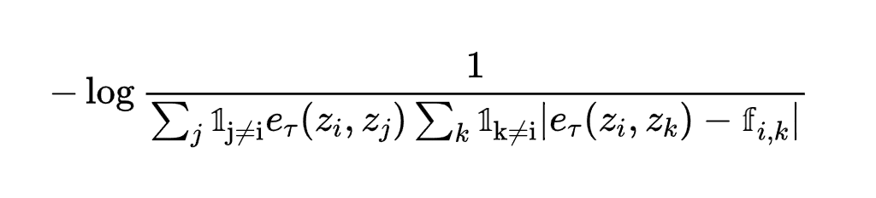
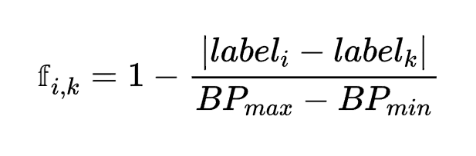
Contrastive Regression
Loss function:
Where:
Notes:
为什么 pos 而没有neg

