Slide 1
Progress Report
2024.4.29
Yida Zhang

Slide 2
Outline
Experiment of Coarse-to-fine Contrastive Classification on real BCG dataset

Slide 3
Architecture
batch
[40,200]
[40,120]
[120,200]
…...
[40,50]
[50,60]
[60,70]
……..
[170,180]
[180,190]
[190, 200]
Total Loss = Classification Loss + Contrastive Loss in each segment + Regression Loss in last layer

Slide 4
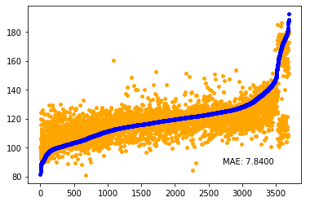
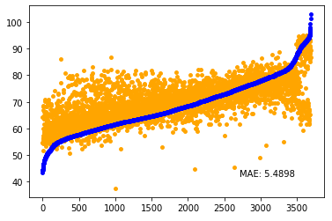
Prediction using the whole framework (Random split the dataset)
Result of S
Result of D
 | MAE of S | MAE of D
FS based features | 8.6 | 6.2
VTCN | 8.0 | 5.9
Proposed framework | 7.8 | 5.4

Slide 5
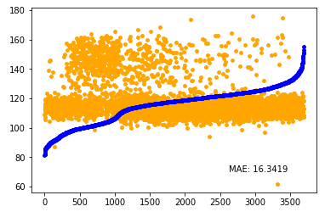
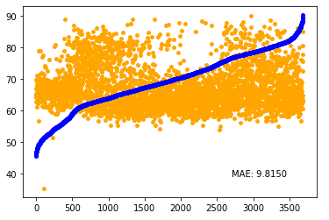
Prediction using the whole framework (Split the dataset based on subjects)
Result of S
Result of D

