Slide 1
Weekly Progress Report
Yida Zhang
2023.8.28

Slide 2
Progress
Improvement of Feature Combination based on GA
Implementation of Gradient-based Interpretation Methods on SCG dataset
Weekly routine work:
Tutorial
Study of theoretical courses: Signal and System, DSP
Notes:
Here are my progress this week. First, I improve the feature combination method based on GA and combine it with feature selection, making it able to generate more complicated features. Second, I implement some gradient-based interpretation methods on our SCG dataset. And I also did the weekly routine work, like writing the tutorial and studying the theoretical courses.

Slide 3
Feature Synthesis/Combination
Feature Set: F = {f₁, f₂,...,f_{n}}
Evaluation Criteria: E = Mutual Information or MAE
Transformation Set: T = {t₁, t₂,...,t_{m}}
Arity = 1: √f, e^{f}
Arity = 2: ＋, －, ×, ÷
Arity = 3: (f₁ + f₂) × f₃
Target: t_{new} where new = arg max E(t_{x}(F))
x
Notes:
First, I would like to introduce my work about the feature combination. When we consider feature engineering, we face two problems. One is how to generate new features through combining existing features, so as to better represent the information or patterns in the dataset. This is called Feature Synthesis or feature combination. And we can formulate this problem as follows, we have a feature set F, a evalutation criteria E to evaluate the quality of combined features, for example we can use mutual information or directly inputing the feature to the LinearRegression and using mae as the metric. And we also need some transformation methods T. The transformation methods can be categorized by arity which means how many features are involved. For example, arity of 1 means operations like square root, cube root. Arity of 2 means addition, subtraction, multiplication, division, etc. Arity of 3 means combinations like (f1+f2)*f3. Our solution space is to apply all combination methods to F, generating new Features, then select the best or the top k features that maximize E, and add them as new features to the feature set.

Slide 4
Feature Selection
Feature Set: F = {f₁, f₂,...,f_{n}}
Evaluation Criteria: E = MAE
Subset of F: F_{s} = {f_{s1}, f_{s2},...,f_{sk}} where k = 2^{n} - 1
Target: f_{new} where new = arg max E(f_{sx})
x
Notes:
The other problem is, when we have many features, how to select the best feasture subset to obtain better prediction results or improve efficiency . This is called feature selection. And we can formulate it as follows, given a feature set F, a evaluation criteria E, we can directly use the mae of prediction as E. Our solution space is the subset of the F excluding the empty set. What we need to do is to find the subset in the solution space that maximizes E. And we can find that both problems are optimization problems to find the optimal solution in the solution space. We can study them as two separate problems, but can also view them as two perspectives of one problem, because feature selection is also a kind of feature combination.

Slide 5
Demonstration
Feature Set: F = {f₁, f₂,...,f₁₀}
Model: Linear Regression
Output: a₁f₁ + a₂f₂ +...+ a₁₀f₁₀ + a₁₁
Feature Combination: (b₁f₃ + √f₇) / e^{f4}
(b₁f₃ + √f₇) / e^{f4} = b₁f₃ / e^{f4} + √f7 / ef4
Arity = 3
Arity = 2
Arity = 2
Key idea: Reduce the complexity of feature combination module, and transfer more work to feature selection module
Notes:
Let's look at this example. We have basic feature set F which includes F1 to F10. We can feed them into a linear regression model and get the Output, which is as shown here, where a1,...,a11 are learned parameters of the model. Based on this setting, we want to conduct feature combination to see if the combined features can better represent the inherent information or patterns in the dataset.
Through some feature combination methods, we find the combination as shonw here is highly correlated with our target in a linear fashion. Let's assume this combined feature represents the true relationship between the features and target. After obtaining suitable combined features, we add them to our feature set and conduct feature selection. Since we assume this feature reflects the true connection between input and target, so after feature selection like Recurssive Feature Elimation, we will only get one feature, which is this combined feature. What I described above treats feature combination and feature selection as two separate problems.
However, when we look back at the combined feature (b1f3+f7^3)/e^f4, we can see the combination is very complex, with operations like exponentiation, addition, multiplication, division., and involves three features. It is actually very complicated to generate such combinations, requiring huge computational resources and time. So I'm thinking, is it necessary to generate the optimal feature already in the feature combination step? Can we lower the requirement of feature combination and leave some work to the feature selection module?
The answer is yes, because we know that linear regression itself is a feature combiner, able to linearly combine our input features. Therefore, we can combine nonlinear parts in the feature combination module, and leave the linear part to the feature selection module. For example, for the combined feature (b1f3+f7^3)/e^f4, we can decompose it into b1f3/e^f4 and f7^3/e^f4, feed them together into the linear regression, and get the same effect as using only (b1f3+f7^3)/e^f4 as input, but there will be less work in the feature combination module, because the arity is reduced from 3 to 2. So what I want to say is that we don’t have to combine the best feature directly in the feature combination module, we only need to combine some non-linear part of it, and use linear regression to do the linear combination.

Slide 6
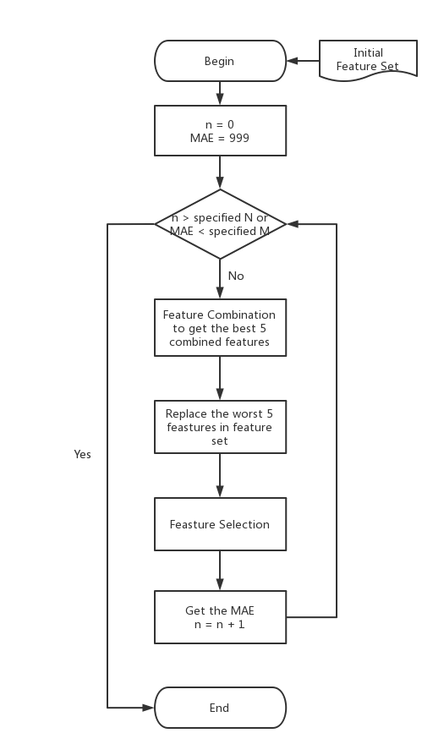
Flowchart of the algorithm
Improvements:
Initialize the gene with 0
Add the Elitism Mechanism
Feature Selection Gene Definition:
0 exclude
1 include
Notes:
The next question is how to conduct nonlinear feature combination and feature selection. As mentioned before, both problems are essentially optimization problems, and genetic algorithms (GA) perform well on optimization problems. Therefore, I use GA to solve this problem. In last week's report, I mentioned GA didn't work well for feature combination on our dataset, because it can’t learn the combination like D21/D12. This week, based on last week's work, I made some modifications and extensions, and now the GA-based method can properly combine the D21/D12.
I modified two parts. First is the gene initialization. Usually GA randomly initializes the genes to simulate more possibilities. But in our case, the combined features are generally not too complex, often just combinations of a few features instead of all. Also, complex features are composed of relatively simple parts. Evolving from simple combinations to complex ones is reasonable. Therefore, I initialize all genes to 0, and introduce feature transformations through mutation rate. The second improvement is elitism, which directly passes the best genes from the previous generation to the next, ensuring the population always evolves towards better directions rather than worse. With these two modifications, my GA-based feature combination method can now learn the D21/D12. In addition, I expanded the gene definition by adding square, square root, exponentiation, enlarging the expression space of T, allowing more complex transformations of features.
Meanwhile, feature selection is no longer done after feature combination. It goes hand-in-hand with feature combination, because it is also part of feature combination. We can still use Genetic algorithm to do Feature selection. The gene is a binary array of length equal to number of features, where 0 means not selecting the feature, and 1 means selecting it. Here is the flowchart of the algorithm. Inside each loop, GA-based feature combination is applied to the existing features. After running GA, the top 5 features are used to replace the worst 5 features in the existing feature set. After replacement, the genes corresponding to the replaced features are set to 1, meaning the new combined features are included in the subset by default. After updating the genes, feature selection method is executed to obtain a feature subset considering the new combined features. Then the feature combination continues to run on the updated feature set. This loop won’t stop until reaching the specified iteration number or reaching the required mae.
Currently I have run the feature combination part of this algorithm on the SCG dataset, and it can accurately capture the D21/D12 feature in most cases. Due to the randomness of GA, in very rare cases it fails to obtain right feature, but the probability of failure decreases as the number of evolutions increases. For D21/D12, the subsequent feature selection module is not needed, because it's already very simple, without requiring linear combinations with other feature. I'm still debugging the feature selection code, and I will generate simulated feature sets next week to validate the effectiveness of the subsequent feature selection algorithm.

Slide 7
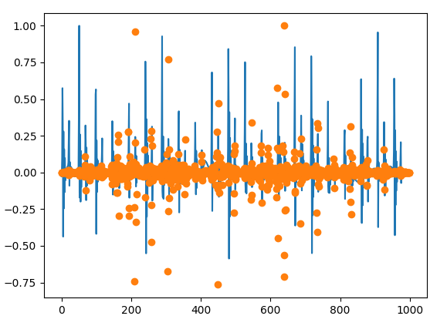
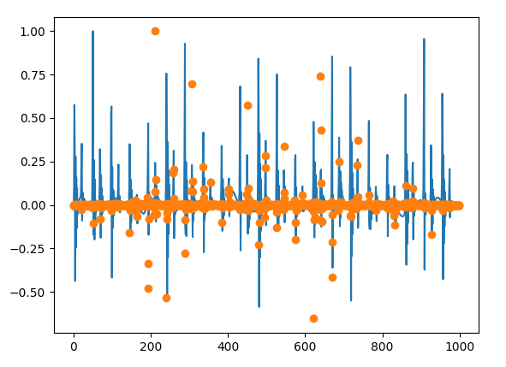
Gradient-based Interpretation Methods on SCG dataset
Just Gradient
Gradient * Input
Notes:
Next part is about the explainable ai. I implement two gradient-based interpretation methods discussed in the survey provided by Professor Song. The two methods both use the gradient of the input to stand for the importance of the input. The orange point in the left figure represants the input about the derivative of the loss, and the orange point in the right figure is the derivative multiple the input itself. The model I use is the CNN which can get the MAE below 3. However, we can find that the two interpretation methods can’t reflect the information, for example the horizontal or the vertical difference between peak1 and peak2. Next week I will try some other interpretation methods.

Slide 8
Tutorial
Feature extraction and analysis
Time-domain features
Peaks detection and envelope: scipy.signal.find_peaks, our peaks detection method
Temporal feature extraction based on TSFEL
Notes:
For this week's tutorial, my main focus is on the time domain features of feature extraction and analysis which is the third section of the outline. I utilized the `find_peaks` function from `scipy.signal` to achieve peak detection. Additionally, I encapsulate the peak detection method which I used for our SCG signals into a function. Moreover, I implemented the extraction of time domain features based on the TSFEL library. In my function, we can choose specific time domain features by setting the parameter of the function, so that we don’t have to modify the JSON file manually.

Slide 9
Thanks for listening

