Slide 1
Progress Report
2024.4.15
Yida Zhang

Slide 2
Outline
Methods to remove the redundant features
Experiments of contrastive regression loss
Notes:
这周的内容主要是多余特征移除和关于新loss的一些实验

Slide 3
Remove redundant features
Train a SVC model to predict whether to remove the feature based on the weight value between feature selection layer and MLP
Linear: a₁x₁+a₂x₂+a₃x₃+a₄
Num of total feature
Num of missed and redundant
10 in 1000 | 20 in 1000 | 30 in 1000 | 40 in 1000 | 50 in 1000
0 | 0 | 0 | 0.5 | 0
Non-Linear: x₁^a₁+lnx₂+e^x₃
Num of total feature
Num of missed and redundant
10 in 1000 | 20 in 1000 | 30 in 1000 | 40 in 1000 | 50 in 1000
0 | 0 | 0.5 | 0 | 2
Interaction: x₁x₂x₃/x₄x₅
Num of total feature
Num of missed and redundant
10 in 1000 | 20 in 1000 | 30 in 1000 | 40 in 1000 | 50 in 1000
0 | 0 | 1 | 1.5 | 3
Notes:
上周我已经尝试了用SVC在interaction这种类型的方程上移除多余特征，效果很好，这周我补做另外两种方程的实验，可以看到效果也是很好的。但是这些实验的训练集和测试集都是同一种方程，但是在实际应用中，我们不可能知道目标特征和label之间的方程到底是哪种，这就需要训练出来的SVC具有泛化性，可以泛化到其他不同种类的方程上。

Slide 4
Remove redundant features
Train: Linear, Test: Non-Linear
Num of total feature
Num of missed and redundant
10 in 1000 | 20 in 1000 | 30 in 1000 | 40 in 1000 | 50 in 1000
0 | 18.3 | 18.8 | 25.2 | 20.3
Train: Non-Linear, Test: Linear
Num of total feature
Num of missed and redundant
10 in 1000 | 20 in 1000 | 30 in 1000 | 40 in 1000 | 50 in 1000
0 | 0.8 | 1.1 | 1.8 | 2.1
Train: Linear, Test: Interaction
Num of total feature
Num of missed and redundant
10 in 1000 | 20 in 1000 | 30 in 1000 | 40 in 1000 | 50 in 1000
0 | 0.6 | 3.9 | 7.2 | 8.1
Train: Interaction, Test: Linear
Num of total feature
Num of missed and redundant
10 in 1000 | 20 in 1000 | 30 in 1000 | 40 in 1000 | 50 in 1000
1.3 | 3.4 | 7 | 9.7 | 13.4
Notes:
所以我分别在这三种方程上，两两互为训练集和测试集继续实验。实验效果如下。可以看到相比于训练集和测试集是同一种方程，在有domain shift的场景下，特征移除的效果都会或多或少的变差。但是我们还可以发现，只要不用linear这种最简单的方程作为训练集，其他方程训练出来的SVC泛化效果其实都还可以接受。
因为在实际场景下，多选的特征对于性能的影响其实很小，最主要的影响还是在于少选特征。而在实验中，多选和少选的比例接近一比一，因此如果我们把这些实验结果除二，这个结果是要远远好于scikitlearn中的方法的，我尝试了RFE和Random Forest进行特征选择，它们在1000选50的情况下，通常都会少选几十个特征。
所以我认为目前这个结果还是可以的。但是目前的问题是我们该如何证明SVC能泛化到任何方程上。关于这个，您有什么看法吗

Slide 5
Remove redundant features
Train: Non-Linear, Test: Interaction
Num of total feature
Num of missed and redundant
10 in 1000 | 20 in 1000 | 30 in 1000 | 40 in 1000 | 50 in 1000
0 | 0.2 | 2 | 2.4 | 5.2
Train: Interaction, Test: Non-Linear
Num of total feature
Num of missed and redundant
10 in 1000 | 20 in 1000 | 30 in 1000 | 40 in 1000 | 50 in 1000
0.1 | 1.5 | 4.6 | 5.4 | 8

Slide 6
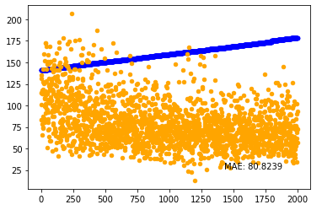
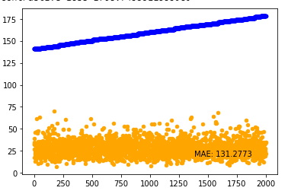

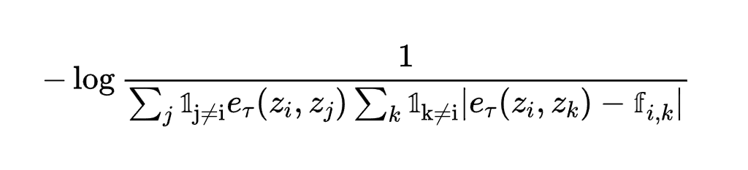
Contrastive Regression (dataset with label shift on S)
Result of S
Result of S

Slide 7
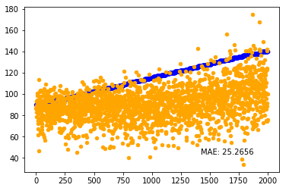
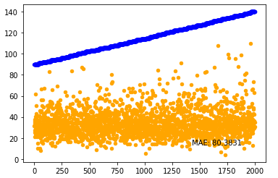
Contrastive Regression
(dataset with different noise and pulse type)
Result of S
Result of S

