Slide 1
Progress Report
2024.4.22
Yida Zhang

Slide 2
Outline
Test feature selection method on real SCG and BCG dataset

Slide 3
Feature Selection on Real SCG Dataset
Selected Features：
MAE: 7.9
Right Features：
0 (HR), 1 (x1), 2 (x2), 3 (y1), 4 (y2)
MAE: 9.6

Slide 4
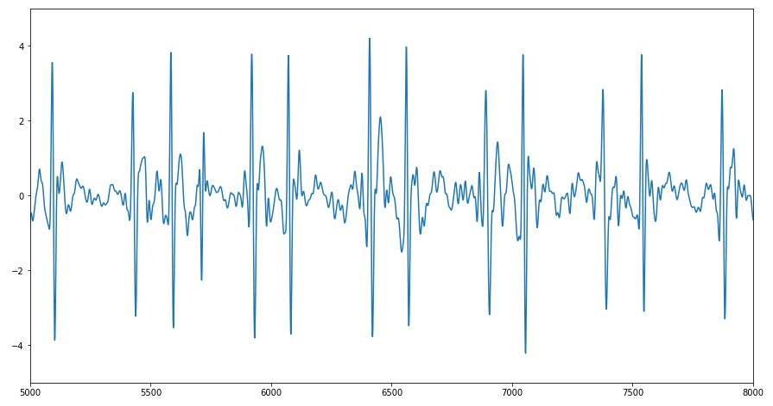
Possible reason for the bad result
The label of BP is for the whole signal, not for a cycle. However, the features of each cycle vary a lot

Slide 5
Feature Selection on Real BCG Dataset
Selected Features：
MAE: 6.2
Right Features：
0 (x1), 1 (y1), 2 (x2), 3 (y2), 4 (x3), 5 (y3)
MAE: 6.4

Slide 6
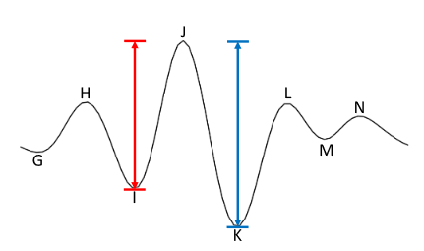
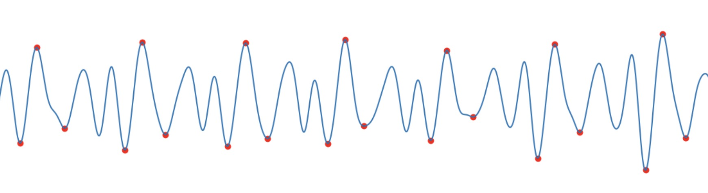
Possible reason for the bad result
Typical BCG cycle
BCG cycle in online dataset
“Given that the bed system records BCGs that represent a superposition of the dorsoventral and head-to-foot axes, it seems reasonable to not expect the same results as seen in other BCG-based blood pressure tracking publications that predominately measure the head-to-foot axial BCG component (i.e., standing–BCG measurement systems).”[1]
[1] Carlson C, Turpin V R, Suliman A, et al. Bed-based ballistocardiography: Dataset and ability to track cardiovascular parameters[J]. Sensors, 2020, 21(1): 156.

