Slide 1
Weekly Progress Report
Yida Zhang
2023.9.4

Slide 2
Progress
Tutorial:
1. Implement the code of six knowledge points based on the outline and apply them to the SCG dataset
2. Read the first chapter of the Practical Time-Frequency Analysis and enrich the tutorial based on Rwave
Research:
3. Implement Perturbation-based method to verify whether the CNN model has learned the right feature
4. Implement IRM^{[1]} to learn the invariant features for S
Theoretical study
[1] Arjovsky M, Bottou L, Gulrajani I, et al. Invariant risk minimization[J]. arXiv preprint arXiv:1907.02893, 2019.
Notes:
Here is my progress for this week:

Slide 3
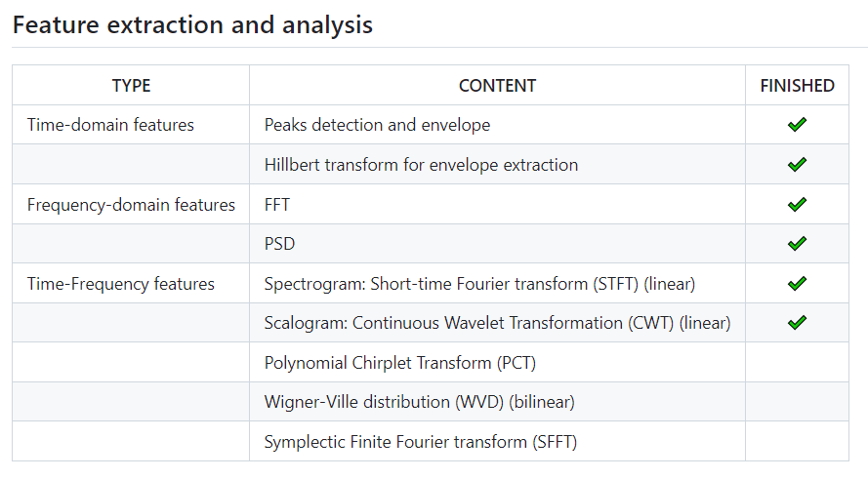
Work 1: Tutorial (based on the outline)
Three steps to complete the tutorial:
Learn the knowledge points to understand the functionality and significance of this method, for example, what information it can reveal from the signal, and what features can be derived from it
Implement the code and apply it to the SCG signal
Think about how this method can assist in predicting S and D
Notes:
The left figure shows the knowledge point I learned and implemented this week. For each knowledge point, I will take three steps.
However, I did not spend too much time delving into their mathematical principles.

Slide 4
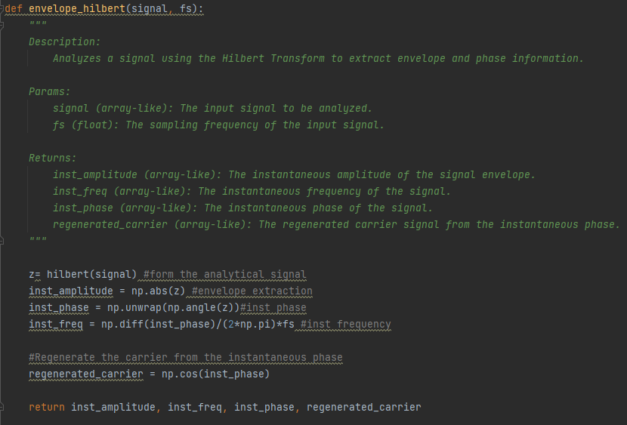
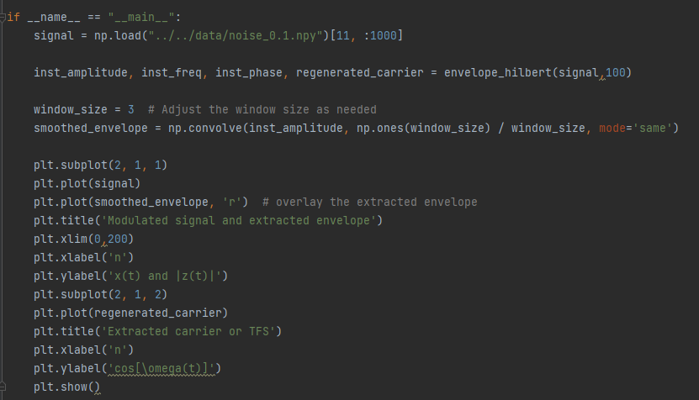
Tutorial (code format)
Encapsulation of the function
Application on SCG signal
Notes:
Here is the code format, I referred to the Python files provided by Professor Song and Jia Yu’s code. This primarily includes adding descriptions, parameters (params), and return values (returns) to the functions. As shown in the left figure, this is the encapsulation of the function with relevant comments. The right figure represents the main function used to apply these encapsulated functions to the SCG dataset and observe the results

Slide 5
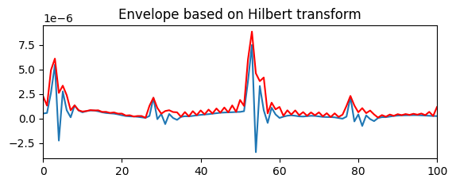
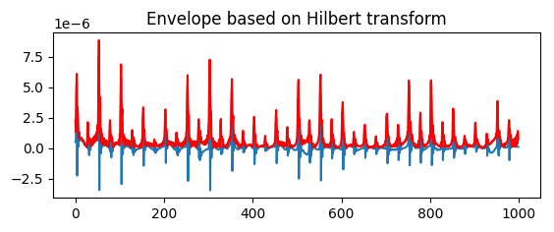
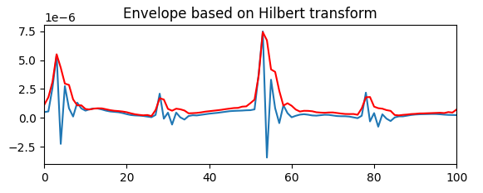
Tutorial (Hilbert Transformation)
Benefits:
Help us observe the trends in signal more clearly, making it easier for us to extract the horizontal positions of the peaks
Using smooth_window to remove the noise
Result: Make it more convenient to extract the feature of peaks
window_size = 3
Notes:
Taking the Hilbert transform as an example, I first learned about it from the link in the outline. Then, I learned and comprehended the code provided in the link, encapsulated it into an easy-to-use function, and applied it to the SCG dataset. As shown in the upper-right figure, this is the result of applying the Hilbert transform to the SCG signal, where we obtain a closely fitting envelope of the SCG. The upper-left figure focuses only on the first 100 sample points to provide a clearer view of the envelope extraction results. After obtaining the envelope, I tried to think about how it could assist in predicting S and D. I think the envelope can more clearly reflect the trends in signal and the positions of peaks, making it easier to extract the horizontal positions of the peaks compared to direct extraction from the signal. However, when we look at upper-left graph, we can see some noise on the current envelope, which could pose challenges when extracting peak points. Therefore, I performed smoothing on the envelope using a sliding window. The lower-left graph shows the smoothing effect with a window size of 3. Once we have the envelope, we can extract relevant features from it. For instance, we can easily extract the horizontal positions of the SCG signal peaks using the findpeaks function from SciPy, which is very convenient.

Slide 6
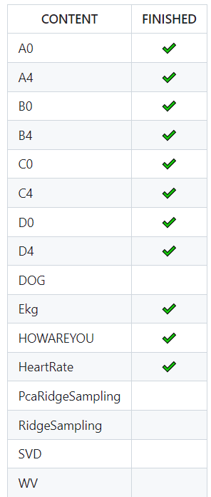
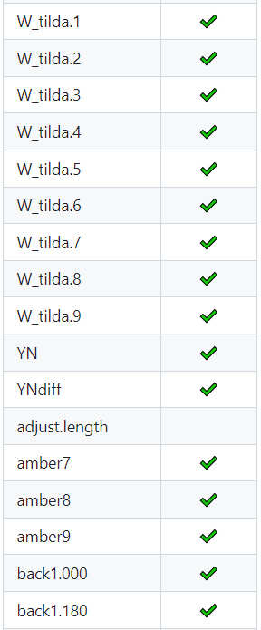
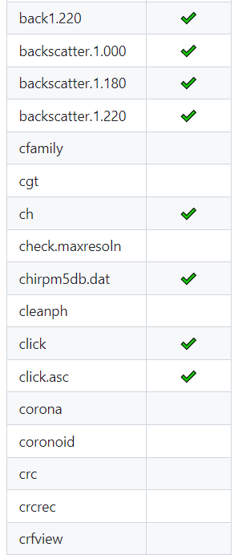
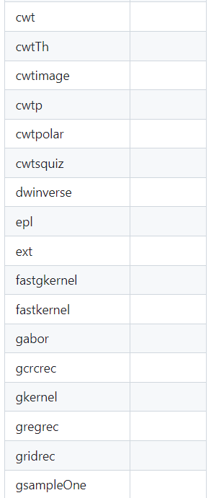
Work 2: Tutorial (based on the Rwave)
Notes:
The second part of the tutorial is based on the Rwave. It is a documentation for R language functions of the book "Practical Time-Frequency Analysis,". I studied the first chapter of this book and found the source code for the Rwave library online. Because the first chapter didn't involve many functions, So this week I just converted all Rwave library data in rda format into formats that Python can read, such as npy. All of these data will be used in the R language function. The figure I show here is the outline of the Rwave documentation. The topics with checkmarks are all about data conversion.

Slide 7
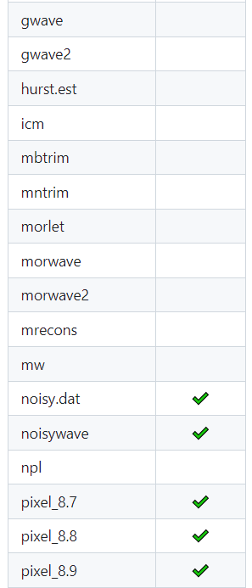
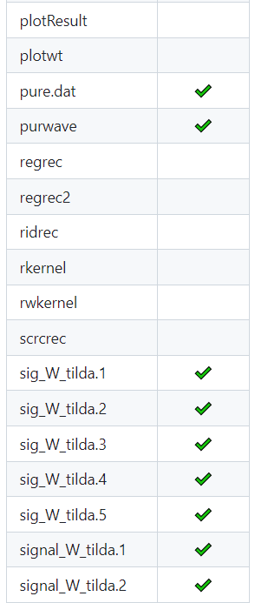
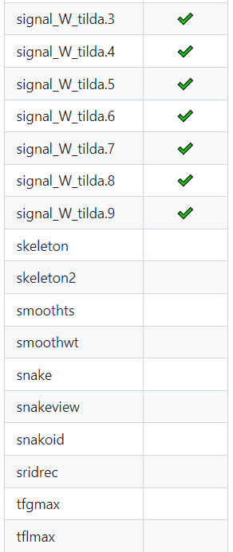
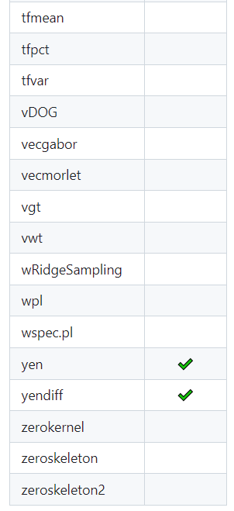
Work 2: Tutorial (based on the Rwave)
Notes:
In addition to the data format conversion completed this week, there are 76 more functions that need to be learned and translated.
I plan to spend four weeks learning and translating the remaining 76 functions, studying and translating about 20 functions each week. For each function, I will follow the same three-step process as before: understanding the theoretical significance, implementing the code, and integrating it with the SCG dataset.

Slide 8
Research
The current situation:
I can use CNN to achieve a satisfactory result of prediction (mae < 3)
CNN can’t predict S well due to the data shift
About D:
Using XAI method to verify whether CNN has learned the right feature
About S:
Using Domain Adaptation method to help CNN learn the invariant feature
Notes:
About research, there are two parts, one focused on S and the other on D.

Slide 9
Work 3: Research (Perturbation-based method)
Key idea:
Alter key features (P2/P1), observe the extent and trend of changes in predictive results, thereby inferring whether the model has learned the key features.
Experimental Design:
Increase(×1.4) and decrease(×0.7) the height of high peaks
Increase(×1.4) the height of high peaks and decrease(×0.7) the height of low peaks
Proportionally increase(×1.4) the height of high peaks and low peaks
Notes:
Regarding D, I employed the XAI (Explainable Artificial Intelligence) method known as Perturbation-based method, just as what i discussed with Professor song last week. I try to alter key features, observe the extent and trend of changes in predictive results, thereby inferring whether the model has learned the key features. I designed three sets of experiments, labeled 1, 2, and 3. In these experiments, 1.4 means increasing peaks magnitude by 1.4 times, and 0.7 means the same and they are reciprocal [rɪˈsɪprəkl].

Slide 10
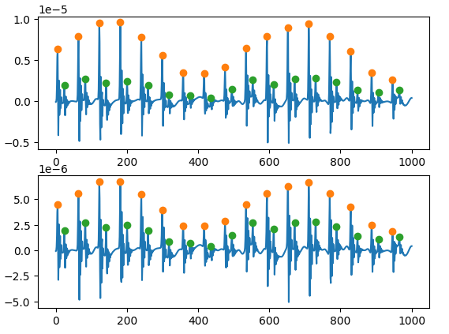
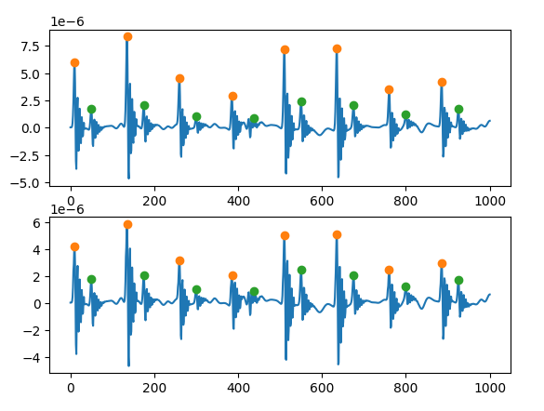
How to change the key feature
I change the heights of the peak points and the two points on each side. It not only won’t impact the statistical features of the signal, but also won’t alter features based on horizontal positions.

Slide 11
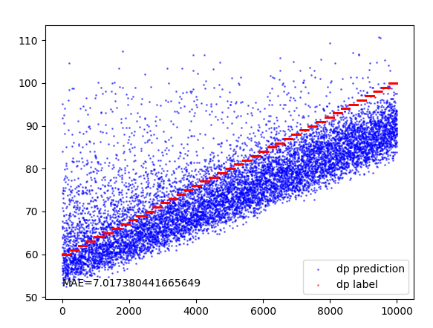
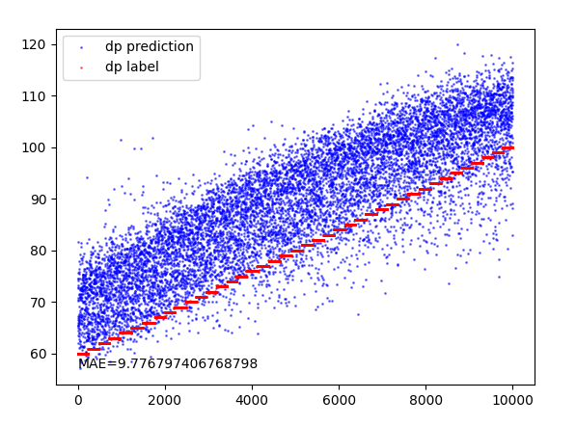
Result of Experiment 1
Key feature: P2(low)/P1(high)
Increase the height of high peaks
Decrease the height of high peaks
Conclusion:
Increasing and decreasing the height of high peaks have opposite effects on predictions, which suggests the possibility that the feature of high peak height has been learned.
Notes:
Experiment 1 involved altering the heights of high peaks. It is evident that these two opposing changes had opposite effects on predictions. Additionally, we observed that the height of high peaks is inversely related to the predictions. This suggests that the CNN has learned features related to the height of peaks, and within this feature, peak height and predictions have an inverse relationship. These results indicate that the CNN has learned a necessary condition for the correct features, as this experiment only pertains to P1.

Slide 12
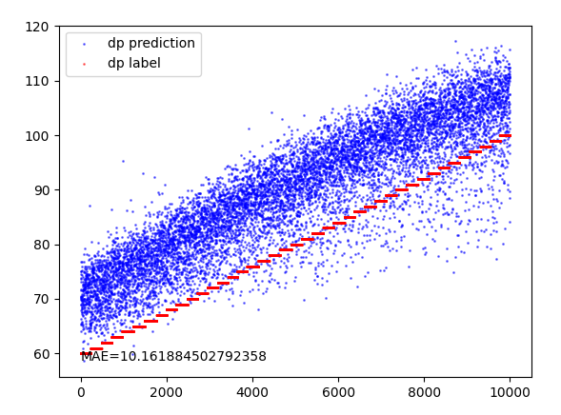
Result of Experiment 2
Key feature: P2(low)/P1(high)
Increase the height of low peaks
Decrease the height of high peaks
Conclusion:
Decreasing the height of high peaks and increasing the height of low peaks have the same impact on predictions, further indicating that the model has learned the correct features.
Notes:
Next, I conducted Experiment 2, where I independently altered the heights of low peaks and decreased the heights of high peaks. The results showed that both changes had a similar impact on the experiment's results. This indicates that the CNN has also learned features related to P2, and there is a positive correlation between P2's height and predictions. These results further align with the characteristics of key features.

Slide 13
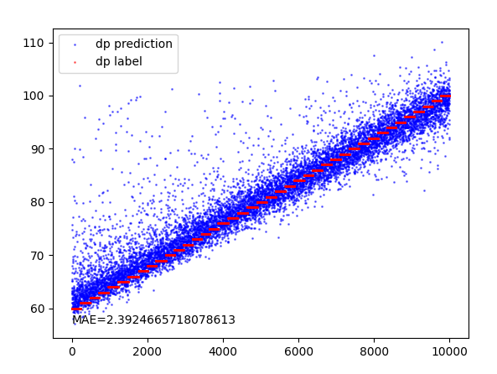
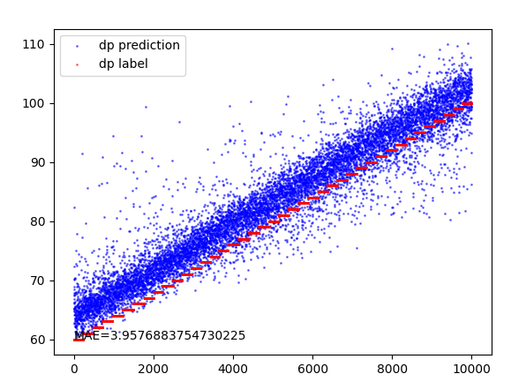
Result of Experiment 3
Key feature: P2(low)/P1(high)
Original height
Proportionally increase the height of high and low peaks
Conclusion:
The model has learned the right features.
Notes:
Finally, in Experiment 3, I proportionally increased the heights of both P1 and P2. The results demonstrated that predictions did not undergo significant changes. This suggests that when key features remain unchanged, the model's predictions also remain stable. This supports the argument that the CNN has learned these key features.

Slide 14
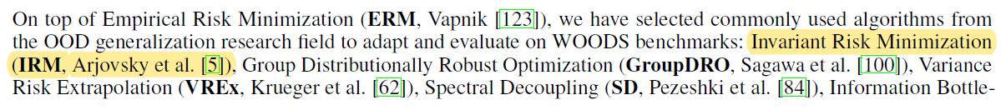
Work 4: IRM^{[1]} (Invariant risk minimization)
Key points:
Learning a feature mapping function that achieves an optimal predictor for all domains in a unified feature space. In other words, there exists a predictor that optimizes the risk for all domains at the same time.
To achieve this goal, the loss function of IRM consists of two components: one is the sum of risks across all environments, which ensures the learning of predictive features, and the other is a penalty term that requires the learned features to make the predictor optimal for each domain.
Implementation Details:
Two datasets for learning invariant features: S ∈ [90,110] and S ∈ [130,150]
One for testing the learning performance: S ∈ [160,180]
[1] Arjovsky M, Bottou L, Gulrajani I, et al. Invariant risk minimization[J]. arXiv preprint arXiv:1907.02893, 2019.
Notes:
The second part of the research is about how to make the CNN to learn the correct features related to S. We know that S have different ranges in different domains, but the relationship between right features and S remains consistent across different domains, as illustrated in my previous presentations. Therefore, I attempted to use domain adaptation methods to help the CNN learn this invariant relationship. I found a method called IRM (Invariant Risk Minimization) in the survey by Professor Song called benchmarks for Out-of-Distribution Generalization in Time Series Tasks . The picture shows the mention of IRM in the survey paper. I learned about IRM through the paper and online resources and implemented it.
Regarding implementation details, I generated three datasets. The first two were used for training the model to learn the invariant relationship, while the third was used to validate the training results. The S in the training sets were set to 90-110 and 130-150, respectively, while the S in the test set was 160-180, differing from those in the training sets. Because the ranges of S in the training sets are distinct, So achieving good performance on both the two training sets requires learning the invariant relationship, rather than relying on features specific to the each training set. If the invariant relationship is learned, the model can perform well on the test set.

Slide 15
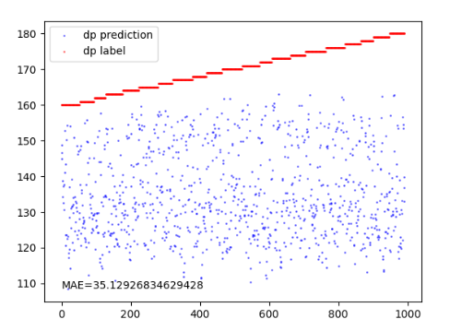
IRM
Most of the predictions are smaller than the labels, indicating that the model is still learning specific features of the training dataset, as the data in the training set is smaller than that in the test set.
Notes:
But the result is not very satisfactory. The red line is the label of the test set.
But I think it still learn something different, because there are many predictions are bigger than 150. We know that biggest value in the trainning set is 150. And I will try to figure out why the result is not good and try other mehods about domain adaptation next week.

Slide 16
Questions:
1. Does this week's tutorial meet the requirements, and where can it be improved?
2. Regarding the translation of R code, there are two ways:
Read "Practical Time-Frequency Analysis" book chapter by chapter and translate the code after finish reading the corresponding chapter.
Learning the code directly and referr to the textbook and online resources when encountering new concepts and difficulties
I think the latter approach might be more efficient. Which do you think would be better?

Slide 17
Thanks for listening

