Slide 1
Weekly Progress Report
Yida Zhang
2023.8.7

Slide 2
Progress
Complex Analysis and Integral Transformations: Two Chapters
Advanced Digital Signal Processing and Noise Reduction: One Chapter
Noise Reduction, Signal Reconstruction and Feature Selection on SCG Signal
Two paper:
Signal Processing Techniques for Removing Noise from ECG Signals
Novel Signal Noise Reduction Method through Cluster Analysis, Applied to Photoplethysmography

Slide 3
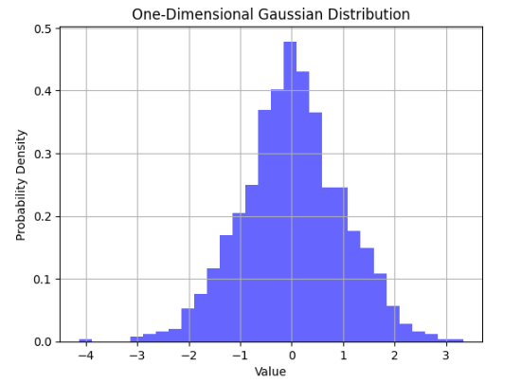
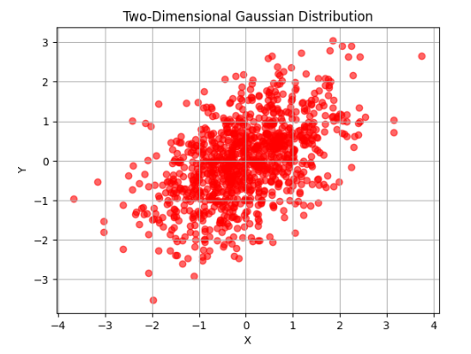
Gaussian Process’s probability distribution
mean = 0
std = 1
mean = [0, 0]
cov = [[1, 0.5], [0.5, 1]]

Slide 4
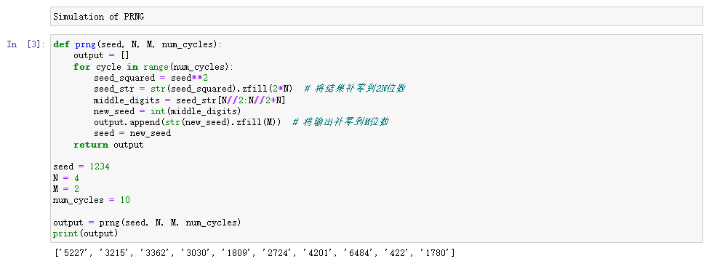
Pseudo-Random Number Generators (PRNG)
Mechanism of PRNG:
(1) Input an initial N-digit seed
(2) Squares the seed to yield a 2N-digit output
(3) The N middle digits of the output is a random number
(4) Treat the random number as a seed and go back to Step 1

Slide 5
Huffman Coding
Input: 111233
Probability: 1: 3/6 2: 1/6 3: 2/6
Prob:1
Prob:1/2
(1)
1
Prob:1/2
0
Prob:1/2
Prob:1/6
(2)
0
1
Prob:1/2
Prob:1/6
Prob:1/3
Prob:1/2
Prob:1/6
Prob:1/3
Prob:1/3
(3)
(1)
(2)
(3)
(1)
(2)
(3)
0
10
11
Output:000101111

Slide 6
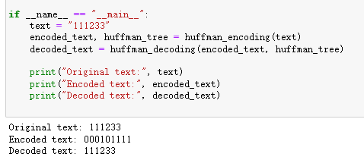
Verification

Slide 7
Respiration Signal Removal
Noise Reduction
Feature Extraction
Feature Selection

Slide 8
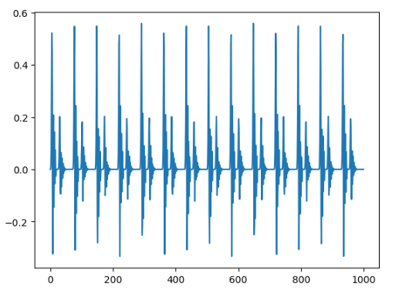
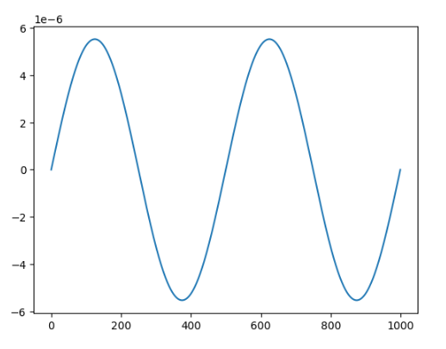
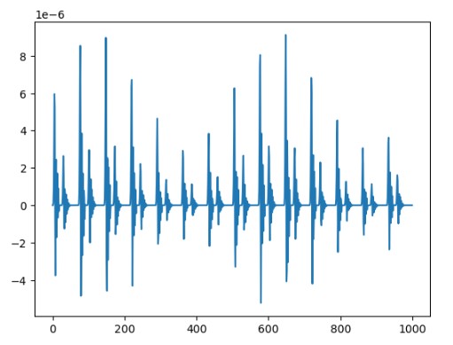
Respiration Signal Removal
Pure SCG
Daubechies wavelet
Respiration Signal
seg_amp*np.sin(2*np.pi*seg_fre*x_space)
SCG with Respiration
SCG = Pure_SCG*(Respiration+2*seg_amp)

Slide 9
Respiration Signal Removal
Assumption 1: The peaks of both peak1 and peak2 are fixed
Assumption 2: The respiration signal is a sinusoidal-shaped signal
Assumption 3: The respiration signal is added to the clean signal through multiplication
For peak1:
Known: H, x
H = (P1 * Sin(wx) + 2 * P1) * P1
Unknown: P1, P2, w
For peak2:
Method: Gradient Descent
Input: x
Output: H
H = (P2 * Sin(wx) + 2 * P1) * P2

Slide 10
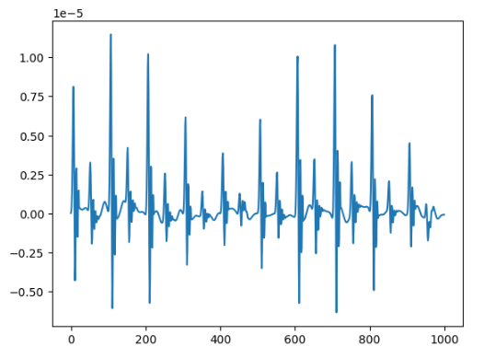
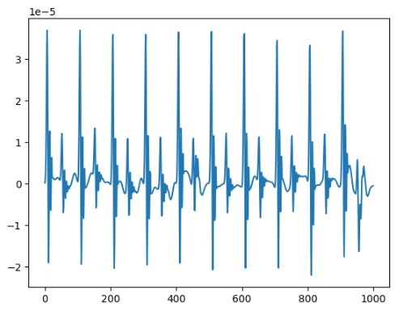
Respiration Signal Removal
Before Respiration Removal
train_set[244,:1000]
After Respiration Removal

Slide 11
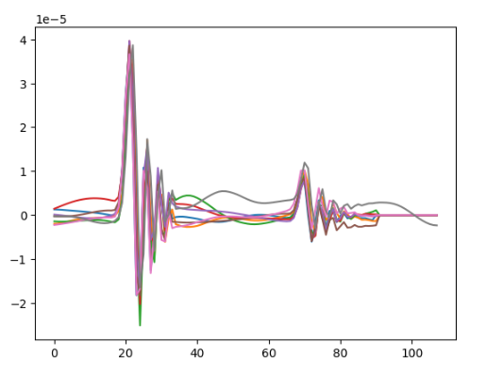
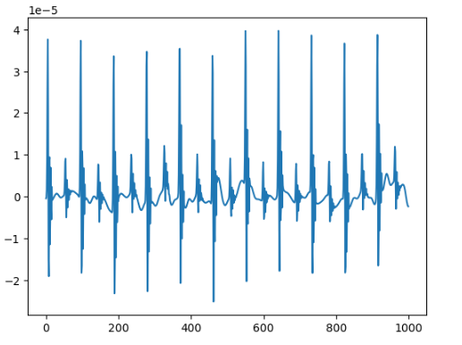
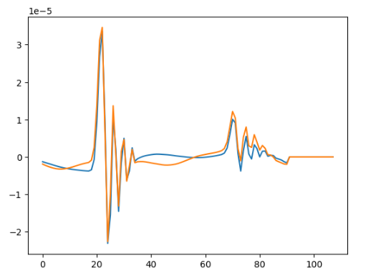
Noise Reduction
Cluster 1: 8 signals
Cluster 2: 2 signals
SCG without Respiration
Reference: Novel Signal Noise Reduction Method through Cluster Analysis, Applied to Photoplethysmography

Slide 12
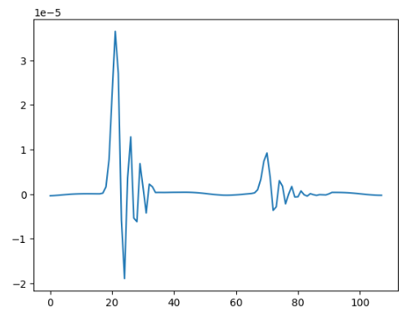
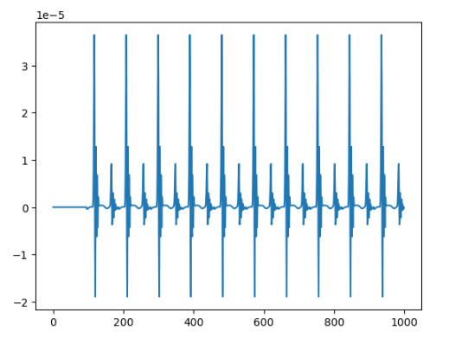
Signal Reconstruction
Average of Cluster 1
Reconstructed Signal
Signal with Noise

Slide 13
Feature Extraction
# Mean
# P1 (Amplitude of Peak)
# P2
# P1-P2
# P1/P2
# D12 (Distance between P1 and P2)
# D21
# D11
# D12/D21
# Skew1
# Skew2
# Kurt1
# Kurt2
# Variance
# PeakToPeak
# Zero Crossing Rate
# Energy
# Number of Periods in 10 Seconds

Slide 14
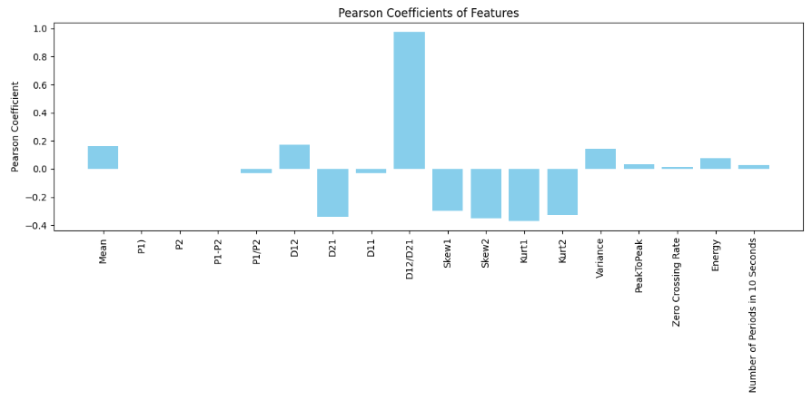
Feature Selection
Pearson correlation coefficient
Selected Features: D12, D12/D21, Skew1, Skew2, Kurt1, Kurt2

Slide 15
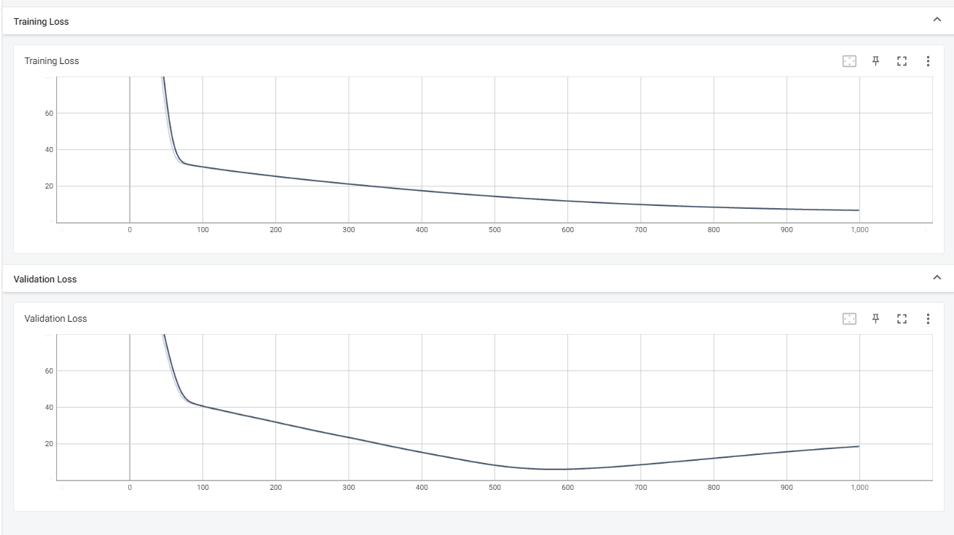
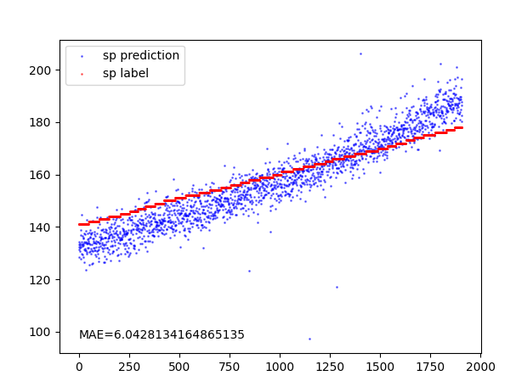
Result (Without Feature Selection)
MAE: 6.04

Slide 16
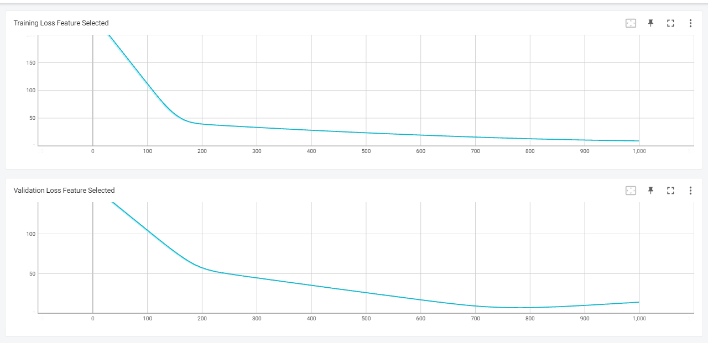
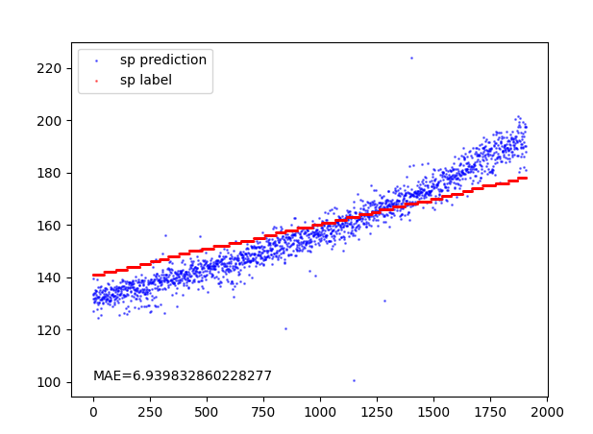
Result (With Feature Selection)
MAE: 6.9

Slide 17
Possible Reasons
In our data, using the Pearson coefficient for feature selection is not suitable because we know that the peak value is also an important feature, but it has been filtered out. Maybe other methods of feature selection can get better result.
Feature selection is only effective when choosing a small number of features from many features such as select 10 from 1000. For a reduction from 12 features to 6 feastures, the effect is not significant.

Slide 18
Study schedule (Next week)
Finish reading the remaining two papers and attempt to implement their methods
Complete the course on Complex Analysis
Choose an appropriate method for feature selection
Continue studying ADSPNR

Slide 19
Question
Why the feature selection have a negtive effect on the result?

Slide 20
Thanks for listening

Slide 21
Verification

