Slide 1
Progress Report
Yida Zhang
8/20/2024

Slide 2
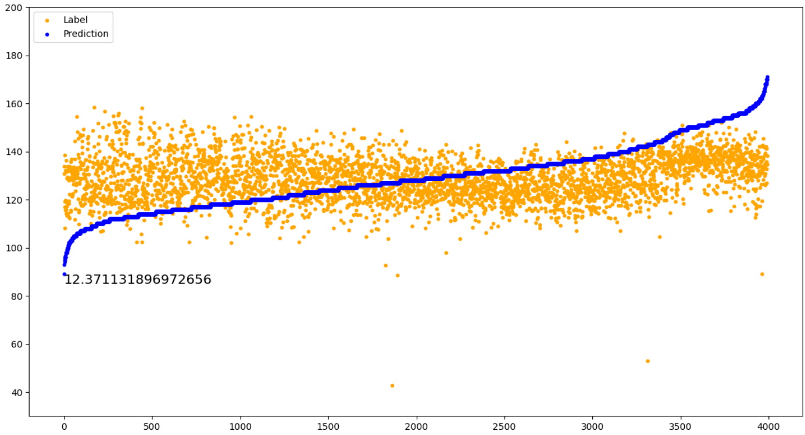
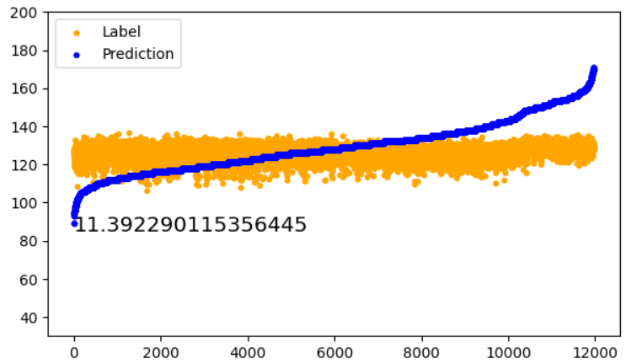
Random Seed | 0 | 42 | 77
MAE | 12.4 | 13.2 | 12.8
Description: Contrastive learning = False, Signal length = 1000
Signal length | 300 | 500 | 1000
MAE | 11.4 | 12.0 | 12.4
Description:
Contrastive learning = False, Random Seed = 0
Test whether TCN performs better on
Notes:
设置不同的seed，用vtcn在长度为1000的信号上进行预测
将信号截成不同的长度，用vtcn进行预测

Slide 3
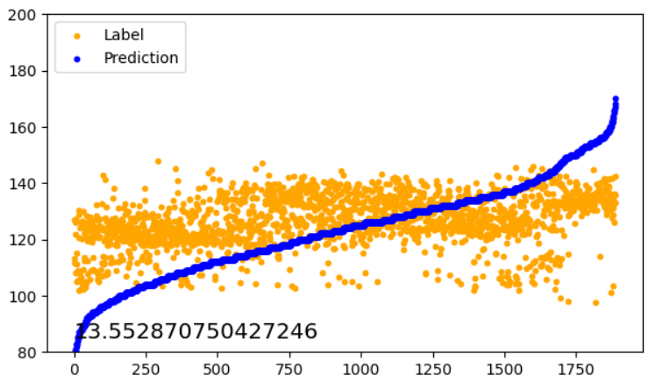
template
Notes:
提取信号template，用vtcn进行预测

Slide 4
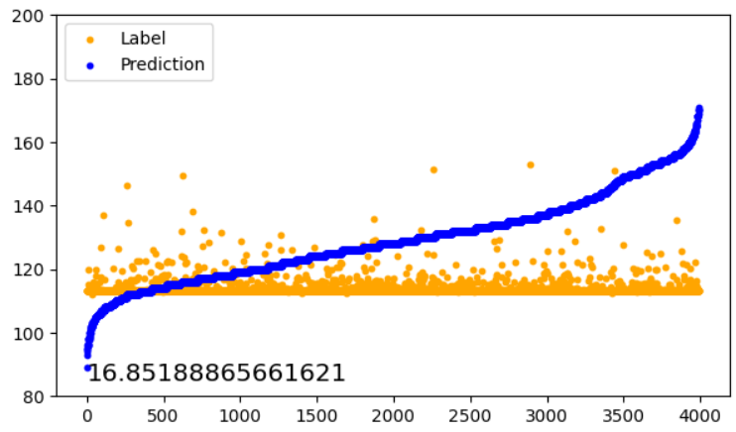
Augmentation | None
MAE | 16.85
Notes:
复现rank n contrast，在长度1000的信号上预测

Slide 5



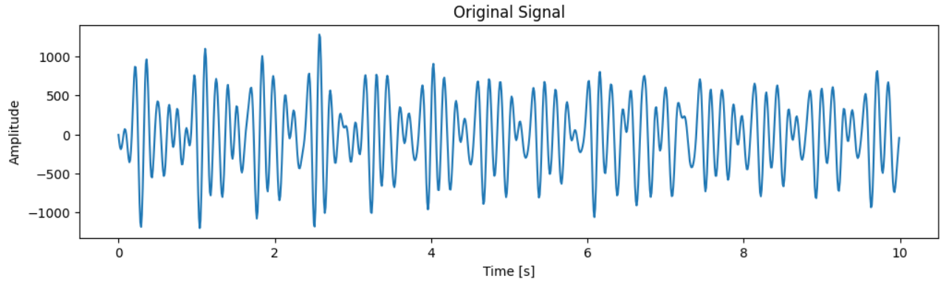
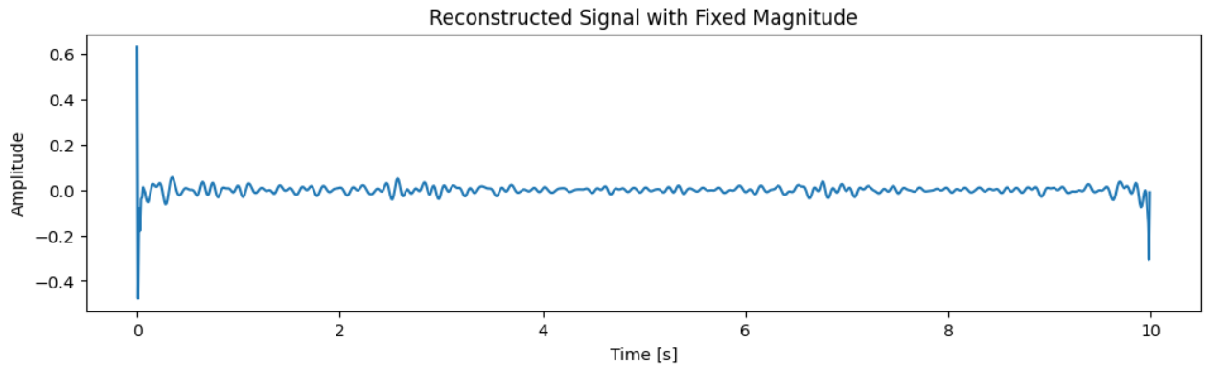
Notes:
说明

