Slide 1
Progress Report
Yida Zhang
8/23/2024

Slide 2
Outline
5 fold and ablation study of VTCN on new STL 3AE4 dataset
Way of separation
Label range of the train set
Use all ICU dataset to train a big model
Notes:
Here is the result of the prediction. The dataset is STL 3AE4 and I separate it into 6 versus 4 as train and test set. The left figure is the result when I plot all the test set. And the right one is the result when we only focus on the range from 90 to 140. Look at the left one, the trend is not obvious, it doesn’t fit the small part and big part. However, when we only focus on the 90-140 part, the trend is very obvious, which shows that if the training data is sufficient, the VTCN can generalize on 3AE4. And why it doesn’t fit well here, it’s because the data amount is very small. They are almost vertical here.

Slide 3
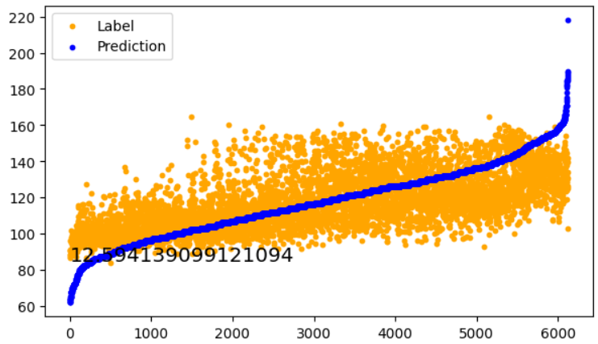
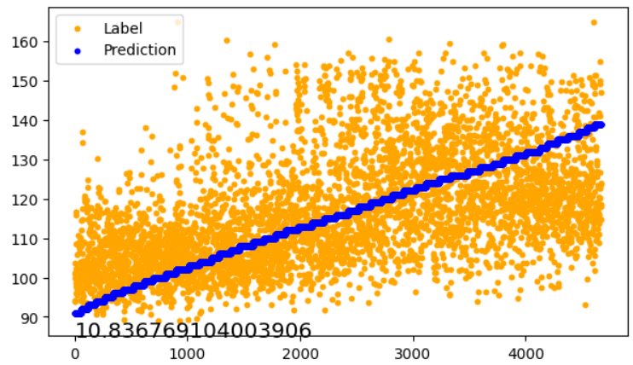
VTCN on STL dataset
Description: Dataset is STL 3AE4, Train/Test ratio: 6/4,
Plot all test data
Plot test data between 90 to 140
Conclusion: On STL 3AE4 dataset, the VTCN can learn the trend of S from 90 to 140. The reason why it can’t fit the large and small range is the small amount of training data in those ranges.
Notes:
Here is the result of the prediction. The dataset is STL 3AE4 and I separate it into 6 versus 4 as train and test set. The left figure is the result when I plot all the test set. And the right one is the result when we only focus on the range from 90 to 140. Look at the left one, the trend is not obvious, it doesn’t fit the small part and big part. However, when we only focus on the 90-140 part, the trend is very obvious, which shows that if the training data is sufficient, the VTCN can generalize on 3AE4. And why it doesn’t fit well here, it’s because the data amount is very small. They are almost vertical here.

Slide 4
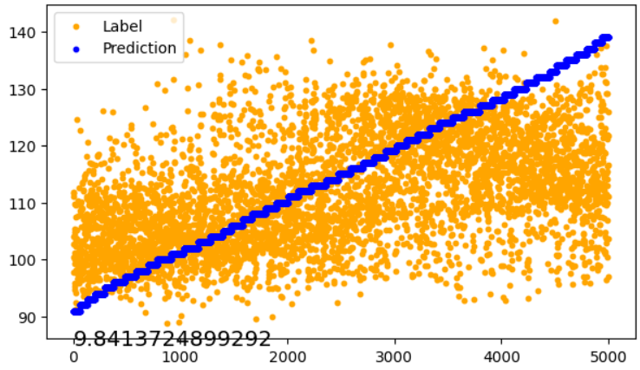
VTCN on STL dataset
Description: Dataset is STL 3AE4, Train/Test ratio: 6/4, the left one uses all train data to train, while the right one uses only train data from 90 to 140 to train
Use train data between 90 to 140 to train
Use all the train data to train
Conclusion: Intuitively, the train and test set should have same range, but the result shows that when the train set is a little bigger, the generalization ability of the model will be enhanced.
Notes:
Then I did some ablation study to explore the effect of the training set. I first use all the training data to train, which is the left figure. Then I use only data from 90 to 140 to train. Intuitively, if the train and test set are in the same range, the result will be better. However, the result shows that when the train set is a little bigger, the result is better. Here we don’t focus on the mae, we only look at the trend. The trend of right figure is better.
I think this is because the extreme value prevent the model from overfitting and then enhancing the generalization ability of the model. That’s why the right figure fits the trend better.

Slide 5
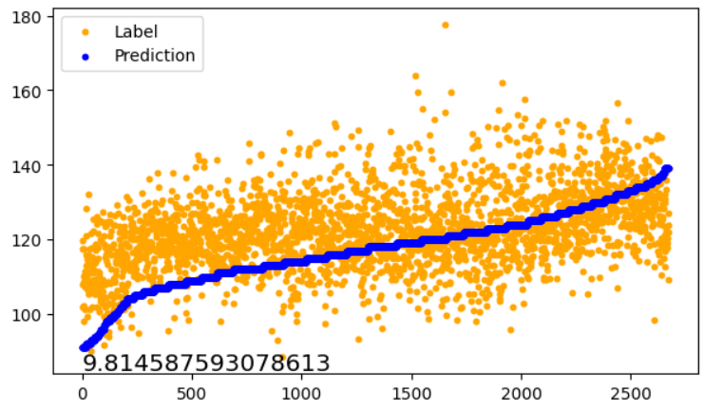
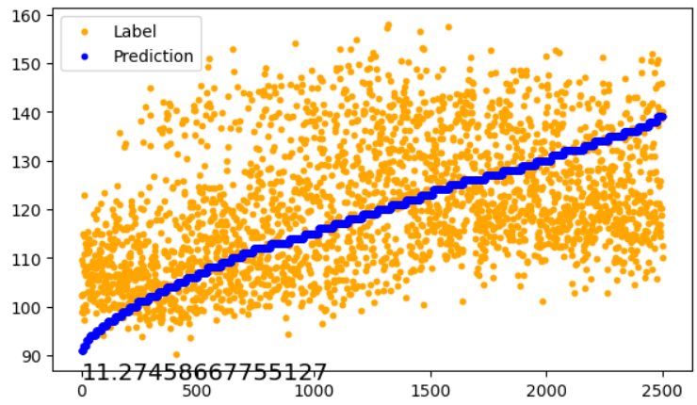
VTCN on STL dataset
Description: Dataset is STL 3AE4, Train/Test ratio: 8/2, the left one uses fold 0 as test set, while the right one uses fold 4 as test set
Fold 0
Fold 4
Conclusion: On the one hand, the two folds both fit the trend, showing the effectiveness of the model; on the other hand, the fold number will influence the result, which proves the model still depends a lot on the data distribution.
Notes:
Then, I try the 5 fold experiment to verify the effectiveness and robustness of the model. In the right figure, we use fold 0 as test set and for the left figure, the test set is fold 4. We can see that

Slide 6
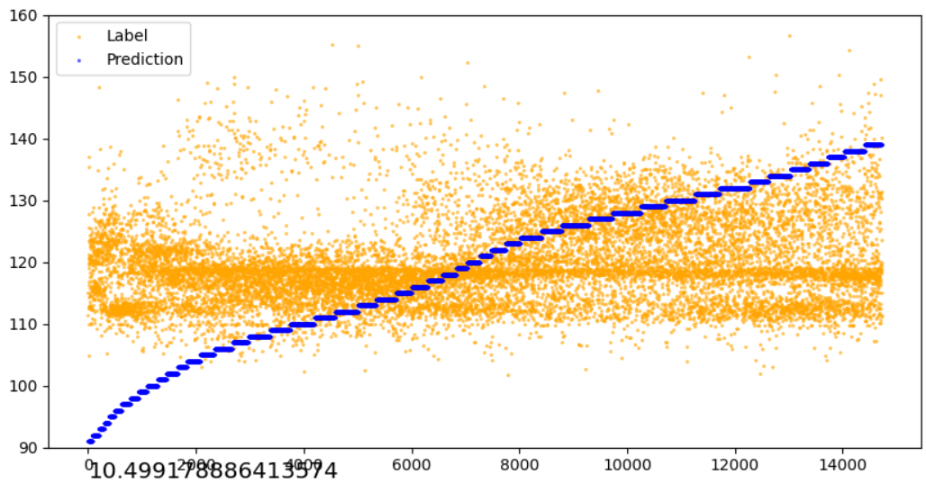
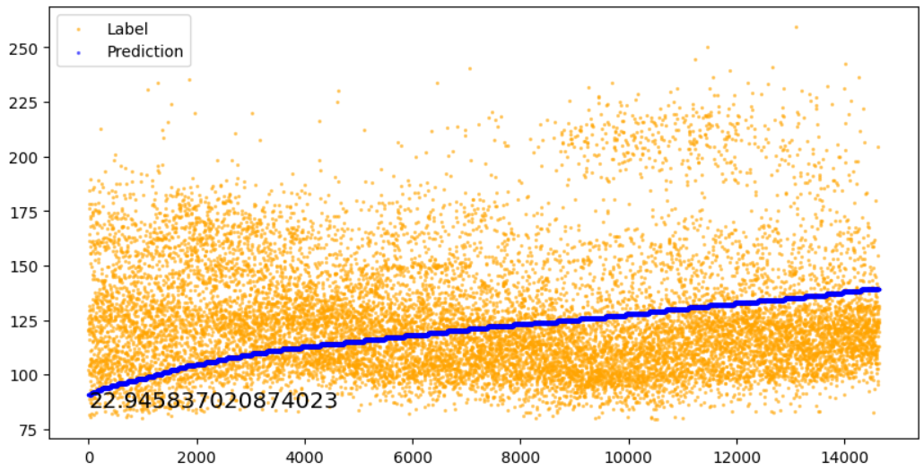
VTCN on all ICU dataset
Description: Dataset is all ICU dataset, use two days as test set and the other as train set
8.6-8.8 as test set
8.16-8.18 as test set
Conclusion: The large amount data doesn’t improve the result.
Notes:
Then I also merged all the ICU dataset to train a big model, to see whether the generalization ability is better. And the result shows

Slide 7
Outline
Try what Prof. Zhang said about the supervised contrastive learning
Try different augmentation method
Use Feature selection layer to integrate other features into the framework

Slide 8
Thanks

