Slide 1
Progress Report
Yida Zhang
8/27/2024

Slide 2
Outline
Contrastive Learning
Threshold
Weighted Threshold
Data Augmentation
Facts
Mixup
Combine other labels into the framework
Notes:
Here is the result of the prediction. The dataset is STL 3AE4 and I separate it into 6 versus 4 as train and test set. The left figure is the result when I plot all the test set. And the right one is the result when we only focus on the range from 90 to 140. Look at the left one, the trend is not obvious, it doesn’t fit the small part and big part. However, when we only focus on the 90-140 part, the trend is very obvious, which shows that if the training data is sufficient, the VTCN can generalize on 3AE4. And why it doesn’t fit well here, it’s because the data amount is very small. They are almost vertical here.

Slide 3
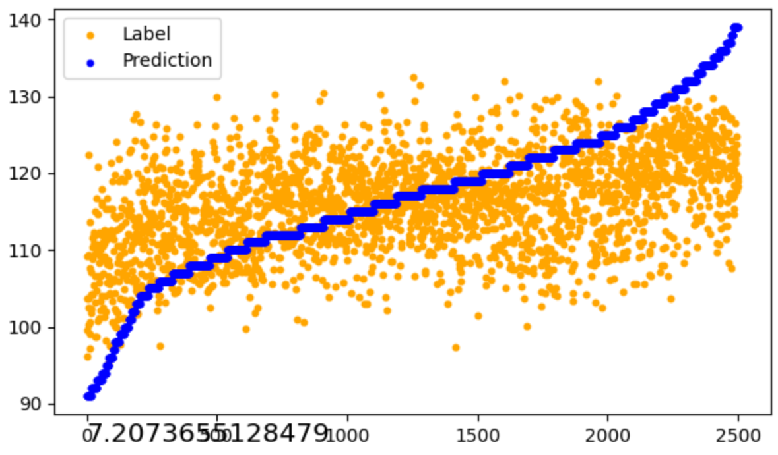
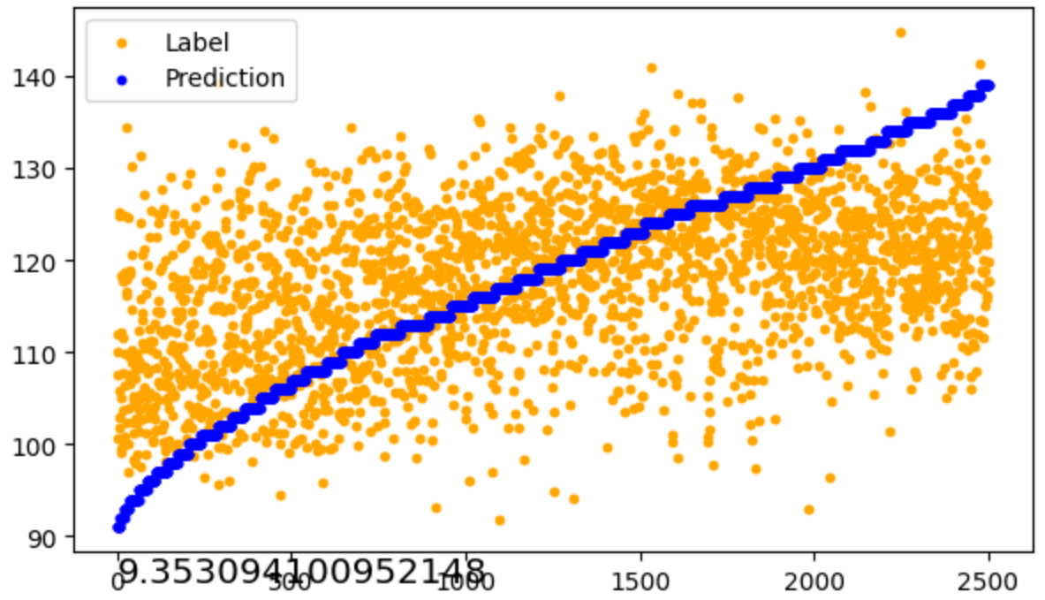
Threshold contrastive learning
Description: Dataset is 3AE4 ranging from 90 to 140 and separated as 5 fold by time. In a minibatch, pairs whose label difference is smaller than 5/10 are positive pairs, other pairs are negative pairs. Without contrastive learning, the MAEs of baseline are around 7.2 (fold 0) and 9.3 (fold 4)
Baseline Fold 0
Baseline Fold 4
Note: The smallest MAE may not has the best trend. Here for the convenient of comparison, we only focus on MAE.
Notes:
Here is the result of the prediction. The dataset is STL 3AE4 and I separate it into 6 versus 4 as train and test set. The left figure is the result when I plot all the test set. And the right one is the result when we only focus on the range from 90 to 140. Look at the left one, the trend is not obvious, it doesn’t fit the small part and big part. However, when we only focus on the 90-140 part, the trend is very obvious, which shows that if the training data is sufficient, the VTCN can generalize on 3AE4. And why it doesn’t fit well here, it’s because the data amount is very small. They are almost vertical here.

Slide 4
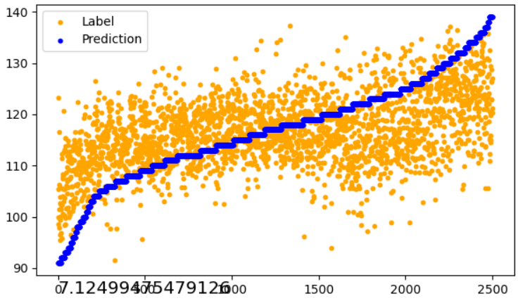
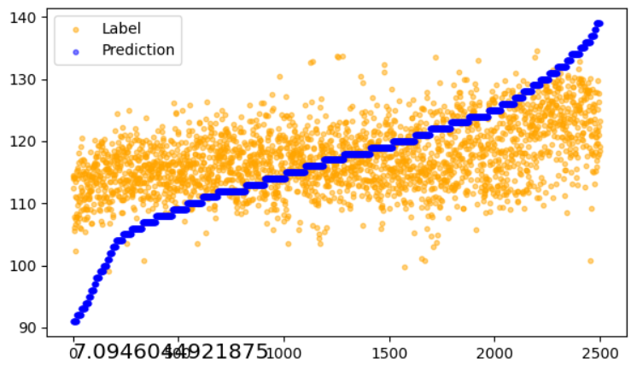
Threshold contrastive learning
Alpha Threshold | 5 | 10 | 50 | 100
5 | 7.12 | 7.43 | 7.61 | 7.61
10 | 7.09 | 7.60 | 7.28 | 7.21
Threshold determines which pair is positive/negative pair; Alpha determines the strength of the contrastive loss
Threshold 5
Alpha 5
Threshold 10
Alpha 5
Notes:
Here is the result of the prediction. The dataset is STL 3AE4 and I separate it into 6 versus 4 as train and test set. The left figure is the result when I plot all the test set. And the right one is the result when we only focus on the range from 90 to 140. Look at the left one, the trend is not obvious, it doesn’t fit the small part and big part. However, when we only focus on the 90-140 part, the trend is very obvious, which shows that if the training data is sufficient, the VTCN can generalize on 3AE4. And why it doesn’t fit well here, it’s because the data amount is very small. They are almost vertical here.

Slide 5
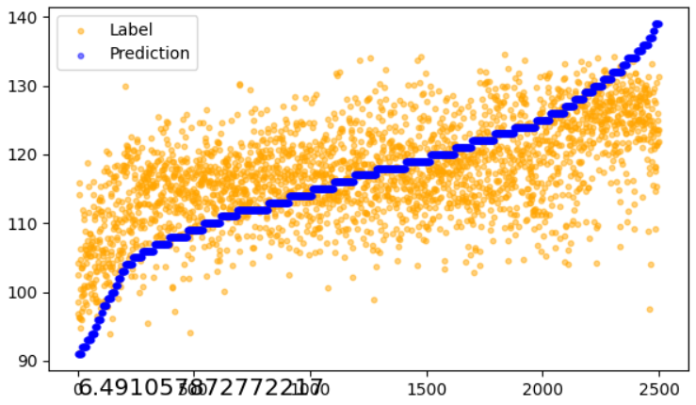
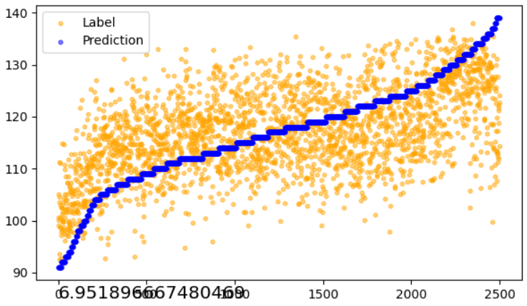
Weighted contrastive learning
Description: Based on the Threshold contrastive learning, we multiple a weight to each pair when calculate the contrastive loss. The weight is determined by the difference of the label, the smaller the difference, the bigger the weight.
Alpha Threshold | 5 | 10 | 50 | 100
10 | 7.54 | 6.49/6.95 | 7.43 | 7.63
Notes:
Here is the result of the prediction. The dataset is STL 3AE4 and I separate it into 6 versus 4 as train and test set. The left figure is the result when I plot all the test set. And the right one is the result when we only focus on the range from 90 to 140. Look at the left one, the trend is not obvious, it doesn’t fit the small part and big part. However, when we only focus on the 90-140 part, the trend is very obvious, which shows that if the training data is sufficient, the VTCN can generalize on 3AE4. And why it doesn’t fit well here, it’s because the data amount is very small. They are almost vertical here.

Slide 6
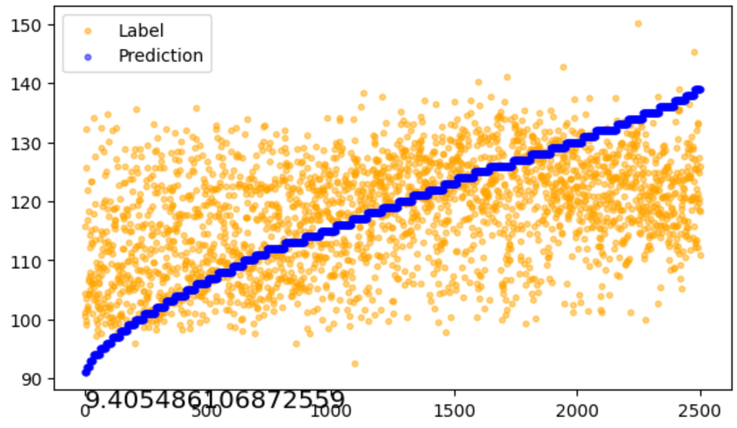
Weighted contrastive learning
Description: Same hyperparameter for fold 4
Baseline fold 4
Fold 4 with weighted contrastive learning
Notes:
Here is the result of the prediction. The dataset is STL 3AE4 and I separate it into 6 versus 4 as train and test set. The left figure is the result when I plot all the test set. And the right one is the result when we only focus on the range from 90 to 140. Look at the left one, the trend is not obvious, it doesn’t fit the small part and big part. However, when we only focus on the 90-140 part, the trend is very obvious, which shows that if the training data is sufficient, the VTCN can generalize on 3AE4. And why it doesn’t fit well here, it’s because the data amount is very small. They are almost vertical here.

Slide 7
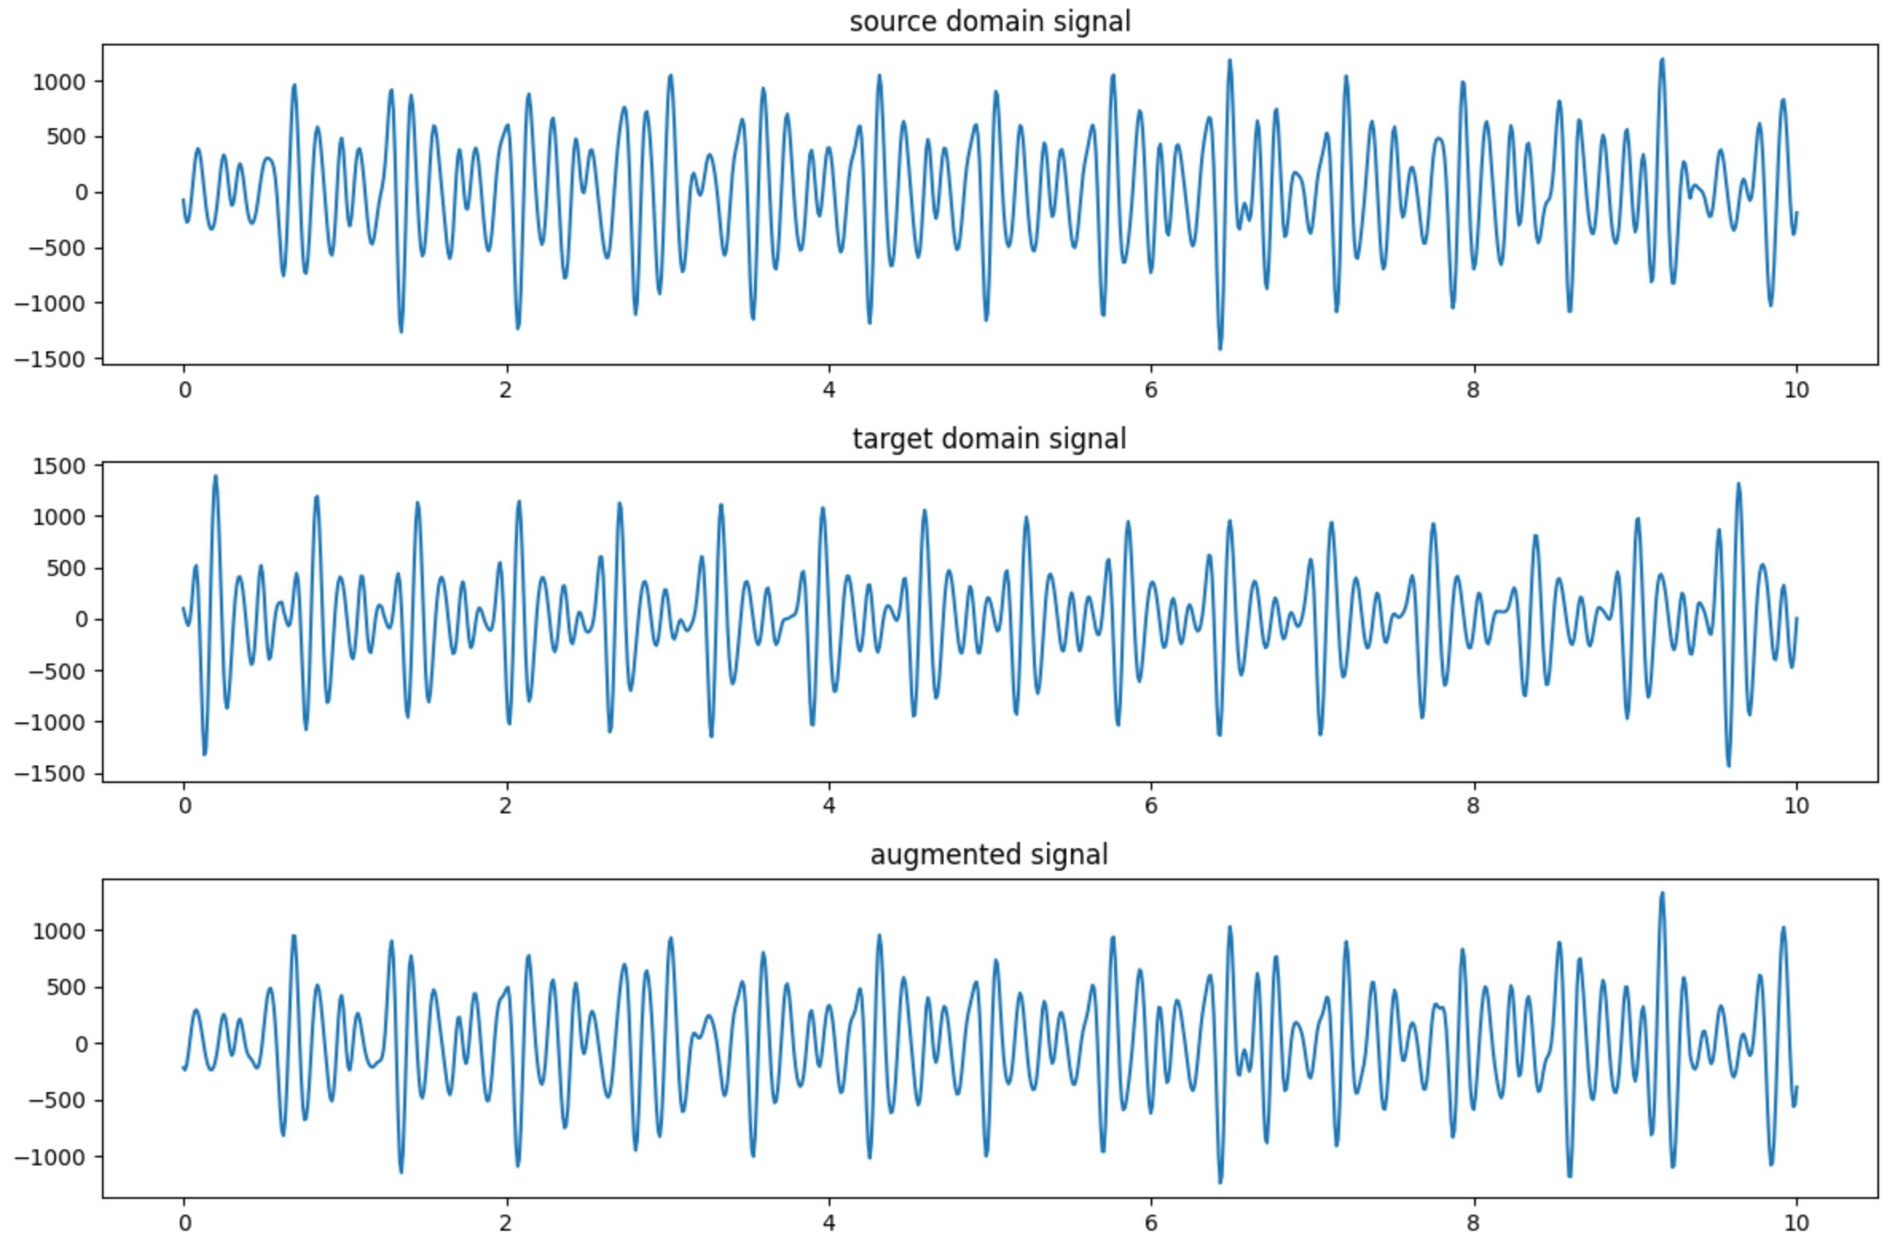
Data augmentation with Facts
Description: Mix the magnitude spectrum of the training and test sets proportionally
Notes:
Here is the result of the prediction. The dataset is STL 3AE4 and I separate it into 6 versus 4 as train and test set. The left figure is the result when I plot all the test set. And the right one is the result when we only focus on the range from 90 to 140. Look at the left one, the trend is not obvious, it doesn’t fit the small part and big part. However, when we only focus on the 90-140 part, the trend is very obvious, which shows that if the training data is sufficient, the VTCN can generalize on 3AE4. And why it doesn’t fit well here, it’s because the data amount is very small. They are almost vertical here.

Slide 8
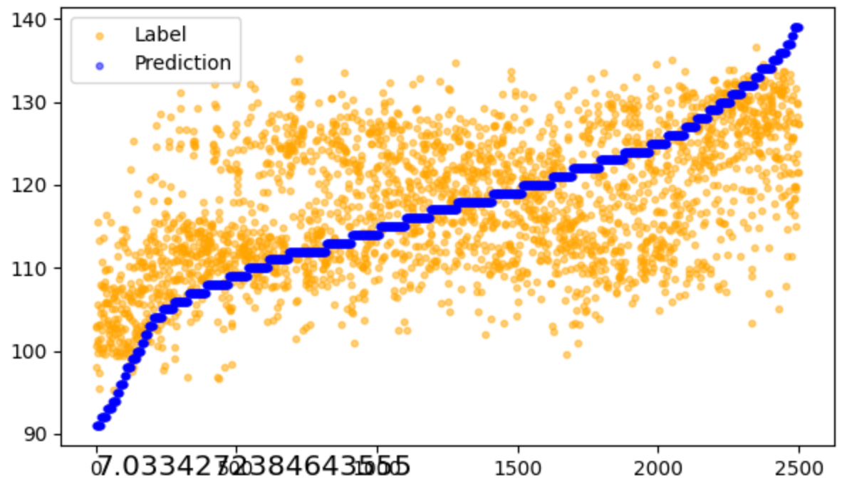

Data augmentation with Facts
Mix ratio | 0.2 | 0.5 | 0.8
Fold 0 | 7.03 | 8.52 | 8.63
Fold 4 | 9.90 | 9.23 | 8.95
Fold 0 baseline: 7.21
Fold 4 baseline: 9.35
Fold 0
Fold 0
Notes:
Here is the result of the prediction. The dataset is STL 3AE4 and I separate it into 6 versus 4 as train and test set. The left figure is the result when I plot all the test set. And the right one is the result when we only focus on the range from 90 to 140. Look at the left one, the trend is not obvious, it doesn’t fit the small part and big part. However, when we only focus on the 90-140 part, the trend is very obvious, which shows that if the training data is sufficient, the VTCN can generalize on 3AE4. And why it doesn’t fit well here, it’s because the data amount is very small. They are almost vertical here.

Slide 9
Data augmentation with Mixup
Description: Mix the signal of training and test sets proportionally
Mix ratio | 0.2 | 0.5 | 0.8
Fold 0 | 8.10 | 7.90 | 8.06
Fold 4 | 9.35 | 9.18 | 9.35
Fold 0 baseline: 7.21
Fold 4 baseline: 9.35
Description: Mix both signal and label of training sets proportionally
Mix ratio | 0.2 | 0.4
Fold 0 | 8.10 | 7.90
Fold 4 | 9.35 | 9.18
Notes:
Here is the result of the prediction. The dataset is STL 3AE4 and I separate it into 6 versus 4 as train and test set. The left figure is the result when I plot all the test set. And the right one is the result when we only focus on the range from 90 to 140. Look at the left one, the trend is not obvious, it doesn’t fit the small part and big part. However, when we only focus on the 90-140 part, the trend is very obvious, which shows that if the training data is sufficient, the VTCN can generalize on 3AE4. And why it doesn’t fit well here, it’s because the data amount is very small. They are almost vertical here.

Slide 10
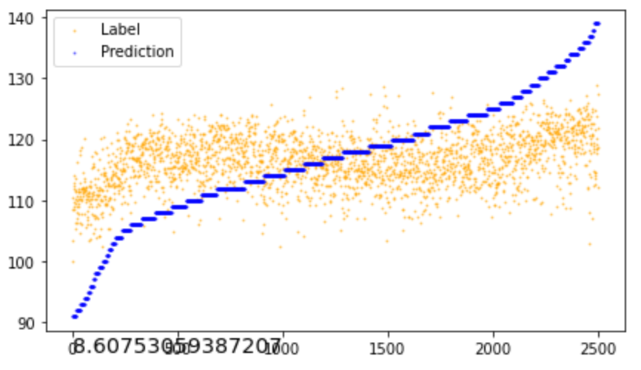
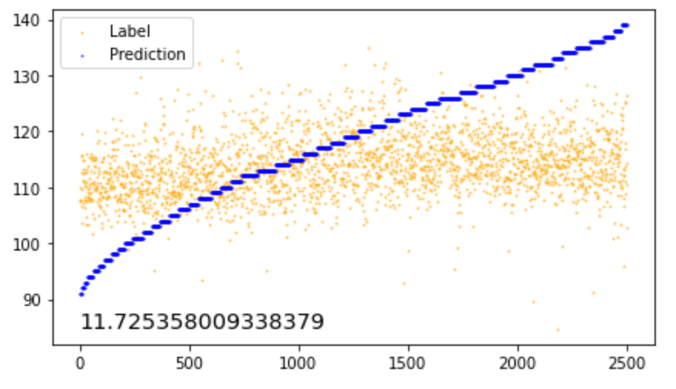
Combine other labels into the framework
fold 0
fold 4
Notes:
Here is the result of the prediction. The dataset is STL 3AE4 and I separate it into 6 versus 4 as train and test set. The left figure is the result when I plot all the test set. And the right one is the result when we only focus on the range from 90 to 140. Look at the left one, the trend is not obvious, it doesn’t fit the small part and big part. However, when we only focus on the 90-140 part, the trend is very obvious, which shows that if the training data is sufficient, the VTCN can generalize on 3AE4. And why it doesn’t fit well here, it’s because the data amount is very small. They are almost vertical here.

Slide 11
Thanks

