Slide 1
Progress Report
Yida Zhang
8/30/2024

Slide 2
Outline
Experiments with all ICU dataset
Dataset Generation

Slide 3
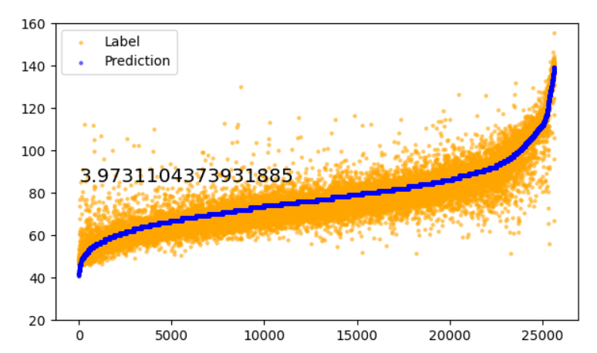
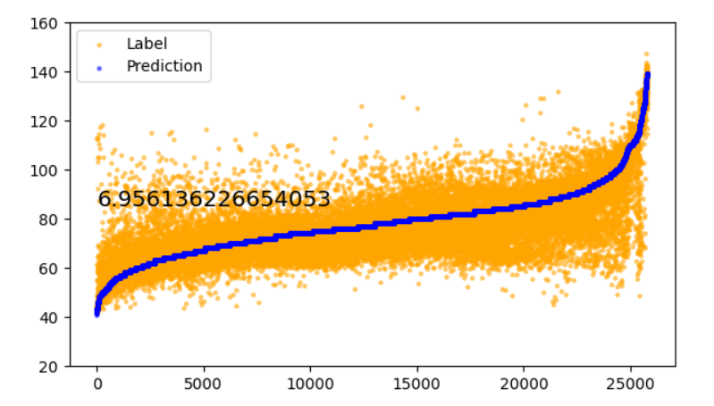
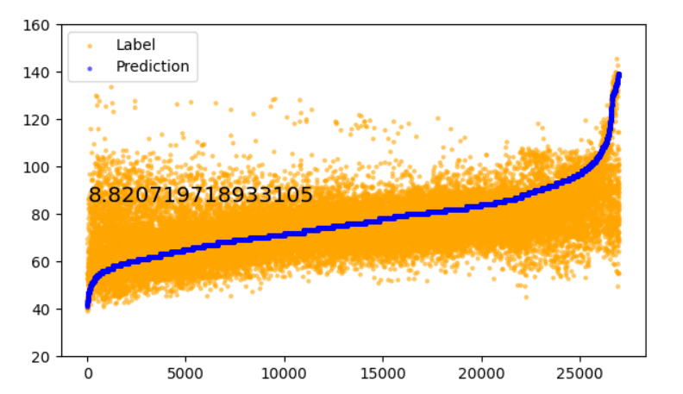
Experiments with all ICU data
Description:
Setup1: Random shuffle all the data by time
Setup2: Treat the data in the same hour as a whole and random shuffle them
Setup3: Treat the data in the same two hour as a whole and random shuffle them
Setup 1
Setup 2
Setup 3
This result shows the existence of the time variation again and indicates that the temporal generalization ability of the TCN is less than one hour if we want a MAE less than 5.

Slide 4
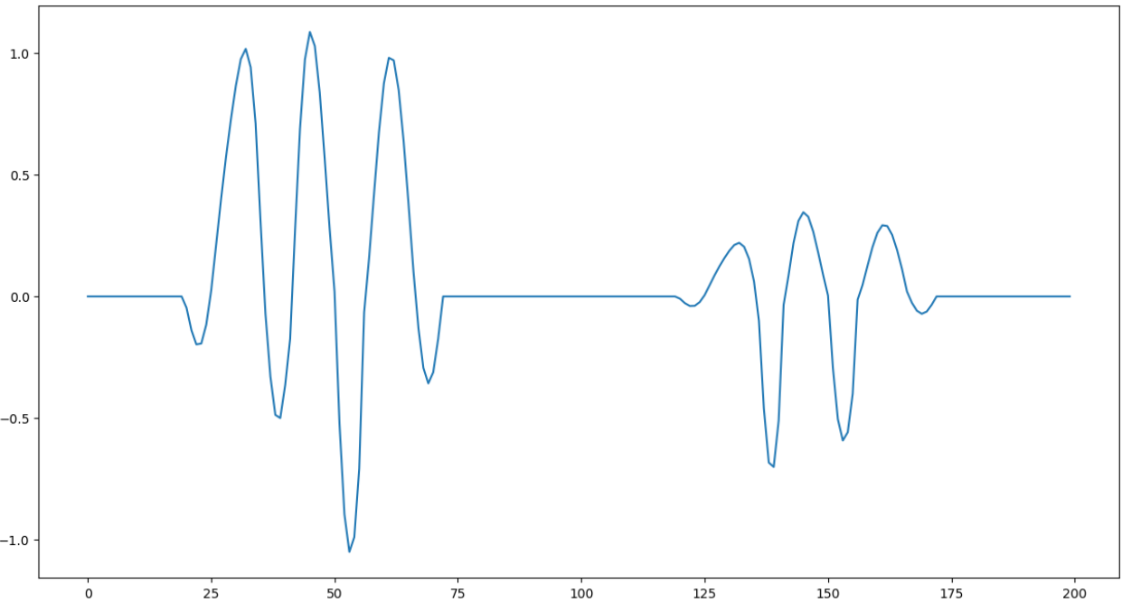
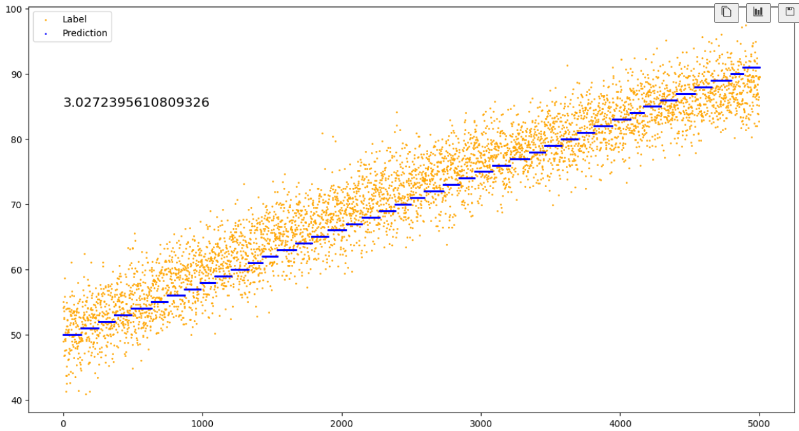
Signal Generation
I tried different noise type, noise level, pulse type and different equations, but DL can all learn the trend.
J1
J2
I1
K2
For D, the equation is: D = 30 * (IJ1 – JK2) = 30 * [(Y_{J1} – Y_{I1}) - (Y_{J2} – Y_{K2})]
The TCN can not only identify the main peak of both S and D cycle, but also can identify the I and K valley in the situation of a lot of random noise. It can distinguish between left and right as well.

Slide 5
Thanks

