Slide 1
Progress Report
Yida Zhang
9/6/2024

Slide 2
Outline
Dataset Generation
Notes:
This week, my main task was generating the dataset, corresponding to steps 4 and 5 in the Google document.

Slide 3
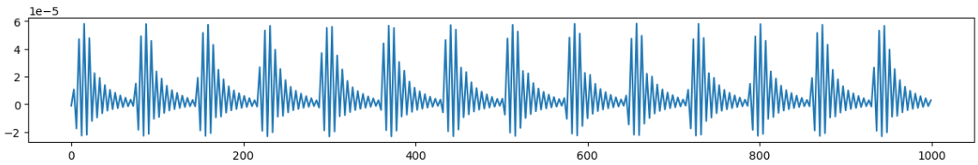
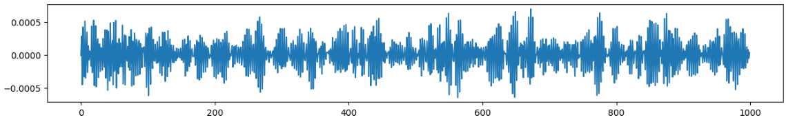
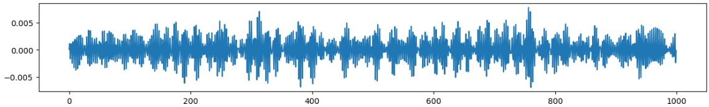
Dataset Generation
Description: Step 4: add white noises or other noises to the waveforms. Implementation: Waveform + mag * np.random.uniform(-1,1,1000) mag = 1e-5/1e-4/1e-3/1e-2
Baseline
Mag = 1e-3
Mag = 1e-2
Notes:
Step 4 involves adding noise to the waveform. My method of adding noise is shown in this formula, and I experimented with four different noise amplitudes. To explore the effect of noise alone, I added it directly to the baseline dataset, instead of the dataset with TPR noise. The following shows the original signal and the signal after adding noise at two different amplitudes.
As can be seen, after adding high-amplitude noise, the signal completely loses its original shape, and theoretically, the deep learning (DL) model shouldn’t be able to learn the trend.

Slide 4
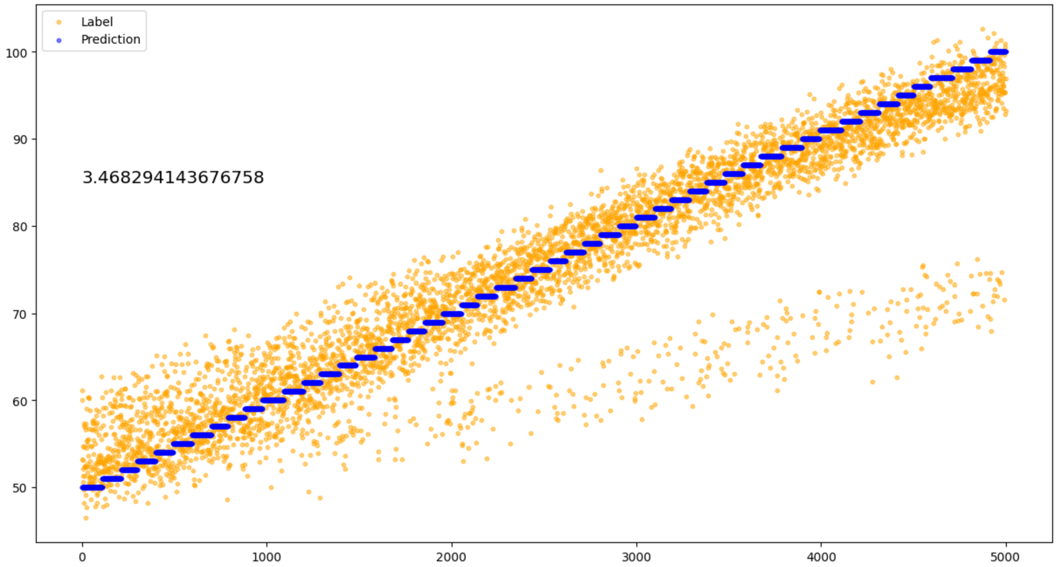
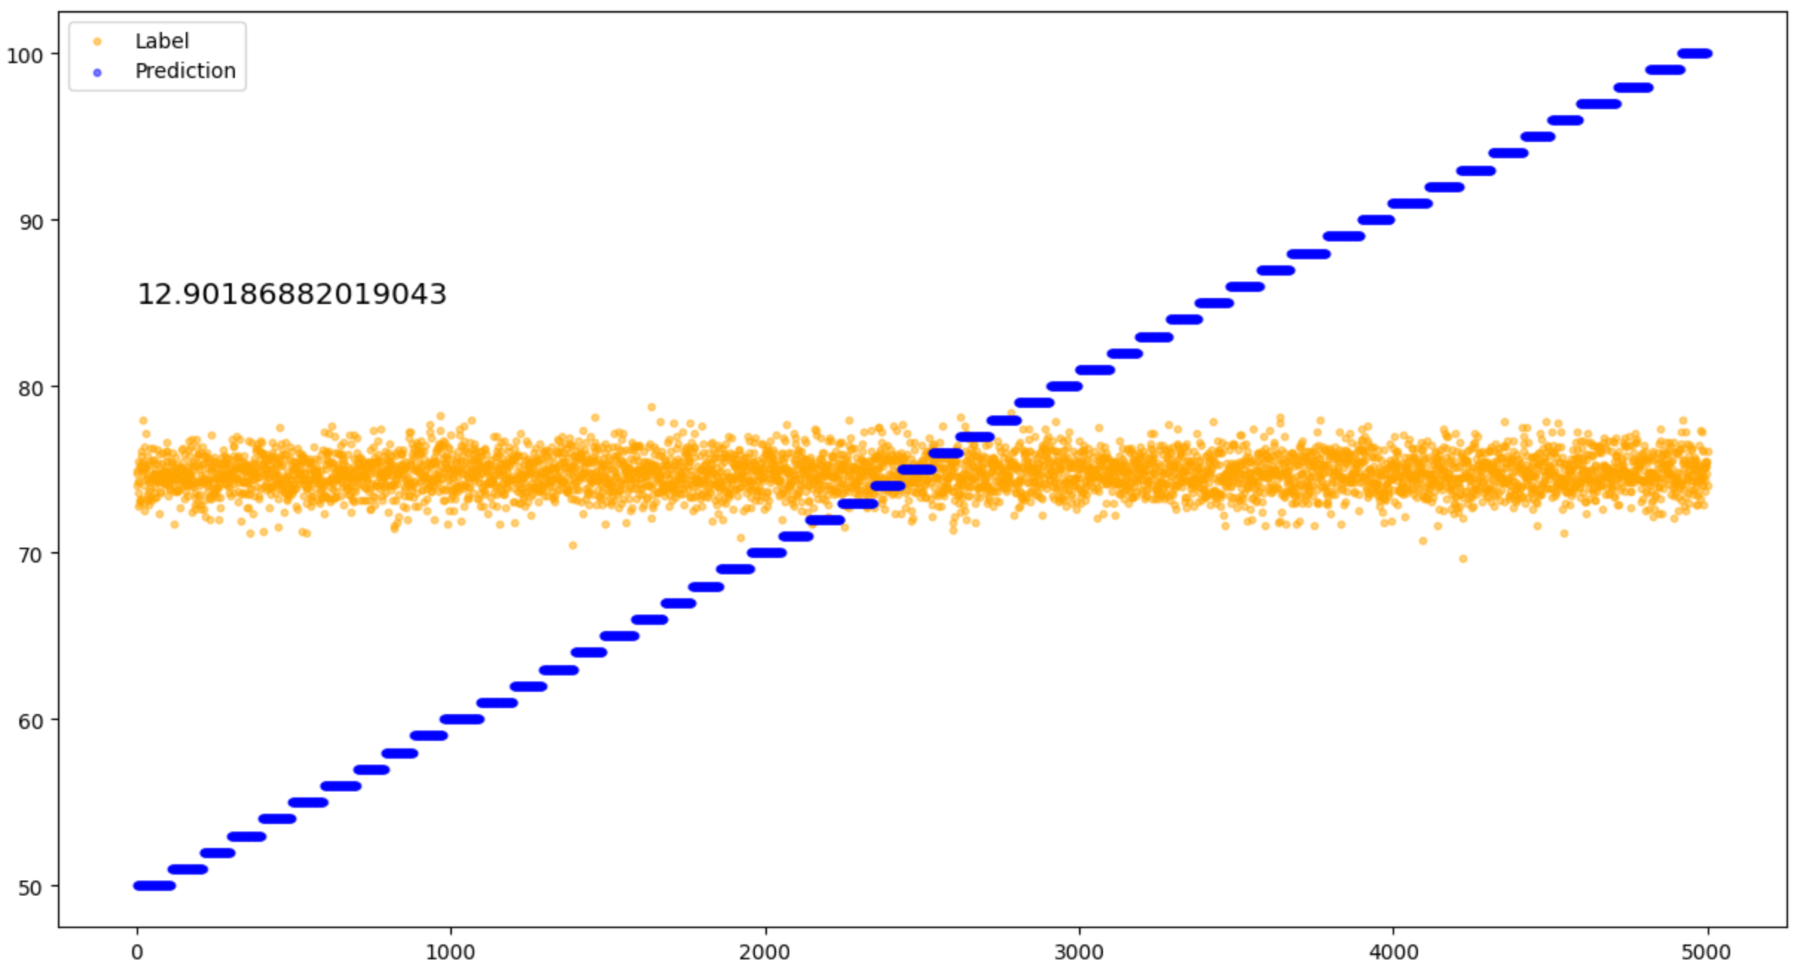
Result of Step 4
Mag = 1e-3 (DL)
Mag = 1e-2 (DL)
Conclusion: Noises with mag greater than 1e-2 will prevent DL learning the trend. For DSP, we can use bandpass filter to remove the noise, so that it can learn the trend.
Notes:
However, surprisingly, the experimental results show that even when the noise amplitude is as large as 1e-3, the DL model can still learn the trend. It’s only when the amplitude increases to 1e-2 that the DL model fails. Therefore, the conclusion is that noises with an amplitude greater than 1e-2 will prevent the DL model from learning the trend. For digital signal processing (DSP), we can use a bandpass filter to remove the noise so that it can still learn the trend.

Slide 5
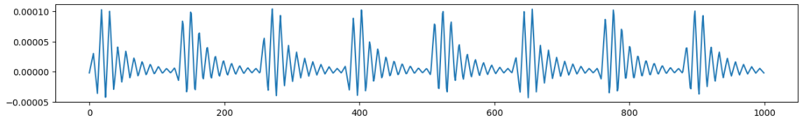
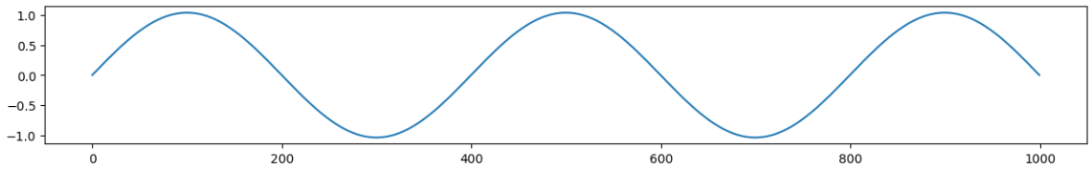
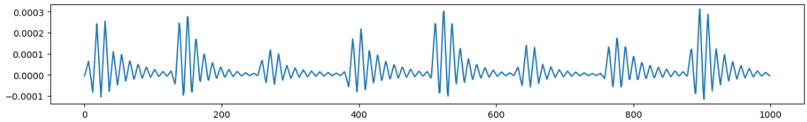
Dataset Generation
Description: Step 5: add respiration effect on top of the signals from step 4
Baseline
Respiration component
Baseline with respiration
Notes:
Step 5 involves adding the effect of respiration to the waveform. Similarly to step 4, to explore the effect of respiration alone, I added it directly to the baseline dataset, instead of the dataset with TPR noise. The three images below show the original signal, the respiration component, and the signal after adding respiration.

Slide 6
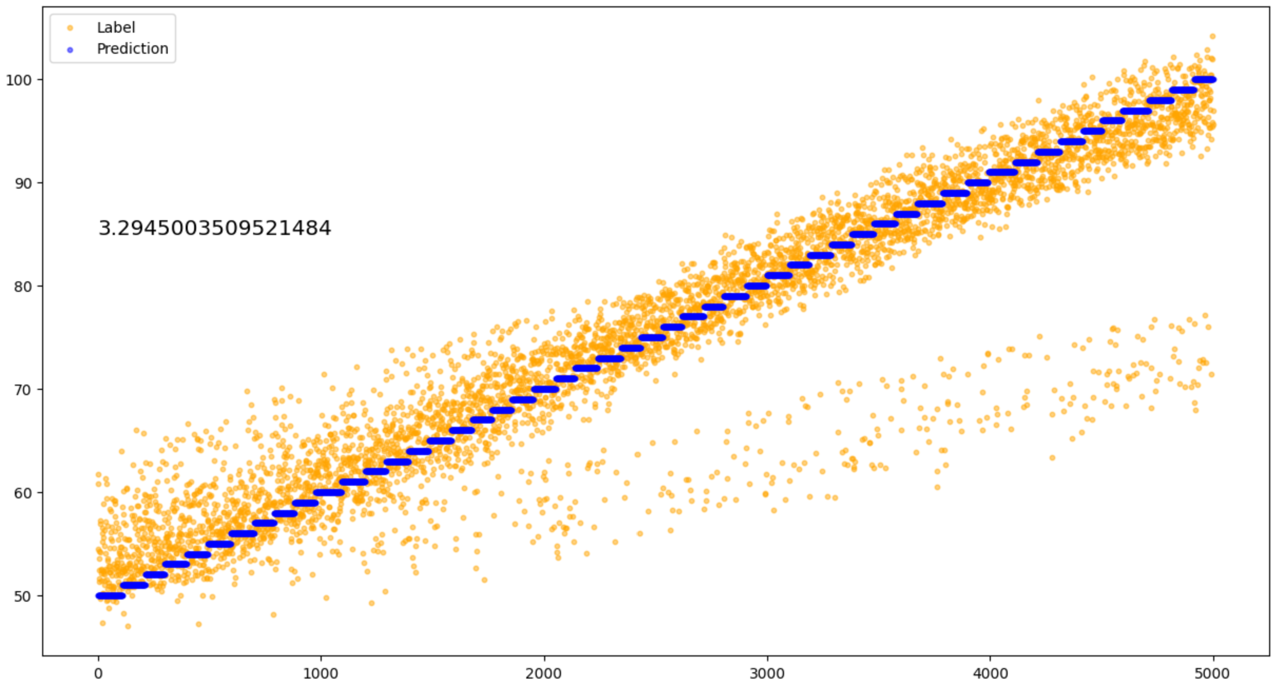
Result of Step 5
Result of baseline with respiration
Conclusion: Respiration will not prevent DL learning the trend.
Notes:
From the experiments, we found that the DL model can still learn the trend in the signal with respiration.

Slide 7
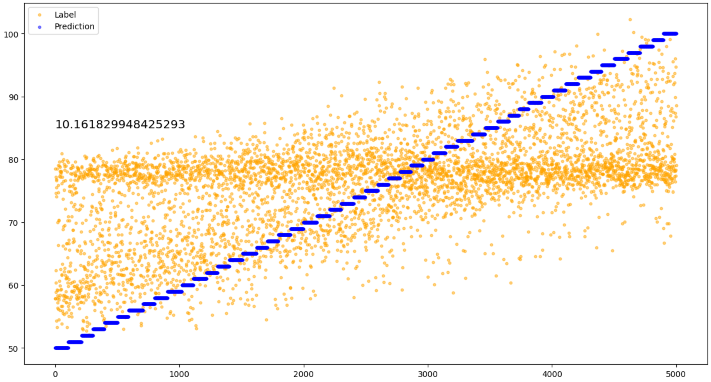
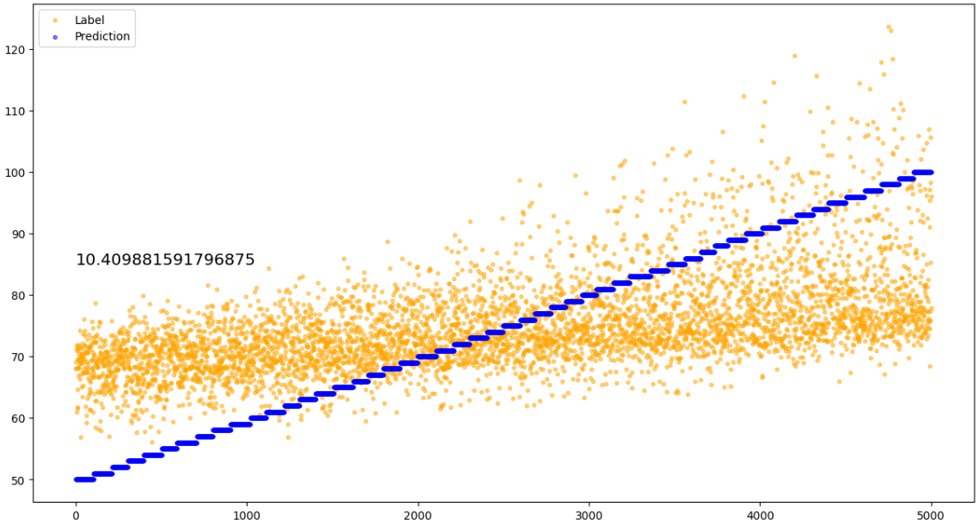
Dataset Generation
Description: Add noise changing with baseline and respiration
DL
DSP
Notes:
Finally, I added both respiration and time-varying TPR noise to the baseline dataset. The experimental results show that neither the DL model nor the DSP method can learn the trend. For the DL model, this is reasonable since we did not provide it with any time-related information, so it cannot learn the time-varying TPR noise. However, for the DSP method, we did provide time information, so I investigated why the DSP method failed and identified three main factors.

Slide 8
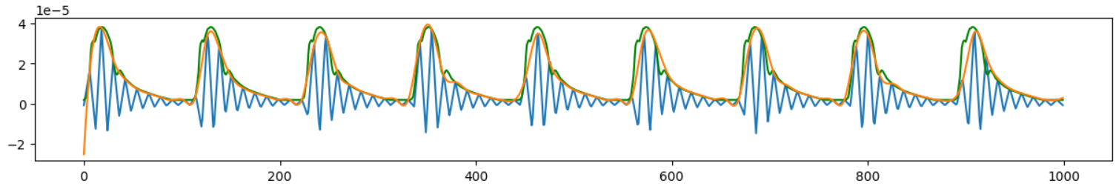
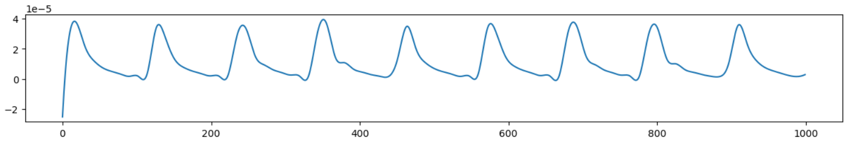
Reason why DSP can’t learn the trend
Reason1: Inaccurate envelope extraction
Reason2: Wrong detection of the small valley
Reason3: Hard to remove the effect of respiration by DSP
Green: Ground Truth Envelope, Orange: Calculated Envelope
Calculated Envelope

Slide 9
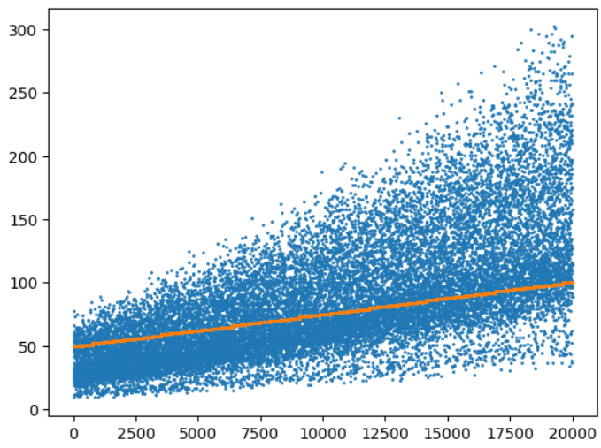
Validation of calculation of SV
Calculated MAP = Calculated SV * HR * TPR, where HR and TPR is the same as the label
Blue dots are calculated MAP and Orange dots are real MAP

Slide 10
Thanks

