Slide 1
Progress Report
2024.1.22
Yida Zhang

Slide 2
Outline
Workflow to choose right lambda and features
An idea to get the proper representation in DL
Questions

Slide 3
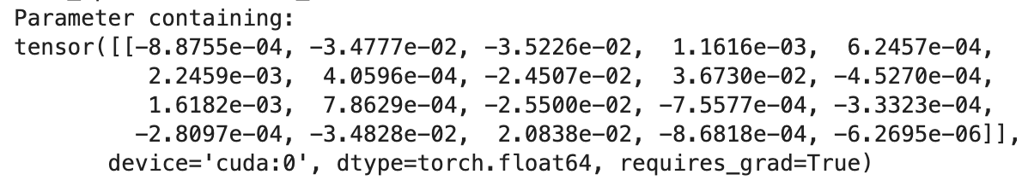
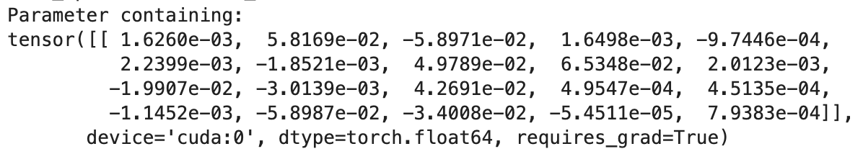
Two Problems
Lambda selection
The index of right features are: [1, 2, 7, 8, 10, 12, 16, 17]
lambda = 0.2
lambda = 0.1
Criteria for selection
How to determine which feature to be chosen?
Choose weights greater than e-2 or greater than e-3?
Notes:
In the last presentation, we know that when the lambda is too big, the algorithm will miss some right features. When some featuers are missed, we need to reduce the lambda mannully, so that we can get the right number of features. For example, in these two pictures, we reduce the lambda from 0.2 to 0.1, so we can capture the missed feature.
However, in real scenario, we don’t know how many features we should choose, so we don’t know how to adjust the lambda. So lambda selection is the first problem that needs to be solved.
And the second problem is how to select features based on the weights. For example, here is the weight of the feature selection layer and this is all we know. Should we only choose the weight greater than e-2 or also choose the weight greater than e-3.
For the problems above, I design a workflow to solve them. Let’s focus on the criteria for selection first.

Slide 4
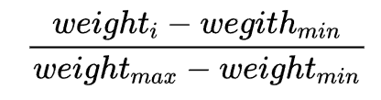
Adaptive Criteria
Use a proportion X as the selection criteria
The proportion of i-th weight:
Example:
Proportion of weights: 0%, 17%, 23%, 35%, 44%, 73%, 100%
X: 50%
Selected weights: 73%, 100%
Idx of function | 7 | 17 | 18 | 20 | 21 | 22
min_right | 17% | 39% | 37% | 69% | 73% | 15%
max_wrong | 4% | 19% | 17% | 7% | 21% | 5%
We can’t get an X satisfying both function 7 and function 21. In other words, the locations of right weights vary a lot between functions, so that we can’t use proportion to determine them.
Notes:
At beginning, I think a adaptive criteria may be suitable.
I use a proportion X as the selection criteria. The definition of a weight’s proportion is here. It denotes the location of a weight in the interval formed by the maximum weight and the minimum weight. Due to that right features’weight are bigger than wrong features’weight. So we can use a X to separate them and use it as a selection criteria.
For example, we have some proportion of weights and we choose the X to be 50. So the selected weights are these two.
So the next thing is find a X that suitable for all the functions. I calculate minimum right weights and maximum wrong weights of all functions. And the suitable X should be smaller than min_right and bigger than max_wrong for all functions. Here I show some functions for illustration. We can find that the min_right weight of funtion 7 is smaller than the max_wrong weight of function 21, which means that we can’t get an X satisfying both function 7 and function 21. In other words, the locations of right weights vary a lot between functions, so this adaptive criteria doesn’t work.

Slide 5
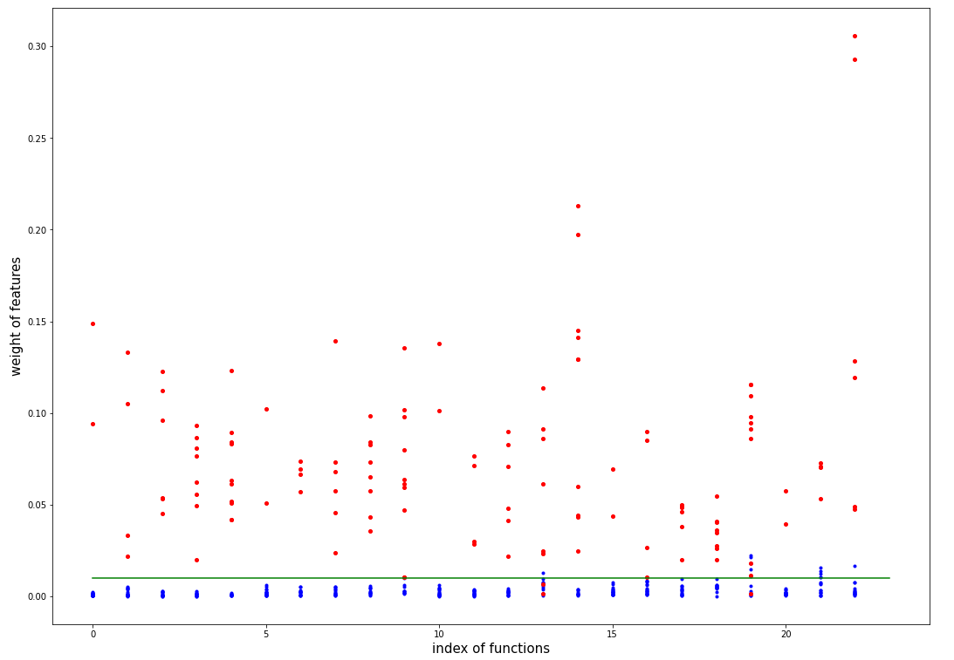
Constant threshold
Red: Right features
Blue: Wrong features
0.01
Notes:
Then I try to find whether the constant threshold can separate the right and wrong features well.
I check all the weights in all functions and plot them. The red point means the right features and the blue point means the wrong features. Surprisingly, we can find that the value 0.01 can separate the right and wrong features in most functions. Its accuracy is far higher than the adaptive method.
So I think the constant threshold works, at least in the synthetic dataset. And I use it in the later lambda selection process.

Slide 6
Lambda Selection
Steps:
Stop Criteria:
Set Lambda as 0
Training with the feature selection layer to get the weight
Use the selection criteria to get the right feature
Only use the right features as input and train FCN
Use the MAE of test set to evaluate Lambda
Lambda += 0.01
Goto the second step
MAE increases for two consecutive epoches
The decrease in MAE is less than 1% of the previous epoch’s MAE for two consecutive epoches
The number of epoch reaches 100
Notes:
For lambda selection, I try all the lambda first and use the mae predicted by selected features as the criteria.
Here are the steps: First, we set the lambda, then we training the FCN with feature selection layer. After doing this, we can get the weight of each features. Then we use the selection criteria to choose right features. After getting the right features, we train the FCN again, but this time, we only use the right features. Finally, we use the MAE of the testset to evaluate the lambda.
Here, I listen to your advice and use a stop criteria to stop the trainining. The stop criteria includes the mae of testset increases for two consecutive [kənˈsekjətɪv] epoches , the decrease in mae is less than one percent of the previous epoch’s MAE and the epoches reach 100. Any of them is met, the training stops.

Slide 7
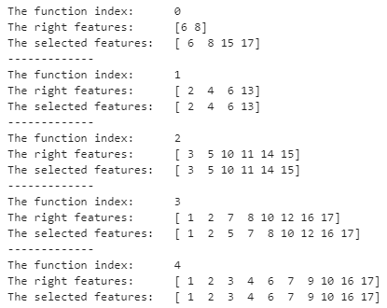
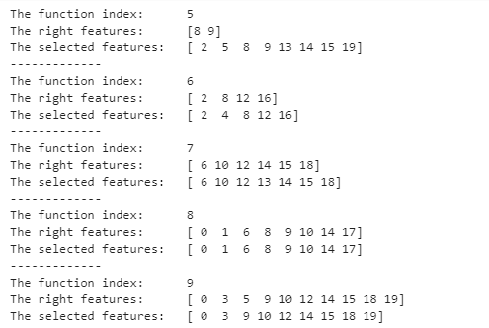
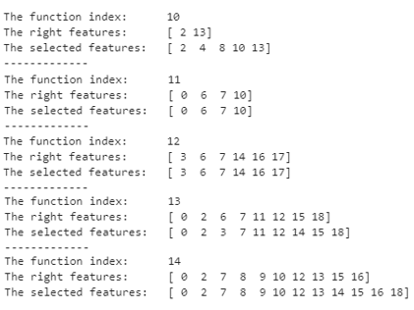
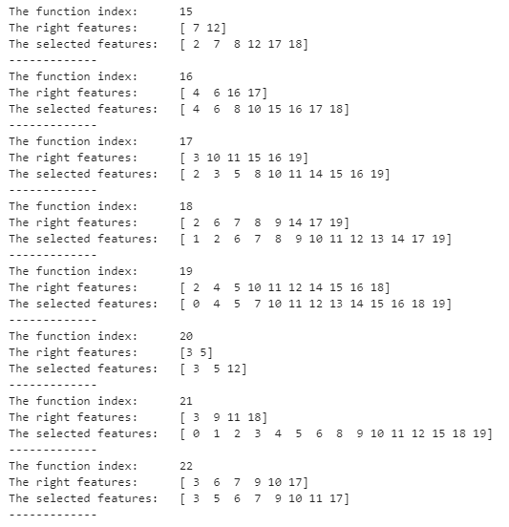
Result Analysis
Phenomenon:
Adding unrelated features will make the prediction result better.
My explanation:
The unrelated features will distract the Neural network, making it not focus on specific feature, so that prevent the overfit and increase the generalization ability.
Notes:
Here we can find that the workflow can select the right features in most cases. Moreover, we can find a interesting phenomenon that is sometimes the selected subset includes some irrevelant features. This phenomenon is very obviously when the number of right features is small. This means that when we add some wrong features into the training process, the mae of testset gets better instead.
Actually, I have observed this phenomenon when I did the technical screen. We know the right features for S is horizontal location and heart rate. But if I add some other dsp features to train the FCN, the mae can be better, even break through the low bound I derive which is about 5.

Slide 8
AutoEncoder
...
...
It uses the Encoder to compress the input data and then uses the Decoder to recover the input. Finally the difference of input and output will be the loss.
If we only measures the difference of what we care, we can use the output of encoder as a representation which contains the information we care.

Slide 9
Questions:
1. What is model guided neural network?
2. What is BSG signal? And what’s the difference between BSG and SCG and BCG

