Slide 1
Progress Report
2024.1.8
Yida Zhang

Slide 2
Outline
Equation of S and error analysis
Experiment on Feature selection layer
Thoughs on Universal Approximation Theorem
Notes:
Here are the outline of the presentation.
First, I wanna discuss with you about the equation of S, because it is the foundation of the subsequent research and I think we have some misunderstanding about it. And at the same time, I will also do some error analysis to explain why I said it is very hard to get the mae under 1 on the wechat.
The second thing is to analysize the result of the feature selection experiment. After that, I will talk about some thoughts about the universal approximation theorem.

Slide 3
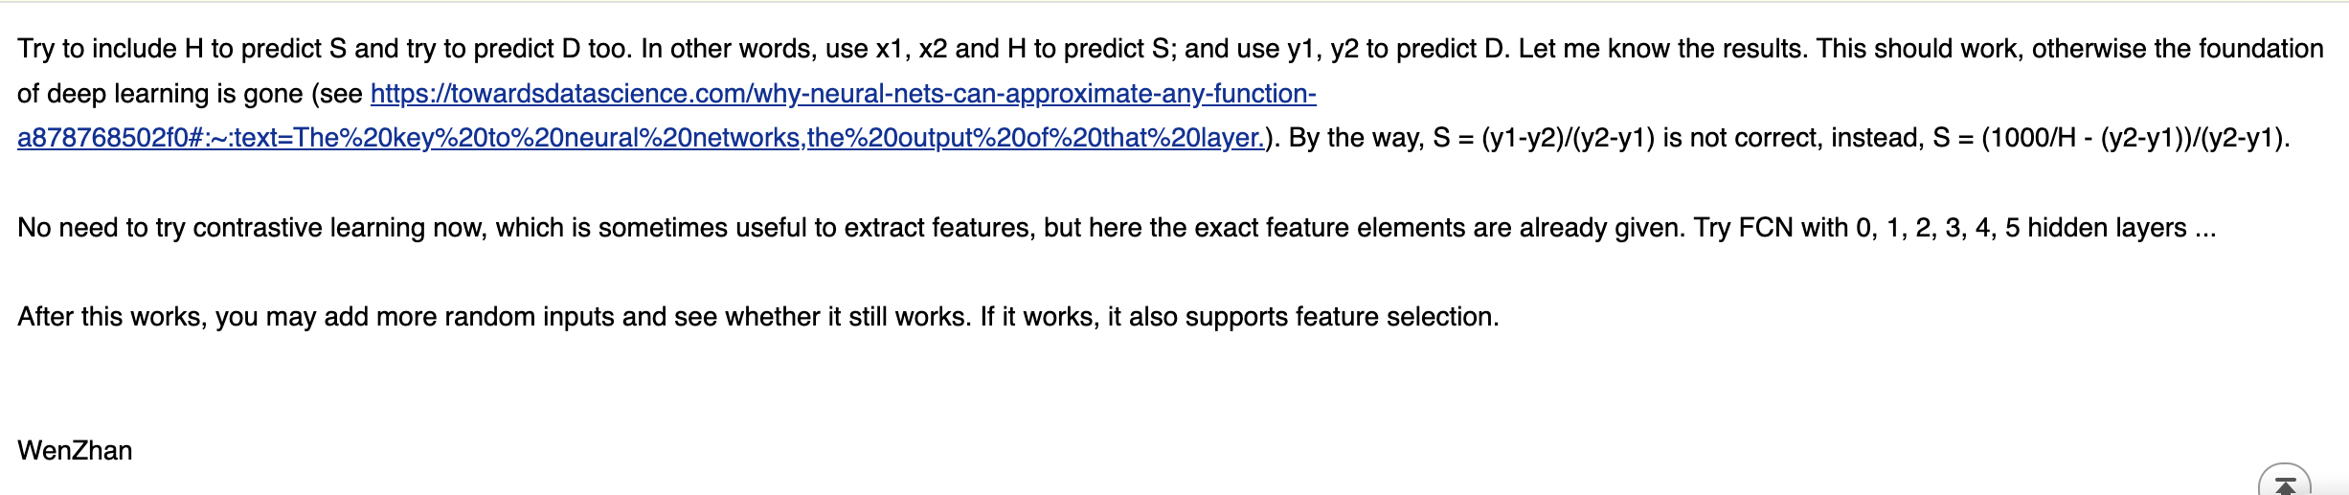
Equation of S and Error Analysis
The equation I derived: S = 320 + 600000 / ((x2 - x1) * hr - 6000)
Error Analysis: (1) Resampling Error
(2) Int Error
(3) Peak Detection Error
The three systematic error limit the low bound of MAE to be around 5
Notes:
The first thing to discuss is the misunderstanding on the equation of S.
About two months ago, you send me an email and mentioned that the equation of S is this one. This is different from what I derived. Since this equation is very important, so I plan to go through the scg generation process very quickly and reach an agreement with you on the equation of S.
This equation is what I derived. So next, I will use jupyter notebook to illustrate the process.
All the code here is copied from the datasim. First, we need to import some packages and define some functions that will be used later. Then we need to define some variables. For the convenience of illustration, I fix the s, d and heart rate. in the real generation process, they are random. Here we set s as one hundred and eighty.
Here we use the daubechies wavelet to generate the basic waveform and the only difference of cardiac_s and cardiac_d is the height which depends on d. Then we resample them to 100 timestamps. We can plot them to see what they look like. Their length is 100 and difference is height.
Then we take the first 40 timestamps as cardiac_s and generate a gap between cardiac_s and cardiac_d. The length of the gap depends on S. Finally, we concatenate the three parts. Until now, we have generated a cycle. And this is a very important time point, we can it time point 1.
Then we need to determine how many cycles we have in 10 seconds which depends on heart rate. So we calculate how many beats in 10 seconds, because we set the heart rate to be 70, so the number of beat is 11. Finally, we resample it to make sure the total length is 1000. We can find that there are 11 cycles in 10 seconds. Here I don’t add the respiratory signal, because it won’t influence the equation of S and D.
Now we have to time point. The proportion remains the same no matter at which time point, because the resampling won’t change the proportion.
Next, I will verify this equation by coding. This is train data, and this is x2-x1, I have already extract them. Then I use the d21 and heart rate to calculate the S.
The blue line is the true S, and the orange one is what we calculate use the equation. It fits the trend which proves that the equation is right. And if I use the function in email. Here is the result which shows the equation is not right.
However, we also find that the calculated S is not very accurate. The orange point is around the blue line, and there are some points above the blue line. This inaccurate predictions are caused by the error in the data generation process.
That’s all for this part. Do you have any comment or something you don’t agree?

Slide 4
Illustration of Resampling Error
X axis
Notes:
The first error is the resampling error. Let’s look at the figure. We just repeat the cycle, so every cycle should be same. However, we can find that in this figure, the cycle is different. It is obvious that the height of every peak is different. This is caused by the resampling.
When we resample to fit the required length, we will change the location of peak slightly. For example in this figure, before resampling, the peak should be this point. But after resampling, the peak is this point. Both of the vertical and horizontal location change. And this is the first error.
The second error is caused by the int function here when we calculate the number of beats in 10 seconds. If the number is 4.9, it will be the 4, the error is twenty percent which is very big. But we can just use the int function in our equation. So that we can eliminate this error. We can find if we use the int function in our equation, the mae will be smaller.
The third error is the peak detection error. Because my algorithm to detect the peak may not works in some signal. And the points above is caused by this error. But this number of them is very small, only 1000 scg signals.
And the mae of equation is about 5. This means that even the network learns the right feature and right function, the mae is hard to be lower than 5.
And for the new dataset, the equation remains the same. But the peak detection error may be greater, because the resonance noise will influence the peak detection a lot.

Slide 5
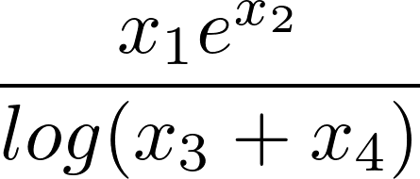
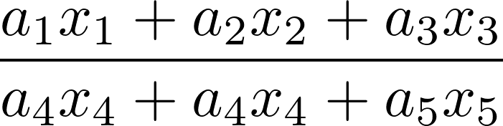

Experiment of Feature Selection Layer
Data Generation: 2000 * 20 random numbers
Five types of functions:
1. Linear:
2. Polynomial:
3. Exponential:
4. Log:
5. Combination:
Number of selected feature: [2,4,6,8,10]
Model: 2 hidden layers FCN with Feature selection layer
Lambda of feature selection layer: 0.1
Epoches: 100
Notes:
The second part is the feature selection and synthesis experiment with the feature selction layer.
First I’d like to introduce the experiment data I generate.
The shape of the dataset is 2000*20,2000 means the number of samples and 20 means the number of features. They are all the random number.
And the function between data and label has five types. In each type of function, the number of selected feature is here. And they are randomly choosed among the 20 features. All the cofficients here which is a and b are all random number. So I totally tested 23 functions.
And here are some other experiment settings. The lambda is a key hyperparameters, it indicates the degree of the selection process.

Slide 6
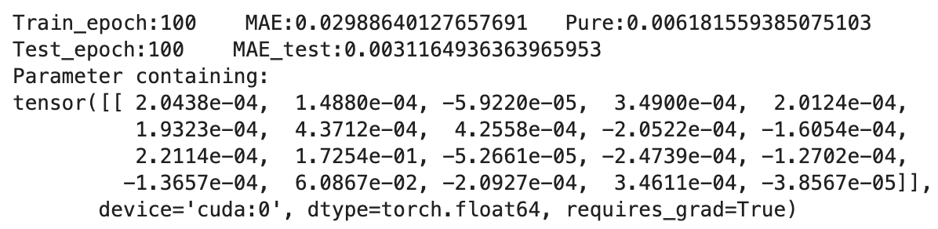
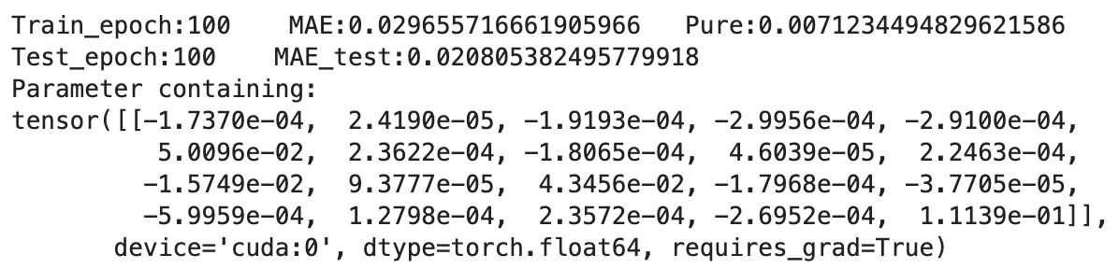
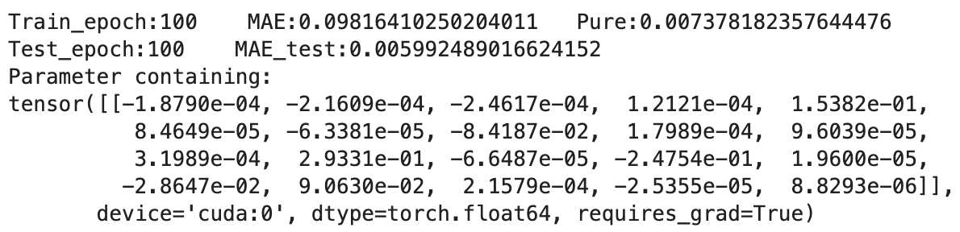
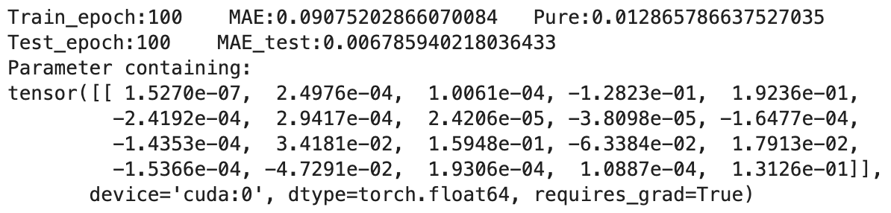
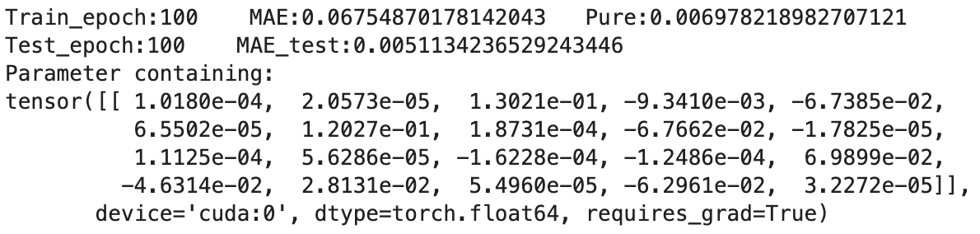
Experiment of Feature Selection Layer: Linear
2 selected features
4 selected features
6 selected features
8 selected features
10 selected features
selected when lambda is 0.01
right select
miss (It should be selected, but not)
redundant (It should not be selected,
but selected)
Notes:
And here are the results of linear function. The 20 numbers here are the weight of feature selection layer which indicates how important the features is. And the red square means the feature is selected. Because the weight of this feature is much bigger than others. And the green square means it is the right feature, but its weight is small, so the algorithm miss this feature. And the blue square means the algorithm select some features which are not right features.
By looking at the result, we can find that only one the number of features is 10, the algorithm miss a feature. If we miss features, that means the degree of the selection is too high, so we reduce the lambda to 0.01. And now, the algorithm can select it.

Slide 7
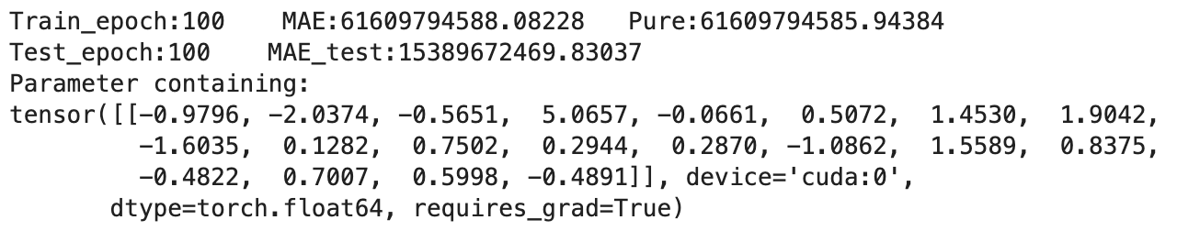
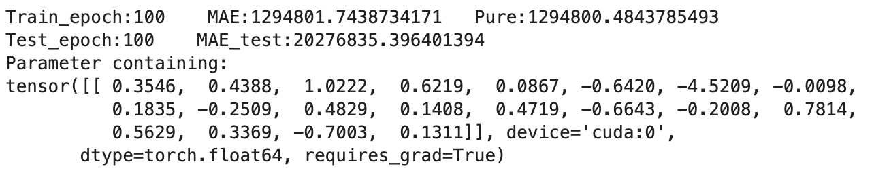
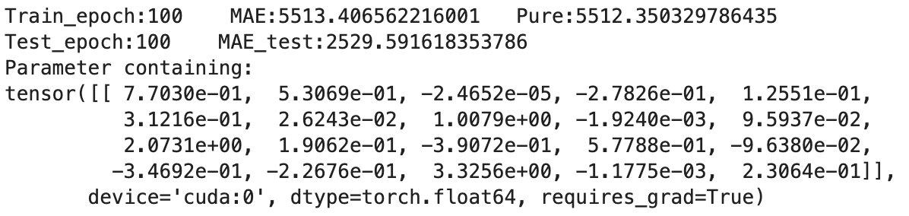
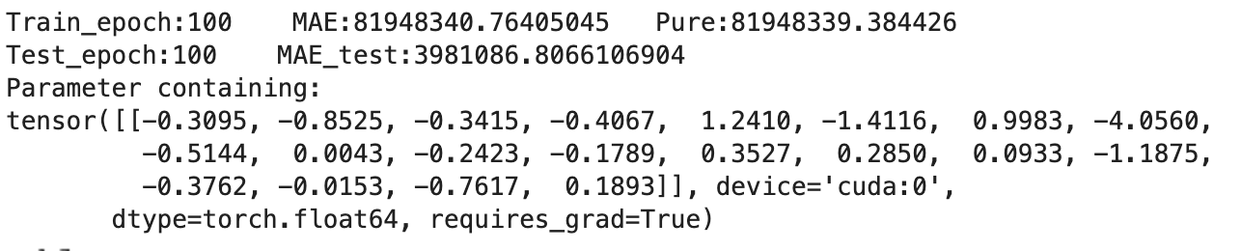
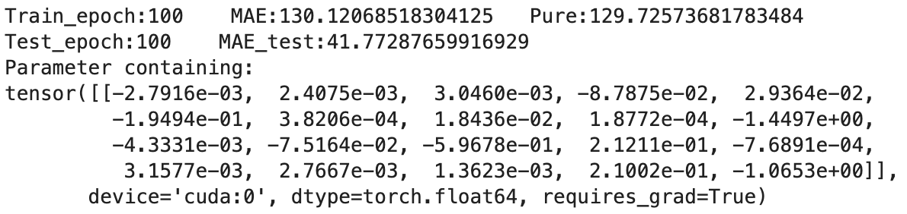
Experiment of Feature Selection Layer: Polynomial
2 selected features
4 selected features
6 selected features
8 selected features
10 selected features
right select
miss (It should be selected, but not)
redundant (It should not be selected,
but selected)
Notes:
Here are the result of polynomial function. The result is bad, because all the weights are similar. And we can also find that the mae is huge. I will discuss this situation detailly later.

Slide 8
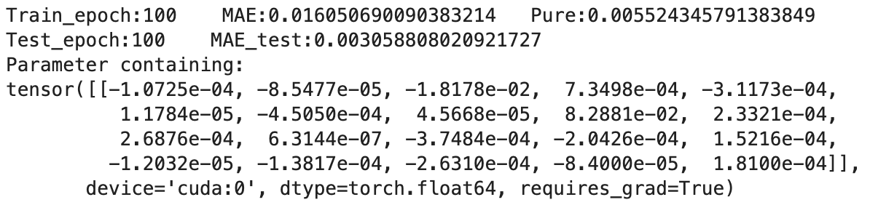
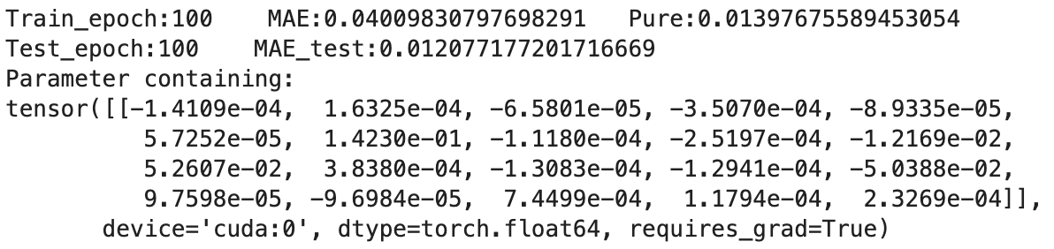
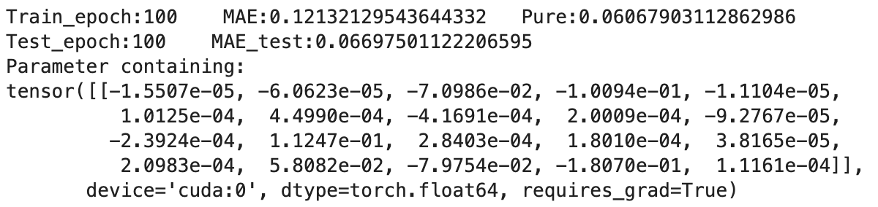
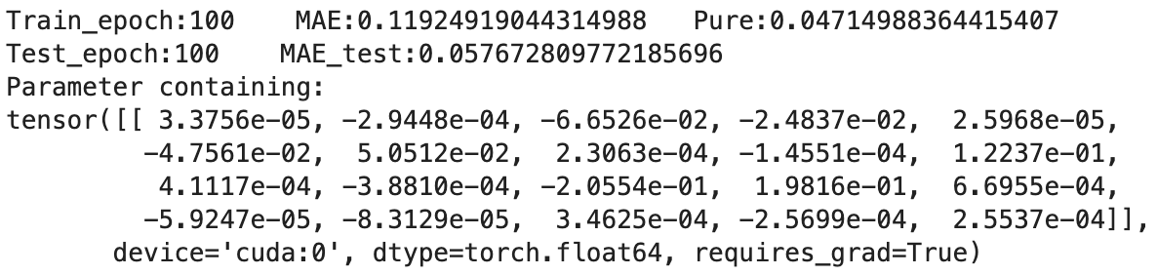
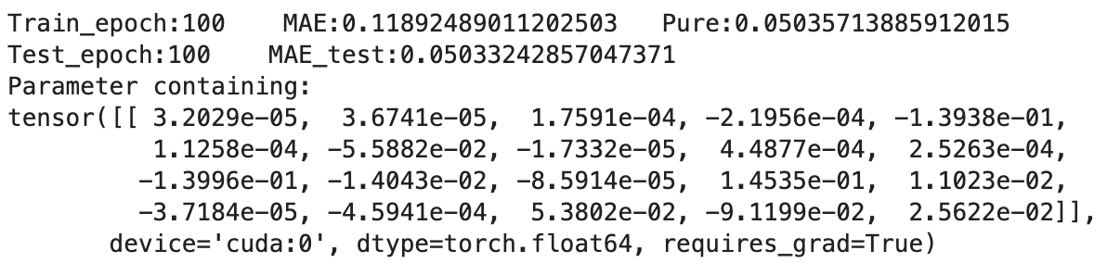
Experiment of Feature Selection Layer: Exponential
2 selected features
4 selected features
6 selected features
8 selected features
10 selected features
selected when lambda is 0.01
right select
miss (It should be selected, but not)
redundant (It should not be selected,
but selected)
Notes:
And this is the result of exponential. Still, when the lambda is 0.1, it will miss some features, but when reduce it to 0.01, the algorithm works.

Slide 9
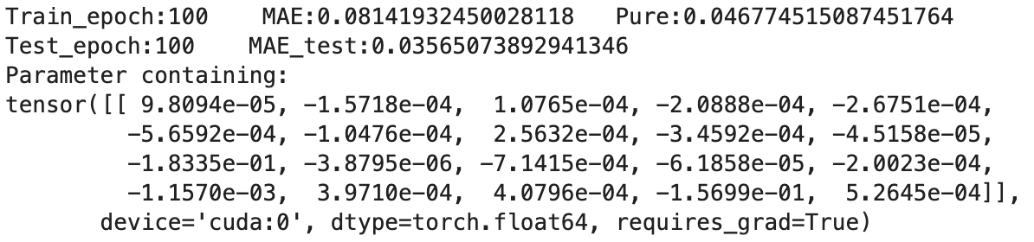
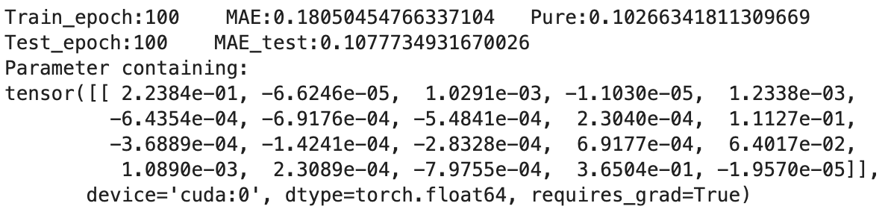
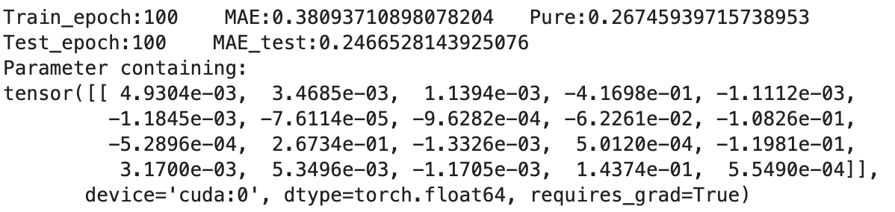
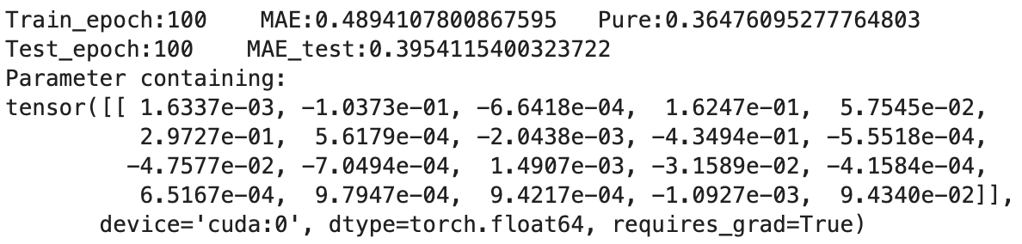
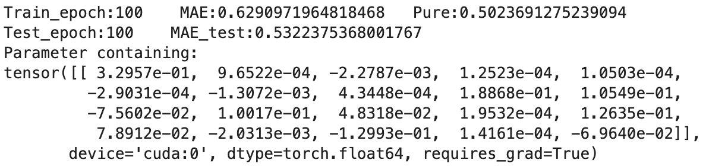
Experiment of Feature Selection Layer: Log
2 selected features
4 selected features
6 selected features
8 selected features
10 selected features
right select
miss (It should be selected, but not)
redundant (It should not be selected,
but selected)
Notes:
And here is the result of log. It works too.

Slide 10
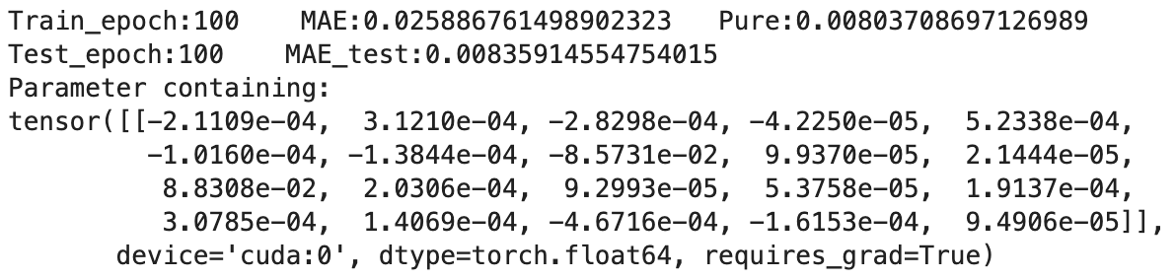
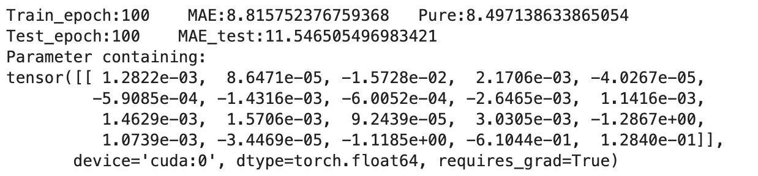
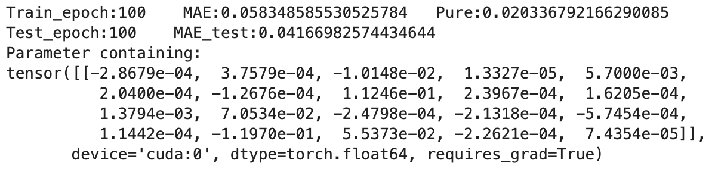
Experiment of Feature Selection Layer: Combination
selected when lambda is 0.05
Notes:
Here is the result of the combination functions. All of them select the right features. However, look at the mae, it is kind of big, because other mae are all below 1. Actually, it is caused by the same reasons as the polynomial function.

Slide 11
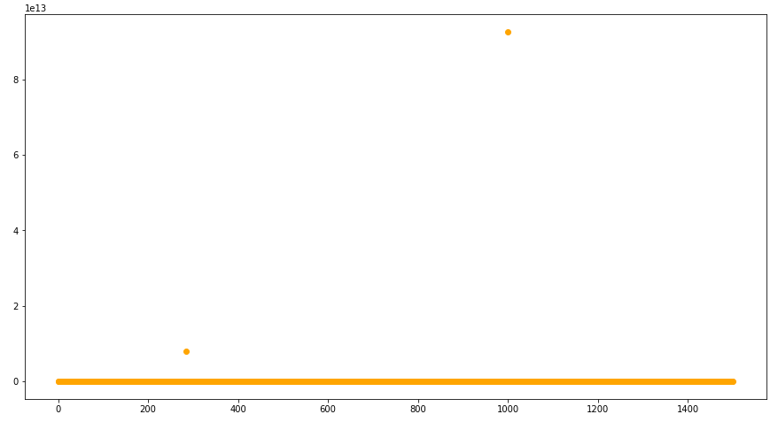
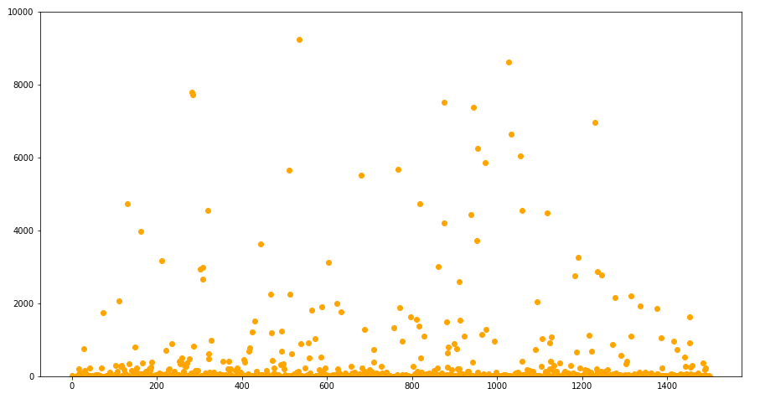
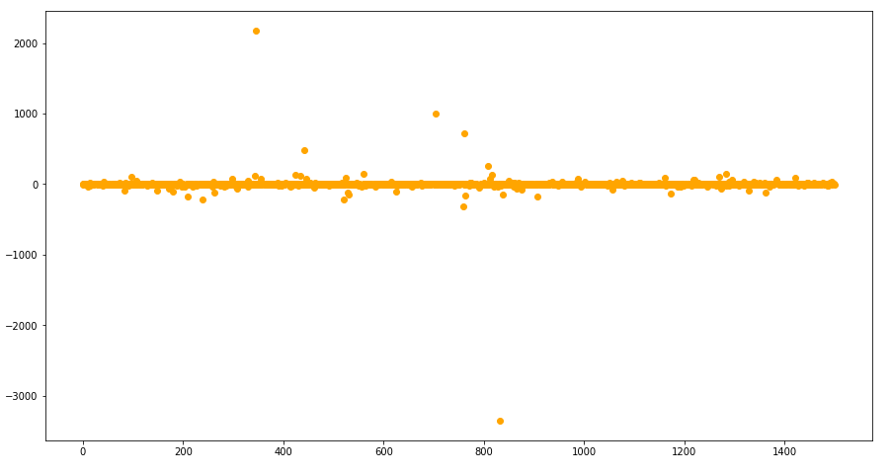
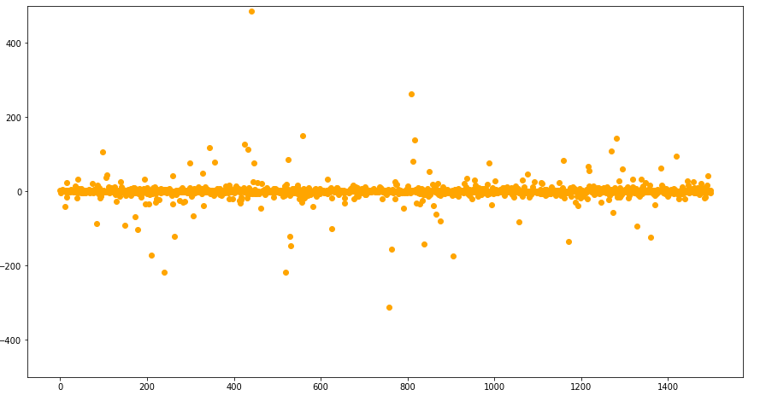
The label of one polynomial function
The label of one polynomial function
(limit the y-axis from 0 to 10000)
The label of
The label of
Notes:
The result why the algorithm can’t select the right features, or in other words, why the neural network can’t learn the right function is, the data shift.

Slide 12
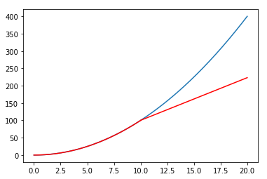
Equation: y = x²
train on [0,10]
test on [0,20]

