Slide 1
Progress Report
2024.6.24
Yida Zhang

Slide 2
Outline
Experiments on real BSG dataset
Some questions and thoughts

Slide 3
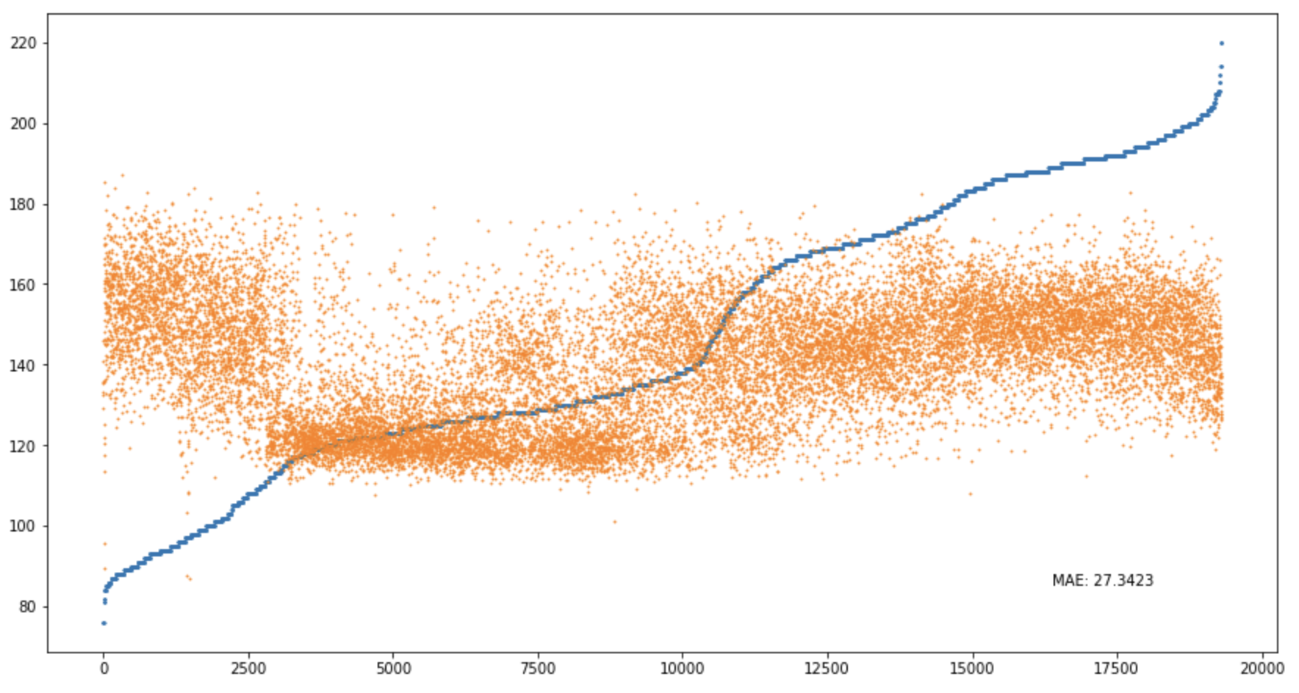
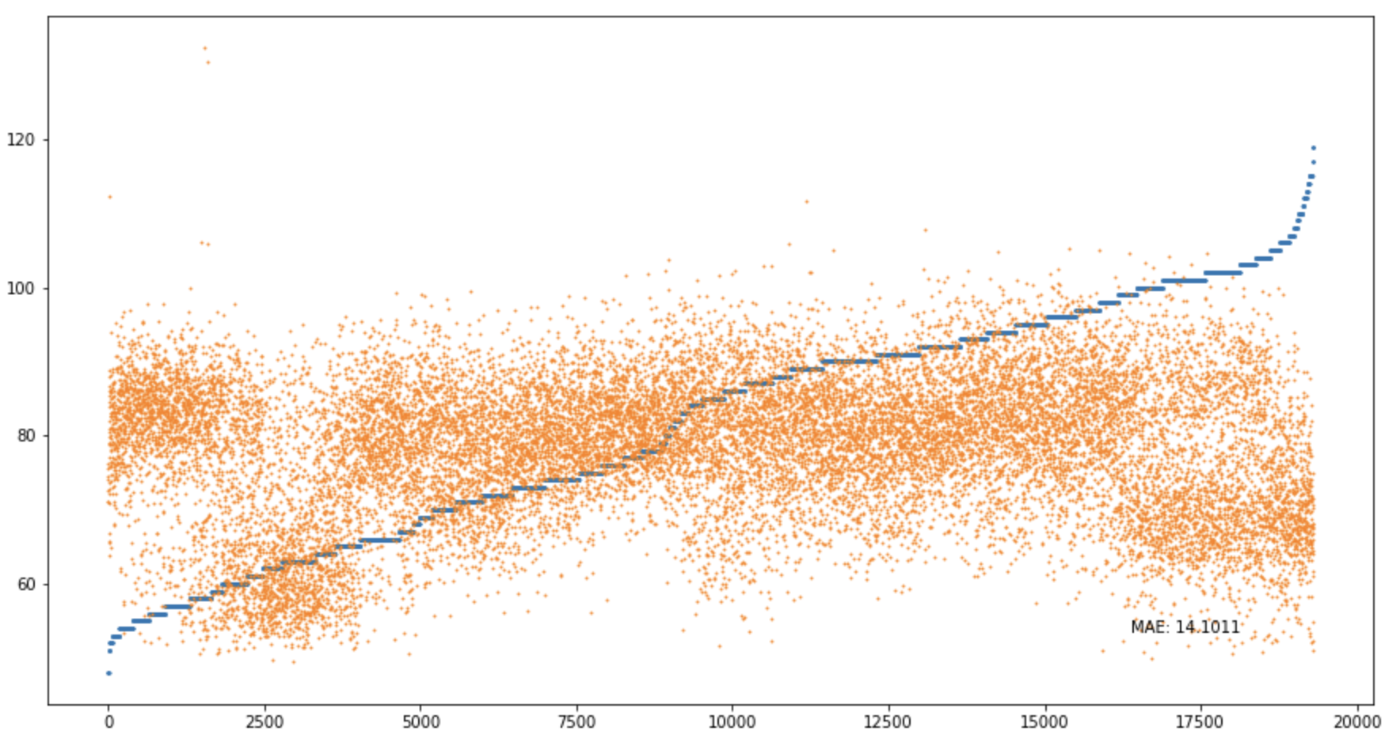
Prediction Result of Different Models
 | XCM | mWDN | gMLP | ResCNN | LSTM-FCN | InceptionTime | OmniScaleCNN | MiniRocket | VTCN
S | 28.7 | 28.7 | 32.5 | 30.2 | 29.7 | 29.2 | 32.9 | 28.8 | 27.3
D | 13.8 | 14.8 | 14.8 | 14.3 | 15.8 | 14.0 | 16.1 | 14.6 | 14.1
VTCN S
VTCN D

Slide 4
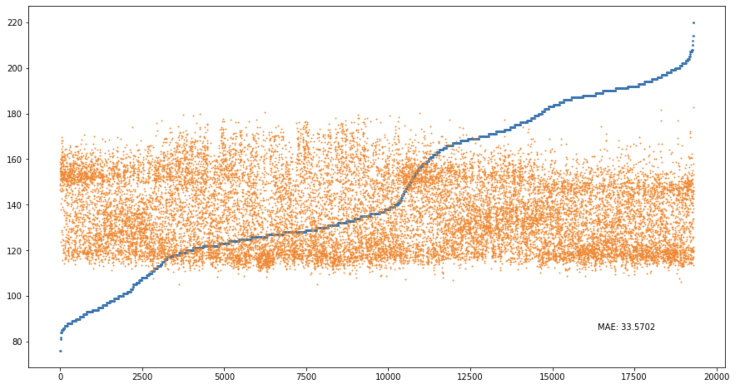
Prediction Result of Feature Selection and Synthesis (FSS)
Prediction Result of S

Slide 5
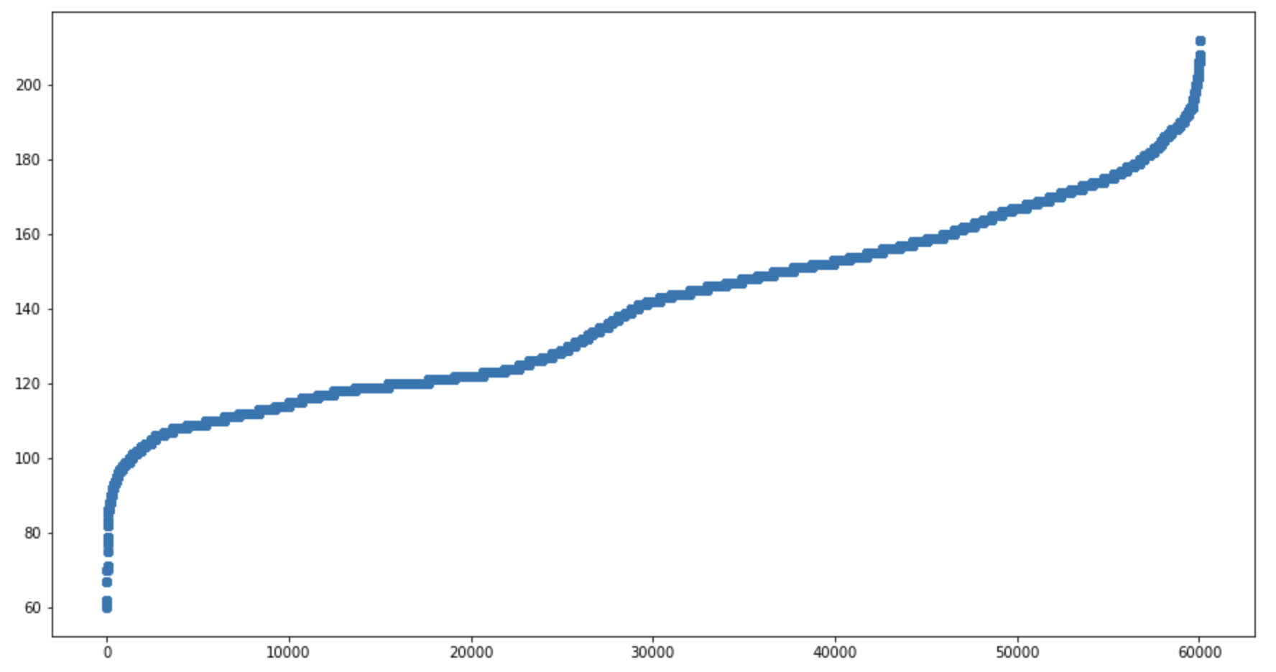
Data Distribution is uneven
S distribution of training set

Slide 6
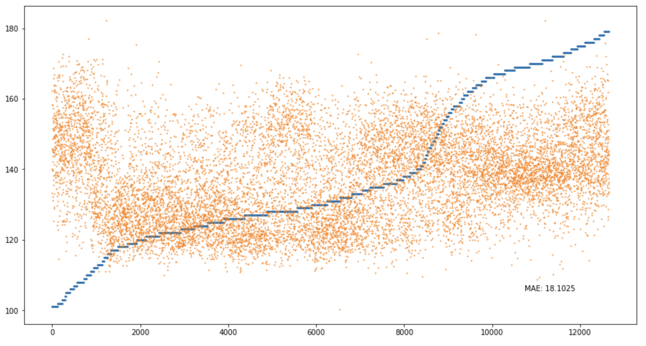
Result after removing unusual data
Prediction Result of S

Slide 7
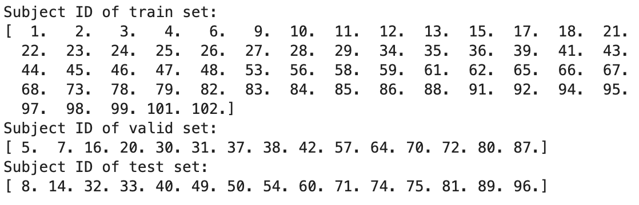
Questions
1. What’s the difference between these three BSG dataset?
all_back_train/test.npy
dataset in the directory “Classification”
CRTU
2. Why separate train, valid and test set like this? Maybe how we separate the dataset will influence the result.

