Slide 1
Progress Report
2024.7.2
Yida Zhang

Slide 2
Outline
Experiments on new BSG dataset
Directly regress the SBP
Pairwise regress the SBP
Some questions and thoughts

Slide 3
Prediction Result Outline (SBP)
Description | MAE
VTCN (Baseline) | 19.2
VTCN + Transformed label | 19.7
VTCN + Few-shot | 13.7
Pairwise VTCN | 10.5
Pairwise VTCN + Few-shot | 9.9

Slide 4
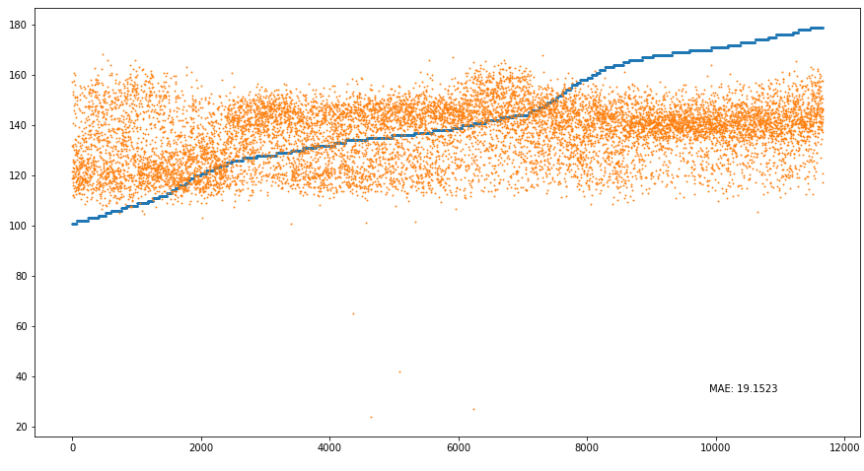
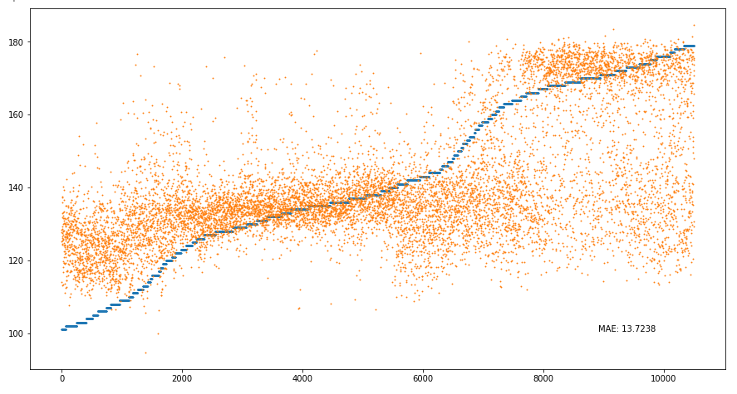
Prediction Result Visualization (Direct regression)
VTCN (Baseline)
VTCN (Few-shot)

Slide 5
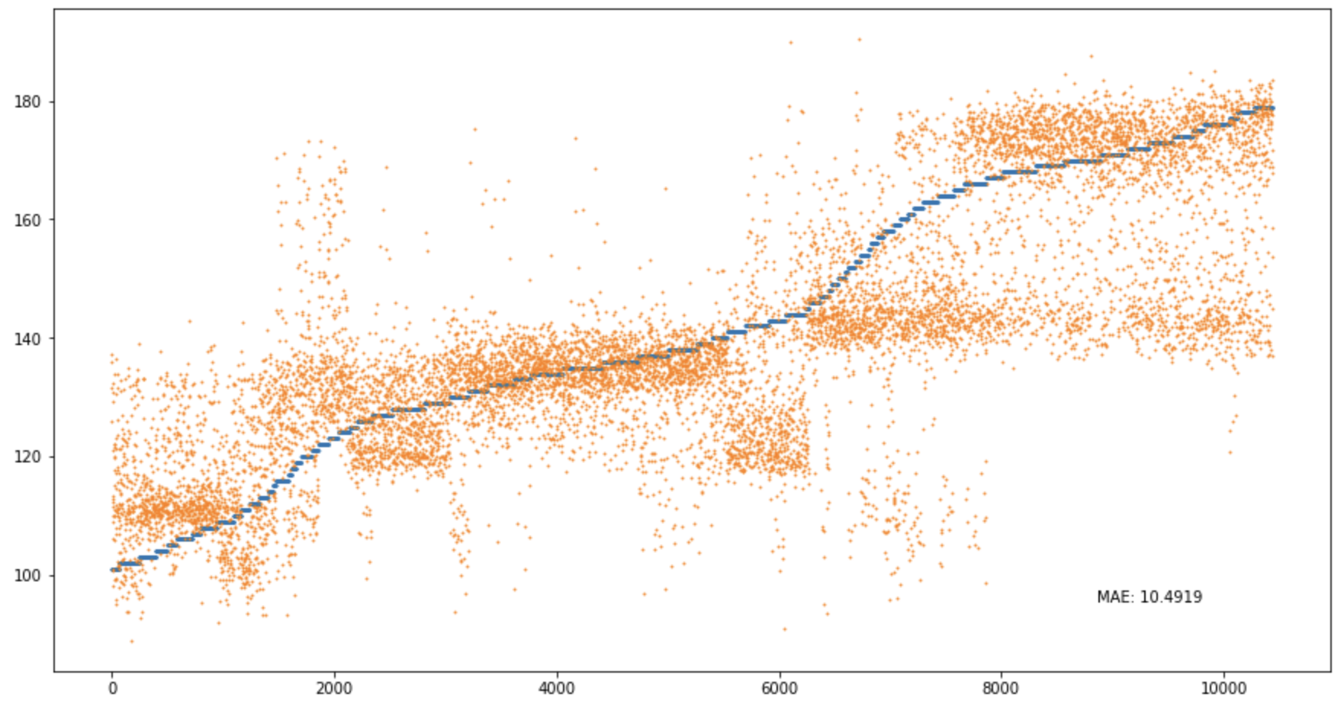
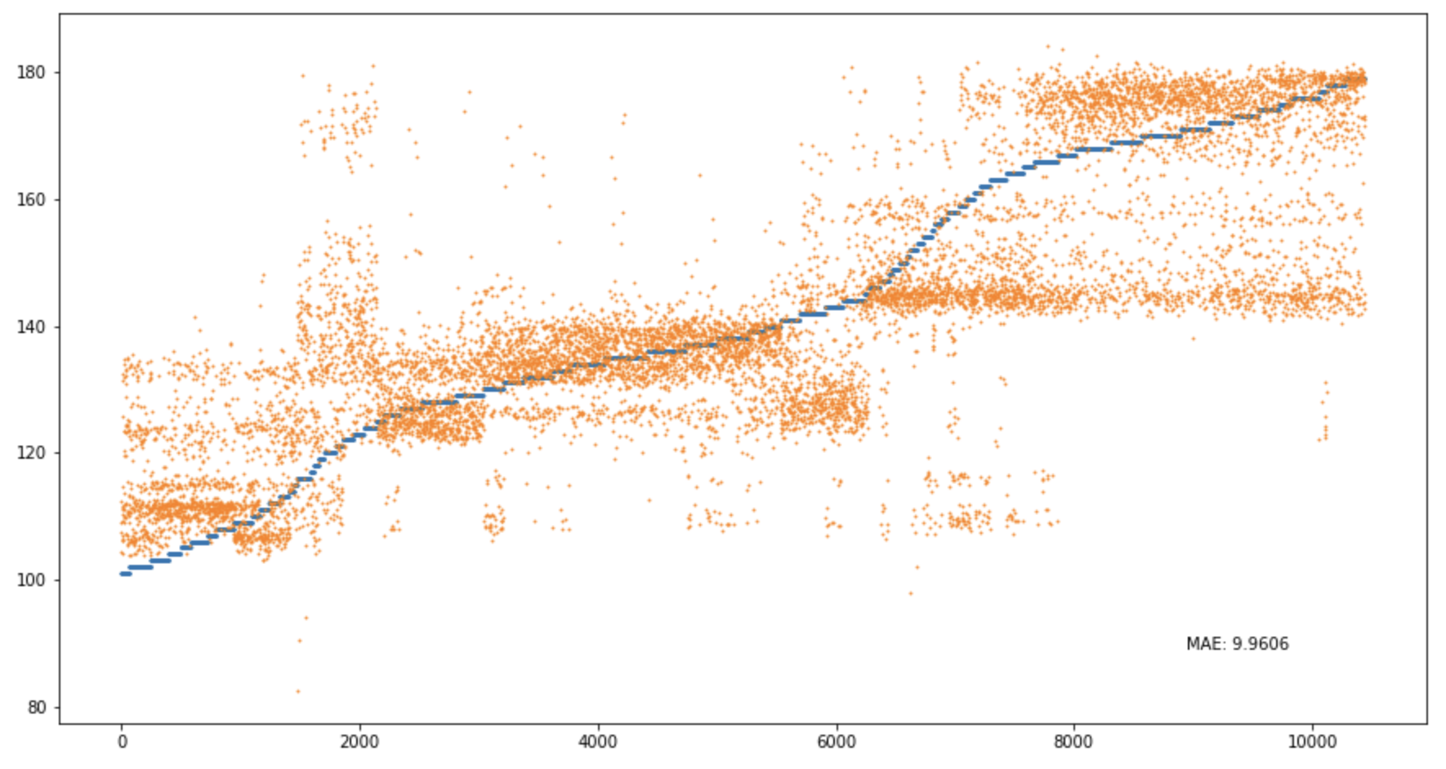
Prediction Result Visualization (Pairwise regression)
Pairwise (Baseline)
Pairwise (Few-shot)

Slide 6
Emplement Detail
x1
y1
Input
Label
-
x2
y2
z1
z2
y1
y2
y1
Train set
Valid/Test set

Slide 7
Discussion
1. To a certain extent, this pairwise method can overcome the issue of significant signal heterogeneity between subjects.
2. Because the BP range of a certain subject is not big, so it is possible that the model actually doesn’t learn anything, and it only predict y2 based on y1, through which it can still get a low MAE.
Questions
1. How to determine the degree of fine-tuning? Is it necessary to construct two additional validation sets for the fine-tuning process during validation and testing?

