Slide 1
Weekly Progress Report
Yida Zhang
2023.9.18

Slide 2
Progress
Tutorial:
1. Learn and implement 18 R language functions as planned
2. Add my features to TSFEL feature generator
3. Adopt the same main framework of tutorial as Jiayu did and refactor my functions to accommodate it
Research:
4. Propose a feature synthesis algorithm based on contrastive learning
5. Learn the code provided by Professor Song and implement it on SCG dataset
6. Read the paper^{[1]} about Contrastive Learning
[1]: Barbano C A, Dufumier B, Duchesnay E, et al. Contrastive learning for regression in multi-site brain age prediction[C]2023 IEEE 20th International Symposium on Biomedical Imaging (ISBI). IEEE, 2023: 1-4.
Notes:
here are my progress this week. First about tutorial, I learn an dimplement 18 R language functions as planned.
And according to your comment on the google doc, I also add my features to tsfel feature generator and adopt the same main framework of tutorail as jiayu did and refactor my functions to accomamodate it
And about research, I propose a feature synthesis algorithm based on contrastive learning and I also learn the code you provided and implement it on SCG dataset.
Because this week I spend too much time on tunning the hyperparameter, so I only read one paper about contrastive learning

Slide 3
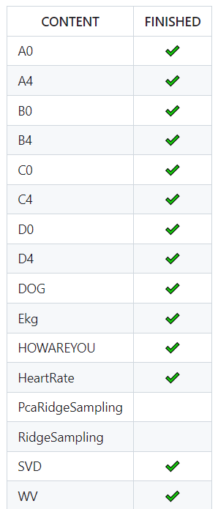
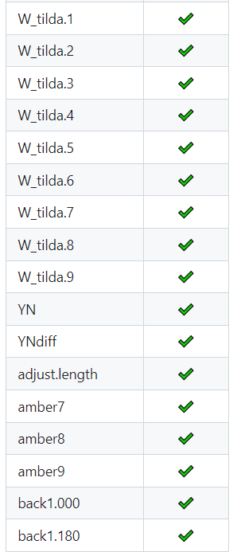
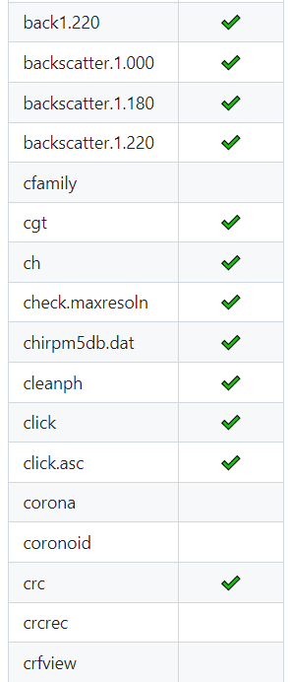
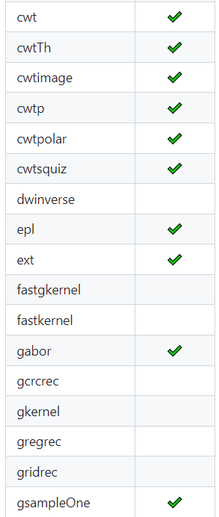
Tutorial
Notes:
Here are the Rwave functions. and The topics enclosed in red boxes are completed this week

Slide 4
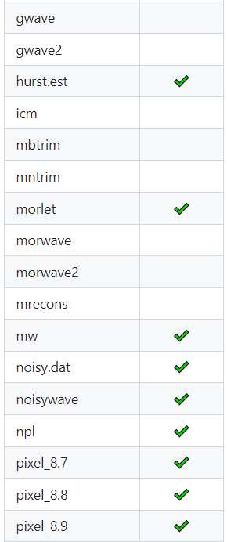
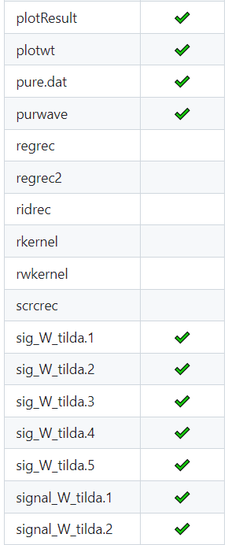
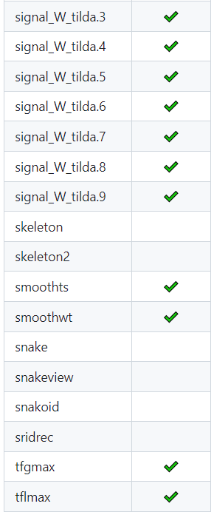
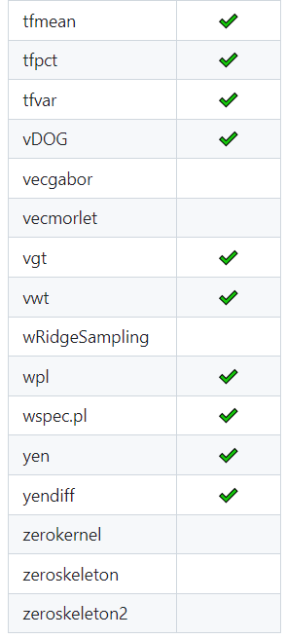
Tutorial

Slide 5
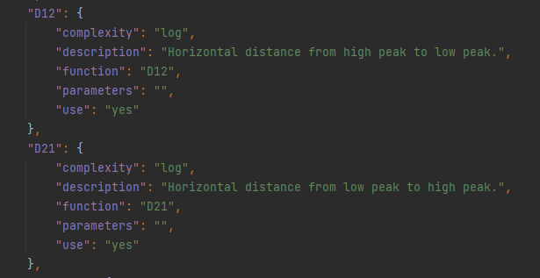
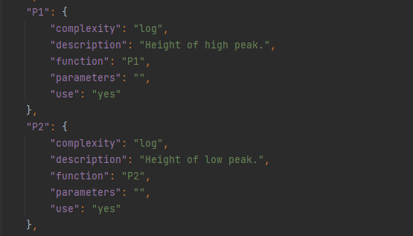
Tutorial
Rwave:
Finished: 94/134 (70%)
Two weeks to finish them all as planned
TSFEL:
Added features: P1, P2, D12, D21
add_feature_json("my_features.py", "all_features.json")
Notes:
我按照官网的教程，在myfeaturespy实现了四个特征的提取函数后，使用add feature json这个函数就可以将我的特征加入json文件，这是一个记录所有特征的字典，通过修改其中use的值就可以来选择要提取哪些特征。
Currently, 94 out of 134 functions have been completed, and it is expected that all of them can be completed in the next two weeks.
Moreover, this week I added four custom features to the tsfel feature set, namely P1, P2, D12, and D21. And we can get all other important features in SCG signal through combining these four features.
I followed the tutorial on the official website and implement the extraction functions for these four features in myfeatures.py. After doing that, I used the 'add_feature_json' function to add my features to a JSON file. This JSON file serves as a dictionary that records all the features, and we can modify the 'use' value to choose which features to extract

Slide 6
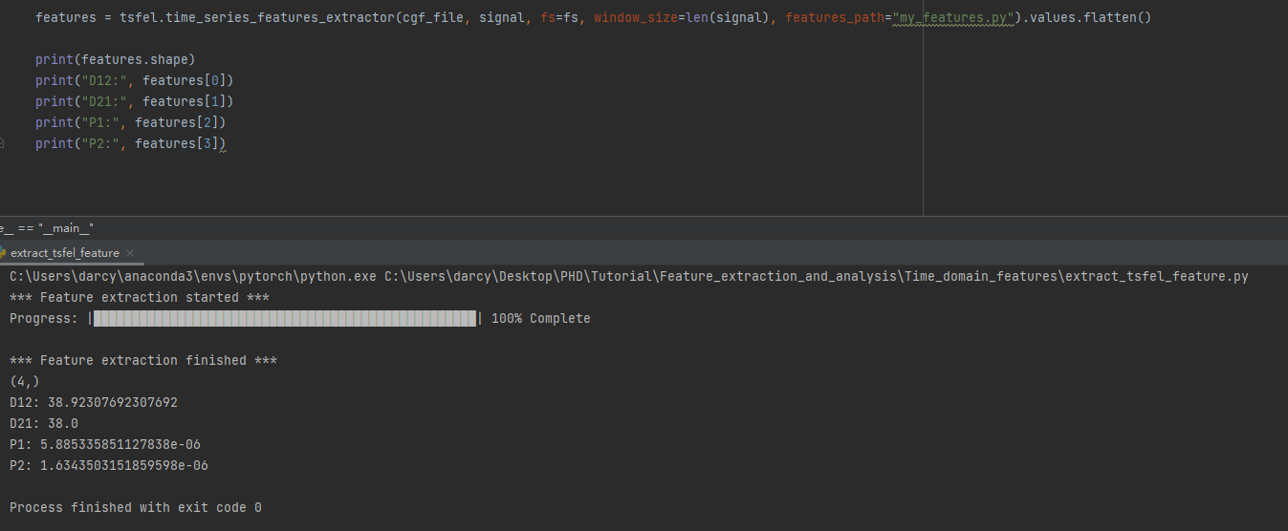
Extract my features using TSFEL
Notes:
By using the extraction functions provided by the tsfel with the modified JSON file as a parameter, we can get the custom features
As shown in the figure, these are the four new features I just added."

Slide 7
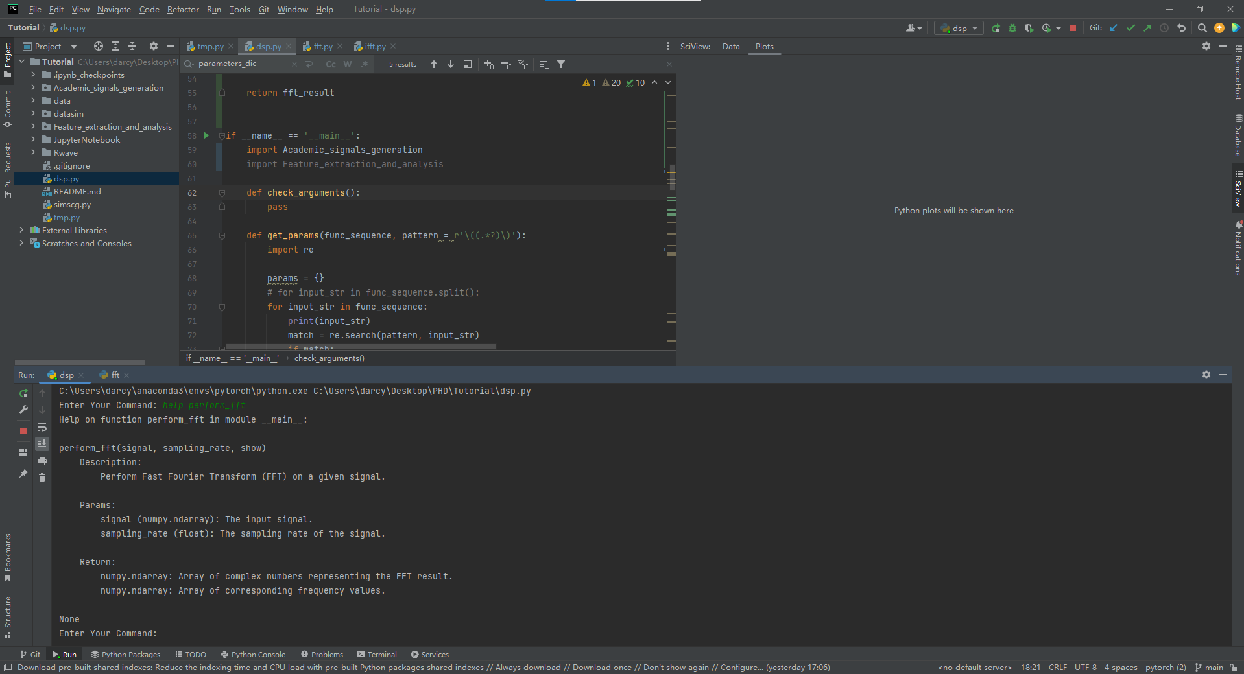
Illustration of main framework
help perform_fft
Notes:
This week, I also adopted the same main framework as Jiayu did and refactor my functions to accommodate it. Here are some demonstrations of the main function. For example, when I input 'help perform_fft,' it will display an introduction to the 'perform_fft' function."

Slide 8
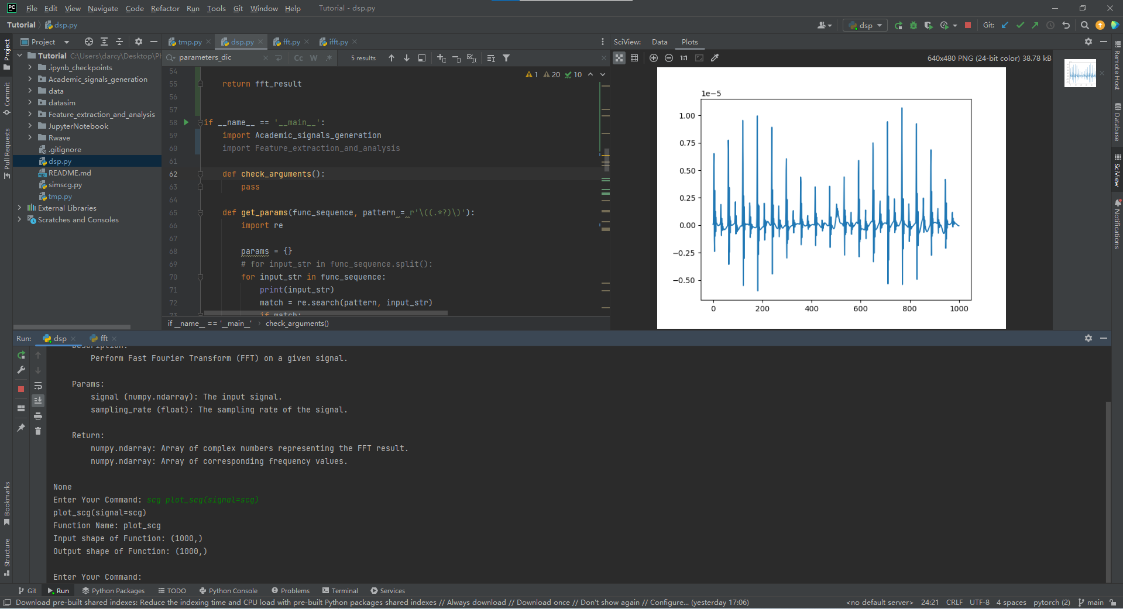
Illustration of main framework
scg plot_scg(signal=scg)
Notes:
When I enter this command, it means passing the SCG signal to the 'plotscg' function. This function will plot the figure of the SCG signal.
And this is the figure of the input scg

Slide 9
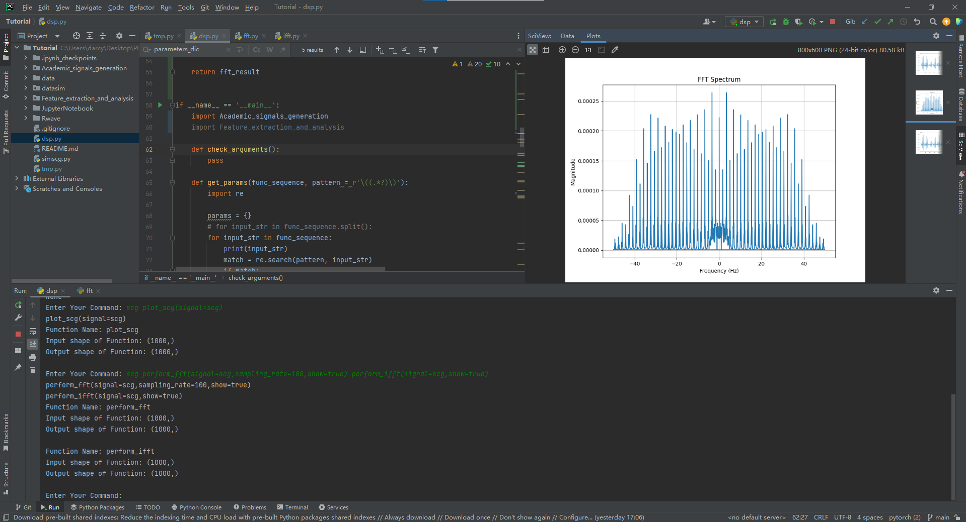
Illustration of main framework
scg perform_fft(signal=scg,sampling rate=100,show=true) perform_ifft(signal=scg,show=true)
Notes:
And when I input a chain of different functions, the output of the former functions will become the input of the latter function. For example, if I input this command, it will first perform a Fourier transform on the SCG signal, and the ouptut of FFT will be the input of the inverse Fourier transform, finally resulting in the original SCG signal. In the top right corner, we can see three images here: the first one is generated using 'plotscg' to visualize the SCG signal, the second one, which is the current display, represents the result of the Fourier transform."

Slide 10
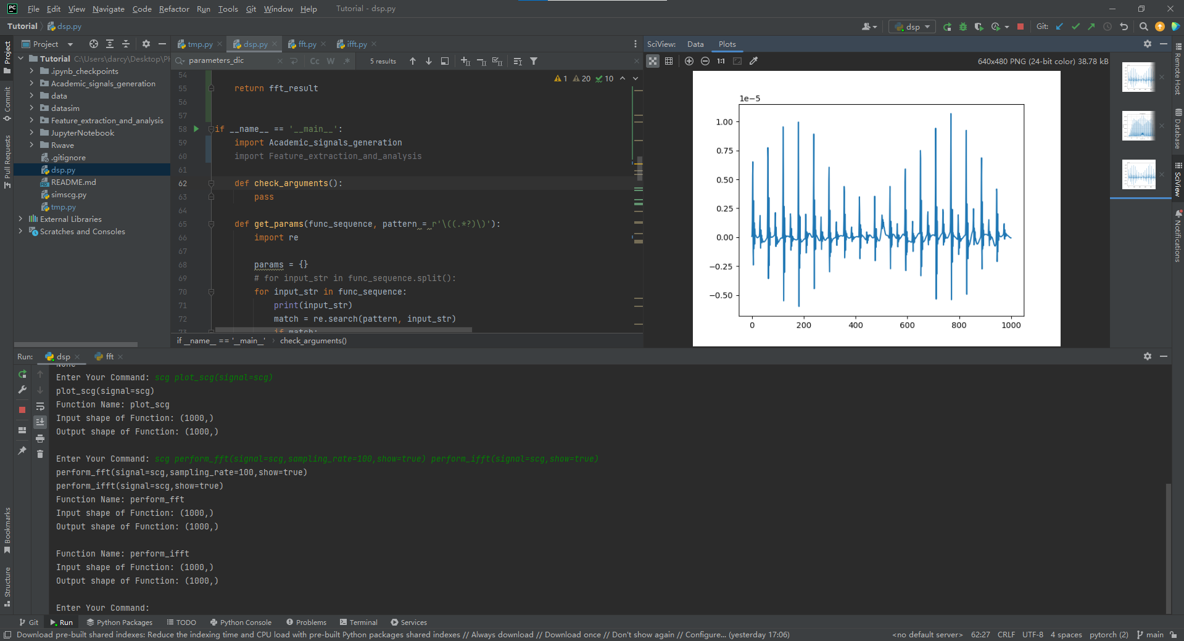
Illustration of main framework
scg perform_fft(signal=scg,sampling rate=100,show=true) perform_ifft(signal=scg,show=true)
Notes:
And the third one is the result of the inverse Fourier transform. As you can see, it is the same as the first image. Currently, I have only refactored a small portion of the functions, and there are still many functions that need to be refactored, especially the 'Rwave' functions. Becasue they have many 'returns' , while the current framework can only accept functions with one 'return' statement. I will discuss with Jiayu about how to solve this problem later, and I think perhaps storing all the return values as a dictionary could be a good way to solve this problem

Slide 11
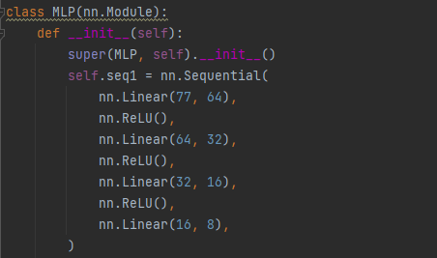
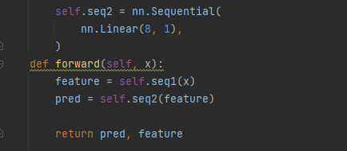
Work 4: Feature Synthesis based on Contrastive Learning
Initial Features: TSFEL + my features (77)
Feature synthesizer: MLP
Two tasks (Loss = loss_pred + loss_contrast):
Make the difference between predictions and targets as small as possible
Make sure the synthesized feature can reflect the key information in the signal
Notes:
Work 4 is a feature synthesis algorithm based on contrastive learning. The purpose of it is try to synthesize some new features which can better represent the information in the signal. And I generate 77 features as the initial features, including all the features from tsfel and additional features like D12 and D21.
The feature synthesizer I used is a simple MLP with the following structure, as shown in the pictures below. It consists of four linear regression layers, each followed by a ReLU activation function. The initial features are processed through 'sequential1' to produce 8 synthesized features. Then, we pass these 8 synthesized features through 'sequential2' to predict the final blood pressure, this one means S or D. The MLP has two returns: the first is the 8 synthesized features and the second is the predicted S based on these 8 features.
This problem has two tasks at the same time. The first task is to make sure XXX, and the second task is to make sure XXXX. Both of these tasks are achieved by minimizing specific loss functions, namely 'loss_pred' and 'loss_contrast.' 'Loss_pred' is straightforward, representing the difference between the predicted values and the target values. Next, I will provide a detailed explanation of how 'loss_contrast' is designed."

Slide 12
The implementation details of contrastive learning
For one batch (batch_size = 4)
No.1
F
T
No.1 and No.2
No.1 and No.3
No.2
D_F12
D_T12
(10)
D_F13
D_T13
(5)
F
T
No.1 and No.3
No.1 and No.2
Difference Calculation
(5)
Rank based on D_T
No.3
D_F13
D_T13
D_F12
D_T12
(10)
F
T
No.1 and No.4
No.1 and No.4
No.4
D_F14
D_T14
(15)
D_F14
D_T14
(15)
F
T
loss_contrast = D_F13 - (D_F12 + D_F14) + D_F12 - D_F14
Notes:
We assume that our batch size is 4, which means that we simultaneously process 4 sets of features. After passing these four sets of features through our feature synthesizer, as mentioned earlier, we obtain a prediction and a set of synthesized features. The 'prediction' is used to calculate 'loss_pred,' so let's set it aside for now. Our current focus is solely on the synthesized features and their corresponding targets. The F means synthesized features and T means target.
First, let's take No1 as our reference and calculate the differences between No1 and No234, including the differences between their targets and synthesized features. After the difference calculation, we will get three values. We then sort them based on DT. The DT12 means that difference of Target between No1 and No2. If DT12 is 10 XXXX, the sorted results would look like this. Finally, based on this rank, we can calculate 'loss_contrast' using the following formula.
The underlying idea is Suppose the distance between the targets of No1 and No3 is the smallest. In that case, if our synthesized features correctly capture the information related to the targets, the distance between their features should also be the smallest. When I subtract smaller values from larger ones each time, the final result will always be minimized. Therefore, by optimizing the loss contrast, we can make the model to generate features that satisfy the order shown in the figure.

Slide 13
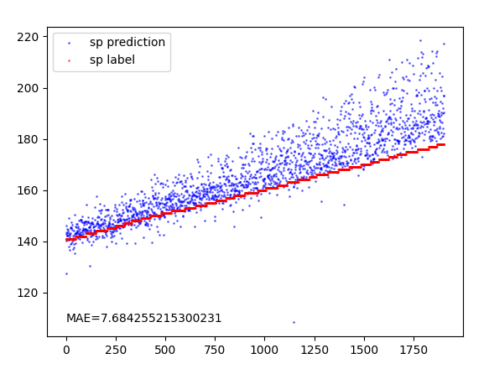
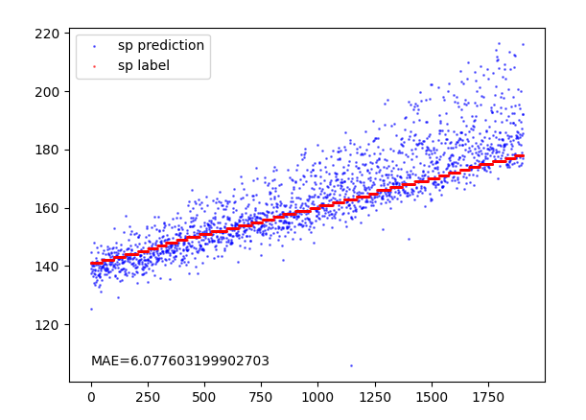
Work 4: Feature Synthesis based on Contrastive Learning
Prediction without Contrastive learning
Prediction with Contrastive learning
Notes:
The left image represents, while the right image shows.
As you can observe, the overall prediction values have shifted downward by a certain distance, indicating that the synthesized features have become more effective.

Slide 14
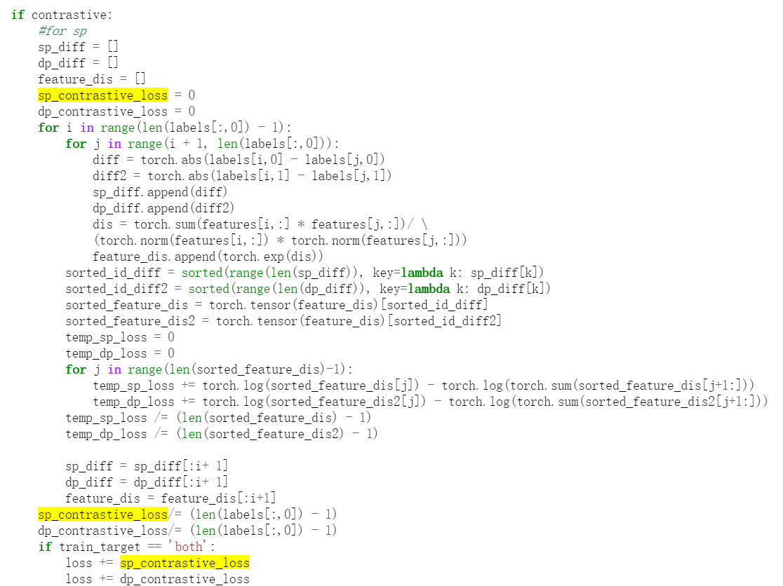
Work 5: Implementation of contrastive learning code
sp_contrastive_loss += temp_sp_loss
dp_contrastive_loss += temp_dp_loss
Notes:
Work 5 is based on the code you provided on google doc. In fact, the design of the loss contrast in work 4 was inspired by this code. However, I've identified an issue with this code. In the picture, the yellow one represents all the operations related to sp_contrastive_loss. You can see that there are no operations related to sp_contrastive_loss within this for loop. As a result, the value of sp_contrastive_loss remains at 0, and the loss does not change at all. I believe that there is something missing here. And the missing code may be this one

Slide 15
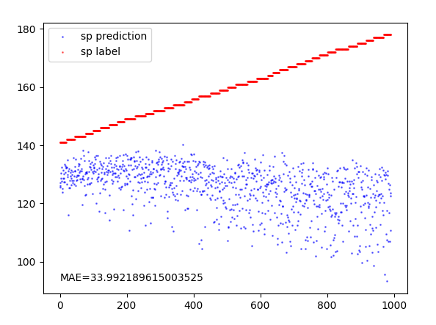
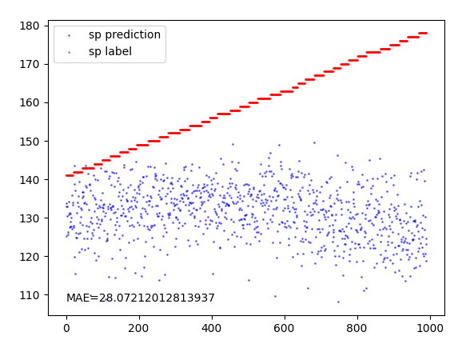
Work 5: Implementation of contrastive learning code
Without Contrastive Learning
With Contrastive Learning
Strange phenomenon: The loss_contrast doesn’t decrease even if I only backward it without the loss_pred
Notes:
这是将contrastive module实现在scg数据集后的结果。左图是没有contrastive learning，右图是prediction with contrastive learning。我们可以发现其实效果并不是很明显，并没有展现出google doc中那样明显的提升。然后我尝试了很多超参数，包括learning rate以及loss pred和loss contrast之间的比例，但结果都不是很好。不仅是在scg数据集上不好，在google文档里的数据集上效果也不是很好。同时我还发现了一个奇怪的现象，我之前一直认为contrastive learning对于结果的影响不明显是因为过多的考虑了losspred，因此我尝试了只优化loss contrast，发现xxxx，这是一个我不理解的地方。
This is the result of implementing the contrastive module on the SCG dataset. The left figure is the prediction without contrastive learning, and the right figure is prediction with contrastive learning. We can observe that the improvement is not very obvious, and it doesn't show the significant enhancement as seen in the Google Doc. I've also experimented with many hyperparameters, including learning rates and the balance between loss_pred and loss_contrast, but the results are all not satisfactory. It's not just on the SCG dataset; the effect was also not great on the dataset mentioned in the Google doc. At the same time, I noticed a strange phenomenon. that is XXXX. This is an point that I don't quite understand."

Slide 16
Questions:
1. Why the loss_contrast doesn’t decrease even if I only backward it only?
2. Is there experience about how to tune the hyperparameters? I have spent too much time on it.

Slide 17
Thanks for listening

