Slide 1
Progress Report
2023.11.13
Yida Zhang

Slide 2
Progress
Paper Reading
Contrastive adversarial knowledge distillation for deep model compression in time-series regression tasks^{[1]}
A Comparative Study on Classification of Sleep Stage Based on EEG Signals Using Feature Selection and Classification^{[2]}
Real-time Continuous Blood Pressure Estimation with Contact-free Bedseismogram
Textbook Learning and Tutorial Building
ADSP and Feature selection
Experiments on Feature Selection and Synthesis
Combination of MAE, MSE and L1, L2 Regularization
Use FCN to approximate different functions
Try feature selection methods in the paper^{[2}]
[1] Qing Xu, Zhenghua Chen et al, Contrastive adversarial knowledge distillation for deep model compression in time-series regression tasks, Neurocomputing, Volume 485, 2022, https://doi.org/10.1016/j.neucom.2021.04.139.
[2] Şen, B., Peker, M., Çavuşoğlu, A. et al. A Comparative Study on Classification of Sleep Stage Based on EEG Signals Using Feature Selection and Classification Algorithms. J Med Syst 38, 18 (2014). https://doi.org/10.1007/s10916-014-0018-0
Notes:
这周我读了三篇论文，一篇是关于contrastive learning。另一篇是利用特征选择来处理EEG信号的特征，以此来进行classification of sleep stage。最后一篇是您实验室的论文，帮助我了解了我们目前的工作走到了哪一步。
此外，我还进行了textbook learning以及tutorial building，马上我会和您展示dsp。py文件和jupyter notebook
第三部分是关于特征合成和特征选择的实验，我尝试了不同loss function和regularization方法的组合，并quest the foundation of unviersal approximation thoery。此外我还复现了论文中的算法在scg数据集上，最后我还尝试了利用GA来进行特征选择。
首先我来展示一下tutorial的工作。

Slide 3
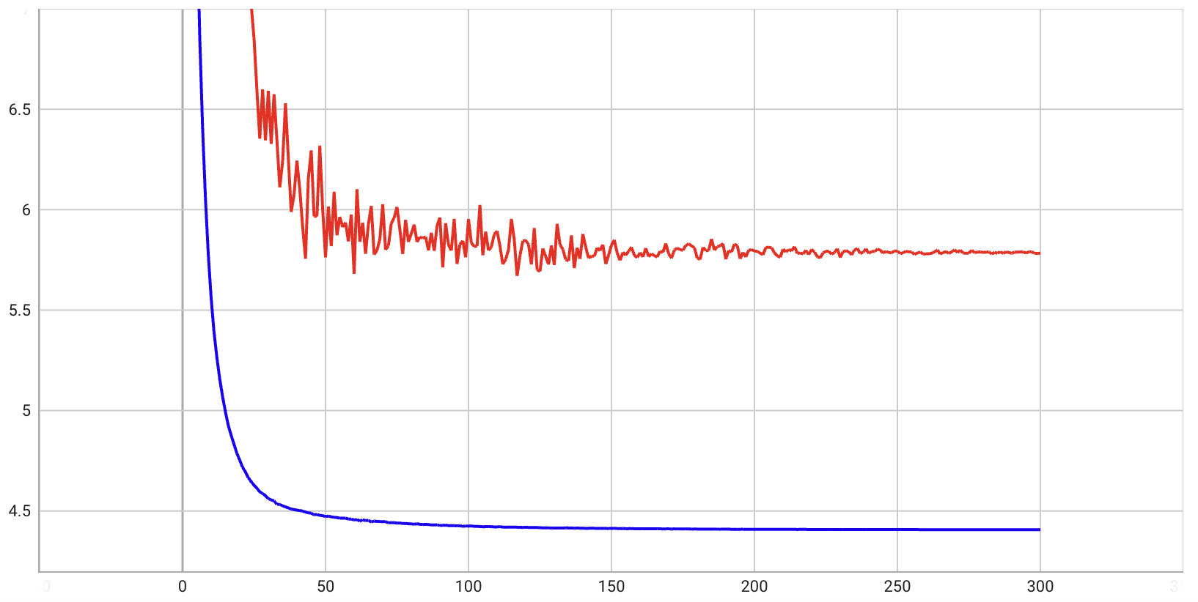
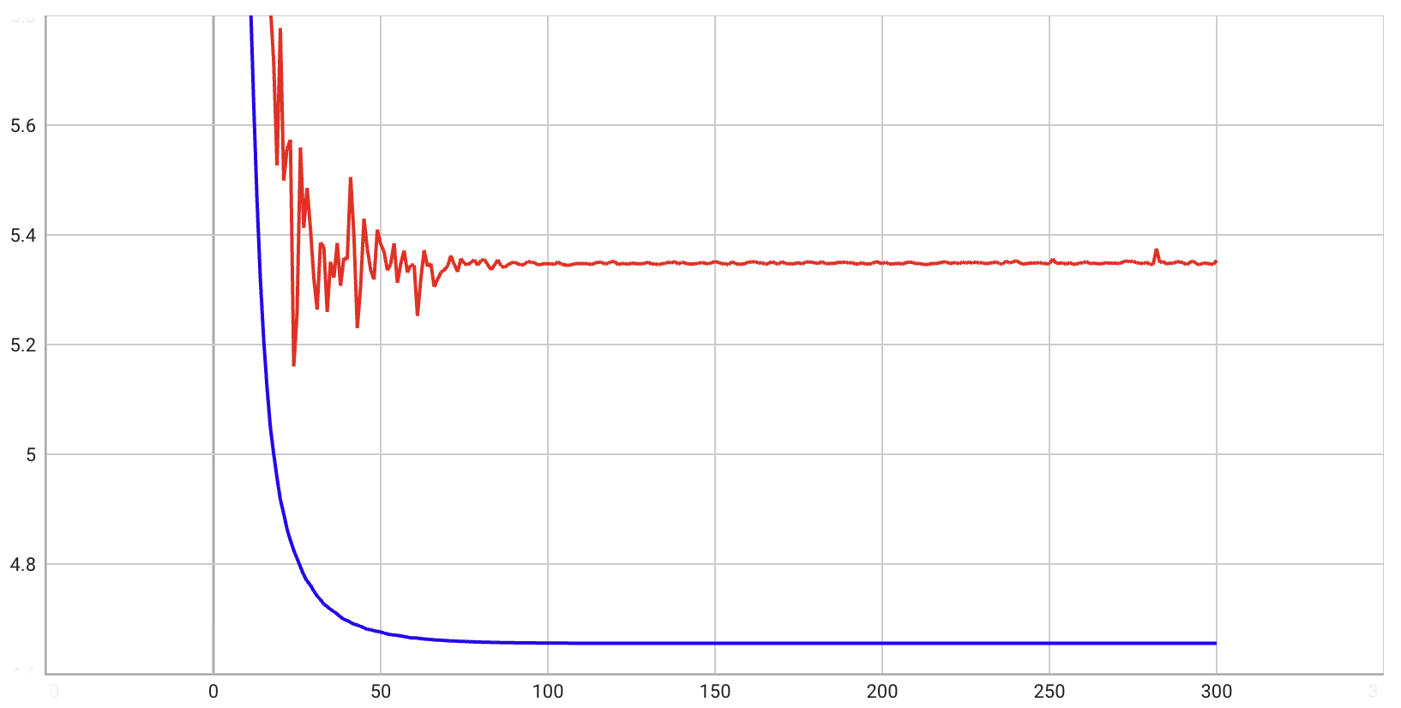
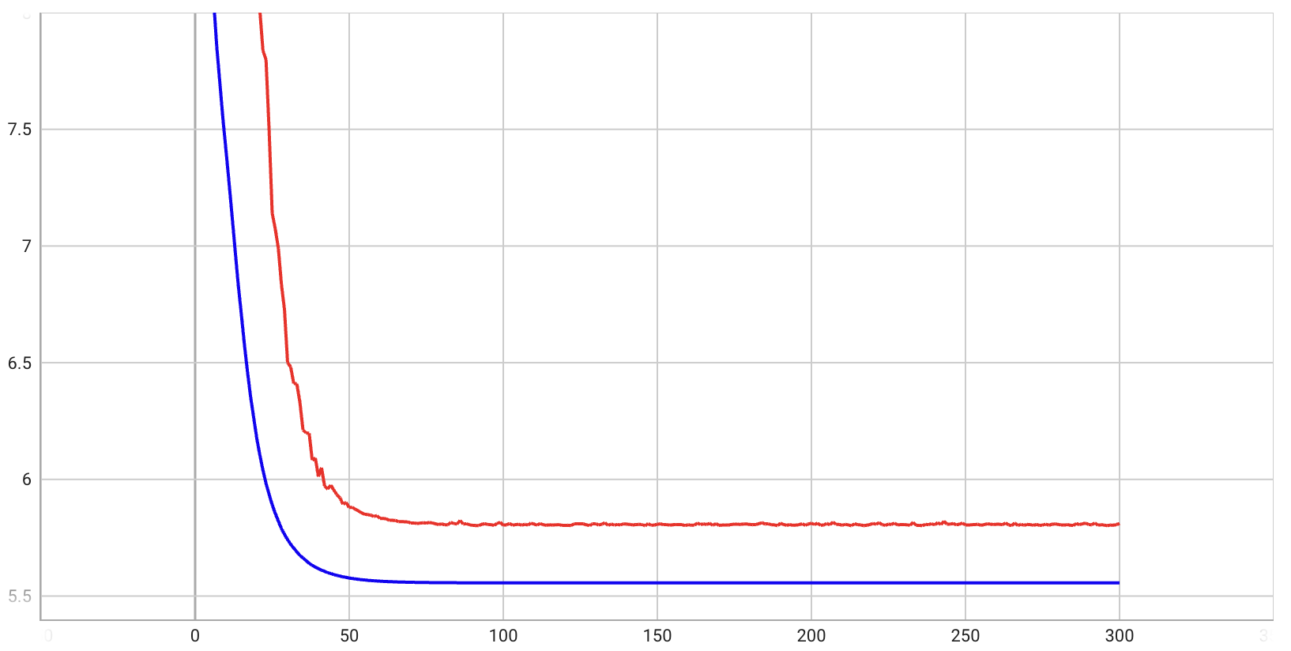
MAE + L1 Regularization
Initial learning rate = 0.001
MAE: 5.8
2 added feature, lamda_l1 = 0.001, gamma = 0.98
MAE: 5.35
MAE: 5.8
8 added feature, lamda_l1 = 0.001, gamma = 0.93
32 added feature, lamda_l1 = 0.001, gamma = 0.90
Notes:
关于实验，我首先按照您的建议，添加了train loss和adaptive learning rate，the equation of the learning rate is here. It will decrease as the training goes on, and the gamma is a very important hyperparameter. MSE，MAE和L1，L2一共有四种组合方式，每种组合方式我都尝试了三种数量的无关特征，分别是2，8，32，并对每种情况都找到了最佳超参数。
在MAE和L1的组合下，我们能够实现五点几的mae，这应该是一个比较不错的结果了，因为在您的那篇论文中，我看到美国对于预测血压的国家标准就是5.

Slide 4
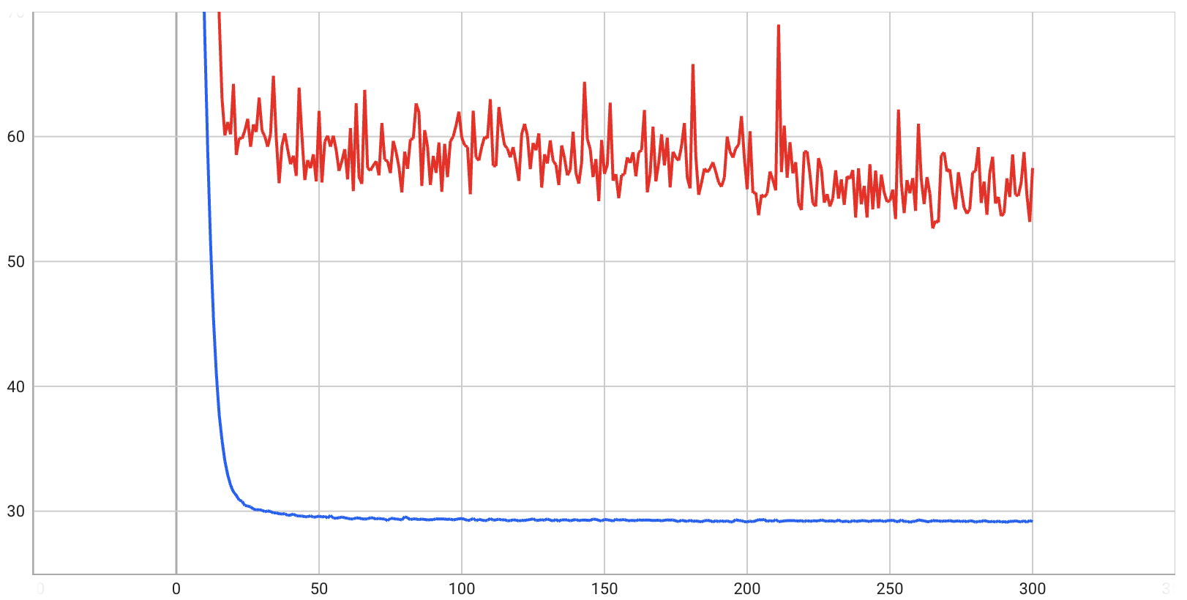
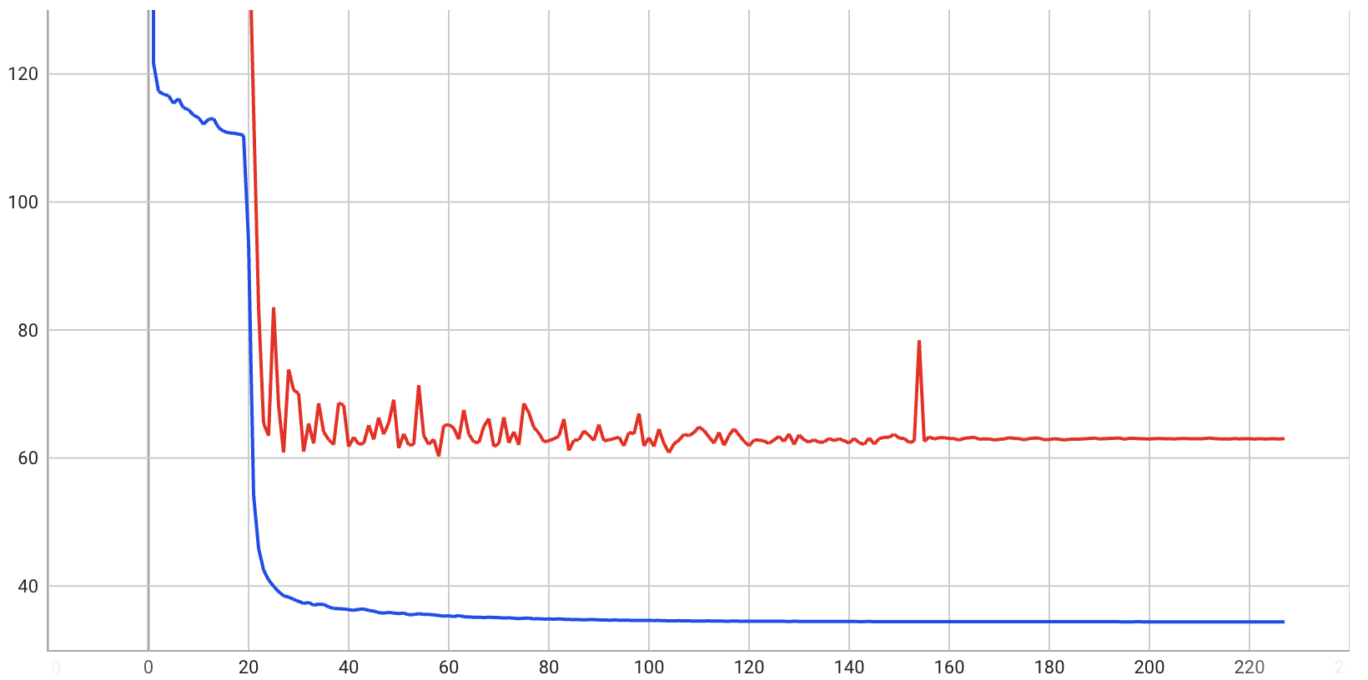
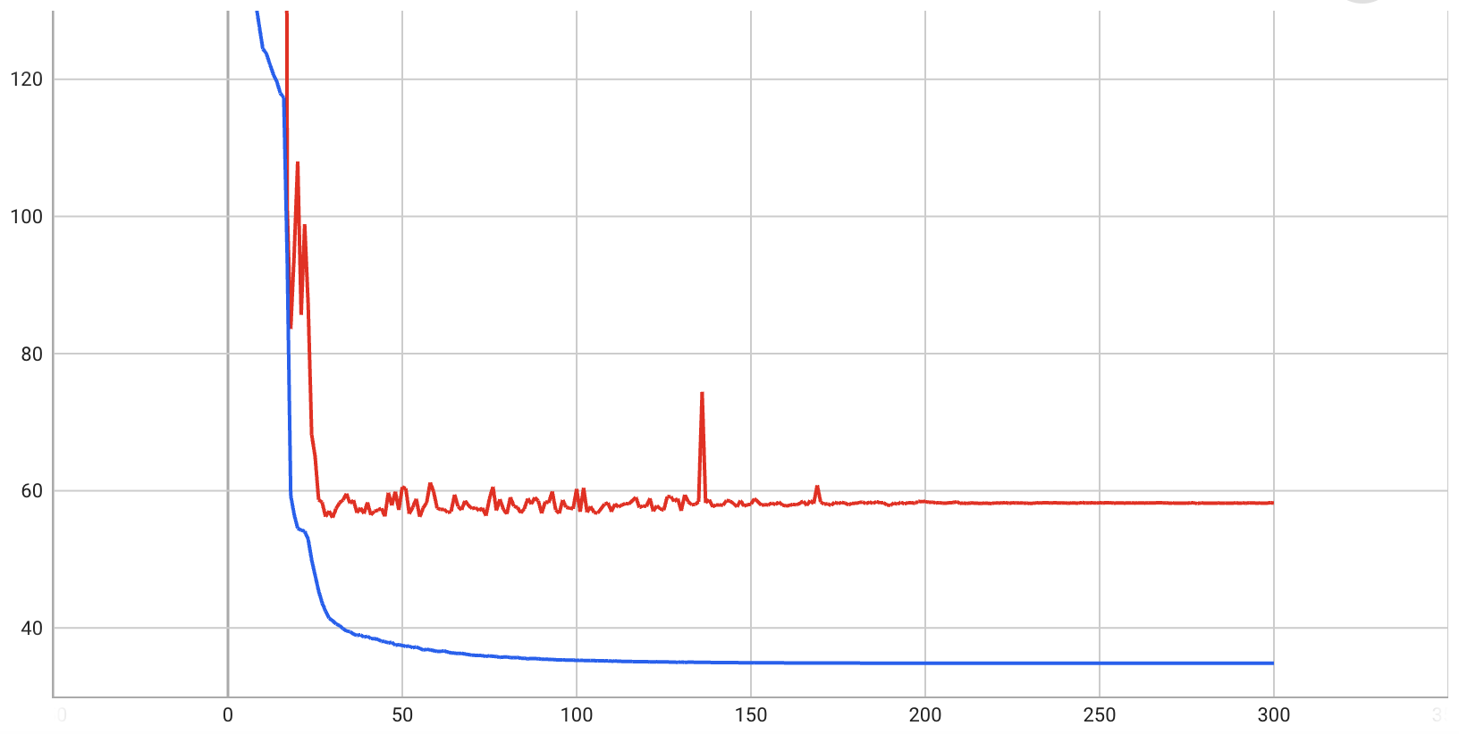
MSE + L1 Regularization
Initial learning rate = 0.01
MSE: 56
RMSE: 7.48
2 added feature, lamda_l1 = 0.01, gamma = 0.95
MSE: 62
RMSE: 7.87
MSE: 59
RMSE:7.68
8 added feature, lamda_l1 = 0.02, gamma = 0.96
32 added feature, lamda_l1 = 0.03, gamma = 0.965
Notes:
这里的RMSE是我通过MSE开根计算得到的，为了便于和MAE的值进行比较，实际上的损失函数是MSE。通过观察这四组结果。我们可以得出一些结论。

Slide 5
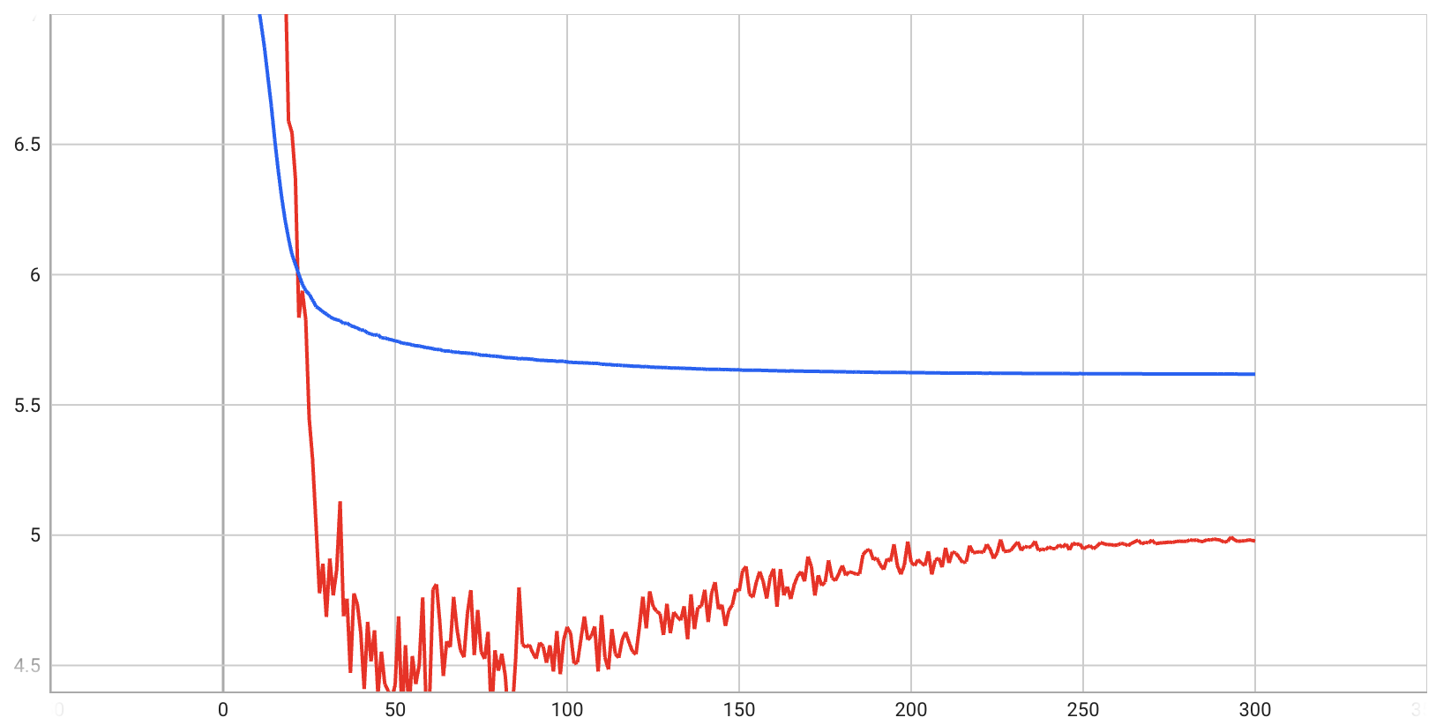
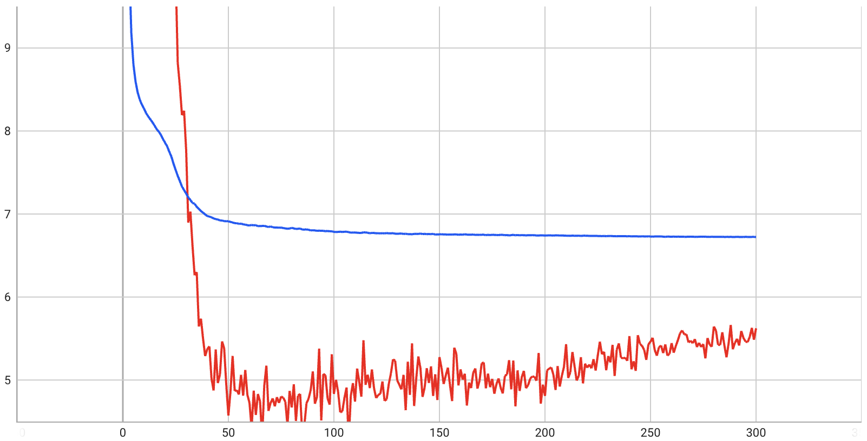
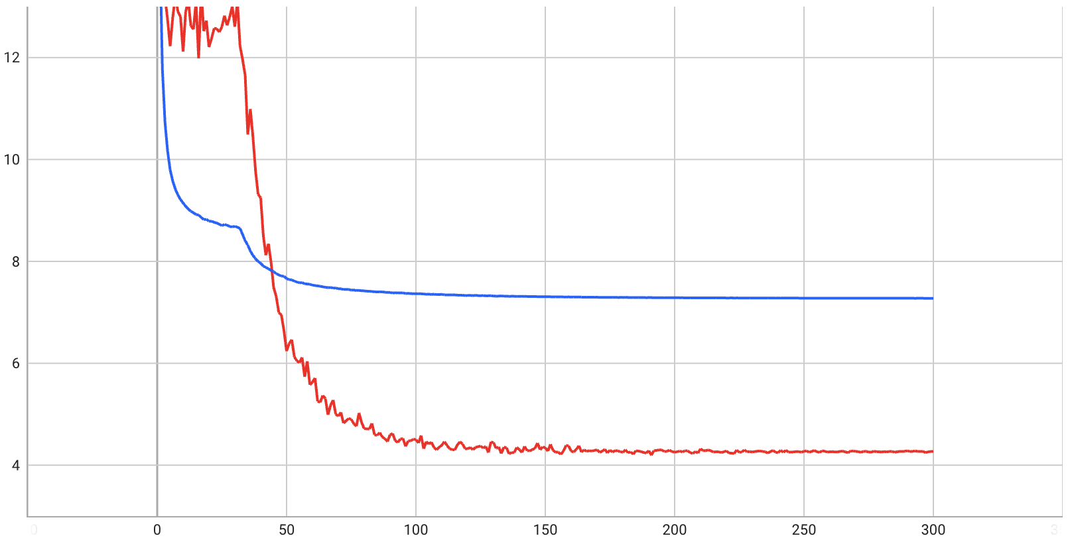
MAE + L2 Regularization
Initial learning rate = 0.001
MAE: 5
2 added feature, lamda_l1 = 0.01, gamma = 0.98
MAE: 5.6
MAE: 4.2
8 added feature, lamda_l1 = 0.02, gamma = 0.99
32 added feature, lamda_l1 = 0.03, gamma = 0.98

Slide 6
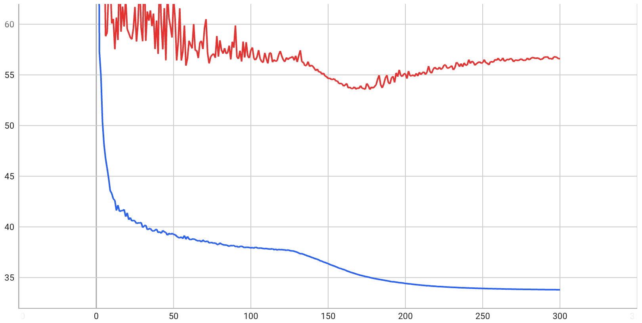
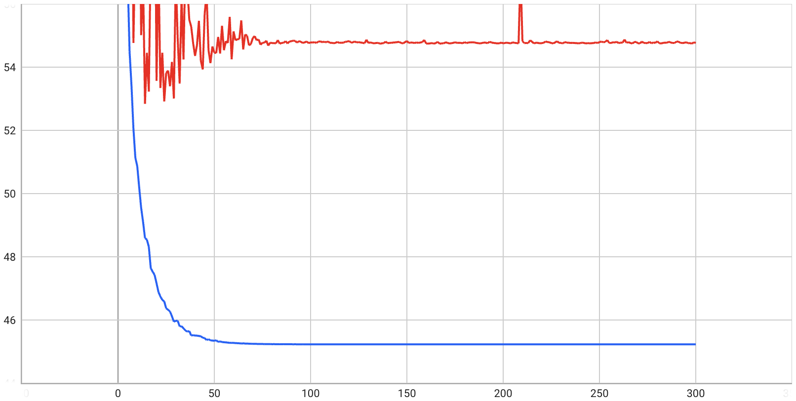
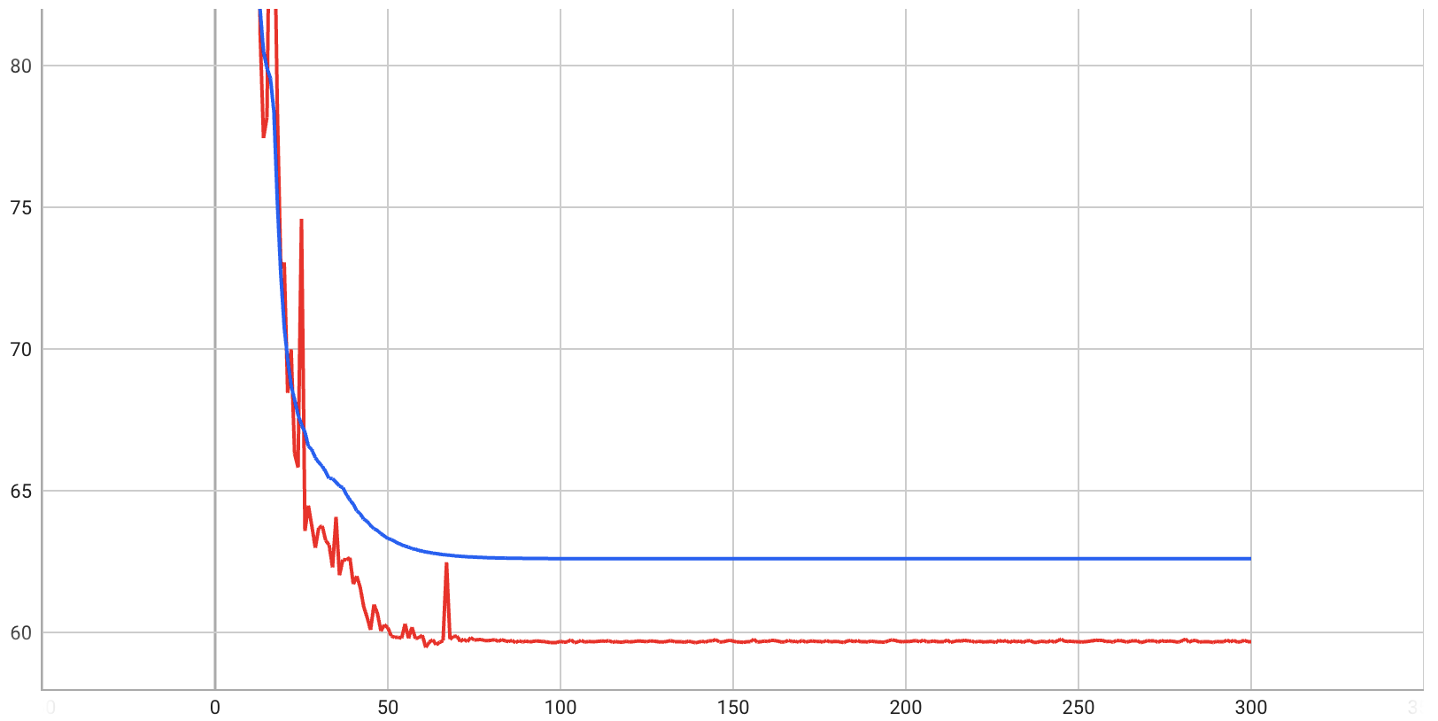
MSE + L2 Regularization
Initial learning rate = 0.01
MSE: 56
RMSE: 7.48
2 added feature, lamda_l1 = 0.05, gamma = 0.975
MSE: 54.5
RMSE: 7.38
MSE: 59.5
RMSE: 7.71
8 added feature, lamda_l1 = 0.1, gamma = 0.905
32 added feature, lamda_l1 = 0.3, gamma = 0.9

Slide 7
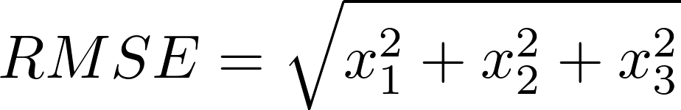

Conclusion
1. MAE has better result than MSE
2. MSE needs bigger learning rate than MAE
3. Both adaptive learning rate and regularization can prevent the bounce. But their mechanisms are different. Regularization prevents the overfit, while the adaptive learning rate prevents jumping out of the optimal
Notes:
1.使用MAE的结果比使用MSE要好。我们可以做一个简短的数学证明。通过这个formula，我们可以得出，一组数据的RMSE应该比其对应的MAE要小，但是我们的RMSE值已经比以MAE要大了，说明MAE的结果比MSE要更好。。
2.对于MSE我们需要使用比MAE更大的学习率。
3.之前我们所面临的问题是，在训练过程中，test loss会出现反弹，也就是它会突然变得很高。通过这次实验，我发现增大regularization的值和使用adaptive learning rate都可以缓解这个问题，但是两者的原理是不同的。regularization是通过防止过拟合来阻止反弹，也就是它通过不让模型的参数过于复杂，从而让模型不学习噪声，以此来增加泛化性，而adaptive learning rate是通过防止模型跳出最优点来阻止反弹。虽然两者都达到了相似的目的，但原理不同。

Slide 8


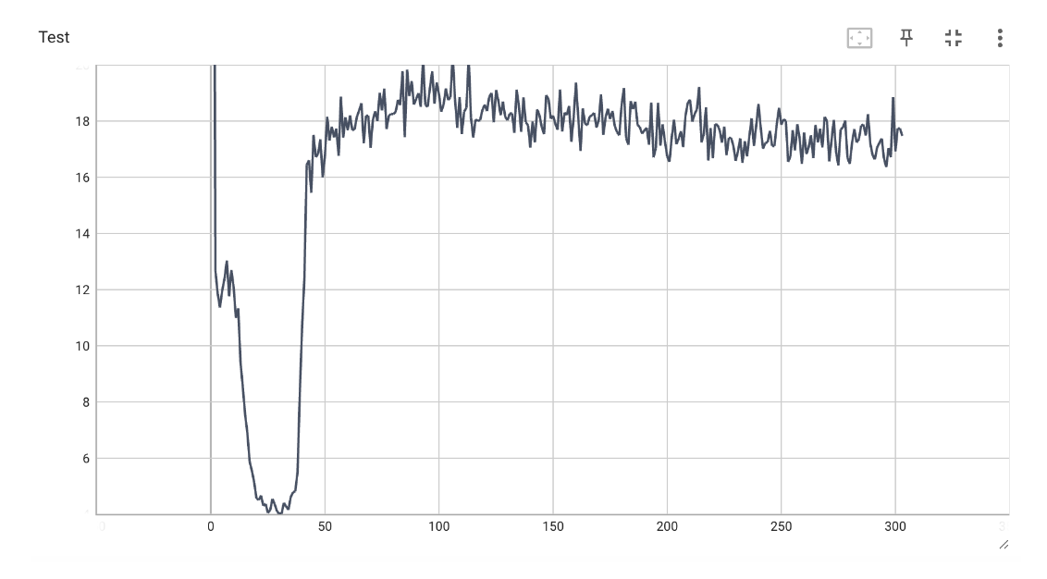

x is constant
decrease
We know that the optimizing step = gradient * learning rate and we hope the optimizing step decrease as the training goes on. For MAE, the gradient is constant, so we should make the learning rate decrease. For MSE, the gradient decreases by itself, so we’d better use bigger gamma than that of MAE.
We should be careful when we use the decreased learning rate. When the gamma is 0.95 and the number of epoch is 100, the learning rate is 0.5 percent of the original. So the test loss doesn’t bouce upward not because the model learn the right function, but because it stop optimizing at the valley.
Notes:
接下来，我要分析一下MSE和MAE，还有L1，L2的区别，这样可以解释一些上面的得出的结论。

Slide 9
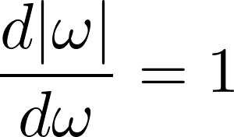
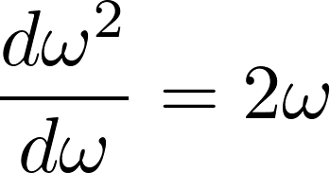

constant
decrease as training goes on
L1 regularization tends to get sparse parameters, because it will reduce the parameters at a constant step until the parameter becomes zero. As a result, L1 regularization is suitable for feature selection.
L2 regularization tends to make the parameters small, but it won’t make them zero. Because the gradient of L2 term will become very small when the parameters are small.

Slide 10
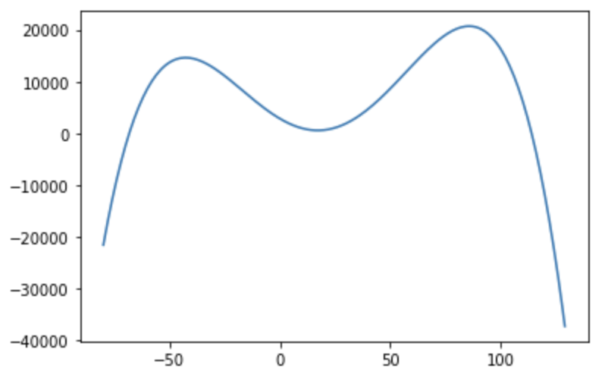
Universal Approximation Theorem
Notes:
下面一部分是用FCN来近似一些数学函数。我首先构造了一个比较复杂的多项式函数，它的公式和形状如图所示。

Slide 11
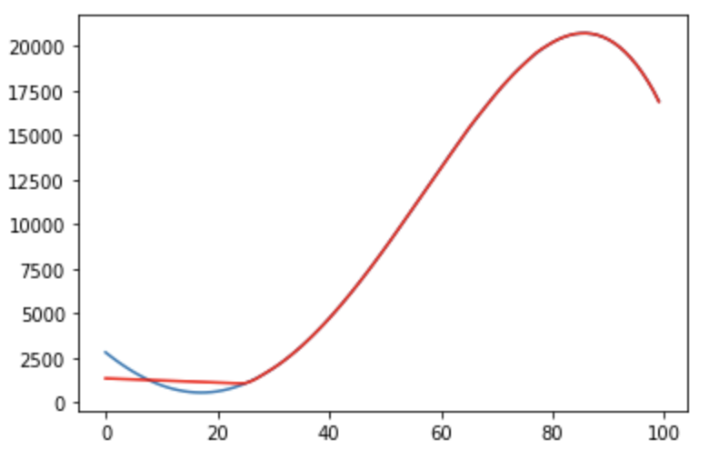
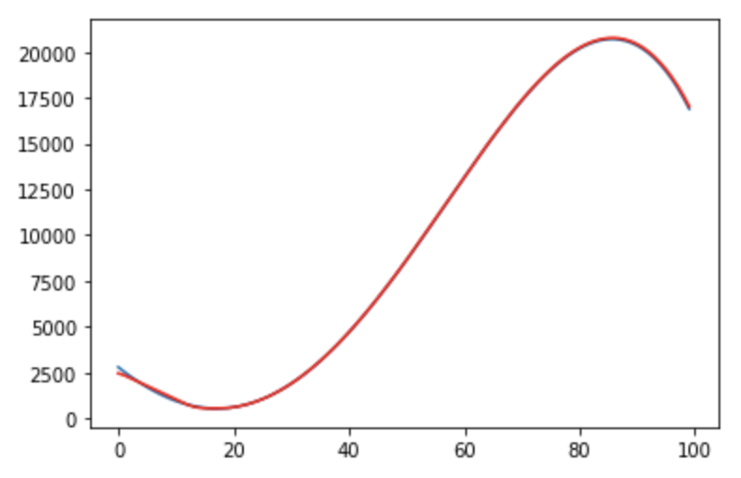
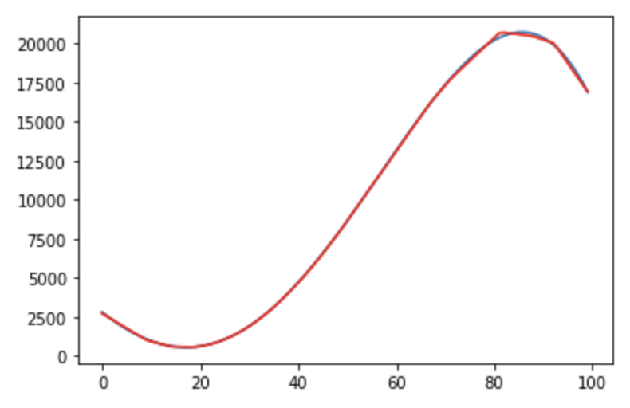
train set: [0,100]
one hidden layer, 60 neuros
one hidden layer, 180 neuros
1. The more neuros, the better learning ability.
2. For the same number of neuros, the more hidden layers, the better learning ability.
Two hidden layers, 30 neuros each layer
Notes:
我在训练FCN的时候选择了0-100作为我的训练域，即x的范围是0-100。可以看到，如果FCN只有一层hidden layer，且hidden layer有60个神经元，那么它无法很好的拟合我们的函数，在左下角这里会有一些偏离。但是当我们把神经元的数量增加到180个的时候，可以看到这是FCN就有拟合曲线的能力了。这可以说明只有神经元个数足够时，FCN才具有拟合一些函数的能力，神经元越多，拟合能力越强，这是非常符合直觉。同时，我还尝试了使用两层hidden layer，每层30个神经元。这样它和第一种情况的神经元个数就相等了，在这种情况下，它也可以拟合出函数，同时它的训练轮数更少，因此我们又可以得出结论。在相同个数的神经元下，层数越多，拟合能力越强。因此，现在神经网络的发展方向不是增加网络的宽度，而是增加网络的长度，即层数。

Slide 12
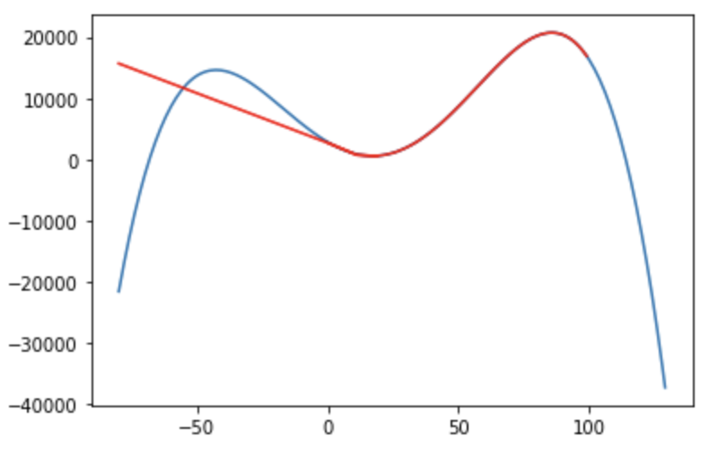
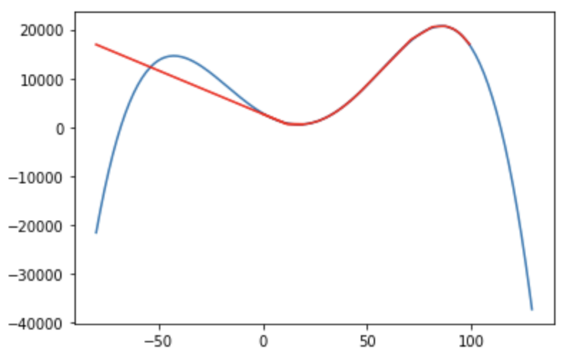
Prediction out of [0,100]
one hidden layer, 180 neuros
Two hidden layers, 30 neuros each layer
Notes:
这两幅图是当训练集仍为0-100，但测试集的范围增大时的情况，我们可以看到，模型只能在训练域中拟合，一旦输入数据超出了训练域，神经网络就会完全失败

Slide 13
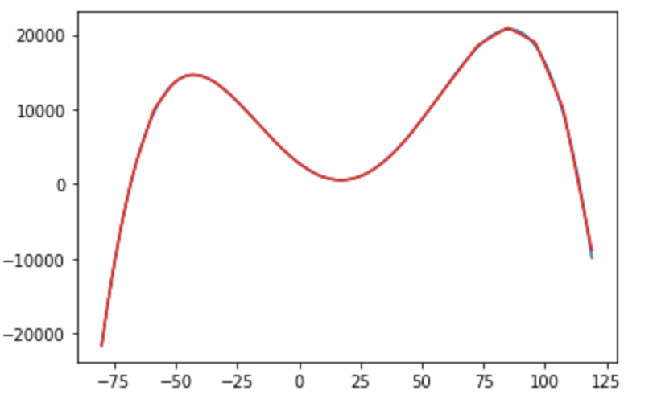
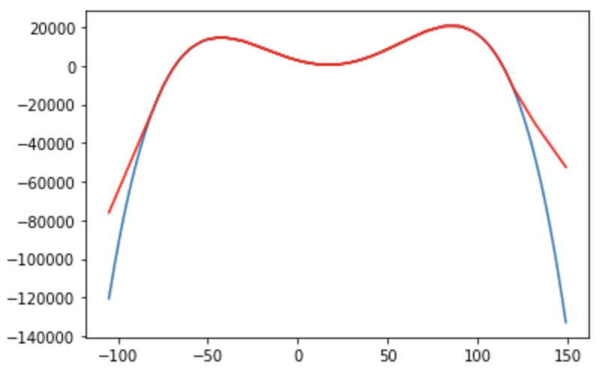
train set: [-80,120]
Notes:
我开始怀疑是不是我的训练域选取有问题，因为我的训练域没有包含全部的趋势，所以这次我扩大的训练域，选择了-80-120作为训练域，结果同样是FCN只能在训练域内拟合，而在训练域外就会失败。

Slide 14
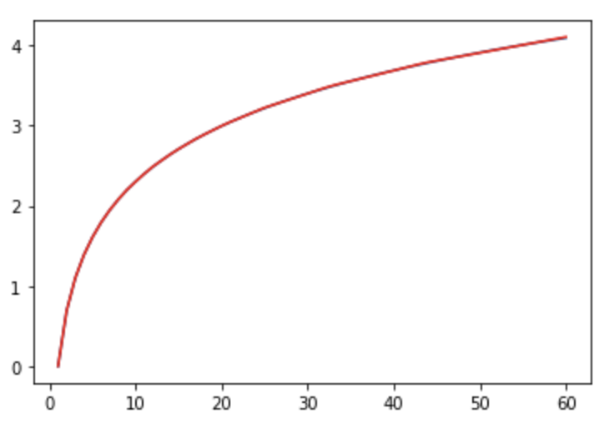
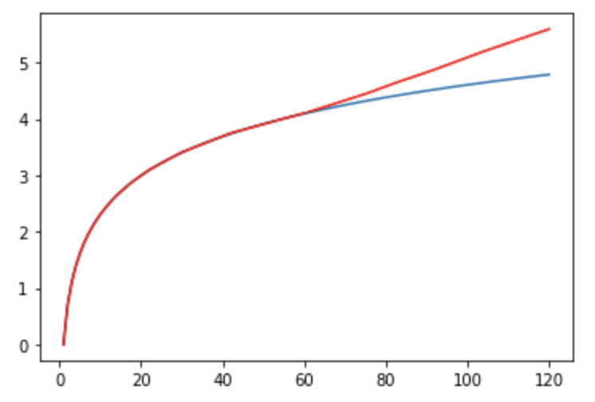
Log
Train set: [1:60]
Test set: [1:120]
Notes:
我还尝试了Log

Slide 15
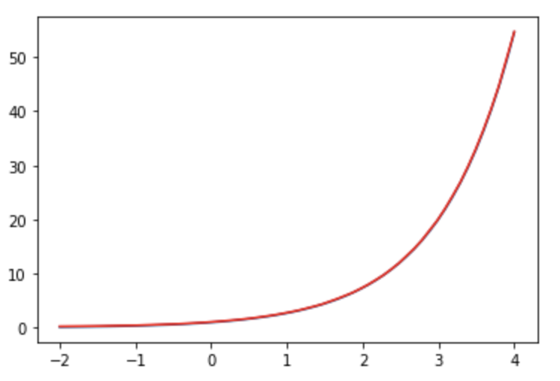
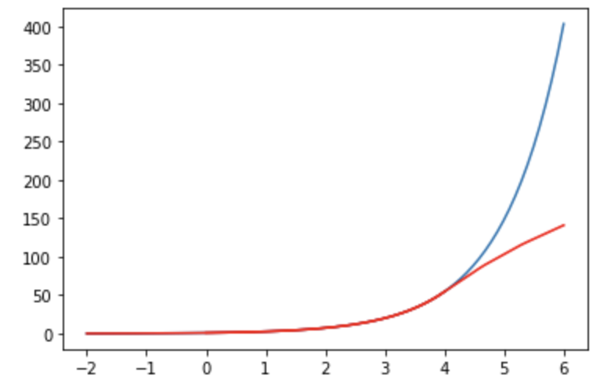
Exponential
Train set: [-2:4]
Test set: [-2:6]
Notes:
Exponential

Slide 16
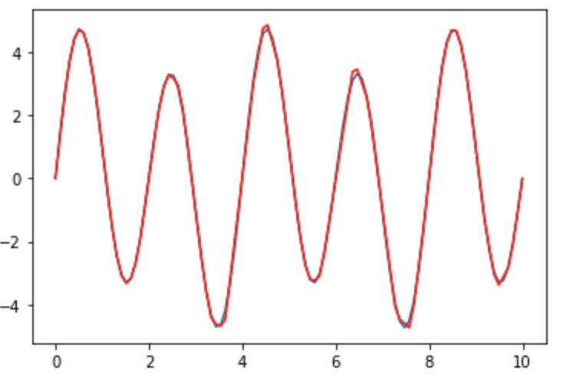
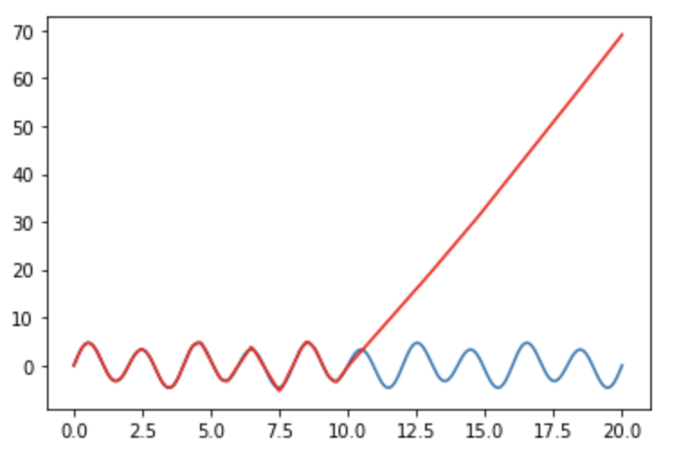
Sin
Train set: [1:10]
Test set: [1:20]
Notes:
sin这几种函数，发现都是同样的问题。

Slide 17
Conclusion
If the number of neuros is big enough, the FCN can approximate any function in a limited range. But what the FCN does is just approximating the value, not learning the function. We can also view the problem from another perspective, in a limited range, we have many function which has the similar value as the label, and the FCN only learns one of them. Essentially, I think this is a OOD problem.
As a result, if we want to learn the right synthesized feature, we can work on two ways. The first is Feature Engineering methods, such as feature selection. Through selecting the features at first, we can alleviate the degree of OOD. Second, we can treat the feature synthesis as a OOD problem and use OOD methods to solve it, such as Regularization and Contrastive learning.
Notes:
总结：如果数据足够且神经元数量足够，神经网络可以拟合一个有限区间内的任何函数，但它只是拟合，并不能学习到其数学表达式。换一个视角来看，在一个特定区间内，有无数个函数读可以形成相似的曲线，神经网络学习只是到了其中的一个，它并不一定是我们想要的数学表达式。所以，这本质上是一个OOD问题。这也是我说的为什么之前的实验结果不一定能够说明我们学习到了正确的合成方法。
因此，如果我们想要合成正确的feature，我认为可以从两个角度来推进，第一个是先利用特征工程的方法，比如一些特征选择方法来筛去一部分明显的无关特征，这样可以减小后续神经网络拟合噪声的可能性。第二步，就是将特征合成问题看作是一个OOD问题，因为上次您信中说到的验证合成结果好坏的方法其实和OOD问题中验证泛化结果好坏的方式很相似。我们想要合成的特征就是OOD问题中想要学习到的invariant feature。

Slide 18
Feature Selection (Filter)
Symmetrical Uncertainty
Fast Correlation-Based Filter
Mutual information
Max-Relevance Min-Redundancy
Reason for the bad result:
The individual feature is meaningless, such as x1, x2
Future plan:
Try wrapper and embeded feature selection methods
Apply OOD method to our dataset
Notes:
因此在这个思路下，我先找了一篇利用特征选择方法来选择生理信号特征的论文，也就是我放在开头的第二篇关于EEG信号的论文。我复线了一些这篇论文中用到的方法，也就是这四种，我把它们也都写到了tutorial的jupyter notebook里了。如果按照特征选择方法的分类，它们都是属于filter方法的，所谓filter方法就是分别计算每个特征与label的相关性，相关性一般都基于一些统计方法，然后选出相关性最高的一些特征。但是实验结果显示这四种方法的特征选择效果都不好，究极原因，我觉得是，我们认为重要的特征单独来看都是没有意义的，比如x1的值，它单独来看没有任何意义，只有x2-x1这样才有意义，因此filter方法在我们所面临的问题上表现很差。所以我接下来可能会尝试wrapper和embeded方法来进行特征选择。

Slide 19
Question
1. Does the tutorial meet your requirement?
2. Is my understanding about the problem right? (View the problem as feature selection and OOD problem) If it is OK, which one should I focus on next? Feature selection or OOD?

