Slide 1
Weekly Progress Report
Yida Zhang
2023.8.7
Notes:
Hello teachers, I would like to present my progress for this week.

Slide 2
Progress
Complex Analysis and Integral Transformations: Two Chapters
Advanced Digital Signal Processing and Noise Reduction: One Chapter
Noise Reduction, Signal Reconstruction and Feature Selection on SCG Signal
Two paper:
Signal Processing Techniques for Removing Noise from ECG Signals
Novel Signal Noise Reduction Method through Cluster Analysis, Applied to Photoplethysmography
Notes:
During this week, I studied two chapters on Complex Functions and Integral Transformations, as well as one chapter on ADSPNR. Additionally, I reviewed two research papers and applied some of their methods to the SCG dataset.

Slide 3
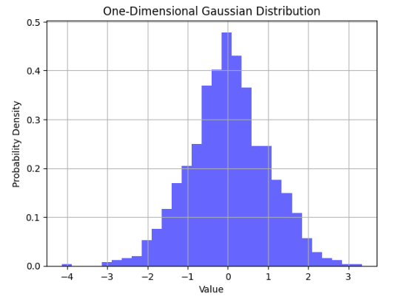
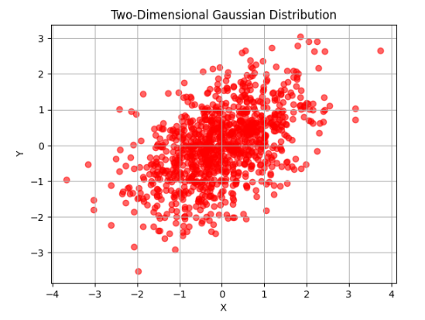
Gaussian Process’s probability distribution
mean = 0
std = 1
mean = [0, 0]
cov = [[1, 0.5], [0.5, 1]]
Notes:
Regarding the ADSPNR, I focused on Chapter 3, Information Theory and Probability Models. This chapter primarily introduced some concepts of information theory and discussed some random processes and their applications. I simulated some random processes using python. For example, here is the probability distribution of a Gaussian process.

Slide 4
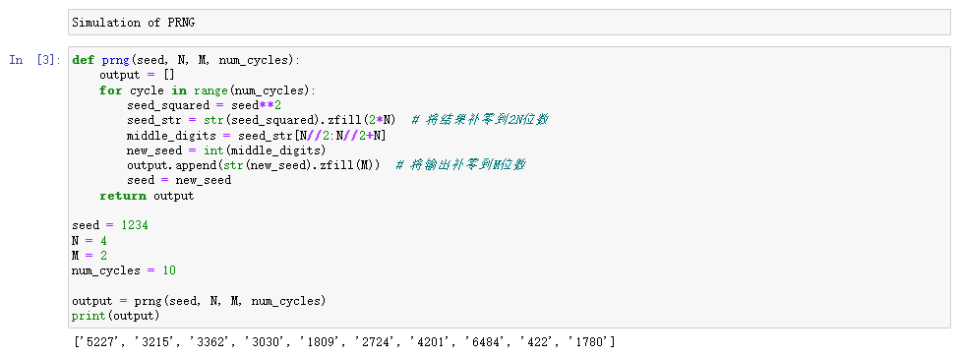
Pseudo-Random Number Generators (PRNG)
Mechanism of PRNG:
(1) Input an initial N-digit seed
(2) Squares the seed to yield a 2N-digit output
(3) The N middle digits of the output is a random number
(4) Treat the random number as a seed and go back to Step 1
Notes:
I also implemented some examples from the book, such as Pseudo[ˈsjuːdəʊ]-Random Number Generators (PRNG). The mechanism behind PRNG involves initializing a seed with N digits, squaring it to obtain a 2N-digit number, and then extracting the middle N digits as the random output number. This process continues iteratively, using the output as the seed for the next round. Here's the implementation code for PRNG.

Slide 5
Huffman Coding
Input: 111233
Probability: 1: 3/6 2: 1/6 3: 2/6
Prob:1
Prob:1/2
(1)
1
Prob:1/2
0
Prob:1/2
Prob:1/6
(2)
0
1
Prob:1/2
Prob:1/6
Prob:1/3
Prob:1/2
Prob:1/6
Prob:1/3
Prob:1/3
(3)
(1)
(2)
(3)
(1)
(2)
(3)
0
10
11
Output:000101111
Notes:
Another application I implemented was Huffman coding. Its principle involves merging the two nodes with the lowest probabilities into a new node, where the probability of the new node is the sum of the probabilities of the two old nodes. This process is repeated until only one node remains. The resulting tree structure assigns 0 to the left branch and 1 to the right branch, so that we can get the code for each symbol. Here's an example illustration. Given an input sequence of 111233, the probabilities of occurrence are 1/2, 1/6, and 1/3, respectively. The merging process results in a tree structure, and we assign 0 and 1 to branches so that we can generate the corresponding codes, matching the output of our code

Slide 6
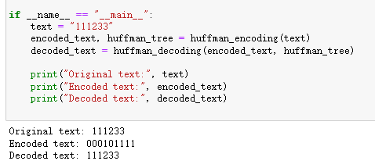
Verification

Slide 7
Respiration Signal Removal
Noise Reduction
Feature Extraction
Feature Selection
Notes:
For the majority of this week, my primary focus was on processing SCG signals. My work can be divided into four main parts: 1, 2, 3, and 4

Slide 8
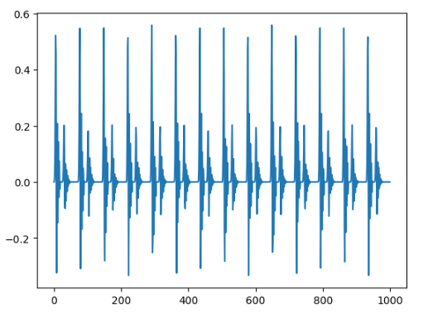
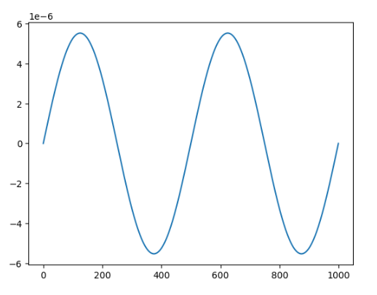
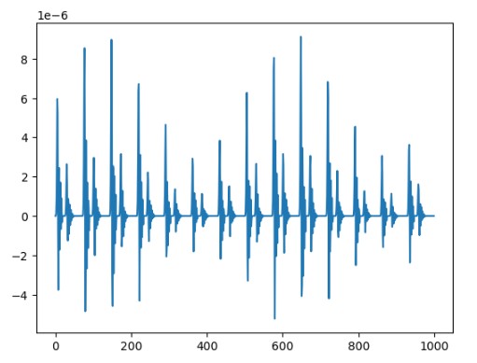
Respiration Signal Removal
Pure SCG
Daubechies wavelet
Respiration Signal
seg_amp*np.sin(2*np.pi*seg_fre*x_space)
SCG with Respiration
SCG = Pure_SCG*(Respiration+2*seg_amp)
Notes:
I began with respiration signal removal since the presence of the respiration signal can significantly affect the accuracy of the extracted features, such as peak heights. Based on the code provided by Professor Song, I learned that Daubechies(盗白ki死) wavelet was used to generate clean SCG signals without noise and respiration components. Subsequently, here is the respiration signal, which is a sinusoidal-shaped signal, as shown here. By multiplying the respiration signal with the clean SCG signal, we can obtain the SCG signal with respiration. The "seg_amp" refers to the maximum value in the clean SCG signal. Given the non-linear nature of signal synthesis, simple filtering and ICA techniques couldn't effectively separate the two components. And I haven’t learned other methods. So, I decided to initially isolate the respiration signal based on the known synthesis information, enabling subsequent processing.

Slide 9
Respiration Signal Removal
Assumption 1: The heights of both peak1 and peak2 are fixed (P1 and P2)
Assumption 2: The respiration signal is a sinusoidal-shaped signal
Assumption 3: The respiration signal is added to the clean signal through multiplication
Gradient Descent Based Parameter Estimation
For peak1:
Known: H, x
H = (P1 * Sin(wx) + 2 * P1) * P1
Unknown: P1, P2, w
For peak2:
Method: Gradient Descent
Input: x
Target: H
H = (P1 * Sin(wx) + 2 * P1) * P2
Notes:
The method I used is based on gradient descent for parameter estimation. Before using this method, three assumptions were made, relying on the known synthesis information. Assumption 1: The height of peak1 and peak2 are fixed and denoted as P1 and P2. Assumption 2: The respiration signal is a sinusoidal[ˈsaɪnəˌsɔɪdəl]-shaped signal. Assumption 3: The synthesis is achieved through multiplication. Utilizing these assumptions, an equation was derived for each peak. We only focus on the peak point, and don’t pay attention to the other part of the signal. Here is the equation, where H and x are known values, x represents time, and H represents the SCG signal value at that time which is x. P1, P2, and w are the parameters we want to estimate. The estimation method involves gradient descent, using x as input and H as the target for fitting

Slide 10
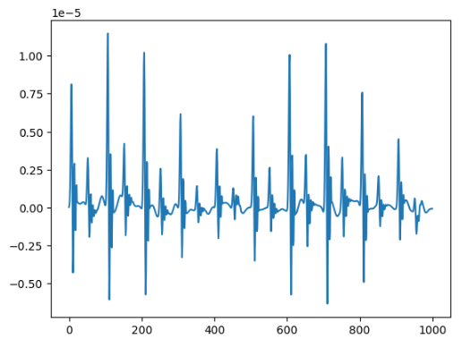
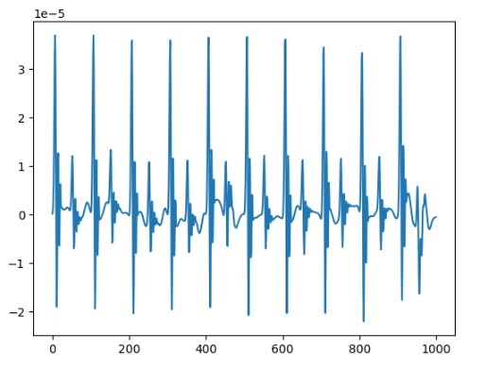
Respiration Signal Removal
Before Respiration Removal
train_set[244,:1000]
After Respiration Removal
Notes:
This approach allowed me to effectively remove the respiration signal. The result shows that the left side is the signal before removal, while the right side is the signal after removal, demonstrating a significant improvement. However, it is important to note that since Assumption 1 is an idealized situation, the effectiveness of my algorithm for removing the respiration signal may not be optimal for certain signals. Consequently, I only select signals with successful removal for further processing.

Slide 11
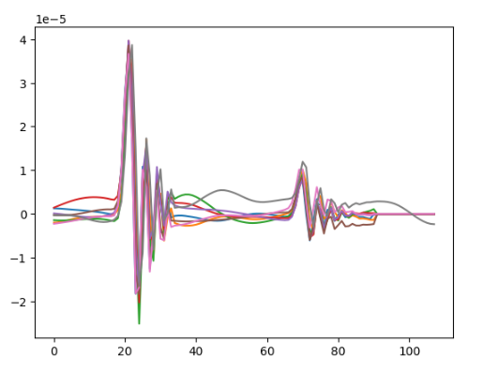
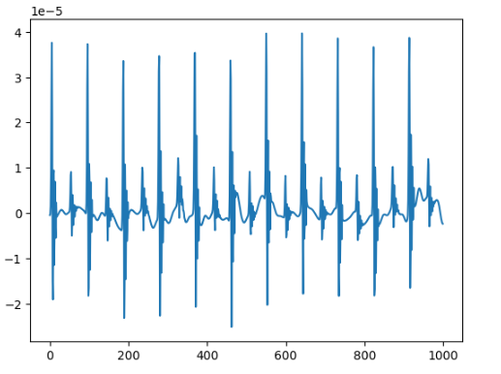
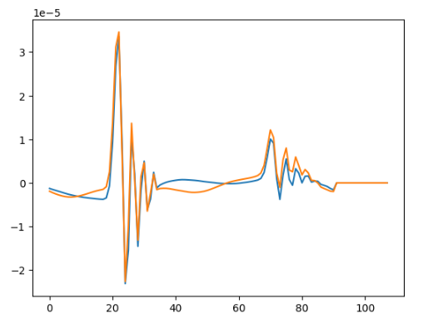
Noise Reduction
Cluster 1: 8 signals
Cluster 2: 2 signals
SCG without Respiration
Reference: Novel Signal Noise Reduction Method through Cluster Analysis, Applied to Photoplethysmography
Notes:
The second step is noise reduction. In this part, I employed the cluster analysis method from Professor Song's paper. Initially, I segment the signals based on their cycles and perform cluster analysis on them. The fundamental principle of cluster analysis is as follows: for each signal, if the distance between the current signal and the center of any existing cluster exceeds a predefined threshold, a new cluster is formed with this signal as its center. Otherwise, the signal is added to the cluster with the least distance. The distance measurement employed here is the root mean square error (RMSE), as mentioned in the paper. For instance, consider this signal. After segmenting it according to its cycles, we proceed with cluster analysis. It's worth noting that the segmentation algorithm I used may result in one less signal than the actual count, but this won't impact subsequent feature extraction. Through cluster analysis, we obtained two clusters, with one containing eight signals and the other containing two signals. The deviation of these two signals from the majority is attributed to their heavy noise influence which means that the two signals are influenced a lot by noise. Therefore, I disregarded these signals in this cluster. I select the cluster with the highest signal count and calculated their average to generate a template signal, effectively achieving denoising

Slide 12
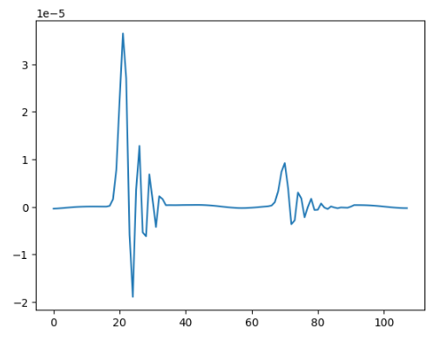
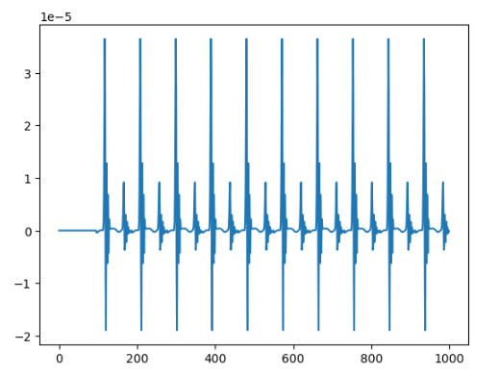
Signal Reconstruction
Average of Cluster 1
Reconstructed Signal
Signal with Noise
Notes:
Here is our template signal. Subsequently, signal reconstruction was performed. It's important to highlight that due to the nature of my segmentation algorithm, the signal's cycle count here is one less than the original signal, just like I mentioned before. However, this does not affect feature extraction. As shown, our reconstructed signal exhibits considerably fewer fluctuations caused by noise compared to the original signal.

Slide 13
Feature Extraction
# Mean
# P1 (Amplitude of Peak)
# P2
# P1-P2
# P1/P2
# D12 (Distance between P1 and P2)
# D21
# D11
# D12/D21
# Skew1
# Skew2
# Kurt1
# Kurt2
# Variance
# PeakToPeak
# Zero Crossing Rate
# Energy
# Number of Periods in 10 Seconds
Notes:
Next is feature selection. I chose 12 features that I consider important, including the peak difference between peak1 and peak2, as well as their horizontal distance.

Slide 14
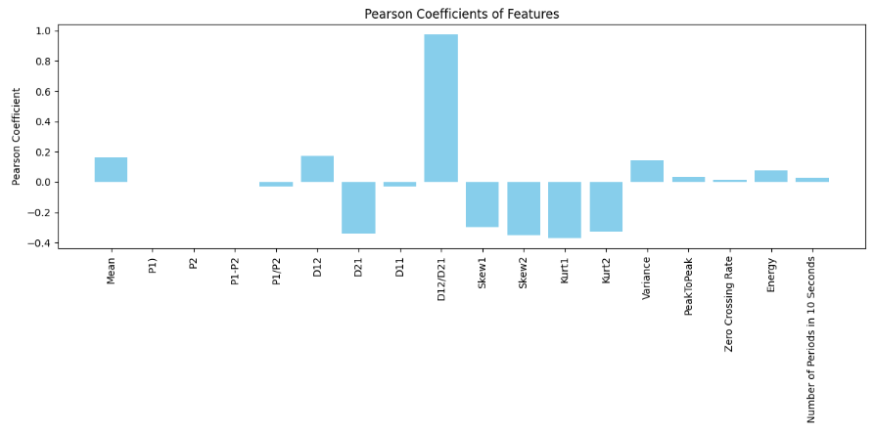
Feature Selection
Pearson correlation coefficient
Selected Features: D12, D12/D21, Skew1, Skew2, Kurt1, Kurt2
Notes:
I then employed the Pearson correlation coefficient for feature selection. This coefficient measures the strength of the linear relationship between two variables. When the Pearson correlation coefficient is 1, it indicates a perfect positive correlation, while a coefficient of -1 indicates a perfect negative correlation. Since I later used linear regression for prediction, I think that the Pearson correlation coefficient is effective for feature selection. The selected feature is about the distance information of peak1 and peak2, and the skewness [sk'ju:nes] and kurtosis [kɜː'təʊsɪs] of them

Slide 15
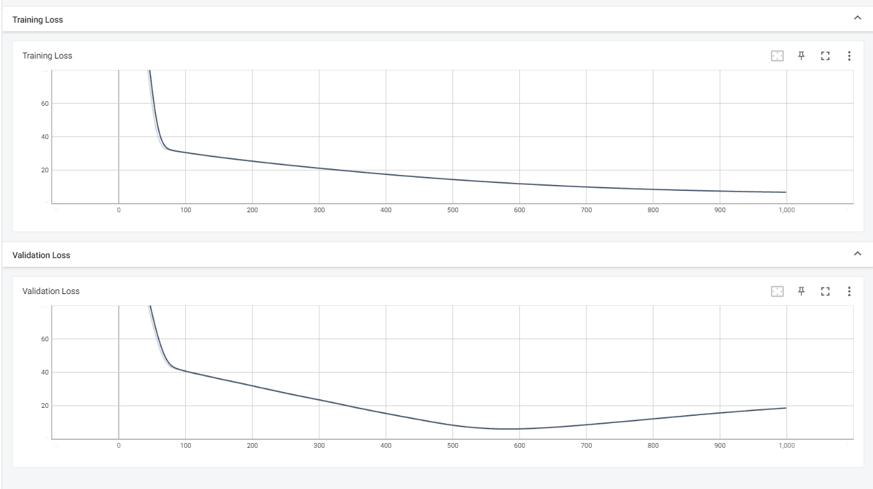
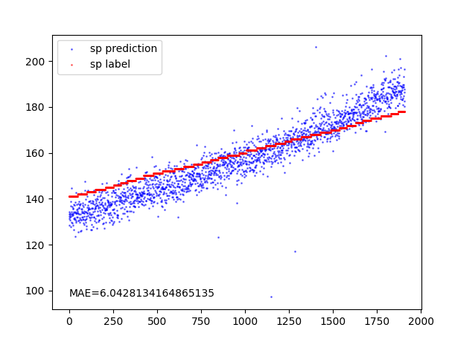
Result (Without Feature Selection)
MAE: 6.04
MAE without noise reduction: 10
Notes:
Here is the result without feature selection, and the Mean Absolute Error (MAE) is 6.04. In the initial version I submitted previously, without noise reduction, the MAE from linear regression was 10, which indicates a significant improvement in prediction accuracy through noise reduction.

Slide 16
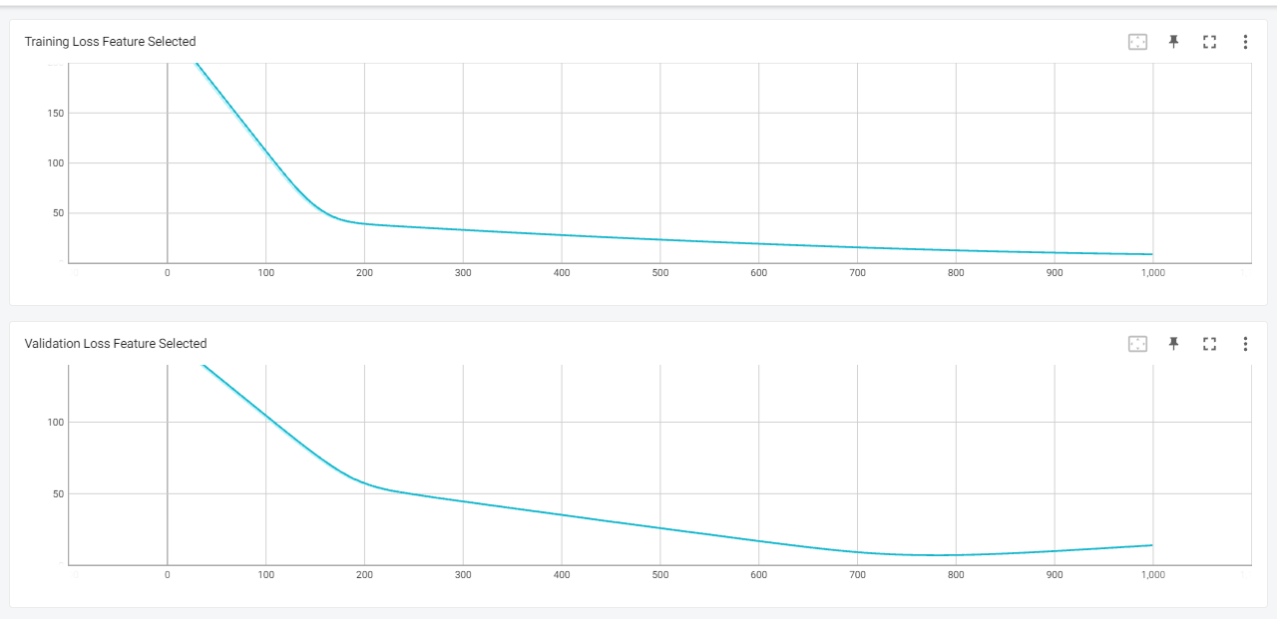
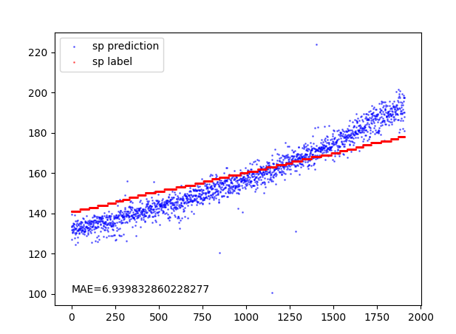
Result (With Feature Selection)
MAE: 6.9
Notes:
And here is the result with feature selection, but it is not very satisfactory. As observed, after training for 100 epochs, the loss with feature selection remains above 100, while the loss without feature selection has dropped below 40. And the mae is worse with feature selection. So, feature selection not only worsened the MAE, but also slowed down the training process, which is contrary to our expectations.

Slide 17
Possible Reasons
In our data, using the Pearson coefficient for feature selection is not suitable because we know that the amplitude of peak is also an important feature, but it has been filtered out. Maybe other methods of feature selection can get better result.
Feature selection is only effective when choosing a small number of features from many features such as select 10 from 1000. For a reduction from 12 features to 6 feastures, the effect is not significant.
Notes:
I think there might be two reasons for this outcome: the first reason, and the second reason.

Slide 18
Study schedule (Next week)
Finish reading the remaining two papers and attempt to implement their methods
Complete the course on Complex Function
Choose an appropriate method for feature selection
Continue studying ADSPNR
Notes:
So, next week I will explore more suitable methods for feature selection. I will continue reading research papers, studying ADSPNR, and completing the course on Complex Functions. The question remains whether there are other contributing factors.

Slide 19
Question
Why the feature selection has a negative effect on the result?

Slide 20
Thanks for listening

