Slide 1

Irmantas Zenkus
Frontend developer at hometogo.de

Slide 2
Hometogo.de
Vacation home search engine
Rapidly evolving startup
Continuous integration

Slide 3
BDD newcomer
Mostly acceptance testing
User interface coverage only
Frontend developers write tests
Frontend developers maintain tests
Business stories are converted to use cases by developers

Slide 4
Priorities for automation
Highest risk
Frequency of failure
Longest use case to achieve goal

Slide 5
Principles
View from customer`s perspective
Cover what is not covered by functional tests
No dependency on data

Slide 6








Technology stack

Slide 7
Nightwatch.js
Fast start
Grunt-nightwatch
Node package manager
Simple API
Drives selenium webdriver
Out of the box browserstack support

Slide 8
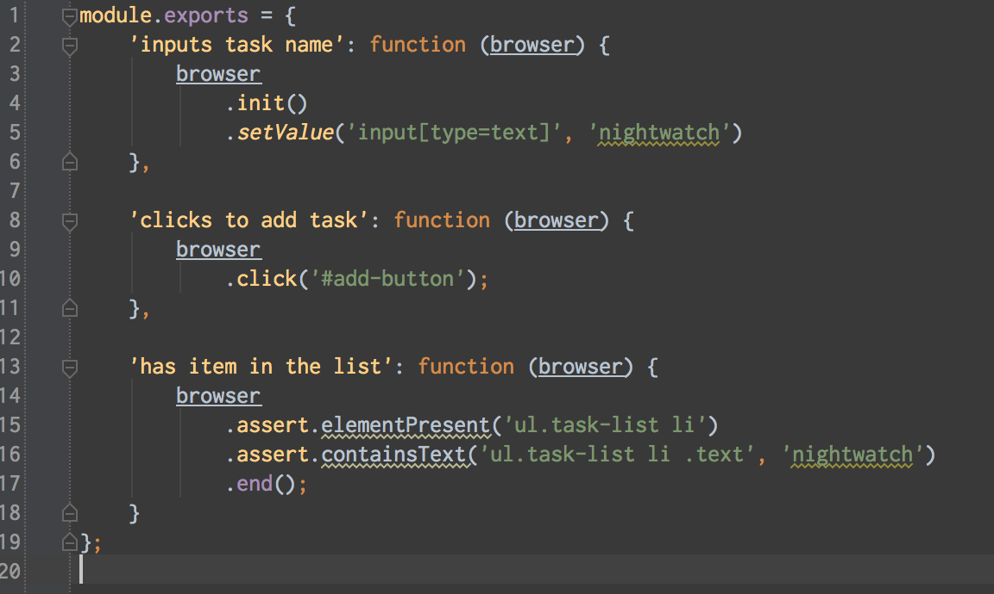
How simple is that?

Slide 9
Problems
Occasional random failures
Difficult to ensure visual quality
No native way of target ajax requests, events and other actions not visible to visitor
Inconsistency among browser drivers

Slide 10


Alternatives
Webdriver.io – best alternative
WebDriverJs – lack of support
CasperJS – lack of features
Many non javascript alternatives

Slide 11
Questions ?

