Slide 1
CGADIUS ( If Gradius and CGAD had a baby)
0705082 Jamie Haddow

Slide 2
Overview of your game
Horizontally scrolling shoot 'em up
Kill the enemies, destroy the asteroids, Reach the end of the level with the highest score possible
Major Mechanics:
  Collision between multiple vectors of objects
    Player/enemies, Bullets/Asteroids, Walls/Asteroids etc
  Using multiple views for the main game/top score segment
  Multiple animations for different objects

Slide 3
Controls
The controls for my project
  The user controls the ship with the arrow keys
  The user fires with the space bar
  If the user wishes to move faster then he can hold the Right Ctrl and use the left or right arrow keys
  Pressing Z will pause the game
  For debugging, the user can use numpad 7 and 9 to move the view quickly

Slide 4
Game screens
There are 4 game states in this project.
  Menu
  Level
  Pause ( by removing the update function in main)
  Credits

Slide 5
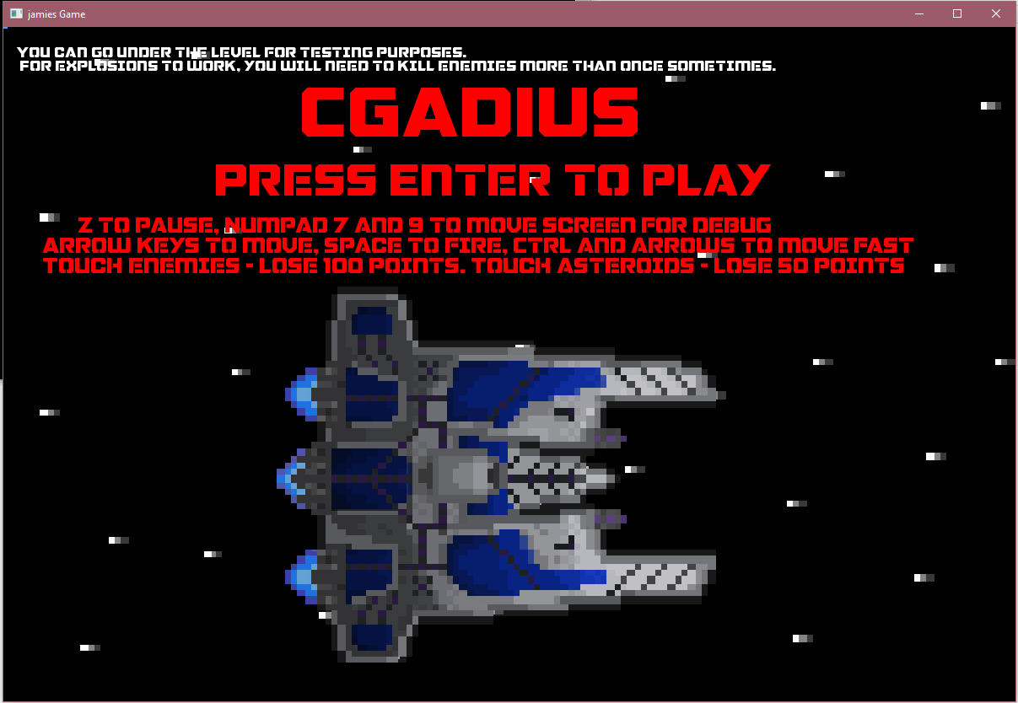
Menu screen
Information to help the user play the game.
White text for debugging purposes
Controls, score system in red for the user.
Animating background screen showing stars fly past and ship engines running

Slide 6
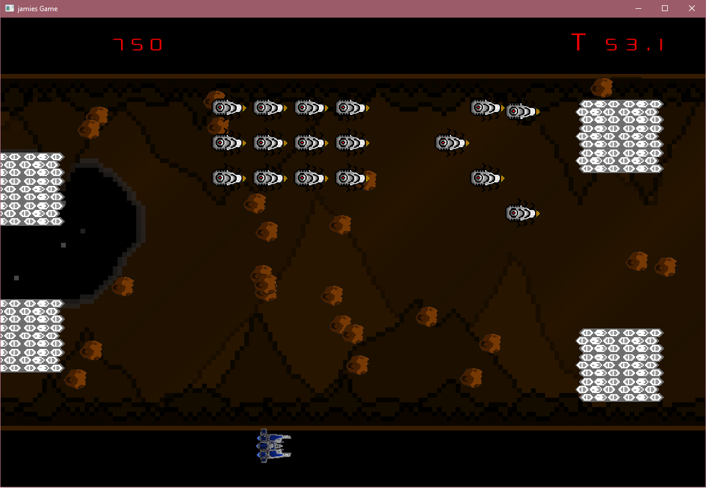
Level screen
Using Two views, the top view keeps the score and timer visible regardless of the player/main levels position
Main area where the game takes place
Multiple collidable objects for the player object to interact with and shoot to gain points or lose points

Slide 7
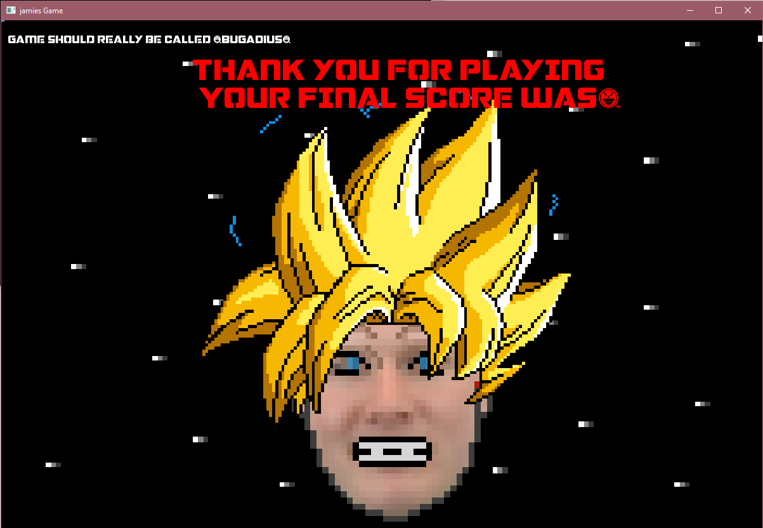
Credit screen
A Thank you message and displaying the end score. However I was unable to get this working and I believe my score might now be trademarked
Animating background screen showing stars and “super saiyan boss” Paul that I was unable implement in time

Slide 8
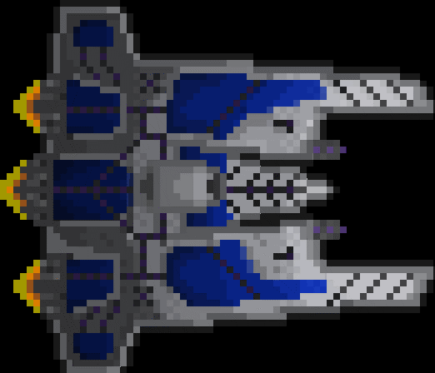
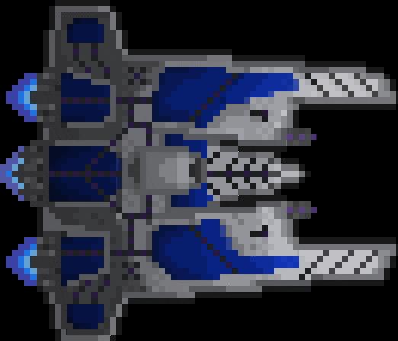
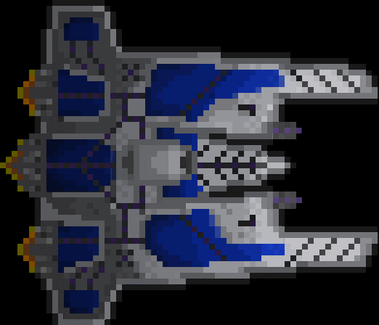
Player sprite
The player has 3 different animations for idle, forward and backwards with a simple bullet sprite to match the purple cannons.

Slide 9
Player sprite
The player has 3 different animations for idle, forward and backwards with a simple bullet sprite to match the purple cannons.

Slide 10
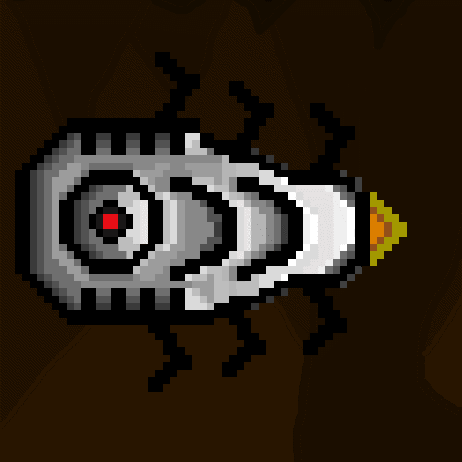

Enemy sprite
The enemy has 2 different animations for idle and exploding. However I was unable to get the idle animation to work and the explosion animation had a few issues I describe later

Slide 11
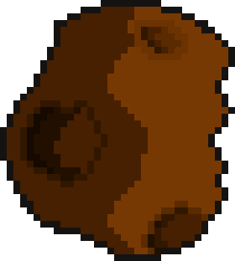
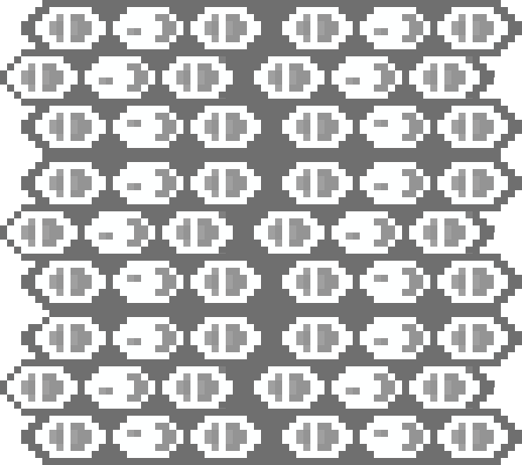
Other sprites
An asteroid sprite was also used but not animated. There were 3 wall segments, but I just used one in the end. If I had time I would have liked to redesign the wall art.

Slide 12
Collision detection and resolution
Every object in my project has a collision of some sort. Asteroids being the most complex.
For the bullets I was able to do a simple collision check as they would always hit the left side of an object. Once they collided, the bullet would setAlive(false) and I manually set their positions off the screen
Enemies had basic collision with the wall objects and the top/bottom of the screen. If the enemy collided with a wall the result was:
enemy.setVelocity(0, enemy.getVelocity().y * (-1));
By using the getVelocity function, if I changed the initial enemy velocities I would have less code to change

Slide 13
Collision detection and resolution
Player/Wall collision and Asteroid/Asteroid, Asteroid/Wall all used the same collision detection as I needed to check for collisions on all 4 sides. If the player collides with a wall: setPosition(wall.getPosition().x - getSize().x, getPosition().y);
Main collision code used for this example of Player and wall(comments in source code):
if (tempX > tempY)
{
if (wallCentre.x > playerCentre.x)
{
velocity.x = 0;
setPosition(wall.getPosition().x - getSize().x, getPosition().y);
}
if (wallCentre.x < playerCentre.x)
{
velocity.x = 0;
setPosition(wall.getPosition().x + wall.getSize().x, getPosition().y);
}
}
else
{
if (wallCentre.y > playerCentre.y)
{
velocity.y = 0;
setPosition(getPosition().x, wall.getPosition().y - getSize().y);
}
else
{
velocity.y = 0;
setPosition(getPosition().x, wall.getPosition().y + wall.getSize().y);
}
}
playerCentre.x = getPosition().x + (getSize().x * 0.5);
playerCentre.y = getPosition().y + (getSize().y * 0.5);
wallCentre.x = wall.getPosition().x + (wall.getSize().x * 0.5);
wallCentre.y = wall.getPosition().y + (wall.getSize().y * 0.5);
float tempX, tempY;
tempX = abs(wallCentre.x - playerCentre.x);
tempY = abs(wallCentre.y - playerCentre.y);
if (tempX < 0)
{
tempX *= -1;
}
if (tempY < 0)
{
tempY *= -1;
}

Slide 14
Collision detection and resolution
For Asteroid Vs Asteroid, I used the same code in the previous slide with these responses:
if (asteroidJCentre.x > asteroidICentre.x)
{
asteroids[i].setVelocity(asteroids[i].getVelocity().x * (-1), asteroids[i].getVelocity().y);
asteroids[j].setVelocity(asteroids[j].getVelocity().x * (-1), asteroids[j].getVelocity().y);
}
if (asteroidJCentre.x < asteroidICentre.x)
{
asteroids[i].setVelocity(asteroids[i].getVelocity().x * (-1), asteroids[i].getVelocity().y);
asteroids[j].setVelocity(asteroids[j].getVelocity().x * (-1), asteroids[j].getVelocity().y);
}
if (asteroidJCentre.y > asteroidICentre.y)
{
asteroids[i].setVelocity(asteroids[i].getVelocity().x, asteroids[i].getVelocity().y * (-1));
asteroids[j].setVelocity(asteroids[j].getVelocity().x, asteroids[j].getVelocity().y * (-1));
}
else
{
asteroids[i].setVelocity(asteroids[i].getVelocity().x, asteroids[i].getVelocity().y * (-1));
asteroids[j].setVelocity(asteroids[j].getVelocity().x, asteroids[j].getVelocity().y * (-1));
}

Slide 15
Collision detection and resolution
For Asteroid Vs Asteroid, I used the same code in the previous slide with these responses:
if (asteroidJCentre.x > asteroidICentre.x)
{
asteroids[i].setVelocity(asteroids[i].getVelocity().x * (-1), asteroids[i].getVelocity().y);
asteroids[j].setVelocity(asteroids[j].getVelocity().x * (-1), asteroids[j].getVelocity().y);
}
if (asteroidJCentre.x < asteroidICentre.x)
{
asteroids[i].setVelocity(asteroids[i].getVelocity().x * (-1), asteroids[i].getVelocity().y);
asteroids[j].setVelocity(asteroids[j].getVelocity().x * (-1), asteroids[j].getVelocity().y);
}
if (asteroidJCentre.y > asteroidICentre.y)
{
asteroids[i].setVelocity(asteroids[i].getVelocity().x, asteroids[i].getVelocity().y * (-1));
asteroids[j].setVelocity(asteroids[j].getVelocity().x, asteroids[j].getVelocity().y * (-1));
}
else
{
asteroids[i].setVelocity(asteroids[i].getVelocity().x, asteroids[i].getVelocity().y * (-1));
asteroids[j].setVelocity(asteroids[j].getVelocity().x, asteroids[j].getVelocity().y * (-1));
}

Slide 16
Game logic
The only real game logic in this game is a scoring system.
If the player destroys an enemy they gains 100 points
If the player destroys an asteroid they gains 50 points
If the player collides with an enemy they lose 100 points
If the player collides with an asteroid they lose 50 points

Slide 17
Bugs and things I would like to improve
The most annoying bug I could not fix would be the enemy idle/explosion animations. I attempted to do the animation much like I did for the player. If I attempted to insert the setTextureRect(currentAnimation->getCurrentFrame()); into the update function I would receive a vector out of range error.
For the explosion animation I would need to allow the explosion animation to play before setting the enemy.setAlive(false). I tried to do this through a timer in Enemymanager but I believe this approach was not working as sometimes the enemy would stop mid explosion and I would need to shoot it again to kill it. My theory was the timer was not operating properly using my method. Someone suggested using thor but I did not have enough time to experiment.
I was also unable to create a working end score. I attempted to pass a reference to the player in the credits constructor, I edits both the credits.cpp and .h and changed the main.cpp credits constructor but it would not allow me to do so for an unknown reason.

Slide 18
References
All artwork created by myself except for the explosion animation Taken from Shutterstock.
Menu and level music taken from http://www.tannerhelland.com/music-directory/
Boss music taken from the Dragonball Z soundtrack

Slide 19
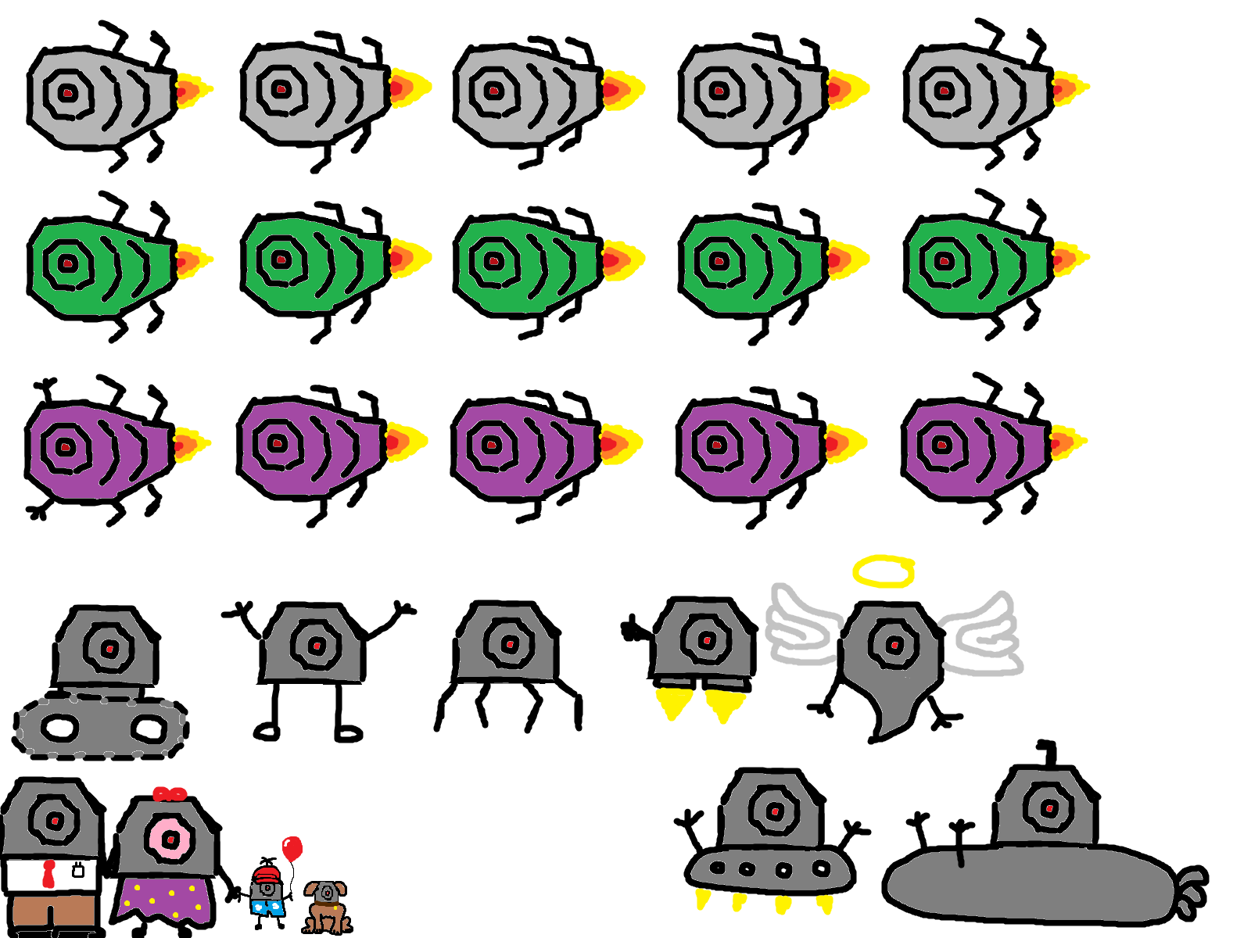

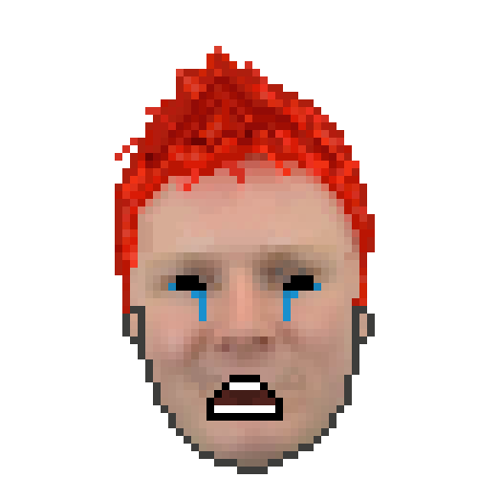




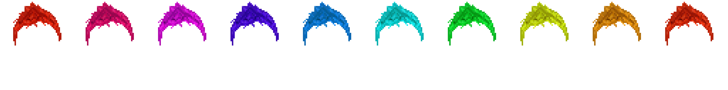
Extras
My rough design for my enemies
The different faces of paul

