Slide 1

ADVANCED MACHINE LEARNING · AN-NAJAH NATIONAL UNIVERSITY
Real-Time American Sign Language Recognition using YOLOv8
Submitted by:
Dareen Abuaisheh · Hana Izzdeen · Mohammed Nabulsi
Instructor: Dr. Adnan Salman
Date: May 23, 2026

Slide 2


MOTIVATION
Introduction
What is ASL?
American Sign Language is the primary visual communication system used by deaf and hard-of-hearing individuals across the United States.
The Communication Gap
Significant barriers persist between ASL users and non-signers, limiting everyday accessibility and social interaction.
AI as a Solution
Computer Vision and Deep Learning enable real-time assistive systems that bridge this gap without specialized hardware.

Slide 3
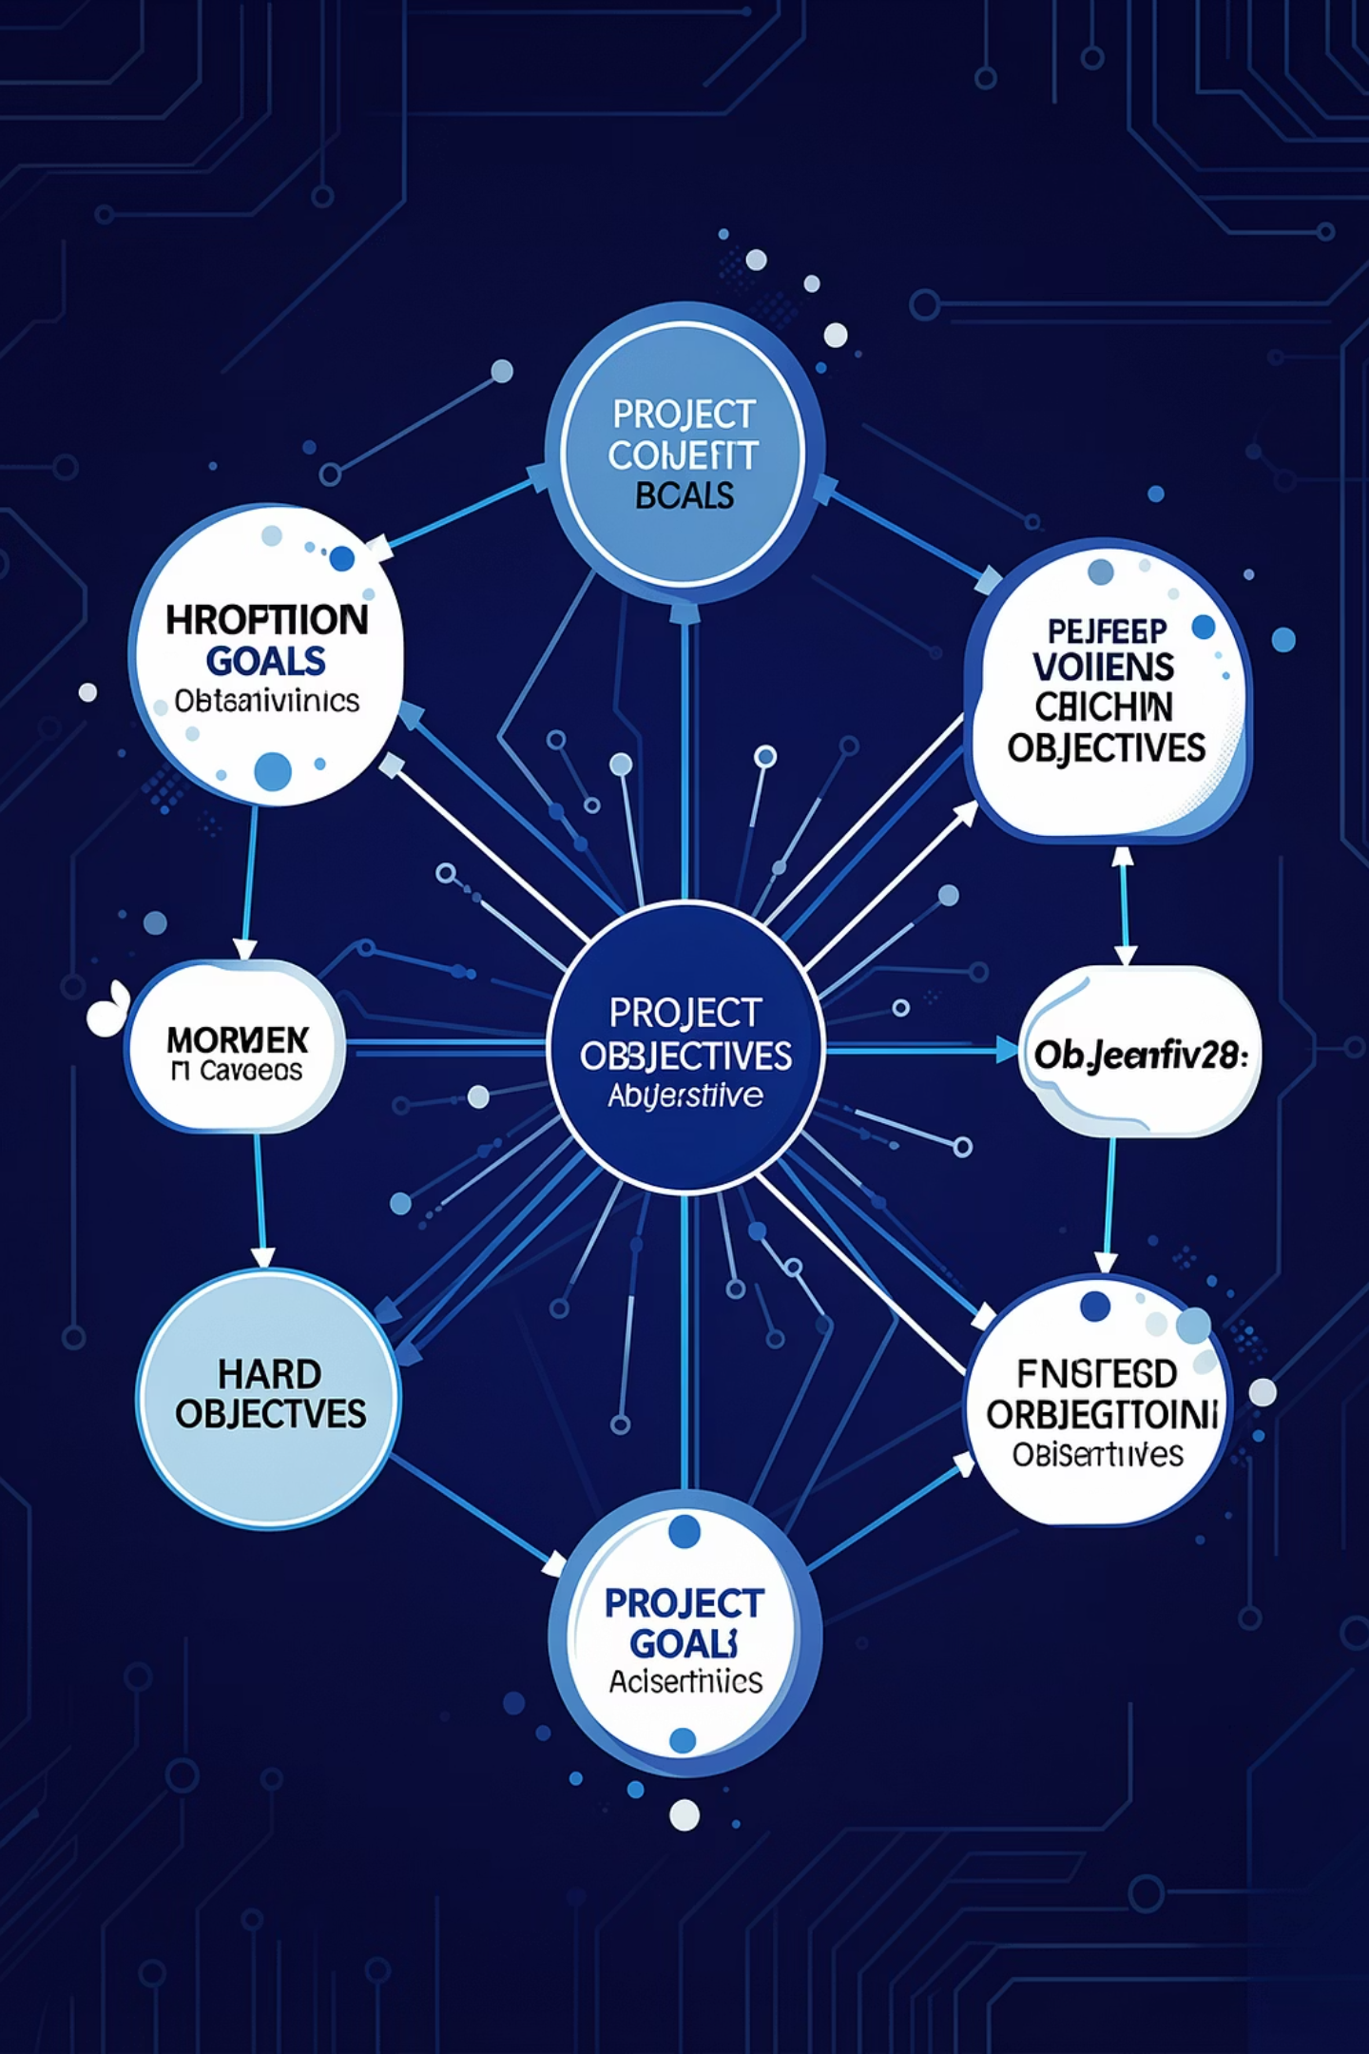
GOALS
Project Objectives
- Develop a real-time ASL recognition system.
- Detect ASL alphabet letters.
- Detect ASL words and gestures.
- Perform real-time webcam-based inference.
- Use YOLOv8 for object detection.
- Improve accessibility using AI technologies.

Slide 4
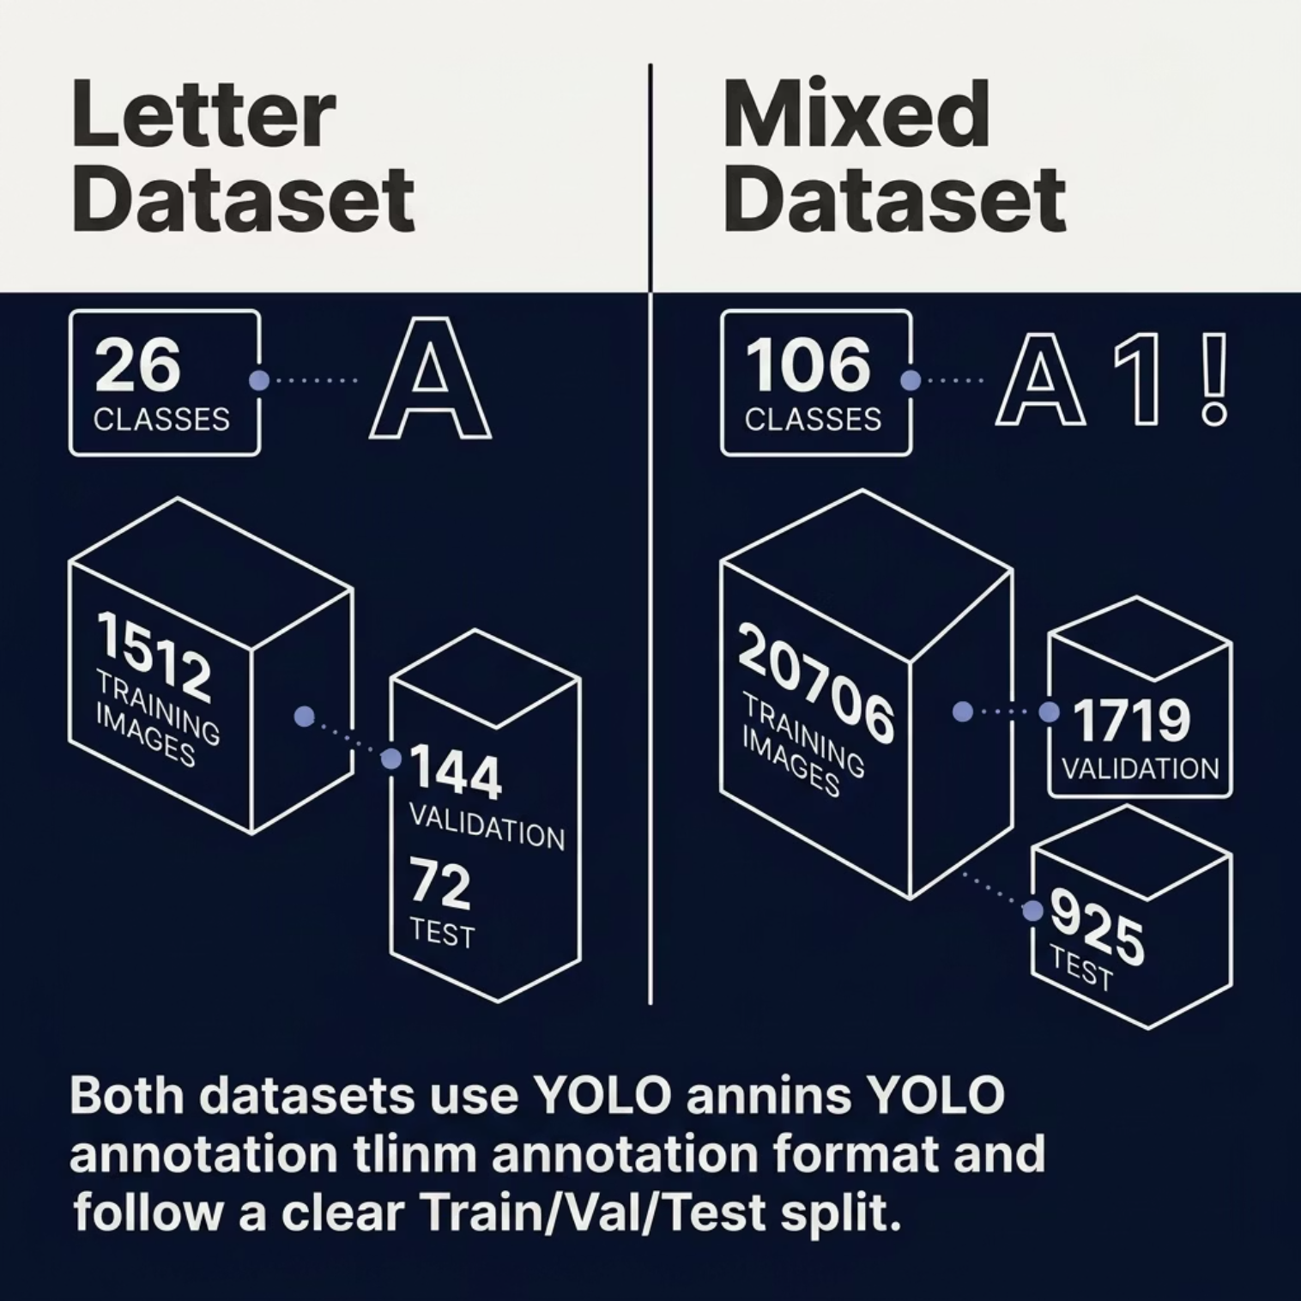

DATA
Datasets
Letter Dataset
26 ASL alphabet classes
1,512 training · 144 validation · 72 test images
Mixed Letter + Word Dataset
106 classes (letters + words)
20,706 training · 1,719 validation · 925 test images
Both datasets use YOLO annotation format
class_id | x_center | y_center | width | height
with standard train/val/test splits.

Slide 5
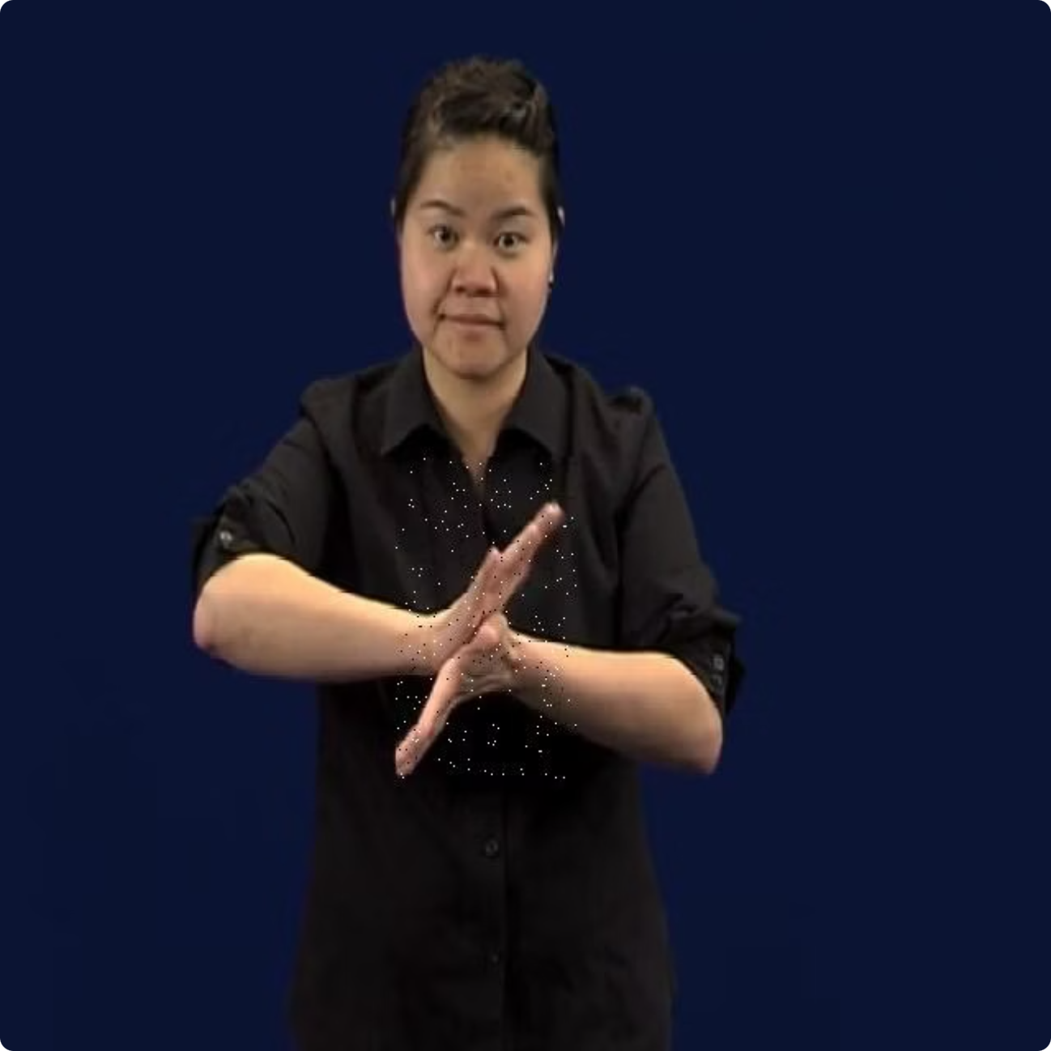

Example from datasets:
Cheese word
B Letter

Slide 6

ARCHITECTURE
Why YOLOv8?
Single-Stage Detection
Speed & Accuracy
Fast inference with strong detection accuracy — ideal for real-time applications.
Localization and classification performed simultaneously in one forward pass.
Transfer Learning
YOLOv8n Selected
Pretrained COCO weights accelerate convergence and improve generalization.
Nano variant chosen for lightweight footprint and webcam compatibility.
Built on PyTorch via the Ultralytics framework.

Slide 7
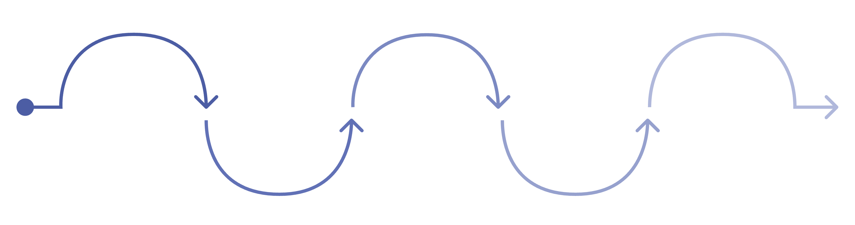
METHODOLOGY
System Pipeline
Dataset
Annotation
Preparation
Training
Validation
Collect ASL video samples
Label frames in YOLO format
Split data and apply augmentation
Train YOLOv8n with CUDA
Evaluate mAP and metrics
Training leveraged CUDA GPU acceleration on an NVIDIA A100, with OpenCV handling frame capture and preprocessing for live webcam inference.

Slide 8
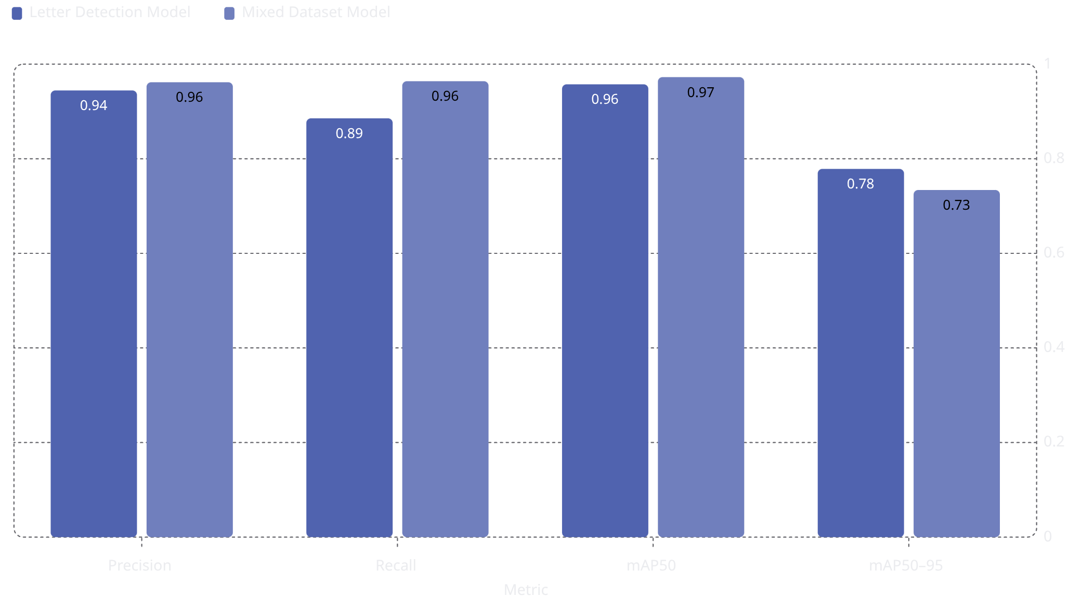
RESULTS
Model Results
Letter Detection Model
Mixed Dataset Model
Precision
Recall
Precision
Recall
0.94436
0.88544
0.96172
0.96392
mAP50
mAP50–95
mAP50
mAP50–95
0.95736
0.77851
0.97259
0.73395
The chart compares the four core performance metrics across both models, highlighting stronger overall precision, recall, and mAP50 for the mixed dataset model.

Slide 9
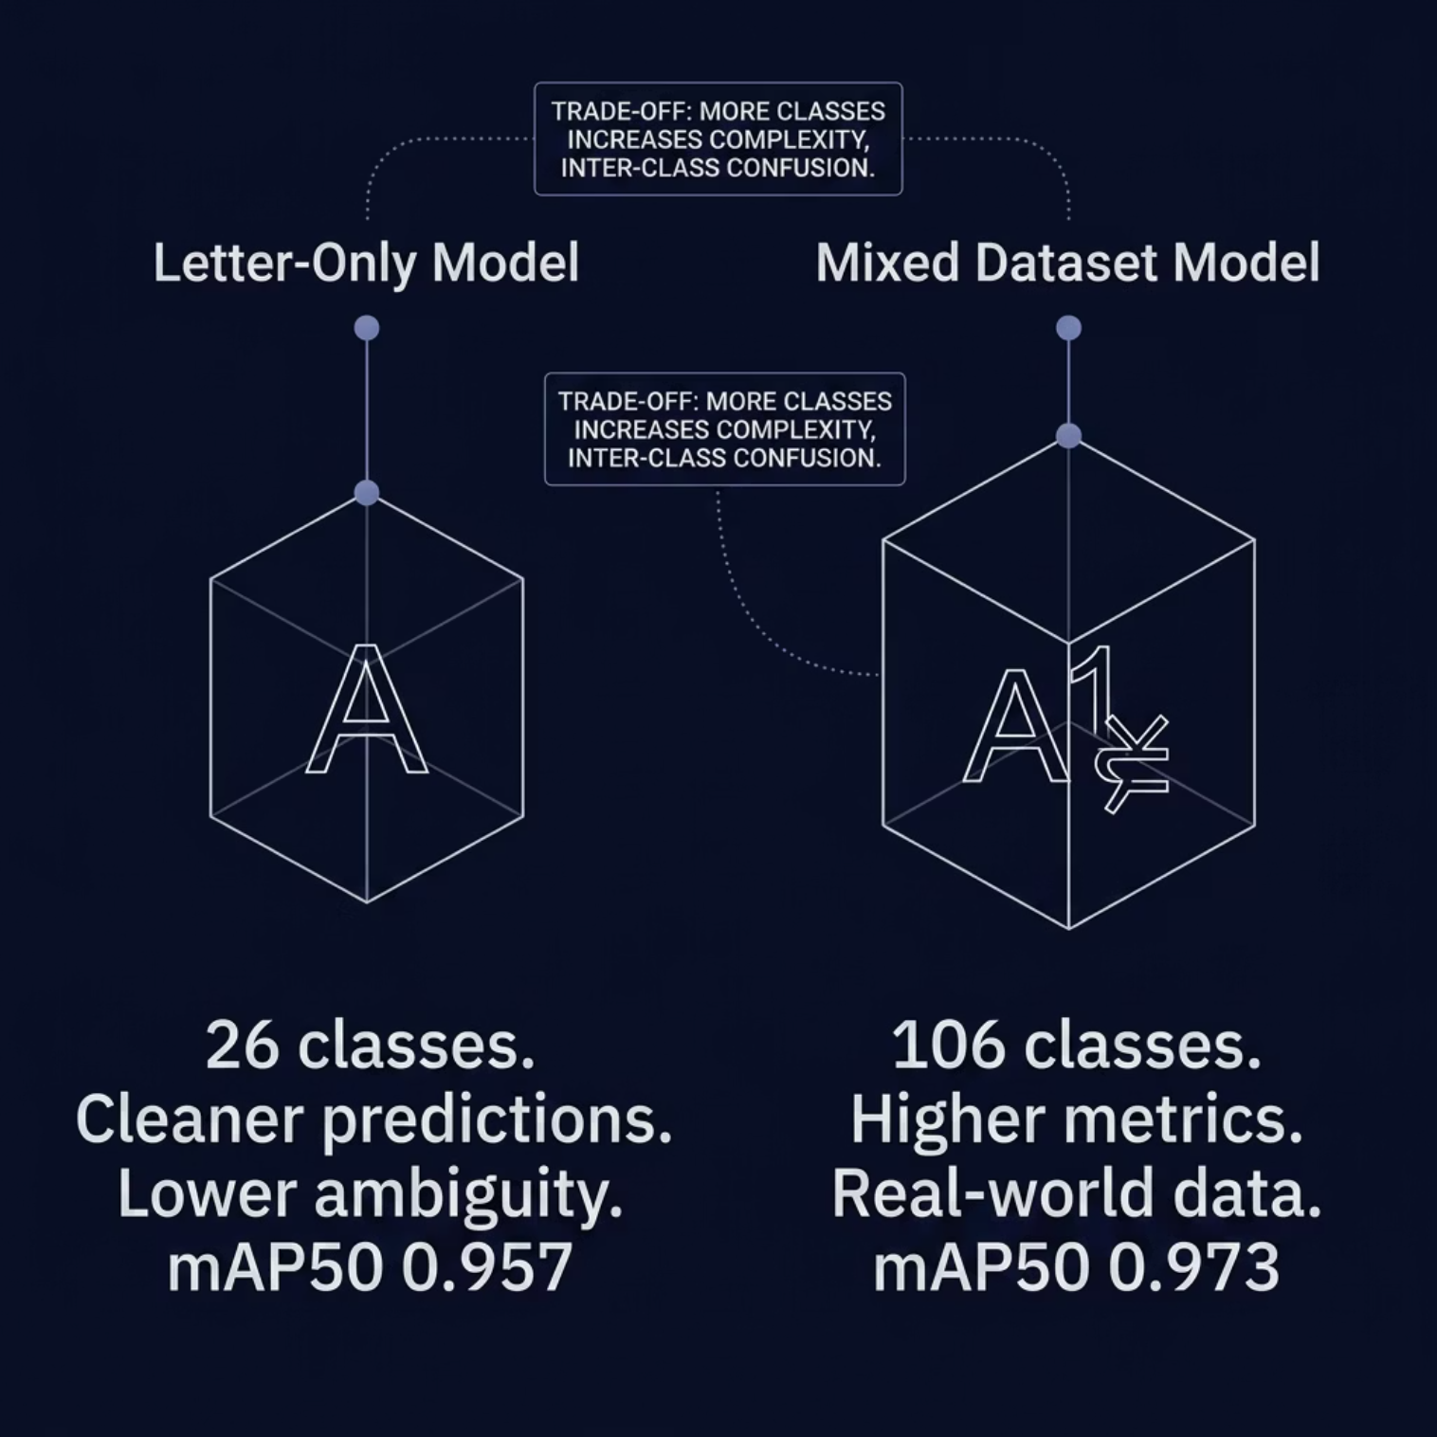
ANALYSIS
Comparative Analysis
Key Observations
Letter-Only: Cleaner predictions due to smaller class space and reduced gesture ambiguity.
Mixed Dataset: Higher overall metrics driven by larger, more diverse training data.
Complexity Trade-off: More classes increased inter-class confusion, slightly lowering mAP50–95.
Real-World Relevance: The mixed model better reflects practical ASL recognition scenarios.

Slide 10
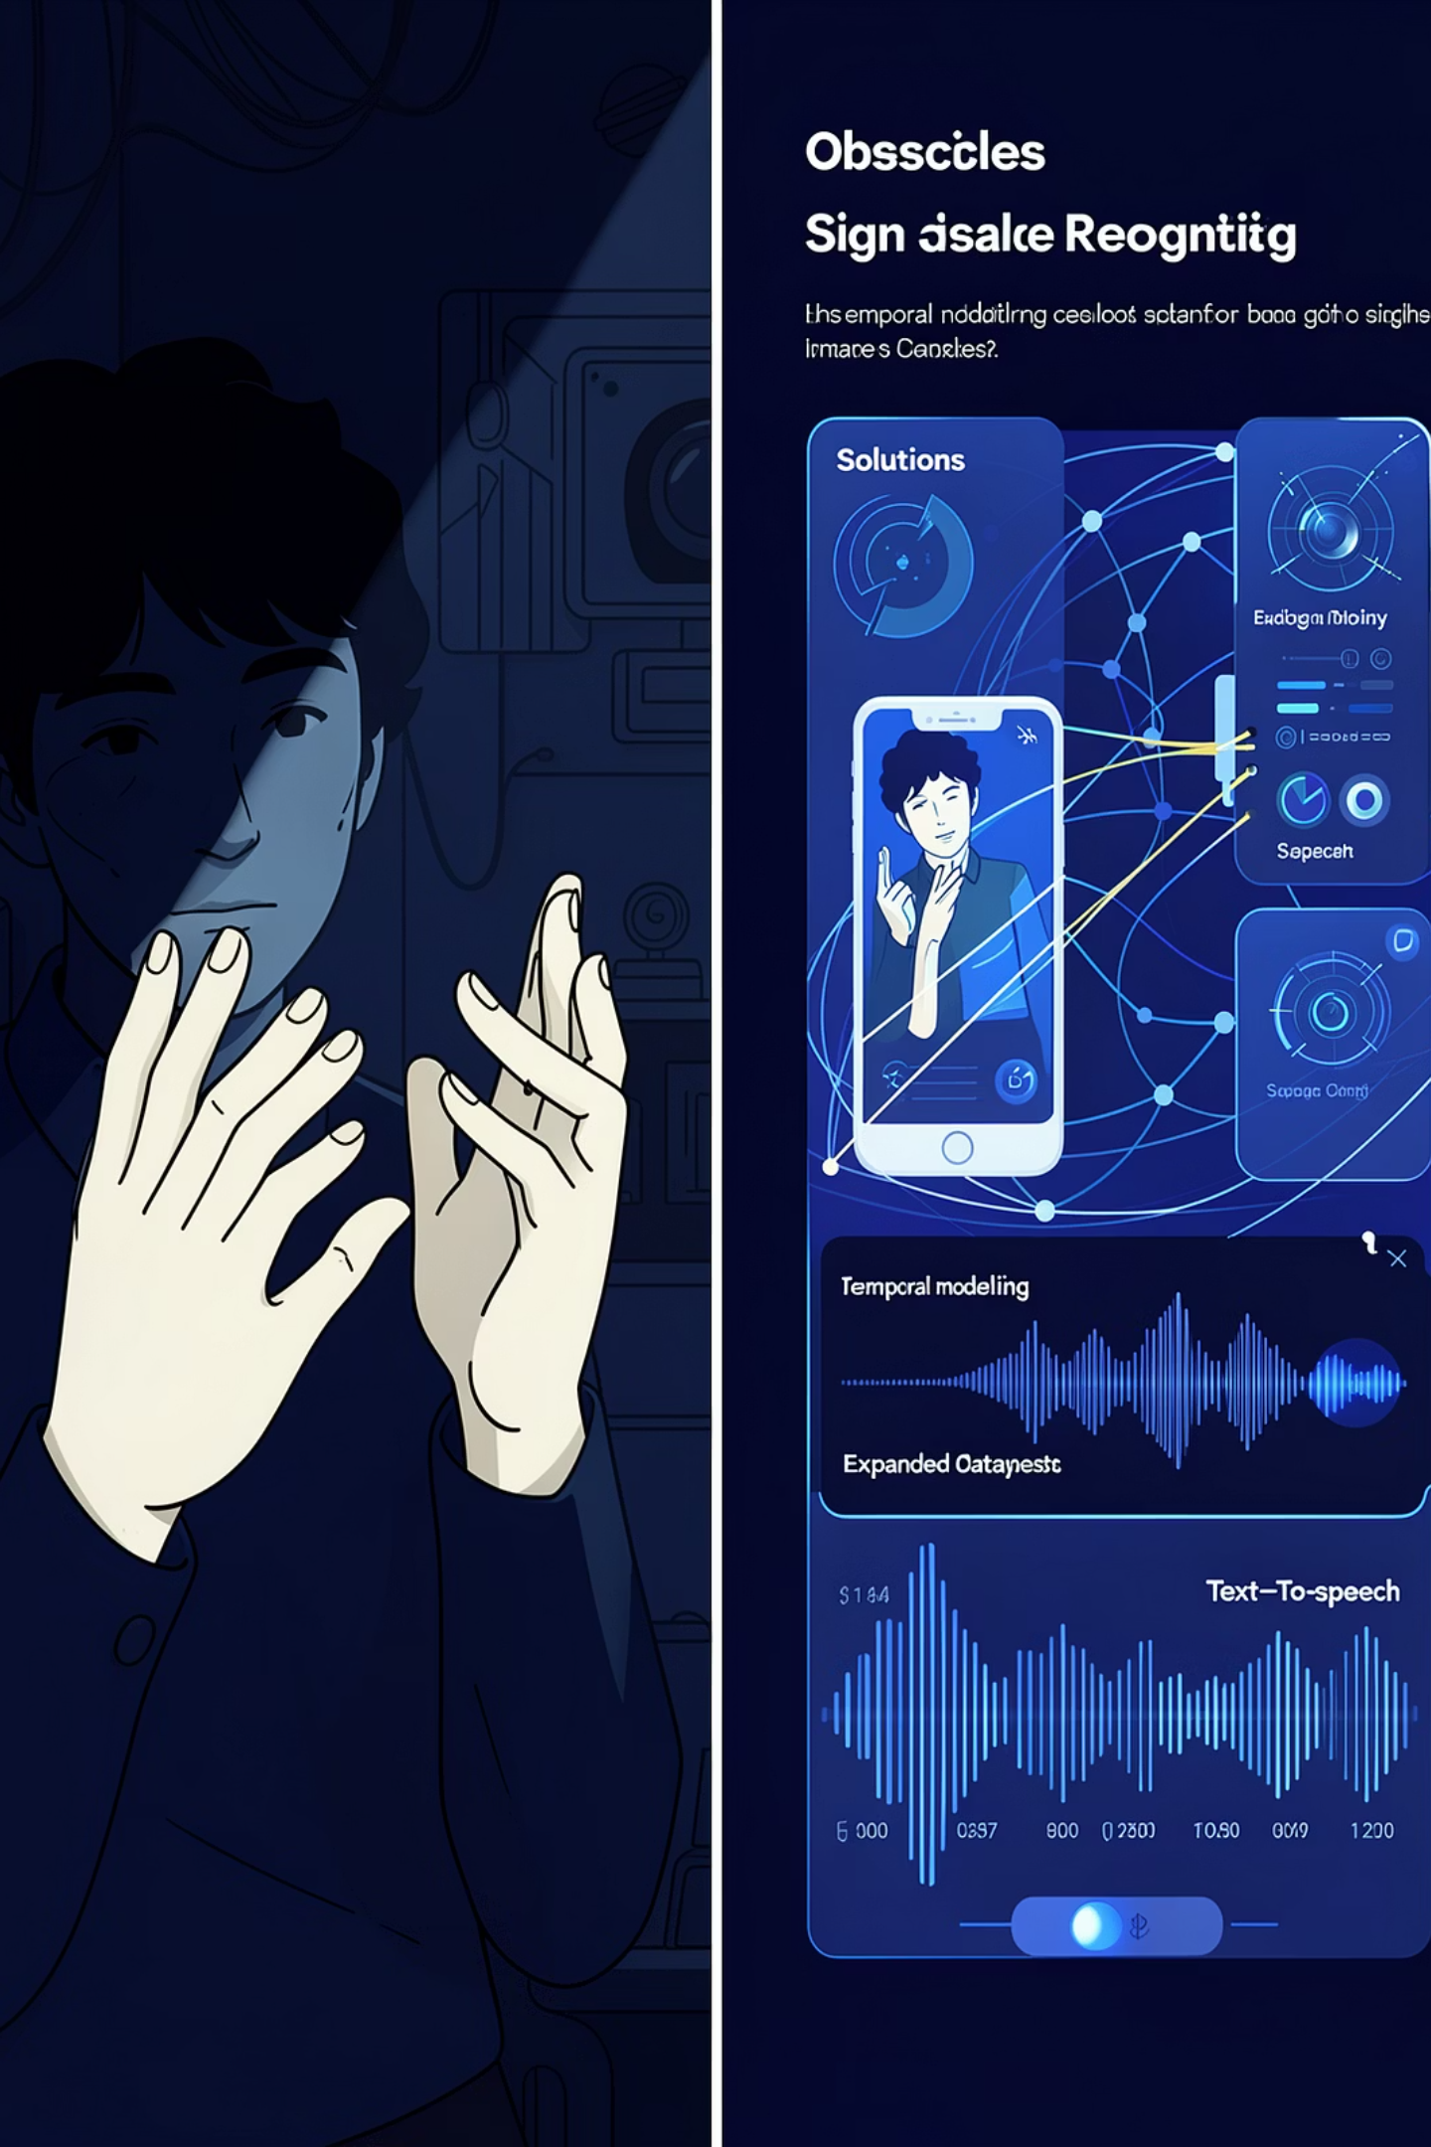
REFLECTION
Challenges and Future Work
Challenges
Future Directions
Lighting variability across environments
High gesture similarity between classes
Background complexity in real-world settings
Webcam resolution and frame-rate limitations
Absence of temporal modeling for dynamic signs
Sentence-level and continuous sign recognition
Temporal modeling via LSTM or Transformer architectures
Expanded, more diverse ASL datasets
Text-to-speech integration for full accessibility pipeline

Slide 11
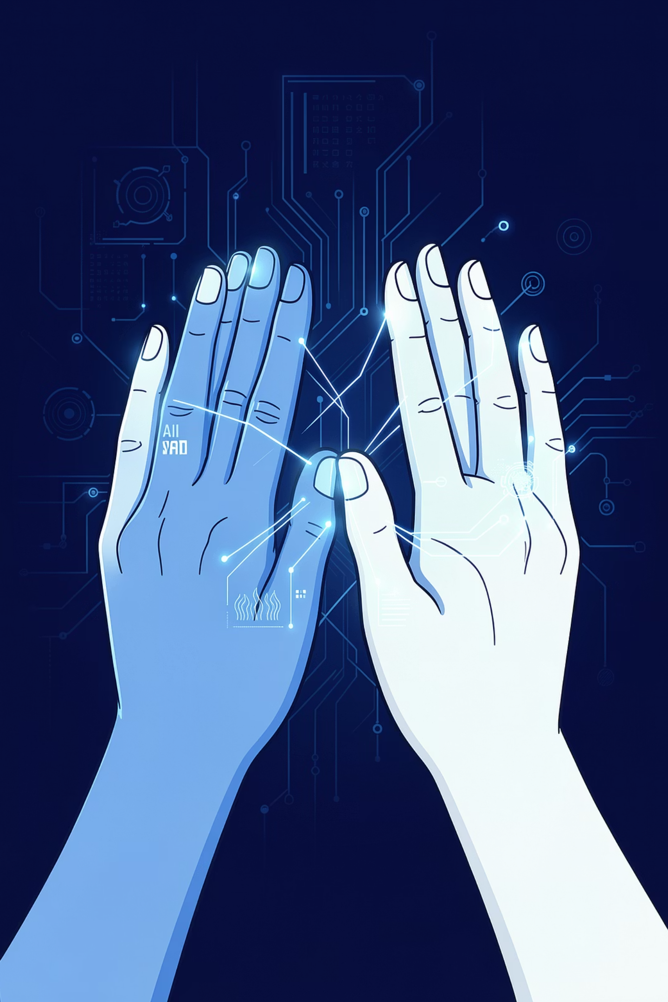
SUMMARY
Conclusion
1
Real-Time System Delivered
2
Dual Detection Modules
Implemented both letter-level (26 classes) and word-level (106 classes) detection with strong mAP scores.
Successfully built an end-to-end ASL recognition pipeline using YOLOv8 with live webcam inference.
3
AI for Accessibility
Demonstrated the practical potential of computer vision to bridge communication gaps for the deaf community.
Thank You
An-Najah National University | May 2026

