Slide 1






Car Sales Analysis

Slide 2

Objective of the
Analysis
To help the company make data-driven decisions by analyzing car sales data.
The main goals were to:
Identify sales trends .
Understand customer behavior .
Discover factors behind high-value purchases .
Highlight areas for improvement .

Slide 3

Agenda
Data Analysis Using Python
Power BI Dashboard & Insights
Insights & Recommendations
Dashboard overview
Key sales metrics
Customer behavior and trends
Company and product performance
Exploratory Data Analysis (EDA)
Dataset Overview
Data cleaning and preparation
Feature engineering
Summary of key findings
Strategic suggestions to improve sales
Targeted actions based on data insights

Slide 4

Data Analysis Using Python
Exploratory Data Analysis (EDA)
Analyzing in Python begins with understanding the data structure, cleaning it, and preparing the dataset.
Dataset Overview
Entries: 23,906 rows
Features: 16 columns
Types: 13 categorical, 3 numerical
The main fields cover car details, customer information, sales data, and dealer information.

Slide 5
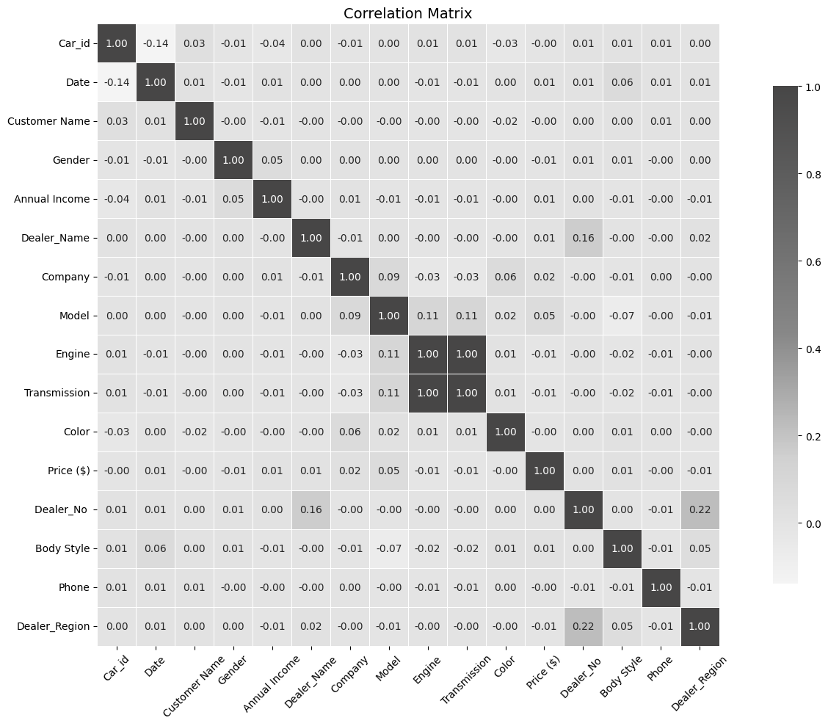

Correlation Analysis

Slide 6
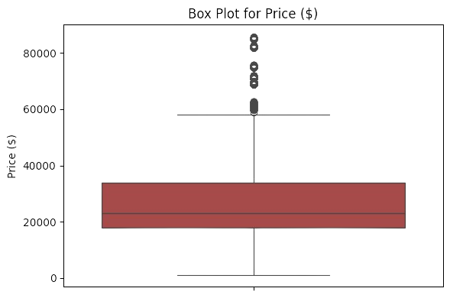
Outliers Detection
Checked for outliers using visualization.
Frequent outliers likely reflect real data.
Kept them to avoid impacting results

Slide 7



Data Cleaning
and preparation
01.
1 Missing value
02.
2 Irrelevant columns
Date Column
03.
Datetime Format

Slide 8

Data Enhancements for Power BI
Grouped by "Car Model"
to summarize total units sold.
Added "Year" Column
for time-based analysis.
Created "Income Category"
(High/Low)
to segment customers by income.

Slide 9

Power BI Dashboard Overview

Slide 10
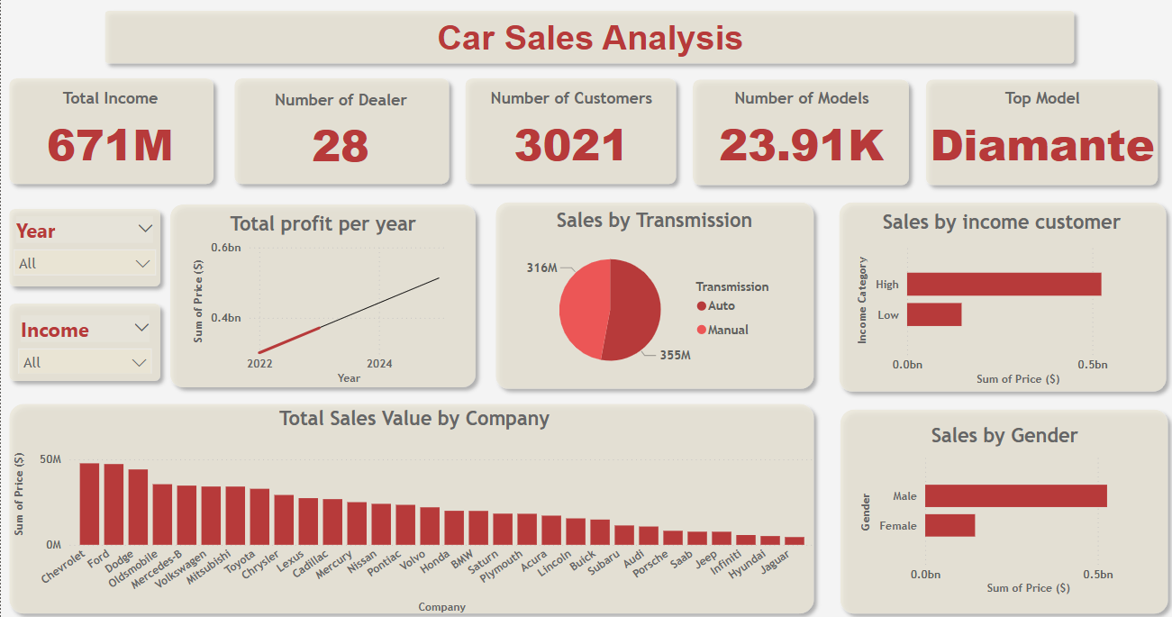

Slide 11
key visualizations
📉 Profit per Year: Sales grew from 2022 to 2023.
🔄 Sales by Transmission: Automatic cars sell more than manual ones.
💰 Sales by Income Category: High-income customers generate more sales.
👥 Sales by Gender: Male customers dominate the market.
🏢 Sales by Company: Chevrolet, Dodge, and Mitsubishi lead in sale

Slide 12

Recommendations
Create income-targeted promotions.
Expand inventory of
top-performing models
(e.g., Diamante).
Launch campaigns for companies with lower sales.
Continue monitoring with regular dashboards and updates.

Slide 13






Automated Reporting with Power BI
Funding Required
concept
Objective
Achievements
Transitioning from manual reports to automated (monthly/weekly) reports.
Developed dynamic,
auto-updating reports with customizable filters and
analyses based on user needs
Support to enhance analysis tools and add additional features.
Save time and effort .

Slide 14
Conclusion
This analysis helped us better understand our sales dynamics and customer profiles. Moving forward, we can use these insights to guide smarter marketing and inventory decisions.

Slide 15

Thank
You

