Slide 1


Corporate overview · October 2026
AI systems integration and consulting
Build AI into the systems
that run your business
ALPHV designs, integrates and runs production AI for legal, insurance, healthcare, hospitality, finance and retail teams, from first model to measurable outcomes.
Founded
Headquarters
Office
Clients in
2023
Kuala Lumpur
Singapore
Malaysia, Singapore and Vietnam

Slide 2
Executive summary
ALPHV takes AI past the pilot and
into the systems that earn revenue
01
Situation
Most companies have tried AI. Far fewer run it inside the systems that earn their revenue. AI pays off after the
pilot, not in it.
02
Complication
Three barriers keep pilots from reaching production. Data sits in silos, legacy systems resist change and pilots
stall at integration.
03
Answer
ALPHV is an AI-native systems integrator. The engineers who scope your AI ship and improve it, with models, hosting and guardrails chosen to fit your systems, data and regulator.
04
Evidence
12 projects delivered and in delivery. 90+ portal automations for a 36-year-old law firm, 80% less manual data
entry time for a Singapore hospitality group, and first of nine at the AI for Insurance Challenge × Tasco.
05
Next step
Every engagement starts from the business case. Tech advisory, a data audit and AI strategy research find
where AI pays back, before any build starts.
Source: alphv.com; alphv.com/about; alphv.com/industries; alphv.com/news/ai-for-insurance-challenge-tasco-winner (October 2026).
ALPHV
Corporate overview 2026
02

Slide 3
Six sections
Contents
01
Point of view
Why AI pays off after the pilot, and the principles we work by
Slides 04–06
02
Who we are
The team, the people, and the platforms and partners we build with
Slides 07–10
03
What we do
Six services, one team, from the first model to the last integration
Slides 11–17
04
Sectors and products
Six sectors with work to show, and five products ready to deploy
Slides 18–21
05
Proof
Nine engagements and a case note, what clients say, and the wins and stages around them
Slides 22–31
06
Engage
How our model differs, and how a first message turns into a plan
Slides 32–35
ALPHV
Corporate overview 2026
03

Slide 4

01
AI pays off after
the pilot. Not in it.
Most companies have tried AI. Far fewer have it running inside the systems
that earn their revenue.

Slide 5






Point of view
Who we are
What we do
Sectors and products
Proof
Engage
The pilot gap
Pilots stall where AI meets data silos,
legacy systems and integration
Start
Barrier 01
Barrier 02
Barrier 03
Goal
Pilot
Data sits in silos
Legacy systems
resist change
Pilots stall
at integration
Production
Where most are
What closes it
What closes it
What closes it
Where few are
Most companies have tried AI.
A data audit of what you
hold and where it sits,
then retrieval over your
own data.
Replace and connect
legacy systems, and build
AI into ERP, CRM and
third-party portals.
One team from business case to production, with improvement scoped in.
AI running
inside the
systems that
earn revenue.
ALPHV was founded in 2023 to close that gap. We embed AI into the core systems you already run, then stay to
improve it after go-live.
So what
Source: alphv.com; alphv.com/about; alphv.com/how-we-work; alphv.com/services (October 2026).
ALPHV
Corporate overview 2026
05

Slide 6




Point of view
Who we are
What we do
Sectors and products
Proof
Engage
What we believe
Four principles shape how we
scope, build and run every system
From a first model to a legacy system replacement, the same four principles apply to every engagement.
Start from the
business case
One team,
no hand-offs
Built around your
systems, data
and regulator
Improvement scoped
in from day one
Tech advisory, a data audit
and AI strategy research
come first, so the build
goes where AI pays back.
The engineers who scope your AI are the ones who ship and improve it. You keep one point of accountability throughout.
Models, hosting and
guardrails are chosen to fit
the systems you already
run, the data you hold and
the rules you answer to.
Monitoring adoption and
model performance is part
of the build. After go-live,
we stay to review, iterate
and improve.
In practice
In practice
In practice
Tech advisory, data audit and AI strategy for EasyRenz
In practice
A law firm’s models run on a locally
hosted NVIDIA GPU workstation
After go-live, we stay to review, iterate and improve
Six services, delivered by one team
Source: alphv.com/how-we-work; alphv.com/services and service pages (October 2026).
ALPHV
Corporate overview 2026
06

Slide 7
02
An AI-native systems
integrator from Kuala Lumpur
ALPHV designs, integrates and runs production AI inside the core systems that
legal, insurance, healthcare, hospitality, finance and retail teams already run.

Slide 8
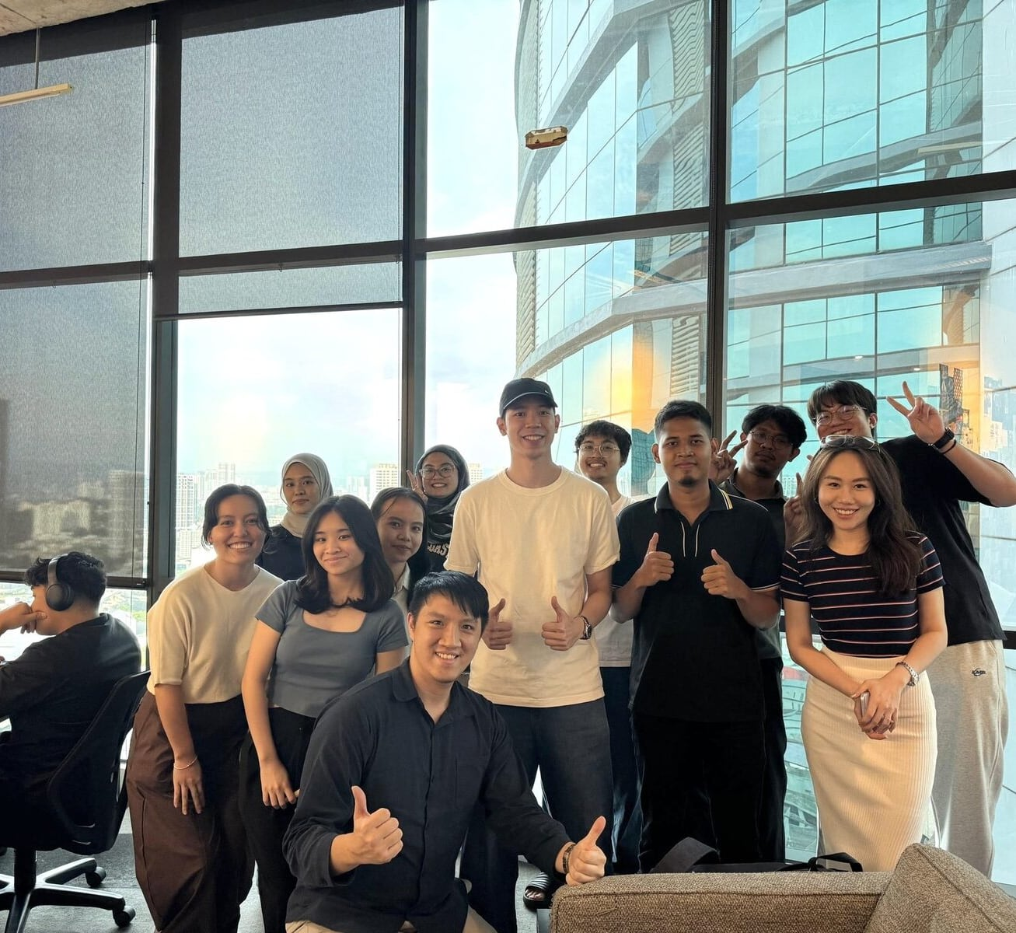
Point of view
Who we are
What we do
Sectors and products
Proof
Engage
ALPHV at a glance
A founder-led team of 15+ builds production AI
from Kuala Lumpur, with an office in Singapore
16
12
Industry verticals served
Projects delivered and in delivery
15+
2
Solutions architects, engineers
and consultants
Office countries: Malaysia (HQ)
and Singapore
Company ALPHV Technologies Sdn Bhd
Reg. No. 202301015604 (1509526-V)
Founded 2023
Status MDEC Malaysia Digital
HQ Bangsar South, Kuala Lumpur
Office WCEGA Tower, Singapore
The ALPHV team, 100% Malaysian and fully local
Clients in Malaysia, Singapore and Vietnam
Source: alphv.com; alphv.com/about (October 2026).
ALPHV
Corporate overview 2026
08

Slide 9













Point of view
Who we are
What we do
Sectors and products
Proof
Engage
People
The people who scope your
system are the people who build it
A 100% Malaysian team, led by a founder who
still writes code. We hire across five role
families, all working on real client systems.
AI engineers
Software engineers,
web and mobile
Solutions architects
UI/UX designers
Consultants
Build retrieval, agents and
fine-tuned models, then
deploy, monitor and
improve them inside
client systems.
Build the web and mobile platforms, portals and integrations that production AI runs inside.
Design architectures that
fit a client’s stack,
choosing models, hosting
and guardrails around
their data and regulator.
Design the interfaces
people use every day,
from client portals and
CRM dashboards to
lending platforms.
Run tech advisory, data
audits and AI strategy
research to find where AI
pays back before any
build starts.
APEX internship programme
8
10+
100%
13
Interns work on hands-
on projects with the team
Cohorts
Interns trained
Hands-on projects
Universities and colleges
Source: alphv.com/careers; alphv.com/apex; alphv.com/about (October 2026). Note: 13 counts the universities and colleges on the APEX page.
ALPHV
Corporate overview 2026
09

Slide 10











Point of view
Who we are
What we do
Sectors and products
Proof
Engage
Platforms and partners
We choose the model, compute and cloud
per project, for your data, cost and residency
Models
How we choose
Data and residency
Cost
Locally hosted models where data must stay in-house
H100 compute shortens
training time and lowers cost
Compute
AI hardware
Capability
Governance
Vision and language models
together where a job
needs both
Guardrails, AI safety and
alignment are part of
the design
H100 compute
GPU workstations
Hardware for Kiralytics
Cloud
Partnerships
24 Apr 2026
Strategic partnership with FPT AI Factory
Dec 2025
Highlighted as one of 12 AI implementation partners at Alibaba Cloud AI Day
15 Jul 2025
Joined the Alibaba Cloud Partner Network, Tier 2 reseller for Malaysia
Technology platforms, not clients.
Source: alphv.com/platforms-and-clients; alphv.com/insights (October 2026).
ALPHV
Corporate overview 2026
10

Slide 11
03
Six services, one team
Every service is shipped and improved by the same engineers who scoped it.

Slide 12
Point of view
Who we are
What we do
Sectors and products
Proof
Engage
Capability framework
Six services cover the path from
first model to the last integration
Production AI inside the systems you already run
ALPHV designs, builds and runs AI systems inside your existing operations.
01
02
03
04
05
06
AI engineering
Agentic
automation
System integration
and consulting
Computer vision
and smart city
Web and
mobile apps
Data, RPA
and MLOps
Knowledge
integration and RAG
Agentic process automation
Strategy before the build
People counting and occupancy
Product strategy
Data science and analytics
UI/UX design
Specialised
fine-tuning
Custom tools, MCP servers and APIs
Replace legacy systems
Vehicle classification
Web platforms
Robotic process automation
Speed detection and flow analysis
Mobile apps
Multimodal intelligence
WhatsApp sales agents
Connect third-party portals
Agentic RPA
Smart city video analytics
DevOps and MLOps pipelines
Document AI
Claims and case handling
Take over projects midway
Method
Architecture
Platforms
Products
Discover · Design · Implement · Improve
A brain, an action layer and guardrails
Models, compute and cloud per project
Kiralytics and avatars, ready to deploy
Source: alphv.com/services and its six service pages; alphv.com/how-we-work; alphv.com/products (October 2026).
ALPHV
Corporate overview 2026
12

Slide 13



Point of view
Who we are
What we do
Sectors and products
Proof
Engage
Full stack AI engineering
Every system combines a brain,
an action layer and guardrails
Three layers in every ALPHV system
In practice: a 36-year-old law firm
The guardrails
AI safety and alignment
A locally hosted NVIDIA GPU workstation
AI governance
Governance guardrails
The models run here, so client data stays inside the firm.
Locally hosted models where data must stay in-house
The action
Agentic process automation
Agentic RPA across 90+ portals
Agentic and autonomous solutions
Custom tool, MCP and API development for agents
Automations across bank, government, SSM and CTOS portals, with workflow, email and WhatsApp.
Multi-agent systems
The brain
Custom knowledge integration, RAG and beyond
Qwen with GenAI-RAG
Foundational intelligence core
Specialised model fine-tuning
Retrieval grounds answers in the firm’s own documents.
Multimodal intelligence across vision and language
Your core systems
ERP · CRM · case management · bank, government, SSM and CTOS portals · email · WhatsApp
One ALPHV platform, in place of legacy
Case management, back office and accounting
Source: alphv.com/services/ai-engineering; alphv.com/services; alphv.com/insights/sovereign-ai-case-management-law-firm (October 2026).
ALPHV
Corporate overview 2026
13

Slide 14


Point of view
Who we are
What we do
Sectors and products
Proof
Engage
Services 1–3
AI engineering, agents and integration
turn business cases into working systems
AI engineering
Agentic automation
System integration
and consulting
Turn your own data into specialised AI
Put AI agents to work across your systems
Replace and connect legacy systems, from
strategy to go-live
Knowledge integration and RAG over
your documents and records
Agentic process automation for documents and claims
Tech advisory, a data audit and AI
strategy research
Specialised fine-tuning, including Qwen2.5-14B on H100 SXM
Custom tool, MCP and API development
for agents
Legacy systems replaced and
third-party portals connected
Multimodal models and document AI
WhatsApp sales agents that sync leads
to your CRM
Projects taken over midway and
delivered
Proof
Proof
Proof
Clinicians at a leading healthcare group review a drafted report instead of writing from scratch
80% less manual data entry time with WhatsApp
AI agents for a Singapore hospitality group
90+ portal automations for a 36-year-old law
firm; iPajak Group’s six branches on one system
Source: alphv.com/services and its six service pages (October 2026).
ALPHV
Corporate overview 2026
14

Slide 15



Point of view
Who we are
What we do
Sectors and products
Proof
Engage
Services 4–6
Vision, platforms and MLOps carry AI to
cameras, users and production pipelines
Computer vision
and smart city
Web and mobile apps
Data, RPA and MLOps
Count, classify and track with
video analytics
Web and mobile platforms used by thousands of people
Keep models accurate in production
People counting and occupancy with Kiralytics MATA
Product strategy and UI/UX design
Data science, analytics and dashboards
Web platforms and mobile apps, engineered through to delivery
RPA, and agentic RPA for document work that needs judgement
Traffic counting and speed detection
with Kiralytics TRAFFIK
AI inside the product, from agents to digital avatars
DevOps and MLOps pipelines that retrain,
evaluate and redeploy
Smart city video analytics
Proof
Proof
Proof
Productised as Kiralytics MATA and TRAFFIK, on live CCTV or with AI hardware from FootfallCam
LocumLah: 3,000 doctors and 600 clinics onboarded; Politikus by Caprice: 32,000 swipes
RPA for PowerDNA’s genetic test report generation,
in Malaysia and China
Source: alphv.com/services and its six service pages (October 2026).
ALPHV
Corporate overview 2026
15

Slide 16
Point of view
Who we are
What we do
Sectors and products
Proof
Engage
How we work
Every engagement moves through four
steps, run by one accountable team
01
02
03
04
Discover
Design
Implement
Improve
Start from the
business case
Design an architecture
that fits your stack
Build AI into production
Improve continuously
after go-live
Run tech advisory, a data audit and
AI strategy research to find where AI
pays back, before any build starts.
Choose models, hosting
and guardrails around your
existing systems, your data and
your regulator.
Integrate retrieval, agents and
automation across your core
systems, including bank, government
and SSM portals.
Monitor adoption, review model performance and iterate, with improvement scoped into the build from day one.
Tech advisory on the systems and processes AI must fit
Models chosen per project
Agents with the tools, MCP servers
and APIs they need to act safely
Model performance reviews, with MLOps to keep models accurate
Locally hosted models where data must stay in-house
A data audit of what you hold and where it sits
Integration with ERP, CRM and
third-party portals
Iterations planned from day one, not bolted on later
So what
Already mid-build? We can take it over, as we did for iPajak Group’s six-branch pawn brokerage system.
Source: alphv.com/how-we-work (October 2026).
ALPHV
Corporate overview 2026
16

Slide 17





Point of view
Who we are
What we do
Sectors and products
Proof
Engage
Regulated sectors
Regulated teams keep data in-house,
reach portals and act within guardrails
Data that stays in-house
Integration with the
systems you run
Guardrails and
governance
Where data must stay inside your organisation,
we deploy locally hosted models, for example on
your own NVIDIA GPU workstation.
Most of our work connects AI to legacy and
third-party systems, including bank,
government, SSM and CTOS portals.
AI safety and alignment and governance guardrails keep each system accountable, from customer conversations to claims.
Client data stays inside the firm for a
36-year-old law firm
90+ third-party portal automations for one
law firm
Intelligent conversation flows with guardrails
Duplicate claims from the same person identified automatically
Models, hosting and guardrails chosen
around your regulator
Projects taken over midway and delivered, as for iPajak Group
CRM features by user access level
Where models run,
chosen per project
Inside your organisation
Partner GPU cloud
Public cloud
Locally hosted models on your own NVIDIA GPU workstation
H100 SXM through FPT AI Factory, for training and fine-tuning
Alibaba Cloud and Google Cloud, chosen for data, cost and residency
Source: alphv.com/industries; alphv.com/services/ai-engineering; alphv.com/platforms-and-clients (October 2026).
ALPHV
Corporate overview 2026
17

Slide 18
04
Work shaped
around your sector
Six sectors with work to show, and five products that package
proven solutions.

Slide 19
Point of view
Who we are
What we do
Sectors and products
Proof
Engage
Industries
Work to show in six sectors, from a
36-year-old law firm to a Vietnamese insurer
Sector
Client
What ALPHV built
Models and systems
Proof
Legal
Abraham Ooi & Partners, 2025
One platform for case management, back office and accounting, replacing legacy
Qwen
GenAI-RAG
90+ third-party portal automations; client data stays inside the firm
Agentic RPA
NVIDIA GPU
Insurance
Tasco Insurance, Vietnam
A multimodal case system that assesses asset damage from images and video
Qwen
Multimodal AI
Proof of concept, 2026: 24/7 damage assessment; no production results yet
Agentic AI
Healthcare
Leading healthcare group, 2026
An engine that assesses medicolegal and
insurance cases and generates the report
Qwen
Claude
RPA
Clinicians review a draft instead of writing from scratch
Hospitality
Singapore hospitality group, 2026
WhatsApp AI agents that handle conversations
24/7 and sync every lead to the CRM
Qwen
WhatsApp
AI agents
80% less manual data entry time
Financial services
Fundaztic and
iPajak Group
Debt recovery management for Fundaztic; pawn brokerage for iPajak Group, taken over midway
System integration
Consulting
6 iPajak branches on one system, across Malaysia
UI/UX
Retail
Eastern Decorator
An AI content factory that automates
e-commerce product photoshoots
Gemini
Multimodal AI
3 content types per product: imagery, copy and listing variants
Workflow automation
Source: alphv.com/industries, its six sector pages and alphv.com/insights (October 2026). Six of the 16 industry verticals ALPHV serves.
ALPHV
Corporate overview 2026
19

Slide 20




Point of view
Who we are
What we do
Sectors and products
Proof
Engage
Products
Five products give engagements
a working starting point
The Kiralytics family
Workforce optimiser
Rostering, GPS-verified attendance and workforce analytics for multi-location retail.
GPS-verified clock-in with geofence validation
Kiralytics SHIFT™
Flagship
Cross-branch KPIs and unified reporting for HQ
Analytics for workforces, shop floors, roads and brands
People and traffic counting
People counting for retail floors and traffic analytics for road planning.
Foot traffic, flow and occupancy on live CCTV
Kiralytics MATA and TRAFFIK
Vehicle classification and speed detection
Sentiment monitoring
Track brand perception across Facebook, X, Instagram, TikTok and news.
Social: Facebook, X, Instagram and TikTok
Kiralytics EMOSI
News coverage alongside social channels
ALPHV avatars
Digital avatars
Digital avatars that take orders, answer questions and screen candidates.
Digital Mamak, Digital Ustaz, Digital Interviewer
For orders, answers and interviews
ALPHV Avatar™
Flagship
Digital Ustaz is live at digitalustaz.com
Video and voice avatars
Turn a 3-minute clip into a life-like avatar
with lip-sync and low-latency replies.
Lip-synced video and voice
ALPHV HelloGen™
Low-latency replies
Also from ALPHV
AI-generated UGC and ads for brands, including a client reel with
50.1K views for @richdadwilliam
Kiralytics FIGHT, a real-time combat sports analysis prototype for national athletes, in development
Source: alphv.com/products and its product pages (October 2026). The 50.1K views come from a separate AI content service, not from ALPHV HelloGen™.
ALPHV
Corporate overview 2026
20

Slide 21
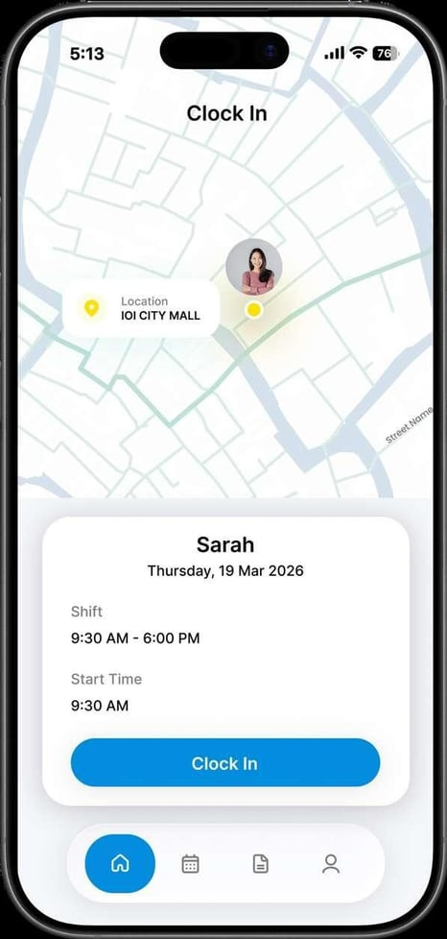
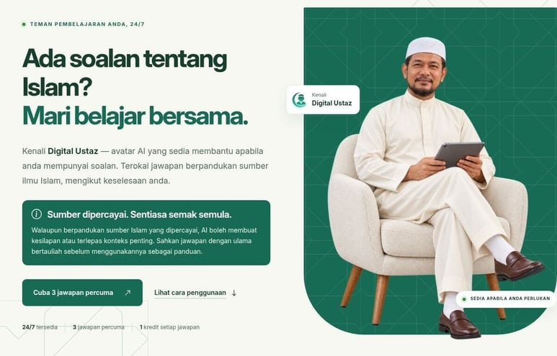




Point of view
Who we are
What we do
Sectors and products
Proof
Engage
Flagship products
Two flagships for day-to-day operations:
branch rostering and role-based avatars
Kiralytics · Workforce optimiser
ALPHV · Digital avatars
Kiralytics SHIFT™
ALPHV Avatar™
Cloud-native rostering, GPS-verified
attendance and workforce analytics for
multi-location retail.
Digital avatars, each built for one role, from the restaurant counter to the
hiring funnel.
One product, three views
Digital Mamak
Takes restaurant orders
Store managers
Plan the roster and approve changes
Digital Ustaz
Rostered staff
Clock in at the branch
Answers questions about Islam 24/7
from the Al-Quran and Hadith; live at
digitalustaz.com
HQ admins
Compare every branch
Digital Interviewer
Screens candidates at scale
Core features
Roster timeline
GPS-verified clock-in
ALPHV HelloGen™ creates a life-like video and voice avatar from a 3-minute clip, with lip-sync and low-latency replies.
Cross-branch KPIs
Real-time attendance
Source: alphv.com/products and its product pages (October 2026).
ALPHV
Corporate overview 2026
21

Slide 22
05
Work in the field, and
the people noticing
Nine engagements and a case note across Malaysia, Singapore and Vietnam,
plus the wins, stages and partnerships around them.

Slide 23
Point of view
Who we are
What we do
Sectors and products
Proof
Engage
Portfolio
Nine engagements and a case note across eight
sectors, from proof of concept to production
Client
Sector · country
What ALPHV built
Result or status
Abraham Ooi & Partners
Legal
Sovereign AI case management, replacing a legacy system
90+ portal automations; in use since 2025
Tasco Insurance
Insurance · Vietnam
Multimodal case system for asset damage claims
Proof of concept, 2026; no production results yet
Leading healthcare group
Healthcare · Malaysia
Medicolegal claims processing, intake to adjudication
4 claim stages in one flow
Leading hospitality group
Hospitality · Singapore
AI CRM with WhatsApp sales agents
80% less manual data entry time
Fundaztic
Financial services
Debt recovery management and a UI/UX overhaul design
Debt recovery system now running
iPajak Group
Financial services · Malaysia
Centralised pawn brokerage system, taken over midway
6 branches on one system; delivered
Eastern Decorator
Retail
AI content factory for e-commerce product content
3 content types per product
FPT AI Factory case note
Retail
Promotions model: Qwen2.5-14B-Instruct on H100 SXM
Promotions model built
A telco
Telecoms
VR and web experience for a travelling roadshow
VR headset and browser from one shared scene
Carlsberg
Brewing and consumer goods
Assisted a core operational data migration
5-month engagement, extraction to cutover
Source: alphv.com/insights and its case pages (October 2026). Country shown where the case page states it.
ALPHV
Corporate overview 2026
23

Slide 24
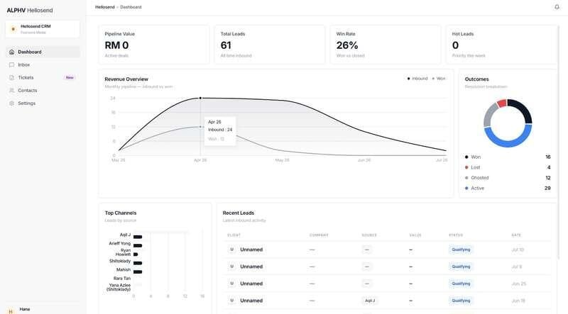
Point of view
Who we are
What we do
Sectors and products
Proof
Engage
Hospitality
WhatsApp AI agents cut manual data entry
time by 80% for a Singapore hospitality group
Agentic automation
Singapore
2026
Qwen
WhatsApp
Situation
Approach
Impact
A leading hospitality group in Singapore talks
to its customers on WhatsApp. Leads from
those conversations were entered into the CRM
by hand.
An AI CRM with WhatsApp sales agents.
80%
Agents handle customer conversations 24/7, in
natural language
Less manual data entry time
Every lead syncs to the CRM, and hot leads
reach sales in real time
24/7
Intelligent conversation flows with guardrails
A CRM dashboard by user access level, with one-click contracts, invoices and reports
Customer conversations handled by AI agents
How it runs. The agents run on Qwen
inside WhatsApp, where the conversations
already happen.
In use, 2026. Every lead reaches the CRM, and the sales team is alerted to hot leads in real time.
AI CRM dashboard, features by user access level
Source: alphv.com/insights/whatsapp-ai-crm-singapore-hospitality (October 2026). Note: the client is not named on alphv.com; 80% is the reduction in
manual data entry time reported on the case page.
ALPHV
Corporate overview 2026
24

Slide 25

Point of view
Who we are
What we do
Sectors and products
Proof
Engage
Legal
A 36-year-old law firm now runs on
sovereign AI, with 90+ portal automations
AI engineering
System integration
2025
Qwen
GenAI-RAG
Agentic RPA
NVIDIA GPU
Situation
Approach
Impact
Case management, back office and accounting
ran on a legacy system, and staff worked across
bank, government, SSM and CTOS portals. The
firm needed AI for document work, without client
data leaving the firm.
One platform replaced the legacy system.
90+
Matters, tasks, teams and a client portal for lawyers, clerks and secretaries
Third-party portal automations, including banks, government, SSM and CTOS
Bank loan document AI extraction and template-based document generation
90+ third-party portal automations, including banks, government, SSM and CTOS
2025
Abraham Ooi & Partners
ALPHV Lawtech Solutions,
delivered 2025
Workflow, email and WhatsApp automation,
with accounting and e-invoicing
In use since delivery
The models run on a locally hosted NVIDIA
GPU workstation, so client data stays
inside the firm.
How it runs. Retrieval grounds answers in the
firm’s own documents, and agentic RPA carries
the work into third-party portals.
In use. The firm runs case management, back office
and accounting on one ALPHV platform, with its
data kept in-house.
Source: alphv.com/insights/sovereign-ai-case-management-law-firm; alphv.com, home page; alphv.com/services/system-integration-and-
consulting (October 2026).
ALPHV
Corporate overview 2026
25

Slide 26

Point of view
Who we are
What we do
Sectors and products
Proof
Engage
Financial services
ALPHV took over iPajak Group’s project
midway and put six branches on one system
Pawn broking
System integration and consulting
Malaysia
Taken over midway
Situation
Approach
Impact
iPajak Group is a multi-branch pawn broker in Malaysia that has disbursed MYR 500 million. Its project to run six branches on one centralised pawn brokerage system was already under way when ALPHV took it over.
A centralised pawn brokerage system for iPajak Group’s branches across Malaysia.
6
Took over a project already in progress
Branches across Malaysia on one pawn brokerage system: delivered and running
Scoped the remaining work with the client
Built and integrated the centralised system
Delivered one system for all six branches
“Daren and the ALPHV team have been
exceptional to work with and have done a
commendable job taking over the project
midway, especially in providing their technical
expertise to meet our specific needs.”
iPajak Group
Multi-branch pawn broker, Malaysia
How it runs. One centralised pawn
brokerage system now serves all six of iPajak
Group’s branches.
Delivered after a mid-project handover.
Chong Voon Ying
CEO, iPajak Group
Source: alphv.com/insights/pawn-brokerage-system-ipajak; alphv.com/services/system-integration-and-consulting; alphv.com/how-we-work
(October 2026). Note: MYR 500 million is the client’s own scale, not an ALPHV result.
ALPHV
Corporate overview 2026
26

Slide 27
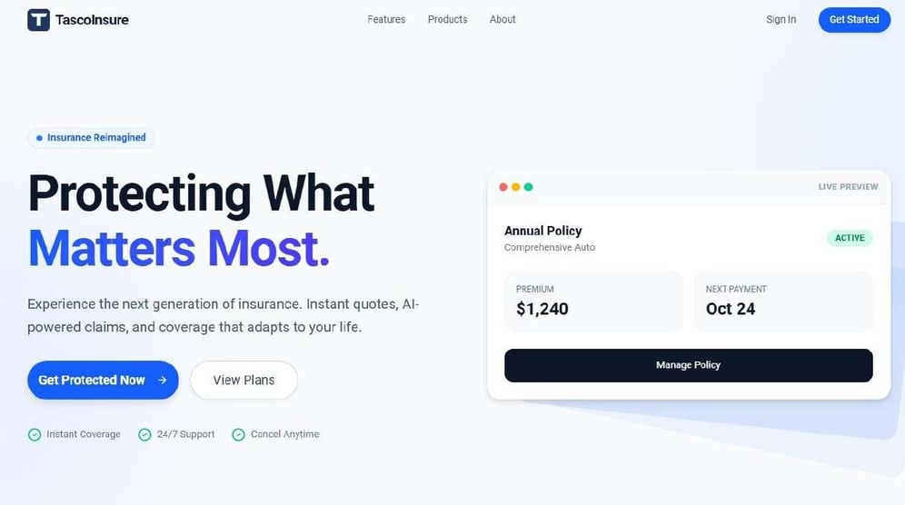
Point of view
Who we are
What we do
Sectors and products
Proof
Engage
Insurance
A proof of concept assesses insurance
damage claims from images and video, 24/7
Agentic automation
Vietnam
Proof of concept, 2026
Qwen
Multimodal AI
Situation
Approach
Impact
Damage claims arrive as images, video and
PDFs, at any hour. With Tasco Insurance in
Vietnam, ALPHV built a proof of concept that
assesses them around the clock, from the first
photo to the claim report.
A multimodal case system that prepares the liability assessment and claim report.
24/7
Images, video and PDFs in one case file
Damage assessment from images and video
Duplicate claims from the same person identified automatically
No production results to report yet
Liability assessment based on Vietnam’s Road Act and compendium
The proof of concept already flags duplicate
claims and prepares the liability assessment and
claim report.
Third-party garage, workflow, email and WhatsApp automation
How it runs. Qwen models read images, video
and documents together, and AI agents move
each case to the claim report.
Related. ALPHV won the AI for Insurance Challenge ×
Tasco, first of nine companies, on 22 Oct 2026.
Tasco Insurance interface, proof-of-concept stage
Source: alphv.com/insights/agentic-ai-insurance-claims-tasco; alphv.com/insights (October 2026). Note: proof of concept; no production results yet.
ALPHV
Corporate overview 2026
27

Slide 28
Point of view
Who we are
What we do
Sectors and products
Proof
Engage
More work
The same team ships claims engines,
content pipelines and a data migration
Healthcare · A leading healthcare group, Malaysia
Retail · Eastern Decorator
Brewing and consumer goods · Carlsberg
Medicolegal claims processing
AI content factory
Core data migration
Qwen and Claude draft each medicolegal report for a clinician to review.
Gemini turns source assets into imagery,
copy and listing variants, with review.
ALPHV assisted Carlsberg in migrating core operational data to a target estate.
4
claim stages in one flow, intake to adjudication
3
content types per product
5 months
from extraction to cutover
Financial services · Fundaztic
Telecommunications · A telco
Retail · Case note with FPT AI Factory
Debt recovery management
VR and web roadshow
Promotions model
Scoped, built and integrated into the lending
operation, plus a UI/UX overhaul design.
A VR experience and a browser build for a travelling roadshow, with on-site support.
Qwen2.5-14B-Instruct, fine-tuned with LoRA and Flash Attention.
DRM
system that Fundaztic now runs
2
clients, VR and web, from one shared scene
H100
SXM compute via FPT AI Factory
Source: alphv.com/insights case pages for the healthcare group, Eastern Decorator, Carlsberg, Fundaztic and the telco, and the FPT AI Factory case note
(October 2026).
ALPHV
Corporate overview 2026
28

Slide 29

In numbers
Platforms built for thousands of
people, and work taken off their teams
Platforms ALPHV designed and engineered
Work taken off teams
3,000
600
32,000
90+
80%
Doctors onboarded to
LocumLah, a Malaysian
locum platform
Clinics onboarded to LocumLah
Swipes on Politikus by
Caprice, Malaysia’s first public
predictions game
Third-party portal
automations for one
law firm
Less manual data entry time for a Singapore hospitality group
Source: alphv.com/services/web-and-mobile-apps; alphv.com/insights/sovereign-ai-case-management-law-firm; alphv.com/insights/whatsapp-ai-
crm-singapore-hospitality (October 2026). Note: 80% is the result reported for one client.
ALPHV
Corporate overview 2026
29

Slide 30





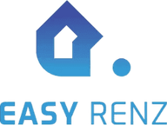




Point of view
Who we are
What we do
Sectors and products
Proof
Engage
Clients
Teams across Malaysia, Singapore
and Vietnam trust ALPHV
“Our objectives and requirements are well captured and built
into solving our problems, incorporating advanced technologies
like AI. ALPHV has good people and is easy to work with
compared to other tech vendors.”
Tracy Gan
COO, Fundaztic
Head of Corporate Strategy and Investment, Paramount Group
Source: alphv.com/platforms-and-clients; alphv.com/industries; alphv.com, home page (October 2026). Logos are the client marks shown on
alphv.com.
ALPHV
Corporate overview 2026
30

Slide 31
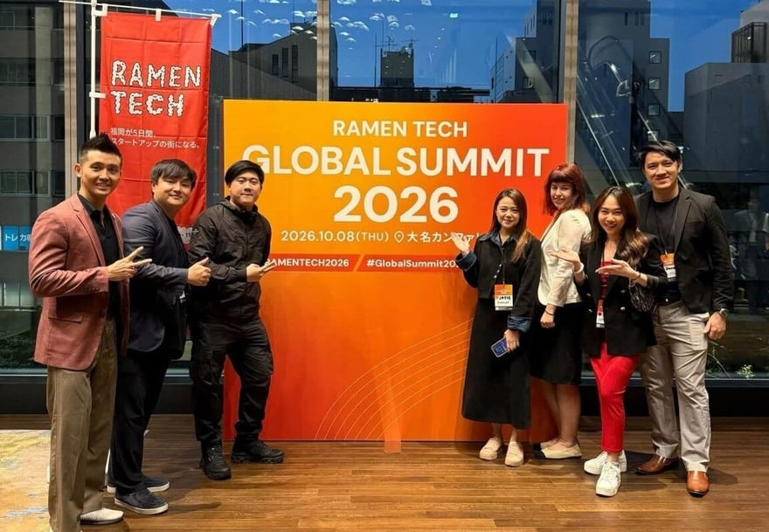
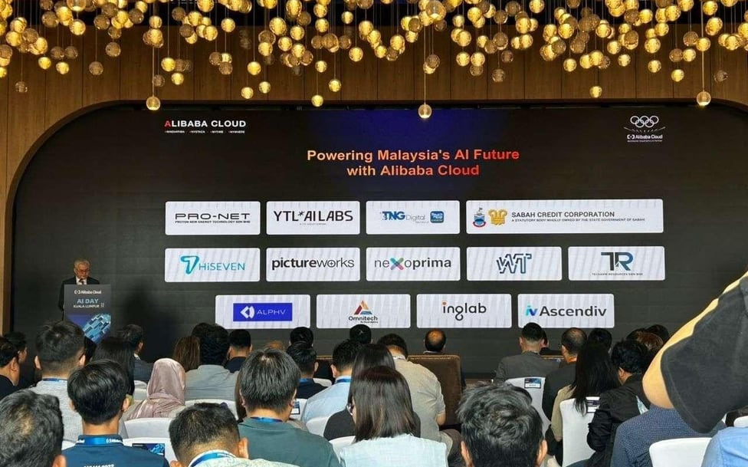
Point of view
Who we are
What we do
Sectors and products
Proof
Engage
Recognition
ALPHV placed first of nine at the AI
for Insurance Challenge × Tasco
2025
2026
Jul 2025
Aug 2025
Sep 2025
Dec 2025
Apr 2026
Sep 2026
Oct 2026
22 Oct 2026
Alibaba Cloud Partner Network, Tier 2 reseller for Malaysia
Technical keynote
at the ASEAN AI
Summit 2025
Agentic AI panel at MDX 2025, Kuala Lumpur
One of 12 AI implementation partners at Alibaba Cloud AI Day
Strategic
partnership with FPT
AI Factory
Selangor AI
Hackathon 2026,
2nd runner-up of 26
RAMEN TECH Global
Summit, Fukuoka:
represented
Singapore,
exhibiting among
124 companies
AI for Insurance Challenge × Tasco: winner, first of nine
Winner · 22 Oct 2026
AI for Insurance Challenge × Tasco
of nine companies, from the US, Turkey, Dubai,
Taiwan, India and Southeast Asia, at the GenAI
Fund and Tasco demo day
1st
RAMEN TECH Global Summit 2026, Fukuoka
Alibaba Cloud AI Day, Kuala Lumpur
Source: alphv.com/insights; alphv.com/about; alphv.com/platforms-and-clients; alphv.com news pages on the AI for Insurance Challenge × Tasco,
RAMEN TECH Global Summit 2026 and Selangor AI Hackathon 2026 (October 2026).
ALPHV
Corporate overview 2026
31

Slide 32
06
One team, from business
case to production
How our model differs, and how a first message turns into a plan.

Slide 33
Point of view
Who we are
What we do
Sectors and products
Proof
Engage
Why ALPHV
Seven questions to ask any AI partner,
and how ALPHV answers them
Question to ask
ALPHV’s answer
Evidence
01
Who builds what you scoped?
The engineers who scope it ship and improve it
A founder-led team of 15+, 100% Malaysian
02
Where does the work start?
With the business case, before any build starts
Tech advisory, data audit and AI strategy for EasyRenz
03
Where will our data run?
Locally hosted, where data must stay in-house
Client data stays inside a 36-year-old law firm
04
Which models?
Per project: Qwen, Claude, OpenAI, Gemini or ILMU
Qwen (legal), Qwen and Claude (medicolegal claims),
Gemini (retail)
05
Can it reach our local systems and portals?
Yes, from ERP and CRM to SSM and CTOS portals
90+ third-party portal automations for one law firm
06
What happens after go-live?
We stay to review, iterate and improve
An Improve step on every service, scoped in from day one
07
Can you take over a project in flight?
Yes. We scope the remaining work, then deliver it
iPajak Group’s six-branch system, taken over midway
Where a global firm may fit better: multi-country transformation programmes that need large teams in many markets at once.
Source: alphv.com/about, /how-we-work, /services, /platforms-and-clients and /insights case pages (October 2026).
ALPHV
Corporate overview 2026
33

Slide 34
Point of view
Who we are
What we do
Sectors and products
Proof
Engage
How to engage
Engagements start from the business
case, wherever your systems are today
What happens after you get in touch
Where we start depends on where you are
01
Tell us about the business case
Strategy before the build
Replace legacy systems
Share what you want AI to change and the systems involved, by form, WhatsApp, phone or email.
Tech advisory, a data audit and AI strategy research to find where AI pays back, before any build starts.
A 36-year-old law firm replaced its legacy system with one ALPHV platform, back office included.
Find where AI pays back
Proof · EasyRenz
Proof · Abraham Ooi & Partners, 2025
02
Tech advisory, a data audit and AI strategy research show where AI pays back, before any build starts.
Connect third-party portals
Take over projects midway
For the same law firm: 90+ portal automations, including banks, government, SSM and CTOS.
We took over iPajak Group’s pawn brokerage system midway and delivered it for six branches.
03
One team designs, builds and improves it
The engineers who scope your AI are the ones who
ship and improve it. No hand-offs.
Proof · 90+ portal automations
Proof · iPajak Group
Source: alphv.com/contact; alphv.com/services/system-integration-and-consulting (October 2026).
ALPHV
Corporate overview 2026
34

Slide 35

Talk to an AI engineer
Let’s build what’s next
Tell us where your business needs to be. We’ll map the path to get there.
Email
WhatsApp or call
Web
admin@alphv.com
+60 16-518 7740
alphv.com
Headquarters
Office
Unit 21-05, Level 21, Tower A, The Vertical Business Suites,
8 Jalan Kerinchi, Bangsar South, 59200 Kuala Lumpur
WCEGA Tower, 21 Bukit Batok Crescent,
Singapore 658065
We automate everything.
ALPHV Technologies Sdn Bhd · Company Reg. No. 202301015604 (1509526-V)

