Slide 1

UWP Composition
Daren May – CRANK211
@darenmay

Slide 2
Old vs. new
Demo

Slide 3
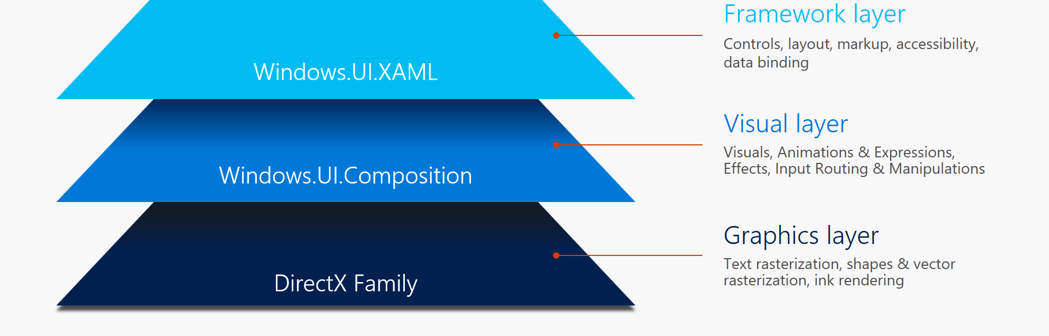
What is composition?

Slide 4
What can it do?
Visual Family
Visuals vs. SpriteVisuals vs. ContainerVisuals
Effects
Use Win2D effects such as Gaussian Blur, Blends, etc.
Animations
KeyFrames & Expressions
Works with XAML
Don’t have to use XAML – can build entire app with Composition!

Slide 5
Visuals – foundational concepts
A Visual is a node in the Visual Tree.
A ContainerVisual inherits from Visual, can contain its own content, but can also have Children
A SpriteVisual inherits from ContainerVisual, so can have Children, however it can host it’s own content via a Brush.
Visual
ContainerVisual
SpriteVisual

Slide 6
Show me VISUALS!
Demo

Slide 7
Show me an app!
Demo

Slide 8
Show me a real app!
Demo

Slide 9
Resources
http://www.crank211.com
@darenmay
Session Source
https://github.com/darenm/CompositionSession
Microsoft Resources
https://blogs.windows.com/buildingapps/2016/08/23/beautiful-apps-made-possible-and-easy-with-windows-ui
https://github.com/Microsoft/WindowsUIDevLabs
http://blog.robmikh.com/

