Slide 1



Denver Dev Day
October 19th, 2018
Thanks to our sponsors!

Slide 2

C# 8.0…?
Daren May
https://github.com/darenm/DDDOct18Csharp8

Slide 3
Recap on Earlier Versions

Slide 4
Releases
1.0
1.2
Classes
Structs
Interfaces
Events
Properties
Delegates
Expressions
Statements
Attributes
Literals
A few minor enhancements
Foreach calls dispose on disposable collections

Slide 5
Releases
2.0
3.0
Generics
Partial types
Anonymous methods
Iterators
Nullable types
Private setters (properties)
Method group conversions (delegates)
Covariance and Contra-variance
Static classes
Implicitly typed local variables
Object and collection initializers
Auto-Implemented properties
Anonymous types
Extension methods
Query expressions
Lambda expressions
Expression trees
Partial Methods

Slide 6
Releases
4.0
5.0
Dynamic binding (late binding)
Named and optional arguments
Generic co- and contravariance
Embedded interop types
Async features
Caller information

Slide 7
Releases
6.0
7.0
Expression Bodied Methods
Auto-property initializer
nameof Expression
Primary constructor
Await in catch block
Exception Filter
String Interpolation
out variables
Tuples
Discards
Pattern Matching
Local functions
Generalized async return types
throw Expressions

Slide 8
Releases
7.1
7.2
async Main methods
default literal expressions
Inferred tuple element names
-refout and –refonly compiler switches
Reference semantics with value types
Non-trailing named arguments
Leading underscores in numeric literals
private protected access modifier

Slide 9
Releases
7.3
Safe code performance enhancements
== and != support for Tuples
Attributes on auto property backing fields
-publicsign to enable (OSS) signing of assemblies.

Slide 10
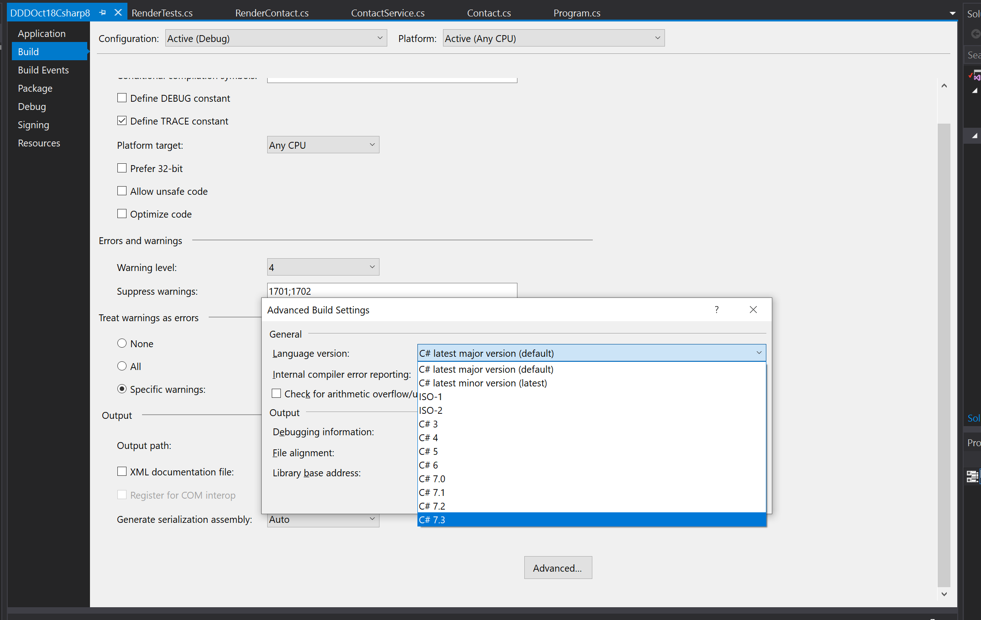
Turn on minor versions…

Slide 11

Where do I find this info?
https://docs.microsoft.com/en-us/dotnet/csharp/whats-new/

Slide 12
C# 8 Proposals

Slide 14
Development in the open
https://github.com/dotnet/csharplang
https://github.com/dotnet/roslyn

Slide 15
Current favorites
Non-Nullable & Nullable Reference Types
Advanced Patterns
Ranges
Async Streams

Slide 16
Nullable Types
Fixing the “Billion-Dollar Mistake”

Slide 17

“I call it my billion-dollar mistake. It was the invention of the null reference in 1965 … I couldn't resist the temptation to put in a null reference, simply because it was so easy to implement.”
Tony Hoare

Slide 18
Demo
Nullable types and other features!
https://github.com/darenm/DDDOct18Csharp8

Slide 19
Lightweight Classes: Records
Succinct format for simple classes:
Implements IEquatable<> and field based equality checks
Immutable (no property setters)
public class Contact(string FirstName, string LastName);
public bool Equals(Contact other) // for IEquatable<Contact>
{
return Equals(FirstName, other.FirstName) && Equals(LastName, other.LastName);
}

Slide 20
Records: With method
// Record declaration
public class MyPoint(int X, int Y);
// Instance of a record
var mp1 = new MyPoint(10, 12);
// instead of
var mp2 = new MyPoint(mp1.X, 15);
// With method
var mp2 = mp1.With(Y: 15);
// or with expression
var mp2 = mp1 with { Y = 15 };

Slide 21
Default Interface Implementations
Means methods can be added to an interface in future versions without breaking source or binary compatibility with existing implementations of that interface.
Enables C# to interoperate with APIs targeting Android (Java) and iOS (Swift), which support similar features.

Slide 22
Today
public interface IDog // v1
{
void Bark();
}
public class Dog: IDog
{
public void Bark() { Console.WriteLine("Bark!"); }
}

Slide 23
Today: Versioning an Interface
// new interface definition
public interface IDog // v2
{
void Bark();
void Howl();
}
public class Dog: IDog
{
public void Bark() { Console.WriteLine("Bark!"); }
public void Howl() { Console.WriteLine("Howl!"); }
}

Slide 24
Tomorrow: Versioning an Interface
// new interface definition
public interface IDog // v2
{
void Bark();
void Howl() { Console.WriteLine("Howl!"); }
}
public class Dog: IDog
{
public void Bark() { Console.WriteLine("Bark!"); }
}

Slide 25
Other potential new features…
Improved Extension Support – Ability to use more than just extension methods. Adding support for properties, static methods and much more.
Records – lightweight classes that implement member equality
Async Disposable – IAsyncDisposable would allow objects to have an async Dispose method.
Default Interface Implementations – allows default implementations of functions to be added to a new version of an interface

Slide 26
End

