Slide 1

NASA Path Phase 4: Milestone 4
Software Engineering Project SWEN 670 9040
Tristan Arjoon, Mario Curtis, Shane Farmer, Claudel Guembu, Sean Johnson
Sponsor: Extra-Vehicular Activity (EVA), Johnson Space Center, NASA
Liaison: Daren Welsh, EVA Instructor & Flight Controller | darenwelsh@gmail.com
Notes:
Project: NASA Path.
Group Members: Tristan Arjoon, Mario Curtis, Shane Farmer, Claudel Guembu, Sean Johnson
We did have a 7th member who was added but then at the last minute told us he is not apart of our group. Jason Fowley (he is listed as our member)
Sponsor: Extra-Vehicular Activity (EVA), Johnson Space Center, NASA
Liaison: Daren Welsh, EVA Instructor & Flight Controller | darenwelsh@gmail.com

Slide 2
Project Overview
Overall NASA Path:
Utilize 3D maps and navigation of an exterior view of the ISS to find the shortest paths for the astronauts. The design is similar to Google Maps with navigation. The client had a 3D model of the exterior of the Space Station, complete with handrails and other interfaces useful to a spacewalker.
Different algorithms were used to:
Find shortest path for astronauts
Specify wing span of crew member
Distances between handrails
Enhance upon the baselined code to add features.

Slide 3
Phase 4 Objectives
Few Previous Work:
Back end calculations
Implemented a GUI features
Drop downs for start to end points
Sliders for crew member wingspan
List of different hand rails
Added distances between handrails
Phase 4 Expected outcomes:
Expand / update baselined code to make use of the entire ISS model
Add indications of when Axial direction and plane changes occur
Provide a legend /key on how to maneuver the ISS.
Depending on team talent and complexity of features shall we implement more.

Slide 4
Schedule (Milestones)
Milestone 1: Week 3 (September 30th)
● Project Management Plan (baseline)
● Presentation
Milestone 2: Week 6 (October 21)
● Project Management Plan (updated)
● Feature documentation and Use Case Testing
● Working code (in repository)
● Presentation (update)
Milestone 3: Week 9 (November 11)
● Project Management Plan (updated)
● Feature documentation / Use Case Testing
● Working code (in repository)
● Presentation (update)
Milestone 4: Week 12 (December 2)
● Project Management Plan (updated)
● Feature documentation and Use Case Testing
● Working code (in repository)
● Presentation (update)
Notes:
Feature documentation will include snapshots of code and output, followed by use case testing supporting various outputs.

Slide 5
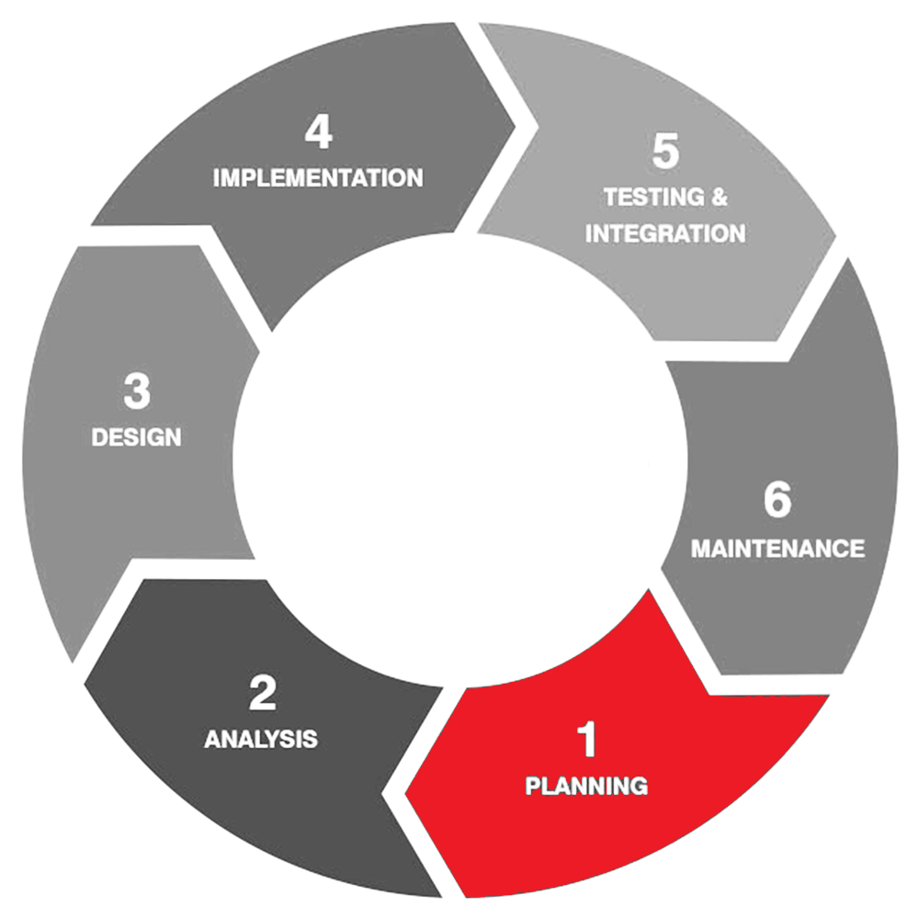
Team Execution Methodology
Software Features
Agile Methodology: Feature Driven Development
Each milestone will include an iterative software development process.
Milestone 1: PMP & Presentation
Milestones 2, 3, 4: Code analysis, Team makeup, design / deploy code, test code and outputs, and maintain during other iterations.

Slide 6
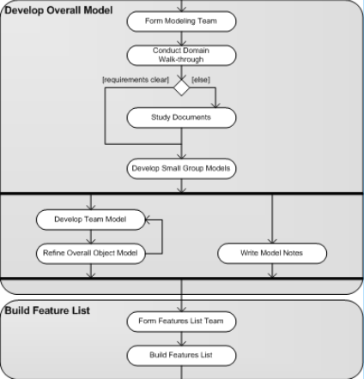
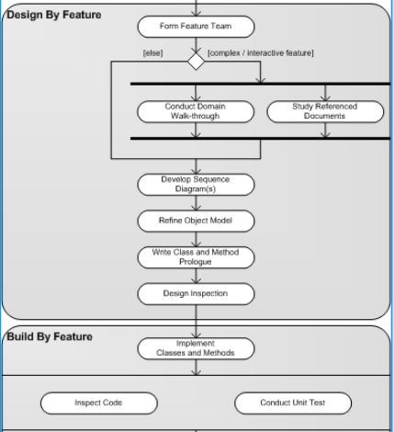
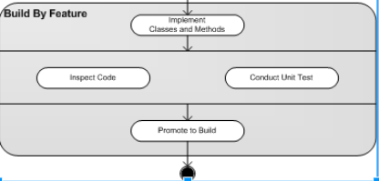
Team Execution Methodology Cont.

Slide 7
Assumptions & Constraints
Assumptions:
The GitHub repository provided by the stakeholder is the most recent.
Rewriting code base to another language (reinvent the wheel).
Existing technology past phases have been utilizing will not change.
All software and development tools are readily available to teammates.
Constraints:
December 2018 ends phase 4.
Team members are working in several time zones.
Limited schedule resources of some members (May have to establish more accountability measures).

Slide 8
Software/Hardware Interfaces
Software Interfaces:
The client computer must have Chrome, Firefox, or IE 11 web browsers installed
The client computer must be running Windows 7 (or higher), Mac OS X (version 10.7.x or higher), or Ubuntu 14 or higher.
To run the current and any future builds of the software, the following software interfaces are needed at minimum:
Java 8 (development platform)
Yarn (package manager)
Hardware Interfaces:
Monitor/Keyboard/Mouse support
An internet connection (TCP/IP) to download/upload files
The client computer must have at least 8GB of random-access memory (RAM)
The client computer must have at least 1GB for the graphics processing unit (GPU)
The client computer must have a 3.4 GHz central processing unit or faster
The client computer must have at least 10GB of free disk space
Notes:
Team members can use any IDE’s I personally will be using Visual studios for code edits and compilation

Slide 9

Questions?
Notes:
Previous teams implemented

