Slide 1

NASA Path Phase 4: Milestone 4
Software Engineering Project SWEN 670 9040
Tristan Arjoon, Mario Curtis, Shane Farmer, Claudel Guembu, Sean Johnson
Sponsor: Extra-Vehicular Activity (EVA), Johnson Space Center, NASA
Liaison: Daren Welsh, EVA Instructor & Flight Controller | darenwelsh@gmail.com
Notes:
Project: NASA Path.
Group Members: Tristan Arjoon, Mario Curtis, Shane Farmer, Claudel Guembu, Sean Johnson, Ryan Murphey
We did have a 7th member who was added but then at the last minute told us he is not apart of our group. Jason Fowley (he is listed as our member)
Sponsor: Extra-Vehicular Activity (EVA), Johnson Space Center, NASA
Liaison: Daren Welsh, EVA Instructor & Flight Controller | darenwelsh@gmail.com

Slide 2
Overview
Review of Project Overview & Objectives
Accomplishments w/Live Demo
Lessons Learned

Slide 3
Project Overview
Overall NASA Path:
Utilize 3D maps and navigation of an exterior view of the ISS to find the shortest paths for the astronauts. The design is similar to Google Maps with navigation. The client had a 3D model of the exterior of the Space Station, complete with handrails and other interfaces useful to a spacewalker.
Different algorithms were used to:
Find shortest path for astronauts
Specify wing span of crew member
Distances between handrails
Enhance upon the baselined code to add features.

Slide 4
Phase 4 Objectives
Few Previous Work:
Back end calculations
Implemented a GUI features
Drop downs for start to end points
Sliders for crew member wingspan
List of different hand rails
Added distances between handrails
Phase 4 Expected outcomes:
Expand / update baselined code to make use of the entire ISS model
Provide a legend /key on how to maneuver the ISS.
Depending on team talent and complexity of features shall we implement more.

Slide 5
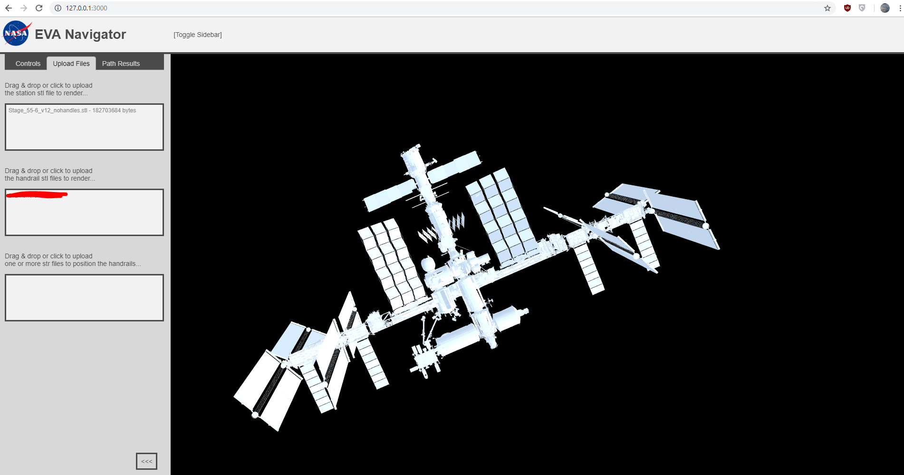
Accomplishments
The entire ISS model was added to codebase to load on application startup

Slide 6
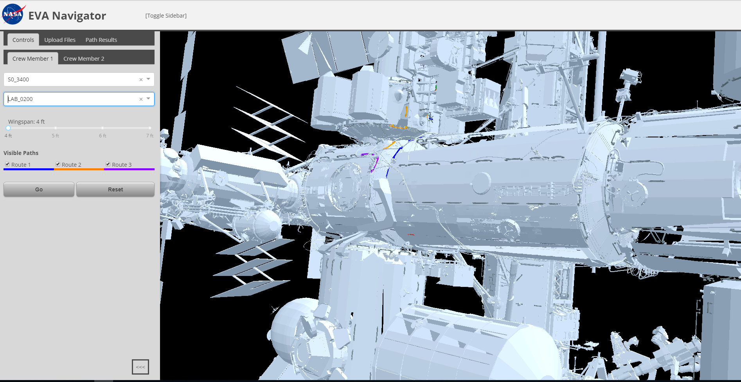
Accomplishments
Aligned handrails to ISS appropriately

Slide 7
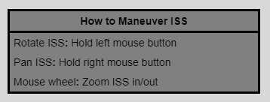
Accomplishments
Implemented an UI legend which is under both crew member tabs

Slide 8
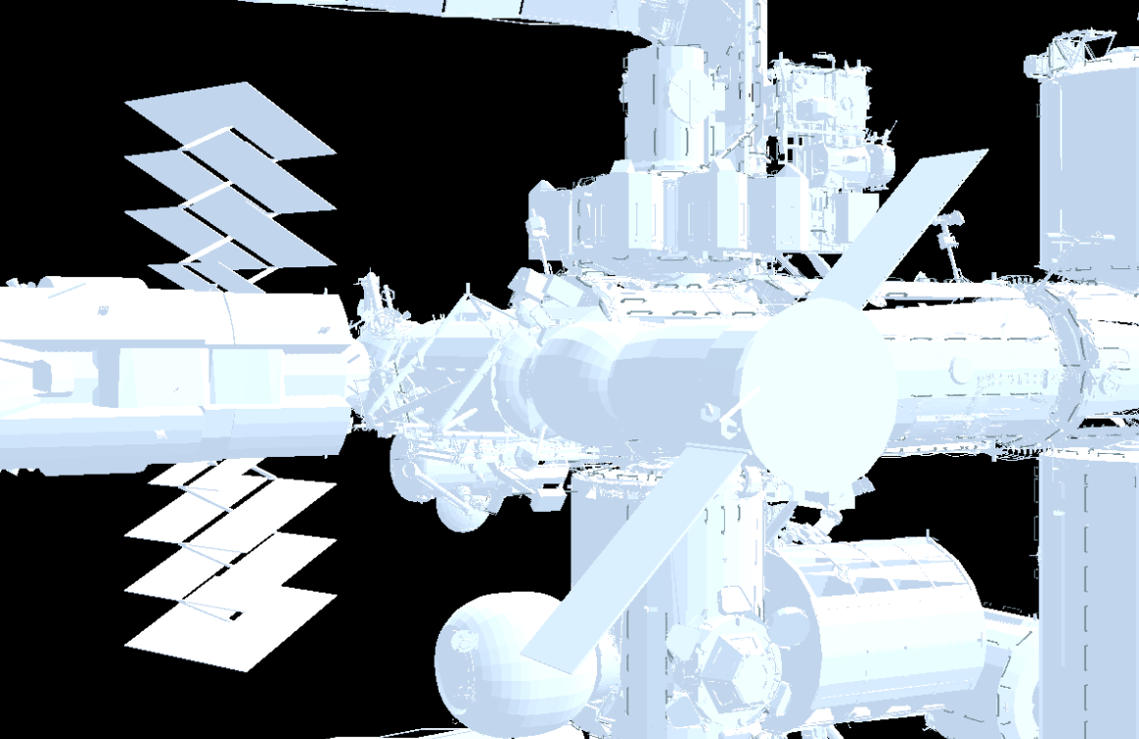
Accomplishments
Altered the brightness of the ISS
BEFORE

Slide 9
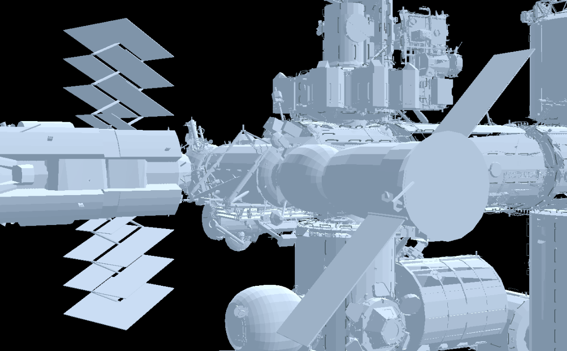
Accomplishments
Altered the brightness of the ISS
AFTER

Slide 10
Live Demo
SHOW DEMO
Notes:
Feature documentation will include snapshots of code and output, followed by use case testing supporting various outputs.

Slide 11
Lessons Learned
Dependency Issues
Problems with the environmental variables

Slide 12
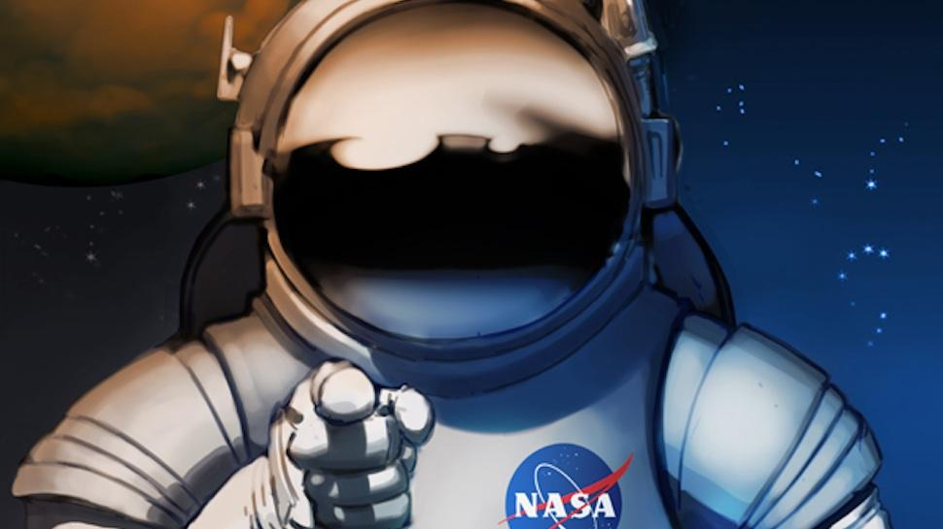
Questions?
Notes:
Previous teams implemented

