Slide 1

SEEKER QT APPLICATION

Slide 2
SEEKER is a QT based application that helps to
find and return belongings to the actual owner.

Slide 4
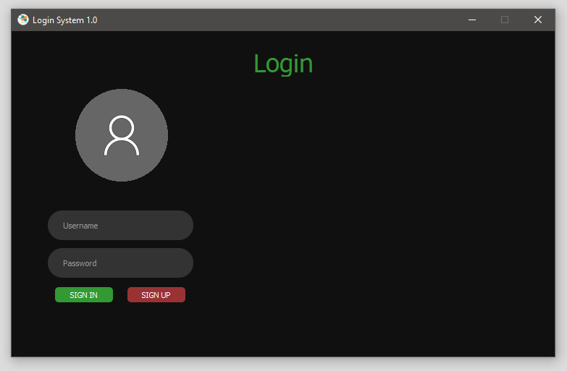

Slide 6
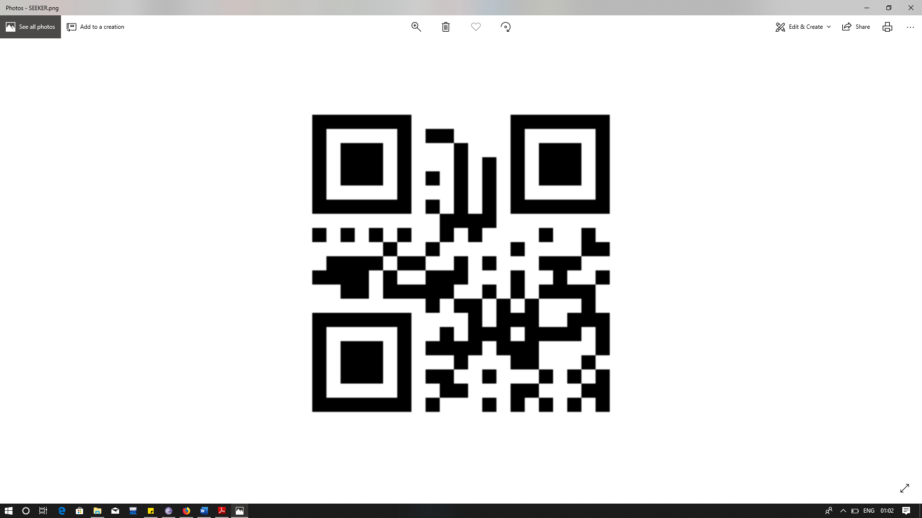

Slide 7
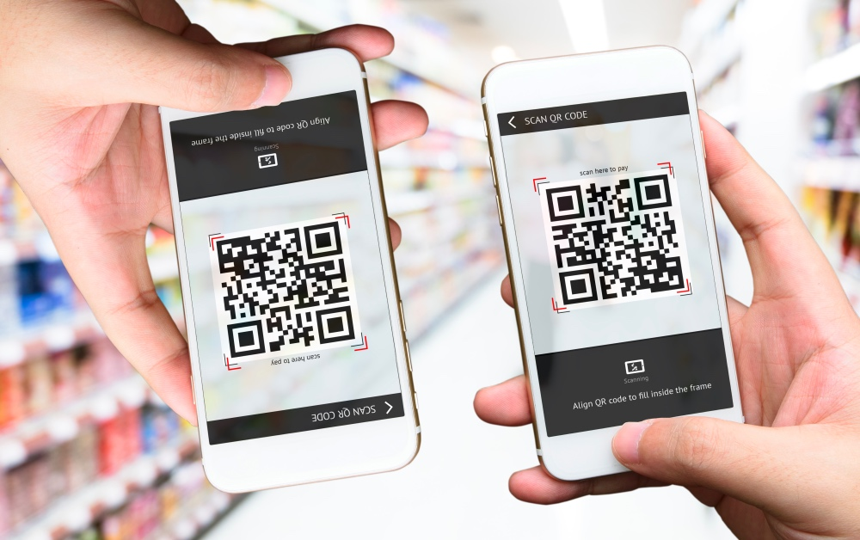

Slide 8
THANK YOU

