Slide 1
An Efficient Solution to Structured Optimization Problems using Recursive Matrices
Darius Rückert¹ and Marc Stamminger¹
¹ University of Erlangen-Nuremberg, Germany

Slide 2
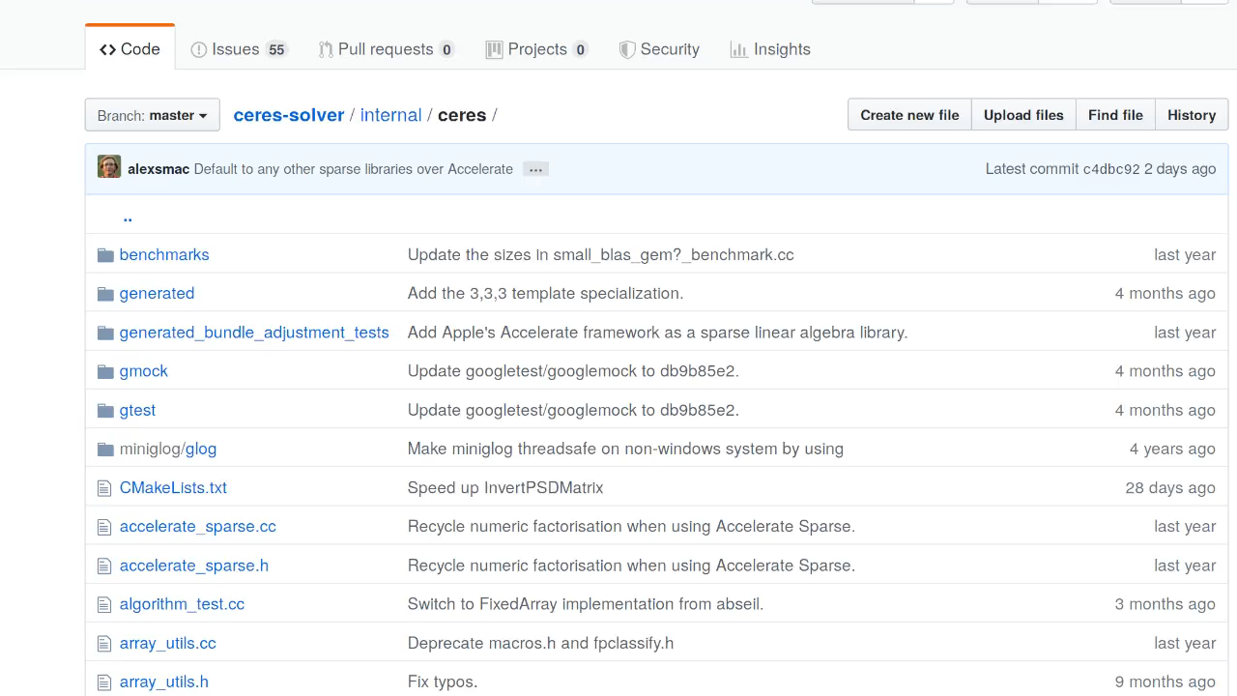
Motivation
> 50 % of the code is for
Sparse Block Matrices
Linear Solvers
Can we get rid of that?
https://github.com/ceres-solver/ceres-solver
Notes:
Thank you for…
I will start the presentation with my personal motivation for this topic.
Here you can see the source code of the ceres solver.
For reference, the ceres is a C++ framework for non-linear least squares problems.
An interesting fact is that over….
I asked myself…
…can we get rid of this code, by using recursive.. ?
The answer is, YES, and here is how….

Slide 3

Overview
Block Matrix
Block Solver
replace with
replace with
Recursive Matrix
Recursive Solver
Eigen Extension
apply to
implement as
Structured Optimization Problem
https://eigen.tuxfamily.org
Notes:
First, we want to replace block matrices….
Then, we also replace the corresponding …. , which can handle both, flat and recursive matrices
Everything is then applied to…. And implemented as an extension….

Slide 4
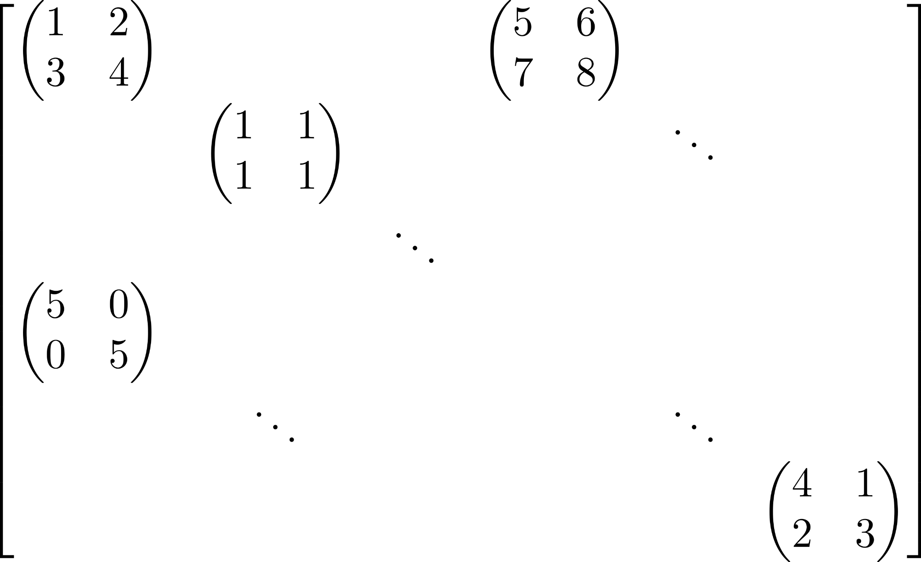
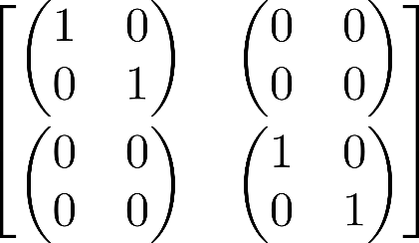
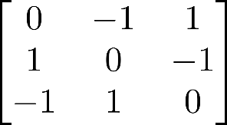
What is a Recursive Matrix?
Definition
A recursive matrix is a rectangular array of numbers
or recursive matrices.
Notes:
So, let’s start at the beginning.
What is…..
A recursive matrix….
Here are a few examples.
A scalar matrix is of course also a….
Next, we have a 2by2 matrix of…
And finally there are also special recursive matrices such as….

Slide 5
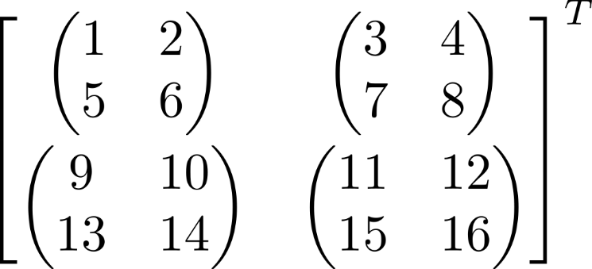
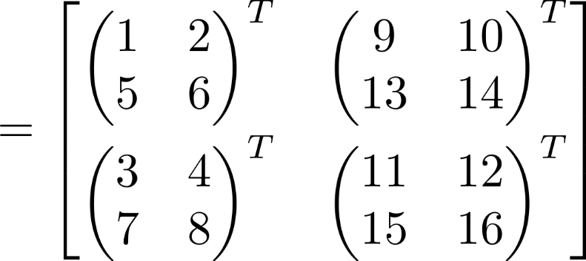
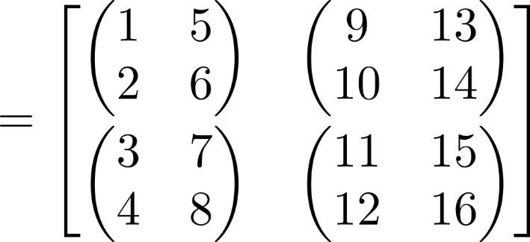
Recursive Matrix Operations
Multiplication
Addition
Transposition
…
Notes:
To use such matrices in our project….
When implementing these operations, keep in mind…
Here you can see the transposition of…
First, this operations is applied to the outer matrix.
After these blocks are swapped, we have to propagate the operations to
And swap the off diagonal elements for each block.
An important observations is that recursive and non-recursive operations give the same results.
So if we take a look at the first row here it is now present in the first column over here.

Slide 6
Recursive Matrices in Eigen
Scalar Matrix
Matrix<float,3,3>
Dense Block Matrix
Matrix<Matrix<float,2,2>2,2>
Sparse Block Matrix
SparseMatrix<Matrix<float,2,2>>
Recursive Operations in Eigen
Not working without extension (see Paper)
Notes:
It is super simple using C++ templates.
Here you can see the type of a flat, scalar matrix….
In this case, each element is….
To construct a recursive matrix….
This also works for special….

Slide 7
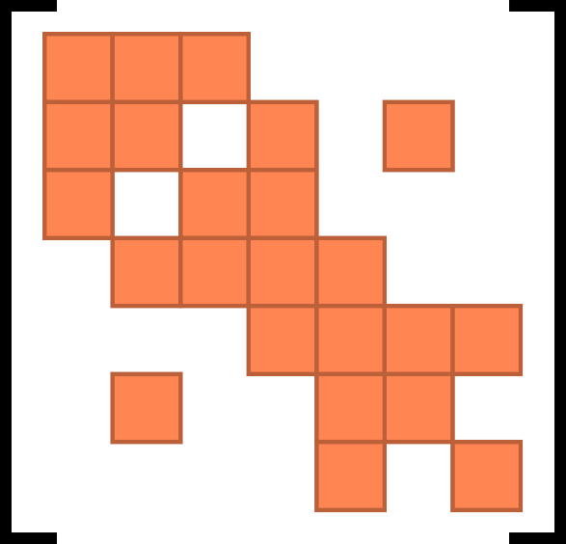
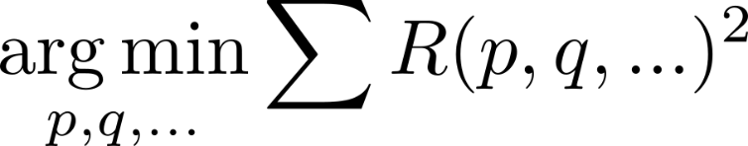


Least-Squares Optimization
Adjacency/Hessian Matrix
Parameter
Residual
Notes:
Now, we want to look…. and how to solve… using…
In the general form, the cost function consists of multiple residual terms…
Where each residual depends on multiple paramters, here p,q,…
An elegant way to visualize such problems is by using a graph.
Each parameter/unknown is a vertex…
An edge is added between two…
If an residual exits that depends on…
The nice thing is, that the adjacency matrix hast the same structure….
Which is used in GN/LM solvers.
So to solve such least squares problem iteratively
We have to solve a linear system of equations using this H matrix.

Slide 8
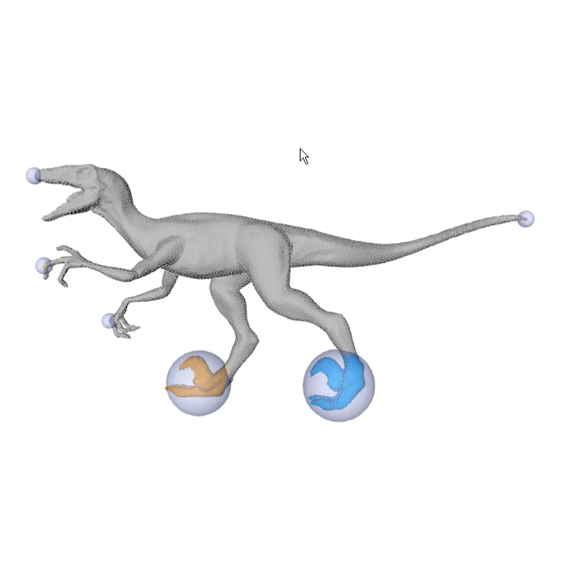
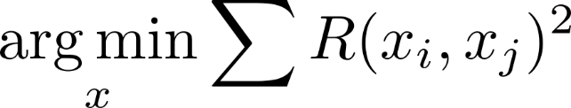

As Rigid as Possible (ARAP)
3x3 Block
Recursive Matrix Type:
SparseMatrix<
Matrix<float,3,3>
> H;
Notes:
I will now show you one example how to use recursive matrices to solve such problems.
Here you can see the energy function of ARAP.
Each residual connects to neighboring …
And therefore the graph has the same structure as the mesh.
Each vertex is connected only to a few other vertices and consist of 3 elements (x,y,z).
The corresponding recursive type of H is…
a sparse matrix
of 3 by 3 matrices.

Slide 9
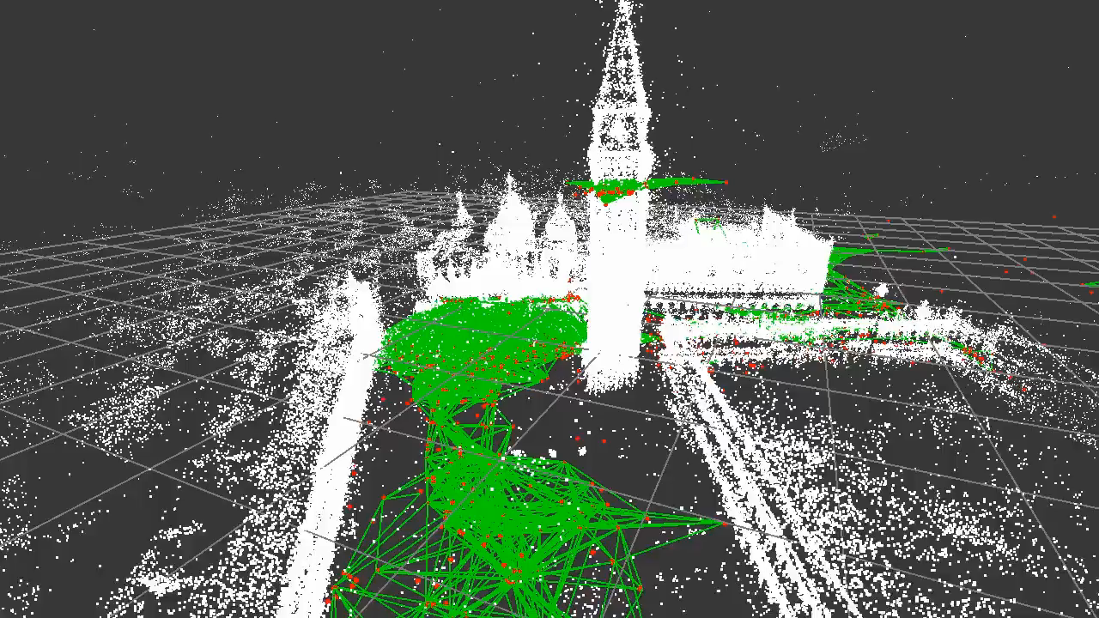
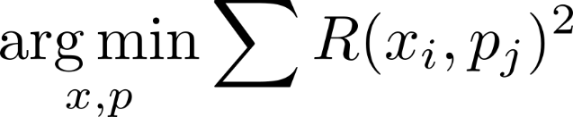
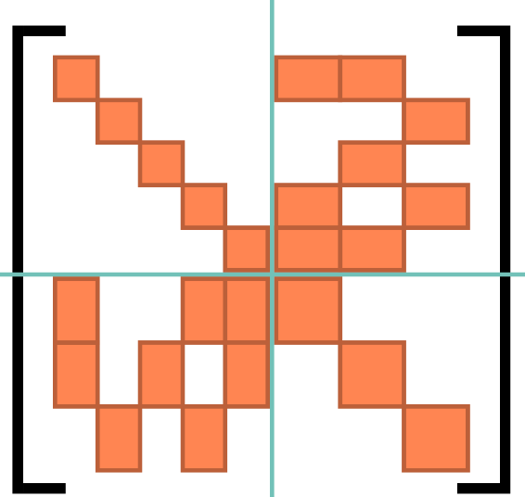
Bundle Adjustment
3x3 Block
Points
Points
Cameras
Cameras
3x6 Block
Points
Recursive Matrix Type:
SparseMatrix<
Matrix<float,-1,-1>
> H;
Cameras
Slow! D:
6x6 Block
Notes:
Let’s take a look now…
Each residual depends on two parameter blocks of different types.
Points (here x) and cameras (here p).
The graph also has special structure, because cameras see points
But there are no edges between two point or between two cameras.
This structure can also be seen in the H matrix.
The top left is diagonal, because points only depend on themselves.
The same counts for the bottom right part of cameras.
The off-diagonal elements carry the actual structure information.
Here, a block is not zero if a camera sees a point.
Now the question is how to define a recursive matrix for this problem?
Cameras have usually more parameters than points and therefore
The matrix consist of small square blocks, large square blocks and rectangular blocks.
Currently the only way to define such a matrix is, to use dynamically sized inner blocks of a sparse matrix.
Yes, that’s not very efficient, and btw. That’s how the ceres…
Is there a better way?

Slide 10
Mixed Matrix
Definition
A mixed matrix is a rectangular array, where
each element can be of a different type.
MixedMatrix22<
Matrix<float,3,3>,
float,
complex<float>,
string
> A;
42
31 + 5i
“Hello”
Notes:
Of course, the answer is yes by using mixed matrices.
A mixed matrix….
Here you can see an example of a 2 by …
The first element is a matrix, the second a number.
In the second row we got a complex number and a string.

Slide 11
Recursive Bundle Adjustment
MixedMatrix22<
DiagonalMatrix<Matrix<float,3,3>>,
SparseMatrix<Matrix<float,3,6>>,
SparseMatrix<Matrix<float,6,3>>,
DiagonalMatrix<Matrix<float,6,6>>
> H;
How do we solve
?
Notes:
So now let’s use a 2by 2 mixed matrix for bundle adjustment.
In this example, 6 parameters are used for the camera, which can express a rigid body transformation.
So the top left element of… is a diagonal block matrix…
The next element is a sparse matrix of rectangular blocks.
The bottom left is the transpose of the top right
And the last element is again a diagonal block matrix.
Ok, great, now we have a beautiful recursive type for H.
But how do we solve the linear system?

Slide 12
Recursive Linear Solvers
“Normal” recursive matrices
Recursive CG, Recursive LDLT,…
Straight forward (see paper)
Mixed recursive matrices
General solvers (CG)
Partially specialized solvers
Notes:
First, for “normal”… for example a sparse block matrix…
More interesting are linear solvers for mixed….
Of course we can use general solver…
But might not be the most efficient.
For some structures specialized solvers are more optimal.

Slide 13
Partially Specialized Solvers
Implementation
Diagonal
Invert Diagonal Matrix
Compute Schur Complement
Solve Reduced System (Recursive Call!)
Compute Solution for Initial System
Arbitrary
Arbitrary
Arbitrary
Mixed 2x2 Matrix
Better than general solver
Notes:
Let’s take a look at one of those specialized solvers.
This example solver only works for mixed matrices of the following format.
The top left is a diagonal matrix and rest can be arbitrary matrices.
The implementation of that solver would first, invert…
Compute the schur complement
And then solve the…
Note here that this reduced solver might be recursive depending on the matrix types.
After that we compute the solution…
And it’s clear that for such a matrix, this solver is better…

Slide 14

Template Matching
Optimal solver is picked at compile time!
Notes:
So the idea is now to build multiple specialized solvers
And use template matching to find the best solver at compile time.
Here we have again our BA matrix.
The compiler tests if this solver is suitable by comparing the elements.
In this case, yes it is suitable because the top left is indeed…
For reference the ceres solver also applies the schur complement.
But it has to analyze the graph structure at runtime, which reduces the performance.

Slide 15
ARAP - Speedup
Bundle Adjustment - Speedup
Notes:
So now I want to show you some results for ARAP and bundle adjustment.
Here you can see the relative speedup in comparison to ceres and G2O.
Our recursive implemetation is shown in orange and you can see
That it is between 4 and 6 times faster.
This speedup is a result of two different reasons.
First, the other solvers have to analyze the graph…
And second, ceres and g2o internally use dynamically sized matrices.
This reduces the performance of all kind of matrix operations, because of caches and vectorization.

Slide 16
Sparse Block Matrix-Vector
Sparse Block Matrix-Matrix
Speedup
Speedup
Block Size
Block Size
Clang 8.0 - 1 Threads on i7-7700K, SSE+AVX
Notes:
The next graph now shows the comparison of sparse block matrix multiplication for different block sizes.
On the left you can see Matrix Vector and on the right matrix-matrix.
The relative speedup in comparison to the MKL library.
For both test, our recursive solution achieves
These results were kind of surprising, because MKL claims to be…
And it got outperformed by 2 lines of recursive matrix code.

Slide 17
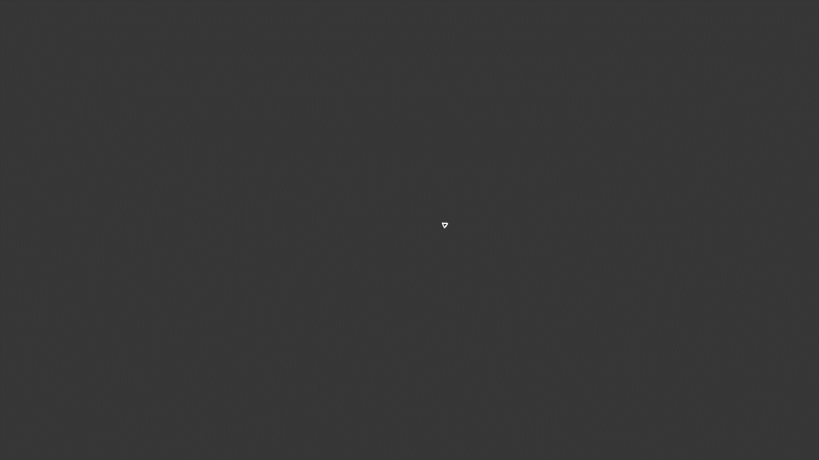
Application
Camera Tracking (SLAM)
Local/Global BA
Pose Refinement
Pose Graph Optimization
1.17 ms/frame (~850 FPS)*
*4 Threads on i7-8850H
Notes:
So in the end I will show you one nice application which greatly benefits from recursive matrices.
And that is camera tracking or (SLAM).
In addition to local/global BA,
Recursive matrices can be used for….
Our implementation averages around 1.2ms per frame over a large dataset.
This corresponds to a framerate of 850 FPS.

Slide 18


Any Questions?
https://github.com/darglein/EigenRecursive
darius.rueckert@fau.de
Notes:
Thank you for your attention.
The code and benchmarks are..
Do you have any questions?

