Slide 1

Predicting Vechicle Failure From Sensor Data
Machine Learning approach for predicting remaining distance before failure
Delia Musat
Daria Copaceanu

Slide 2


The problem
Can vehicle sensor measurements be used to predict how many kilometers remain before a vehicle failure?

Slide 3

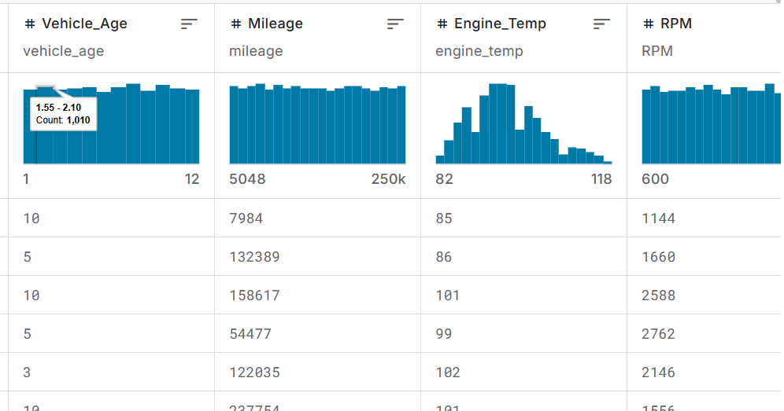
Dataset
Total features: 16
Samples: 12000
Features used: 7(first try)
16(last try)
Target: km_before_defect
Machine Learning Task: Classification
Predict a continuous value: kilometers remaining before vehicle failure

Slide 4
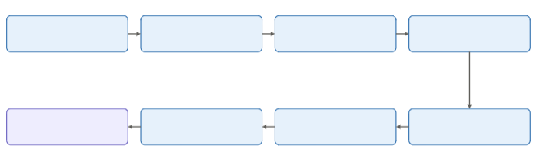
Methodology
Exploratory Data Analysis
Feature engineering
Dataset
Data Cleaning
Best Model
Evaluation
Regresion Models
Train / Test Split

Slide 5
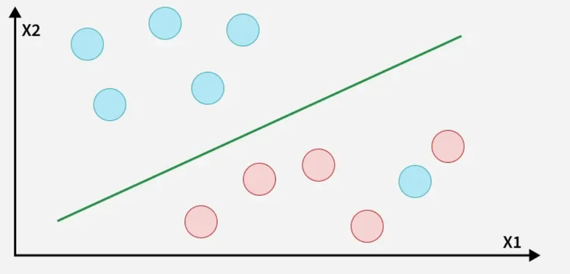
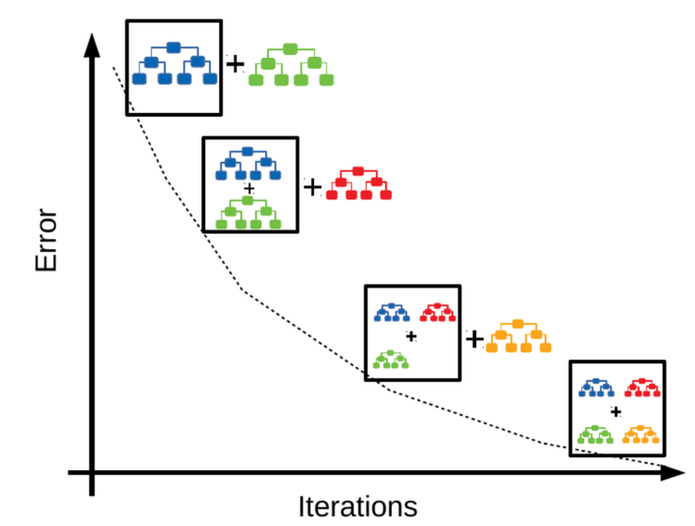
Machine Learning Methods
Finds a function that predicts the target while keeping prediction errors within an acceptable margin.
Builds decision trees sequentially, with each new tree correcting errors made by previous trees.

Slide 6

Results
SVM Results
  7 features: 74.29%
  8 features: 79.46%
  All features: 71.96%
XGBoost Results
  7 features: 78.62%
  8 features: 88.21%
  All features: 95.58%

Slide 7

Questions?

Slide 8
Thank You

